Slide 1
Purpose of Automation Playbooks
Information Gathered
Disk, memory, CPU load, timezone, NTP sync
Services & processes status
Errors & system logs
Network info & connectivity
Kubernetes pods, DB, alarms, NPC, ISTIO, ZTS status
Pre- & post-patch configs (fstab, resolv.conf, network-scripts, sshd, passwd)
Package DB & repos info
What Automation Does
Runs proactive health checks across servers/pods/clusters
Validates thresholds & blocks unsafe patching
Creates backups for rollback & compliance
Executes patching/upgrades in maintenance mode
Generates HTML reports (system health, errors, status)
Sends email alerts to admins
Provides secure GUI (CGI) for easy, error-free playbook runs
Ensures consistency, repeatability, and scalability

Slide 2
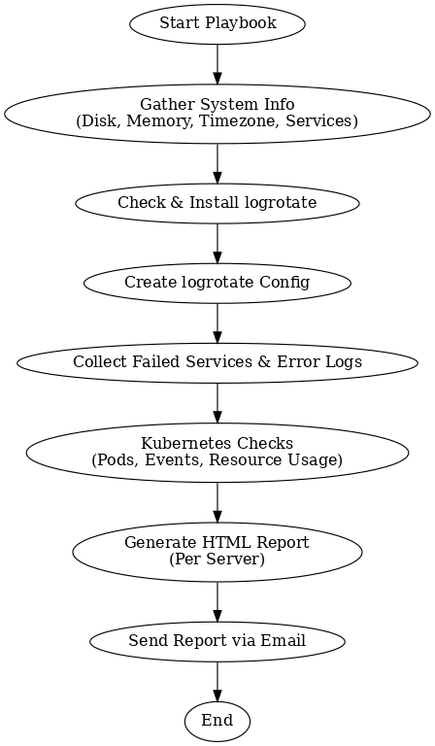
Health-Check playbook for Cisco &Nokia PCF Nodes
Required:
Proactive Monitoring → Detects issues before they cause outages
Consistency → Same checks executed across all environments (Dev, QA, Prod)
Reduce Manual Errors → Removes human dependency in repetitive checks
Faster Validation → Saves time compared to manual step-by-step checks
Scalability → Easily runs across 100s of servers/pods at once
Compliance & Audit → Keeps a record of health status for reporting
Purpose
Automate system health checks (disk, memory, services, errors).
Ensure log rotation for common services.
Collect Kubernetes status & events.
Provide per-server HTML reports for clarity.
Email reports to admins for proactive monitoring.

Slide 3
ME and SM Check Playbook
Converted ME & SM Bash scripts to Ansible playbook – reduced runtime from 4–5 mins/server to seconds with parallel execution, replaced hardcoded variables with dynamic values for reusability, and added HTML reporting for errors, pod status, applications, and Nokia node health checks.
Required :
Manual checks were slow (30–45 mins) and error-prone.
Bash scripts ran sequentially (4–5 mins/server).
Hardcoded variables blocked reuse.
Needed faster, parallel execution and automated reporting.
Purpose
Automate Kubernetes & telecom health checks.
Detect pod, network, DB, and alarm issues quickly.
Ensure consistency and scalability across environments.
Generate an HTML report for easy troubleshooting.

Slide 4
SM check
Required:
Manual health checks are time-consuming and error-prone.
Different teams run inconsistent commands, leading to inaccurate results.
No centralized report available; findings often remain scattered.
Helps in early detection of issues (pods not ready, alarms, network or DB errors).
Ensures critical components (NPC, ISTIO, ZTS, etc.) are always validated after deployments or incidents.
✅ Benefits of Automation
Consistency & Accuracy – Same set of checks every time, no missed steps.
Faster Execution – 15+ checks completed in minutes, instead of manual effort.
Centralized HTML Report – Single, structured report for easy review and sharing.
Scalability – Run across multiple clusters/namespaces effortlessly.
Repeatability – Can be scheduled or triggered on-demand with identical results.
Improved Reliability – Reduces downtime risk by catching issues early

Slide 5
Health&Me check Playbook
Required:
Multiple servers & pods → manual checks are slow & error-prone
Critical services (NPC, SPS, DB, LDAP, ISTIO, ZTS, etc.) need regular validation
Manual effort doesn’t scale for large clusters
Ensures standardized & centralized health reporting
Benefits
Consistency – Same checks everywhere
Speed – Hours reduced to minutes
Accuracy – No human error
Centralized Reports – HTML + ZIP archive
Scalability – Works for 10 or 100+ hosts
Reliability – Built-in error handling
Audit-Ready – Easy sharing & compliance
Effort Saving – 5 hours → 5 minutes

Slide 6
CGI Playbook
Required:
To safely run Ansible playbooks via a web GUI instead of CLI.
Prevents manual errors and unauthorized commands.
Provides a standard, secure, and user-friendly execution process.
Benefits
Easy GUI for non-CLI users.
Secure (whitelist, validation, no raw shell).
Consistent and error-free runs.
Built-in diagnostics for quick troubleshooting.
Saves time and reduces manual effort.

Slide 7
