Slide 1
VisionAssist - Lost & Found AI
System Architecture & UML Design
Voice-activated assistant + computer vision - deployed on AWS (EKS + SageMaker)
Architecture - Deployment - AWS infra - Use case - Class - 5 sequences - Activity - State

Slide 2
•
What's inside
Thirteen diagrams covering the whole system, its AWS deployment and each component
1
Architecture overview
8
Sequence: Voice locate query
The four decoupled layers end to end
The "Where is my phone?" flow
2
Deployment topology
9
Sequence: On-demand scan
Docker Compose (local dev)
Worker-less webcam to /api/scan
3
Infrastructure — AWS
10
Sequence: Detection & alert
EKS + SageMaker production stack
Camera worker, YOLO, polling
4
Use case diagram
11
Sequence: Reminders
Actors and what users can do
Create + due-poll TTS announce
5
Class diagram
12
Activity: Intent routing
The data model and services
How the assistant decides
6
Sequence: Authentication
13
State diagrams
Register, login + JWT, with failures
Reminder, Alert & item lifecycles
7
Sequence: Item registration
Mapping a name to an object class

Slide 3
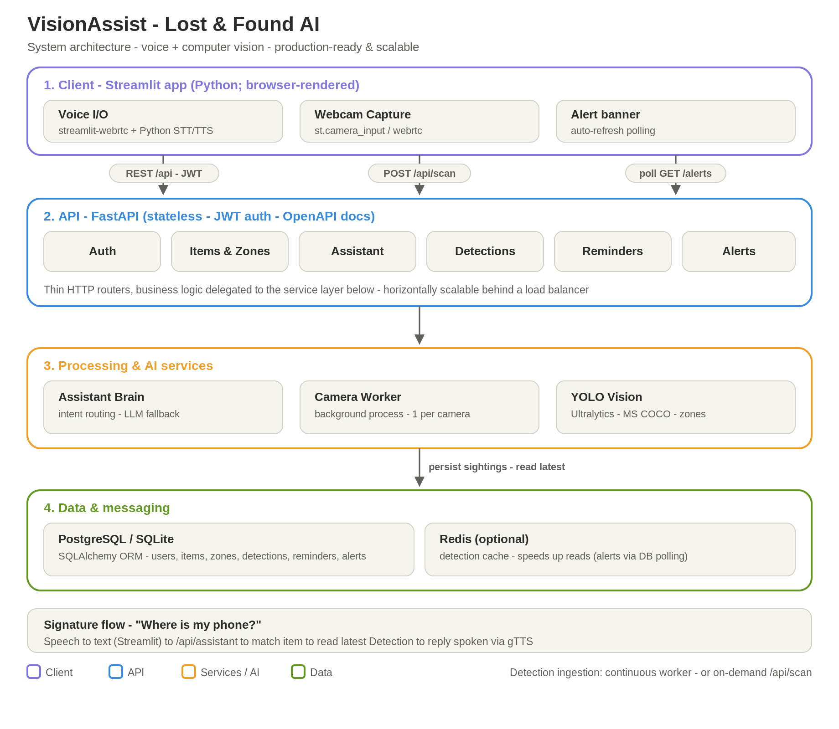
1
Architecture Overview
Layered system diagram
IN BRIEF
Four decoupled layers: client, API, services, data.
Streamlit (Python) UI handles voice, webcam capture and alert polling.
Stateless FastAPI routes requests; real logic lives in the service layer.
YOLO vision + a camera worker detect and locate items.
PostgreSQL stores everything; Redis scales real-time alerts.

Slide 4
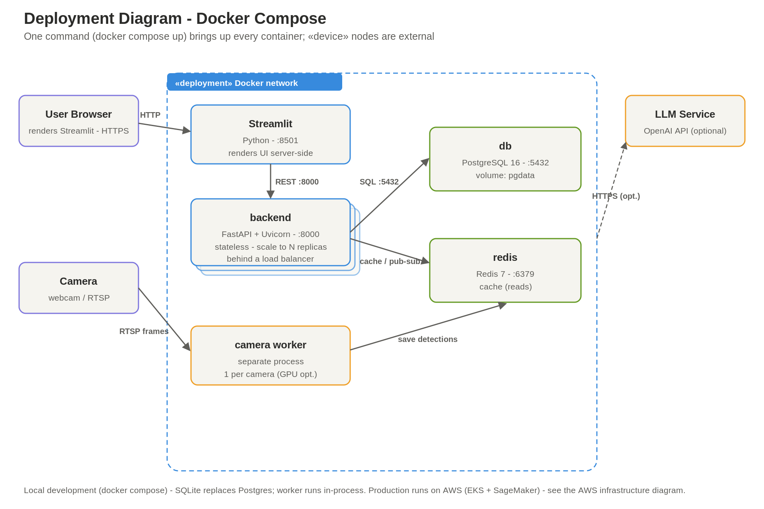
2
Deployment Topology
UML - Docker Compose nodes (local dev)
IN BRIEF
One command (docker compose up) starts every container.
Streamlit UI, backend (FastAPI), db (Postgres), redis.
Backend is stateless - scale to N replicas behind a load balancer.
The camera worker runs as its own process, one per camera.
Production runs on AWS - see the next slide.

Slide 5
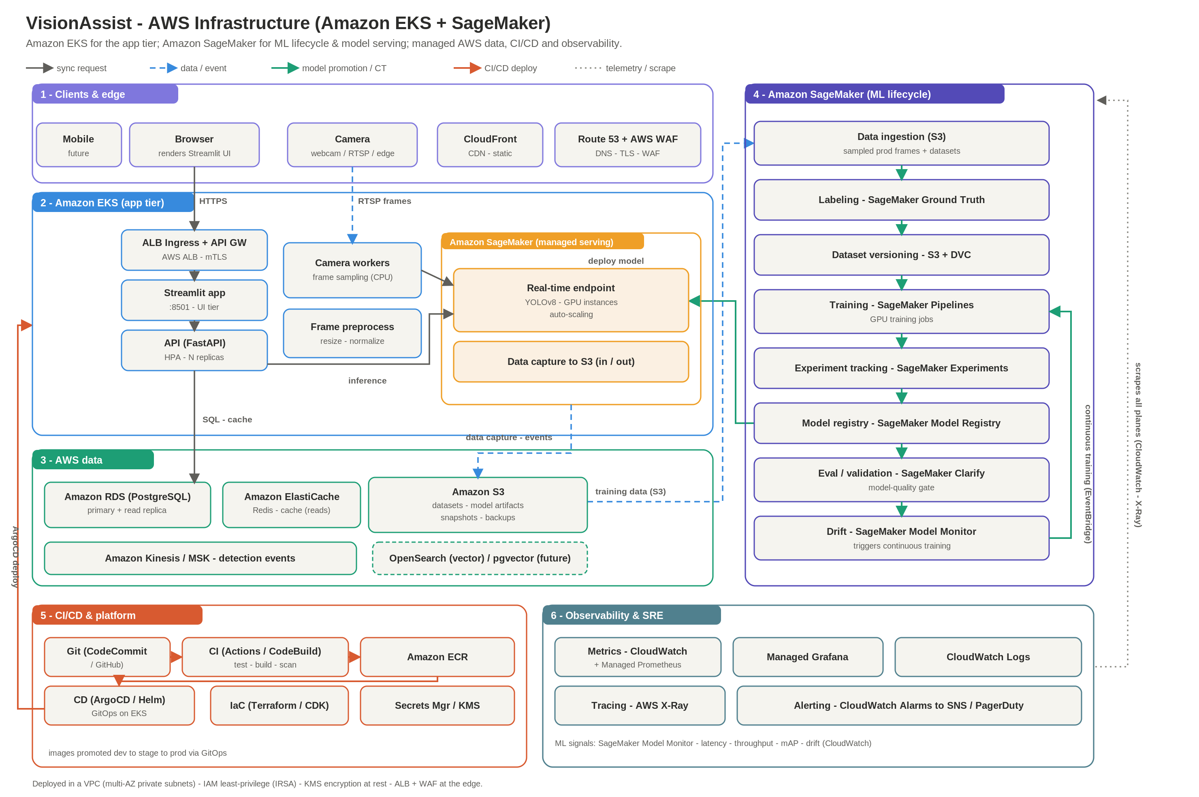
3
Infrastructure - AWS
Amazon EKS + SageMaker (production)
IN BRIEF
EKS app tier: Streamlit + FastAPI behind an ALB (CloudFront/Route 53/WAF at the edge).
Amazon SageMaker hosts the YOLO real-time endpoint and the ML lifecycle.
Managed data: RDS (Postgres), ElastiCache (Redis), S3, Kinesis/MSK.
CI/CD: GitHub Actions -> Amazon ECR -> ArgoCD on EKS.
Observability: CloudWatch, X-Ray, Managed Grafana; Model Monitor for drift.

Slide 6
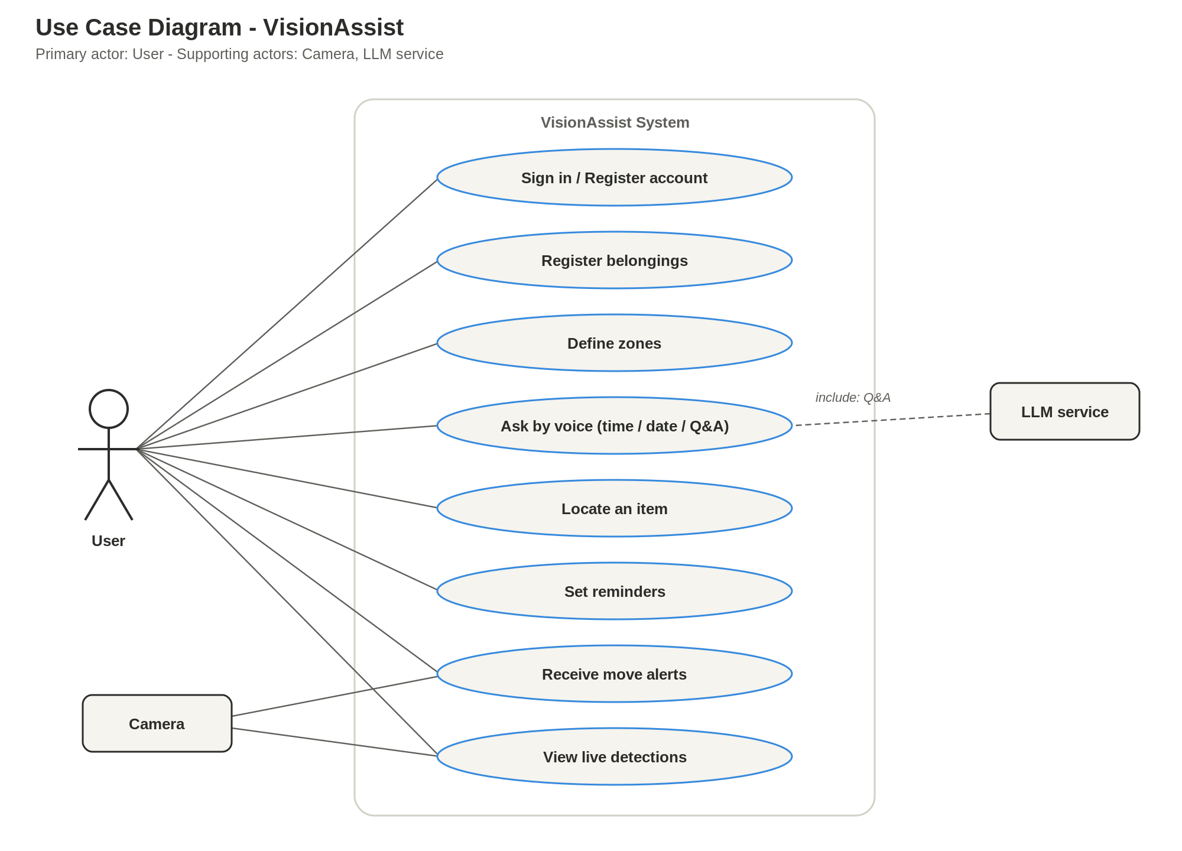
4
Use Case Diagram
UML - actors & use cases
IN BRIEF
Primary actor is the User.
Core actions: sign in, register belongings, define zones.
Ask by voice - time, date and general Q&A.
Locate items, set reminders, receive move alerts.
Camera feeds detections; an LLM service supports Q&A.

Slide 7
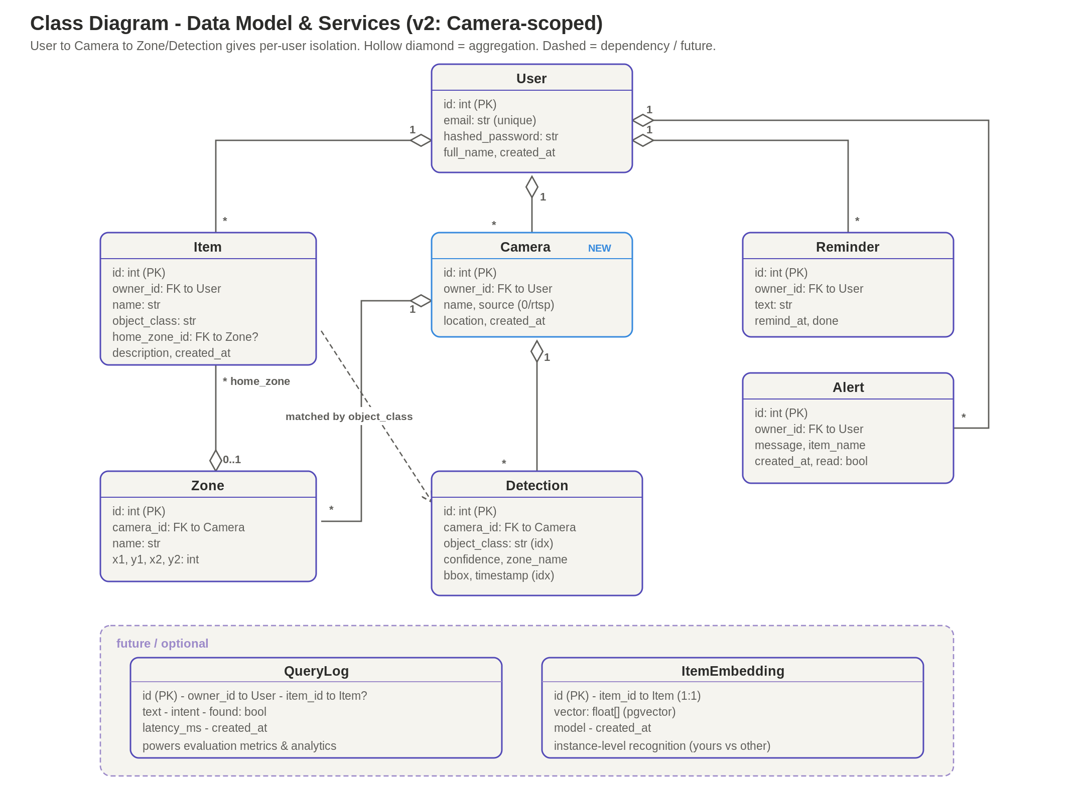
5
Class Diagram (Data Model)
UML - structure & relationships (Camera-scoped)
IN BRIEF
User owns Items, Cameras, Reminders and Alerts.
Camera owns Zones and Detections - proper per-user scoping.
Item maps a friendly name to a detectable object_class.
Detection records each sighting: class, zone, confidence, time.
Future: QueryLog (metrics) + ItemEmbedding (instance ID).

Slide 8
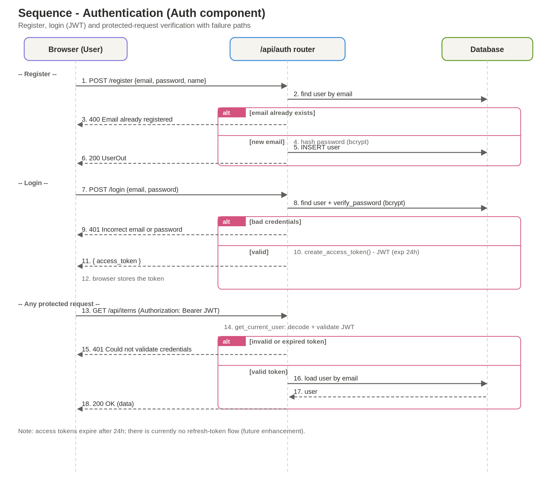
6
Sequence: Authentication
UML - Auth component (with failure paths)
IN BRIEF
Register checks for an existing email (400 if taken).
Login verifies bcrypt password; issues a JWT, else 401.
Streamlit session_state stores the token (24h).
Protected requests validate the JWT, else 401.
No refresh-token flow yet - a noted future enhancement.

Slide 9
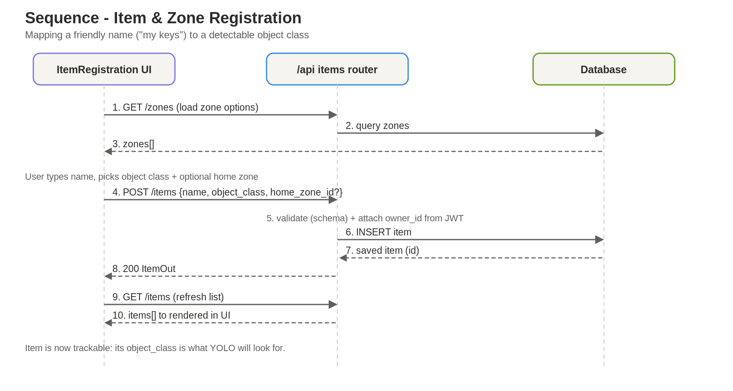
7
Sequence: Item Registration
UML - Items & Zones component
IN BRIEF
The form first loads available zones.
User names the item and picks an object type.
POST /items validates and tags it to the owner.
Saved to the database; the list refreshes.
The object_class is exactly what YOLO will track.

Slide 10
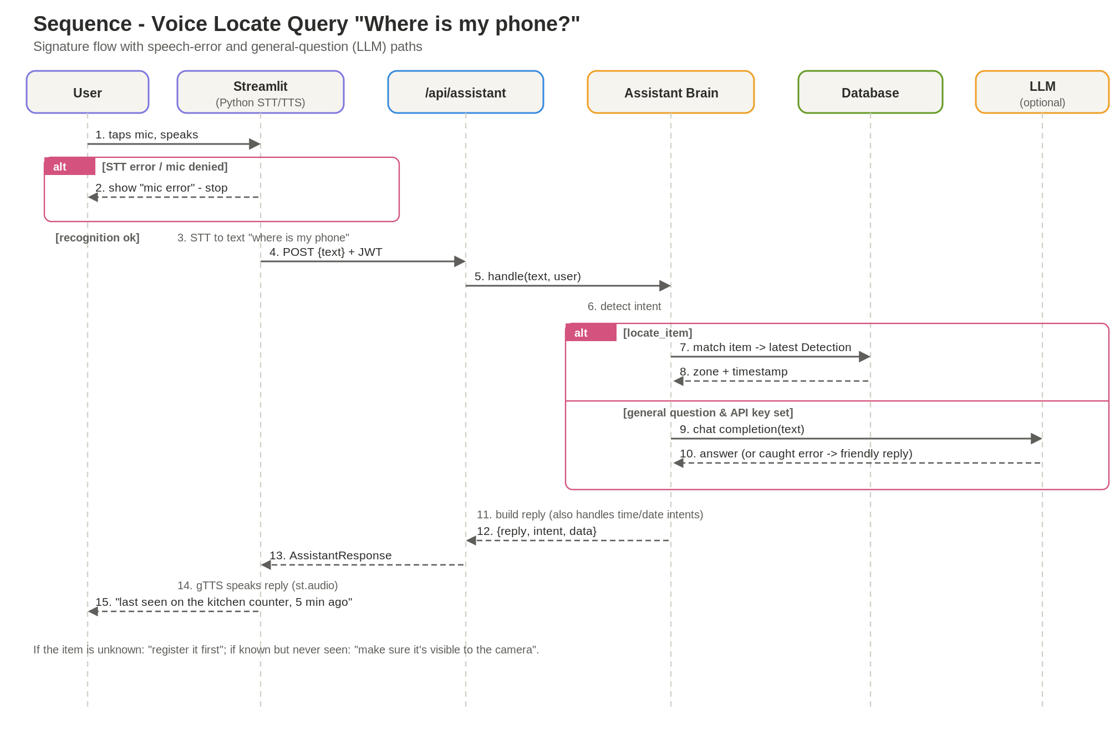
8
Sequence: Voice Locate Query
UML - signature flow (+ STT error & LLM path)
IN BRIEF
Streamlit captures mic (webrtc/recorder); Python STT; errors stop early.
Text is sent to /api/assistant with the JWT.
Locate intent matches the item + latest detection.
General questions fall back to the LLM (if a key is set).
Spoken answer via gTTS / st.audio.

Slide 11
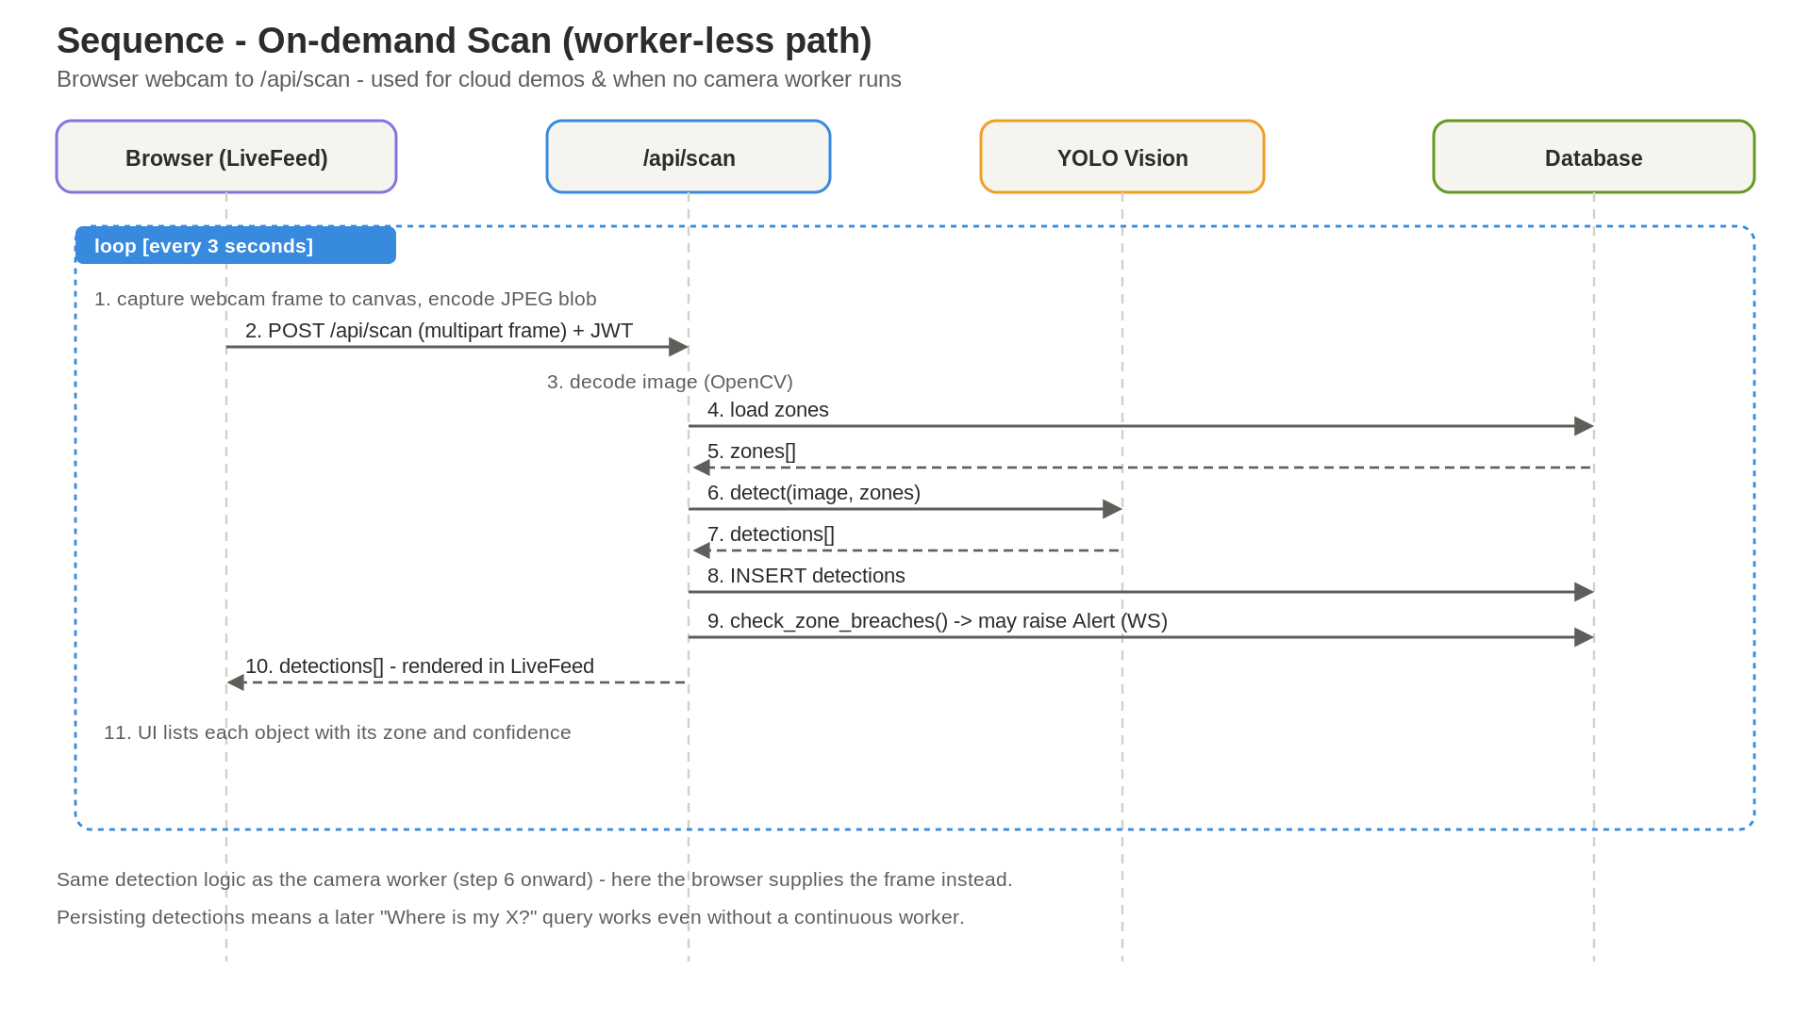
9
Sequence: On-demand Scan
UML - worker-less detection path
IN BRIEF
Used when no camera worker runs (e.g. a cloud demo).
Streamlit captures frames (st.camera_input).
Posts the JPEG to /api/scan.
Same YOLO detect + zone + save logic as the worker.
Detections persist, so later 'locate' queries still work.

Slide 12
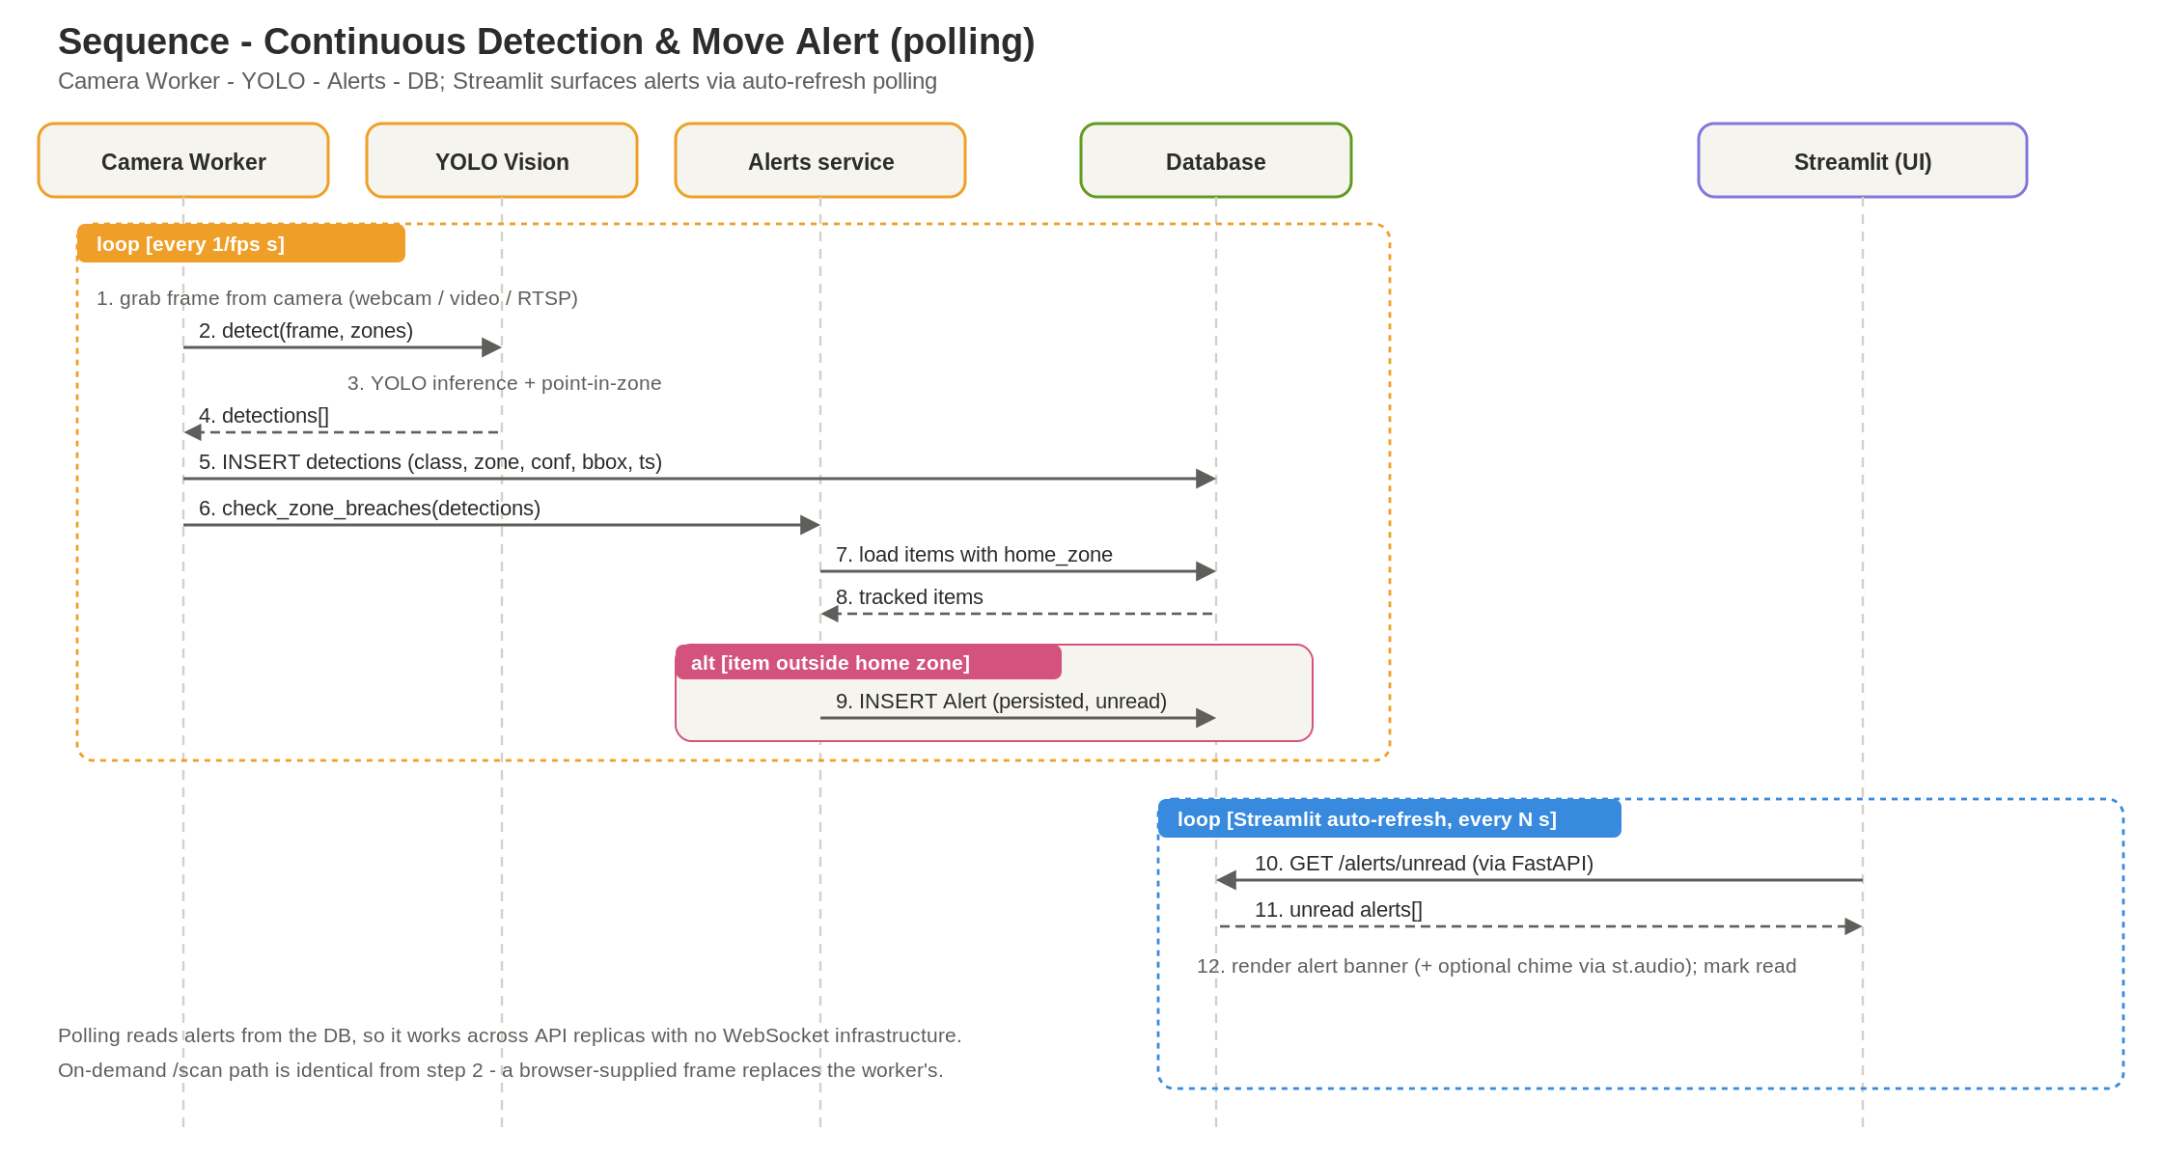
10
Sequence: Detection & Move Alert
UML - vision & alert pipeline (alerts via polling)
IN BRIEF
The camera worker samples a frame on a loop.
YOLO detects objects and assigns each a zone.
Sightings are saved to the database.
If an item leaves its home zone, an alert is raised.
Surfaced via Streamlit auto-refresh polling of /alerts.

Slide 13
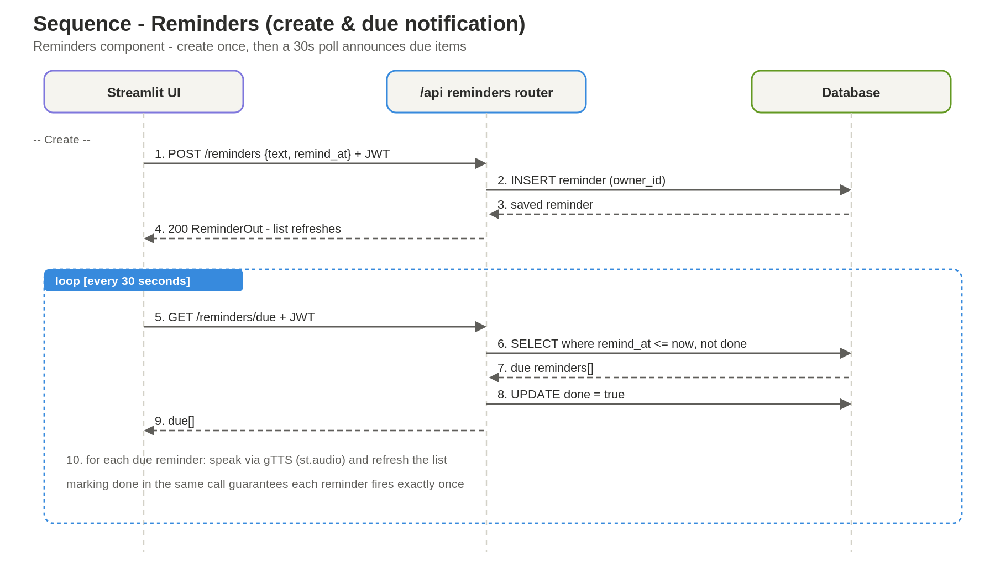
11
Sequence: Reminders
UML - create & due notification
IN BRIEF
Create posts text + time, stored against the user.
A 30-second loop polls /reminders/due.
Due reminders are marked done in the same call.
Each reminder therefore fires exactly once.
The app speaks each due reminder aloud (gTTS).

Slide 14
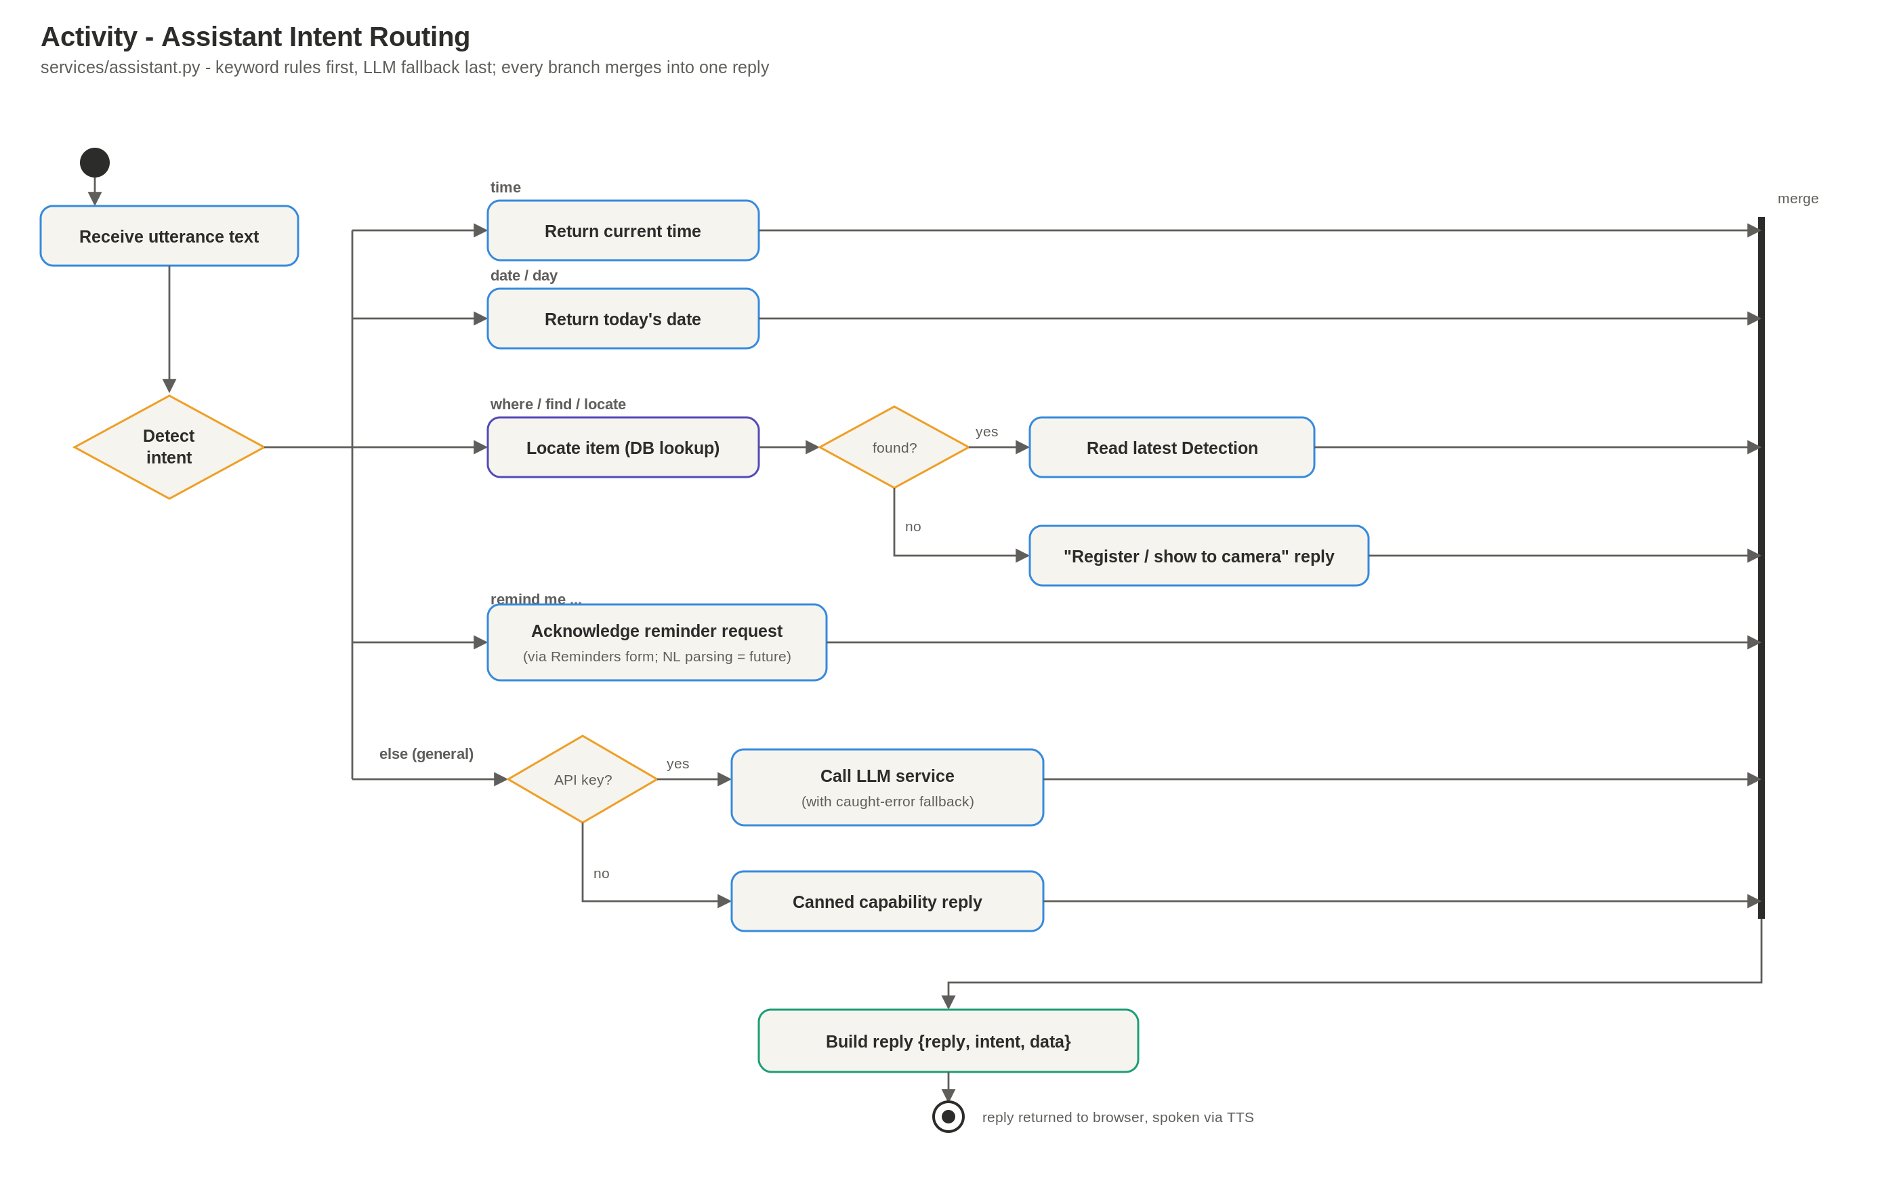
12
Activity: Assistant Intent Routing
UML - decision logic
IN BRIEF
Single entry point: the transcribed text.
Intent detected by fast, offline keyword rules.
Branches to time, date, locate or reminder-ack.
Reminders are created via the form/REST, not NL (today).
LLM fallback is wrapped with an error path.

Slide 15
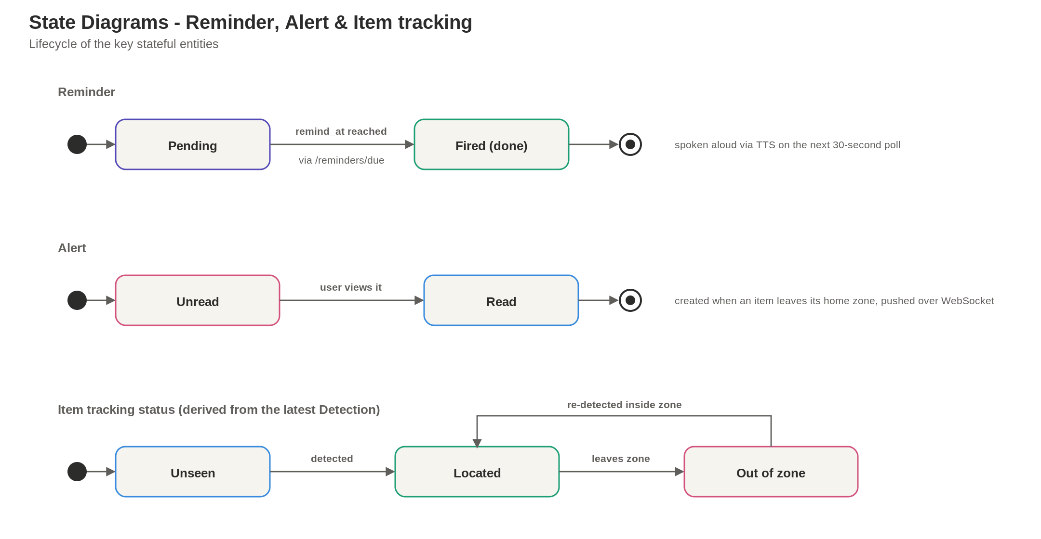
13
State Diagrams
UML - entity lifecycles
IN BRIEF
Reminder: Pending to Fired when its time is reached.
Alert: Unread to Read once the user views it.
Item: Unseen to Located to Out-of-zone, and back.
Item status is derived from the latest Detection.
Rounds out the dynamic + structural UML set.

Slide 16
Why this design holds up
Modular
Each layer has one job and a clear interface - easy to test and extend.
Scalable
Stateless API on EKS, SageMaker-managed serving, polling alerts across replicas.
Portable
SQLite to RDS is a one-line change; Docker locally, EKS + SageMaker in prod.
Private by design
Only detection metadata is stored - frames processed in memory / data-captured to S3.
VisionAssist - Lost & Found AI - Architecture & UML deck

