Slide 1
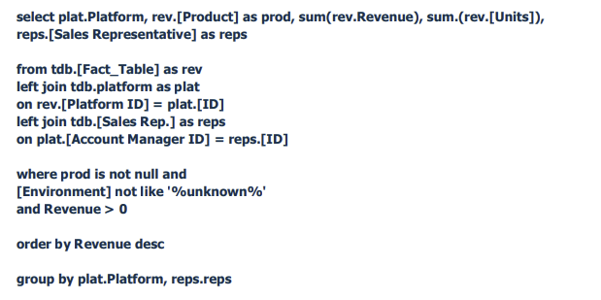
Should be sum(rev.[units])
Use reps alias for two different things
This will exclude NULL (not sure if intended)
Group By comes before the Order By
Issues with group by including aliases

