Slide 1
Lesson 2 of 4
Quickly deploy “PetClinic” to the cloud

Slide 2
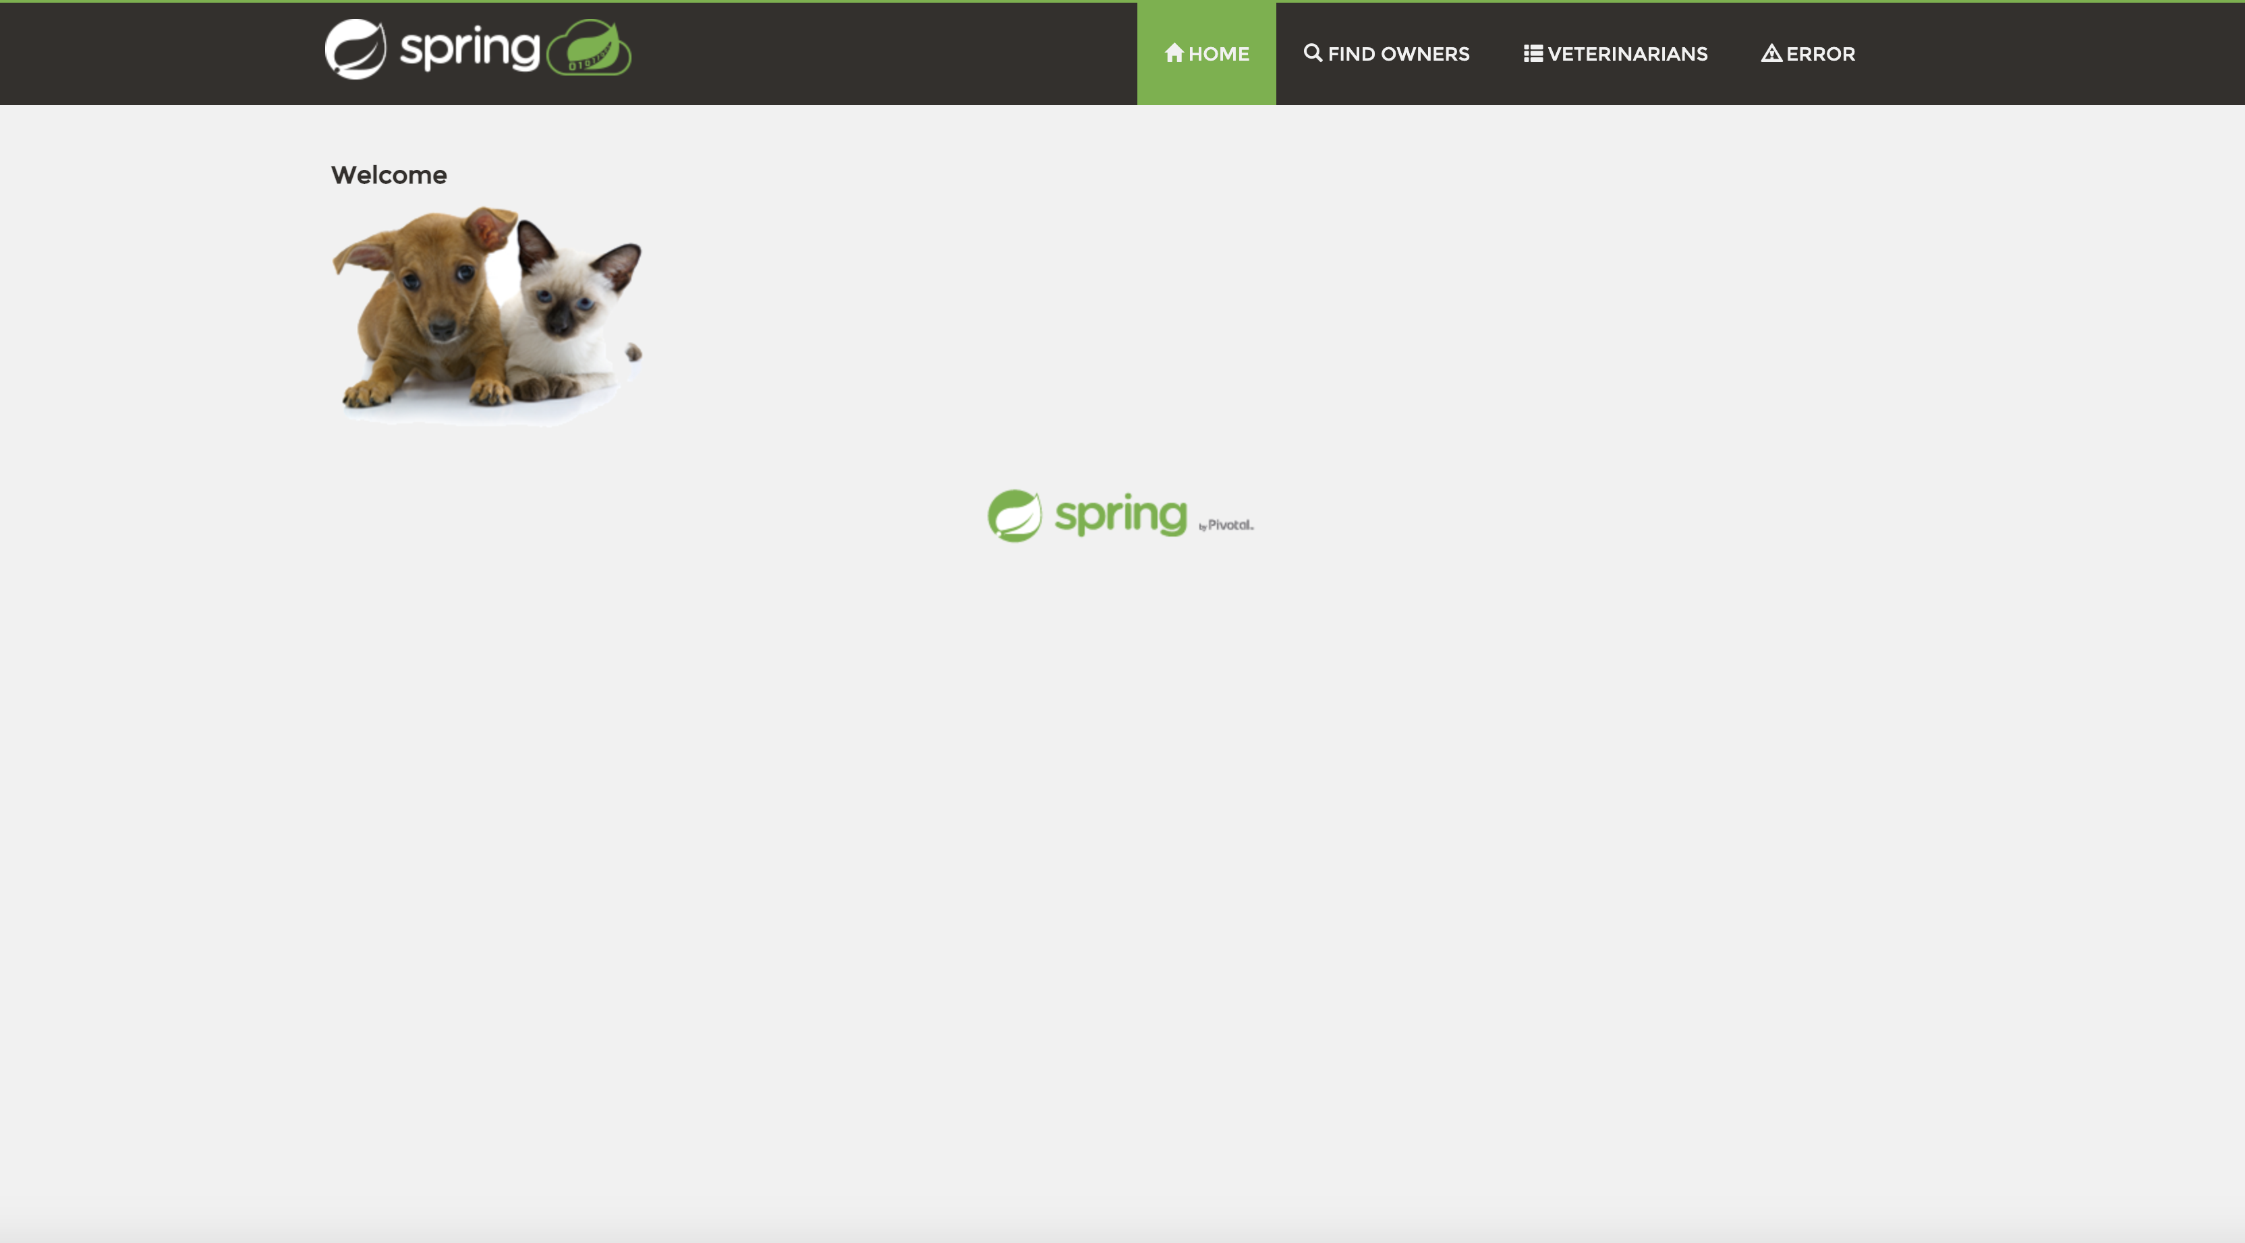
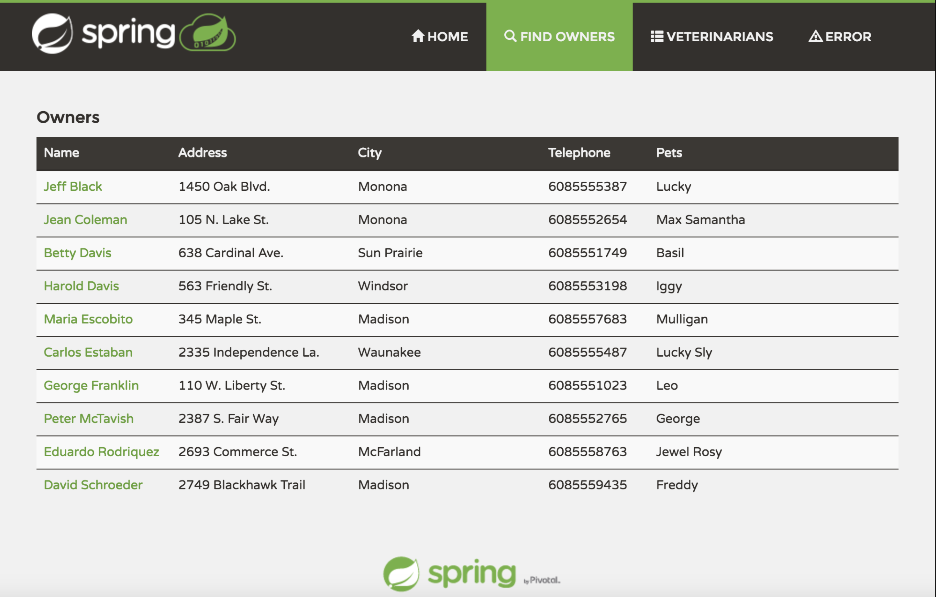
The Existing Application
(You don’t actually need to change its code, we’re using what’s familiar.)

Slide 3
Deploy into Azure Spring Cloud
Clone Github repository branch locally
Build using maven build tool wrapper
Quick set up with Azure CLI
Create the application instance in Azure Spring Cloud
Deploy Spring PetClinic JAR to Azure Spring Cloud via CLI

Slide 4
Clone the `initial-app` GitHub Branch to your workspace
git clone -b initial-app https://github.com/admiralappsec/workshop-testing.git

Slide 5
Build via Maven wrapper
cd workshop-testing
mvnw clean package -DskipTests -Denv=cloud
**Note –
Make sure mvnw is executable, if an error pops up around execution, please use this command to make mvnw executable (while in the same directory as mvnw):
`chmod +x mvnw`

Slide 6
Quick Set-Up with Azure CLI
az login --service-principal -u "${AZURE_APPLICATION_ID}" -p "${AZURE_CLIENT_SECRET}" --tenant "${AZURE_TENANT_ID}";
az account set --subscription "${AZURE_SUBSCRIPTION_ID}";
az configure --defaults group="${AZURE_RESOURCE_GROUP_NAME}" spring-cloud="${AZURE_SP_SERVICE_NAME}";

Slide 7
Create the Application in Azure Spring Cloud
az spring-cloud app create --name ${APP_NAME} --instance-count 1 --is-public true --memory 2 --jvm-options='-Xms2048m -Xmx2048m' --enable-persistent-storage true

Slide 8
Deploy Spring PetClinic JAR to Azure Spring Cloud
az spring-cloud app deploy --name ${APP_NAME} \
--jar-path ${APP_JAR}
**note – Make sure you are in the same directory as the JAR file when executing the above commands. The maven build will automatically put the deployable JAR inside the following directory: `workshop-testing/target`
Once deployed, you can verify the successful deployment by entering the following command into your command line and taking the URL and entering this value into your browser:
az spring-cloud app show --name ${APP_NAME} | grep url

