Slide 1
9
8
5
7
4
1
0
6
2
3
Max-heap
0
1
2
3
4
5
6
7
8
9
9
8
5
7
4
1
0
6
2
3

Slide 2
push
push
9
push
6
9
push
7
6
6
5
7
7
7
5
5
5
5
8
8
8
8
8
pop
pop
9
pop
6
6
pop
7
7
7
5
5
5
5
8
8
8
8
8

Slide 3
11
4
11
2
1
5
10
3
2
10
1
9
8
9
6
4
5
3
7
7
6
8

Slide 4
10 11 # number of people, relationship between each
1 2
3 1
3 4
5 4
3 5
4 6
5 2
2 1
7 1
9 10
8 9
1
9
7
2
3
8
10
5
4
6

Slide 5
root
key | value
be | 1
bee | 2
beetle | 3
sea | 4
seal | 5
seat | 6
sell | 7
seller | 8
she | 9
shell | 10
b
s
e
1
e
h
e
2
a
4
l
e
9
t
l
t
l
7
l
5
6
l
e
l
10
e
3
r
8

Slide 6
1
a
1
2
b
10
5
7
1 3 4 c d
3
c
2
4
d
15
2
3
4
40
5
e

Slide 7
1
2
3
1 4
3 2
3 6
4 2
4 7
4 8
5 4
5 6
6 8
Smallest-numbered available vertex first
1 3 5 4 2 6 7 8
More-connection first
3 5 6 1 4 8 2 7
Arbitrary
5 1 3 4 2 7 6 8
4
5
6
7
8

Slide 8
Tabulation (iterative)
Memoization
(recursive)

Slide 9
A
B
C
D
E
F
G
H
I
A
E
C
D
G
I
A
B
C
D
E
F
G
H
I
A
B
C
D
E
F
G
H
I
A
E
C
D
G
I
A
E
C
D
G
I

Slide 10
2
5
12
3
10
6
8
14
4
11
7
15
2
5
12
3
10
6
8
14
4
11
7
15
2
5
12
3
10
6
8
14
4
11
7
15
0
1
2
3
4
5
6
7
8
9
10
11
Array
2
5
12
3
10
6
8
14
4
11
7
15
Result
1
2
3
2
3
3
4
5
3
5
4
6
Path
-1
0
1
0
1
1
5
6
3
6
5
7

Slide 11
0
1
2
3
4
5
6
7
8
9
10
11
Array
2
5
12
3
10
6
8
14
4
11
7
15
0
1
2
3
4
5
Result
0 (2)
3 (3)
8 (4)
10 (7)
9 (11)
11 (15)
Path
-1
0
1
0
3
3
5
6
3
6
8
9

Slide 12
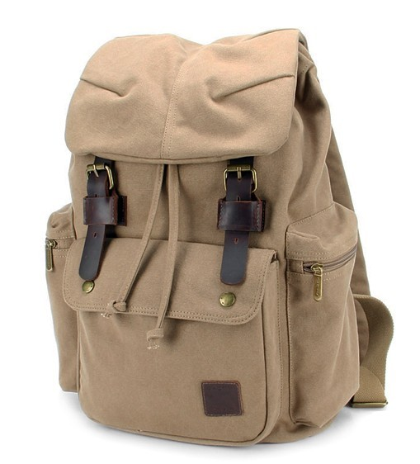
4kg, 10$
4kg, 10$
4kg, 10$
× 2
4kg, 10$
6kg, 4$
6kg, 4$
6kg, 4$
6kg, 4$
× 1/3
1kg, 1$
1kg, 1$
1kg, 1$
1kg, 1$
1kg, 2$
1kg, 2$
1kg, 2$
1kg, 2$
2kg, 2$
2kg, 2$
2kg, 2$
× 2
2kg, 2$
10 kg
10 kg, max $
not smaller than 14 $
min kg
multiple items
max $
fractional one item
max $

