Slide 1
Anomaly Detection System
admire-eurohpc.eu
Wojciech Stefaniak (PSNC)
May 27 2024
Grant Agreement number: 956748 — ADMIRE — H2020-JTI-EuroHPC-2019-1

Slide 2
Agenda
Overview of Anomaly Detection System
Component structure
How does it work?
Visualisation

Slide 3
Overview of Anomaly Detection System
What is Anomaly Detection System about?
Detects anomalies in HPC systems based on collected metrics
Monitors system as a whole
Monitors particular nodes
Developed to help system administrators
What is Anomaly Detection System not about?
Detecting anomalies in application behaviour (it can however detect anomaly if application enters an undesired state from a system perspective)
Detecting application patterns/types

Slide 4
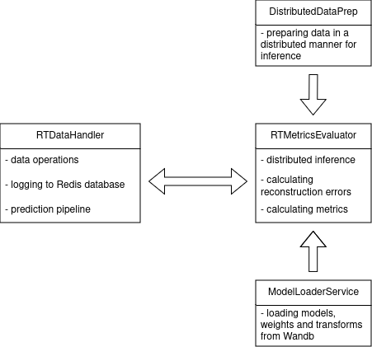
Component Structure
RTDataHandler handles :
reading data from database
invoking prediction pipeline
updating history
logging to Redis database
RTMetricsEvaluator handles :
Calculating reconstruction error for a window, history, entire time series and respective metrics
Process speed up with distributed inference using Pytorch’s DDP

Slide 5
WP6 Integration
Intelligent Controller
Anomaly
Detection
Redis
Database

Slide 6
How does it work?
Current window
History
Notes:
Concatenating both history and current window to see if we get any anomalies in the current time-stamp
We need history, because without it we don’t know how current state relate to what was seen before (if the temperature outside is high and it affects temperature of cpus and it slowly risen from the morning we won’t detect an anomaly, because we know previous 24 hours). However if we just compare small windows we could see differences between them

Slide 7
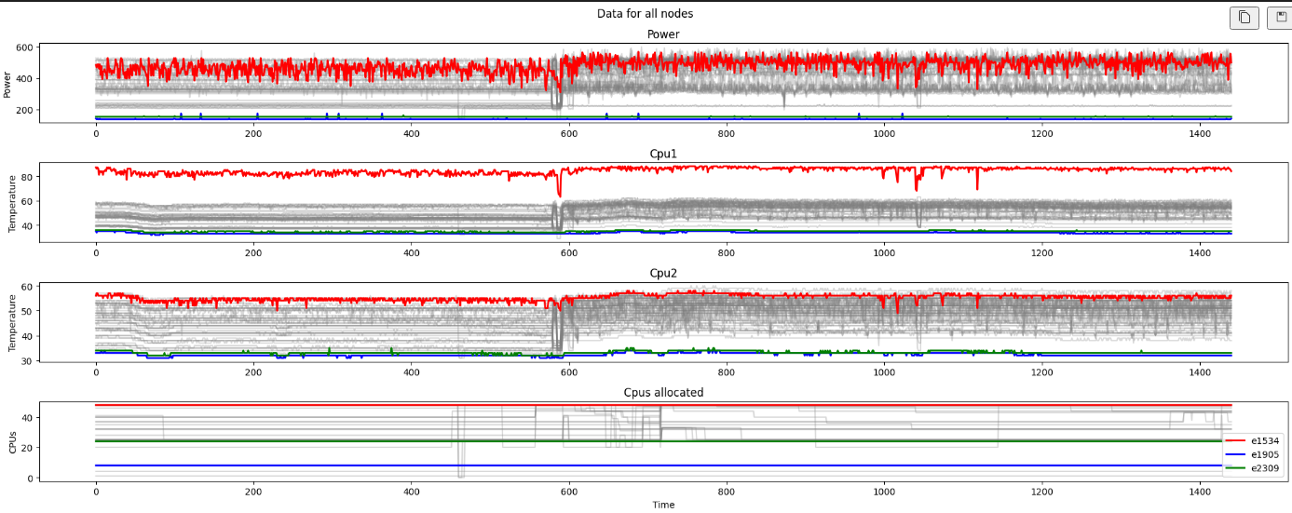
Visualisation

Slide 8
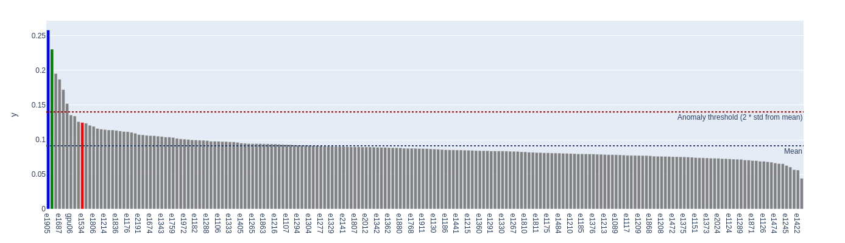
Visualisation

Slide 9
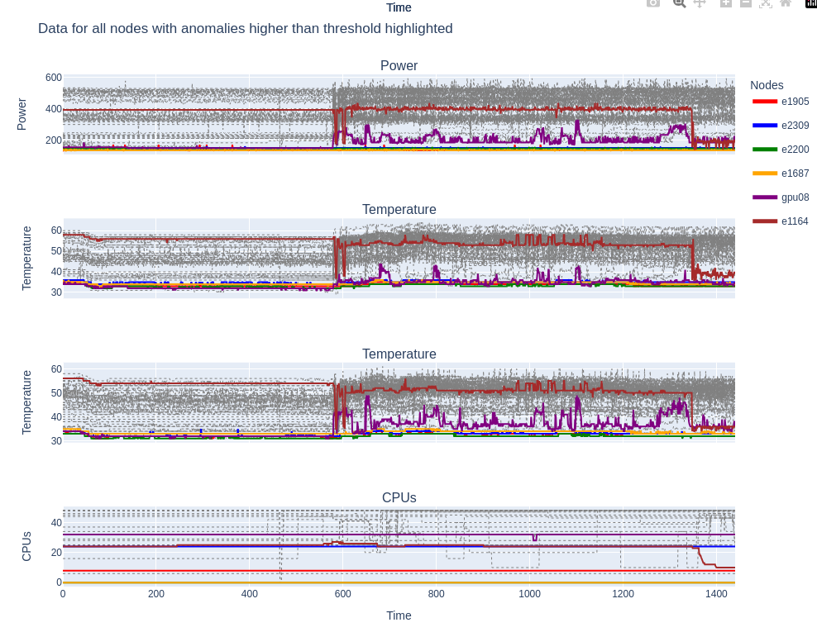
Visualisation

Slide 10
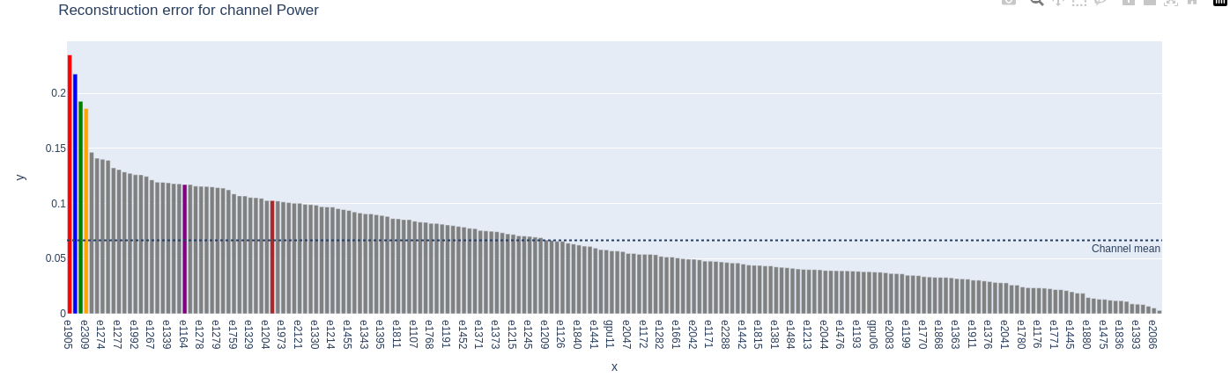
Visualisation

Slide 11
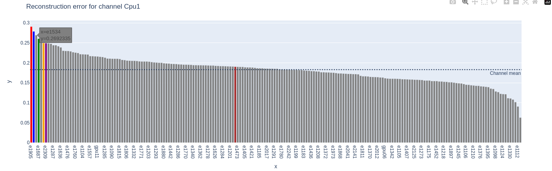
Visualisation

Slide 12
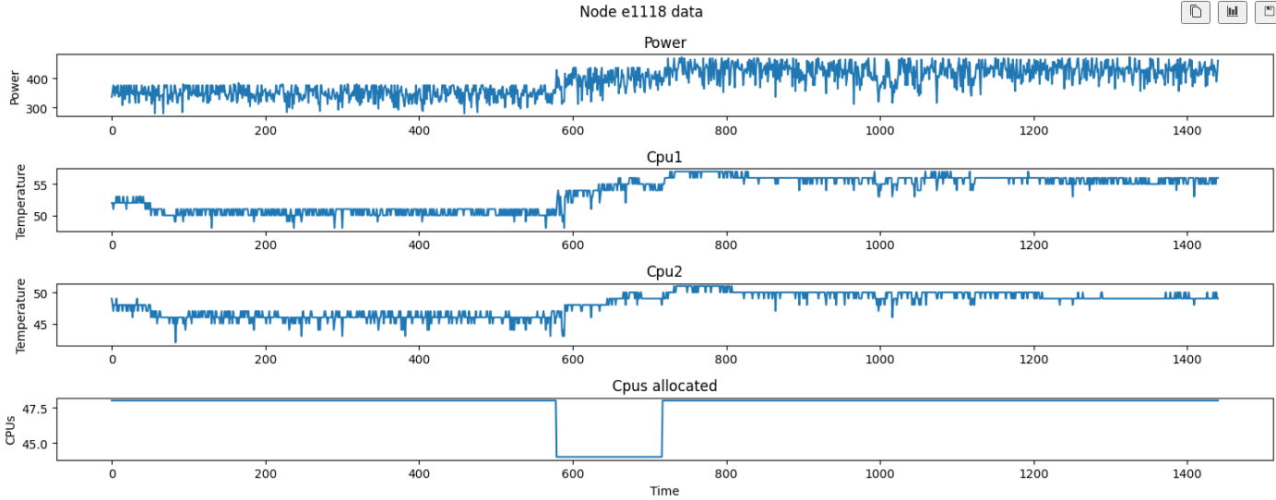
Visualisation - low reconstruction error

Slide 13
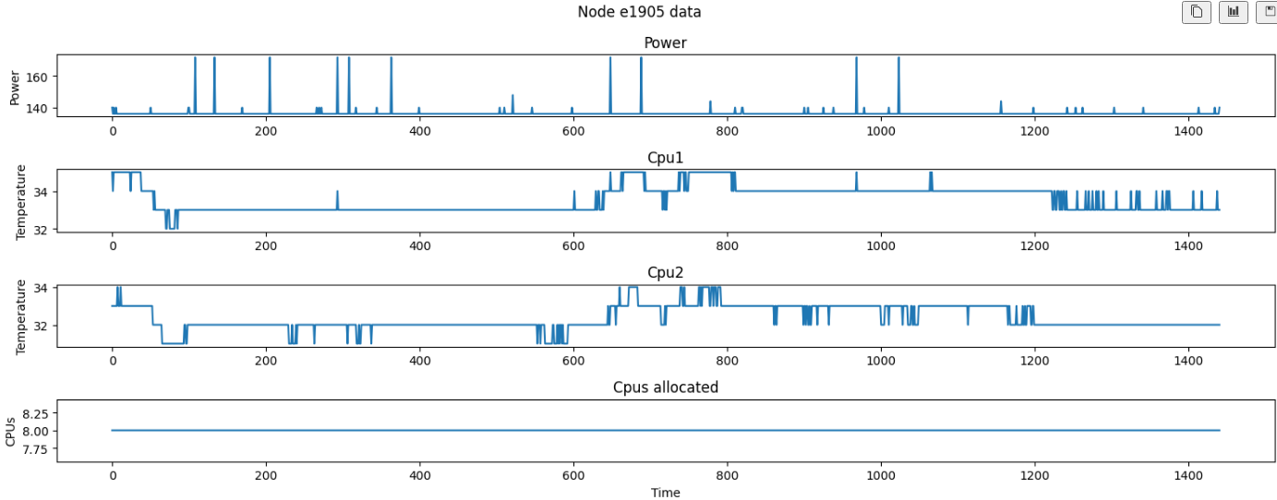
Visualisation - high reconstruction error

