Slide 1

Analysis of AMCAT Data

Slide 2
About me
I am a B.Tech graduate with a passion for data science.
Throughout my academic journey, I've developed strong problem-solving skills and an analytical mindset.
My interest in data science stems from its ability to extract meaningful insights from complex datasets, driving informed decision-making and innovation across various industries.
Despite lacking prior work experience, I am eager to immerse myself in the field and contribute to impactful projects.
I'm committed to continuous learning and staying updated with the latest advancements.
Connect with me on LinkedIn: https://www.linkedin.com/in/nehanth77/ and explore my projects on GitHub: https://github.com/admirer77 .

Slide 3
Objective of the Project
Introduction
Data Import
Data Cleaning Steps
Data Manipulation Steps
Univariate Analysis
Bivariate Analysis
Research Questions
Bonus
Conclusion

Slide 4
Introduction
In the exploratory data analysis (EDA) of the MBA placement dataset, I conducted univariate analysis to understand the distributions of numerical and categorical variables through histograms, boxplots, and countplots.
Additionally, bivariate analysis was performed to explore relationships between variables, including scatter plots to examine the relationship between salary and percentage in 10th grade, swarm plots to visualize the relationship between gender and specialization, and a stacked bar plot to analyze the distribution of placements based on gender.

Slide 5
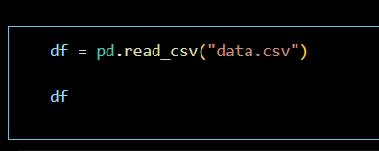
Data Import
Data was downloaded from the given link and imported to the dataframe with the below code.

Slide 6
Data Cleaning Steps
The DOL column consist of present values and dates too.
So, two dataframes are created by having DOL column consist of only present values in one dataframe and the other with dates.
So that it is easy to calculate the time worked by the employees who left.

Slide 7
Data Manipulation Steps
I manipulated the dataframe in a way that I found many answers to some questions.
Created a dataframe where DOL has only dates
time_worked_df = df[df["DOL"] != "present"]
Created a column which has the time difference between the date of join and date of resignation
time_worked_df["time_of_work"] = time_worked_df["DOL"] - time_worked_df["DOJ"]
Created a dataframe where DOL has only present
present_df = df[df['DOL'] == "present"]
Created a df which have high salary
high_salary_df = df[df["Salary"] == 4000000.0]
Created a df which have 4 columns of high_salary_df
h_sal_df = high_salary_df[["ID","10percentage","12percentage","collegeGPA"]]

Slide 8
Data Manipulation Steps (Continue..)
Created a dfs of male and female separately
male_df = df[df["Gender"] == "m"]
female_df = df[df["Gender"] == "f"]
Created a df of jobcity not equal to -1
filtered_df = df[df["JobCity"] != -1]
Created a column of time column
time_worked_df['time_column'] = pd.to_datetime(time_worked_df['DOL'], format='%m/%d/%Y %I:%M:%S %p’)
Created a column of year
time_worked_df['year'] = time_worked_df['time_column'].dt.year
Created a df which have year == 2015
_2015_left_df = time_worked_df[(time_worked_df["year"] == 2015)]

Slide 9
Data Manipulation Steps (Continue..2)
Bonus question
Created df as per requirements
df_18_1_19 = df[(df["DOJ"] < "18/1/19 0:00") & (df["Specialization"] == "computer science & engineering") & (df["Designation"].isin(["programming analyst", "software engineer", "hardware engineer", "associate engineer"]))]
Female and male dfs
female_df = df[df['Gender'] == ‘f']
male_df = df[df['Gender'] == 'm']

Slide 10
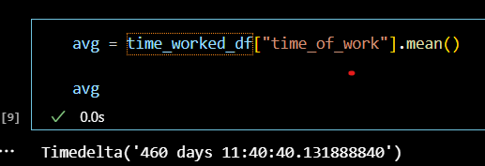
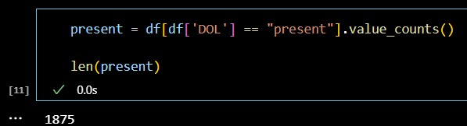
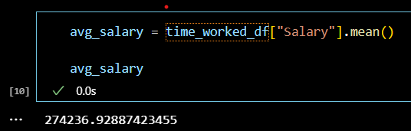
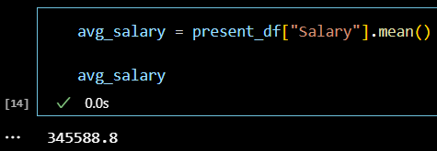
Univariate Analysis

Slide 11
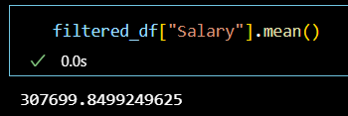
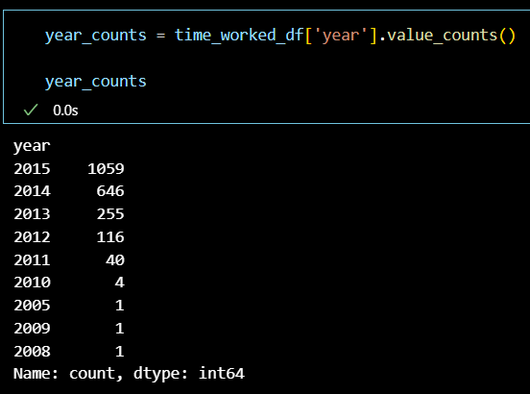
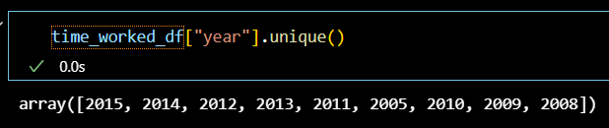
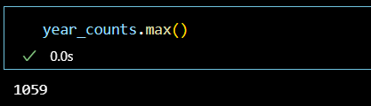
Univariate Analysis (Continue..)

Slide 12
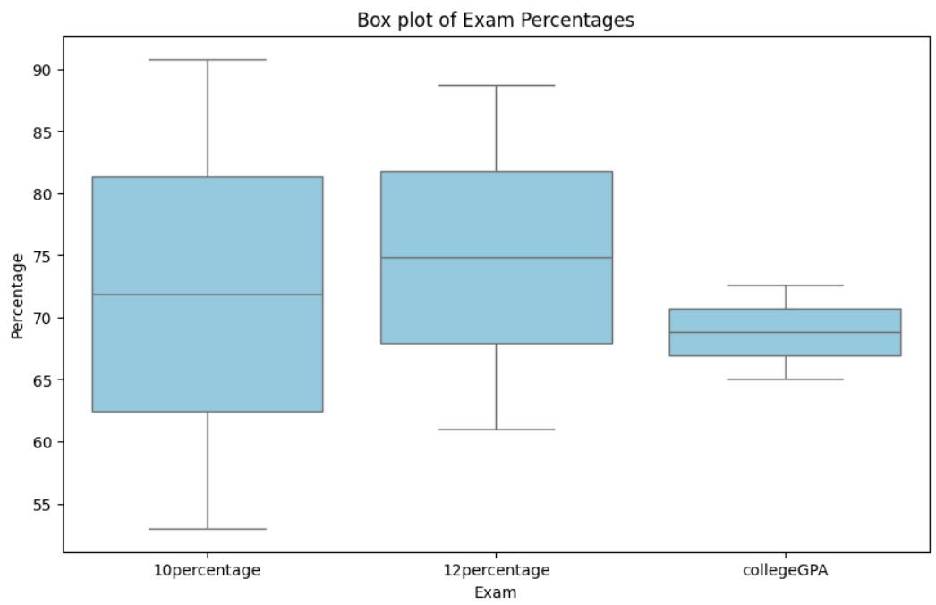
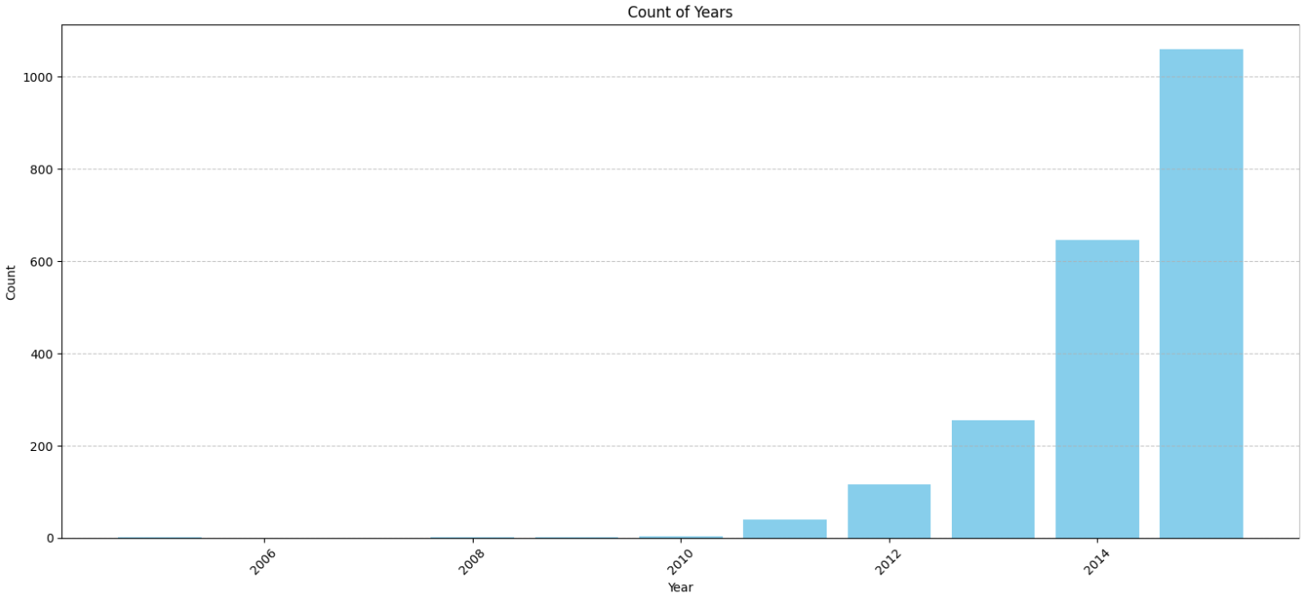
Bivariate Analysis

Slide 13
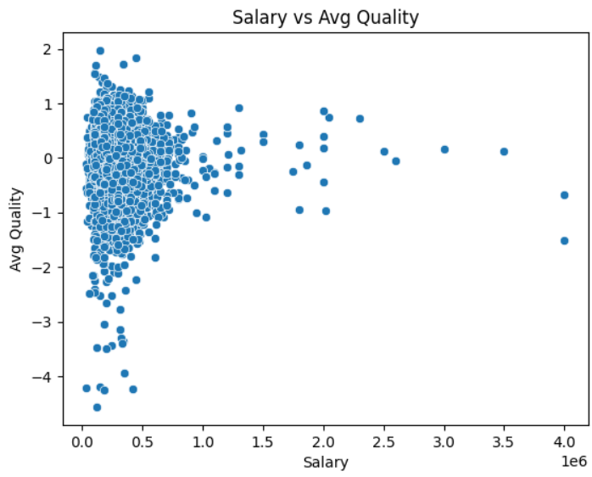
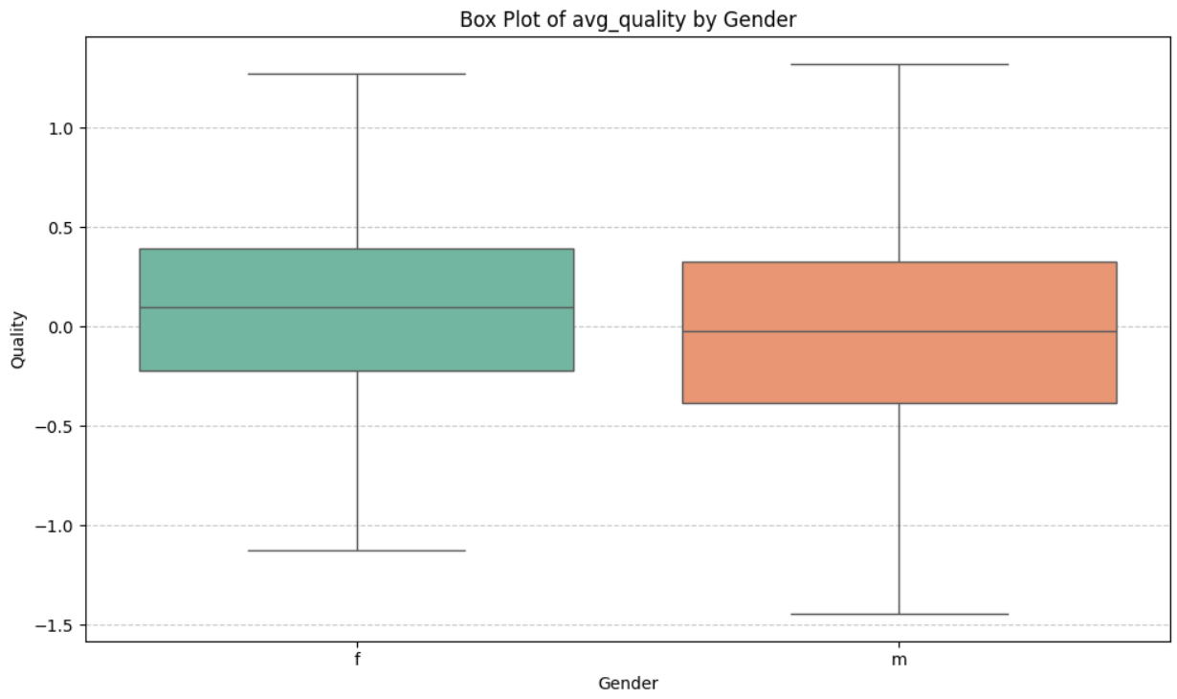
Bivariate Analysis (Continue…1)

Slide 14
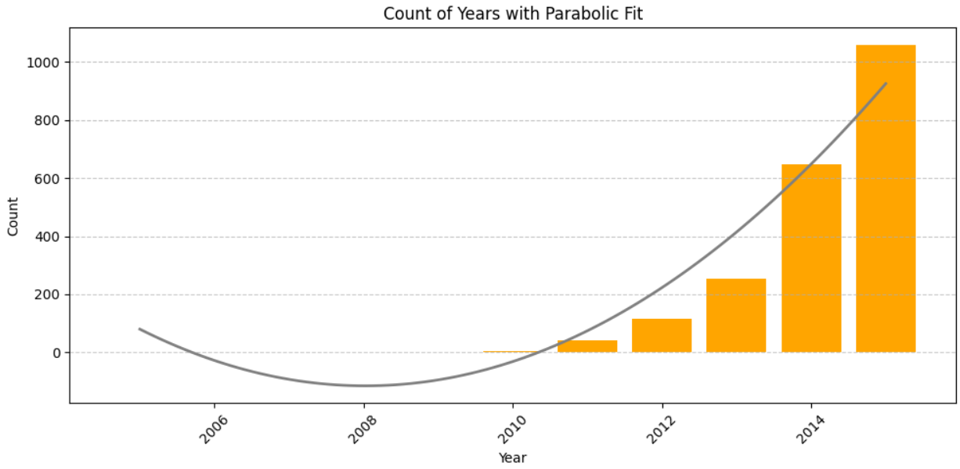
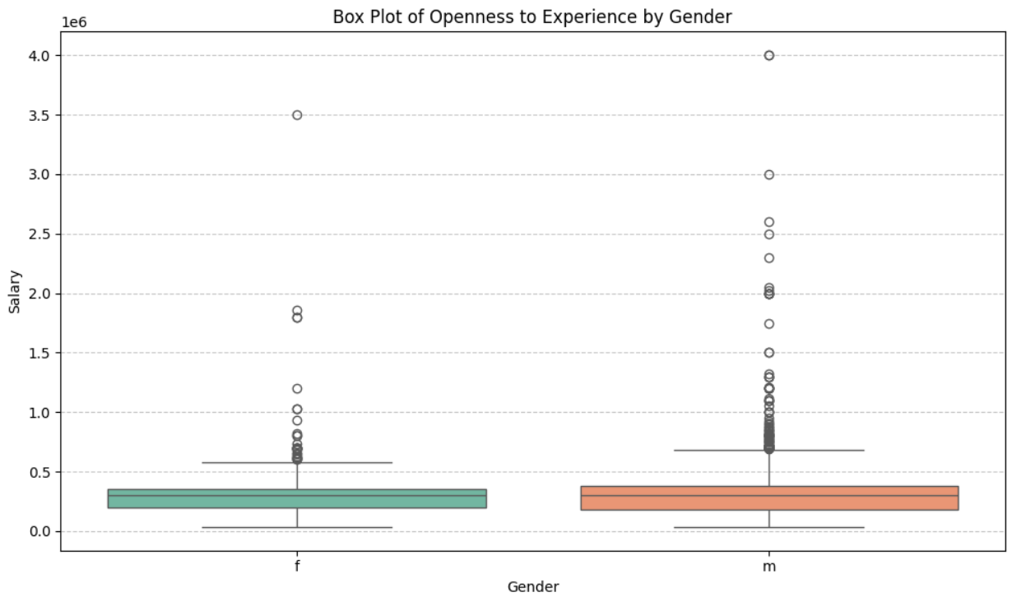
Bivariate Analysis (Continue…2)

Slide 15
Research Questions
What is the avg time, salary worked of employees who left the compony?
Count of employees still working and find no of employees have more than 1000000 salary.
Avg salary employees who are still working?
What is the 10th, 12th and College percentile of highest salary employee. Plot an effective graph?
Compare men average salary and women salary?
Find the count of men and women who left the company and not left the company and for every thing find salary greater than 500000?
Filter the df with job city and find the avg Salary?
In which year most of the employees left the company and what is the lowesr salary in that year?
Consider qualities of employee and find avg. Compare between female and male?
Plot the Salary quality graph?

Slide 16
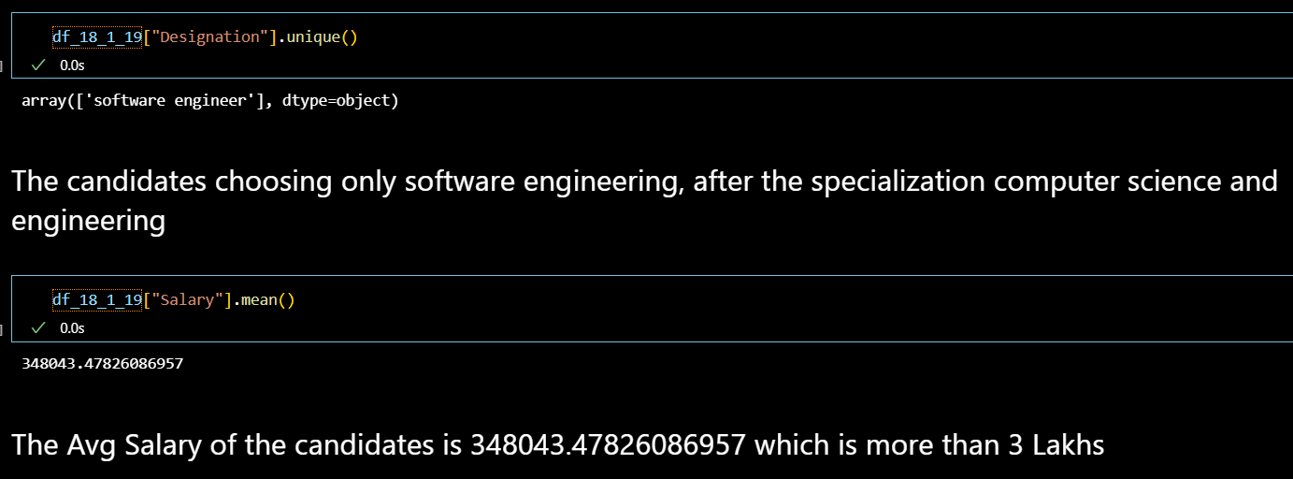
Bonus Question
Times of India article dated Jan 18, 2019 states that “After doing your Computer Science Engineering if you take up jobs as a Programming Analyst, Software Engineer, Hardware Engineer and Associate Engineer you can earn up to 2.5-3 lakhs as a fresh graduate.” Test this claim with the data given to you.

Slide 17
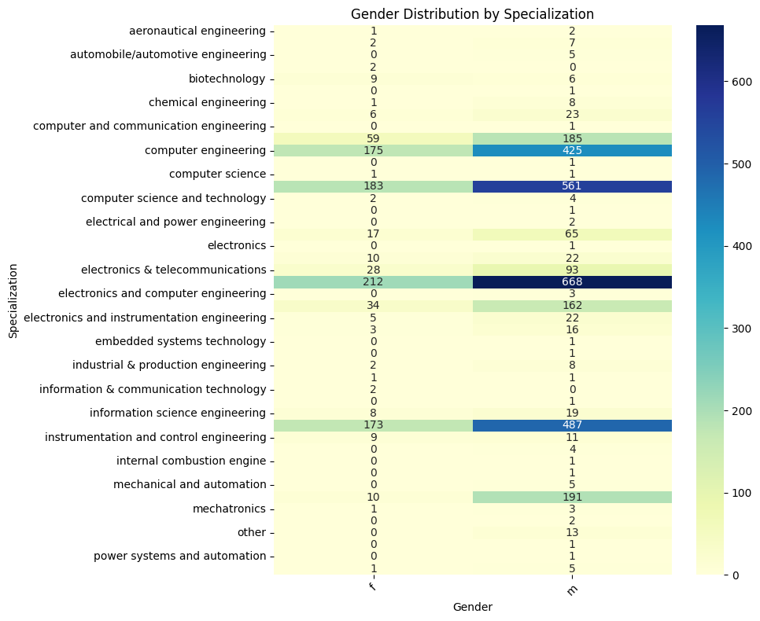
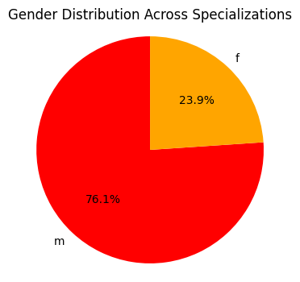
Bonus Question (Continue…)
2. Is there a relationship between gender and specialization? (i.e. Does the preference of Specialization depend on the Gender?)

Slide 18
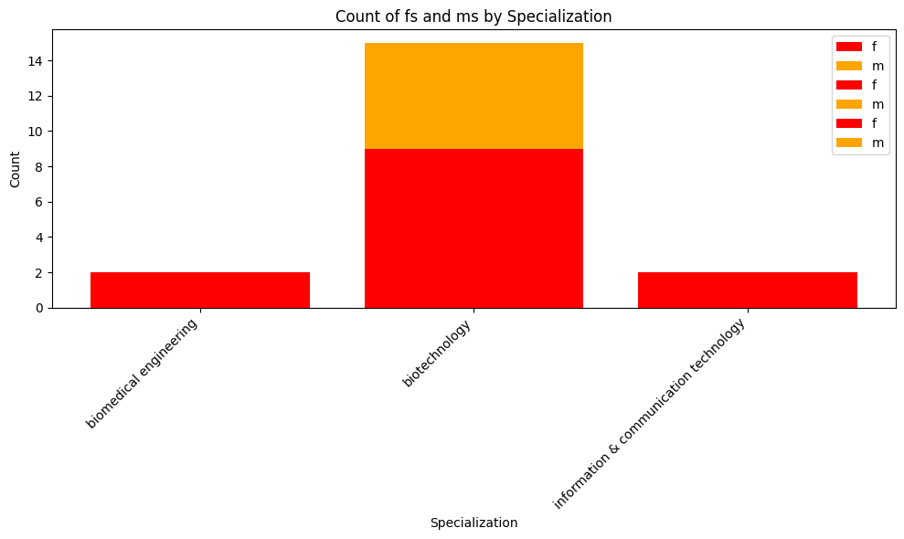
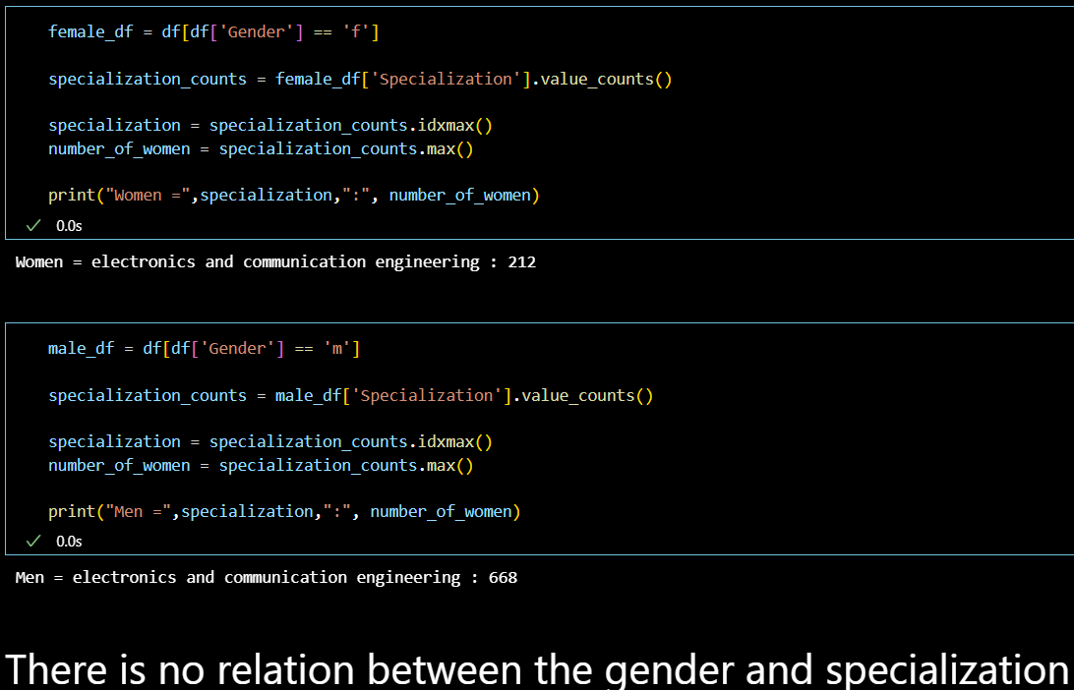

Slide 19
Conclusion
Regarding my experience and challenges working on web scraping and data analysis projects, I found the process to be both rewarding and challenging.
Web scraping posed challenges such as handling dynamic web pages, dealing with anti-scraping measures, and ensuring data integrity and quality.
However, overcoming these challenges through the use of appropriate tools and techniques allowed me to gather valuable data for analysis.
Additionally, conducting data analysis provided opportunities to gain insights, identify patterns, and draw meaningful conclusions from the data.
Overall, the experience enhanced my skills in data collection, cleaning, analysis, and visualization, while also highlighting the importance of perseverance and problem-solving in overcoming challenges encountered during the project.

Slide 20

THANK YOU

