Slide 1

Pressure Gauge Reader
From robot inspection photos to trusted, governed gauge readings in minutes — with a human in the loop
Refinery operator rounds · Databricks Data Intelligence Platform
Notes:
Open with the customer and the business persona: operations leadership at a refinery running robot inspection rounds.

Slide 2
Every gauge read in minutes, not days
[TBD] hrs / week
of manual gauge transcription removed per site
< 5 min
from robot photo to a trusted reading in the app
100%
of excursions and low-confidence readings checked by a human
Inspection robots already photograph hundreds of analog gauges per round — but readings are still transcribed by hand or by a third-party vendor, outside the data platform
A vision model now reads every image as it lands, with a confidence score; only uncertain or out-of-limit readings go to a reviewer
Readings, corrections and excursions are governed in one place and can be queried in plain English
Notes:
Lead with the outcome for the executive sponsor. Replace [TBD] with the impact model: rounds/day x gauges x minutes x loaded cost.

Slide 3
Value for both sides of the business
Executive sponsor — VP Operations / HSE
Domain owner — Reliability / Maintenance lead
Fewer people in hazardous areas for routine rounds: [TBD] exposure hours avoided per year
Vendor dependency removed: [TBD] cost per image today vs. pay-per-token on the platform
Excursions surfaced the same shift, not at the next manual round
One review queue, sorted by risk: low confidence, unreadable, above limit
Every correction audited (who, when, why) and fed back to the lakehouse
Ask questions in plain English: “Are any pressures unusually high?”
Notes:
Frame value for both personas the AI roleplay will play: the business stakeholder and the technical/domain stakeholder.

Slide 4

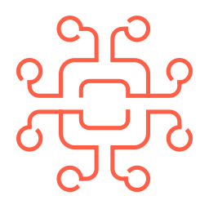






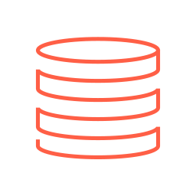
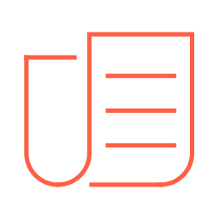

Architecture: one governed data journey
Unity AI Gateway
GPT-5.5 vision model
Genie Agent
Ask in plain English
Databricks App
Review queue (React)
Reviewer
confirm · override · unreadable
Gauge images
(JPG, per round)
Lakeflow
Auto Loader
Incremental, exactly-once ingest from the UC Volume
UC Volume
Bronze
ai_query: reading, unit, scale, confidence
Silver
Parsed readings + quality checks
Gold
Readings + limits + review status
Lakebase
Serving copy + review decisions
Gauge metadata
(CSV: tag, site, limits)
Lakehouse Sync (CDC)
Unity Catalog explicit grants · lineage · raw volume · governed model access · audit
Robot inspection rounds
Auto Loader reads each new image once; the vision model is called inside the streaming table via Unity AI Gateway (usage, cost and access governed)
Gold applies each gauge's operating limit and flags readings that need a human: low confidence, unreadable, or above limit
Reviewers work in a React app on Lakebase; decisions flow back to Delta through Lakehouse Sync and into gold
Genie answers plain-English questions over the governed gold table, on behalf of the signed-in user
Notes:
Walk left to right: land, read, refine, serve, review, ask. Point out the closed loop (dashed arrow) and the Unity Catalog band under everything.

Slide 5
Demo: one inspection round
1 Land
30 gauge photos and the round's metadata arrive in the raw volume
2 Read
Pipeline reads every dial once: value, unit, confidence, image issues
3 Triage
Review queue: 9 readings need a human, 4 above limit, 1 unreadable
4 Correct
Reviewer fixes a misread needle (5.0 → 1.0 bar) with a reason
5 Ask
“Which readings have needed human intervention?” — Genie answers with SQL
Tell: the problem and the outcome · Show: the app and Genie · Tell: what it means for the business
Everything shown runs on synthetic metadata and publicly licensed gauge photos
Notes:
Keep the live demo under 8 minutes. Have the PI-3102 correction ready as the human-in-the-loop moment.

Slide 6
Trust: governed AI with a human in the loop
Human in the loop
Unity Catalog
Unity AI Gateway
Confidence below 70%, unreadable dials and excursions always go to a reviewer
Every decision is appended (never overwritten) and audited
Human correction rate tracked as live accuracy
Analysts see the gold table only; the app reads images read-only
Lineage from raw image to the answer in Genie
Genie runs with the user's own permissions
Every model call attributed: requester, tokens, latency, status
Model access governed by UC EXECUTE
Swap or fall back models without pipeline changes

Slide 7
Decisions and trade-offs
Foundation vision model via ai_query, not a custom CNN: no labelled data or training; confidence-based review covers the gaps
Model called inside the streaming table: each image read and billed once; reviewed readings never change on refresh
Lakebase for the review step: low-latency transactional writes; synced table stays read-only, decisions return via Lakehouse Sync
Snapshot sync for serving: gold is a materialized view; at ~120 images/day a snapshot takes seconds
“Unusually high” = above the gauge's operating limit (default 75% of full scale), so Genie never invents thresholds
GPT-5.5 chosen after testing 15 vision models: best accuracy among batch-capable models, with a confidence score that separates right from wrong

Slide 8
Path to production
Connect the robot fleet platform's image export to the raw volume (file-arrival trigger already in place)
Load real gauge tags and operating limits from the asset register
Pilot one site for [TBD] weeks; target human correction rate below [TBD]%
Alerting on excursions into the maintenance work-order system
Promote with Declarative Automation Bundles (dev → prod), named reviewer / analyst groups

