Slide 1

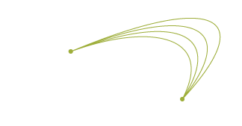
BIDS GraphXD 2021
March 23, 2021
BIDS.berkeley.edu • BIDS@berkeley.edu • @UCBIDS #bidsXD
Notes:
NetworkX
Title: The Shoe Archive of Puzrish-Dagan, 2100-2000 BC.
Description: In this demonstration, we will use NetworkX to help solve a riddle contained in a small administrative archive of cuneiform tablets from the ancient Sumerian city-state of Puzrish-Dagan, modern Drehem, Iraq. The archive contains many records of the production of fine shoes, along with precious metals and gems, but why does this small collection of 300 texts exist among thousands of administrative records? To help answer this question, we use network analysis in order to map the relationships between the actors of this small archive, and visualize the social network to find the leaders and their cliques in the archive.

Slide 2



BIDS GraphXD 2021 • Tuesday, March 23, 2021 • 1:00 – 2:00 PM Pacific Session 3: NetworkX Application Tutorial
Network Analysis of Ancient Sumerian Texts
Adam Anderson
BIDS Research Program Training Manager
Niek Veldhuis
Professor of Assyriology, UC Berkeley
and the
Sumerian Networks Project Data Science Discovery Team
BIDS.berkeley.edu • BIDS@berkeley.edu • @UCBIDS #bidsXD

Slide 3


BIDS GraphXD 2021 • Tuesday, March 23, 2021 • 1:00 – 2:00 PM Pacific Session 3: NetworkX Application Tutorial
Network Analysis of Ancient Sumerian Texts
Yashila Bordag
Data Science Discovery Program Student Developer
Colman Bouton
Data Science Discovery Program Student Developer
and the
Sumerian Networks Project Data Science Discovery Team
BIDS.berkeley.edu • BIDS@berkeley.edu • @UCBIDS #bidsXD

Slide 4
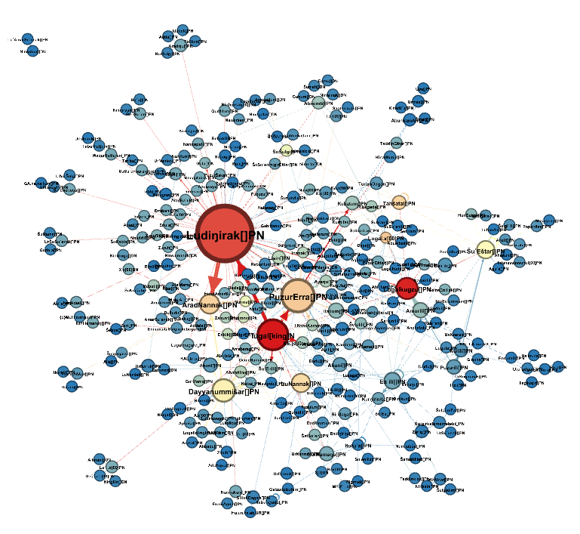
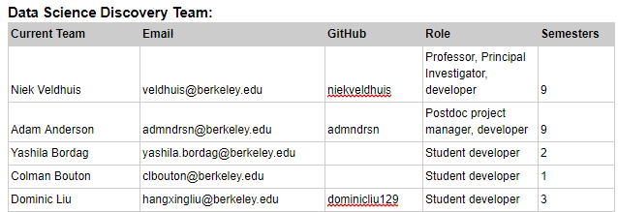
Sumerian Networks
DS-Discovery Team Presents:
Description: In this demonstration, we will use NetworkX to help solve a riddle contained in a small administrative archive of cuneiform tablets from the ancient Sumerian city-state of Puzrish-Dagan, modern Drehem, Iraq. The archive contains many records of the production of fine shoes, along with precious metals and gems, but why does this small collection of 300 texts exist among thousands of administrative records? To help answer this question, we use network analysis in order to map the relationships between the actors of this small archive, and visualize the social network to find the leaders and their cliques in the archive.
Network Analysis of Ancient Sumerian Texts
The Shoe Archive of Puzrish-Dagan, 2100-2000 BC.

Slide 5
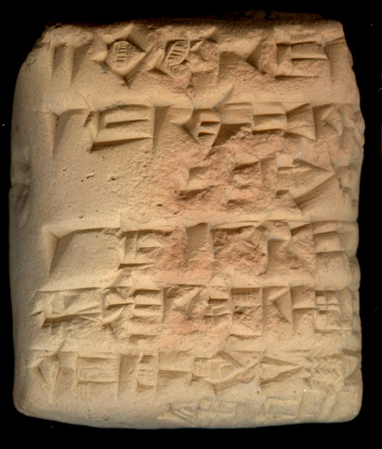
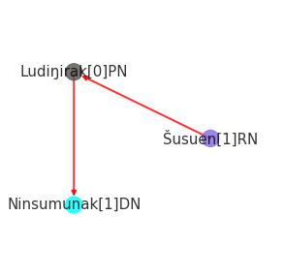
The Data in its Various Forms
a-ru-a šu-{d}suen
ki lu₂-dingir-ra-ta
arua[offering]N; Šusuen[1]RN
ki[place]N; Ludiŋirak[1]PN
Cuneiform Tablets
Digitization
Lemmatization
Graph
Notes:
Niek

Slide 6
Tablets
Puzriš-Dagan: Royal Archive
Today: Drehem (south Iraq)
Ca. 2060 - 2000 BCE
Looted, sold on blackmarket
Original arrangement of tablets unknown
15,000 tablets spread over the world
Mostly animals
Treasure & Shoe archive; ca 300 tablets
Tablet Image
Goes Here
Notes:
Niek
The archive we’re going to look at is nominally represented in the full collection of texts from Drehem.

Slide 7
ORACC: Open Richly Annotated Cuneiform Corpus
2 har ku₃-babbar 10 gin₂-ta
n; har[ring]N; kugbabbar[silver]N; n; giŋ[unit]N
2 silver rings 10 shekels each
{d}nin-sun₂ u₃-suh₅{ki}
Ninsumunak[1]DN; Usuh[1]SN
For Ninsumun of Usuh
a-ru-a šu-{d}suen
arua[offering]N; Šusuen[1]RN
Offering of Šusuen (the king)
ki lu₂-dingir-ra-ta
ki[place]N; Ludiŋirak[1]PN
expended by Ludiŋira
Lemmatization of tablets performed by scholars in the field
ORACC provides standards for transliteration and lemmatization.
Tablets assigned unique id number
Data and metadata can be downloaded in JSON format
Notes:
Niek

Slide 8
Rule-based Generator of Nodes and Edges
2 har ku₃-babbar 10 gin₂-ta
n; har[ring]N; kugbabbar[silver]N; n; giŋ[unit]N
2 silver rings 10 shekels each
{d}nin-sun₂ u₃-suh₅{ki}
Ninsumunak[1]DN; Usuh[1]SN
For the goddess Ninsumun of Usuh
a-ru-a šu-{d}suen
arua[offering]N; Šusuen[1]RN
Offering of Šusuen (the king)
ki lu₂-dingir-ra-ta
ki[place]N; Ludiŋirak[1]PN
expended by Ludiŋira
Nodes:
Persons (PN)
Kings (RN)
Deities (DN)
Roles:
Recipient
Offerer
Source
Keywords:
arua (offering)
ki (from)
Resulting directed graph

Slide 9
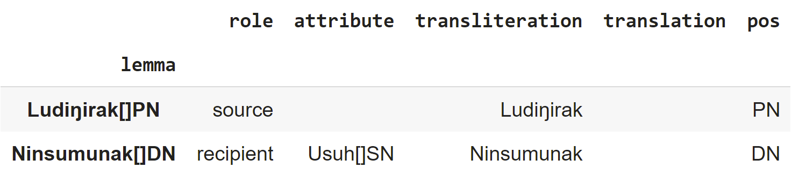
Data Overview - Nodes
Nodes - people identified as either a source or recipient in the text
lemma - the word which was identified as an actor in a transaction in the text
translation, transliteration, pos - metadata from the lemma
role - role the actor played in a transaction
attribute - other attributes associated with the node in the text
nodes_frame:
Notes:
After parsing the data, we are left with our nodes and edges.
The node dataframe contains a set of rows, each of which is a particular node, where each column is an attribute of the node. Each node is associated with an entity in the text who either sends or receives transactions. The attributes the node has includes the lemma which was identified as an entity, the part of speech, translation, and transliteration of the lemma, the role the node played in the transactions, and finally the other attributes the node has.
In the tutorial, we will use a dataframe called nodes_frame to add attributes to the nodes in the NetworkX graph.

Slide 10
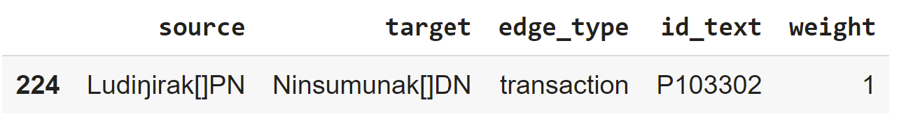
Data Overview - Edges
Edges - transactions which relate different nodes together
source and target defines directionality, source is the source in the text, target is the recipient in the text
edge_type: how the nodes are related
id_text: id of the tablet the edge was scraped from
weight: number of transactions between two individuals
edges_frame:
Notes:
The edge dataframe also contains a set of rows, each of which is a directed edge from one node to another. The edge’s weight is determined by the number of transactions found between two individuals. The edges each have sources, targets, edge_types which define the type of relationship between the nodes, the id_text which identifies which tablet the edge was scraped from.
In the notebook, we will use this dataframe to define the NetworkX graph and add the edge attributes.

Slide 11
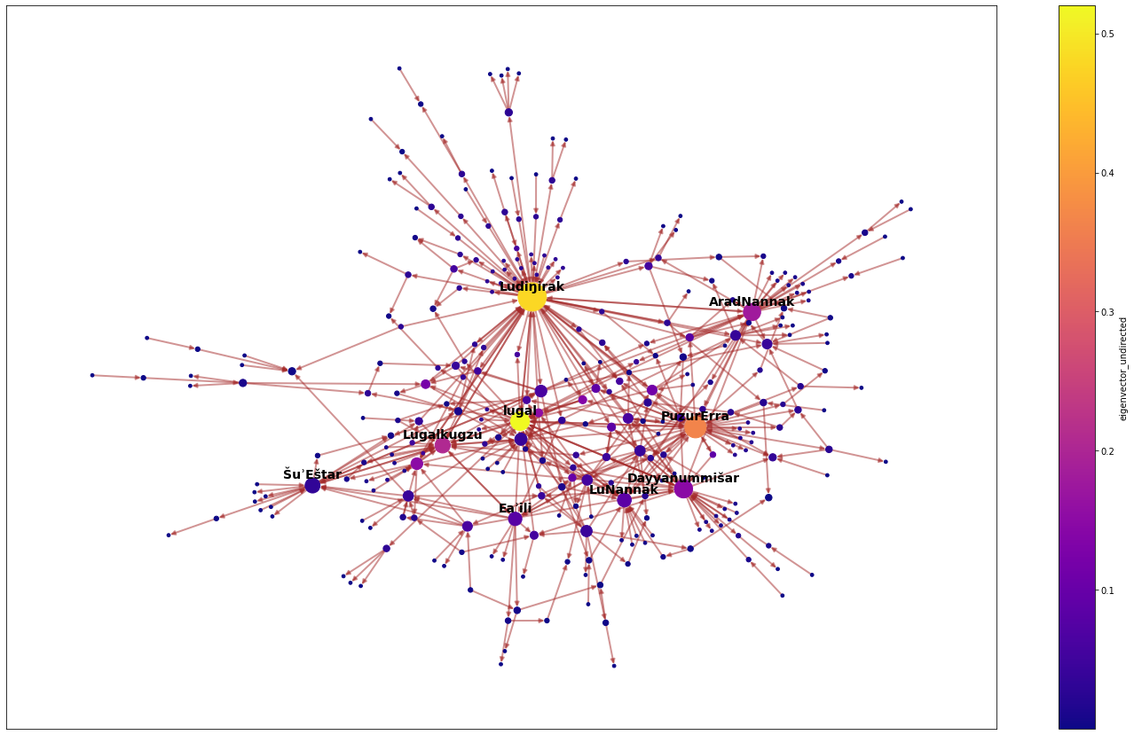
Notes:
Now we see the results in networkX
The complete network graph, with nodes sized by eigenvector centrality (i.e. ‘importance of the actors’)
Open Notebook

Slide 12
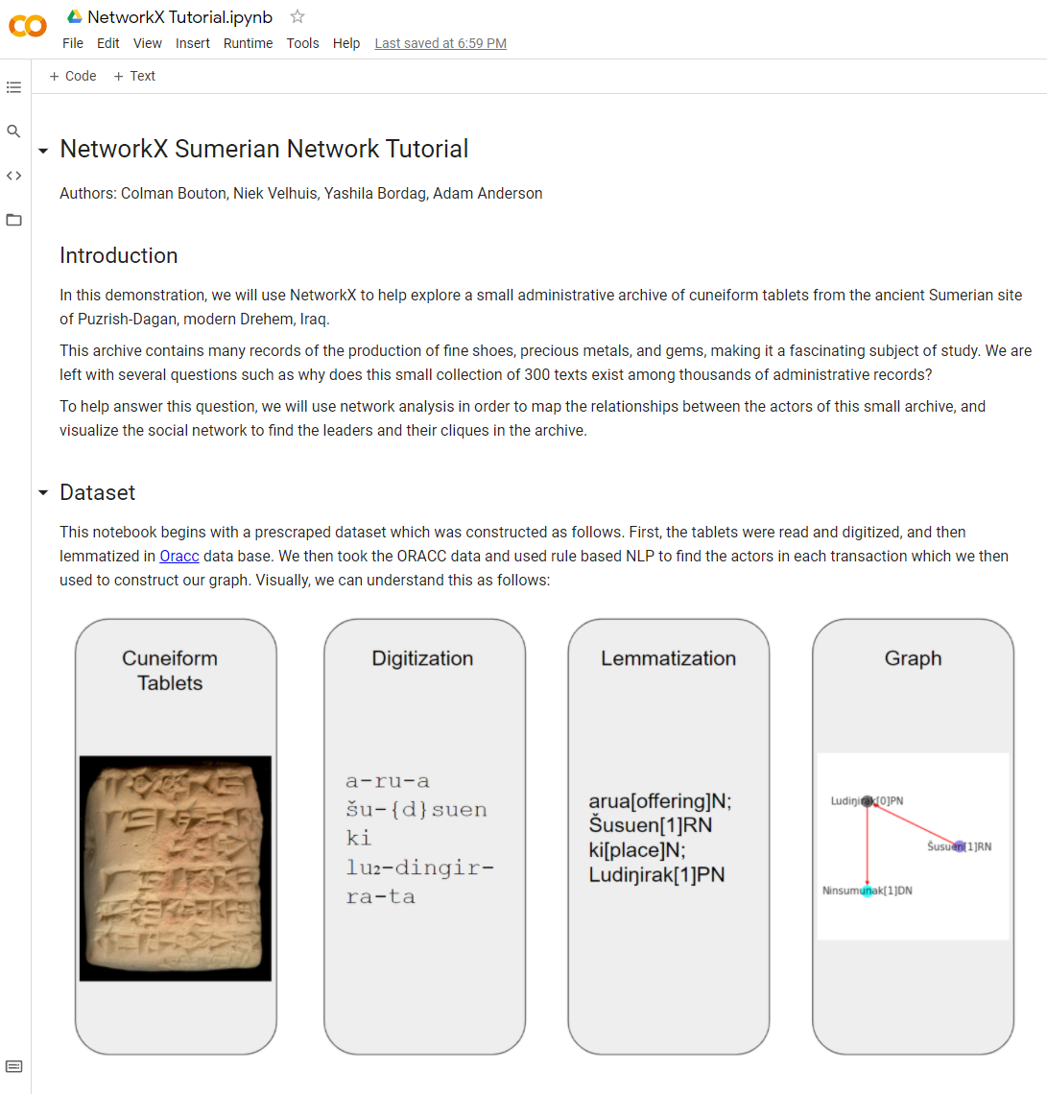
Network X Demo
https://bit.ly/3lvd9AD

