Slide 1
CS351 Project 3
Alex Gonzales
Andrew Morin
Tyson Craner

Slide 2
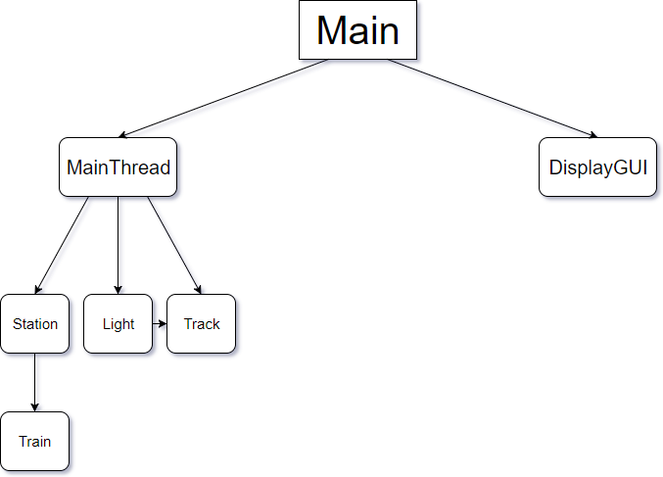

Slide 3
public class Main extends Application
public void start()
Begins the main thread and initializes the GUI.
public static void main()
Launches the JavaFX Application.

Slide 4
public class DisplayGUI extends AnimationTimer
public void DisplayGUI()
Takes the pane and MainThread from Main and sets the GUI panel and main thread. Also initializes the Station, Track, and Light components.
public boolean engageTrackSwitchUp()
Checks to see if there is an up direction in the trains direction queue and if so returns true.
public synchronized void trackListener()
Listens to the train, track, and station objects and sets values to later be updated in the GUI.
public void lights()
Creates the Light GUI object and changes to red or green.
public void initStation(), initTracks()
Initializes the Station, Tracks, and Lights GUI objects respectively.
public void handle()
Inherited from AnimationTimer and updates GUI at 60 fps.

Slide 5
public class MainThread extends Thread
public Thread[][] reader()
Reads a configured txt file and creates the dynamic map of components. Also sets the neighboring tracks
public Thread[][] initialize()
Takes the map created by reader() and starts all of the Threads.
public synchronized void setStartStation()
Takes a LinkedList of Stations and determines which stations are starts and ends.
public synchronized void pickStation()
Starts the Thread on the Stations.

Slide 6
public class Station extends Thread implements Component
public synchronized Track firstTrack()
Returns the first Track to the right or left of the Stations respectively.
public synchronized void setStartStation()
Takes a LinkedList of Stations and determines which stations are starts and ends.
public synchronized void finishLine()
Takes an end station and sets the end to the current Station.
public void run()
Inherited by Thread, initializes the Train object with the start and end Stations.
public Rectangle getDisplayStation()
Returns a Rectangle object to draw the Stations.
public synchronized void getTrainFromTrack()
Called when the Train arrives at the end Station, killing the Train object.

Slide 7
public class Track extends Thread implements Component
public void setTrack()
Sets the name of the current track and saves the Track objects touching it to the left and right.
public void setTrackRStation, setTrackLStation()
Sets the Track to the left and right of the station respectively.
public void setSwitchTrackD, setSwitchTrackU()
Sets the Tracks connecting the switch above and below the Train respectively. Also keeps track of the direction of the Train.
public Track[] returnNeighbors()
Returns an array with the nextU, nextR, nextD, and lextL Track objects.
public synchronized void moveTrain()
Removes the Train object from the current Track and passes it to the next.
public synchronized void findNext()
Finds the next direction in the Trains route.

Slide 8
public class Track extends Thread implements Component (cont.)
public synchronized void operation()
Determines whether or not the Train can continue moving in the current direction. Makes sure the Train is the first in the queue and waits for locked routes and red lights. Calls moveTrain() to actually move the Train.
public void run()
Inherited by Thread, this is the main loop of the Track object. Determines when the Train has arrived at a Station and sets the next direction of the Train.

Slide 9
public class Light extends Track
public boolean isRed()
Determines whether or not the light is red.
public void setRed()
Changes the light red or green.
public void getLightId()
Changes the light red or green.

