Slide 1

Quantum Computer Programming
Qiskit Section
Andrés Muñoz-Moller
Quantum Information and Computing Team

Slide 2
Questions Lectures 1
What is the difference between a bit and a qubit?
Classical Bit → System that has classical states 0 or 1.
Quantum States → Unit (column) vectors in a Hilbert space.
Qubit (Quantum bit) → Quantum state in a two-dimensional Hilbert space.
What is a superposition of states?
Superposition of states = Linear combination of the basis states.

Slide 3
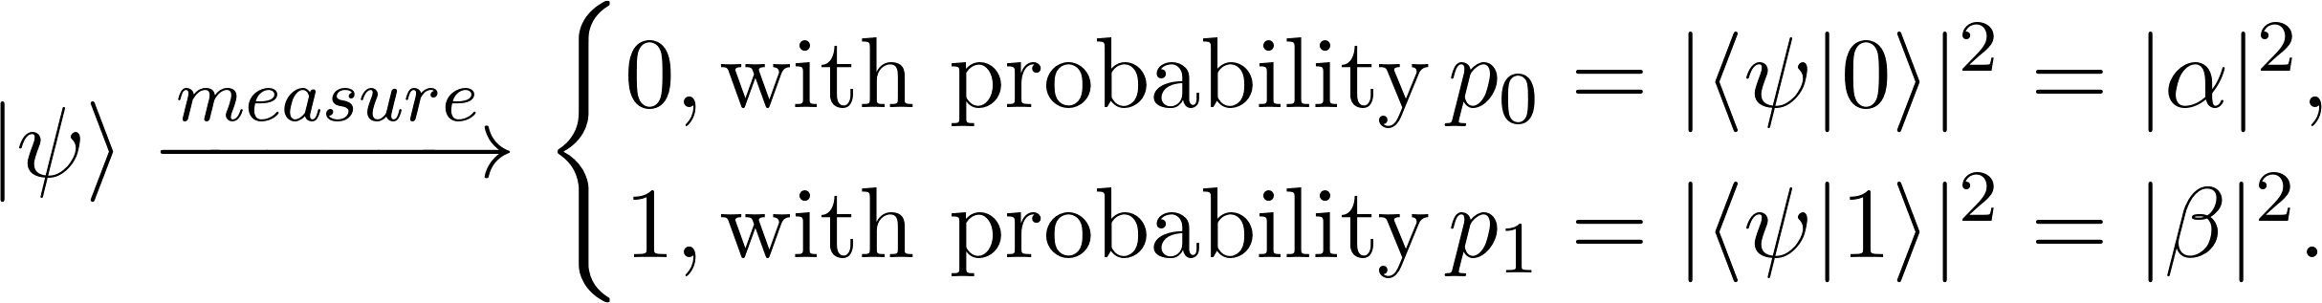
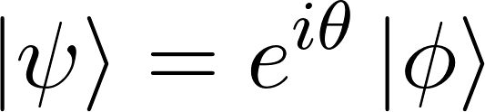
Questions Lectures 1
How do we obtain information about a qubit?
What is a global phase?
Global Phase

Slide 4
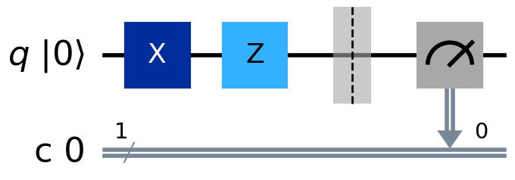
Questions Lectures 1
What are some components of a quantum circuit?
Quantum Gates
Initial State
Quantum Register
Classical Register
Measurement
Notes:
IBM Quantum Computers architecture corresponds to superconducting qubits.

