Slide 1
Big Mountain Skiing Case Study
Pricing/Operation Recommendations

Slide 2
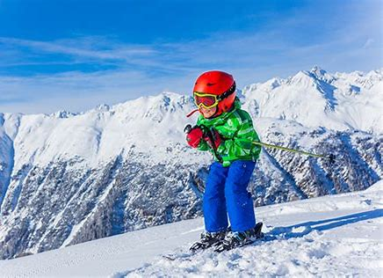
Background/Goals for Study
Goals:
Increase ticket revenue
Identify/cut resort services that do not result in depressing revenue.
Current Situation: Big Mountain Skiing
Current pricing for Big Mountain at $81/ticket.
Set by premium charge over national market average
Current operation:
105 runs
14 lifts of various types (triples, quads, fast quads, etc.)
600 acres of snow making + nightskiing area
Vertical drop: 2353 ft.
Total skiable area: 3000 acres

Slide 3
Strategy
Where does Big Mountain fit?
National Market
Are there market subsets? Should Big Mountain be considered only with a market subsegment?
Resort Offerings:
# Runs
# Lifts
Skiiable area, etc.
Ticket prices
Resort features
Construct model to:
Identify key resort features determinant of ticket prices
Find appropriate pricing for Big Mountain based off:
Key resort features + location in market segment/subsegment
Expected value of pricing for given resort features + market

Slide 4
Key Insights Gained
No discernible market subsegmentation. Setting pricing using prices in Montana specifically doesn’t make sense.
Key resort features allowing for higher ticket pricing:
Number of runs
Resort’s max vertical drop
Resort area where snow is guaranteed
Number of high speed quad lifts
Recommended ticket price range: $95 +- $10 (compared to current $81).
Result of regression model on price vs. key features on entire national market segment.
Shut down 4-5 underutilized runs (slow and incremental roll-out with this).
Decrease in ticket price recommended by adjustments
Add a new, longer run with a ski lift that extends the max vertical drop by 150 ft.
People will pay for an additional, well equipped run with a larger vertical range.

Slide 5
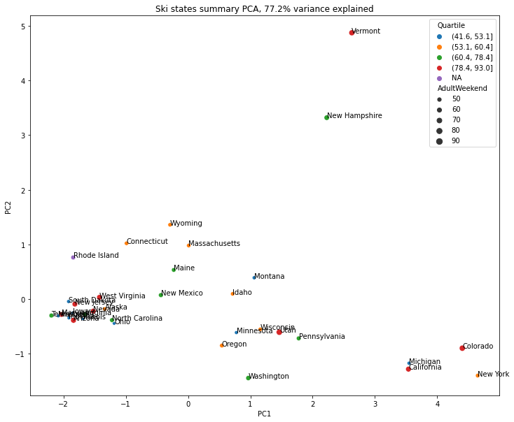
Market Segmentation by State?
State Ticket Price Distribution
Relevant distinguishing factors:
PC2 proportional to resorts / capita in a state
PC2 roughly related to the amount of skiable area + the average length of the season in the state
PC2
Ticket pricing and quartiles do not show obvious grouping by state.
Pricing will thus be assumed to be determined by resort characteristics
We thus include entire national market in our analysis.
PC1

Slide 6
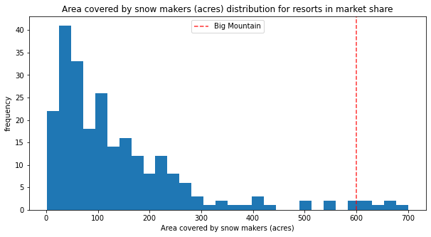
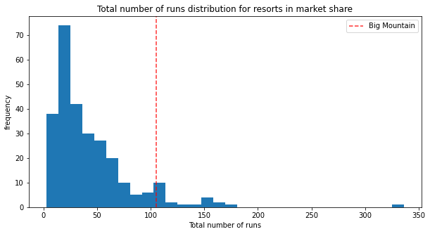
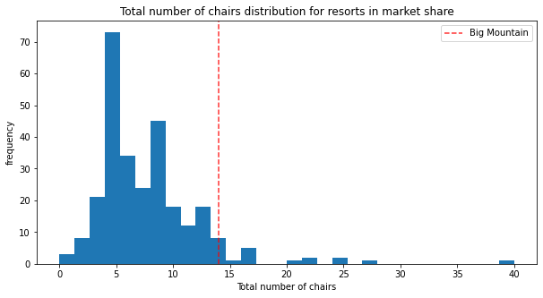
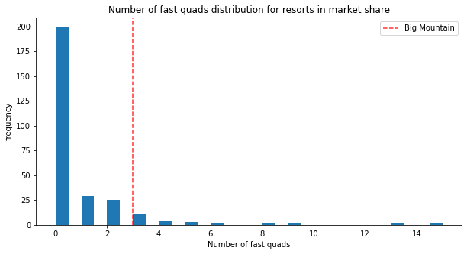
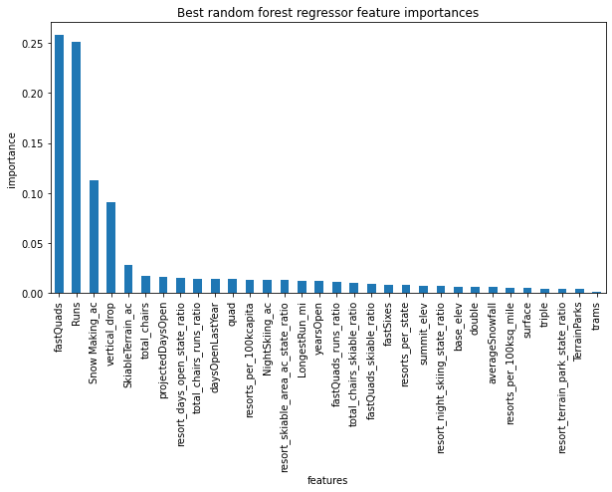
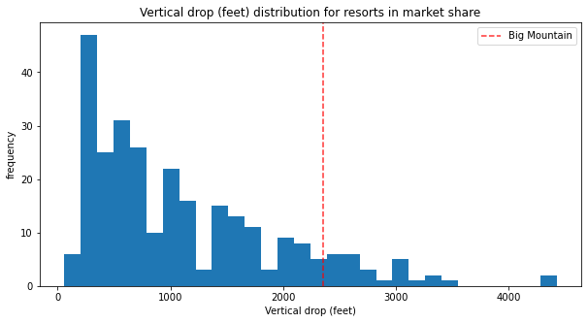
Big Mountain Skiing vs. National Distribution
Big Mountain is at the top end of the distribution for all the factors dominantly correlated with the ticket price.
Note: $78-$93 range is the highest price quartile in national distribution. Our regression places estimated price at $95 +- 10. Makes some sense.

Slide 7
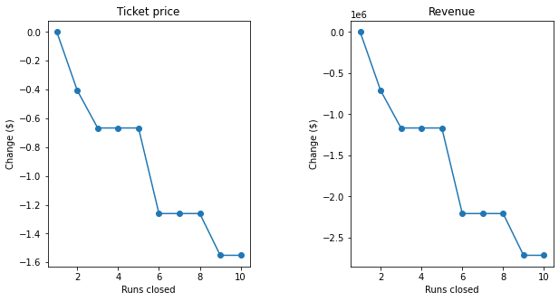
Closing runs / additional recommendations
Regression model allows some insight into how closing runs from Big Mountain’s operating point would correlate with recommended adjustments to ticket pricing.
Decreasing one run could be done w/o price reduction. ~ 3- 5 run reduction @ < $1 ticket price reduction. Might be worth investigating incrementally closing ~ 3 to 5 runs and seeing the effect.
Operating costs for runs to be closed? → For estimating actual profit from this move.
Additional recommendation
New modernized run with new lift + adding 150 ft to vertical drop (resort can improve specs on this) supports an additional ticket price increase of $2.

Slide 8
Conclusions
Big Mountain skiing is at the top of the national distribution for various features that correlate with higher prices.
Analysis recommends pricing at $95 +- 10 / ticket. Current pricing @ $81 / ticket
Shows that even conservatively Big Mountain underpricing by ~ $4 per ticket.
Estimated increase of revenue via conservative increase: $7 million by adjusting by this much (assuming 350K visitors buying 5 tickets per season).
Could consider also shutting down 3-5 antiquated/underutilized runs and replacing them with a single modernized run that has a larger vertical drop. Model predicts how this should influence pricing. However, need additional data of operational costs to make conclusions on how this effects revenue.

