Slide 1
Dissolved Oxygen on the California Coastline
Praveen Gowtham
SpringBoard Data StoryTelling

Slide 2
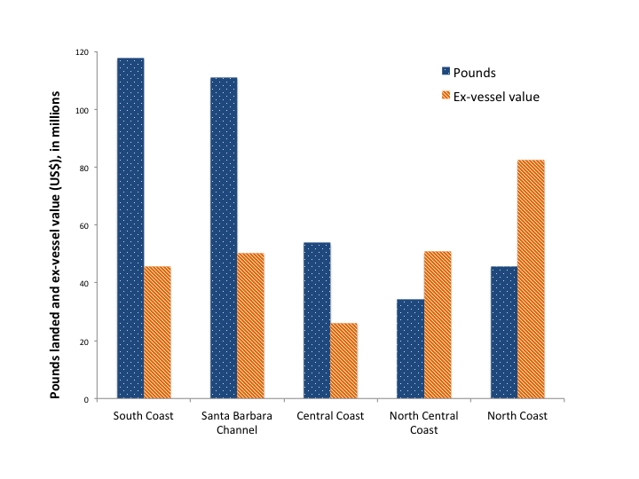
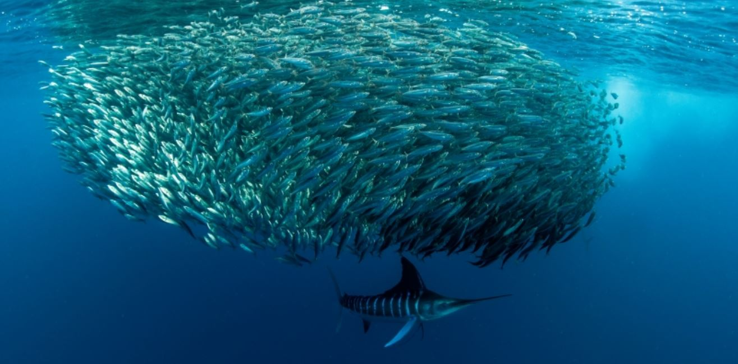
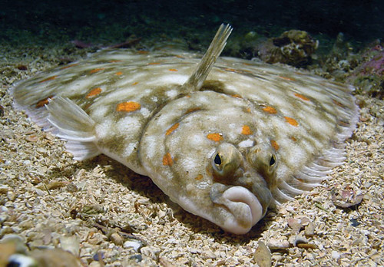
Motivation: California Coastal Economies / Food Source
2013 California Fisheries: Catch and Value
Scale: Order 100-500 M lbs. of fish landed per year.
Value of order $200M USD/year.
Sardines, Mackerel, etc.
> 30M lbs./year
Pelagic Fish
Demersal Fish
Flounder, sole, halibut, etc.
> 15M lbs./year

Slide 3
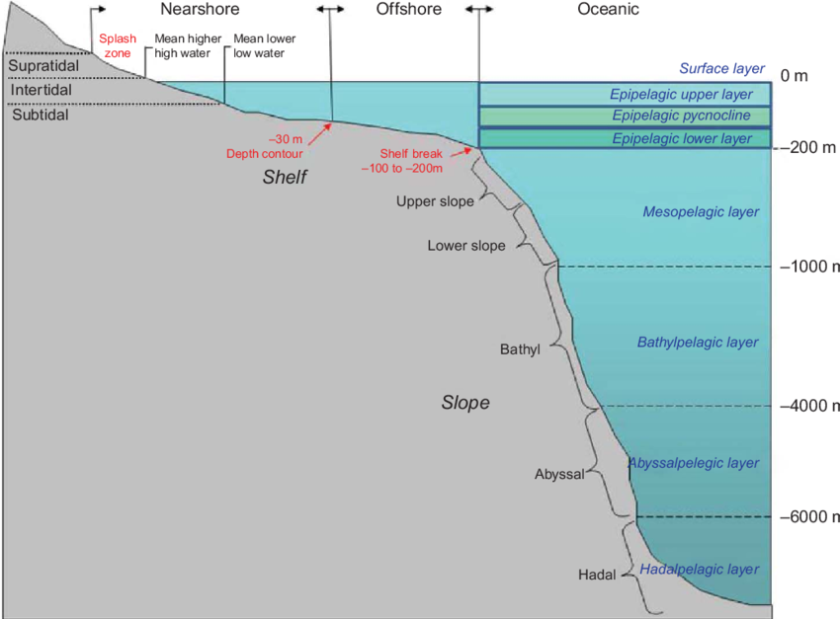
Motivation: Ocean-life Health/Diversity
Water Column
Pelagic Fish
Demersal Fish
Species health depends on physical properties through water column and from shelf to open ocean

Slide 4
Dissolved Oxygen
Dissolved O2 is key for: Fish, mollusks, bacterial life.
Questions:
How is O2 distributed in coastal oceans?
What are driving factors?
Are there signs of oxygen stress that could be affecting coastal fish communities?

Slide 5
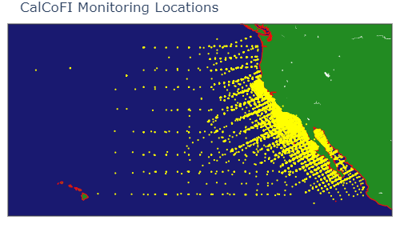
California Cooperative Fisheries Investigation (CalCoFI)
Ongoing study since 1949.
Collect bottle samples at depth from over 1000 stations at regular time intervals.
Measure physical variables (Temp, Salinity, O2, etc.)

Slide 6
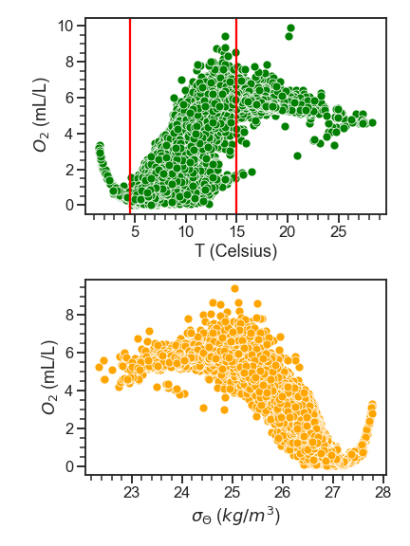
Dissolved Oxygen and Temperature/Water Density
O2 vs T and water density – mirror each other
Very clearly there are 3 different regimes

Slide 7
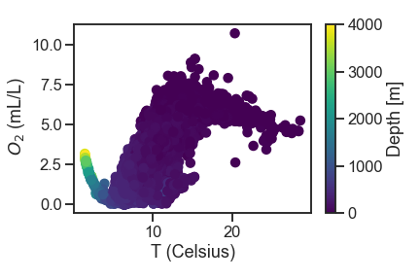
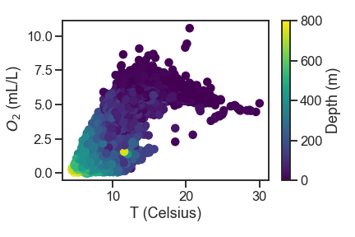
Depth-Stratified O2 vs T behavior
Three different regimes of dissolved O₂ vs T
Three different depth ranges

Slide 8
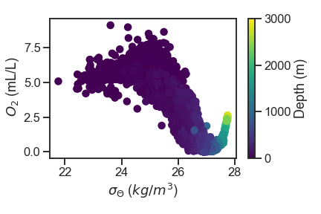
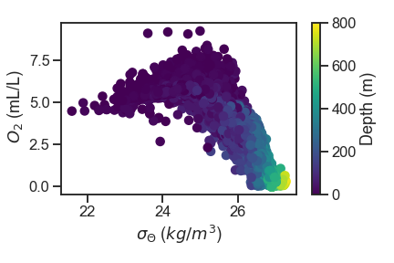
Depth-Stratified O2 vs T behavior
Density follows similar trend.
In upper layer: O2 increases as density increases.
In middle layer: situation reverses.
In deep: Oxygen recovers as water starts to get denser and denser.

Slide 9
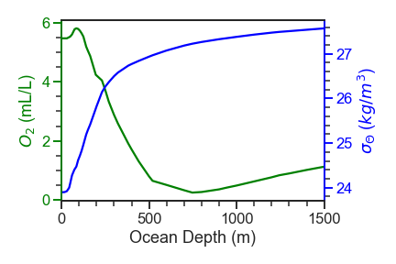
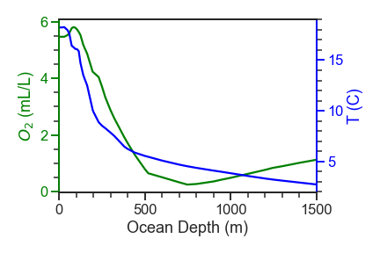
Temperature, Salinity and dissolved O₂
Initial constant density/temperature at shallowest depths.
Steep T, density gradient:
Prevents oxygen rich surface water
from mixing effectively into the deep.
Pycnocline
O2 minimum
Factor in O2 level plummeting.
Thermocline

Slide 10
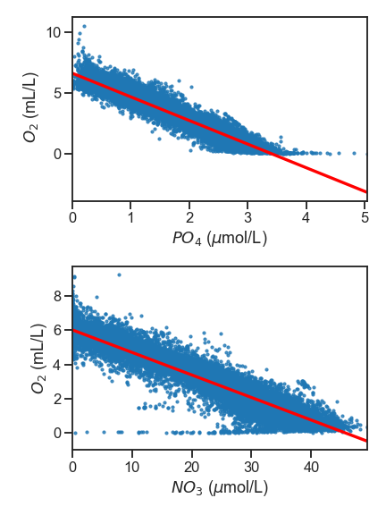
Dissolved Oxygen and Nutrients
Dissolved O₂ concentration decreases with increasing
phosphate/nitrate nutrient concentration linearly.
Dissolved O₂ at high PO₄ goes to total oxygen absence.

Slide 11
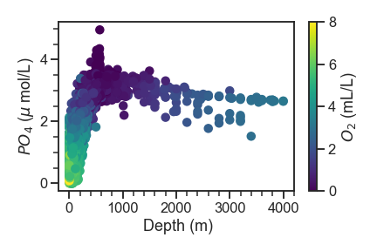
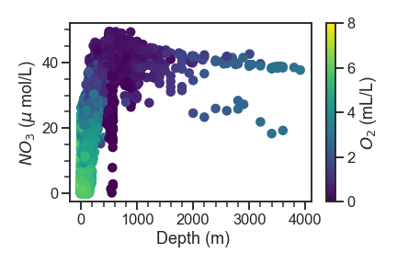
Dissolved Oxygen and Nutrients
In first 200 m :
Nitrates/phosphates drop, O₂ increases
Process for creating phytoplankton:
106 CO₂ + 120 H₂O + 16 HNO₃ + 1 H₃PO₄ → light → (CH₂O)₁₀₆(NH₃)₁₆PO₄ + 137O₂
+ Photosynthesis
Phosphates/Nitrates from deep ocean
and sediment (mid-depth): upwelling, diffusion
Max in PO4 at mid-depth (not being eaten at fast enough rate).

Slide 12
Dissolved Oxygen and Nutrients
In first 200 m :
Nitrates/phosphates drop, O₂ increases
Process for creating phytoplankton:
106 CO₂ + 120 H₂O + 16 HNO₃ + 1 H₃PO₄ → light → (CH₂O)₁₀₆(NH₃)₁₆PO₄ + 137O₂
+ Photosynthesis
Phosphates/Nitrates from deep ocean
and sediment (mid-depth): upwelling, diffusion
Max in PO4 at mid-depth (not being eaten at fast enough rate).
Low light, hypoxic

Slide 13
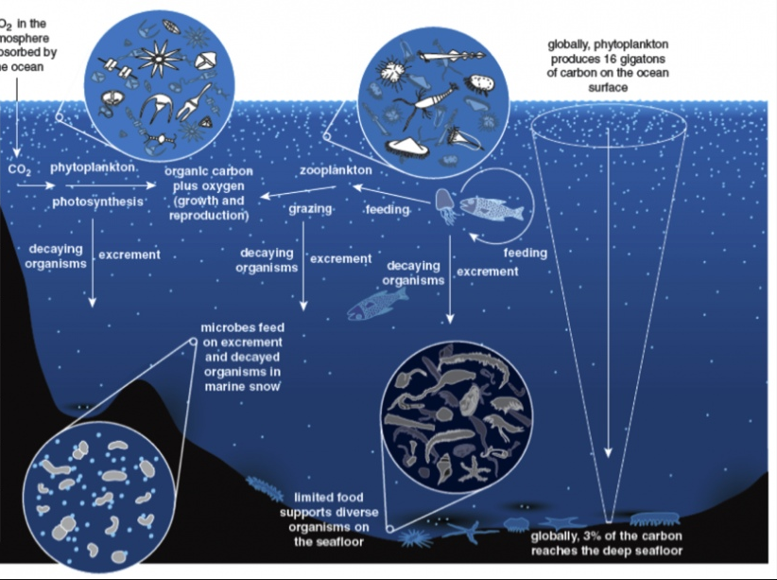
Aerobic Bacteria
Consume organic decay,
O2 for respiration
O2 plummets, low O2
resupply

Slide 14
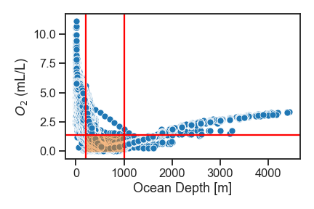
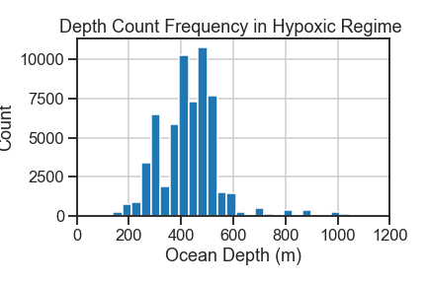
Dissolved Oxygen and Depth
Dissolved oxygen levels hit a minimum in a depth region of ~ 200 – 1000 m.
Dissolved O₂ < 1.4 mL/L: most hypoxic water samples at depths of ~ 200 -1000 m.
Count histogram not best way to represent this.

Slide 15
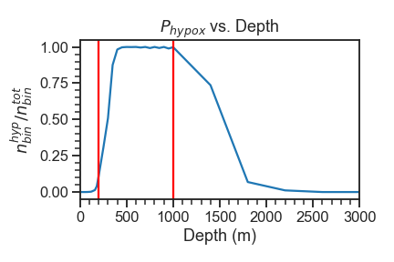
Dissolved Oxygen and Depth
Dissolved oxygen levels hit a minimum in a depth region of ~ 200 – 1000 m.
Probability of in a depth range of water being hypoxic vs.
ocean depth (O₂ < 1.4 ml/L).

Slide 16
Dissolved Oxygen and Nutrients
Dissolved oxygen levels hit a minimum in a depth region of ~ 200 – 1000 m.
Nearly all water from 400-1000 m is hypoxic.
Oxygen Minimum Zone
Where does this occur?

Slide 17
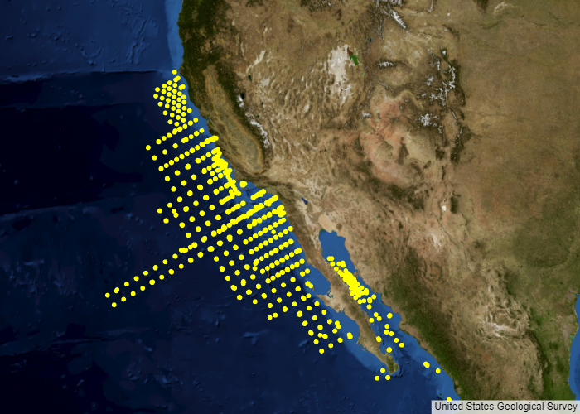
Spatial Mapping of Oxygen Minimum Zone
Latitude/Longitude Coords of Hypoxic points at 200 m – 1000 m.
Oxygen minimum zone (OMZ) extends
from continental shelf break out to
open ocean.
High concentration off Southern California.

Slide 18
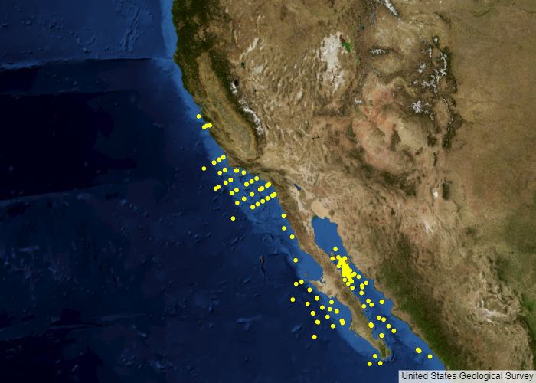
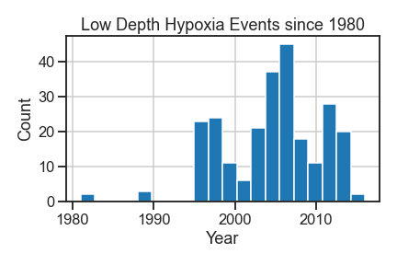
Coastal Hypoxia Leakage?
Mid-depth OMZ is natural and persistent feature on many western coasts
But leakage into shallow waters: increasing threat with rising global temperature (thermocline into shallower waters)
Possible leakage of OMZ from deep into continental shelf
Recent increase in coastal
hypoxic events

Slide 19
Conclusion
Hypoxia at mid-depths / OMZ → natural phenomenon off Southern Cal coast
But areas of low oxygen should be payed attention to as climate warms.
Small changes in physical variables can lead to large and drastic changes in entire system.
Future work
Time series analysis of dissolved O2 levels on coastal shelves
+
Time series analysis of coastal and connected open ocean surface temperatures/chlorophyll.
Time series regression models may be useful here.

