Slide 1
Time Series Data Analysis Using BigML
Github
Il-Yeol Song, Ph.D.
College of Computing & Informatics
Drexel University
Philadelphia, PA 19104

Slide 2
What is Time Series Data
Time series data is a type of observation where the variables takes different values based on time. Eg: Financial Data, Stock Data or even electricity consumption, production come under this kind of data.
We can generalize that a time series is simply a series of data points ordered in time. In a time series, time is often the independent variable and the goal is usually to make a forecast for the future.
Ex. Time series data visualized

Slide 3
What makes Time Series data different?
Time series is simply a series of data points ordered in time. In a time series, time is often the independent variable and the goal is usually to make a forecast for the future.We need the data to be sequentially arranged.
Main components of Time series is:
Level
Noise
Seasonality
Stationary
Auto co-related

Slide 4
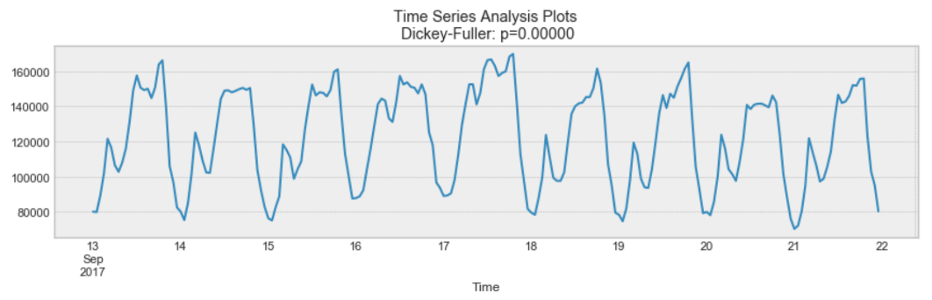
Seasonality:
Seasonality refers to periodic fluctuations. Many time series display seasonality.
Eg: For example, retail sales tend to peak for the Christmas season and then decline after the holidays. So time series of retail sales will typically show increasing sales from September through December and declining sales in January and February.
If seasonality is present, it must be incorporated into the time series model.

Slide 5
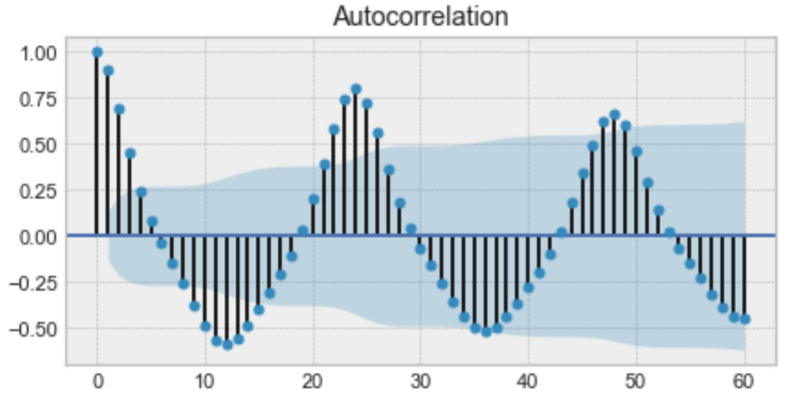
Auto Co-relation
Autocorrelation is the similarity between observations as a function of the time lag between them.
It is when a time series is linearly related to a lagged version of itself. By contrast, correlation is simply when two independent variables are linearly related.
Majority of the algorithms to analyze Time-Series rely on the assumption that there is no auto correlations.
Above is an example of an autocorrelation plot. Looking closely, you realize that the first value and the 24th value have a high autocorrelation. Similarly, the 12th and 36th observations are highly correlated. This means that we will find a very similar value at every 24 unit of time.

Slide 6
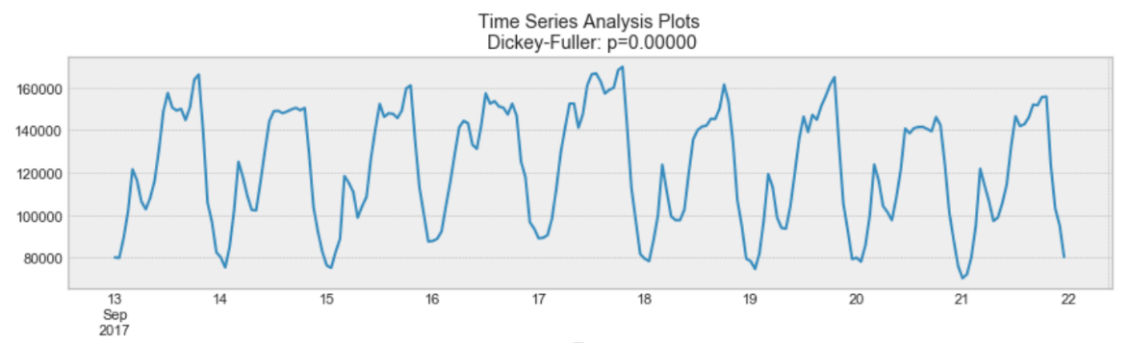
Stationarity:
A time series is said to be stationary if its statistical properties do not change over time. In other words, it has constant mean and variance, and covariance is independent of time.
Looking again at the same plot, we see that the process above is stationary. The mean and variance do not vary over time.
Ideally, we want to have a stationary time series for modelling. Of course, not all of them are stationary, but we can make different transformations to make them stationary.

Slide 7
Algorithms:
When a series contains a trend, seasonality, and noise, then you can define that series by the way those components interact with each other.
These interactions can be reduced to what is called either a
Multiplicative: A multiplicative time series is when the fluctuations in the time series increase over time and is dependent on the level of the series
Time series = t (trend) * s (seasonality) * n (noise)
Additive: An additive model is when the fluctuations in the time series stay constant over time.
Time series = t (trend) + s (seasonality) + n (noise)

Slide 8
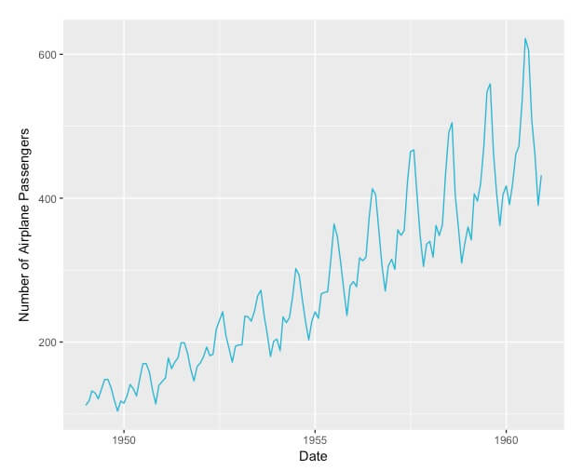
When to use Multiplicative Model:
We will use multiplicative models when the seasonality of the model would increase with the level over time. In the graph below, you can see that the seasonality of airplane passengers increases as the level increases:

Slide 9
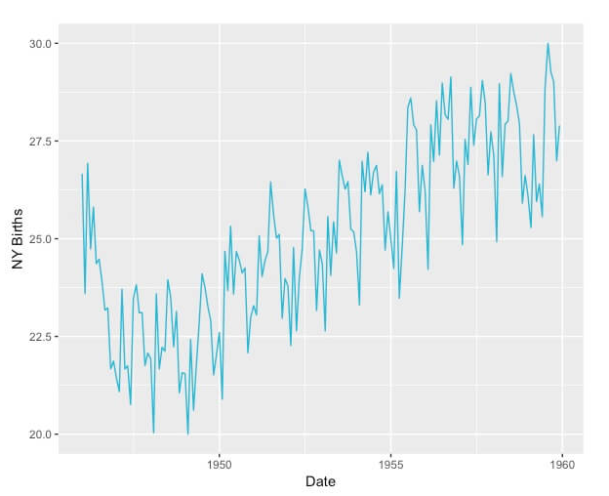
When to use Additive Model
We will use Additive model when model’s seasonality is constant from year to year and not related to the increase or decrease in the level over time. Below is a graph of births in New York where you can see that although the level increases, the seasonality stays the same

Slide 10
Exponential Smoothing
Exponential smoothing is a time series forecasting method for univariate data that can be extended to support data with a systematic trend or seasonal component.
BigML uses Triple Exponential smoothing.
Triple Exponential Smoothing is an extension of Exponential Smoothing that explicitly adds support for seasonality to the univariate time series.
Additive Seasonality: Triple Exponential Smoothing with a linear seasonality.
Multiplicative Seasonality: Triple Exponential Smoothing with an exponential seasonality.

Slide 11
Model Performance Metrics:
BigML uses multiple models with different combination of Multiplicity and Additivity is used.
BigML provides a set of metrics so you can select the best performing model
AIC: Measures the trade-off between the goodness-of-fit and the model’s complexity.
AICc: Introduces a correction element for smaller datasets
BIC: It is similar to the AIC, but it penalizes more heavily model complexity. The lower the BIC, the better.
R Squared: The R squared can be interpreted as the model’s goodness-of-fit to the training data.

Slide 12

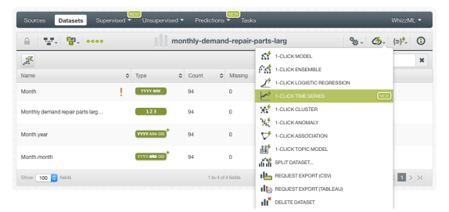
Timeseries with 1-Click in BigML
The time series icon in BigML is:
We first load the data into BigML.
We then create the data set as we did earlier.
We can then create a 1-CLICK TIME SERIES option in the 1-click action menu from the dataset view.

Slide 13
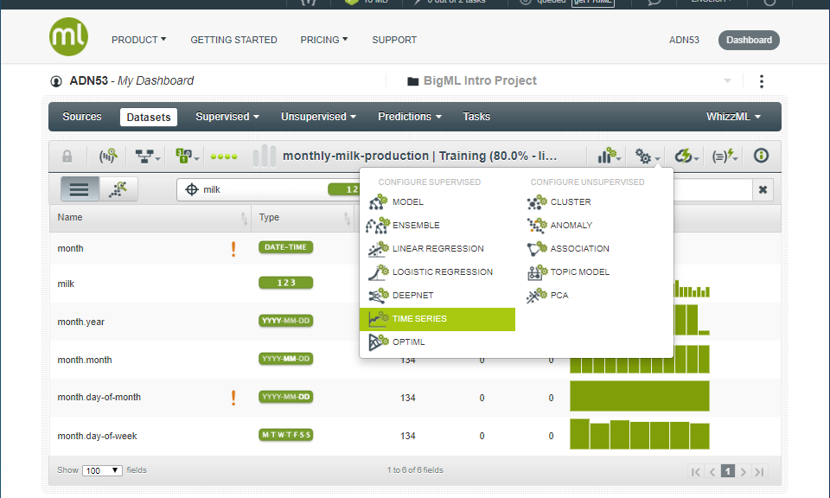
Time Series Configuration Options
You can configure a number of parameters that affect the way BigML creates time series.
We will click on the Gear icon and we will get the following menu.

Slide 14
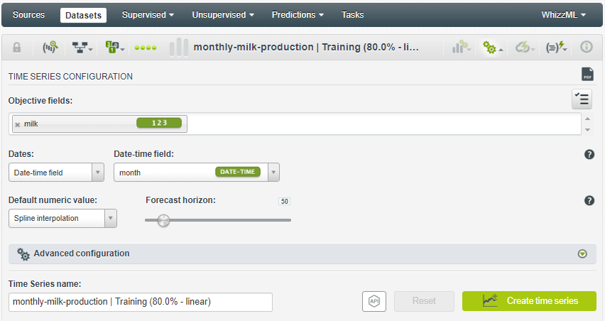
Time Series Configuration Options (Conti..)
Objective Fields:
The objective fields are the fields you want to predict. Time series only support numeric fields as objective fields.
You can select one or more objective fields to create your time series by including them in the search box shown in the figure below.
BigML treats each objective field independently, i.e., a set of time series models will be trained for each selected field separately.

Slide 15
Time Series Configuration Options (Conti..)
BigML allows you to set the dates of your data so you can visualize them in the x-axis of the time series chart.
If your data contains a date-time field, it will be automatically selected to be included in the chart
Alternatively, you can manually configure the dates of your data to be shown in the chart. You need to input the date associated with the first instance and the time interval between successive instance

Slide 16
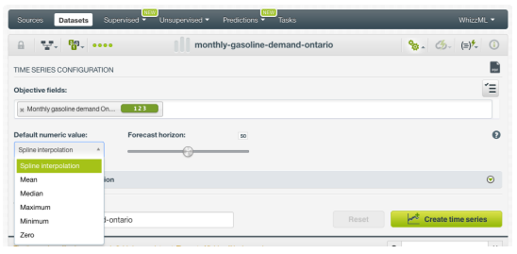
Time Series Configuration Options (Conti..)
Default Numeric Value:
In the case your objective fields include missing values, BigML automatically replaces them by spline interpolation.
You can also select to replace them by the field’s Mean, Median, Maximum, Minimum or by Zero.

Slide 17
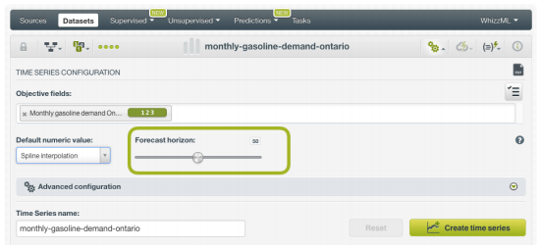
Time Series Configuration Options (Conti..)
Forecast Horizon:
BigML automatically computes a forecast along with your time series creation.
By doing this, you will be able to see your model forecast along with your model view.
By default, BigML computes the forecast for a horizon of 50 future data points but you can use the slider shown in Figure below to forecast up to 400 data points.

Slide 18
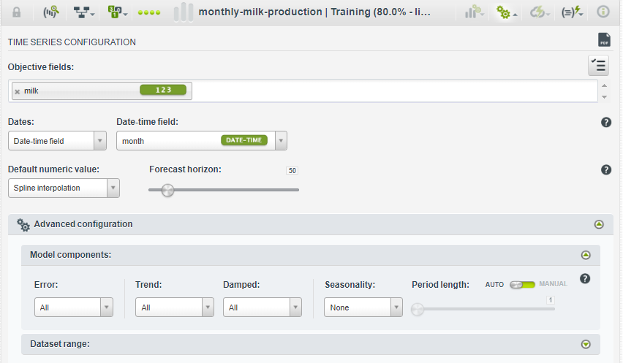
Time Series Configuration Options (Conti..)
Model Components:
By combining the different components (the error, the trend and the seasonality) and their variations (multiplicative, additive, damped and not damped) BigML explores multiple versions of the forecast formula so you can choose the model that better fits your training data and make most accurate predictions.
By default, BigML analyzes all combinations by default.

Slide 19
Time Series Configuration Options (Conti..)
Error: The error represents the unpredictable variations in the time series data, and how they influence observed values. It can be additive or multiplicative
Trend and Damping:
Your time series data may have an increasing trend (positive slope), a decreasing trend (negative slope) or no trend (horizontal line).
The trend can also be damped, in which case the growth will be constant at some point in the future, or not damped, if the trend keeps growing indefinitely.

Slide 20
Time series analysis
We will load the data into BigML and create a data set of it.
We will be using monthly milk production data from 2002 till 2015.
Data Features:
Date: dd:mm:yyyy
Milk : Milk produced (in million Gallons)

Slide 21
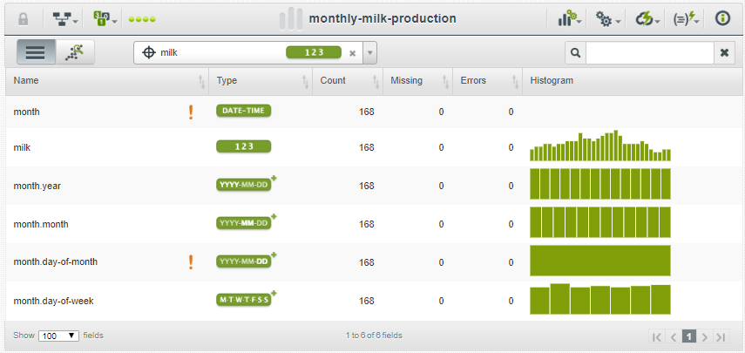
Time series analysis
The data set looks like this:
Month.year, month.month, month.day-of-month and month.day-of-week are auto generated by BigML.

Slide 22
Time series analysis
We will then split the data into Test and Training fields using one click Linear Split. This will create 2 data sets with 80% train and 20% test data.
We will then set the objective field as ‘milk’ as we will be predicting total milk production.

Slide 23
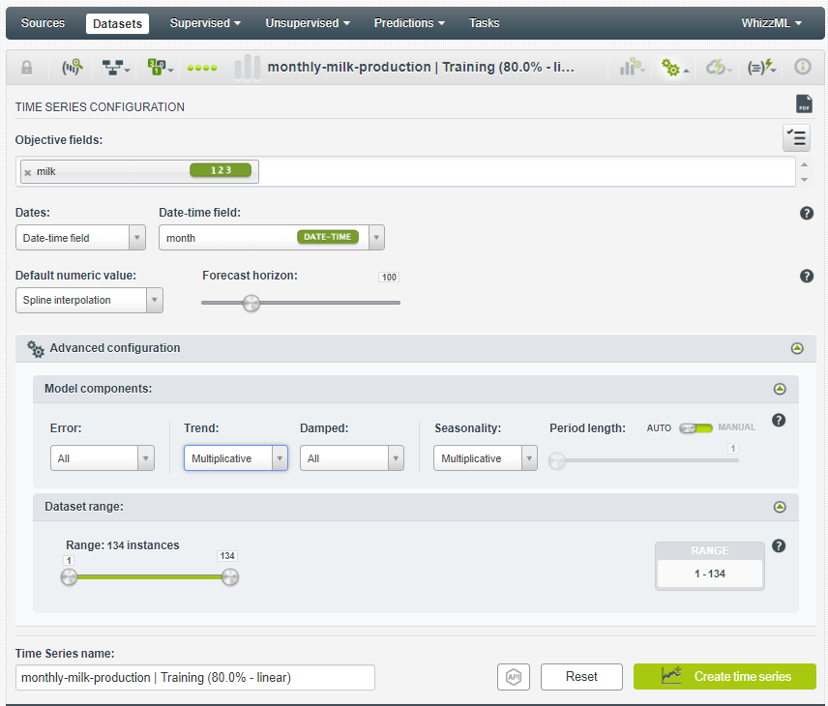
Time series analysis – Customized
Parameters:
We select the parameters as indicated below:

Slide 24
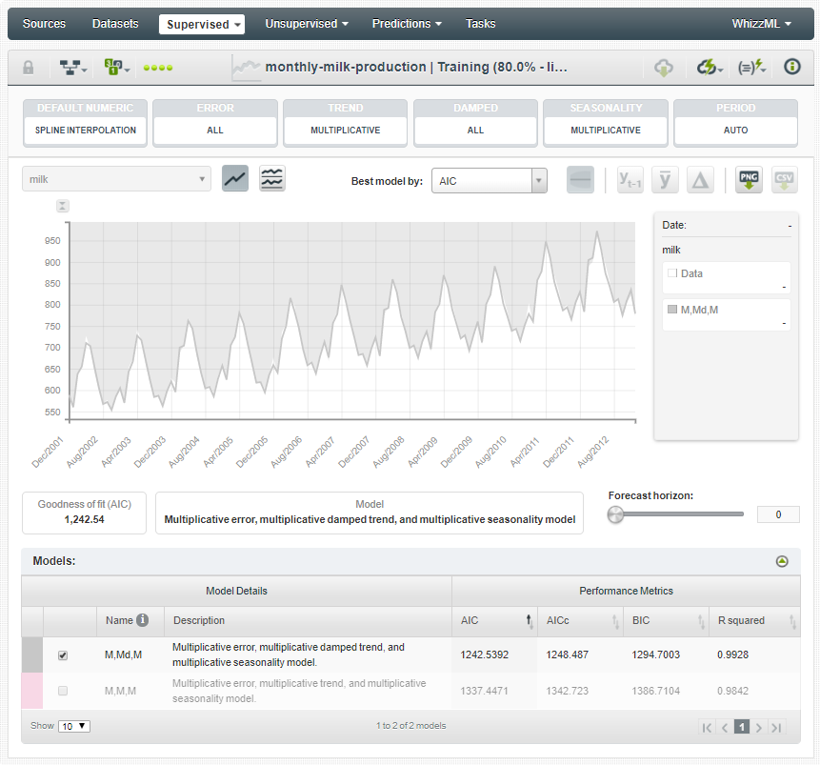
Time series analysis – Customized
These models represent the different combinations of the forecast components (error, trend, seasonality) and their variations (multiplicative, additive, damped, not damped). The models you select in the table will be plotted in the chart.
Name: each model has a name that represents the variations of its main components ”Error, Trend, Seasonality”. A name like ”A,A,A” represents an additive error, Additive damped trend, and an additive seasonality model.
Model Details: the model details include the description of the components explained before and its standard name in the literature. For example, a model named “A,A,N” (additive errors, additive trend, and no seasonality) is commonly known as Holt’s linear method.

Slide 25
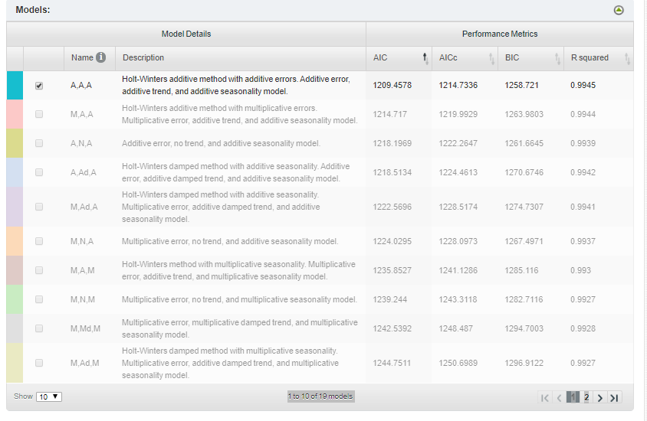
Time series analysis – 1 Click Model
You can see all different models and their performance metrics in the ‘Models:’ tab in the lower end.

Slide 26
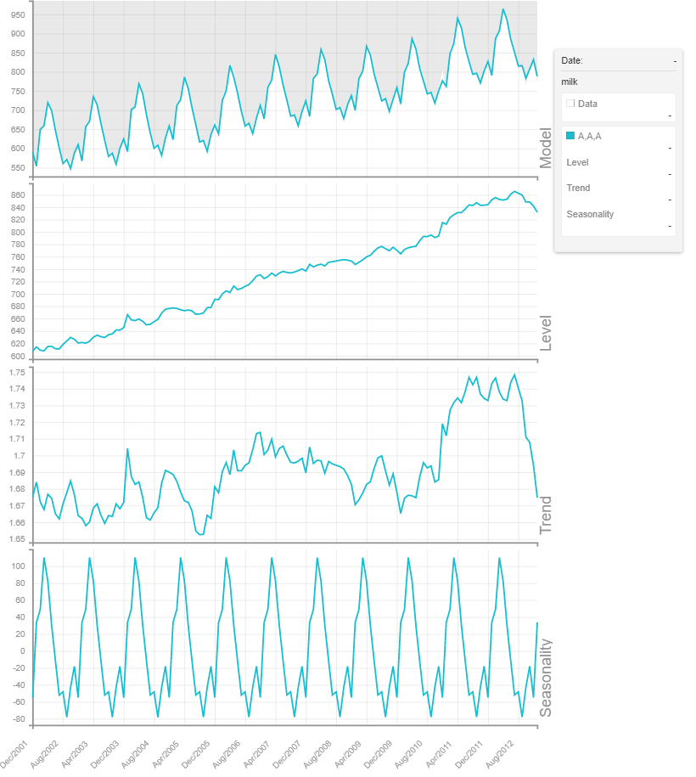
Time series analysis – 1 Click Model
We can see the decomposed model by clicking on
We can see the different
components of the data
like trend, level, seasonality
of the supplied data.
We can clearly see that
there is clear seasonality
here.

Slide 27

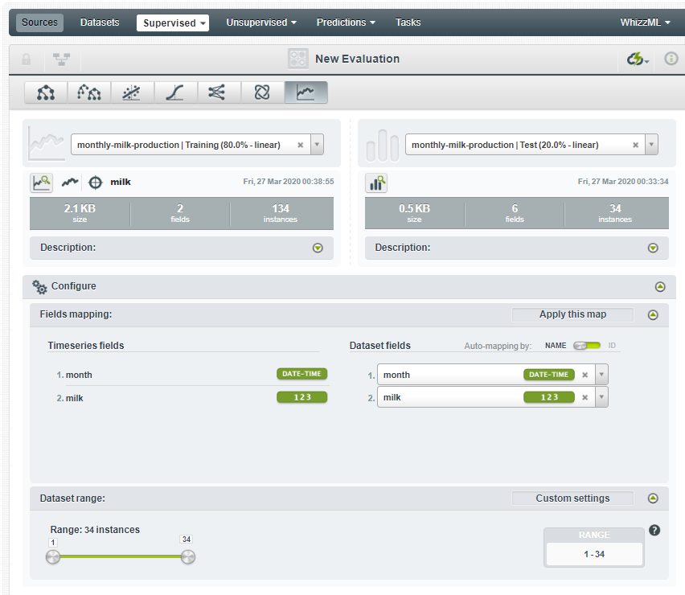
Time series analysis – Configured Model
Evaluation:
We will now evaluate the generated model with 1 Click evaluation under the Cloud symbol.
We select the remaining 20% of the dataset. We do this by typing ‘monthly-milk-production| Test (20.0% - Linear)

Slide 28
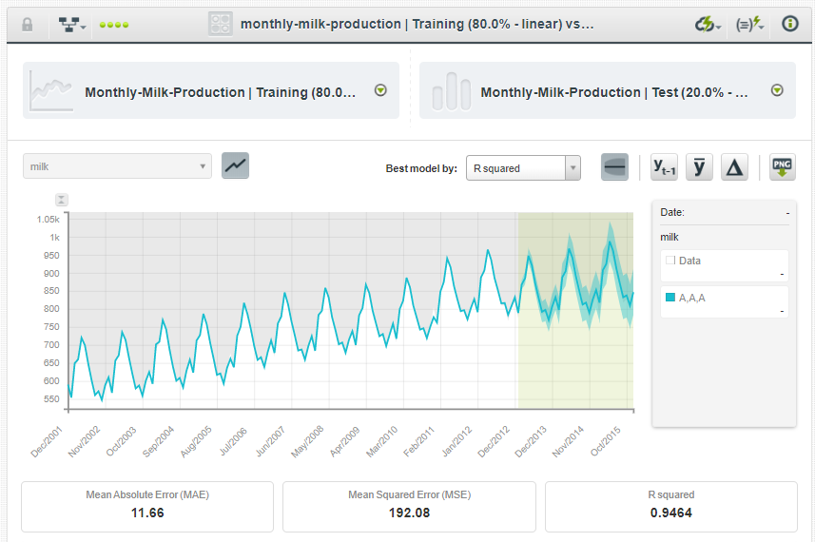
Time series analysis – Evaluation

Slide 29
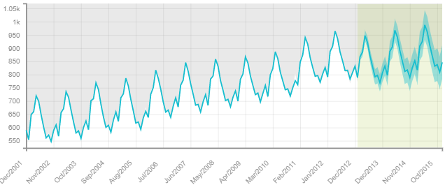
Time series analysis – Evaluation
We will get the following predicted value.
Predicted values are on the right end of the graph, shaded in grey.
We have achieved R squared value of 0.9464

Slide 30
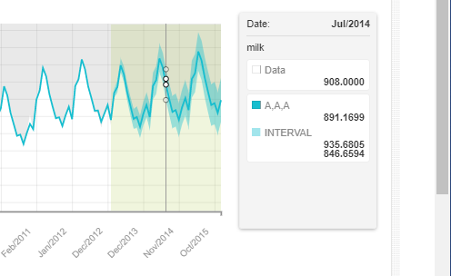
Time series analysis – Evaluation
When we hover over this grey part, we can see the values that was actually predicted by the best model and the data in the remaining 20%.
Interval specifies the Maximum and Minimum possible value for that time.

Slide 31
Additional Materials
https://www.slideshare.net/bigml/accelerating-machine-learning-adoption-in-the-automotive-industry?next_slideshow=1
https://algorithmia.com/blog/introduction-to-time-series
https://machinelearningmastery.com/time-series-forecasting/

Slide 32

Question?

