Slide 1
Computer Networks
Lecture 1
(Course Introduction)
Adnan Iqbal
Fall 2025
PAF-IAST
Notes:
How can I show that networking is now part of life?
Live Examples in the Class Room – Breakdown into
a)Daily Life Usage
Turning on/off AC
Connecting/Disconnecting projector
Quran Recitation + Attaching audio with sound
Playing game on internet (Stickcricket World T20) [5 Minutes]
Playing game on internet (Checkers) [5 Minutes]
Ask students to tell a song and then find it on net and then running it. [5 Minutes]
Playing a game with each other on Systems [10 Minutes]
A mobile call – Asking some body to call me for a minute [2 Minutes]
-- A discussion on all these things
c) Advancing Humanity at Large
Other Examples (Demos)
Space Exploration
- https://www.universetoday.com/101196/how-do-astronauts-on-the-space-station-stay-in-touch-with-earth/
Aeroplanes / Air Traffic Control
https://www.youtube.com/watch?v=V1hCY1lHlkU
https://www.youtube.com/watch?v=m5KOgETF78o
Remote Surgery
https://www.youtube.com/watch?v=d7IojFFHtiA
https://www.youtube.com/watch?v=PwEpnZeF38M
Soldier
https://www.youtube.com/watch?v=2ZDsKbzfCXw (At 10:42)
Drones
https://www.theguardian.com/commentisfree/cifamerica/video/2011/jun/15/drone-attack-protocol
http://www.dailymail.co.uk/news/article-3225719/Wiped-RAF-team-sitting-3-000-miles-away-controversial-technology-remote-controlled-drone-attack.html
http://newatlas.com/parrot-disco-drone-party/45064/
b) Solution of our Problems

Slide 2
What is a Communication Network?
Whenever two or more devices talk to each other, it is a Communication Network.
It may be as simple as only two devices communicate in a room (Example blue tooth data transfer between two cell phones)
It may be as large as millions of devices are connected over very large distances. (Example Internet)
Notes:
Examples: Very simple, Very Complex

Slide 3
Why do we need to understand computer networks?
Notes:
We take all (or many of) these networks for granted.

Slide 4
Why Study This Course?
Academic
Career
Just for fun ☺

Slide 5
Why Study This Course?
Adv Computer Networks
Web Technologies
Cloud Networking
Mobile Application Development
Computer Networks
Network Performance Analysis
Concurrent and Distributed Systems
Network Security
Network Admin / Certifications

Slide 6




Certifications
Entry Level Certifications: CompTIA Network+
Intermediate Certifications: CCNA
Advanced: CCNP , CCIE
Specialized
Cloud Provider Based
Security Related

Slide 7
Why study this course?
Have you heard the term VPN?

Slide 8
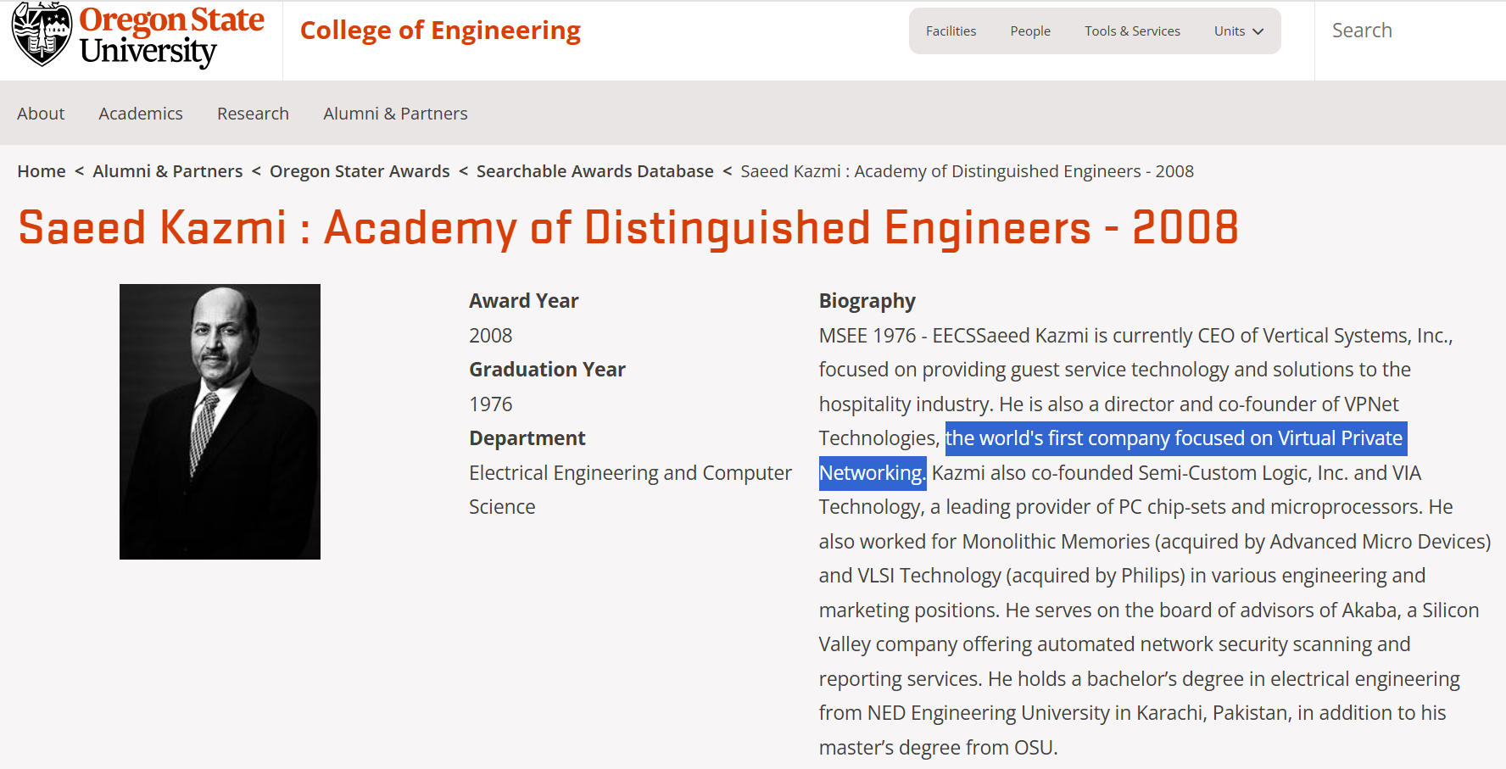
Why study this course?
Have you heard the term VPN?

Slide 9
Why study this course?
Have you heard about Cavium Networks?

Slide 10
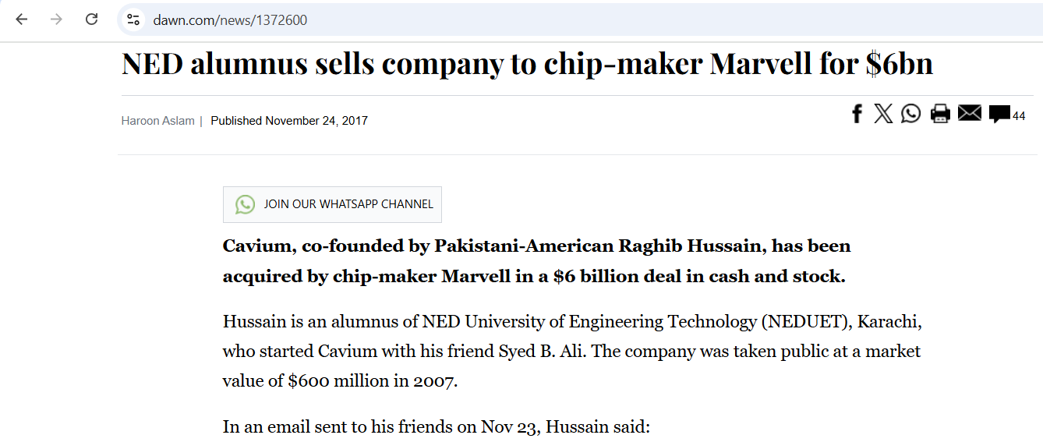
Why study this course?
Have you heard about Cavium Networks?

Slide 11
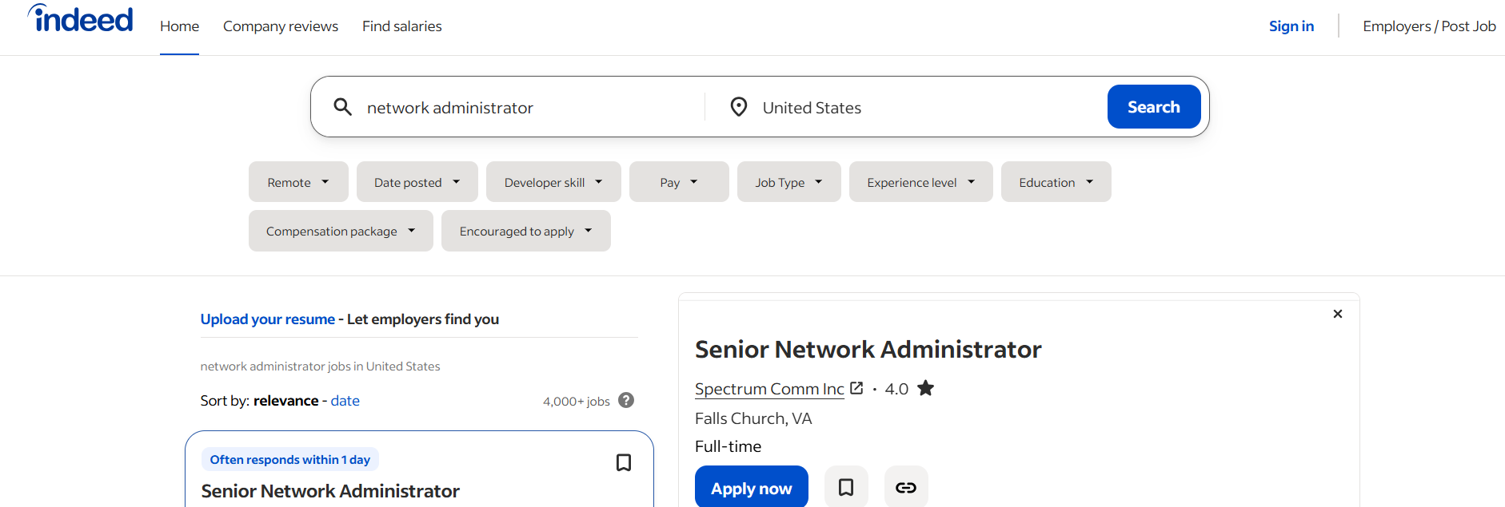
Why study this course?

Slide 12
Why this Course?
Infrastructure Design
Hardware
Connectivity
Application
Design and Development
Maintenance
Security Monitoring
Engineering
Computing
System Design
Notes:
What is in this Module for a Electrical Engineering student?
What is in this Module for a Computer Science student?

Slide 13


Why this Course? (An Example)
Internet Service Provider
Internet Service Provider
Current Situation
Wanted Situation
Q: How to achieve Wanted Situation from Current Situation?
Notes:
You are a manager/Administrator in the ISP (You may be a TE or a CS).
You figure out a problem and now you think of a solution.
So first of all, to be a good network admin/manager you must know the concepts very well.
If you are from CS, you will say , well let us develop some software services inside our ISP which can perform this task.
And if you are TE/EE you will say no, we should use/develop some hardware based solution as software solutions can be very slow.
The point here is, whether you are from CS background or a TE background, solutions cannot be proposed until you have good grasp of networking concepts.

Slide 14
Applications making use of Network
Email
WWW
Youtube
Skype
Facebook
Google
Whatsapp
Cloud
Big Data
Blockchain
Internet of Things

Slide 15
What to expect in this Course
Basic concepts of computer networks
Study of existing protocols
Performance Analysis
Theoretical and Programming based assignments

Slide 16
Course Content [Theory]
Introduction/History
Application Layer
Transport Layer
Network Layer
Data Link Layer
Wireless Networks

Slide 17

Text
Text Books
Computer Networking
A Top-Down Approach
James F. Kurose , Keith W. Ross
8th Edition

Slide 18
Grading
Theory
Quizzes 20%
Assignments 20%
Mid-term 20% [Open Book]
Final 40% [Open Book]

Slide 19
Question
Now we have enormous applications of networks and communications, this did not happen all at once. How did it all start? What was the state of networking few decades ago?

Slide 20
Reading Material
Self Reading: Chapter 1 Kurose
Section 1.7 [History]
Computer communications-How we got where we are
IVAN T. FRISCH and HOWARD FRANK
written in 1975
https://www.livescience.com/20727-internet-history.html
Video Session
History of Internet –BBC Documentary 2018
https://www.youtube.com/watch?v=oNUl_9ZYA6w
Reading required before next class
Chapter 1: Sections 1.1, 1.2, 1.3

