Slide 1

Bank Loan Report: Unveiling Lending Performance
This report offers a comprehensive view of our bank's lending performance, leveraging interactive dashboards and SQL insights to track key metrics and identify potential risks.

Slide 2

Project Overview: Data-Driven Decisions
Comprehensive Tracking
Portfolio Quality
Monitors loan applications, funded amounts, repayments, interest rates, and borrower risk.
Classifies loans into 'Good' and 'Bad' categories to assess health and identify risks.
Pattern Analysis
Enhanced Efficiency
Analyzes trends, regions, and borrower profiles to uncover lending and repayment patterns.
Enables data-driven decisions for portfolio health and operational efficiency.

Slide 3
Dataset Summary: Key Features
Loan & Borrower ID
Financial Details
Loan ID, Issue Date, State, Purpose
Loan Amount, Total Payment, Interest Rate, DTI
Loan Status Info
Borrower Profile
Current Status, Good/Bad Loan Category
Employment Length, Home Ownership, Loan Grade, Term
Time-Based Attributes
Segment Analysis
Month/Year of Issue for MTD & MoM analysis
Loan Purpose, Address State, Term, Home Ownership, Employment

Slide 4
Bank Loan Summary: Key Performance Indicators
38,576
$435.8M
$473.1M
12.05%
Total Loan Applications
Total Funded Amount
Total Amount Received
Avg. Interest Rate
Total capital disbursed.
Average rate across all loans.
Overall applications processed.
Cumulative payments collected.
13.33%
Avg. Debt-to-Income
Average DTI ratio of borrowers.

Slide 5

Month-to-Date Performance (Dec 2021)
MTD Loan Applications
4,314 (Dec 2021) vs. 4,035 (Nov 2021)
MTD Funded Amount
$53.98M (Dec 2021) vs. $47.75M (Nov 2021)
MTD Amount Received
$58.07M (Dec 2021) vs. $50.13M (Nov 2021)
MTD Avg. Interest Rate
12.36% (Dec 2021) vs. 11.94% (Nov 2021)
MTD Avg. DTI
13.67% (Dec 2021) vs. 13.30% (Nov 2021)

Slide 6
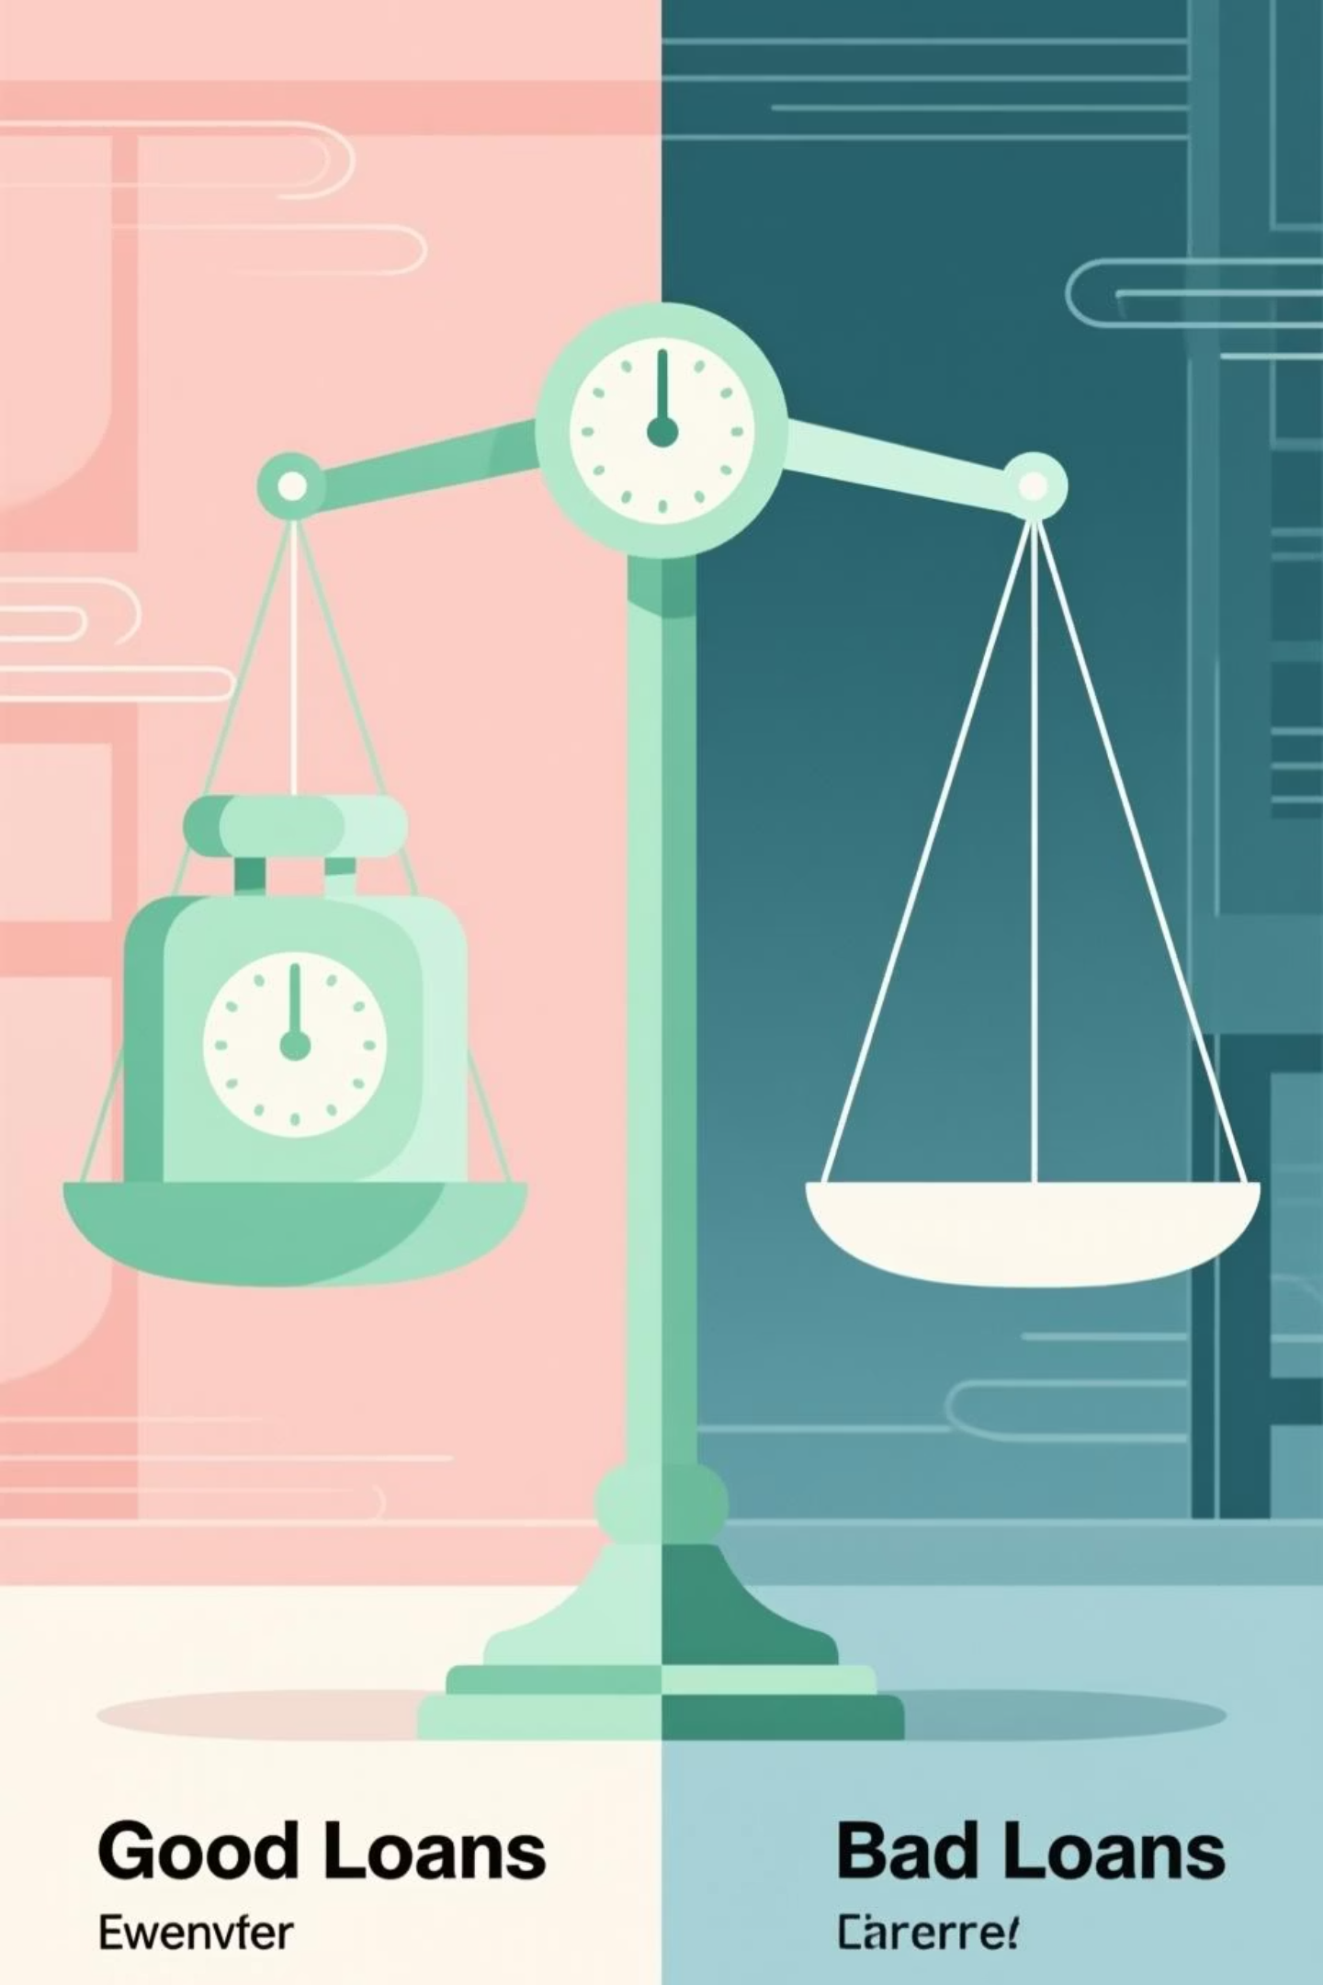

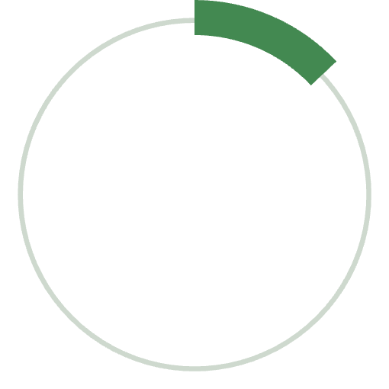
Loan Portfolio Quality
Good Loans
86%
Applications: 33,243
Funded Amount: $370.2M
Received Amount: $435.8M
Good Loan Percentage
Loans that are Fully Paid or Current.
Bad Loans
13%
Applications: 5,333
Funded Amount: $65.5M
Received Amount: $37.3M
Bad Loan Percentage
Loans that are Charged Off.

Slide 7
Loan Status Summary
Loan Status
Loan Applications
Received Amount
Funded Amount
Int Rate
DTI
Current
1,098
$24.2M
$18.9M
15.10%
14.72%
Fully Paid
32,145
$411.6M
$351.4M
11.64%
13.17%
Charged Off
5,333
$37.3M
$65.5M
13.88%
14.00%

Slide 8
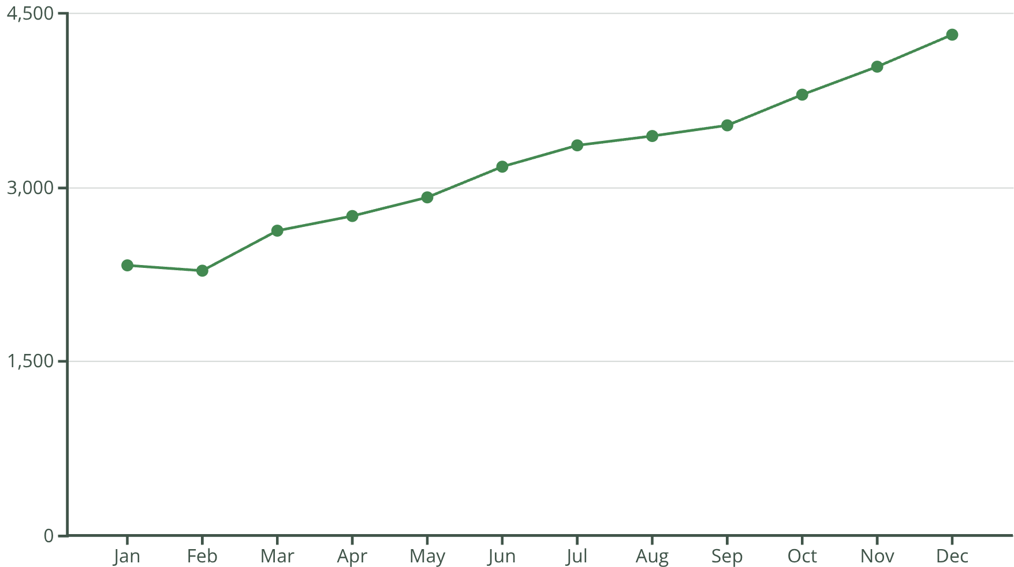
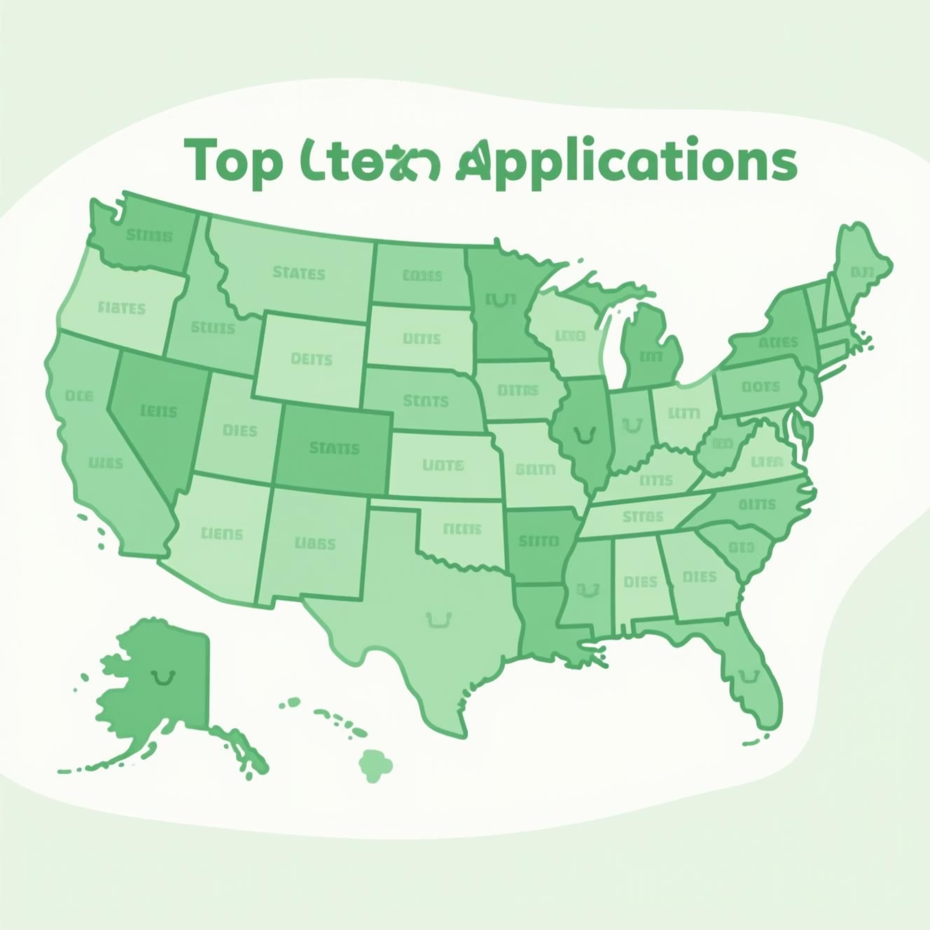
Loan Applications by Month & State
Monthly Trends
Top States
California: 6,894 applications
New York: 3,701 applications
Florida: 2,773 applications
Texas: 2,664 applications
New Jersey: 1,822 applications
Loan applications show a steady increase throughout the year,
peaking in December.

Slide 9

Loan Overview: Term, Employment & Purpose
Loan Term
36-month terms dominate with 28,237 applications, compared to 10,339 for 60-month terms.
Employment Length
Borrowers with 10+ years of employment submit the most applications (8,870).
Loan Purpose
Debt consolidation is the primary purpose (18,214 applications), followed by credit card (4,998).
Home Ownership
Renters (18,439) and mortgage holders (17,198) are the largest segments.

Slide 10
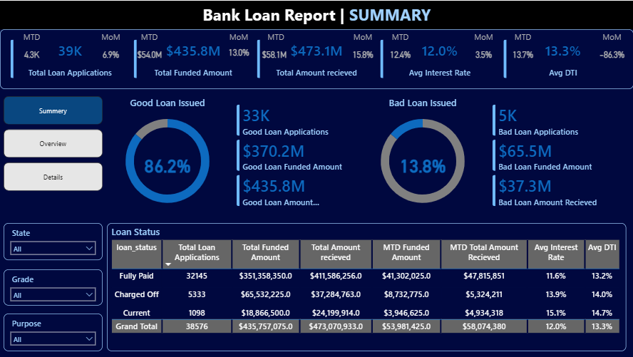

Slide 11
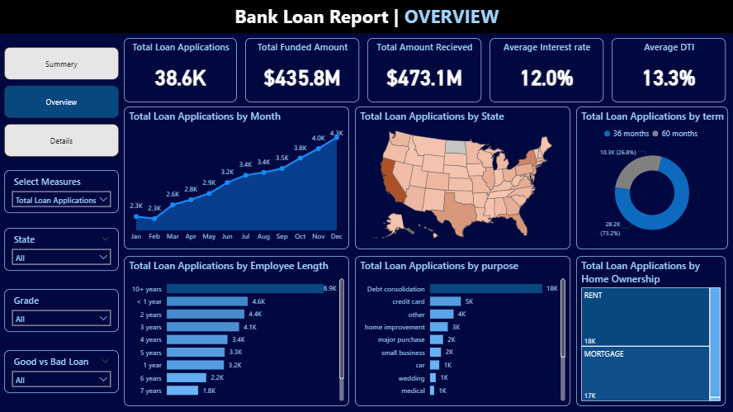

Slide 12






Business Recommendations
Risk-Based Pricing
Adjust interest rates based on employment stability and borrower risk profiles.
Expand Loan Offerings
Launch specialized debt consolidation and credit card refinancing products.
Strengthen Verification
Enhance employment and income verification to reduce defaults.
Focus on High-Performers
Increase marketing to reliable customer groups in top-performing states.
Diversify Loan Terms
Introduce more flexible loan durations to balance risk and customer needs.
Enhance Customer Support
Proactively assist at-risk borrowers to improve repayment rates.

Slide 13
Thank You

