Slide 1
Twitter Data Analysis
By : Mohammed Abdul Mateen (160118737-023)
Shaik Abdullah Adnan (160118737-024)
Guided By: Dr. K. Radhika
HOD, IT Dept.

Slide 2
Contents
Introduction
Aim
Hardware & Software Requirements
Implementation
Screenshots
Conclusion & Future Scope
Bibliography

Slide 3


Introduction
About Twitter
Twitter is social networking and microblogging service.
Users use mobile phone or computers to send and to read messages, called “tweets”.
They appear on user’s profile page.
Why Twitter?
Twitter gives us better approximation of public sentiment as opposed to conventional internet articles and web blogs.
Moreover the response on twitter is more prompt and also more general.
Valuable customer insights.

Slide 4
AIM
We often forget that every piece of information can be used for development purposes. Here twitter is a soul of information. Opinion mining is the main agenda. It is the process of determining the emotional tone behind a series of words through tweets used to gain an understanding of the attitudes, opinions and emotions expressed within an online mention. How do we decide which tweets to use? The tweets are seized through aiming particular twitter account, specific hashtag or a combination of hashtags.

Slide 5
Hardware & Software Requirements
Processer – Intel® Core™ i5 @ 1.80GHz or above
Installed Memory – Minimum of 4 GB of RAM.
Hard Disk – Minimum 100 GB.
Operating system : Linux/Windows
Python platform (Anaconda2,Spyder,Jupyter)
NLTK package
Modern web browser
Twitter API (Twitter developer account)

Slide 6
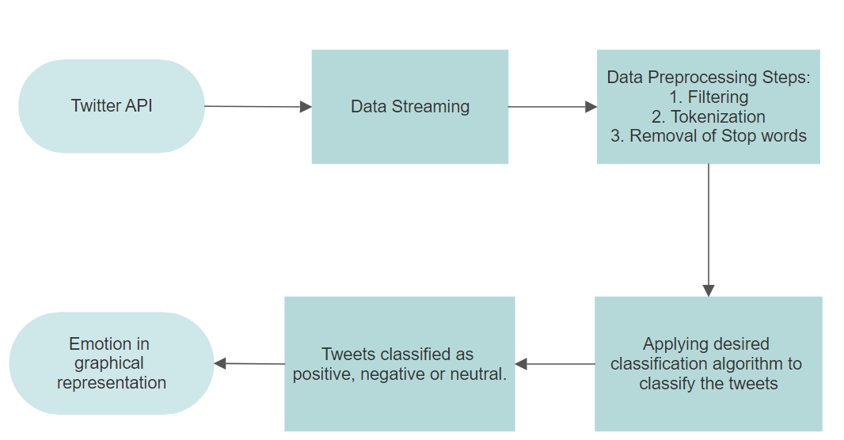
Implementation

Slide 7
Implementation

Slide 8
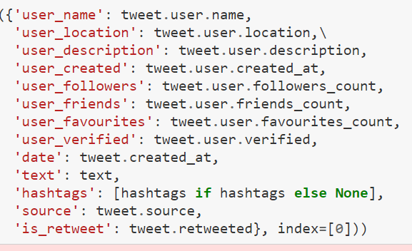
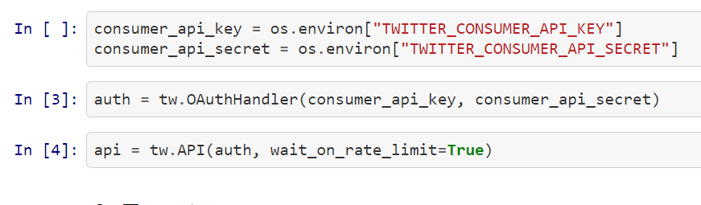
Screenshots
Authenticating the twitter API
Data retrieved from tweets

Slide 9
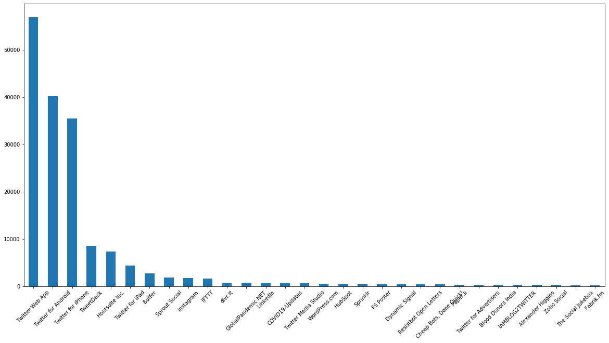
tweets vs device graph

Slide 10
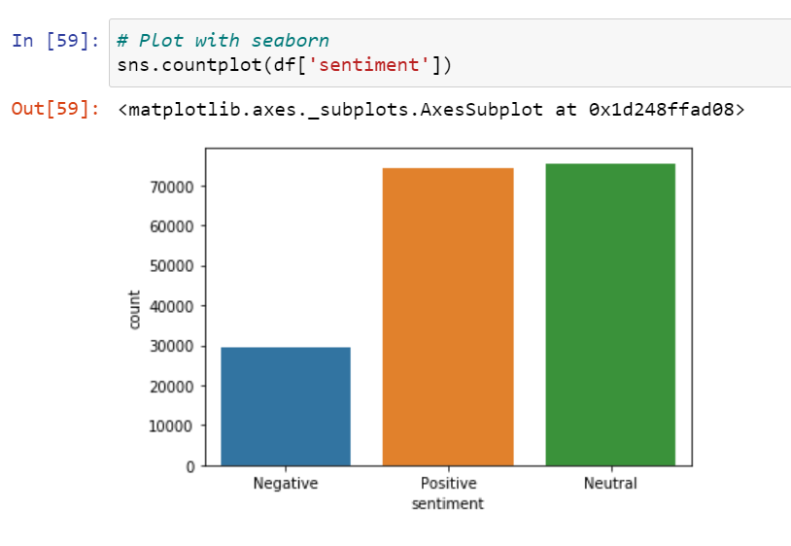
Visualization the sentiment of tweets

Slide 11
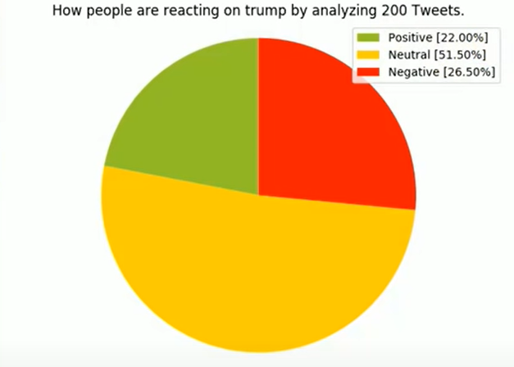
Pie-chart visualization of the score

Slide 12
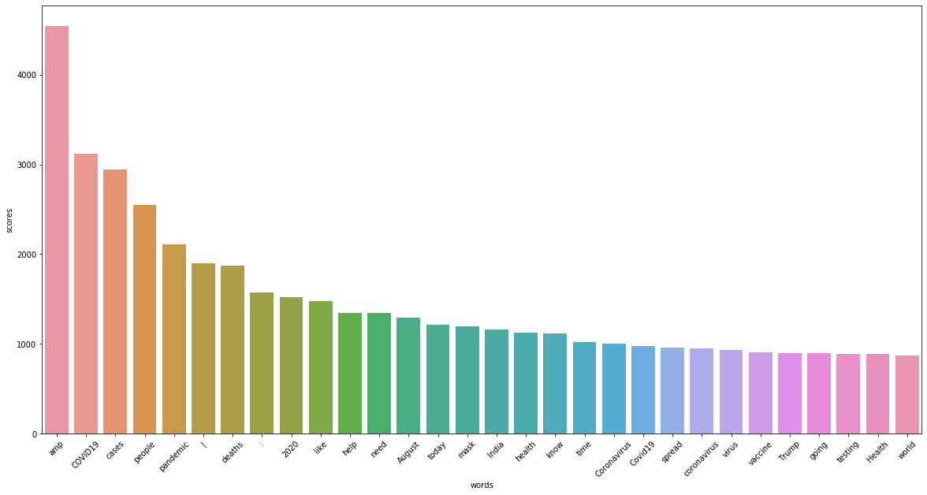
Tokenization of tweet data

Slide 13
Conclusion & Future scope
Twitter sentiment analysis comes under the category of text and opinion mining. It focuses on analysing the sentiments of the tweets and feeding the data to a machine learning model to train it and then check its accuracy, so that we can use this model for future use according to the results.
This research topic has evolved during the last decade with models reaching the efficiency of almost 85%-90%. But it still lacks the dimension of diversity in the data.

Slide 14
Thank You

