Slide 1
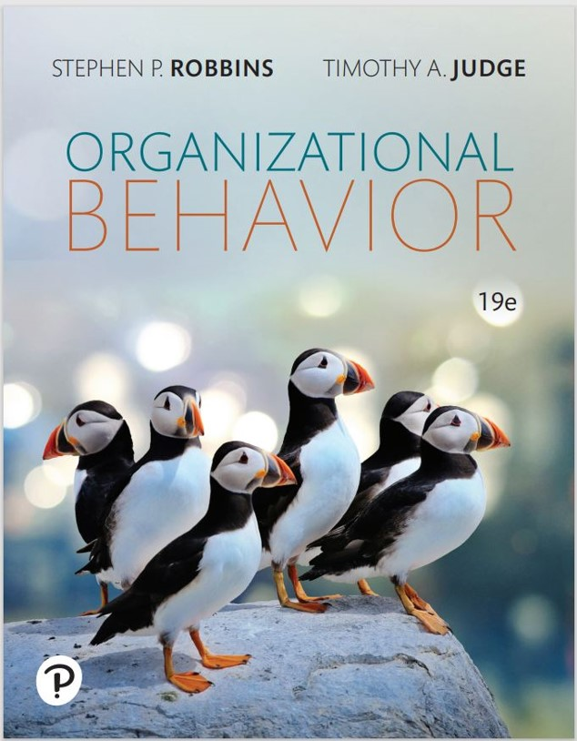
Organizational Behavior
Nineteenth Edition
Chapter 2
Diversity, Equity, and Inclusion in Organizations
Copyright © 2023, 2019, 2017 Pearson Education, Inc. All Rights Reserved
Notes:
If this PowerPoint presentation contains mathematical equations, you may need to check that your computer has the following installed:
1) MathType Plugin
2) Math Player (free versions available)
3) NVDA Reader (free versions available)
Welcome to this Organizational Behavior course that uses the 19th edition of the textbook, Organizational Behavior by Robbins and Judge. This is considered among the most widely used OB textbooks in the world. Robbins and Judge are recognized as definitive aggregators of OB concepts, applications, and practices. The course and this book will provide you with a resource that will benefit you throughout your degree program and your professional life.

Slide 2
Learning Objectives
2.1 Describe the two major forms of workplace diversity.
2.2 Demonstrate how workplace prejudice and discrimination undermines organizational effectiveness.
2.3 Explain how four major theoretical perspectives contribute to our understanding of workplace diversity.
2.4 Describe the role diversity plays in the interactions between people.
2.5 Discuss the implications of cross-cultural matters for organizational behavior (O B).
2.6 Describe how organizations manage diversity effectively.
Notes:
After studying this chapter, you should be able to:
Describe the two major forms of workplace diversity.
Demonstrate how workplace prejudice and discrimination undermines organizational effectiveness.
Explain how four major theoretical perspectives contribute to our understanding of workplace diversity.
Describe the role diversity plays in the interactions between people.
Discuss the implications of cross-cultural matters for organizational behavior (OB).
Describe how organizations manage diversity effectively.

Slide 3
Understanding Diversity (1 of 3)
Surface-level diversity
Gender
Age
Race
Ethnicity
Deep-level diversity
Values
Personality
Work preferences
Notes:
Everyone brings differences to the organizations where they work. These differences can create energy and excitement in the workplace, but they can also cause conflict. So, it is important that we have an understanding of how diversity works in organizations.
When we look at the workplace, we recognize two levels of diversity. Surface-level diversity represents the characteristics that are easily observed such as race, gender, and age. Deep-level diversity represents the aspects that are more difficult to see at first glance such as values, personality, and work preferences.

Slide 4
Understanding Diversity (2 of 3)
Biographical characteristics such as age, gender identity, race, and ethnicity are some of the most obvious ways employees differ.
Gender identity
Glass ceiling
Glass cliff
Sexual orientation
Notes:
Biographical characteristics such as age, gender identity, race, and ethnicity are some of the most obvious ways employees differ. We define race as the heritage people use to identify themselves; ethnicity is the additional set of cultural characteristics that often overlaps with race.
Stereotypes of older workers as being behind the times, grumpy, and inflexible are changing. In fact, industries like health care, education, government, and nonprofit service often welcome older workers. But older workers are still perceived as less adaptable and less motivated to learn new technology. Despite the stereotypes, the majority of studies have shown “virtually no relationship between age and job performance.”
Gender identity and sexual orientation also don’t affect job performance or leadership. With regard to gender identity, we mean peoples’ deeply held sense of or identification with their own gender. Bear in mind that gender identity does not necessarily match one’s sex at birth, is not visible to others, and cannot be neatly categorized. By sexual orientation, we mean peoples’ patterns of enduring physical, emotional, and/or romantic attraction toward others.

Slide 5
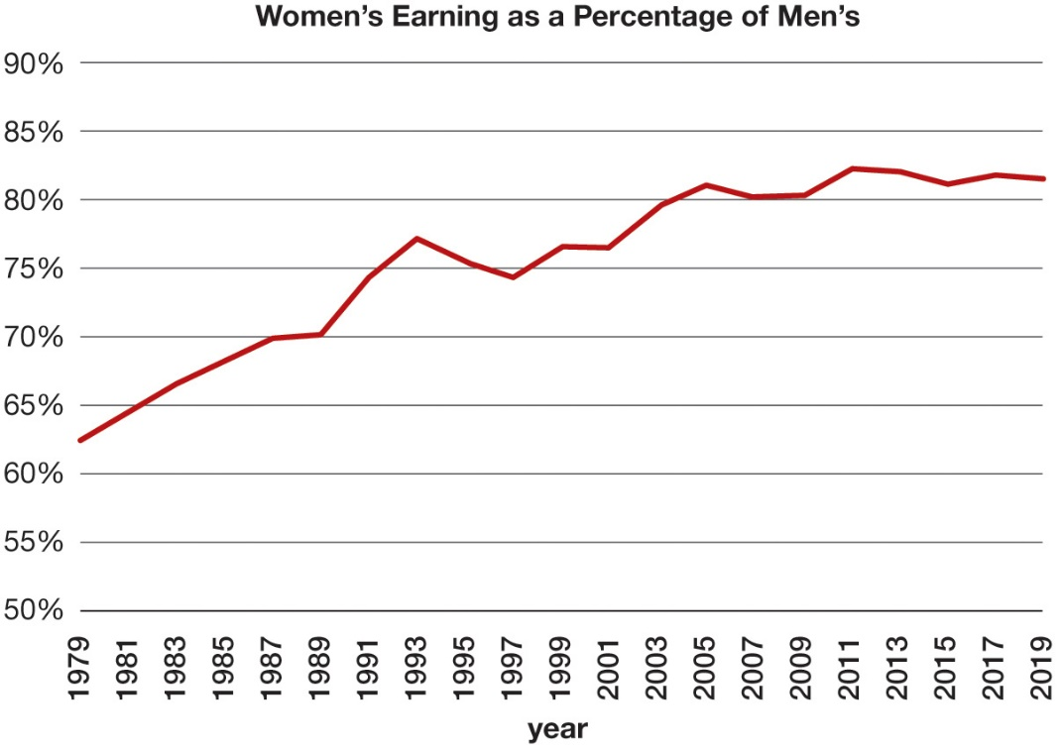
Understanding Diversity (3 of 3)
OB POLL Gender Pay Gap: Narrowing but Still There
Note: Full-time wage and salary workers. Percentage of annual averages of median weekly earnings.
Source: U.S. Bureau of Labor Statistics, “Highlights of Women’s Earnings in 2019” (Report N o. 1089, December 2020),
https://www.bls.gov/opub/reports/womens-earnings/2019/home.htm
Notes:
This OB Poll shows that differences in pay, benefits, and rewards concerning gender are strong and substantial, with recent estimates that they are up to fourteen times the size of performance differences.
Long Description:
The horizontal axis is labeled years and ranges from 1979 to 2019 in increments of 2. The vertical axis is marked with the percentage and ranges from 50 percent to 90 percent in increments of 5 percent. The approximate data from the graph is as follows. The line starts from 62.5 percent in 1979 and grows with an increasing and fluctuating trend till 81.5 percent in 2019. The small and wide peaks are at 77 percent in 1993, 80.5 percent in 2005, and 82.5 percent in 2011.

Slide 6
Prejudice and Discrimination in Organizations (1 of 2)
Prejudice is an attitude representing broad, generalized feelings toward a group or its members that maintains a hierarchy between that group and other groups.
Sexism, racism, ageism
Implicit bias refers to a prejudice that may be hidden outside one’s conscious awareness.
Notes:
Sexism, racism, and ageism are examples of prejudice toward gender identities, races and ethnicities, and age. Prejudice is an attitude representing broad, generalized feelings toward a group or its members that maintains the hierarchy between that group and other groups.
When prejudice involves positive feelings it is benevolent prejudice.
Implicit bias refers to prejudice that may be hidden outside one’s conscious awareness.

Slide 7
Prejudice and Discrimination in Organizations (2 of 2)
Discrimination involves actions or behaviors that create, maintain, or reinforce some groups’ advantages over other groups and their members.
Disparate impact occurs when employment practices have a discriminatory effect on a legally protected group of people.
Disparate treatment is intentional and represents employment practices intended to have a discriminatory effect on a legally protected group of people.
Notes:
Managing diversity effectively requires working to eliminate unfair discrimination, or actions and behaviors that create, maintain, or reinforce some groups’ advantages over other groups and their members. Discrimination can take many forms as shown in the next slide in Exhibit 2.1.
Discrimination can go beyond an individual and involve the organization. Disparate impact occurs when employment practices have a discriminatory effect on a legally protected group of people.
Bear in mind that while disparate impact is unintentional (it focuses on the discriminatory “impact” of neutral employment practices), disparate treatment is intentional and represents employment practices intended to have a discriminatory effect on a legally protected group of people.
In general, organizations go to great lengths to avoid disparate impact, which can present substantial legal challenges if it occurs.

Slide 8
Workplace Discrimination and Organizational Effectiveness (1 of 2)
Exhibit 2.1 Forms of Discrimination
Type of Discrimination | Definition | Examples from Organizations
Discriminatory policies or practices | Actions taken by representatives of the organization that deny equal opportunity to perform or unequal rewards for performance. | Older workers may be targeted for layoffs because they are highly paid and have lucrative benefits.
Sexual harassment | Unwanted sexual advances and other verbal or physical conduct of a sexual nature that create a hostile or offensive work environment. | Salespeople at one company went on company-paid visits to strip clubs, brought strippers into the office to celebrate promotions, and fostered pervasive sexual rumors.
Intimidation | Overt threats or bullying directed at members of specific groups of employees. | Black employees at some companies have found nooses hanging over their work stations.
Notes:
This Exhibit lists definitions and examples of different types of discrimination. Increasing legal scrutiny and social disapproval have reduced most overt forms of discrimination, but less obvious discrimination, like incivility or exclusion, continues to exist. This type of discrimination can be difficult to eliminate because it’s less easily observed, and because it’s not always intentional. Even so, it can have serious negative implications for an organization including reduced productivity, increased turnover, and increased conflict among employees.
Microaggressions, or the automatic, subtle, stunning exchanges between people that negatively impact those with minority or marginalized backgrounds can be just as detrimental as more overt forms of discrimination.

Slide 9
Workplace Discrimination and Organizational Effectiveness (2 of 2)
Exhibit 2.1 Forms of Discrimination
Type of Discrimination | Definition | Examples from Organizations
Mockery and insults | Jokes or negative stereotypes; sometimes the result of jokes taken too far. | Arab employees have been asked at work whether they were carrying bombs or were members of terrorist organizations.
Exclusion | Exclusion of certain people from job opportunities, social events, discussions, or informal mentoring; can occur unintentionally. | Many women in finance claim they are assigned to marginal job roles or are given light workloads that do not lead to promotion.
Incivility | Disrespectful treatment, including behaving in an aggressive manner, interrupting the person, or ignoring their opinions. | Women attorneys note that they are frequently cut off when speaking and that others do not adequately acknowledge their comments.
Sources: Based on J. Levitz and P. Shishkin, “More Workers Cite Age Bias After Layoffs,” The Wall Street Journal, March 11, 2009, D1–D2; W. M. Bulkeley, “A Data-Storage Titan Confronts Bias Claims,” The Wall Street Journal, September 12, 2007, A1, A16; D. Walker, “Incident With Noose Stirs Old Memories,” McClatchy-Tribune Business News, June 29, 2008; D. Solis, “Racial Horror Stories Keep E E O C Busy,” Knight-Ridder Tribune Business News, July 30, 2005, 1; H. Ibish and A. Stewart, Report on Hate Crimes and Discrimination Against Arab Americans: The Post-September 11 Backlash, September 11, 2001–October 11, 2001 (Washington, D C: American-Arab Anti-Discrimination Committee, 2003); A. Raghavan, “Wall Street’s Disappearing Women,” Forbes, March 16, 2009, 72–78; and L. M. Cortina, “Unseen Injustice: Incivility as Modern Discrimination in Organizations,” Academy of Management Review 33, n o. 1 (2008): 55–75.
Notes:
This Exhibit lists definitions and examples of different types of discrimination. Increasing legal scrutiny and social disapproval have reduced most overt forms of discrimination, but less obvious discrimination, like incivility or exclusion, continues to exist. This type of discrimination can be difficult to eliminate because it’s less easily observed, and because it’s not always intentional. Even so, it can have serious negative implications for an organization including reduced productivity, increased turnover, and increased conflict among employees.
Microaggressions, or the automatic, subtle, stunning exchanges between people that negatively impact those with minority or marginalized backgrounds can be just as detrimental as more overt forms of discrimination.

Slide 10
Prejudice, Discrimination, and Diversity (1 of 5)
Social categorization is a process through which people make sense of others by constructing social categories, or groups sharing similar characteristics.
Ingroups and outgroups
Notes:
Social categorization can lead to the fragmentation of work groups and teams. As people associate with those more similar to themselves, form subgroups with those people, and judge others as belonging to outgroups, groups and teams can fracture, leading to lower team performance.
Unfortunately, social categorization can also result in people making inferences about what others are like or are interested in that are not true, or they may even lead you to misclassify them as belonging to that group. These incorrect inferences are at the root of much of the prejudicial thinking that acts as a barrier to diverse and inclusive workplaces.

Slide 11
Prejudice, Discrimination, and Diversity (2 of 5)
Stereotyping is judging someone based on our perception of the group to which the person belongs.
Stereotype threat describes the degree to which we are concerned with being judged or treated negatively based on a certain stereotype.
Can be combatted by treating employees as individuals and not highlighting group differences.
Stigma represents attributes that cannot be readily seen, are concealable, and convey an identity that is devalued in certain social contexts.
Notes:
Stereotype threat has serious implications for the workplace. Stereotype threat can occur during preemployment tests and assessments, performance evaluations, and everyday workplace exchanges. It can lead to underperformance on tests, performance evaluations, training exercises, negotiations, and everyday interactions with others as well as to disengagement, poor job attitudes, a reluctance to seek feedback, and poor performance in the employees experiencing the threat.
Sometimes, people are concerned with being judged by or treated negatively based on attributes or characteristics that are not visible. These people are aware that there are negative connotations associated with these characteristics and so try to hide or conceal them. Stigma represents attributes that cannot be readily seen, are concealable, and convey an identity that is devalued in certain social contexts.

Slide 12
Prejudice, Discrimination, and Diversity (3 of 5)
System justification theory suggests that group members may often accept, rationalize, legitimize, or justify their experiences with inequality, prejudice, and discrimination compared with other groups.
Social dominance theory suggests that prejudice and discrimination are based on a complex hierarchy, with one group dominating over another and the dominating group enjoying privilege not afforded to the subordinate group.
Notes:
System justification thrives when people believe that they have low personal control, that the situation is inescapable, and that they depend on or are grateful to the system (and do not want to jeopardize the relationship).
Social dominance orientation (SDO) reflects whether people desire and support this hierarchy and whether they believe that some groups are inferior and others are superior. Many researchers have suggested that an individual’s SDO is one of the most important predictors of whether they hold prejudicial beliefs or discriminate against others.

Slide 13
Prejudice, Discrimination, and Diversity (4 of 5)
Intersectionality is the idea that identities interact to form different meanings and experiences.
Double jeopardy
Diversity as a cultural mosaic
Biographical or demographic
Geographical
Associative
Notes:
Intersectionality highlights the complexity in understanding diversity in organizations and recognizes that social categories themselves may not be enough to understand individuals’ unique contributions to their organizations.
Intersectionality can unfortunately lead to enhanced negative effects for people with multiple stigmatized characteristics, also referred to as double jeopardy.
OB theorists have suggested the metaphor of a cultural mosaic: that people are made up of multiple characteristics, attributes, and identities that can be used to describe people.
As shown in the next slide, the tiles of a person’s mosaic can be biographical or demographic (e.g., age, race, ethnicity, gender identity), geographical (e.g., the climate, temperature, location), or associative (e.g., employer, religion, political affiliation, hobbies).

Slide 14
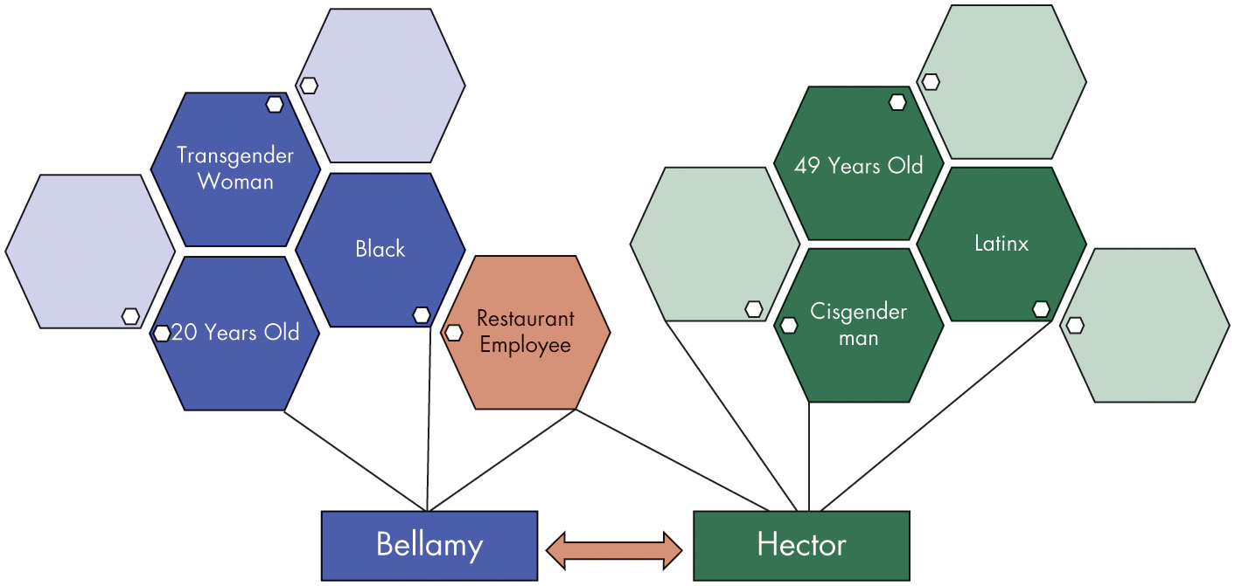
Prejudice, Discrimination, and Diversity (5 of 5)
Exhibit 2.2 The Cultural Mosaic
Source: Adapted from G. T. Chao and H. Moon, “The Cultural Mosaic: A Metatheory for Understanding the Complexity of Culture,” Journal of Applied Psychology 90, no. 6 (2005): 1128–40.
Notes:
Exhibit 2.2 shows an illustration of cultural mosaic theory.
Workers may also hold cultural mosaic beliefs (CMB) that influence their support for diversity, acceptance, and inclusion of people from different backgrounds. Furthermore, workers may choose to emphasize some of the tiles in their mosaics more so than the others, depending upon the setting (e.g., at home versus at work).
Long Description:
Bellamy is linked to the following mosaics: 20 years old, black, transgender woman, restaurant employee and two empty mosaics.
Hector is linked to the following mosaics: cisgender man, Latinx, 49 years old, restaurant employee and three empty mosaics.
Restaurant employee mosaic which is connected to both Bellamy and Hector is highlighted. Bellamy and Hector are reversible which is shown by double headed arrow between them.

Slide 15
Diversity Dynamics (1 of 2)
Group Composition
Building a team
Consider:
Surface-level diversity
Deep-level diversity
Functional diversity
Notes:
A common dilemma that managers and team leaders is how to build a team to increase performance and cohesion and reduce conflict. Research shows only a modest link between actual diversity and perceived diversity. Other studies indicate that members seek to balance a need to belong and a need to be distinctive in groups.
Despite the inconclusive nature of research on group composition, a number of findings have emerged about surface-level, deep-level, and functional diversity in groups and teams. Surface-level diversity appears to increase group conflict, especially in the early stages of a group’s tenure, which often lowers group morale and raises group turnover.
At a deeper level, groups in which members’ values or opinions differ tend to experience more conflict, but leaders who can get the group to focus on the task at hand and encourage group learning are able to reduce these conflicts and enhance discussion of group issues. Functional diversity may improve team performance and innovation, but these effects are contingent on several factors. For example, functional diversity can influence team creativity by facilitating knowledge sharing. Further, new ventures led by functionally diverse teams of founders tend to be more successful in competitive environments.

Slide 16
Diversity Dynamics (2 of 2)
A side effect in diverse teams may be fault lines
Fault lines are perceived divisions that split groups into two or more subgroups based on individual differences such as sex, race, age, work experience, language, and education.
Notes:
Research on fault lines has shown that they are generally detrimental to group functioning and performance. Subgroups may compete, which takes time away from core tasks and harms group performance, especially when the group is under threat.
Are fault lines ever a good thing? One study suggested that fault lines regarding skill, knowledge, and expertise may be beneficial in a results-driven organizational culture. Why? A results-driven culture focuses people’s attention on what is important to the company rather than on problems arising from subgroups.
Studies show that problems stemming from strong fault lines may be overcome when the roles are crosscut, when the group is given a common goal to strive for, and when similar pairs are recruited within a diverse group.

Slide 17
Cross-Cultural O B (1 of 7)
Hofstede’s Framework
Power distance
Individualism versus collectivism
Masculinity versus femininity
Uncertainty avoidance
Long-term versus short-term orientation
Later
Indulgence versus restraint
Notes:
One of the most widely referenced approaches for analyzing variations among cultures was introduced in the late 1970s by Geert Hofstede. Hofstede’s framework focuses on five dimensions of culture: power distance, individualism versus collectivism, masculinity versus femininity, uncertainty avoidance, and long-term versus short-term orientation. More recently, Hofstede has proposed an additional dimension: indulgence versus restraint.

Slide 18
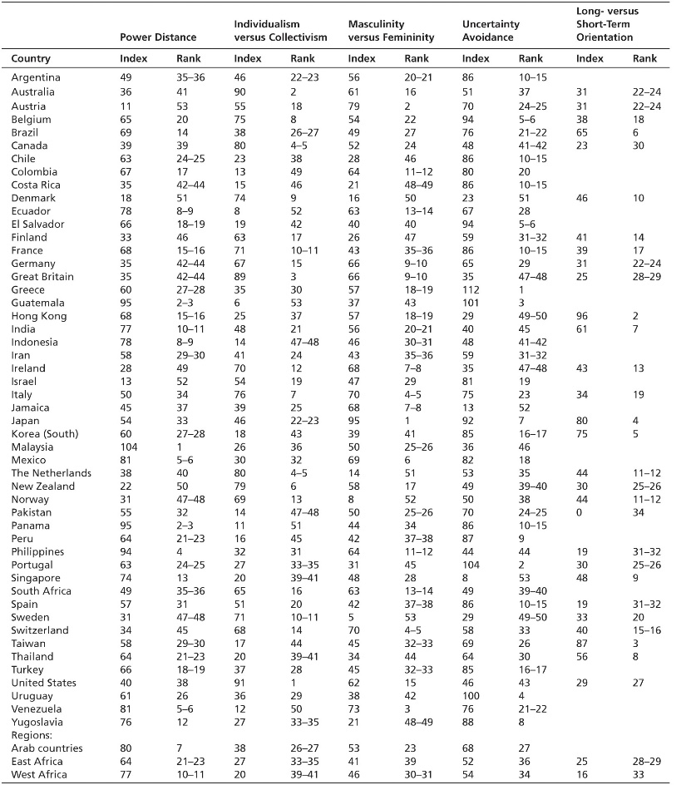
Cross-Cultural O B (2 of 7)
Exhibit 2.3 Hofstede’s Cultural Values by Nation
Note: “Index” refers to the given country’s score on the dimension, 0 = extremely low to 100 = extremely high. “Rank” refers to the relative ranking of the country compared to the others in Hofstede’s database, with 1 = the highest rank.
Source: Copyright Geert Hofstede BV, hofstede@bart.nl. Reprinted with permission.
Notes:
How do different countries score on Hofstede’s dimensions? Exhibit 2.3 shows the ratings of the countries for which data are available.
Long Description:
The table has 5 columns: power distance, individualism versus collectivism, masculinity versus femininity, uncertainty avoidance, and long- versus short-term orientation. Each of these column is further divided into two columns: index and rank. The data from the table in the format country: power distance index, power distance rank, individualism versus collectivism index, individualism versus collectivism rank, masculinity versus femininity index, masculinity versus femininity rank, uncertainty avoidance index, uncertainty avoidance rank, long- versus short-term orientation index, long- versus short-term orientation rank is as follows.
Argentina: 49, 35 to 36, 46, 22 to 23, 56, 20 to 21, 86, 10 to 15, no data, no data.
Australia: 36, 41, 90, 2, 61, 16, 51, 37, 31, 22 to 24.
Austria: 11, 53, 55, 18, 79, 2, 70, 24 to 25, 31, 22 to 24.
Belgium: 65, 20, 75, 8, 54, 22, 94, 5 to 6, 38, 18.
Brazil: 69, 14, 38, 26 to 27, 49, 27, 76, 21 to 22, 65, 6.
Canada: 39, 39, 80, 4 to 5, 52, 24, 48, 41 to 42, 23, 30.
Chile: 63, 24 to 25, 23, 38, 28, 46, 86, 10 to 15, no data, no data.
Colombia: 67, 17, 13, 49, 64, 11 to 12, 80, 20, no data, no data.
Costa Rica: 35, 42 to 44, 15, 46, 21, 48 to 49, 86, 10 to 15, no data, no data.
Denmark: 18, 51, 74, 9, 16, 50, 23, 51, 46, 10.
Ecuador: 78, 8 to 9, 8, 52, 63, 13 to 14, 67, 28, no data, no data.
El Salvador: 66, 18 to 19, 19, 42, 40, 40, 94, 5 to 6, no data, no data.
Finland: 33, 46, 63, 17, 26, 47, 59, 31 to 32, 41, 14.
France: 68, 15 to 16, 71, 10 to 11, 43, 35 to 36, 86, 10 to 15, 39, 17.
Germany: 35, 42 to 44, 67, 15, 66, 9 to 10, 65, 29, 31, 22 to 24.
Great Britain: 35, 42 to 44, 89, 3, 66, 9 to 10, 35, 47 to 48, 25, 28 to 29.
Greece: 60, 27 to 28, 35, 30, 57, 18 to 19, 112, 1, no data, no data.
Guatemala: 95, 2 to 3, 6, 53, 37, 43, 101, 3, no data, no data.
Hong Kong: 68, 15 to 16, 25, 37, 57, 18 to 19, 29, 49 to 50, 96, 2.
India: 77, 10 to 11, 48, 21, 56, 20 to 21, 40, 45, 61, 7.
Indonesia: 78, 8 to 9, 14, 47 to 48, 46, 30 to 31, 48, 41 to 42, no data, no data.
Iran: 58, 29 to 30, 41, 24, 43, 35 to 36, 59, 31 to 32, no data, no data.
Ireland: 28, 49, 70, 12, 68, 7 to 8, 35 47 to 48, 43, 13.
Israel: 13, 52, 54, 19, 47, 29, 81, 19, no data, no data.
Italy: 50, 34, 76, 7, 70, 4 to 5, 75, 23, 34, 19.
Jamaica: 45, 37, 39, 25, 68, 7 to 8, 13, 52, no data, no data.
Japan: 54, 33, 46, 22 to 23, 95, 1, 92, 7, 80, 4.
South Korea: 60, 27 to 28, 18, 43, 39, 41, 85, 16 to 17, 75, 5.
Malaysia: 104, 1, 26, 36, 50, 25 to 26, 36, 46, no data, no data.
Mexico: 81, 5 to 6, 30, 32, 69, 6, 82, 18, no data, no data.
The Netherlands: 38, 40, 80, 4 to 5, 14, 51, 53, 35, 44, 11 to 12.
New Zealand: 22, 50, 79, 6, 58, 17, 49, 39 to 40, 30, 25 to 26.
Norway: 31, 47 to 48, 69, 13, 8, 52, 50, 38, 44, 11 to 12.
Pakistan: 55, 32, 14, 47 to 48, 50, 25 to 26, 70, 24 to 25, 0, 34.
Panama: 95, 2 to 3, 11, 51, 44, 34, 86, 10 to 15, no data, no data.
Peru: 64, 21 to 23, 16, 45, 42, 37 to 38, 87, 9, no data, no data.
Philippines: 94, 4, 32, 31, 64, 11 to 12, 44, 44, 19, 31 to 32.
Portugal: 63, 24 to 25, 27, 33 to 35, 31, 45, 104, 2, 30, 25 to 26.
Singapore: 74, 13, 20, 39 to 41, 48, 28, 8, 53, 48. 9.
South Africa: 49, 35 to 36, 65, 16, 63, 13 to 14, 49, 39 to 40, no data, no data.
Spain: 57, 31, 51, 20, 42, 37 to 38, 86, 10 to 15, 19, 31 to 32.
Sweden: 31, 47 to 48, 71, 10 to 11, 5, 53, 29, 49 to 50, 33, 20.
Switzerland: 34, 45, 68, 14, 70, 4 to 5, 58, 33, 40, 15 to 16.
Taiwan: 58, 29 to 30, 17, 44, 45, 32 to 33, 69, 26, 87, 3.
Thailand: 64, 21 to 23, 20, 39 to 41, 34, 44, 64, 30, 56, 8.
Turkey: 66, 18 to 19, 37, 28, 45, 32 to 33, 85, 16 to 17, no data, no data.
United States: 40, 38, 91, 1, 62, 15, 46, 43, 29, 27.
Uruguay: 61, 26, 36, 29, 38, 42, 100, 4, no data, no data.
Venezuela: 81, 5 to 6, 12, 50, 73, 3, 76, 21 to 22, no data, no data.
Yugoslavia: 76, 12, 27, 33 to 35, 21, 48 to 49, 88, 8, no data, no data.
Regions:
Arab countries: 80, 7, 38, 26 to 27, 53, 23, 68, 27, no data, no data.
East Africa: 64, 21 to 23, 27, 33 to 35, 41, 39, 52, 36, 25, 28 to 29.
West Africa: 77, 10 to 11, 20, 39 to 41, 46, 30 to 31, 54, 34, 16, 33.

Slide 19
Cross-Cultural O B (3 of 7)
The G L O B E Framework
Power distance
Uncertainty avoidance
Future orientation
Institutional collectivism
Ingroup collectivism
Gender egalitarianism
Assertiveness
Humane orientation
Performance orientation
Notes:
The Global Leadership and Organizational Behavior Effectiveness (GLOBE) research program is an ongoing cross-cultural investigation of leadership and national culture. The GLOBE framework builds upon Hofstede’s work identifying nine dimensions on which national culture differ.
While sharing similar names, the different cultural dimensions identified in the GLOBE study are not identical to those identified in Hofstede’s research.

Slide 20
Cross-Cultural O B (4 of 7)
Exhibit 2.4 Hofstede–GLOBE Comparison
Hofstede’s Dimensions | GLOBE
Power distance: Extent to which a society accepts an unequal distribution of power | Power distance: Extent to which a society accepts an unequal distribution of power
Uncertainty avoidance: Extent to which a society feels threatened by and avoids ambiguity | Uncertainty avoidance: Extent to which a society seeks orderliness, structure, and laws to avoid ambiguity
Long-term orientation: Extent to which a society emphasizes the future and persistence (versus the present and change) | Future orientation: Extent to which a society believes its actions can influence the future
Notes:
Exhibit 2.4 shows the linkages between dimensions from the GLOBE framework and Hofstede’s Framework. Both studies have a lot in common and lead to similar conclusions.
The findings of these studies are incredibly important to be aware of in this day and age. With the advent of globalization, companies often engage in multinational projects, work in multinational teams, and send their employees to work in different cultures that may be radically different than what they are used to. Understanding what is valued (and what is not valued) in each culture is very “valuable” information to have today.

Slide 21
Cross-Cultural O B (5 of 7)
Exhibit 2.4 Hofstede–GLOBE Comparison
Hofstede’s Dimensions | GLOBE
Collectivism: Extent to which a society emphasizes acting as a tight-knit collective (versus as independent individuals) | Institutional collectivism: Extent to which a society supports collective action and resource distribution Ingroup collectivism: Extent to which a society values loyalty, pride, patriotism, and cohesion
Masculinity: Extent to which a society favors traditional masculine roles such as power and control (versus little differentiation of gender roles) | Gender egalitarianism: Extent to which a society deemphasizes traditional gender roles Assertiveness: Extent to which a society emphasizes confidence and advocating for what one wants Humane orientation: Extent to which a society values caring, friendliness, altruism, fairness, kindness, and generosity Performance orientation: Extent to which a society values producing results, excellence, and productivity
Source: Adapted from R. Hadwick, “Should I Use GLOBE or Hofstede? Some Insights That Can Assist Cross-Cultural Scholars, and Others, Choose the Right Study to Support Their Work,” paper presented at Australian & New Zealand Academy of Management, Wellington, NZ (December 2011); R. J. House, P. J. Hanges, M. Javidan, P. W. Dorfman, and V. Gupta, Culture, Leadership, and Organizations: The GLOBE Study of 62 Societies (Thousand Oaks, CA, 2004): X. Shi Sage and J. Wang, “Interpreting Hofstede Model and GLOBE Model: Which Way to Go for Cross-Cultural Research?” International Journal of Business and Management 6, no. 5 (2011): 93–99.
Notes:
Exhibit 2.4 shows the linkages between dimensions from the GLOBE framework and Hofstede’s Framework. Both studies have a lot in common and lead to similar conclusions.
The findings of these studies are incredibly important to be aware of in this day and age. With the advent of globalization, companies often engage in multinational projects, work in multinational teams, and send their employees to work in different cultures that may be radically different than what they are used to. Understanding what is valued (and what is not valued) in each culture is very “valuable” information to have today.

Slide 22
Cross-Cultural OB (6 of 7)
Cultural tightness-looseness refers to the degree to which there are clear, pervasive norms within societies, a clear understanding of sanctions for violating those norms, and no tolerance for deviating from those norms.
Religion
U.S. law prohibits discrimination based on religion, but it is still an issue, especially for Muslims.
Notes:
Culturally tight countries like Japan have historically experienced a great deal of threat, which has led to the emergence of clear, strong norms. On the other hand, loose countries like the United States tend to be more ambivalent toward restrictions to autonomy and liberty.
Cultural tightness tends to influence whether high-performance HR systems are more or less effective. In tight cultures, there are strong norms in place, and so workers are motivated to follow them—as such, when rigorous hiring systems, training programs, reward systems, and participative decision-making practices are enacted by organizations, they tend to be successful because workers tend to implement the practices.
Discrimination based on religion is prohibited in the United States; however, it continues to be an issue in the workplace. Muslims in particular may face discrimination, but bias against other religious beliefs exists as well. In fact, religious discrimination claims represent an increasing share of all discrimination claims in the United States.

Slide 23
Cross-Cultural O B (7 of 7)
Expatriate Adjustment
Organizations should select employees for international assignments who are capable of adjusting quickly and ensure they have the support they need for their assignment.
Cultural Intelligence (C Q) is a worker’s ability to effectively function in culturally diverse settings and situations.
Notes:
Several factors should be targeted to help the adjustment process for expatriates.
Feelings of empowerment along with the motivation to interact with those of other cultures were found in to be related to adjustment, satisfaction, and reduced intentions to leave prematurely.
Those with previous culture-specific work experience as well as higher self-esteem and self-efficacy tend to adjust and be promoted more quickly.
Several other factors work in concert to affect different forms of adjustment, including language ability, relational skills, role clarity and autonomy, organizational support, and familial support.
Finally, cultural tightness–looseness matters: Nearly all expatriates will have a difficult time adapting to tight countries because they have to adapt to strongly observed, heavily enforced norms.
CQ has been found to be associated with expatriate career aspirations and adjustment, job performance, psychological health and well-being, cross-cultural leadership, negotiation performance, and OCB in organizations. CQ has motivational effects that influence worker performance. For instance, individuals with high CQ feel more comfortable voicing their ideas with culturally dissimilar peers and supervisors.

Slide 24
Implementing Diversity Management (1 of 7)
Diversity management involves the use of evidence-based strategies to manage and leverage the inherent diversity of the workforce.
Diversity—celebrate rather than denigrate differences.
Equity—strive to provide access to the same opportunities for all workers, recognizing that some people are afforded privileges and advantages while others are confronted with barriers and obstacles.
E E O C
Inclusion—create an environment in which all people feel valued, welcomed, and included.
Notes:
The theory and research we have reviewed up to this point paint a bigger picture of prejudice, discrimination, and cultural misunderstanding that a mere understanding of diversity may fall short of addressing. Instead, organizations would do well to broaden their scope to focus on what can be done to ameliorate inequity, unfairness, and exclusion.
This has led organizations to focus on diversity, equity, and inclusion (DEI) as three strategic and principled goals to strive toward.
First, a focus on diversity involves celebrating rather than denigrating the differences between people and enhancing the representation of diverse, marginalized people in the workforce.
Second, a focus on equity involves striving to provide access to the same opportunities for all workers, recognizing that some people are afforded privileges and advantages while others are confronted with barriers and obstacles.
Third, a focus on inclusion involves creating an environment in which all people feel valued, welcomed, and included.

Slide 25
Implementing Diversity Management (2 of 7)
Common ingroup identity involves transforming workers’ focus on what divides them to what unites them, changing perceptions of “us” and “them” to a more inclusive “we.”
Contact hypothesis proposes that the more people from diverse backgrounds interact with one another, the more prejudice and discrimination between the groups will decrease over time.
Notes:
Overall, the evidence on the common ingroup identity model has been promising. It has even been demonstrated to have an effect on implicit bias, with experiments showing a reduction in bias scores on the IAT. However, although common ingroup identity is a powerful tool, it’s important to avoid using it in a way that inadvertently overshadows people’s diverse identities.
Contact may be one of the most promising ways in which majority group members begin to think differently about diversity and become aware of and psychologically invested in the interests of minority groups. In addition, virtual and imagined contact have an impact on prejudice reduction, inclusion, and anxiety reduction and can even lead to future, direct contact.

Slide 26
Implementing Diversity Management (3 of 7)
Diversity management practices
Lead for diversity
Advocate for diversity as a resource.
Promote positive intergroup interactions.
Stimulate discussions and conversations among those of different backgrounds to manage the organization’s knowledge.
Encourage continuous reflection of the organization’s diversity practices, processes, and goals.
Notes:
Primarily, leaders should assume four primary roles in diversity leadership: (1) advocate for diversity as a resource, (2) promote positive intergroup interactions, (3) stimulate discussions and conversations among those of different backgrounds to manage the organizations’ knowledge, and (4) encourage continuous reflection on the organizations’ diversity practices, processes, and goals.

Slide 27
Implementing Diversity Management (4 of 7)
Diversity management practices
Promote inclusion
Facilitate belongingness by supporting all workers as members of the team and including them in decision making.
Convey that their uniqueness is valued by encouraging diverse contributions and helping all members fully contribute.
Promote equity
Demonstrate expectations.
Communicate policies.
Notes:
To promote inclusion, leaders need to first focus on themselves with a sense of humility, authenticity, and understanding of their own diverse characteristics. Then, leaders can facilitate belongingness and convey the value of uniqueness.
Finally, managers can do much to promote equity in their organizations by clearly demonstrating expectations and communicating policies to employees so they can understand how and why certain practices are followed.

Slide 28
Implementing Diversity Management (5 of 7)
Diversity recruitment and staffing
Target recruitment messages to specific demographic groups.
Diversity training and development
Tailor training and development to D E I needs.
Foster trainee motivation.
Encourage goal setting.
Consider mentorship programs.
Notes:
The hiring process is one of the most important places to apply diversity management efforts. Hiring managers need to value fairness and objectivity in selecting employees and focus on the productive potential of new recruits.
Most diversity training programs have three distinct components. First, they teach people about the legal framework for equal employment opportunity and encourage fair treatment of all people regardless of their demographic characteristics. Second, they teach people how a diverse workforce is better able to serve a diverse market of customers and clients. Third, they foster personal development practices that bring out the skills and abilities of all workers, acknowledging how differences in perspective can be a valuable way to improve performance for everyone.

Slide 29
Implementing Diversity Management (6 of 7)
Diversity culture values and prioritizes diversity and inclusion and believes that it should be fostered within the organization.
Diversity climate reflects the shared perceptions of diversity and inclusion enhancing policies, practices, and procedures in the organization.
Notes:
Management will not be as effective unless managers consider the organization’s culture and climate for diversity.
As with DEI initiatives in general, diversity cultures and climates simultaneously emphasize prejudice and discrimination reduction, enhancing representation, and advocating for inclusion.

Slide 30
Implementing Diversity Management (7 of 7)
The challenge of diversity management
Authenticity matters.
Tokensim can be detrimental.
Paradoxical effects can happen.
External environments influence results.
Notes:
Managers can craft evidence-based practices, a DEI-friendly culture and climate in their organization, take strategic action toward DEI goals, and still fall flat. Managers would do well to consider and address these challenges in their own diversity management initiatives.
First, authenticity plays a huge role.
Second, many leaders and managers half-heartedly committed to DEI will engage in tokenism, or a perfunctory effort to enhance representation to make it seem like their company values diversity. Feeling tokenized can have detrimental effects for the worker or manager in that position and can be perceived by the public as inauthentic.
Third, diversity management can lead to several paradoxical effects.
Fourth, organizations do not exist in a vacuum.

Slide 31
Implications for Managers (1 of 3)
Strive to be aware of and sensitive to the complex implications of diversity in your organization.
Assess and challenge your own beliefs, prejudices, and stereotypes to increase your awareness of bias.
Take efforts to root out illegal, discriminatory practices, both overt and subtle, in your organization.
Look beyond readily observable biographical characteristics and consider individuals’ capabilities before making management decisions.
Notes:
Strive to be aware of and sensitive to the complex implications of diversity in your organization.
Assess and challenge your own beliefs, prejudices, and stereotypes to increase your awareness of bias.
Take efforts to root out illegal, discriminatory practices, both overt and subtle, in your organization.
Look beyond readily observable biographical characteristics and consider individuals’ capabilities before making management decisions.

Slide 32
Implications for Managers (2 of 3)
Educate your colleagues, subordinates, and others about both the ethical and business case for diversity to increase buy-in for diversity management.
Identify the potential impact of diversity dynamics in your groups and teams and be mindful of them when administering assessments, building teams, and resolving conflict.
The more you understand and consider differences between cultural values, norms, and identities, the better you will be able to adapt to and manage cross-cultural dynamics in your organization.
Notes:
Educate your colleagues, subordinates, and others about both the ethical and business case for diversity to increase buy-in for diversity management.
Identify the potential impact of diversity dynamics in your groups and teams and be mindful of them when administering assessments, building teams, and resolving conflict.
The more you understand and consider differences between cultural values, norms, and identities, the better you will be able to adapt to and manage cross-cultural dynamics in your organization.

Slide 33
Implications for Managers (3 of 3)
Implement evidence-based best practices when developing your organization’s diversity management initiatives, focusing on diversity, equity, and inclusion.
Strive to develop a diverse culture and climate where employees feel that diversity, equity, and inclusion are valued and put into practice and feel safe to contribute as their authentic selves.
Be mindful of the fact that diversity management may not be successful right away. There are many barriers to its effectiveness, some avoidable (e.g., authenticity and tokenism) and some unavoidable (e.g., systemic bias, your organization’s cultural context).
Notes:
Implement evidence-based best practices when developing your organization’s diversity management initiatives, focusing on diversity, equity, and inclusion.
Strive to develop a diverse culture and climate where employees feel that diversity, equity, and inclusion are valued and put into practice and feel safe to contribute as their authentic selves.
Be mindful of the fact that diversity management may not be successful right away. There are many barriers to its effectiveness, some avoidable (e.g., authenticity and tokenism) and some unavoidable (e.g., systemic bias, your organization’s cultural context).

Slide 34
Discussion Questions
Think about your workplace (or another organization you are familiar with). Do you see evidence of prejudice or discrimination? What form does it take and how does it impact the organization?
How can an understanding of Hofstede’s Framework and the G L O B E Framework help companies better navigate a global economy? Consider your response from the perspective of domestic employees and expatriates.
How is your university using D E I strategies to manage diversity and create an inclusive environment? In your opinion, what could be done better? Are there situations in which you still feel prejudice or discrimination?

Slide 35

Copyright
This work is protected by United States copyright laws and is provided solely for the use of instructors in teaching their courses and assessing student learning. Dissemination or sale of any part of this work (including on the World Wide Web) will destroy the integrity of the work and is not permitted. The work and materials from it should never be made available to students except by instructors using the accompanying text in their classes. All recipients of this work are expected to abide by these restrictions and to honor the intended pedagogical purposes and the needs of other instructors who rely on these materials.

