Slide 1


Organizational Behavior
Nineteenth Edition
Chapter 8
Motivation: From Concepts to Applications
Copyright © 2023, 2019, 2017 Pearson Education, Inc. All Rights Reserved
Notes:
If this PowerPoint presentation contains mathematical equations, you may need to check that your computer has the following installed:
1) MathType Plugin
2) Math Player (free versions available)
3) NVDA Reader (free versions available)
Welcome to this Organizational Behavior course that uses the 19th edition of the textbook, Organizational Behavior by Robbins and Judge. This is considered among the most widely used OB textbooks in the world. Robbins and Judge are recognized as definitive aggregators of OB concepts, applications, and practices. The course and this book will provide you with a resource that will benefit you throughout your degree program and your professional life.

Slide 2
Learning Objectives
8.1 Describe how the job characteristics model (J C M) motivates through job design.
8.2 Compare the main ways jobs can be redesigned.
8.3 Explain how specific alternative work arrangements can motivate employees.
8.4 Describe how employee involvement measures can motivate employees.
8.5 Demonstrate how different types of extrinsic pay programs can influence employee motivation.
8.6 Show how flexible benefits can motivate employees.
8.7 Identify the motivational benefits of intrinsic rewards.
Notes:
After studying this chapter, you should be able to:
Describe how the job characteristics model (JCM) motivates through job design.
Compare the main ways jobs can be redesigned.
Explain how specific alternative work arrangements can motivate employees.
Describe how employee involvement measures can motivate employees.
Demonstrate how different types of extrinsic pay programs can influence employee motivation.
Show how flexible benefits can motivate employees.
Identify the motivational benefits of intrinsic rewards.

Slide 3
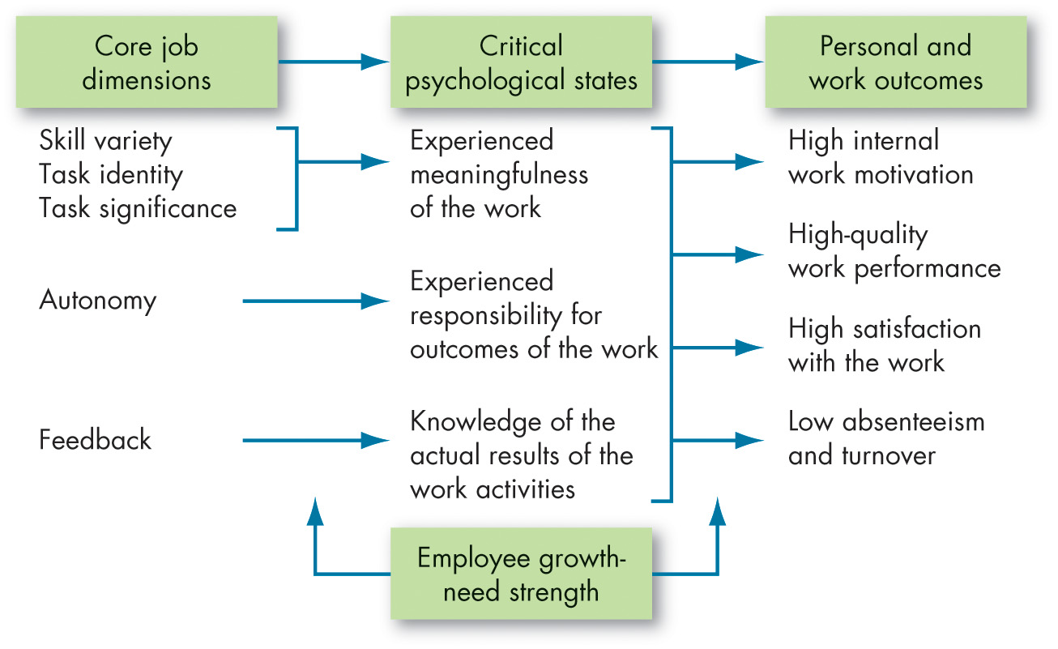
The Job Characteristics Model (1 of 2)
Exhibit 8.1 The Job Characteristics Model
Source: Based on J. R. Hackman and G. R. Oldham, “Development of Job Diagnostic Survey,” Journal of Applied Psychology 60, n o. 2 (1975): 159–70; J. L. Pierce, I. Jussila, and A. Cummings, “Psychological Ownership Within the Job Design Context: Revision of the Job Characteristics Model,” Journal of Organizational Behavior 30, n o. 4 (2009): 477–96.
Notes:
The Job Characteristics Model (JCM) as shown here in Exhibit 8.1, proposes that any job may be described by five core job dimensions:
Skill variety is the degree to which the job requires a variety of different activities, so the worker can use a number of different skills and talents.
Task identity is the degree to which the job requires completion of a whole and identifiable piece of work.
Task significance is the degree to which the job has a substantial impact on the lives or work of other people.
Autonomy is the degree to which the job provides substantial freedom, independence, and discretion to the individual in scheduling the work and determining the procedures to be used in carrying it out.
Feedback is the degree to which carrying out the work activities required by the job results in the individual obtaining direct and clear information about the effectiveness of his or her performance.
The first three dimensions—skill variety, task identity, and task significance—combine to create meaningful work the incumbent will view as important, valuable, and worthwhile. From a motivational standpoint, the JCM proposes that individuals obtain internal rewards when they learn (knowledge of results) that they personally (experienced responsibility) have performed well on a task they care about (experienced meaningfulness). Individuals with a high growth need are more likely to experience the critical psychological states when their jobs are enriched—and respond to them more positively—than are their counterparts with low growth need.
Long Description:
Left to right flow is from core job dimensions to personal and work outcomes, through critical psychological states and is as follows.
The dimensions, skill variety, task identity, and task significance flows to experienced meaningfulness of the work psychological state. The autonomy dimension flows to experiences responsibility for outcomes of the work psychological state. The feedback dimension flows to knowledge of the actual results of the work activities psychological state. All these psychological state leads to the following personal and work outcomes: high internal work motivation, high-quality work performance, high satisfaction with the work and low absenteeism and turnover. Employee growth-needs strength influences the flow from job dimensions to psychological state and from psychological state to outcomes.

Slide 4
The Job Characteristics Model (2 of 2)
The core dimensions of the job characteristics model (J C M) can be combined into a single predictive index called the motivating potential score (M P S).
If jobs score high on motivating potential, the model predicts that motivation, performance, and satisfaction will improve, and that absences and turnover will be reduced.
Notes:
The core dimensions of the JCM can be combined into a single predictive index called the motivating potential score (MPS). To be high on motivating potential, jobs must be high on at least one of the three factors that lead to experienced meaningfulness, and high on both autonomy and feedback. If jobs score high on motivating potential, the model predicts that motivation, performance, and satisfaction will improve, and absence and turnover will be reduced.
In general, research supports the JCM, although some personality and context differences exist.

Slide 5
Compare the Main Ways Jobs Can Be Redesigned (1 of 2)
Repetitive jobs provide little variety, autonomy, or motivation.
Job Rotation
Periodic shifting from one task to another.
Referred to as cross-training.
Benefits: reduces boredom, increases motivation, and helps employees better understand their work contributions.
Drawbacks: creates disruptions, requires extra time for supervisors addressing questions and training time, and reduced efficiencies.
Notes:
People generally seek out jobs that are challenging and stimulating, but repetitive jobs provide little variety, autonomy, or motivation. One way to make repetitive jobs more interesting is job rotation, which is also known as cross-training. It involves periodic shifting of an employee from one task to another. When an activity is no longer challenging, the employee is shifted to a different task.
The benefits of job rotation are that it reduces boredom, increases motivation, and helps employees better understand their work contributions. Indirect benefits include employees with wider ranges of skills that give management more flexibility in scheduling, adapting to changes, and filling vacancies. Some drawbacks of job rotation include disruptions, a need for extra time for supervisors addressing questions and training time, and reduced efficiencies.

Slide 6
Compare the Main Ways Jobs Can Be Redesigned (2 of 2)
Job Enrichment
Increasing a job’s high-level responsibilities to increase intrinsic motivation.
Involves adding another layer of responsibility and meaning.
Can be effective at reducing turnover.
Relational Job Design
To make jobs more prosocially motivating:
Connect employees with the beneficiaries of their work.
Meet beneficiaries firsthand.
Notes:
In job enrichment, high-level responsibilities are added to the job to increase a sense of purpose, direction, and meaning and increase intrinsic motivation.
Job enrichment has its roots in Herzberg’s theories of providing hygiene, or motivating factors to the job to increase motivation.
Early reviews suggested that job enrichment can be effective at reducing turnover, almost twice as effective as giving employees a “realistic preview” of the work before they join the organization.
While redesigning jobs on the basis of job characteristics theory is likely to make work more intrinsically motivating to people, more contemporary research is focusing on how to make jobs more prosocially motivating to people. One way to make jobs more prosocially motivating is to better connect employees with the beneficiaries of their work, for example, by relating stories from customers who have found the company’s products or services to be helpful. Beneficiaries of organizations might include customers, clients, patients, and users of products or services. Meeting beneficiaries firsthand allows employees to see that their actions affect a real, live person, and that their jobs have tangible consequences. In addition, connections with beneficiaries make customers or clients more accessible in memory and more emotionally vivid, which leads employees to consider the effects of their actions more. Finally, connections allow employees to easily take the perspective of beneficiaries, which fosters higher levels of commitment.

Slide 7
How Specific Alternative Work Arrangements Motivate Employees (1 of 7)
Exhibit 8.2 Possible Flextime Staff Schedules
Blank | Schedule 1
Percent Time: | 100% = 40 hours per week
Core Hours: | 9:00 A.M.–5:00 P.M., Monday through Friday (1 hour lunch)
Work Start Time: | Between 8:00 A.M. and 9:00 A.M.
Work End Time: | Between 5:00 P.M. and 6:00 P.M.
Blank | Schedule 2
Percent Time: | 100% = 40 hours per week
Work Hours: | 8:00 A.M.–6:30 P.M., Monday through Thursday (1/2 hour lunch)
blank | Friday off
Work Start Time: | 8:00 A.M.
Work End Time: | 6:30 P.M.
Notes:
Alternative work arrangements are also used to boost motivation. They include flextime, defined as flexible work hours like those shown in Exhibit 8.2. This allows employees some discretion over when they arrive at and leave work. While most of the evidence for flextime stacks up favorably, one review of over 40 studies suggests that flextime is related to positive work outcomes in general, but only weakly—the effects are much stronger when considering reductions in absenteeism, and, to a lesser degree, improvements in productivity and schedule satisfaction. Flextime tends to reduce absenteeism because employees can schedule their work hours to align with personal demands, reducing tardiness and absences, and they can work when they are most productive. A major drawback is that it’s not applicable to all jobs or all workers.

Slide 8
How Specific Alternative Work Arrangements Motivate Employees (2 of 7)
Blank | Schedule 3
Percent Time: | 90% = 36 hours per week
Work Hours: | 8:30 A.M.–5:00 P.M., Monday through Thursday (1/2 hour lunch)
 | 8:00 A.M.–Noon Friday (no lunch)
Work Start Time: | 8:30 A.M. (Monday–Thursday); 8:00 A.M. (Friday)
Work End Time: | 5:00 P.M. (Monday–Thursday); Noon (Friday)
Blank | Schedule 4
Percent Time: | 80% = 32 hours per week
Work Hours: | 8:00 A.M.–6:00 P.M., Monday through Wednesday (1/2 hour lunch)
 | 8:00 A.M.–11:30 A.M. Thursday (no lunch)
blank | Friday off
Work Start Time: | Between 8:00 A.M. and 9:00 A.M.
Work End Time: | Between 5:00 P.M. and 6:00 P.M.

Slide 9
How Specific Alternative Work Arrangements Motivate Employees (3 of 7)
Job Sharing
Two or more people split a traditional full-time job.
Declining in use.
Can be difficult to find compatible pairs of employees who can successfully coordinate the intricacies of one job.
Increases flexibility and can increase motivation and satisfaction when a full-time job is just not practical.
Notes:
Job sharing allows two or more individuals to split a traditional full-time job. Only 10 percent of U.S. organizations offered job sharing in 2015. Reasons it is not more widely adopted are likely the difficulty of finding compatible partners to share a job and the historically negative perceptions of individuals not completely committed to their job and employer. The major drawback is finding compatible pairs of employees who can successfully coordinate the intricacies of one job.
However, job sharing allows an organization to draw on the talents of more than one individual in a given job. From the employee’s perspective, job sharing increases flexibility and can increase motivation and satisfaction when a full-time job is just not practical.

Slide 10
How Specific Alternative Work Arrangements Motivate Employees (4 of 7)
Telecommuting
Working from home or anywhere else the employee chooses that is outside the physical workplace.
Assess-create-support framework
Assessing employee telecommuting needs.
Creating practices that empower employees to maintain work–home boundaries.
Supporting these practices through adjustment, encouragement, role-modeling, and monitoring.
Notes:
Telecommuting refers to working from home or anywhere else the employee chooses that is outside the physical workplace.
During the COVID-19 pandemic, researchers developed the assess-create-support framework to help aid in establishing effective telecommuting practices. This framework involves assessing employee telecommuting needs, creating practices that empower employees to maintain work–home boundaries, and supporting these practices through adjustment, encouragement, role-modeling, and monitoring. Indeed, adaptation may be an important component to the success of telecommuting, as tailored approaches to develop each employee’s schedule may lead to better performance while working from home.

Slide 11
How Specific Alternative Work Arrangements Motivate Employees (5 of 7)
Telecommuting Advantages
Positively related to objective performance and job satisfaction.
Reduced work-family conflict.
Reduced carbon emissions.
Notes:
There are reasons for and against telecommuting. Telecommuting is positively related to objective performance and job satisfaction. Moreover, employees who work virtually more than 2.5 days a week tended to experience the benefits of reductions in work-family conflict more intensely than those who are in the office the majority of their work week. Beyond the benefits to organizations and their employees, telecommuting has potential benefits to society. One study estimated that if people in the United States telecommuted half the time, carbon emissions would be reduced by approximately 51 metric tons per year.

Slide 12
How Specific Alternative Work Arrangements Motivate Employees (6 of 7)
Telecommuting Disadvantages
Employer
Social loafing.
Difficult to coordinate teamwork.
Difficult to evaluate non-quantitative performance.
Employee
Increased feelings of isolation and reduced coworker relationship quality.
May not be noticed for his or her efforts.
Notes:
Disadvantages of telecommuting for the employer include potential for social loafing, difficulty coordinating teamwork, and difficulty evaluating non-quantitative performance. Disadvantages for the employee include that he or she may not be as noticed for his or her efforts, increased feelings of isolation, and poorer coworker relationship quality.

Slide 13
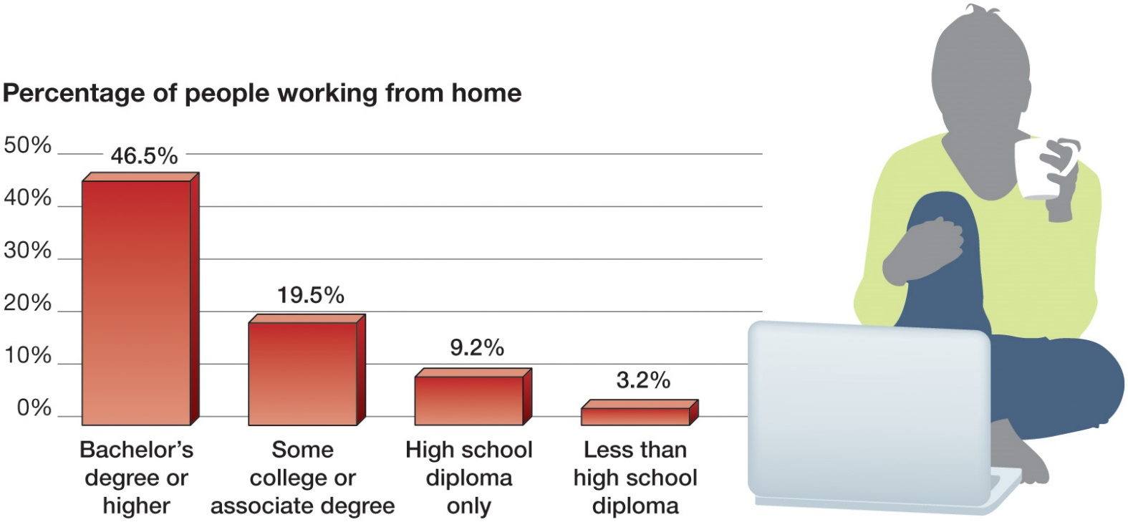
How Specific Alternative Work Arrangements Motivate Employees (7 of 7)
OB POLL Who Works From Home?
Source: Bureau of Labor Statistics, “Job Flexibilities and Work Schedules—2017–2018: Data From the American Time Use Survey,” Bureau of Labor Statistics [news release], September 4, 2019,
https://www.bls.gov/news.release/pdf/flex2.pdf
Notes:
Telecommuting seems to mesh with the cultural transition to knowledge work.
As the OB poll indicates, people with more education are more apt to work from home.
Long Description:
The horizontal axis is marked with different kinds of education. The vertical axis is labeled with the percentage of people working from home and ranges from 0 percent to 50 percent in increment of 10 percent. The data from the graph in the format degree: percent of people working from home is as follows. Bachelor’s degree or higher: 46.5 percent. Some college or associate degree: 19.5 percent. High school diploma only: 92 percent. Less than high school diploma: 3.2 percent.

Slide 14
Employee Involvement and Employee Motivation (1 of 3)
Employee Involvement: a participative process that uses employees’ input to increase their commitment to the organization’s success.
Examples of Employee Involvement Programs
Participative management
Representative participation
Notes:
Employee involvement refers to a participative process that uses employees’ input to increase their commitment to the organization’s success. Two examples of such programs are participative management and representative participation.

Slide 15
Employee Involvement and Employee Motivation (2 of 3)
Participative management
Joint decision making.
Acts as a panacea for poor morale and low productivity.
Trust and confidence in leaders is essential.
Studies of the participation–performance have yielded mixed results.
Notes:
Participative management is the first of the options for employee involvement programs. Common to all participative management programs is joint decision making, wherein subordinates share a significant degree of decision-making power with their immediate superiors. Participative management has, at times, been promoted as a panacea for poor morale and low productivity. But for it to work, employees must be engaged in issues relevant to their interests so they’ll be motivated, they must have the competence and knowledge to make a useful contribution, and trust and confidence must exist among all parties.
Studies of the participation–organizational performance relationship have yielded mixed findings. Organizations that institute participative management do have higher stock returns, lower turnover rates, and higher estimated labor productivity, although these effects are typically not large.

Slide 16
Employee Involvement and Employee Motivation (3 of 3)
Representative participation
Workers are represented by a small group of employees who actually participate in decision making.
Almost every country in Western Europe requires representative participation.
The two most common forms:
Works councils
Board representatives
Notes:
Representative participation is spreading. Almost every country in Western Europe has some type of legislation requiring it. It is the most widely legislated form of employee involvement around the world. The goal is to redistribute power within an organization, putting labor on a more equal footing with the interests of management and stockholders.
The two most common forms include works councils that link employees with management. They are groups of nominated or elected employees who must be consulted when management makes decisions involving personnel. Second is board representatives, who are employees who sit on a company’s board of directors and represent the interests of the firm’s employees. The overall influence of representative participation seems to be minimal. The evidence suggests that works councils are dominated by management and have little impact on employees or the organization. If one were interested in changing employee attitudes or in improving organizational performance, representative participation would be a poor choice.

Slide 17
Extrinsic Pay Programs and Employee Motivation (1 of 8)
What to Pay:
Complex process that entails balancing internal equity and external equity.
Some organizations prefer to pay leaders by paying above market.
Paying more may net better-qualified and more highly motivated employees who may stay with the firm longer.
Notes:
Now, let’s talk about using rewards to motivate people, and specifically, what to pay employees. As we saw in the chapter on attitudes, pay is not a primary factor driving job satisfaction. However, it does motivate people, and companies often underestimate its importance in keeping top talent.
So, what should an organization do? How should the pay structure be established? The answer is not easy—it’s a complex process that entails balancing internal equity and external equity. Some organizations prefer to pay leaders by paying above market. Keep in mind that paying more may net better-qualified and more highly motivated employees who may stay with the firm longer.

Slide 18
Extrinsic Pay Programs and Employee Motivation (2 of 8)
How to Pay:
Variable-pay programs:
Piece-rate plans
Merit-based pay
Bonuses
Profit sharing
Employee stock ownership plans
Earnings therefore fluctuate up and down.
Notes:
Rewarding individual employees through variable-pay programs is becoming more common in the workplace. A number of organizations are moving away from paying solely on credentials or length of service. Piece-rate plans, merit-based pay, bonuses, profit sharing, and employee stock ownership plans are all forms of a variable-pay program, which base a portion of an employee’s pay on some individual and/or organizational measure of performance. Individual earnings therefore fluctuate up and down.

Slide 19
Extrinsic Pay Programs and Employee Motivation (3 of 8)
Piece-Rate Pay
A pure piece-rate plan provides no base salary and pays the employee only for what he or she produces.
Limitation: not a feasible approach for many jobs.
The main concern for both individual and team piece-rate workers is financial risk.
Notes:
The first of the variable pay programs is piece-rate pay plans. Here, workers are paid a fixed sum for each unit of production completed. A pure piece-rate plan provides no base salary and pays the employee only for what he or she produces. The main concern for both individual and team piece-rate workers is financial risk.
The main limitation of the piece-rate plan is that it doesn’t work for all types of jobs. Although incentives are motivating and relevant for some jobs, it is unrealistic to think they can constitute the only piece of some employees’ pay.

Slide 20
Extrinsic Pay Programs and Employee Motivation (4 of 8)
Merit-Based Pay
Allows employers to differentiate pay based on performance.
Creates perceptions of relationships between performance and rewards.
Limitations:
Based on annual performance appraisals.
Merit pool fluctuates.
Union resistance.
Notes:
The second variable pay method is the merit-based pay plan. These plans are based on performance appraisal ratings. Their main advantage is that they allow employers to differentiate pay based on performance, and so create perceptions of relationships between performance and rewards. Most large organizations have merit pay plans, particularly for salaried employees. Limitations to merit-based plans include that they are based on annual performance appraisals, that the merit pool fluctuates based on economic conditions, and that unions typically resist merit-based pay plans.

Slide 21
Extrinsic Pay Programs and Employee Motivation (5 of 8)
Bonuses
An annual bonus is a significant component of total compensation for many jobs.
Increasingly include lower-ranking employees.
Many companies now routinely reward production employees with bonuses when profits improve.
Downside: employees’ pay is more vulnerable to cuts.
Notes:
The use of bonuses is becoming more common in many organizations. An annual bonus is a significant component of total compensation for many jobs.
Bonus plans increasingly include lower-ranking employees; many companies now routinely reward production employees with bonuses in the thousands of dollars when profits improve. The incentive effects of performance bonuses should be higher than those of merit pay because rather than paying for performance years ago, which was rolled into base pay, bonuses reward recent performance. When times are bad, firms can cut bonuses to reduce compensation costs. The downside of bonuses is that employees’ pay is more vulnerable to cuts.

Slide 22
Extrinsic Pay Programs and Employee Motivation (6 of 8)
Profit-Sharing Plans
Organization-wide programs that distribute compensation based on some established formula centered around a company’s profitability.
Appear to have positive effects on employee attitudes at the organizational level.
Employees have a feeling of psychological ownership.
Notes:
Profit-sharing plans are organization-wide programs that distribute compensation based on some established formula centered around a company’s profitability. Compensation can be direct cash outlays or, particularly for top managers, allocations of stock options. Profit-sharing plans at the organizational level appear to have positive impacts on employee attitudes; employees report a greater feeling of psychological ownership.

Slide 23
Extrinsic Pay Programs and Employee Motivation (7 of 8)
Employee Stock Ownership Plan (E S O P)
A company-established benefit plan in which employees acquire stock, often at below-market prices, as part of their benefits.
Increases employee satisfaction and innovation.
Employees need to psychologically experience ownership.
Can reduce unethical behavior.
Can be used for community wealth building.
Notes:
Another variable-pay option is the employee stock ownership plan, or ESOP. An ESOP is a company-established benefit plan in which employees acquire stock, often at below-market prices, as part of their benefits.
Research on ESOPs indicates that they increase employee satisfaction and innovation. ESOPs have the potential to increase employee job satisfaction and work motivation, but employees need to psychologically experience ownership.
ESOP plans for top management can reduce unethical behavior. CEOs are more likely to manipulate firm earnings reports to make themselves look good in the short run when they don’t have an ownership share, even though this manipulation will eventually lead to lower stock prices. However, when CEOs own a large amount of stock, they report earnings accurately because they don’t want the negative consequences of declining stock prices.

Slide 24
Extrinsic Pay Programs and Employee Motivation (8 of 8)
Evaluation of Variable Pay
Do variable-pay programs increase motivation and productivity?
Generally, yes, but that doesn’t mean everyone is equally motivated by them.
Notes:
Do variable-pay programs increase motivation and productivity? Generally, yes, but that doesn’t mean everyone is equally motivated by them.
Managers should monitor their employees’ performance–reward expectancy, since a combination of elements that makes employees feel that their greater performance will yield them greater results will be the most motivating.

Slide 25
Show How Flexible Benefits Turn Benefits Into Motivators
Developing a Benefits Package
Flexible benefits individualize rewards.
Allow each employee to choose the compensation package that best satisfies his or her current needs and situation.
Today, almost all major corporations in the United States offer flexible benefits.
However, it may be surprising that their usage is not yet global.
Notes:
Flexible benefits individualize rewards by allowing each employee to choose the compensation package that best satisfies his or her current needs and situation.
Flexible benefits can accommodate differences in employee needs based on age, marital status, spouses’ benefit status, and number and age of dependents.
Today, almost all major corporations in the United States offer flexible benefits.
However, it may be surprising that their usage is not yet global.

Slide 26
Identify the Motivational Benefits of Intrinsic Rewards
Employee Recognition Programs
Organizations are increasingly recognizing that recognition programs and other ways of increasing an employee’s intrinsic motivation work.
Research suggests that financial incentives may be more motivating in the short term, but in the long run nonfinancial incentives work best.
Praise is free!
Notes:
Employee recognition programs are plans to encourage specific employee behaviors by formally appreciating specific employee contributions. They range from a spontaneous and private thank-you to widely publicized formal programs in which specific types of behavior are encouraged and the procedures for attaining recognition are clearly identified.
An obvious advantage of recognition programs is that they are inexpensive: praise is free! With or without financial rewards, they can be highly motivating to employees.

Slide 27
Implications for Managers (1 of 2)
Where possible, design and redesign jobs to harness employee motivation, focusing on the job characteristics model’s elements.
Consider alternative work arrangements to empower your employees to manage their work and home lives. Resist the urge to monitor and control employees closely—autonomy and flexibility can be highly motivating.
Notes:
Where possible, design and redesign jobs to harness employee motivation, focusing on the job characteristics model’s elements.
Consider alternative work arrangements to empower your employees to manage their work and home lives. Resist the urge to monitor and control employees closely—autonomy and flexibility can be highly motivating.

Slide 28
Implications for Managers (2 of 2)
Allow employees to participate in decisions that affect them. Employees can contribute to setting work goals, choosing their own benefits packages, and solving productivity and quality problems.
Link rewards to performance. Rewards should be contingent on performance, and employees must perceive the link between the two.
Check the motivation systems for inequity. Employees should perceive that individual effort and outcomes explain differences in pay and other rewards.
Notes:
In addition,
Allow employees to participate in decisions that affect them. Employees can contribute to setting work goals, choosing their own benefits packages, and solving productivity and quality problems.
Link rewards to performance. Rewards should be contingent on performance, and employees must perceive the link between the two.
Check the motivation systems for inequity. Employees should perceive that individual effort and outcomes explain differences in pay and other rewards.

Slide 29
Discussion Questions
The COVID-19 pandemic forced millions of in-person workers to work from home. Now some people want to continue to telecommute. Is the option to work from home a benefit that can be used to motivate employees, or should it be a standard option when remote work is feasible?
Some employers are questioning whether they still need to pay their employees adjustments for living in high-cost cities if the employee has moved to a lower cost location and now works from home. Are these employees still entitled to the extra pay? Would employees be less motivated if it is taken away?

Slide 30

Copyright
This work is protected by United States copyright laws and is provided solely for the use of instructors in teaching their courses and assessing student learning. Dissemination or sale of any part of this work (including on the World Wide Web) will destroy the integrity of the work and is not permitted. The work and materials from it should never be made available to students except by instructors using the accompanying text in their classes. All recipients of this work are expected to abide by these restrictions and to honor the intended pedagogical purposes and the needs of other instructors who rely on these materials.

