Slide 1


Organizational Behavior
Nineteenth Edition
Chapter 9
Foundations of Group Behavior
Copyright © 2023, 2019, 2017 Pearson Education, Inc. All Rights Reserved
Notes:
If this PowerPoint presentation contains mathematical equations, you may need to check that your computer has the following installed:
1) MathType Plugin
2) Math Player (free versions available)
3) NVDA Reader (free versions available)
Welcome to this Organizational Behavior course that uses the 19th edition of the textbook, Organizational Behavior by Robbins and Judge. This is considered among the most widely used OB textbooks in the world. Robbins and Judge are recognized as definitive aggregators of OB concepts, applications, and practices. The course and this book will provide you with a resource that will benefit you throughout your degree program and your professional life.

Slide 2
Learning Objectives (1 of 2)
9.1 Distinguish between the different types of groups.
9.2 Describe the punctuated-equilibrium model of group development.
9.3 Show how role requirements change in different situations.
9.4 Demonstrate how norms exert influence on an individual’s behavior.
Notes:
After studying this chapter, you should be able to:
Distinguish between the different types of groups.
Describe the punctuated-equilibrium model of group development.
Show how role requirements change in different situations.
Demonstrate how norms exert influence on an individual’s behavior.

Slide 3
Learning Objectives (2 of 2)
9.5 Show how status and size differences affect group performance.
9.6 Describe how cohesion is related to group effectiveness.
9.7 Contrast the strengths and weaknesses of group decision making.
Notes:
Additional objectives for this chapter.
Show how status and size differences affect group performance.
Describe how cohesion is related to group effectiveness.
Contrast the strengths and weaknesses of group decision making.

Slide 4
Distinguish Between Different Types of Groups (1 of 3)
A group is defined as two or more individuals, interacting and interdependent, who have come together to achieve particular objectives.
Groups can be either formal or informal.
Formal groups: those defined by the organization’s structure.
Informal groups: alliances that are neither formally structured nor organizationally determined.
Notes:
A group is defined as two or more individuals, interacting and interdependent, who have come together to achieve particular objectives. Groups can be either formal or informal.
Formal groups, like an airline flight crew, are those defined by the organization’s structure, with designated work assignments establishing tasks. The behaviors that one should engage in are stipulated by and directed toward organizational goals. In contrast, informal groups are alliances that are neither formally structured nor organizationally determined, but instead are natural formations in the work environment in response to the need for social contact. So, for example, three employees from different departments who regularly eat lunch together is an informal group.

Slide 5
Distinguish Between Different Types of Groups (2 of 3)
Social identity theory considers when and why individuals consider themselves members of groups.
People have emotional reactions to the failure or success of their group because their self-esteem gets tied into the performance of the group.
Relational identification
Collective identification
Notes:
Why do people form groups? Our tendency to take personal pride or offense for the accomplishments of a group is the territory of social identity theory.
Social identity theory proposes that people have emotional reactions to the failure or success of their group because their self-esteem gets tied into the performance of the group.
Within our organizations and groups, we develop many identities through (1) relational identification, when we connect with others because of our roles, and (2) collective identification, when we connect with the aggregate characteristics of our groups.

Slide 6
Distinguish Between Different Types of Groups (3 of 3)
Ingroups and Outgroups
Social categorization (and social identity) processes can sometimes lead people to think of people who share their social identity as the ingroup and people from different groups as outgroups.
Notes:
As we described in the chapter on diversity, social categorization (and social identity) processes can sometimes lead people to think of people who share their social identity as the ingroup and people from different groups as outgroups. In the diversity chapter, we described how this can be a strong source of prejudice and discrimination. People fall into the dangerous trap of believing that those who belong to different outgroups are “all the same,” contributing to the polarization of people.

Slide 7
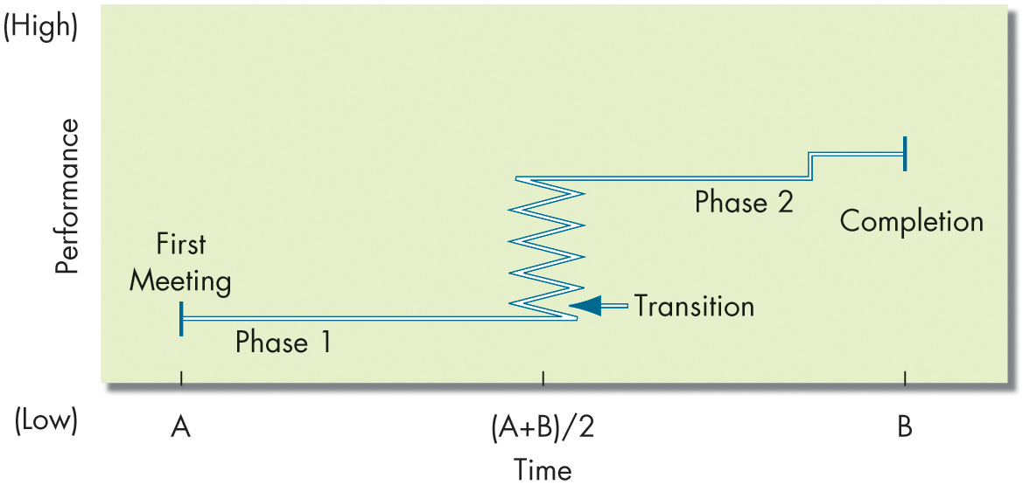
Describe the Punctuated-Equilibrium Model
Exhibit 9.1 The Punctuated-Equilibrium Model
Notes:
Temporary groups with deadlines don’t seem to follow the usual five-stage model. Studies indicate they have their own unique sequencing of actions (or inaction). Their first meeting sets the group’s direction. This first phase of group activity is one of inertia. A transition takes place at the end of this phase, which occurs exactly when the group has used up half its allotted time. A transition initiates major changes. A second phase of inertia follows the transition, and the group’s last meeting is characterized by markedly accelerated activity. This pattern, called the punctuated-equilibrium model, is shown in Exhibit 9.1.
The first meeting sets the group’s direction. A framework of behavioral patterns and assumptions emerges. These lasting patterns can appear as early as the first few seconds of the group’s life. Once set, the group’s direction is solidified and is unlikely to be reexamined throughout the first half of its life. This is a period of inertia—the group tends to stand still or become locked into a fixed course of action even if it gains new insights that challenge initial patterns and assumptions.
Then a transition takes place when the group has used up half its allotted time. The midpoint appears to work like an alarm clock, heightening members’ awareness that their time is limited and that they need to “get moving.” A transition initiates major changes. This ends Phase 1 and is characterized by a concentrated burst of changes, dropping of old patterns, and adoption of new perspectives. The transition sets a revised direction for Phase 2. Phase 2 is a new equilibrium or period of inertia. In this phase, the group executes plans created during the transition period. The group’s last meeting is characterized by markedly accelerated activity.
Long Description:
The horizontal axis is labeled time. The vertical axis is labeled performance and ranges from low to high performance. The data from the graph is as follows. The first meeting starts at a point corresponding to value A on the horizontal axis, continues with the phase 1 at a constant performance, and then the transition occurs at the end of phase 1, where the performance increases with time fluctuations, and then phase 2 begins with a constant performance. There is a slight increase in the performance when nearing completion which is at a value B on the horizontal axis. The transition state occurs at a value corresponding to half of the sum of A and B on the horizontal axis.

Slide 8
Show How Role Requirements Change (1 of 2)
Role: a set of expected behavior patterns attributed to someone occupying a given position in a social unit.
Role perception: one’s perception of how to act in a given situation.
Role expectations: how others believe one should act in a given situation.
Psychological contract
Notes:
All group members are actors, each playing a role. We are required to play a number of diverse roles, both on and off our jobs. Many of these roles are compatible; some create conflicts. Different groups impose different role requirements on individuals.
Role perception refers to one’s view of how one is supposed to act in a given situation. We get these perceptions from stimuli all around us—friends, books, YouTube, etc.
Role expectations refers to how others believe you should act in a given situation. The psychological contract is an unwritten agreement that exists between employees and their employer. It sets out mutual expectations—what management expects from workers, and vice versa. It defines the behavioral expectations that go with every role. If role expectations as implied are not met, expect negative repercussions from the offended party.

Slide 9
Show How Role Requirements Change (2 of 2)
Role conflict: situation in which an individual faces divergent role expectations.
We can experience interrole conflict when the expectations of our different, separate groups are in opposition.
Notes:
Role conflict: At the extreme, two or more role expectations are mutually contradictory. It exists when compliance with one role requirement may make more difficult the compliance with another.
We can experience interrole conflict when the expectations of our different, separate groups are in opposition.
During mergers and acquisitions, employees can be torn between their identities as members of their original organization and of the new parent company.
Multinational organizations also have been shown to lead to dual identification—with the local division and with the international organization.

Slide 10
Show How Norms Exert Influence On an Individual’s Behavior (1 of 8)
Norms:
Acceptable standards of behavior within a group that are shared by the group’s members.
Notes:
All groups have norms, or acceptable standards of behavior that are shared by the group’s members. Norms tell members what they ought and ought not to do under certain circumstances.

Slide 11
Show How Norms Exert Influence On an Individual’s Behavior (2 of 8)
Norms and Emotions
Norms can dictate the experience of emotions for the individuals and for the groups—in other words, people grow to interpret their shared emotions in the same way.
Notes:
Norms can dictate the experience of emotions for the individuals and for the groups—in other words, people grow to interpret their shared emotions in the same way.

Slide 12
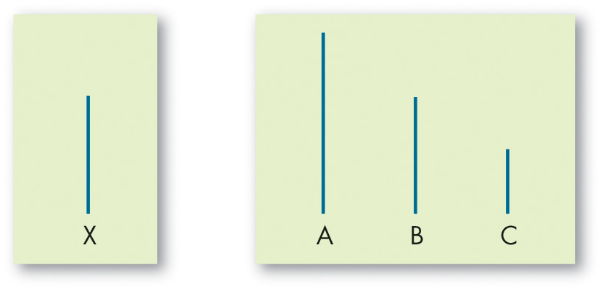
Show How Norms Exert Influence On an Individual’s Behavior (3 of 8)
Exhibit 9.2 Examples of Cards Used in Asch’s Study
Notes:
There is considerable evidence that groups can place strong pressures on individual members to change their attitudes and behaviors to conform to the group’s standard. The pressure that group exerts for conformity was demonstrated by Solomon Asch.
Groups of seven or eight people were asked to compare two cards held by the experimenter, as shown in Exhibit 9-2. One card had one line; the other had three lines of varying length. Under ordinary conditions, subjects made less than one percent error. The experiment began with several sets of matching exercises. All the subjects gave the right answers. On the third set, however, the first subject gave an obviously wrong answer, the next subject gave the same wrong answer, and so did the others until it got to the unknowing subject.
The results obtained by Asch demonstrated that over many experiments and many trials, subjects conformed in about 37% of the trials; the subjects gave answers that they knew were wrong but that were consistent with the replies of other group members. Has time altered the validity of these findings of nearly 50 years ago, and are they generalizable across cultures? Yes, levels of conformity have steadily declined. Furthermore, Asch’s findings are culture-bound. Conformity to social norms is higher in collectivist cultures than in individualist cultures.
Individuals conform to the important groups to which they belong or hope to belong. However, all groups do not impose equal conformity pressures on their members. Important groups are referred to as reference groups. The reference group is characterized as one where the person is aware of the others; the person defines themselves as a member, or would like to be a member; and the person feels that the group members are significant to them.
Long Description:
There are two cards. The first card has one line in medium length and is labeled X. The second card has three lines in which the first line is the longest and is labeled A, the second line is of medium length and is labeled B, and the third line is the shortest and is labeled C.

Slide 13
Show How Norms Exert Influence On an Individual’s Behavior (4 of 8)
Norms and Behavior
A recent study found that, in a task group, individuals’ emotions influenced the group’s emotions and vice versa.
Hawthorne Studies
Notes:
Norms in the workplace significantly influence employee behavior. Experiments conducted between 1924 and 1932 by Elton Mayo at Western Electric at the company’s Hawthorne Works in Chicago. The Hawthorne researchers began by examining the relationship between the physical environment and productivity. Illumination and other working conditions were selected to represent this physical environment.
The researchers’ initial findings contradicted their anticipated results. As a follow-up, the researchers began a second set of experiments in the relay assembly test room at Western Electric. Observations covering a multiyear period found this small group’s output increased steadily. It became evident this group’s performance was significantly influenced by its status as “special.” In essence, workers in both the illumination and assembly-test-room experiments were reacting to the increased attention they received.
A third study, in the bank wiring observation room, was introduced to ascertain the effect of a sophisticated wage incentive plan. The most important finding of this study was that employees did not individually maximize their outputs. Their output became controlled by a group norm that determined what was a proper day’s work.
Interviews determined the group was operating well below its capability and was leveling output to protect itself.
Members were afraid that if they significantly increased their output, the unit incentive rate would be cut, the expected daily output would be increased, layoffs might occur, or slower workers would be reprimanded.
The norms the group established included a number of “don’ts”:
Don’t be a rate-buster, turning out too much work.
Don’t be a chiseler, turning out too little work.
Don’t squeal on any of your peers.
How did the group enforce these norms?
The methods included sarcasm, name-calling, ridicule, and even punches to the upper arm of any member who violated the group’s norms.
Members also ostracized individuals whose behavior was against the group’s interest.

Slide 14
Show How Norms Exert Influence On an Individual’s Behavior (5 of 8)
Positive Norms and Group Outcomes
One goal of every organization with corporate social responsibility (C S R) initiatives is for its values to hold normative sway over employees.
If employees aligned their thinking with positive norms, these norms would become stronger, and the probability of positive impact would grow exponentially.
Notes:
One goal of every organization with corporate social responsibility (CSR) initiatives is for its values to hold normative sway over employees. After all, if employees aligned their thinking with positive norms, these norms would become stronger, and the probability of positive impact would grow exponentially.

Slide 15
Show How Norms Exert Influence On an Individual’s Behavior (6 of 8)
Exhibit 9.3 Typology of Unethical or Deviant Workplace Behavior
Category | Examples
Production | Leaving early Intentionally working slowly Wasting resources
Property | Sabotage Lying about hours worked Stealing from the organization
Political | Showing favoritism Gossiping and spreading rumors Blaming coworkers
Personal aggression | Sexual harassment Verbal abuse Stealing from coworkers
Sources: Based on S. H. Appelbaum, G. D. Iaconi, and A. Matousek, “Positive and Negative Deviant Workplace Behaviors: Causes, Impacts, and Solutions,” Corporate Governance 7, no. 5 (2007): 586–98; and R. W. Griffin and A. O’Leary-Kelly, The Dark Side of Organizational Behavior (New York: Wiley, 2004).
Notes:
Deviant workplace behavior—also known as antisocial behavior or workplace incivility—refers to voluntary behavior that violates significant organizational norms and, in doing so, threatens the well-being of the organization or its members. Exhibit 9.3 shows a typology of deviant workplace behaviors.

Slide 16
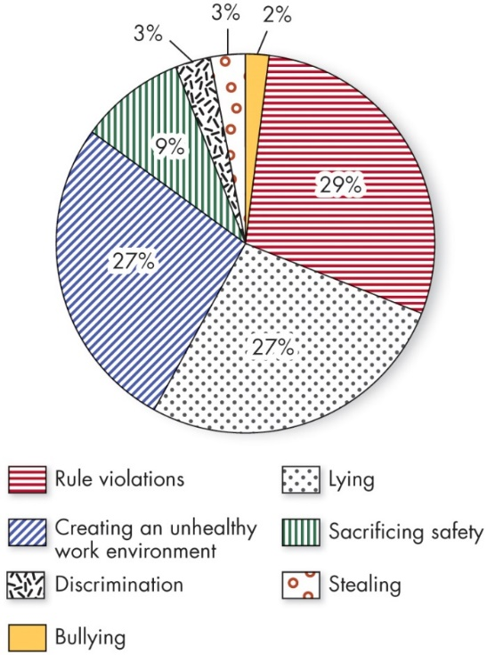
Show How Norms Exert Influence On an Individual’s Behavior (7 of 8)
OB POLL What Types of Workplace Deviance Are Most Common?
Source: Based on Z. Ivcevic, J. I. Menges, and A. Miller, “How Common Is Unethical Behavior in US Organizations?,” Harvard Business Review , March 20, 2020,
https://hbr.org/2020/03/how-common-is-unethical-behavior-in-u-s-organizations
Notes:
The OB Poll illustrates some of the most common forms of unethical, deviant behavior in organizations.
Long Description:
The data from the pie chart in the format types of workplace deviance: its percentage is as follows. Rule violations: 29 percent. Lying: 27 percent. Creating an unhealthy work environment: 27 percent. Sacrificing safety: 9 percent. Discrimination: 3 percent. Stealing: 3 percent. Bullying: 2 percent.

Slide 17
Show How Norms Exert Influence On an Individual’s Behavior (8 of 8)
Norms and Culture
Do people in collectivist cultures have different norms than people in individualist cultures? Of course they do.
But did you know that our orientation may be changed, even after years of living in one society.
Notes:
Do people in collectivist cultures have different norms than people in individualist cultures? Of course they do. But did you know that our orientation may be
changed, even after years of living in one society? In a recent experiment, an organizational role-playing exercise was given to a neutral group of subjects; the exercise stressed either collectivist or individualist norms. Subjects were then given a task of their personal choice or were assigned one by an ingroup or outgroup person. When the individualist-primed subjects were allowed personal choice of the task, or the collectivist-primed subjects were assigned the task by an ingroup person, they became more highly motivated.

Slide 18
Show How Status and Size Differences Affect Group Performance (1 of 3)
Status: a socially defined position or rank given to groups or group members by others.
Status characteristics theory: status is derived from one of three sources:
The power a person wields over others.
A person’s ability to contribute to a group’s goals.
An individual’s personal characteristics.
Notes:
Status is a socially defined position or rank given to groups or group members by others.
Status characteristics theory suggests that differences in status characteristics create status hierarchies within groups. Status is derived from one of three sources. First is the power a person wields over others. Second is a person’s ability to contribute to a group’s goals. And third is an individual’s personal characteristics.

Slide 19
Show How Status and Size Differences Affect Group Performance (2 of 3)
Status and Norms: high status individuals often have more freedom to deviate from norms.
Status and Group Interaction: high status people are often more assertive.
Status Inequity: perceived inequity creates disequilibrium and can lead to resentment and corrective behavior.
Notes:
Status and norms can influence behavior in organizations. High-status members of groups often are given more freedom to deviate from norms than other group members. High-status people also are better able to resist conformity pressures. This explains why many star athletes, famous actors, top-performing salespeople, and outstanding academics seem oblivious to appearance or social norms.

Slide 20
Show How Status and Size Differences Affect Group Performance (3 of 3)
Group size affects the group’s overall behavior.
Large groups are good for gaining diverse input.
Smaller groups are better doing something with input.
Social loafing: the tendency for individuals to expend less effort when working collectively than alone.
Notes:
The size of a group affects the group’s overall behavior, but the effect depends on the dependent variables. Large groups of a dozen or more members are good for gaining diverse input. Smaller groups of about seven members are better at doing something productive with that input.
One of the most important findings about the size of a group concerns social loafing, or the tendency for individuals to expend less effort when working collectively than alone.

Slide 21
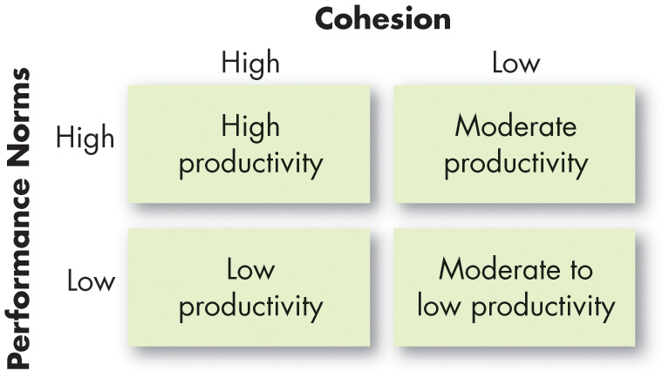
Cohesion and Group Effectiveness
Exhibit 9.4 Relationship Among Group Cohesion, Performance Norms, and Productivity
Notes:
Groups differ in their cohesiveness, or the degree to which members are attracted to each other and are motivated to stay in the group. Cohesiveness is important because it’s related to the group’s productivity. As shown here in Exhibit 9.4, the relationship of cohesiveness and productivity depends on the performance-related norms established by the group. If performance-related norms are high, a cohesive group will be more productive. If cohesiveness is high and performance norms are low, productivity will be low.
Encourage group cohesiveness by:
Making the group smaller
Encouraging agreement with group goals
Increasing the time members spend together
Increasing the status of the group and the perceived difficulty of attaining membership in the group
Stimulating competition with other groups
Giving rewards to the group rather than to individual members
Physically isolating the group
Long Description:
The table consists of four columns: effectiveness criteria, interacting, type of group brainstorming, and nominal. The row entries in the format effectiveness criteria: interacting, type of group brainstorming, nominal is as follows. Row 1. Number and quality of ideas: low, moderate, high. Row 2. Social pressure: high, low, moderate. Row 3. Money costs: low, low, low. Row 4. Speed: moderate, moderate, moderate. Row 5. Task orientation: low, high, high. Row 6. Potential for interpersonal conflict: high, low, moderate. Row 7. Commitment to solution: high, not applicable, moderate. Row 8. Development of group cohesiveness: high, high, moderate.

Slide 22
Group Decision Making (1 of 8)
Strengths of group decision making:
More complete information and knowledge
Increased diversity of views
Increased acceptance of solutions
Weaknesses of group decision making:
Time consuming
Conformity pressures
Dominance of a few members
Ambiguous responsibility
Notes:
Are group decisions better than those made by individuals alone? The strengths of group decision making include: more complete information and knowledge, increased diversity of views, and increased acceptance of a solution. The weaknesses of group decision making include: the fact that it’s more time consuming; there are conformity pressures; one or a few members can dominate group discussion; and responsibility can be ambiguous.

Slide 23
Group Decision Making (2 of 8)
Effectiveness and efficiency of group decisions:
Accuracy
Speed
Creativity
Acceptance
Notes:
Are groups more effective and efficient at making decisions than individuals? The answer depends on how effectiveness is defined.
Group decisions can be more accurate than the decisions of the average individual in the group, but less accurate than the judgments of the most accurate. Individuals are quicker at making decisions, but groups can be more creative and may be better at accepting the final solution.
In summary, groups offer an excellent vehicle for performing many of the steps in the decision-making process. They are a source of both breadth and depth of input for information gathering. When the final solution is agreed upon, there are more people in a group decision to support and implement it. Group decisions consume time, create internal conflicts, and generate pressures toward conformity.

Slide 24
Group Decision Making (3 of 8)
Groupthink: situations in which group pressures for conformity deter the group from critically appraising unusual, minority, or unpopular views.
Groupshift: a change between a group’s decision and an individual decision that a member within the group would make.
Notes:
Groupthink is related to norms and affects decision making. It describes situations in which group pressures for conformity deter the group from critically appraising unusual, minority, or unpopular views.
Groupshift, also known as group polarization, describes the way of discussing a given set of alternatives and arriving at a solution whereby group members tend to exaggerate the initial positions they hold. Groups generally shift toward a more extreme version of the group’s original position.

Slide 25
Group Decision Making (4 of 8)
Most group decision making takes place in interacting groups.
Members meet face-to-face and rely on both verbal and nonverbal interaction to communicate with each other.
Interacting groups often censor themselves and pressure individual members toward conformity of opinion.
Notes:
Most group decision making takes place in interacting groups. In these groups, members meet face-to-face and rely on both verbal and nonverbal interaction to communicate with each other. Interacting groups often censor themselves and pressure individual members toward conformity of opinion.

Slide 26
Group Decision Making (5 of 8)
Brainstorming can overcome pressures for conformity.
In a brainstorming session:
The group leader states the problem.
Members then “free-wheel” as many alternatives as they can.
No criticism is allowed.
One idea stimulates others, and group members are encouraged to “think the unusual.”
Notes:
Brainstorming and the nominal group technique (discussed in the next slide) can reduce problems inherent in the traditional interacting group. Brainstorming is meant to overcome pressures for conformity in the interacting group that dampens the development of creative alternatives. In a typical brainstorming session, a half dozen to a dozen people sit around a table, the group leader states the problem clearly, and members then “free-wheel” as many alternatives as they can in a given length of time. No criticism is allowed, and all the alternatives are recorded for later discussion and analysis. One idea stimulates others, and group members are encouraged to “think the unusual.”

Slide 27
Group Decision Making (6 of 8)
The nominal group technique: restricts discussion or interpersonal communication during the decision making process.
Group members are all physically present, but members operate independently.
Permits the group to meet formally but does not restrict independent thinking, as does the interacting group.
Nominal groups outperform brainstorming groups.
Notes:
The nominal group technique is different. It restricts discussion or interpersonal communication during the decision-making process. Group members are all physically present, but members operate independently.
The chief advantage of the nominal group technique is that it permits the group to meet formally but does not restrict independent thinking, as does the interacting group.
Research shows that the nominal group is generally more effective than the brainstorming group.

Slide 28
Group Decision Making (7 of 8)
Steps for a nominal group:
Each member independently writes down their ideas on the problem.
After this silent period, each member presents one idea to the group.
The ideas are discussed for clarity.
Each group member rank-orders the ideas.
The idea with the highest aggregate ranking determines the final decision.
Notes:
Here are the steps in the nominal group technique. First, a problem is presented, and then each member independently writes down their ideas on the problem. After this silent period, each member presents one idea to the group. Each member takes his or her turn. The group now discusses the ideas for clarity and evaluates them. Each group member silently and independently rank-orders the ideas. The idea with the highest aggregate ranking determines the final decision.

Slide 29
Group Decision Making (8 of 8)
Exhibit 9.5 Evaluating Group Effectiveness
Effectiveness Criteria | Interacting | Type of Group Brainstorming | Nominal
Number and quality of ideas | Low | Moderate | High
Social pressure | High | Low | Moderate
Money costs | Low | Low | Low
Speed | Moderate | Moderate | Moderate
Task orientation | Low | High | High
Potential for interpersonal conflict | High | Low | Moderate
Commitment to solution | High | Not applicable | Moderate
Development of group cohesiveness | High | High | Moderate
Notes:
Exhibit 9.5 shows that each of the group-decision techniques has its own set of strengths and weaknesses. The choice depends on what criteria you want to emphasize and the cost-benefit trade-off.

Slide 30
Implications for Managers (1 of 4)
How can you expect group members to contribute toward or act as a part of the group if they do not identify with the group? Managers would do well to promote group members’ identification and manage identity threats while at the same time avoiding biased ingroup favoritism.
When forming new work groups, try to consider and anticipate the “group life cycle” and the phases groups move through. Groups rarely are immediately effective without careful placement, training, and onboarding. Recognizing the current stage of any given group can help managers provide the support and assistance they need to aid the group and address any problems that arise.
Notes:
How can you expect group members to contribute toward or act as a part of the group if they do not identify with the group? Managers would do well to promote group members’ identification and manage identity threats while at the same time avoiding biased ingroup favoritism.
When forming new work groups, try to consider and anticipate the “group life cycle” and the phases groups move through. Groups rarely are immediately effective without careful placement, training, and onboarding. Recognizing the current stage of any given group can help managers provide the support and assistance they need to aid the group and address any problems that arise.

Slide 31
Implications for Managers (2 of 4)
Role clarity through aligned role expectations and perceptions is essential for group members to understand what is expected of them.
Managers should establish clear psychological contracts within groups, fulfill their part of the contract, and rebuild trust when it is broken.
When experiencing role conflict, try to be creative in how you approach it. Often when you are able to adapt there are creative solutions that enable both roles to be fulfilled. Also, for employees experiencing role conflict, management support and resources can help balance competing demands.
Notes:
In addition:
Role clarity through aligned role expectations and perceptions is essential for group members to understand what is expected of them.
Managers should establish clear psychological contracts within groups, fulfill their part of the contract, and rebuild trust when it is broken.
When experiencing role conflict, try to be creative in how you approach it. Often when you are able to adapt there are creative solutions that enable both roles to be fulfilled. Also, for employees experiencing role conflict, management support and resources can help balance competing demands.

Slide 32
Implications for Managers (3 of 4)
Norms can have a powerful influence on behavior in organizations, and sometimes we are not even aware of them (or that they are directing behavior). Try to keep a pulse on norms in your work group (and the example you are setting).
Managers should be mindful of status differences in their work groups. They should establish checks and balances so leaders do not justify unethical behavior or unethically try to maintain their status. They should actively encourage lower-status members to contribute and provide a psychologically safe environment for them to voice their ideas, thoughts, and concerns.
Notes:
In addition:
Role clarity through aligned role expectations and perceptions is essential for Norms can have a powerful influence on behavior in organizations, and sometimes we are not even aware of them (or that they are directing behavior). Try to keep a pulse on norms in your work group (and the example you are setting).
Managers should be mindful of status differences in their work groups. They should establish checks and balances so leaders do not justify unethical behavior or unethically try to maintain their status. They should actively encourage lower-status members to contribute and provide a psychologically safe environment for them to voice their ideas, thoughts, and concerns.

Slide 33
Implications for Managers (4 of 4)
Design work groups of the appropriate size for the group’s function to avoid social loafing.
Consider building your work group’s cohesion to reduce turnover and increase the group’s effectiveness.
Some decisions are better left to individuals. But if the group must make the decision collaboratively, the group should strive to avoid groupthink and groupshift, encourage open communication among members, and take on a structured approach to fulfill its purpose (e.g., nominal group technique).
Notes:
Finally:
Design work groups of the appropriate size for the group’s function to avoid social loafing.
Consider building your work group’s cohesion to reduce turnover and increase the group’s effectiveness.
Some decisions are better left to individuals. But if the group must make the decision collaboratively, the group should strive to avoid groupthink and groupshift, encourage open communication among members, and take on a structured approach to fulfill its purpose (e.g., nominal group technique).

Slide 34
Discussion Questions
Have you experienced groupthink or groupshift situations in any of the student organizations in which you participate? How has it affected the organization’s goals?
Imagine that you’ve been asked to participate in a group where you know social loafing has been a problem. How would you address the issue?
Discuss interrole conflict as it applies to student athletes. How do their demands for practice and competition conflict with demands from professors and other academic entities?

Slide 35

Copyright
This work is protected by United States copyright laws and is provided solely for the use of instructors in teaching their courses and assessing student learning. Dissemination or sale of any part of this work (including on the World Wide Web) will destroy the integrity of the work and is not permitted. The work and materials from it should never be made available to students except by instructors using the accompanying text in their classes. All recipients of this work are expected to abide by these restrictions and to honor the intended pedagogical purposes and the needs of other instructors who rely on these materials.

