Slide 1


Organizational Behavior
Nineteenth Edition
Chapter 13
Power and Politics
Copyright © 2023, 2019, 2017 Pearson Education, Inc. All Rights Reserved
Notes:
If this PowerPoint presentation contains mathematical equations, you may need to check that your computer has the following installed:
1) MathType Plugin
2) Math Player (free versions available)
3) NVDA Reader (free versions available)
Welcome to this Organizational Behavior course that uses the 19th edition of the textbook, Organizational Behavior by Robbins and Judge. This is considered among the most widely used OB textbooks in the world. Robbins and Judge are recognized as definitive aggregators of OB concepts, applications, and practices. The course and this book will provide you with a resource that will benefit you throughout your degree program and your professional life.

Slide 2
Learning Objectives (1 of 2)
13.1 Contrast leadership and power.
13.2 Explain the three bases of formal power and the two bases of personal power.
13.3 Explain the role of dependence in power relationships.
13.4 Identify influence tactics and their contingencies.
Notes:
After studying this chapter, you should be able to:
Contrast leadership and power.
Explain the three bases of formal power and the two bases of personal power.
Explain the role of dependence in power relationships.
Identify influence tactics and their contingencies.

Slide 3
Learning Objectives (2 of 2)
13.5 Identify the causes and consequences of abuse of power.
13.6 Describe how politics work in organizations.
13.7 Identify the causes, consequences, and ethics of political behavior.
Notes:
Additional objectives for this chapter.
Identify the causes and consequences of abuse of power.
Describe how politics work in organizations.
Identify the causes, consequences, and ethics of political behavior.

Slide 4
Contrast Leadership and Power (1 of 2)
Power refers to the capacity, discretion, and means to enforce one’s will over others.
Power may exist but not be used.
Probably the most important aspect of power is that it is a function of dependence.
A person can have power over you only if he or she controls something you desire.
Notes:
Power refers to a capacity, discretion, and means to enforce one’s will over others. Power may exist but not be used. It is, therefore, a capacity or potential. Probably the most important aspect of power is that it is a function of dependence. The more people rely or depend upon the powerful person—who controls something the others rely on or want—the more powerful that person becomes. When people begin to have more alternatives and options or begin to rely on themselves or different people, the powerful person loses power.

Slide 5
Contrast Leadership and Power (2 of 2)
Leadership and power:
Goal compatibility
Power does not require goal compatibility, merely dependence.
The direction of influence
Leadership focuses on the downward influence on one’s followers.
Notes:
What is the relationship between leadership and power? Power doesn’t require goal compatibility, just dependence. In contrast, leadership requires some congruence between the goals of the leader and those being led. The direction of influence for leaders is downward.

Slide 6
Explain Formal Power and Personal Power (1 of 2)
Formal Power
Coercive Power
Reward Power
Legitimate Power
Personal Power
Expert Power
Referent Power
Notes:
We can divide power into two general groupings: formal and personal.
Formal power is based on an individual’s position in an organization. There are three types of formal power: coercive, reward, and legitimate. Coercive power depends on fear of negative results from failing to comply or acting in a way that would anger the power-holder. Coercive power comes also from withholding key information. People in an organization who have data or knowledge others need can make others dependent on them.
Reward power is the opposite of coercive power. People comply because doing so produces positive benefits; therefore, one who can distribute rewards that others view as valuable will have power over those others. These rewards can be either financial—such as controlling pay rates, raises, and bonuses—or nonfinancial, including recognition, promotions, interesting work assignments, friendly colleagues, and preferred work shifts or sales territories.
Legitimate power is shown in formal groups and organizations through one’s structural position. It represents the power a person receives as a result of his or her position in the formal hierarchy. Legitimate power is broader than the power to coerce and reward. It includes acceptance of the authority of a position by members of an organization.
The second group of power—personal power—comes from an individual’s unique characteristics and includes expert power and referent power.
Expert power is influence wielded as a result of expertise, special skill, or knowledge. As jobs become more specialized, we become increasingly dependent on experts to achieve goals. Referent power is based on identification with a person who has desirable resources or personal traits. If I admire and identify with you, you can exercise power over me because I want to please you. Referent power develops out of admiration of another and a desire to be like that person; it is a lot like charisma. It also explains why celebrities are paid millions of dollars to endorse products in commercials. Some people who are not in formal leadership positions nonetheless have referent power and exert influence over others because of their charismatic dynamism, likability, and emotional effects on us.

Slide 7
Explain Formal Power and Personal Power (2 of 2)
Which Bases of Power Are Most Effective?
It’s complicated!
Different bases of power are effective depending upon the perceptions and characteristics of the dependent.
Referent power can be an especially powerful motivator.
Notes:
Which bases of power are most effective? This is a complicated question. Regarding the dependents in the power relationship, different bases of power are effective depending upon the perceptions and characteristics of the dependent. For example, dependents view angry leaders as higher on formal power, and in turn are more loyal toward these leaders and perceive them as more effective. On the other hand, dependents are likely to perceive coercive and low-referent leaders as ineffective, become less loyal toward these leaders, and even engage in deviant behaviors directed at these leaders. It does appear though, that referent power can be an especially powerful motivator.

Slide 8
Explain the Role of Dependence in Power Relationships (1 of 5)
The General Dependence Postulate
When you possess anything others require but that you alone control, you make them dependent upon you and, therefore, you gain power over them.
Dependence, then, is inversely proportional to the alternative sources of supply.
Notes:
The general dependency postulate says the greater B’s dependency on A, the greater the power A has over B. When you possess anything that others require but that you alone control, you make them dependent upon you and, therefore, you gain power over them. Dependency, then, is inversely proportional to the alternative sources of supply. This is why most organizations develop multiple suppliers rather than using just one. It also explains why so many of us aspire to financial independence.

Slide 9
Explain the Role of Dependence in Power Relationships (2 of 5)
What Creates Dependence?
Importance
Scarcity
Nonsubstitutability
Notes:
What creates dependence? To create dependence, the thing(s) you control must be perceived as being important. However, note that there are many degrees of importance, from needing the resource for survival to wanting a resource that is in fashion or adds to convenience.
A resource also needs to be perceived as scarce to create dependence. The scarcity–dependency relationship can further be seen in the power of occupational categories. Individuals in occupations in which the supply of personnel is low relative to demand can negotiate compensation and benefit packages far more attractive than can those in occupations where there is an abundance of candidates.
Nonsubstitutability means the fewer viable substitutes for a resource, the more power control that resource provides.

Slide 10
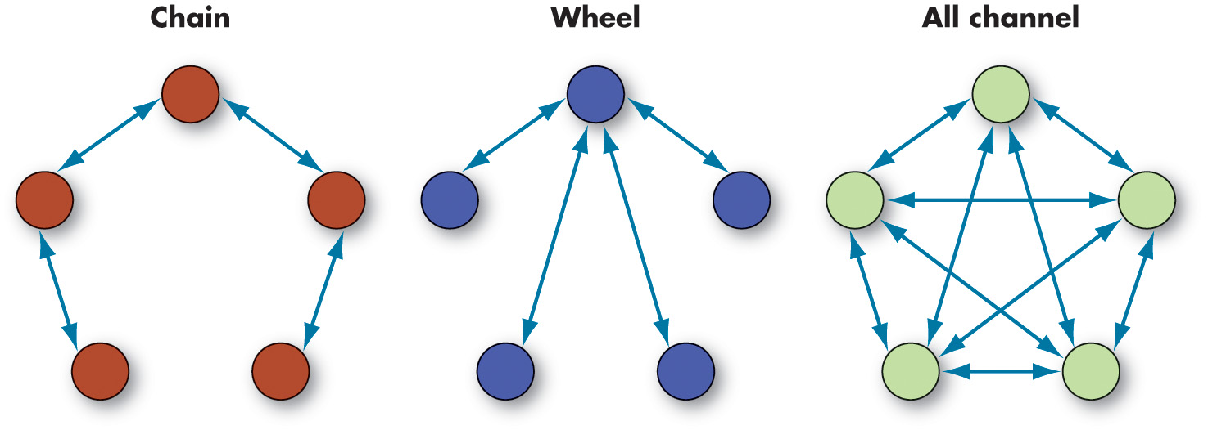
Explain the Role of Dependence in Power Relationships (3 of 5)
Exhibit 13.1 Three Common Small-Group Networks
Notes:
Formal organizational networks can be complicated, including hundreds of people and a half dozen or more hierarchical levels. However, they have substantial implications for power and influence in organizations, as information flows through networks.
As shown in Exhibit 13.1, we have condensed these networks into three common small groups of five people each: chain, wheel, and all-channel. The chain rigidly follows the formal chain of command; this network approximates the communication channels you might find in a rigid three-level organization. The wheel relies on a central figure to act as the conduit for all group communication; it simulates the communication network you might find in a work group directed by a manager. The manager’s central role, especially in larger work groups, enables them to enjoy access to diverse ideas and knowledge, support, and higher power and status. The all-channel network permits group members to actively communicate with each other; it is most often characterized by self-managed teams, in which group members are free to contribute and no single person takes on a leadership role. Many organizations today like to aspire toward the all-channel network, meaning that anyone can communicate with anyone.
Long Description:
Chain consists of 5 people. Among them, two people communicate to each other.
Wheel relies on a central figure to act as the conduit for all group communication.
The all-channel network permits group members to actively communicate with each other.

Slide 11
Explain the Role of Dependence in Power Relationships (4 of 5)
Exhibit 13.2 Small-Group Networks and Effectiveness Criteria
Criteria | Chain | Networks Wheel | All-Channel
Speed | Moderate | Fast | Fast
Accuracy | High | High | Moderate
Emergence of a leader | Moderate | High | None
Member satisfaction | Moderate | Low | High
Notes:
As Exhibit 13.2 demonstrates, the effectiveness of each network is determined by the outcome you are interested in.

Slide 12
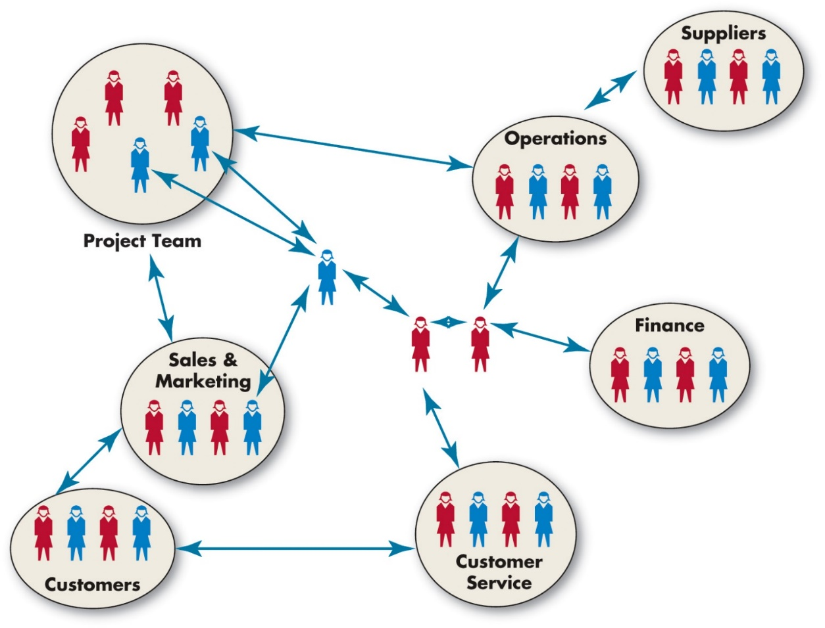
Explain the Role of Dependence in Power Relationships (5 of 5)
Exhibit 13.3 An Organizational Sociogram
Notes:
One tool to assess the exchange of resources and dependencies within an organization is social network analysis. This method examines patterns of communication among organizational members to identify how information flows between them.
Within a social network, or connections between people who share professional interests, each individual or group is called a node, and the links between nodes are called ties. When nodes communicate or exchange resources frequently, they are said to have very strong ties.
Exhibit 13.3 shows a graphical illustration of the associations among individuals in a social network, called a sociogram. It functions like an informal version of an organization chart. The difference is that a formal organization chart shows how authority is supposed to flow, whereas a sociogram shows how resources really flow in an organization.
Networks can create substantial power dynamics such as enforcing norms or creating change within an organization. So, employees who have many connections to an organizational social network are less likely to engage in corruption. Those in the position of brokers tend to have more power because they can leverage the unique resources they can acquire from different groups. In other words, many people are dependent upon brokers, which gives the brokers more power.
There are many ways to implement a social network analysis in an organization. Some organizations keep track of the flow of e-mail communications or document sharing across departments. Other organizations look at data from human resources information systems, analyzing how supervisors and subordinates interact with one another.
Long Description:
Groups of people named project team, sales and marketing, customers, customer service, finance, operations and suppliers, interact with each other. Individuals are also involves in this interactions.

Slide 13
Identify Influence Tactics and Their Contingencies (1 of 5)
Influence tactics:
Legitimacy
Rational persuasion
Inspirational appeals
Consultation
Exchange
Personal appeals
Ingratiation
Pressure
Coalitions
Notes:
Research has identified nine distinct influence tactics:
First is legitimacy: relying on your authority position or saying a request accords with organizational policies or rules.
Second is rational persuasion: presenting logical arguments and factual evidence to demonstrate a request is reasonable.
Third is inspirational appeals: developing emotional commitment by appealing to a target’s values, needs, hopes, and aspirations.
Fourth is consultation: increasing the target’s support by involving him or her in deciding how you will accomplish your plan.
Fifth is exchange: rewarding the target with benefits or favors in exchange for following a request.
Sixth is personal appeals: asking for compliance based on friendship or loyalty.
Seventh is ingratiation: using flattery, praise, or friendly behavior prior to making a request.
Eighth is pressure: using warnings, repeated demands, and threats.
Ninth is coalitions: enlisting the aid or support of others to persuade the target to agree.

Slide 14
Identify Influence Tactics and Their Contingencies (2 of 5)
Some tactics are more effective than others.
Rational persuasion, inspirational appeals, and consultation are equally effective in influencing performance at work.
Pressure tends to backfire.
Using ingratiation can improve relational outcomes of influence at work.
Notes:
Some tactics are more effective than others. Rational persuasion, inspirational appeals, and consultation tend to be equally effective in influencing performance at work. Rational persuasion, although still effective at helping build relationships at work, tends to not be as superbly effective as inspirational appeal and consultation. The pressure tactic tends to backfire and is typically the least effective. Using ingratiation can improve relational outcomes of influence at work, for example, during job interviews, but perhaps only when the audience does not really care about the outcome of the request or if it is routine.

Slide 15
Identify Influence Tactics and Their Contingencies (3 of 5)
Exhibit 13.4 Preferred Influence Tactics by Influence Direction
Upward Influence | Downward Influence | Lateral Influence
Rational persuasion | Rational persuasion Inspirational appeals Ingratiation Legitimacy | Rational persuasion Consultation Ingratiation Exchange Legitimacy Personal appeals Coalitions
Notes:
As Exhibit 13.4 shows, rational persuasion is the only tactic effective across organizational levels. Inspirational appeals work best as a downward influencing tactic with subordinates.

Slide 16
Identify Influence Tactics and Their Contingencies (4 of 5)
Automatic and Controlled Processing of Influence
Automatic processing: a relatively superficial consideration of evidence and information that takes little time or effort and makes use of heuristics.
Controlled processing: a detailed consideration of evidence and information relying on facts, figures, and logic.
Need for cognition: a personality trait of individuals depicting the ongoing desire to think and learn.
Notes:
We often rely on automatic processing, a relatively superficial consideration of evidence and information that takes little time or effort, making use of heuristics like those we discussed in the chapter on perception and decision making. Automatic processing can lead people to jump to conclusions about others that would normally, after careful thought, cause someone to be more skeptical or critical.
In contrast, controlled processing involves a detailed consideration of evidence and information relying on facts, figures, and logic. Controlled processing requires effort and energy, but it is harder to fool someone who has taken the time and effort to engage in it.
So, what makes someone engage in either shallow or deep processing? Some research suggests that a motivational trait, need for cognition, predicts the tendency to engage in controlled processing. These individuals are more likely to be persuaded by evidence and facts and are more likely to evaluate arguments carefully and critically before coming to a conclusion. Those who are lower in their need for cognition are more likely to use automatic processing strategies, relying on intuition and emotion to guide their evaluation of persuasive messages.

Slide 17
Identify Influence Tactics and Their Contingencies (5 of 5)
Applying Influence Tactics
People differ in terms of their political skill: their ability to influence others to enhance their own objectives.
The politically skilled are more effective users of all the influence tactics.
Cultures within organizations differ markedly: some are warm, relaxed, and supportive; others are formal and conservative.
People who fit the culture of the organization tend to obtain more influence.
Notes:
People differ in terms of their political skill—their ability to influence others to enhance their own objectives. The politically skilled are more effective users of all influence tactics, leading to many positive outcomes in the workplace. People who are politically skilled have higher self-efficacy, job satisfaction, work productivity, and career success. They are less likely to be victims of workplace aggression. Political skill also appears more effective when the stakes are high.
Finally, the politically skilled are able to exert their influence without others detecting it, a key element in effectiveness.
Also, we know that cultures within organizations differ markedly: some are warm, relaxed, and supportive; others are formal and conservative. Some cultures encourage participation and consultation, some encourage reason, and still others rely on pressure. People who fit the culture of the organization tend to obtain more influence. Specifically, extroverts tend to be more influential in team-oriented organizations, and highly conscientious people are more influential in organizations that value working alone on technical tasks. Part of the reason people who fit the culture are influential is that they are able to perform especially well in the domains deemed most important for success. In other words, they are influential because they are competent. So the organization itself will influence which subset of power tactics is viewed as acceptable for use.

Slide 18
Causes and Consequences of Abuse of Power (1 of 4)
Does power corrupt?
Power leads people to:
Place their own interests ahead of others.
React, especially negatively, to any threats to their competence.
See people as tools to obtain their instrumental goals.
Be more willing to denigrate others.
Be overconfident in decision making.
Notes:
Does power corrupt? Evidence suggests that power leads people to place their own interests ahead of others. Powerful people react—especially negatively—to any threats to their competence. Power also appears to lead individuals to “objectify” others—to see them as tools to obtain their instrumental goals—and to see relationships as more peripheral. People in power are more willing to denigrate others. Power also leads to overconfident decision making.
People do not necessarily hold on to power forever. Power can be systematically maintained over time, or it can be lost.

Slide 19
Causes and Consequences of Abuse of Power (2 of 4)
Sexual harassment: any unwanted activity of a sexual nature that affects an individual’s employment and creates a hostile work environment.
Sexual harassment is more likely to occur when there are large power differentials.
Managers have a responsibility to protect their employees from a hostile work environment.
Notes:
Sexual harassment is defined as any unwanted activity of a sexual nature that affects an individual’s employment and creates a hostile work environment.
Most studies confirm that the concept of power is central to understanding sexual harassment. Sexual harassment is more likely to occur when there are large power differentials.
The bottom line is that managers have a responsibility to protect their employees from a hostile work environment.

Slide 20
Causes and Consequences of Abuse of Power (3 of 4)
Mangers should:
Make sure an active policy defines what constitutes sexual harassment, informs employees they can be fired for sexually harassing another employee, and establishes procedures for how complaints can be made.
Reassure employees that they will not encounter retaliation if they issue a complaint.
Notes:
The following are some ways managers can protect themselves and their employees from sexual harassment:
Make sure an active policy defines what constitutes sexual harassment, informs employees they can be fired for sexually harassing another employee, and establishes procedures for how complaints can be made.
Reassure employees that they will not encounter retaliation if they issue a complaint.

Slide 21
Causes and Consequences of Abuse of Power (4 of 4)
In addition, managers should:
Investigate every complaint and include the legal and human resource departments.
Make sure offenders are disciplined or terminated.
Set up in-house seminars to raise employee awareness of the issues surrounding sexual harassment.
Notes:
Managers also need to:
Investigate every complaint and include the legal and human resource departments.
Make sure offenders are disciplined or terminated.
Set up in-house seminars to raise employee awareness of the issues surrounding sexual harassment.

Slide 22
Describe How Politics Work in Organizations (1 of 3)
Political behavior: activities that are not required as part of one’s formal role in the organization, but that influence the distribution of advantages within the organization.
Outside of one’s specified job requirements.
Encompasses efforts to influence decision-making goals, criteria, or processes.
Includes such behaviors as withholding information, whistle-blowing, spreading rumors, and leaking confidential information.
Notes:
Political behavior is defined as those activities that are not required as part of one’s formal role in the organization, but that influence, or attempt to influence, the distribution of advantages and disadvantages within the organization. This definition encompasses key elements. Political behavior is outside one’s specified job requirements. It encompasses efforts to influence the goals, criteria, or processes used for decision making. It includes such varied political behaviors as withholding key information from decision makers, whistle-blowing, spreading rumors, and leaking confidential information.

Slide 23
Describe How Politics Work in Organizations (2 of 3)
The reality of politics
People view politics differently
Reactive
Reluctant
Strategic
Integrated perception
Notes:
Research has demonstrated that there are multiple ways people construe politics: (1) some are reactive, believing that it involves engaging in destructive and manipulative behavior; some are (2) reluctant, viewing it as a necessary evil; still others are (3) strategic and view politics as a useful way of getting things done; and finally, some have more of an (4) integrated perception, viewing politics as central to the reality of decision making.
Interviews with experienced managers show that most believe political behavior is a major part of organizational life. Many managers report some use of political behavior is ethical if it does not directly harm anyone else. They describe politics as necessary and believe someone who never uses political behavior will have a hard time getting things done.

Slide 24
Describe How Politics Work in Organizations (3 of 3)
Grapevine: an organization’s informal communication network.
The grapevine and gossip are viewed negatively by most people.
Notes:
The informal communication network in a group or organization is called the grapevine.
Typically, the grapevine and gossip are viewed negatively by most people. Indeed, research shows that untrustworthy gossip can cause people to unfairly judge and dislike others.
Overall, the grapevine is a mixed blessing, leading to positive performance because of the sense of social pressure it produces while also undermining employee well-being.
Furthermore, rumors and gossip transmitted through the grapevine may play an important role in transmitting information, exercising political will, and navigating the hierarchy.

Slide 25
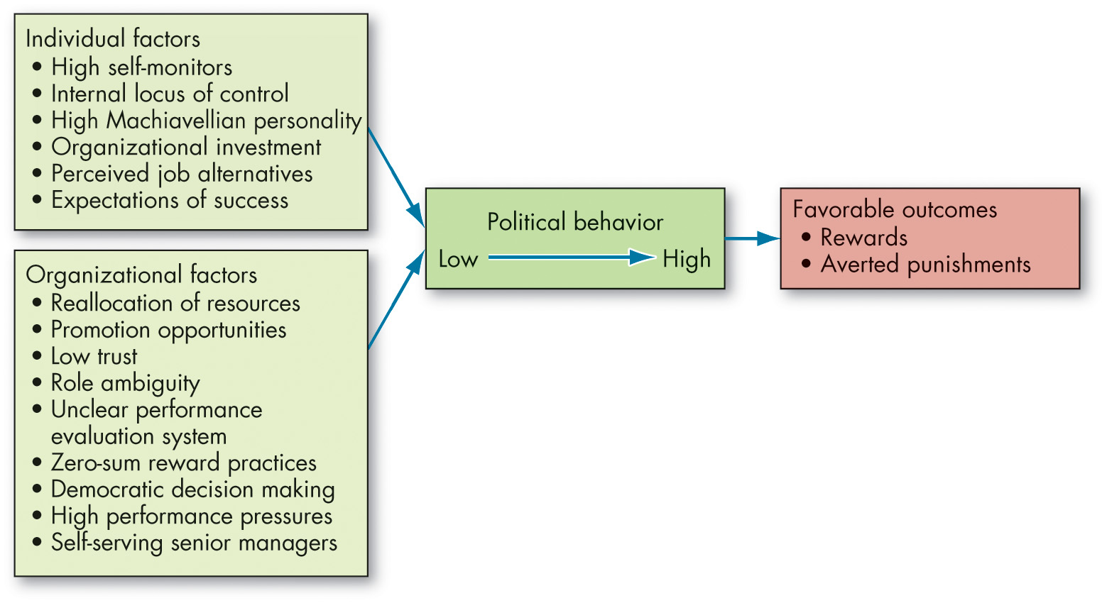
Causes and Consequences of Political Behavior (1 of 14)
Exhibit 13.5 Factors That Influence Political Behavior
Notes:
Now that we have discussed the constant presence of politics in organizations, let us discuss the causes and consequences of these behaviors.
Factors contributing to political behavior, as shown here in Exhibit 13.5, include individual factors. Researchers have identified certain personality traits, needs, and other factors that are likely to be related to political behavior. Employees who are high self-monitors, possess an internal locus of control, and have a high need for power are more likely to engage in political behavior. The high self-monitor is more sensitive to social cues and is more likely to be skilled in political behavior than the low self-monitor. Individuals with an internal locus of control are more prone to take a proactive stance and attempt to manipulate situations in their favor. The Machiavellian personality is comfortable using politics as a means to further his/her self-interest. An individual’s investment in the organization, perceived alternatives, and expectations of success will also influence the tendency to pursue illegitimate means of political action.
The organizational factors that influence politics are many. Political activity is probably more a function of the organization’s characteristics than of individual difference variables. When an organization’s resources are declining, when the existing pattern of resources is changing, and when there is opportunity for promotions, politics is more likely to surface. Cultures characterized by low trust, role ambiguity, unclear performance evaluation systems, zero-sum reward allocation practices, democratic decision making, high pressures for performance, and self-serving senior managers will create breeding grounds for politicking. When organizations downsize to improve efficiency, people may engage in political actions to safeguard what they have. Promotion decisions have consistently been found to be one of the most political in organizations.
Long Description:
The flowchart flows from left to right.
The individual factors are high self-monitors, internal locus of control, high Machiavellian personality, organizational investment, perceives job alternatives, and expectations of success.
The organizational factors are reallocation of resources, promotion opportunities, low trust, role ambiguity, unclear performance evaluation system, zero-sum reward practices, democratic decision making, high performance pressures, and self-serving senior managers.
Political behavior flow from left to right.
Rewards and averted punishments are the favorable outcomes.

Slide 26
Causes and Consequences of Political Behavior (2 of 14)
Factors Contributing to Political Behavior Acquiescence
Reciprocity
Consistency/commitment
Social proof
Liking
Authority
Scarcity
Unity
Notes:
In many ways, political behavior is a very interpersonal phenomenon. It involves interaction between two or more people, with one or more of these people attempting to influence the others to do something. Professor Robert Cialdini has devoted much of his career to identifying the social forces behind how people can be influenced.
Many of these may seem familiar to you—indeed, they are common social forces that have a substantial impact on behavior in organizations.
• Reciprocity: People are motivated to give back to others who have done something for them.
• Consistency/commitment: People are motivated to remain consistent with and committed toward decisions or choices they have already made.
• Social proof: People look to others for proof, verification, and validation that they have acted in the right way.
• Liking: People who like one another tend to agree with one another. • Authority: People are more likely to say yes to requests from power-holders.
• Scarcity: People want more of what is not as available or that which is becoming less available.
• Unity: The newest principle of persuasion: People are most influenced by those with whom they identify.

Slide 27
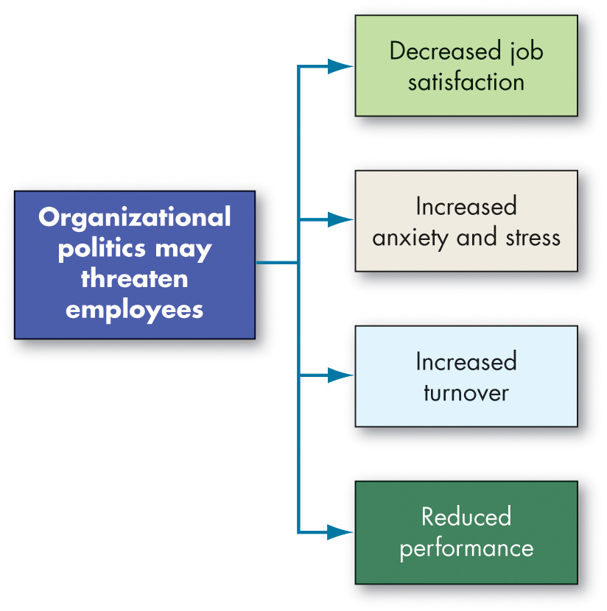
Causes and Consequences of Political Behavior (3 of 14)
Exhibit 13.6 Employee Responses to Organizational Politics
Notes:
How do people in general react to organizational politics? Let’s look at the evidence.
In general, most people view politics in one of four ways: (1) as destructive and manipulative, (2) as a necessary evil, (3) as a useful strategy to get things done, and (4) as an immutable aspect of organizational life.
Regardless, for most people who are unwilling to play the politics game, outcomes tend to be predominantly negative. See Exhibit 13.6 for a diagram of this situation, illustrating how politics lead to decreased job satisfaction, increased anxiety and stress, increased turnover, and reduced performance.

Slide 28
Causes and Consequences of Political Behavior (4 of 14)
Exhibit 13.7 Defensive Behaviors
Avoiding Action
Overconforming. Strictly interpreting your responsibility by saying things like “The rules clearly state...”or “This is the way we’ve always done it.”
Buck passing. Transferring responsibility for the execution of a task or decision to someone else.
Playing dumb. Avoiding an unwanted task by falsely pleading ignorance or inability.
Stretching. Prolonging a task so that one person appears to be occupied—for example, turning a two-week task into a 4-month job.
Stalling. Appearing to be more or less supportive publicly while doing little or nothing privately.
Notes:
When employees see politics as a threat, they often respond with defensive behaviors—reactive and protective behaviors to avoid action, blame, or change. Exhibit 13.7 provides some examples of these behaviors. Defensive behaviors are often associated with negative feelings toward the job and work environment. In the short run, employees may find that defensiveness protects their self-interest, but in the long run it wears them down. People who consistently rely on defensiveness find that, eventually, it is the only way they know how to behave. At that point, they lose the trust and support of their peers, bosses, employees, and clients.

Slide 29
Causes and Consequences of Political Behavior (5 of 14)
Avoiding Blame
Bluffing. Rigorously documenting activity to project an image of competence and thoroughness, known as “covering your rear.”
Playing safe. Evading situations that may reflect unfavorably. It includes taking on only projects with a high probability of success, having risky decisions approved by superiors, qualifying expressions of judgment, and taking neutral positions in conflicts.
Justifying. Developing explanations that lessen one’s responsibility for a negative outcome and/or apologizing to demonstrate remorse, or both.
Scapegoating. Placing the blame for a negative outcome on external factors that are not entirely blameworthy.
Misrepresenting. Manipulation of information by distortion, embellishment, deception, selective presentation, or obfuscation.

Slide 30
Causes and Consequences of Political Behavior (6 of 14)
Avoiding Change
Prevention. Trying to prevent a threatening change from occurring.
Self-protection. Acting in ways to protect one’s self-interest during change by guarding information or other resources.

Slide 31
Causes and Consequences of Political Behavior (7 of 14)
Voice and silence
Voice: informal, discretionary communication of suggestions, concerns, or opinions about work-related issues to people who might be able to take appropriate action.
Silence: involves the discretionary withholding of suggestions, concerns, or opinions about work-related issues from those who might be able to do something about it.
Notes:
By definition, voice is a form of influence— it challenges the status quo, supports others’ viewpoints, adds constructively, or is defensive or destructive. It also reaffirms the employee experience—by giving voice to others, is space for people to share their concerns and ideas in a way that contributes to the organization and crafts a fair, equitable work environment.
It is easy to ignore silence because it is defined by the absence of influence. However, this is often a mistake—silence itself can be a form of influence, communicating noninterest, the inability to deal with a topic, or a desire to cooperate smoothly without interruption.

Slide 32
Causes and Consequences of Political Behavior (8 of 14)
Exhibit 13.8 Impression Management (I M) Techniques
Conformity
Agreeing with someone else’s opinion to gain their approval is a form of ingratiation.
Example: A manager tells their supervisor, “You’re absolutely right on your reorganization plan for the western regional office. I couldn’t agree with you more.”
Favors
Doing something nice for someone to gain that person’ s approval is a form of ingratiation.
Example: A salesperson says to a prospective client, “I’ve got two tickets to the theater tonight that I can’t use. Take them. Consider it a thank-you for taking the time to talk with me.”
Notes:
We know that people have an ongoing interest in how others perceive and evaluate them. Being perceived positively by others should have benefits for people in organizations. The process by which individuals attempt to control the impression others form of them is called impression management (IM).
Exhibit 13.8 shows IM techniques.

Slide 33
Causes and Consequences of Political Behavior (9 of 14)
Excuses
Explaining a predicament-creating event aimed at minimizing the apparent severity of the predicament is a defensive IM technique.
Example: A sales manager says to their supervisor, “We failed to get the ad in the paper on time, but no one responds to those ads anyway.”
Apologies
Admitting responsibility for an undesirable event and simultaneously seeking to get a pardon for the action is a defensive IM technique.
Example: An employee says to their supervisor, “I’m sorry I made a mistake on the report. Please forgive me.”

Slide 34
Causes and Consequences of Political Behavior (10 of 14)
Self-Promotion
Highlighting your best qualities, downplaying your deficits, and calling attention to your achievements is a self-focused IM technique.
Example: A salesperson tells their supervisor, “Micah worked unsuccessfully for three years to try to get that account. I sewed it up in six weeks. I’m the best closer this company has.”
Enhancement
Claiming that something you did is more valuable than most other members of the organizations would think is a self-focused IM technique.
Example: A journalist tells their editor, “My work on this celebrity divorce story was really a major boost to our sales” (even though the story only made it to page 3 in the entertainment section).

Slide 35
Causes and Consequences of Political Behavior (11 of 14)
Flattery
Complimenting others about their virtues in an effort to make yourself appear perceptive and likeable is an assertive IM technique.
Example: A new sales trainee says to their peer, “You handled that client’s complaint so tactfully! I could never have handled that as well as you did.”
Exemplification
Doing more than you need to in an effort to show how dedicated and hard working you are is an assertive IM technique.
Example: An employee sends an e-mail from a work computer while working late so that the supervisor will know how long they have been working.
Source: Based on M. C. Bolino, K. M. Kacmar, W. H. Turnley, and J. B. Gilstrap, “A Multi-Level Review of Impression Management Motives and Behaviors,” Journal of Management 34, n o. 6 (2008): 1080–109.

Slide 36
Causes and Consequences of Political Behavior (12 of 14)
The Ethics of Behaving Politically
Questions to consider:
What is the utility of engaging in politicking?
How does the utility of engaging in the political behavior balance out any harm (or potential harm) it will do to others?
Does the political activity conform to standards of equity and justice?
Notes:
Although there are no clear-cut ways to differentiate ethical from unethical politicking, there are some questions you should consider.
For example, what is the utility of engaging in politicking? Sometimes we engage in political behavior for little good reason. Major league baseball player Al Martin claimed he played football at USC when in fact he never did. As a baseball player, he had little to gain by pretending to have played football. Outright lies like this may be a rather extreme example of impression management, but many of us have distorted information to make a favorable impression. One thing to keep in mind is whether it’s really worth the risk.
When faced with an ethical dilemma regarding organizational politics, one question to ask is, “How does the utility of engaging in the political behavior balance out any harm (or potential harm) it will do to others?” Complimenting a supervisor on his or her appearance in order to curry favor is probably much less harmful than grabbing credit for a project that others deserve.
Also, does the political activity conform to standards of equity and justice? Sometimes it is difficult to weigh the costs and benefits of a political action, but its ethicality is clear. The department head who inflates the performance evaluation of a favored employee and deflates the evaluation of a disfavored employee—and then uses these evaluations to justify giving the former a big raise and nothing to the latter—has treated the disfavored employee unfairly.
Unfortunately, powerful people can become very good at explaining self-serving behaviors in terms of the organization’s best interests. They can persuasively argue that unfair actions are really fair and just. Our point is that immoral people can justify almost any behavior. Those who are powerful, articulate, and persuasive are most vulnerable to ethical lapses because they are likely to be able to get away with unethical practices successfully. If you have a strong power base, recognize the ability of power to corrupt. Remember that it’s a lot easier for the powerless to act ethically, if for no other reason than they typically have very little political discretion to exploit.

Slide 37
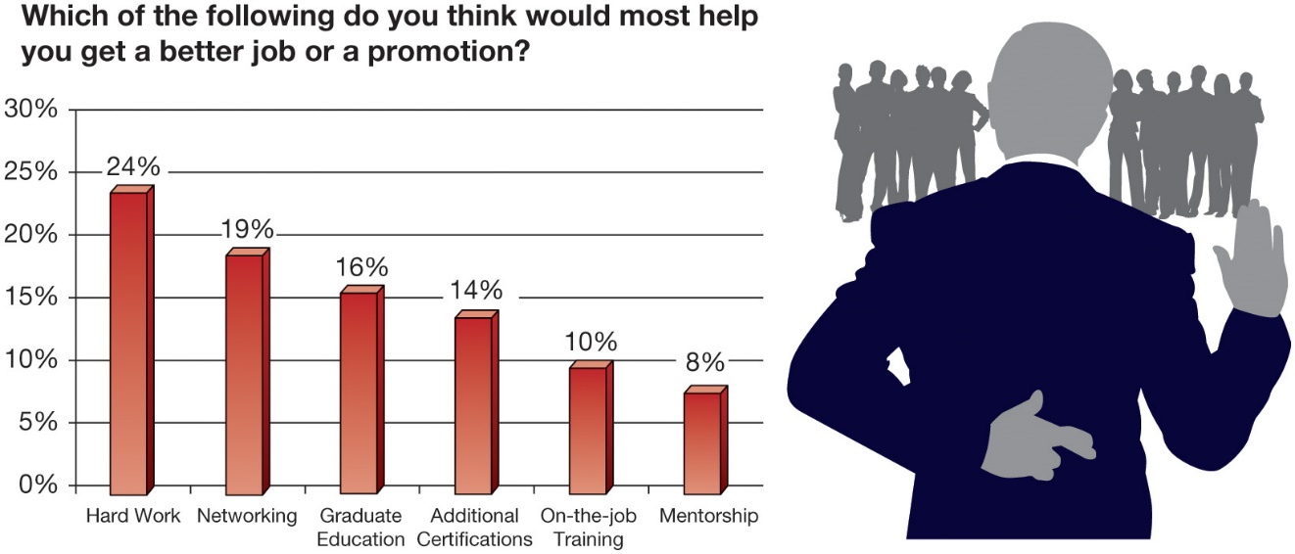
Causes and Consequences of Political Behavior (13 of 14)
OB POLL Networking Key Factor in Employee Advancement
Source: Based on CNBC-SurveyMonkey, Workplace Happiness Index, July 2019,
https://www.surveymonkey.com/curiosity/cnbc-workplace-happiness-indexjuly-2019/;
see also J. Andrews, “Working Hard No Longer Enough to Get a Promotion. Here’s How to Stand Out,” CNBC , July 19, 2019,
https://www.cnbc.com/2019/07/19/working-hard-is-not-enough-to-get-a-promotion-heres-how-to-stand-out.html
Notes:
In considering the OB Poll, you may think that if you work hard, advancement should come easy. However, there is a different way to think about this, as Professor Bud Bilanich of the University of Denver notes: “Working hard. . . isn’t going to be enough because your competition is also working hard and making contributions.” “To me, I think that hard work . . . is kind of like the price of admission.” The second most critical factor highlights the role of politics in making your hard work pay off: politics.
Long Description:
The graph is titled which of the following do you think would most help you get a better or a promotion.
The horizontal axis is marked with different factors. The vertical axis is marked with percentage. The data from the graph in the format factors: percentage is as follows. Hard work: 24 percent. Networking: 19 percent. Graduate education: 16 percent. Additional certifications: 14 percent. On-the-job training: 10 percent. Mentorship: 8 percent.

Slide 38
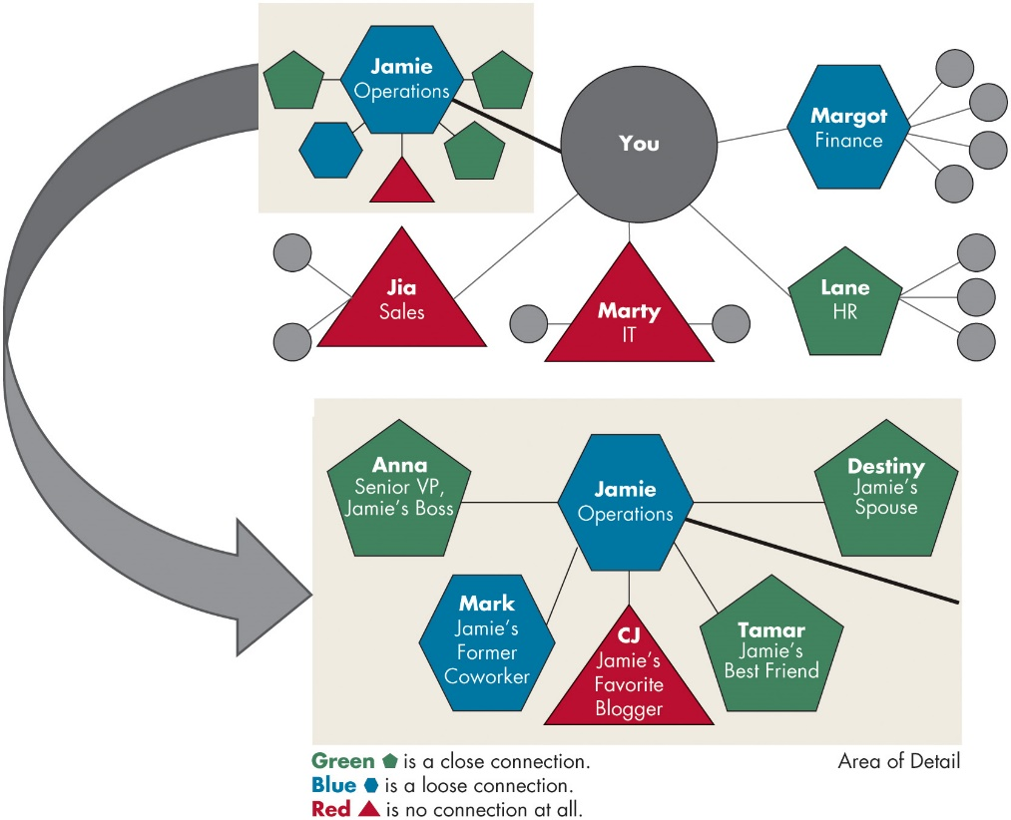
Causes and Consequences of Political Behavior (14 of 14)
Exhibit 13.9 Drawing Your Political Map
Source: Based on D. Clark, “A Campaign Strategy for Your Career,” Harvard Business Review (November 2012): 131–4.
Notes:
Mapping your political career. One of the most useful ways to think about power and politics is in terms of your own career.
Think about your career in your organization of choice. What are your ambitions? Who has the power to help you get there? What is your relationship with these people? The best way to answer these questions is with a political map, like the one shown in Exhibit 13.9, which can help you sketch out your relationships with the people upon whom your career depends.
Power and politics are a part of organizational life.
Long Description:
The political map has two sections. The first section shows that you are connected to Jamie, operations; Jia, sales; Marty, I T; Lane, H R; and Margot, finance. Jia and Marty are marked with no connection at all. Lane is a close connection. Margot is a loose connection. Jamie operations has got three close connections, one loose connection, and one no connection at all. The second section below shows that Jamie, operations is connected with Anna, senior V P, Jamie's boss; Destiny, Jamie's spouse; and Tamar, Jamie's best friend; who all are in close connection with Jamie, Mark, Jamie's former coworker is in loose connection, and C J, Jamie's favorite blogger is in no connection at all. The first section get connected with the second section.

Slide 39
Implications for Managers (1 of 5)
Consider cultivating multiple bases of power and selectively (yet ethically) drawing upon them when the situation calls for it.
In managing your business, unit, team, or career, consider the network of dependence and communication (e.g., the grapevine) between people and organizations and use this information to guide strategic decisions.
As a manager, inspirational appeals work very well in inspiring subordinates toward a common goal. As an employee, rational persuasion is the most effective approach when managing upward, and ingratiation is most effective with coworkers.
Notes:
Consider cultivating multiple bases of power and selectively (yet ethically) drawing upon them when the situation calls for it.
In managing your business, unit, team, or career, consider the network of dependence and communication (e.g., the grapevine) between people and organizations and use this information to guide strategic decisions.
As a manager, inspirational appeals work very well in inspiring subordinates toward a common goal. As an employee, rational persuasion is the most effective approach when managing upward, and ingratiation is most effective with coworkers.

Slide 40
Implications for Managers (2 of 5)
In general, it is best to avoid pressure tactics and defensive behaviors.
The sequencing of influence tactics matters—it is better to start with “softer” influence tactics (e.g., inspirational appeals) and move to “harder” tactics (e.g., coalitions) if the softer tactics fail.
Understand that people process influence attempts both automatically and in a controlled fashion—leverage your influence attempts in a way that accommodates and recognizes both types of processing.
Notes:
In addition,
In general, it is best to avoid pressure tactics and defensive behaviors.
The sequencing of influence tactics matters—it is better to start with “softer” influence tactics (e.g., inspirational appeals) and move to “harder” tactics (e.g., coalitions) if the softer tactics fail.
Understand that people process influence attempts both automatically and in a controlled fashion—leverage your influence attempts in a way that accommodates and recognizes both types of processing.

Slide 41
Implications for Managers (3 of 5)
Influence and politics are skills to be learned— work to develop your skill and cultivate motivation for political influence.
For those reluctant to engage in politics, try to reframe the behavior (to yourself or to others) as prosocial or to help others.
To reduce the likelihood of problematic political behavior, try to reframe resource allocation fairly, avoiding a zero-sum approach where possible.
Notes:
Furthermore,
Influence and politics are skills to be learned— work to develop your skill and cultivate motivation for political influence.
For those reluctant to engage in politics, try to reframe the behavior (to yourself or to others) as prosocial or to help others.
To reduce the likelihood of problematic political behavior, try to reframe resource allocation fairly, avoiding a zero-sum approach where possible.

Slide 42
Implications for Managers (4 of 5)
Both voice and silence are strategic influence behaviors—although they may be more or less appropriate depending on the situation, in general, voice is a preferable behavior, and silence can be a damaging behavior. Try to foster an environment where people feel safe sharing and voicing their concerns and avoiding environments that dissuade people from sharing.
Notes:
In addition,
Both voice and silence are strategic influence behaviors—although they may be more or less appropriate depending on the situation, in general, voice is a preferable behavior, and silence can be a damaging behavior. Try to foster an environment where people feel safe sharing and voicing their concerns and avoiding environments that dissuade people from sharing.

Slide 43
Implications for Managers (5 of 5)
Everyone engages in I M to some extent, and it can be very effective earlier on in a business relationship. However, as time passes, others may be more likely to recognize that you are using these techniques, and they can backfire.
Pick your battles. Not all situations require political behavior to be solved. Whenever confronted with a situation that might require political influence, ask yourself several questions. Is it worth it? Can others be harmed by my political behavior? Can I engage in political behavior while also following standards for justice and ethics?
Notes:
Finally,
Everyone engages in IM to some extent, and it can be very effective earlier on in a business relationship. However, as time passes, others may be more likely to recognize that you are using these techniques, and they can backfire.
Pick your battles. Not all situations require political behavior to be solved. Whenever confronted with a situation that might require political influence, ask yourself several questions. Is it worth it? Can others be harmed by my political behavior? Can I engage in political behavior while also following standards for justice and ethics?

Slide 44
Discussion Questions
Have you ever experienced or observed an abuse of power in the workplace? Discuss the situation: how it occurred and how it was resolved. What does the experience tell you about power differentials in the workplace?
Many managers believe that politics is a major part of organizational life. Do you agree? Is using political behavior in the workplace ethical as long as it doesn’t hurt anyone directly?
Think about your own political map. What are your ambitions and who has the power to help you achieve them?

Slide 45

Copyright
This work is protected by United States copyright laws and is provided solely for the use of instructors in teaching their courses and assessing student learning. Dissemination or sale of any part of this work (including on the World Wide Web) will destroy the integrity of the work and is not permitted. The work and materials from it should never be made available to students except by instructors using the accompanying text in their classes. All recipients of this work are expected to abide by these restrictions and to honor the intended pedagogical purposes and the needs of other instructors who rely on these materials.

