Slide 1

Organizational Behavior
Nineteenth Edition
Chapter 15
Foundations of Organization Structure
Copyright © 2023, 2019, 2017 Pearson Education, Inc. All Rights Reserved
Notes:
If this PowerPoint presentation contains mathematical equations, you may need to check that your computer has the following installed:
1) MathType Plugin
2) Math Player (free versions available)
3) NVDA Reader (free versions available)
Welcome to this Organizational Behavior course that uses the 19th edition of the textbook, Organizational Behavior by Robbins and Judge. This is considered among the most widely used OB textbooks in the world. Robbins and Judge are recognized as definitive aggregators of OB concepts, applications, and practices. The course and this book will provide you with a resource that will benefit you throughout your degree program and your professional life.

Slide 2
Learning Objectives
15.1 Identify seven elements of an organization’s structure.
15.2 Identify the characteristics of the simple structure, the bureaucracy, and the matrix structure.
15.3 Identify the characteristics of the virtual structure, the team structure, and the circular structure.
15.4 Describe the effects of downsizing on organizational structures and employees.
15.5 Contrast the reasons for using mechanistic versus organic structural models.
15.6 Analyze the behavioral implications of different organizational designs.
Notes:
After studying this chapter, you should be able to:
Identify seven elements of an organization’s structure.
Identify the characteristics of the simple structure, the bureaucracy, and the matrix structure.
Identify the characteristics of the virtual structure, the team structure, and the circular structure.
Describe the effects of downsizing on organizational structures and employees.
Contrast the reasons for using mechanistic versus organic structural models.
Analyze the behavioral implications of different organizational designs.

Slide 3
Identify Seven Elements of an Organization’s Structure (1 of 10)
Exhibit 15.1 Key Design Questions and Answers for Designing the Proper Organizational Structure
The Key Question | The Answer Is Provided by
To what degree are activities subdivided into separate jobs? | Work specialization
On what basis will jobs be grouped together? | Departmentalization
To whom do individuals and groups report? | Chain of command
How many individuals can a manager efficiently and effectively direct? | Span of control
Where does decision-making authority lie? | Centralization and decentralization
To what degree will there be rules and regulations to direct employees and managers? | Formalization
Do individuals from different areas need to regularly interact? | Boundary spanning
Notes:
An organizational structure defines how job tasks are formally divided, grouped, and coordinated. There are six key elements, shown here in Exhibit 15.1. They are work specialization, departmentalization, chain of command, span of control, centralization and decentralization, and formalization.

Slide 4
Identify Seven Elements of an Organization’s Structure (2 of 10)
Work specialization: the division of labor into separate activities.
Increasing efficiency and productivity through specialization
Repetition of work
Training for specialization
Microspecialization
Notes:
Let’s focus on the first of the elements, work specialization. Work specialization, or division of labor, describes the degree to which activities in the organization are subdivided into separate jobs. In essence, an entire job is broken into a number of steps, each completed by a separate individual.
Overall, specialization is a means of making the most efficient use of employees’ skills and even successfully improving them through repetition. Less time is spent changing tasks, putting away tools and equipment from a prior step, and getting ready for another.

Slide 5
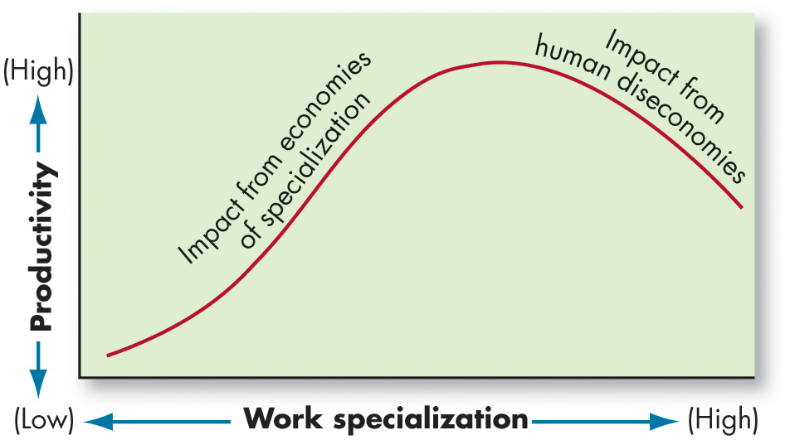
Identify Seven Elements of an Organization’s Structure (3 of 10)
Exhibit 15.2 Economies and Diseconomies of Work Specialization
Notes:
As shown in Exhibit 15.2, work specialization increases efficiency and productivity by encouraging the creation of customized inventions and machinery. However, despite its advantages, specialization could be carried too far. Human diseconomies may begin to surface in the form of boredom, fatigue, stress, low productivity, inferior quality, increased absenteeism, and high turnover, which more than offset the economic advantages.
Long Description:
The horizontal axis is labeled work specialization and ranges from low to high. The vertical axis is labeled productivity and ranges from low to high. The data from the graph is as follows. The line is a bell shaped curve and starts near the origin, and gradually increases to reach the high performance value. This part of the curve is labeled as impact from economies of specialization. The curve then decreases gradually and is this part of the curve is labeled impact from human diseconomies.

Slide 6
Identify Seven Elements of an Organization’s Structure (4 of 10)
Grouping jobs together so common tasks can be coordinated is called departmentalization.
By functions performed.
By type of product or service the organization produces.
By geography.
By process differences.
By type of customer.
Notes:
The second element in an organization’s structure is departmentalization, or grouping jobs together so common tasks can be coordinated. One of the most popular ways to group activities is by functions performed. For example, a manufacturing manager might organize his or her plant by separating engineering, accounting, manufacturing, personnel, and purchasing specialists into common departments. The advantage to this type of grouping is obtaining efficiencies from putting like specialists together.
Tasks can also be departmentalized by the type of product or service the organization produces. The major advantage to this type of grouping is increased accountability for product performance under a single manager. Another way to departmentalize is on the basis of geography or territory. The sales function, for instance, may have western, southern, mid-western, and eastern regions.
Process departmentalization can be used for processing customers as well as products. For example, at the state motor vehicles office you might find: validation by motor vehicles division, processing by the licensing department, and payment collection by the treasury department.
A final category of departmentalization is by type of customer. Microsoft, for instance, recently reorganized around four customer markets: consumers, large corporations, software developers, and small businesses. The assumption is that customers in each department have a common set of problems and needs that can best be met by having specialists for each.

Slide 7
Identify Seven Elements of an Organization’s Structure (5 of 10)
Chain of command: an unbroken line of authority that extends from the top of the organization to the lowest echelon and clarifies who reports to whom.
Once a basic cornerstone in organization design.
Two complementary concepts:
Unity of command
Authority
Notes:
The third element in the organization’s structure is the chain of command. The chain of command is an unbroken line of authority that extends from the top of the organization to the lowest echelon and clarifies who reports to whom. It was once a basic cornerstone in the design of organizations, but it is far less important today. Two complementary concepts are authority and unity of command. Authority is the rights inherent to management to give orders and expect the orders to be obeyed. The principle of unity of command helps preserve the concept of an unbroken line of authority. It states that a person should have only one superior to whom he/she is directly responsible.

Slide 8
Identify Seven Elements of an Organization’s Structure (6 of 10)
The chain of command is less relevant today because of technology and the trend of empowering people.
Operating employees make decisions once reserved for management.
Increased popularity of self-managed and cross-functional teams.
Many organizations still find that enforcing the chain of command is productive.
Notes:
Times change, and so do the basic tenets of organizational design. The concepts of chain of command have less relevance today because of technology and the trend of empowering employees. A low-level employee today can access information in seconds that a generation ago was available only to top managers. Operating employees are empowered to make decisions previously reserved for management.
Add the popularity of self-managed and cross-functional teams, and the creation of new structural designs that include multiple bosses, and you can see why authority and unity of command hold less relevance. Still, many organizations find that they can be most productive by enforcing the chain of command. Indeed, one survey of more than 1,000 managers found that 59% of them agreed with the statement, “There is an imaginary line in my company’s organizational chart. Strategy is created by people above this line, while strategy is executed by people below the line.” However, this same survey found that buy-in to the organization’s strategy by lower-level employees was inhibited by too much reliance on hierarchy for decision making.

Slide 9
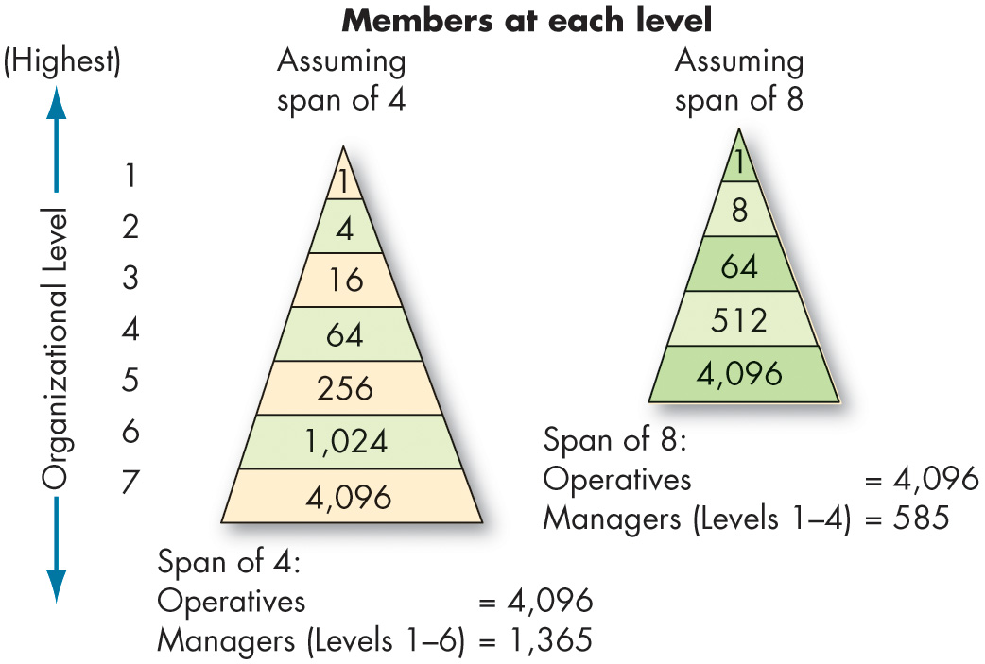
Identify Seven Elements of an Organization’s Structure (7 of 10)
Exhibit 15.3 Contrasting Spans of Control
Notes:
How many employees can a manager direct efficiently and effectively? The span of control describes the number of levels (or layers) and managers in an organization. All things being equal, the wider or larger the span, the fewer the levels, and the more employees at each level, the more efficient the organization.
Long Description:
The organizational level flows down from the highest level at the top to the lowest level at the bottom and is numbered from 1 to 7.
The data is represented in a triangle where the base is broad and the other two sides taper at the top.
The figure in the left is titled assuming span of 4. The data in the format organizational level: members at the level is as follows. 1: 1. 2: 4. 3: 16. 4: 64. 5: 256. 6: 1024. 7: 4096. The calculation below the figure reads: span of 4. Operatives equals 4096. Managers from levels 1 to 6 equals 1365.
The figure in the right is titled assuming span of 8. The data in the format organizational level: members at the level is as follows. 1: 1. 2: 8. 3: 64. 4: 512. 5: 4096. The calculation below the figure reads: span of 8. Operatives equals 4096. Managers from levels 1 to 4 equals 1585.

Slide 10
Identify Seven Elements of an Organization’s Structure (8 of 10)
Centralization and Decentralization
Centralization refers to the degree to which decision making is concentrated at a single point in the organization.
Advantages of a decentralized organization:
Can act more quickly to solve problems.
More people provide input into decisions.
Employees are less likely to feel alienated from those who make decisions that affect their work lives.
Notes:
The next element is centralization and decentralization. Centralization refers to the degree to which decision making is concentrated at a single point in the organization. In centralized organizations, top managers make all the decisions, and lower-level managers merely carry out their directives. In organizations at the other extreme, decentralized decision making is pushed down to the managers closest to the action.
The concept of centralization includes only formal authority—that is, the rights inherent in a position. An organization characterized by centralization is inherently different structurally from one that’s decentralized. A decentralized organization can act more quickly to solve problems, more people provide input into decisions, and employees are less likely to feel alienated from those who make decisions that affect their work lives.
Management efforts to make organizations more flexible and responsive have produced a recent trend toward decentralized decision making by lower-level managers, who are closer to the action and typically have more detailed knowledge about problems than top managers.

Slide 11
Identify Seven Elements of an Organization’s Structure (9 of 10)
Formalization: the degree to which jobs within the organization are standardized.
A highly formalized job means a minimum amount of discretion over what to do.
Low formalization—job behaviors are relatively non-programmed, and employees have a great deal of freedom to exercise discretion in their work.
Notes:
The final element in the model is formalization, or the degree to which jobs within the organization are standardized.
A highly formalized job gives the job incumbent a minimum amount of discretion over what is to be done, when it is to be done, and how he or she should do it. Employees can be expected to always handle the same input in exactly the same way. The greater the standardization, the less input the employee has into how the job is done.
Low formalization, where job behaviors are relatively non-programmed, allows employees to have a great deal of freedom to exercise discretion in their work. The degree of formalization can vary widely between organizations and within organizations.

Slide 12
Identify Seven Elements of an Organization’s Structure (10 of 10)
Boundary spanning occurs when individuals form relationships with people outside their formally assigned groups.
Positive results are especially strong in organizations that encourage extensive internal communication; in other words, external boundary spanning is most effective when it is followed up with internal boundary spanning.
Notes:
We’ve described ways that organizations create well-defined task structures and chains of authority.
These systems facilitate control and coordination for specific tasks, but if there is too much division within an organization, attempts to coordinate across groups can be disastrous.
One way to overcome compartmentalization and retain the positive elements of structure is to encourage or create boundary-spanning roles.
Within a single organization, boundary spanning occurs when individuals form relationships with people outside their formally assigned groups. Boundary-spanning activities occur not only within but also between organizations.
Positive results are especially strong in organizations that encourage extensive internal communication; in other words, external boundary spanning is most effective when it is followed up with internal boundary spanning.
Organizations can use formal mechanisms to facilitate boundary-spanning activities. One method is to assign formal liaison roles or develop committees of individuals from different areas of the organization. Development activities can also facilitate boundary spanning. Employees with experience in multiple functions, such as accounting and marketing, are more likely to engage in boundary spanning. Many organizations try to set the stage for these sorts of positive relationships by creating job rotation programs so new hires get a better sense of different areas of the organization. A final method to encourage boundary spanning is to bring attention to overall organizational goals and shared identity concepts.

Slide 13
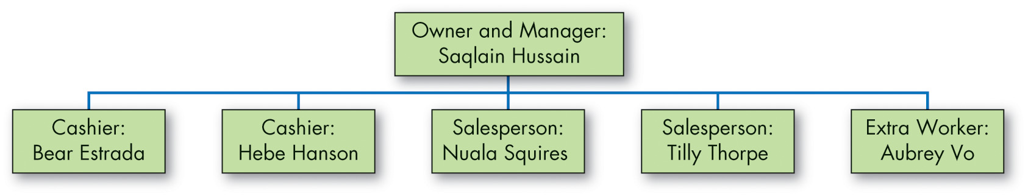
Common Organizational Frameworks and Structures (1 of 6)
Exhibit 15.4 A Simple Structure (Jack Gold’s Men’s Store)
Notes:
Now that you’re familiar with the elements in an organization’s structure, let’s talk about the more common organizational designs: the simple structure, the bureaucracy, and the matrix.
Exhibit 15.4 shows an example of the simple structure, an organization design that is characterized most by what it is not rather than what it is: it is not elaborate. It has a low degree of departmentalization, wide spans of control, authority centralized in a single person, and little formalization. The simple structure is a “flat” organization; it usually has only two or three vertical levels. One individual has the decision-making authority.
Long Description:
The owner and manager, Saqlain Hussain has the following members under him. Cashier, Bear Estrada; cashier, Hebe Hanson; salesperson, Nuala Squires; salesperson, Tilly Thorpe; and extra worker, Aubrey Vo.

Slide 14
Common Organizational Frameworks and Structures (2 of 6)
Simple structure: the manager and the owner are one and the same.
Strengths:
Simple, fast, and flexible.
Inexpensive to maintain.
Accountability is clear.
Weaknesses:
Difficult to maintain in anything other than small organizations.
Risky—everything depends on one person.
Notes:
The simple structure is most widely practiced in small businesses in which the manager and the owner are one and the same.
The strength of the simple structure lies in its simplicity. It is fast, flexible, inexpensive to maintain, and accountability is clear. One major weakness is that it is difficult to maintain in anything other than small organizations. It becomes increasingly inadequate as an organization grows because its low formalization and high centralization tend to create information overload at the top. As size increases, it is very difficult for the owner-manager to make all the choices. The simple structure’s other weakness is that it is risky—everything depends on one person. Illness can literally destroy the information and decision-making center of the company.

Slide 15
Common Organizational Frameworks and Structures (3 of 6)
A bureaucracy is characterized by standardization.
Highly routine operating tasks.
Very formalized rules and regulations.
Tasks grouped into functional departments.
Centralized authority.
Narrow spans of control.
Decision making that follows the chain of command.
Notes:
In contrast, standardization is the key concept for all bureaucracies. The bureaucracy is characterized by six traits: highly routine operating tasks achieved through specialization; very formalized rules and regulations; tasks grouped into functional departments; a strong centralized authority; there are narrow spans of control; and decision making follows the chain of command.

Slide 16
Common Organizational Frameworks and Structures (4 of 6)
Strengths of bureaucracy:
Ability to perform standardized activities in a highly efficient manner.
Weaknesses of bureaucracy:
Subunit conflicts.
Unit goals dominate.
Obsessive behavior.
Covering weak management.
Notes:
The bureaucracy’s primary strength is in its ability to perform standardized activities in a highly efficient manner. Putting like specialties together in functional departments results in economies of scale, minimum duplication of personnel and equipment, etc. Bureaucracies get by nicely with less talented and less costly middle- and lower-level managers.
Some of bureaucracy’s weaknesses are that specialization creates subunit conflicts, and functional unit goals can override the organization’s goals. Also, an obsessive concern with following the rules can develop, and the bureaucracy is efficient only as long as employees confront familiar problems with programmed decision rules.

Slide 17
Common Organizational Frameworks and Structures (5 of 6)
The matrix structure combines two forms of departmentalization—functional and product:
The strength of functional is putting specialists together.
Product departmentalization facilitates coordination.
It provides clear responsibility for all activities related to a product, but with duplication of activities and costs.
Notes:
The third organization design is the matrix structure. This structure is common in advertising agencies, universities, and entertainment companies. It combines two forms of departmentalization—functional and product.
The strength of functional departmentalization is putting like specialists together and the pooling and sharing of specialized resources across products. Its major disadvantage is the difficulty of coordinating tasks. Product departmentalization facilitates coordination. It provides clear responsibility for all activities related to a product, but with duplication of activities and costs.

Slide 18
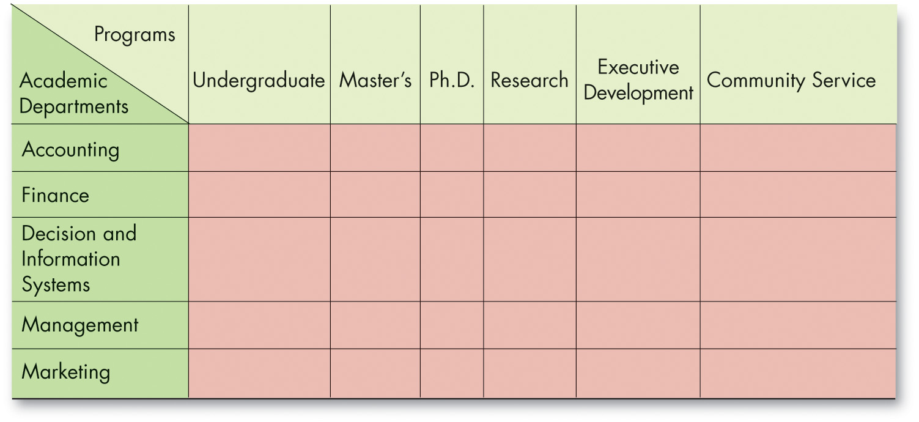
Common Organizational Frameworks and Structures (6 of 6)
Exhibit 15.5 Matrix Structure for a College of Business Administration
Notes:
The most obvious structural characteristic of the matrix is that it breaks the unity of command concept. Exhibit 15.5 shows the matrix form as used in a college of business administration. Its strength is its ability to facilitate coordination when the organization has a multiplicity of complex and interdependent activities. The dual lines of authority reduce tendencies of departmental members to protect their worlds. It facilitates the efficient allocation of specialists.
The major disadvantages of the matrix lie in the confusion it creates, its propensity to foster power struggles, and the stress it places on individuals. Violation of the unity of command concept increases ambiguity that often leads to conflict. Confusion and ambiguity also create the seeds of power struggles. Reporting to more than one boss introduces role conflict, and unclear expectations introduce role ambiguity.
Long Description:
The columns consists of programs, undergraduate, master’s, Ph. D., research, executive development, and community service.
The row consists of academic departments, accounting, finance, decision and information systems, management, and marketing.
Academic departments and programs are shown in the top left corner of the matrix.

Slide 19
Newer Trends in Organizational Design (1 of 4)
The Virtual Organization
The essence of the virtual organization is that it is typically a small, core organization that outsources major business functions.
Also referred to as a network organization.
It is highly centralized, with little or no departmentalization.
Notes:
The essence of the virtual organization is that it is typically a small, core organization that outsources major business functions. The virtual organization is also referred to as a network organization. It’s highly centralized, with little or no departmentalization.

Slide 20
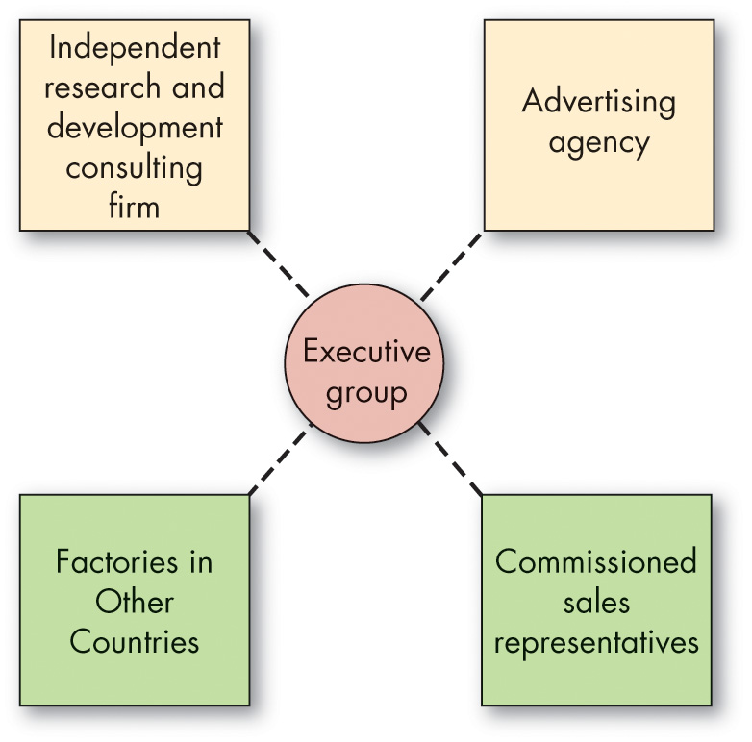
Newer Trends in Organizational Design (2 of 4)
Exhibit 15.6 A Virtual Structure
Notes:
Exhibit 15.6 shows a virtual organization in which management outsources all of the primary functions of the business. The dotted lines in this exhibit represent those relationships typically maintained under contracts. Managers in virtual structures spend most of their time coordinating and controlling external relations, typically by way of computer-network links.
Network organizations often take many forms. Some of the more “traditional” forms include the franchise form in which there are managers, systems, and other experts in the central node (i.e., executive group), whereas customer sales and services are carried out by franchise units. This popular form of network organization is very common in service business models, such as 7-Eleven, McDonald’s, Jimmy John’s, and Dunkin’ Donuts. However, in this form, franchisees do not tend to collaborate or coordinate with one another, and may actually be in direct competition for resources from the executive group. Another example is the starburst form in which a “parent” firm splits off one of its functions into a “spinoff” firm. For example, in 2012 Netflix split off its DVD function into its own separate entity, now DVD.com.
The major advantage to the virtual organization is its flexibility. The primary drawback is that it reduces management’s control over key parts of its business. Virtual organizations’ drawbacks have become increasingly clear as their popularity has grown. They are in a state of perpetual flux and reorganization, which means roles, goals, and responsibilities are unclear, setting the stage for political behavior
Long Description:
The functions are outsourced to independent research and development consulting firm, advertising agency, factories in other countries, and commissioned sales representatives.

Slide 21
Newer Trends in Organizational Design (3 of 4)
The team structure: eliminates the chain of command and replaces departments with empowered teams.
Removes vertical and horizontal boundaries.
Breaks down external barriers.
Flattens the hierarchy and minimizes status and rank.
When fully operational, the team structure may break down geographic barriers.
Notes:
The team structure seeks to eliminate the chain of command and replace departments with empowered teams. This structure removes vertical and horizontal boundaries in addition to breaking down external barriers between the company and its customers and suppliers. By removing vertical boundaries, management flattens the hierarchy and minimizes status and rank.
Cross-hierarchical teams (which include top executives, middle managers, supervisors, and operative employees), participative decision-making practices, and the use of 360-degree performance appraisals (in which peers and others evaluate performance) can be used. When fully operational, the team structure may break down geographic barriers.
Today, most large U.S. companies see themselves as team-oriented global corporations; many, such as Coca-Cola and McDonald’s, do as much business overseas as in the United States, and some struggle to incorporate geographic regions into their structure.

Slide 22
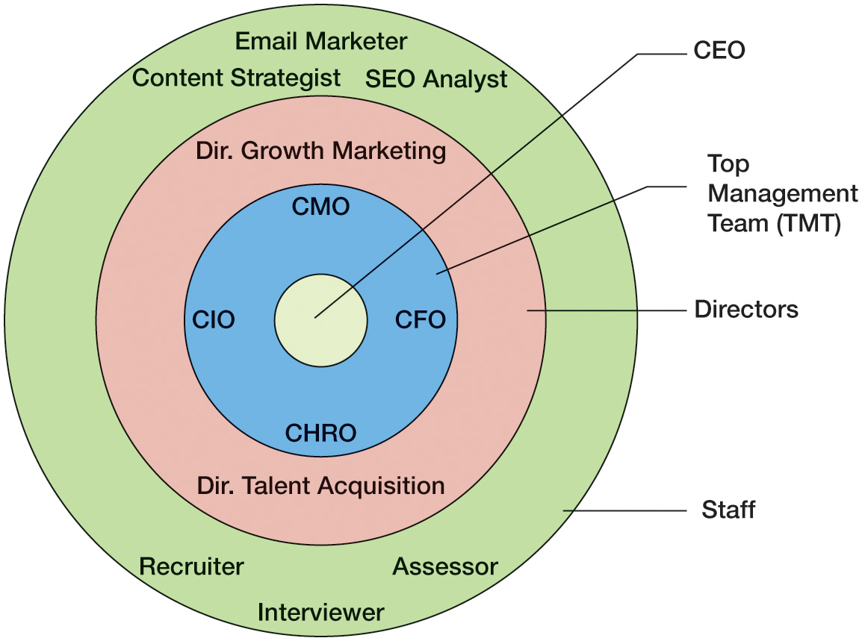
Newer Trends in Organizational Design (4 of 4)
Exhibit 15.7 A Circular Structure
Notes:
Exhibit 15.7 shows the circular structure..
The circular structure has intuitive appeal for creative entrepreneurs, and some small innovative firms have claimed it. However, as in many of the current hybrid approaches, employees are apt to be unclear about whom they report to and who is running the show.
We are still likely to see the popularity of the circular structure spread. The concept may have intuitive appeal for spreading a vision of corporate social responsibility (CSR) initiatives, for instance.
Long Description:
The C E O is at the center. Next to the C E O comes the C M O, C F O, C H R O, and C I O in the next level and are the top management team, T M T. The third consecutive level consists of director growth marketing and director talent acquisition and is labeled directors. The fourth and the outermost circle has email marketer, content strategist, S E O analyst, recruiter, interviewer, and assessor and is labeled staff.

Slide 23
Effects of Downsizing on Organizations and Employees (1 of 3)
The Leaner Organization: Downsizing
The goal of the new organizational forms we’ve described is to improve agility by creating a lean, focused, and flexible organization.
Downsizing is a systematic effort to make an organization leaner by selling off business units, closing locations, or reducing staff.
Notes:
The leaner organization leads to organizational downsizing. The goal of the new organizational forms we’ve described is to improve agility by creating a lean, focused, and flexible organization. Downsizing is a systematic effort to make an organization leaner by selling off business units, closing locations, or reducing staff. It has been very controversial because of its potential negative impacts on employees.

Slide 24
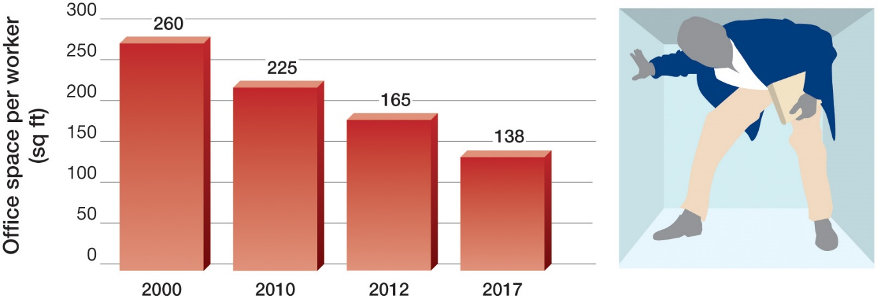
Effects of Downsizing on Organizations and Employees (2 of 3)
O B Poll The Incredible Shrinking Office
Source: J. Cipolla, “How Much Office Space per Employee Do You Need?” Squarefoot, April 9, 2020,
https://www.squarefoot.com/blog/office-space-peremployee/;
CoreNet Global, “Office Space per
Worker Will Drop to 100 Square Feet or Below for Many Companies Within Five Years, According to New Research From CoreNet Global,” CoreNet Global [press release], February 28, 2012,
https://www.prnewswire.com/news-releases/office-s pace-per-workerwill-drop-to-100-square-feet-or-below-for-many-companies-within-five-years-according-to-new-research-from-corenet-global-140702483.html#:~:text=All%20Products,Office%20Space%20Per%20Worker%20Will%20Drop%20to%20100%20Square%20Feet,New%20Research%20From%20CoreNet%20Global
Notes:
Downsizing does not necessarily mean physically shrinking the size of your office, although that has been happening, too as the OB Poll shows.
Long Description:
The horizontal axis is marked with years and ranges from 2000 to 2017. The vertical axis is labeled office space per worker in square feet and ranges from 0 to 300 in increments of 50. The data from the graph in the format year: office space in square feet is as follows. 2000: 260 square feet. 2010: 225 square feet. 2012: 165 square feet. 2017: 138 square feet.

Slide 25
Effects of Downsizing on Organizations and Employees (3 of 3)
Strategies for downsizing include:
Investment
Communication
Participation
Assistance
Make cuts carefully and help employees through the process.
Notes:
There are several strategies for downsizing:
Investment. Companies that downsize to focus on core competencies are more effective when they invest in high-involvement work practices afterward.
Communication. When employers make efforts to discuss downsizing with employees early, employees are less worried about the outcomes and feel the company is taking their perspective into account.
Participation. Employees worry less if they can participate in the process in some way. In some companies, voluntary early retirement programs or severance packages can help achieve leanness without layoffs.
Assistance. Providing severance, extended health-care benefits, and job search assistance demonstrates a company does really care about its employees and honors their contributions.
Companies that make themselves lean can be more agile, efficient, and productive—but only if they make cuts carefully and help employees through the process.

Slide 26
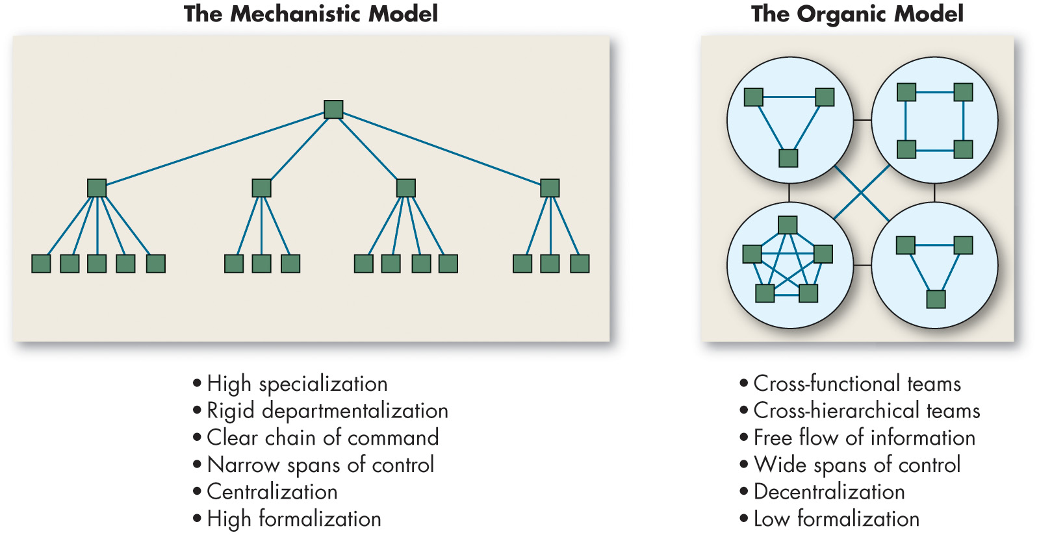
Mechanistic Versus Organic Structural Models (1 of 8)
Exhibit 15.8 Mechanistic Versus Organic Models
Notes:
We’ve described organizational designs ranging from the highly structured bureaucracy to the amorphous boundaryless organization. There are also two extreme models of organizational design, as seen here in Exhibit 15.8.
First, the mechanistic model is synonymous with bureaucracy and has extensive departmentalization, high formalization, a limited information network (mostly downward), and little participation in decision making. The organic model uses cross-hierarchical and cross-functional teams, low formalization, a comprehensive information network, and high participation in decision making.
Why are some organizations structured along mechanistic lines while others are organic? In this section, we present the major causes or determinants of an organization’s structure.
Long Description:
The figure in the left is labeled the mechanistic model. The head had four departments under him and each department has either 3, 4 or 5 sections under it. The components of this model are: high specialization, rigid departmentalization, clear chain of command, narrow spans of control, centralization, and high formalization.
The figure on the right is labeled as organic model. In this model, four groups with either 3, 4 or 5 teams, interacting among themselves are connected with each other. The components of this model are cross-functional teams, cross-hierarchical teams, free flow of information, wide spans of control, decentralization, and low formalization.

Slide 27
Mechanistic Versus Organic Structural Models (2 of 8)
An organization’s structure is a means to help management achieve its objectives.
Most current strategy frameworks focus on three dimensions:
Innovation strategy
Cost-minimization strategy
Imitation strategy
Notes:
An organization’s structure is a means to help management achieve its objectives. Objectives derive from the organization’s overall strategy. Structure should follow strategy. Most current strategy frameworks focus on three strategy dimensions—innovation, cost minimization, and imitation—and the structural design that works best with each.
An innovation strategy means a strategy for meaningful and unique innovations. This strategy may appropriately characterize 3M Company. A cost-minimization strategy tightly controls costs, refrains from incurring unnecessary innovation or marketing expenses, and cuts prices in selling a basic product. This describes Walmart’s strategy. An imitation strategy tries to copy successful ideas of innovators and capitalize on the best of both in order to minimize risk and maximize opportunity for profit. It moves into new products or new markets only after viability has been proven by innovators, for example, when manufactures mass-market fashion goods that are rip-offs of designer styles.

Slide 28
Mechanistic Versus Organic Structural Models (3 of 8)
Exhibit 15.9 The Strategy–Structure Relationship
Strategy | Structural Option
Innovation | Organic: A loose structure; low specialization, low formalization, decentralized
Cost minimization | Mechanistic: Tight control; extensive work specialization, high formalization, high centralization
Imitation | Mechanistic and organic: Mix of loose with tight properties; tight controls over current activities and looser controls for new undertakings
Notes:
Exhibit 15.8 describes the structural option that best matches each strategy. Innovators need the flexibility of the organic structure, whereas cost minimizers seek the efficiency and stability of the mechanistic structure. Imitators combine the two structures. They use a mechanistic structure to maintain tight controls and low costs in their current activities but create organic subunits in which to pursue new undertakings.

Slide 29
Mechanistic Versus Organic Structural Models (4 of 8)
Organization Size
Large organizations—employing 2,000 or more people—tend to have more specialization, more departmentalization, more vertical levels, and more rules and regulations than do small organizations.
The impact of size becomes less important as an organization expands.
Notes:
An organization’s size significantly affects its structure. Large organizations—employing 2,000 or more people—tend to have more specialization, more departmentalization, more vertical levels, and more rules and regulations than do small organizations. The impact of size becomes less important as an organization expands. Once an organization has around 2,000 employees, it’s already mechanistic. An additional 500 employees will not have much impact. However, adding 500 employees to a 300-employee firm is likely to result in a mechanistic structure.

Slide 30
Mechanistic Versus Organic Structural Models (5 of 8)
Technology: the way an organization transfers its inputs into outputs.
Numerous studies have examined the technology-structure relationship.
Organizational structures adapt to their technology.
Notes:
Technology refers to how an organization transfers its inputs into outputs. Every organization has at least one technology for converting financial, human, and physical resources into products or services.

Slide 31
Mechanistic Versus Organic Structural Models (6 of 8)
An organization’s environment includes outside institutions or forces that can affect its performance.
Dynamic environments create significantly more uncertainty for managers than do static ones.
Three dimensions:
Capacity
Volatility
Complexity
Notes:
An organization’s environment includes outside institutions or forces that can affect its performance, such as suppliers, customers, competitors, government regulatory agencies, and public pressure groups.
Dynamic environments create significantly more uncertainty for managers than do static ones.

Slide 32
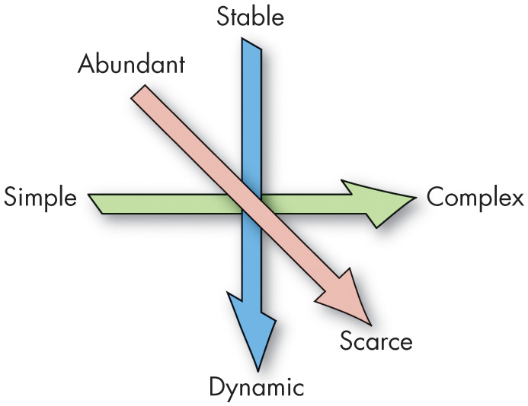
Mechanistic Versus Organic Structural Models (7 of 8)
Exhibit 15.10 Three-Dimensional Model of the Environment
Notes:
Any organization’s environment has three dimensions: capacity, volatility, and complexity. Capacity is the degree to which it can support growth. Rich and growing environments generate excess resources, which can buffer times of relative scarcity. Volatility refers to the degree of instability in an environment, characterized by a high degree of unpredictable change. The environment is dynamic, making it difficult for management to predict accurately the probabilities associated with various decision alternatives. At the other extreme is a stable environment. Complexity is the degree of heterogeneity and concentration among environmental elements. Simple environments are homogeneous and concentrated. In contrast, environments characterized by heterogeneity and dispersion are called complex.
Exhibit 15.10 summarizes our definition of the environment along its three dimensions. The arrows indicate movement toward higher uncertainty. Thus, organizations that operate in environments characterized as scarce, dynamic, and complex face the greatest degree of uncertainty because they have high unpredictability, little room for error, and a diverse set of elements in the environment to monitor constantly. Given this three-dimensional definition of environment, we can offer some general conclusions about environmental uncertainty and structural arrangements. The more scarce, dynamic, and complex the environment, the more organic a structure should be. The more abundant, stable, and simple the environment, the more the mechanistic structure will be preferred.

Slide 33
Mechanistic Versus Organic Structural Models (8 of 8)
Another factor that shapes organizational structure is institutions.
Regulatory pressures.
Simple inertia.
Culture.
Fads or trends.
Institutional pressures are often difficult to see specifically because we take them for granted, but that doesn’t mean they aren’t powerful.
Notes:
Another factor that shapes organizational structure is institutions. These are cultural factors that act as guidelines for appropriate behavior. Institutional theory describes some of the forces that lead many organizations to have similar structures and, unlike the theories we’ve described so far, focuses on pressures that aren’t necessarily adaptive.
The most obvious institutional factors come from regulatory pressures; certain industries under government contracts, for instance, must have clear reporting relationships and strict information controls. Sometimes simple inertia determines an organizational form—companies can be structured in a particular way just because that’s the way things have always been done. Organizations in countries with high power distance might have a structural form with strict authority relationships because it’s seen as more legitimate in that culture. Some have attributed problems in adaptability in Japanese organizations to the institutional pressure to maintain authority relationships. Sometimes organizations start to have a particular structure because of fads or trends.
Many companies have recently tried to copy the organic form of a company like Google only to find that such structures are a very poor fit with their operating environment. Institutional pressures are often difficult to see specifically because we take them for granted, but that doesn’t mean they aren’t powerful.

Slide 34
Analyze the Behavioral Implications of Different Organizational Designs (1 of 3)
An organization’s structure can have significant effects on its members.
It’s impossible to generalize!
Not everyone prefers the freedom and flexibility of organic structures.
Some people are most productive and satisfied when work tasks are standardized and ambiguity minimized.
Notes:
This chapter opened by implying that an organization’s structure can have significant effects on its members. A review of the evidence leads to a pretty clear conclusion: you can’t generalize! Not everyone prefers the freedom and flexibility of organic structures. Different factors stand out in different structures as well. In highly formalized, heavily structured, mechanistic organizations, the level of fairness in formal policies and procedures is a very important predictor of satisfaction. In more personal, individually adaptive, organic organizations, employees value interpersonal justice more. Some people are most productive and satisfied when work tasks are standardized and ambiguity minimized—that is, in mechanistic structures. So, any discussion of the effect of organizational design on employee behavior has to address individual differences.

Slide 35
Analyze the Behavioral Implications of Different Organizational Designs (2 of 3)
Organizational Designs and Employee Behavior
Work specialization contributes to higher employee productivity.
No evidence supports a relationship between span of control and employee satisfaction or performance.
Fairly strong evidence links centralization and job satisfaction, meaning that less centralization is associated with higher satisfaction.
National culture influences the preference for structure.
Notes:
The evidence generally indicates that work specialization contributes to higher employee productivity—but at the price of reduced job satisfaction. However, work specialization is not an unending source of higher productivity.
While research fails to support a relationship between span of control and employee satisfaction or performance, we find fairly strong evidence linking centralization and job satisfaction. In general, less centralized organizations have a greater amount of autonomy, which appears positively related to job satisfaction.
Research suggests national culture influences the preference for structure. Organizations that operate with people from high-power-distance cultures, such as Greece, France, and most of Latin America, find their employees are much more accepting of mechanistic structures than are employees from low-power-distance countries. So consider cultural differences along with individual differences when predicting how structure will affect employee performance and satisfaction.

Slide 36
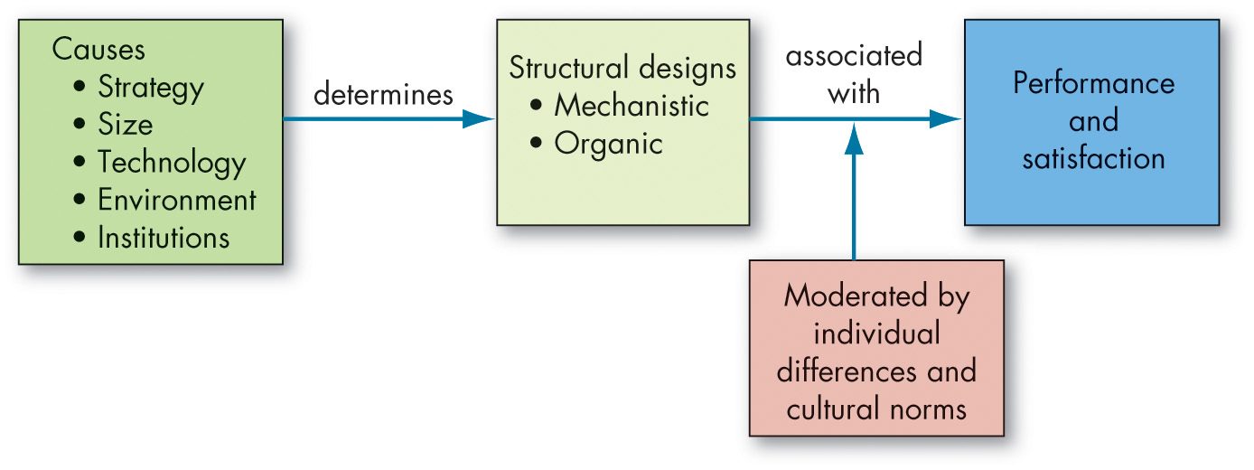
Analyze the Behavioral Implications of Different Organizational Designs (3 of 3)
Exhibit 15.11 Organizational Structure: Its Determinants and Outcomes
Notes:
The theme of this chapter is that an organization’s internal structure contributes to explaining and predicting behavior. That is, in addition to individual and group factors, the structural relationships in which people work has a bearing on employee attitudes and behavior. What’s the basis for this argument? To the degree that an organization’s structure reduces ambiguity for employees and clarifies concerns, it shapes their attitudes and facilitates and motivates them to higher levels of performance. Exhibit 15.11 summarizes what we’ve discussed.
Long Description:
The flow from left to right is as follows. The causes determines the structural designs associated with performance and satisfaction. This association is moderated by individual differences and cultural norms. Components of causes are strategy, size, technology, environment, and institutions. Mechanistic and organic are the components of structural designs.

Slide 37
Implications for Managers (1 of 3)
Structure follows strategy. Work backward from your organization’s strategy and mission to determine the appropriate structure.
Consider the key elements of organizations (e.g., departmentalization, specialization) when determining the appropriate structure. Some elements (e.g., chain of command, span of control, [de]centralization, boundary spanning) have unique implications for how employees and managers interact with one another.
Notes:
Structure follows strategy. Work backward from your organization’s strategy and mission to determine the appropriate structure.
Consider the key elements of organizations (e.g., departmentalization, specialization) when determining the appropriate structure. Some elements (e.g., chain of command, span of control, [de]centralization, boundary spanning) have unique implications for how employees and managers interact with one another.

Slide 38
Implications for Managers (2 of 3)
Many modern organizations today have shifted to an organic team structure, which allows for greater flexibility and empowers teams to realize the organization’s mission. However, even mechanistic bureaucracies have their place if the goal is entirely standardized functions and outputs. It is important not to get swept up in trends and instead focus on the mission, strategy, and environment and structure the organization accordingly.
Although sometimes downsizing is necessary and can lead to short-term cost reductions, weigh the decision to downsize wisely, as it can negatively affect the employees and morale.
Notes:
Furthermore,
Many modern organizations today have shifted to an organic team structure, which allows for greater flexibility and empowers teams to realize the organization’s mission. However, even mechanistic bureaucracies have their place if the goal is entirely standardized functions and outputs. It is important not to get swept up in trends and instead focus on the mission, strategy, and environment and structure the organization accordingly.
Although sometimes downsizing is necessary and can lead to short-term cost reductions, weigh the decision to downsize wisely, as it can negatively affect the employees and morale.

Slide 39
Implications for Managers (3 of 3)
Depending on your organization’s mission, innovation, cost-minimization, or imitation strategies (among others) could be adopted. However, realize that strategy often changes as a function of environmental pressures or opportunities. Flexible organizational structures enable flexible adaptation. This becomes more difficult the larger and more institutionalized organizations become.
Notes:
Finally,
Depending on your organization’s mission, innovation, cost-minimization, or imitation strategies (among others) could be adopted. However, realize that strategy often changes as a function of environmental pressures or opportunities. Flexible organizational structures enable flexible adaptation. This becomes more difficult the larger and more institutionalized organizations become.

Slide 40
Discussion Questions
How do you think the move toward more people working from home will change how companies are structured? In your response consider chain of command, span of control, degree of centralization, and boundary spanning.
Choose three companies that you are familiar with and explore their organization strategy and mission along with their structure. How does the choice of structure support the organization in achieving its strategic goals?
In addition to the motion picture industry, where else is the virtual structure appropriate? Why?

Slide 41

Copyright
This work is protected by United States copyright laws and is provided solely for the use of instructors in teaching their courses and assessing student learning. Dissemination or sale of any part of this work (including on the World Wide Web) will destroy the integrity of the work and is not permitted. The work and materials from it should never be made available to students except by instructors using the accompanying text in their classes. All recipients of this work are expected to abide by these restrictions and to honor the intended pedagogical purposes and the needs of other instructors who rely on these materials.

