Slide 1
Petrol index
Adnan Sami

Slide 2
Why petrol ?
Basic Need

Slide 3
Factor
GDP per capita​

Slide 4
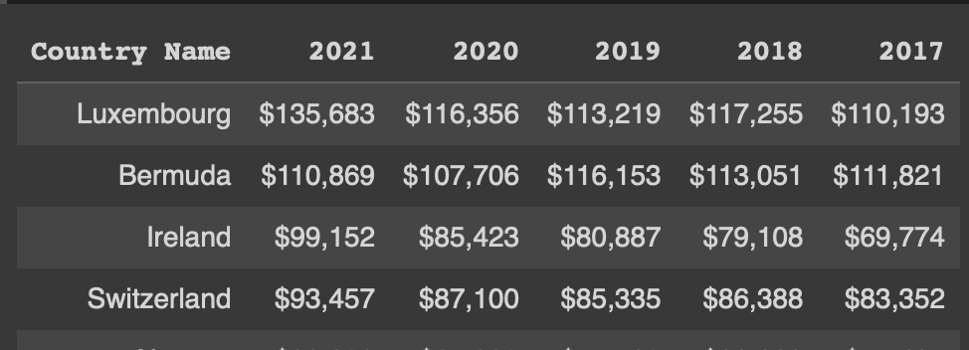
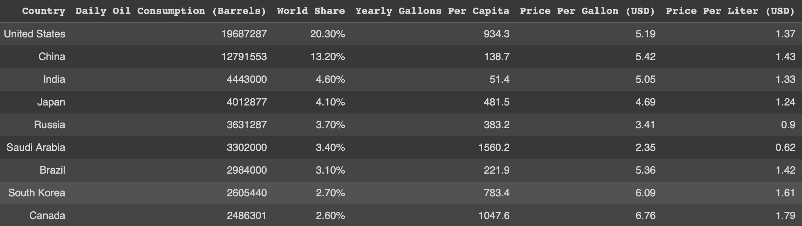
tables
GDP per capita
Petrol prices

Slide 5
Cleaning the data
Joined two tables by country
Dropped extra columns
GDP per capita
$
$135,683
135683
,
USD to CAD

Slide 6
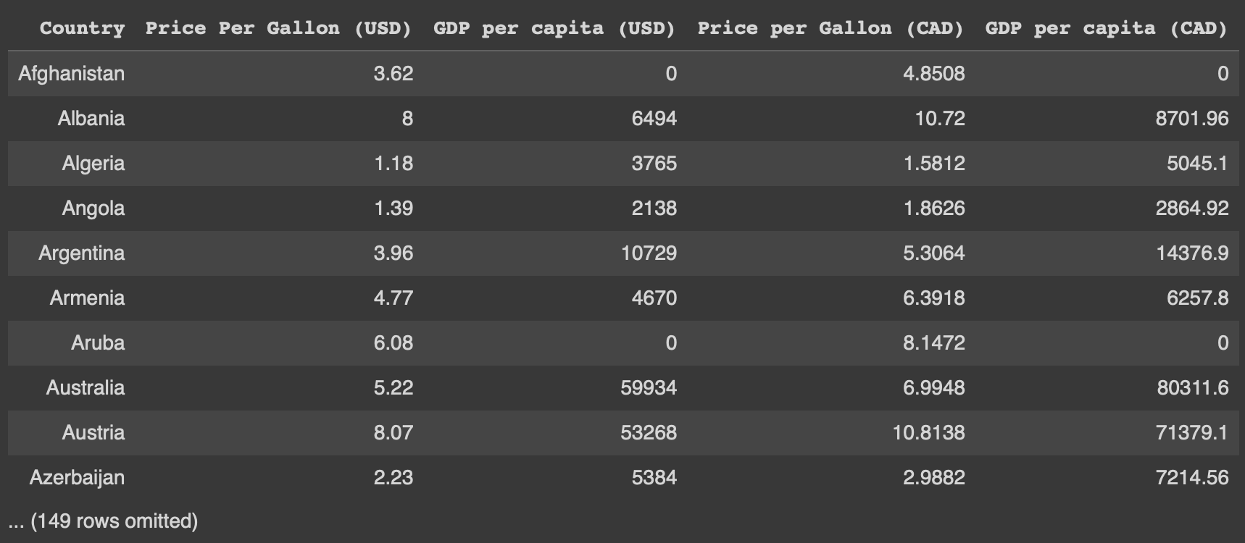
updated table

Slide 7
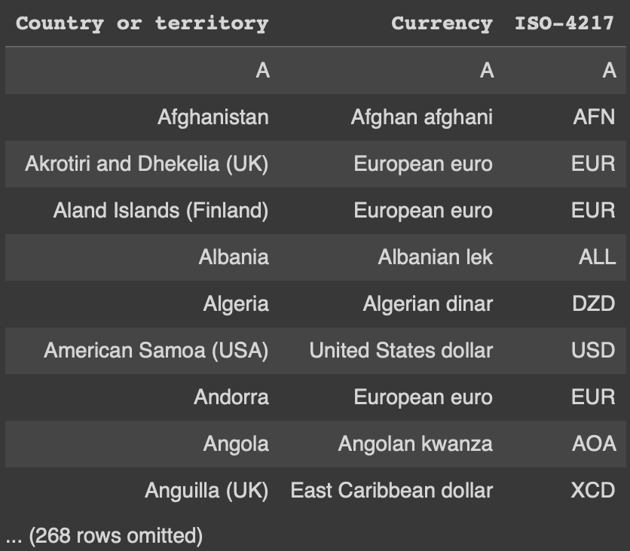
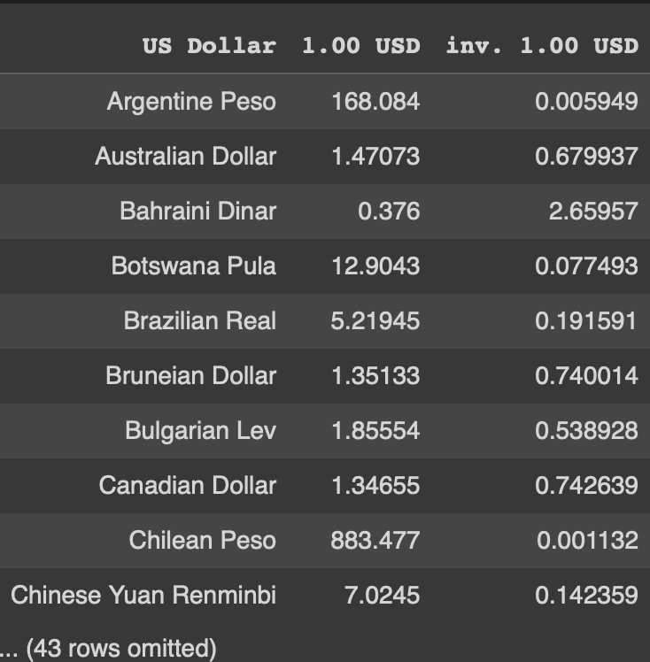
Original currencies
Currency codes
Exchange Rates

Slide 8
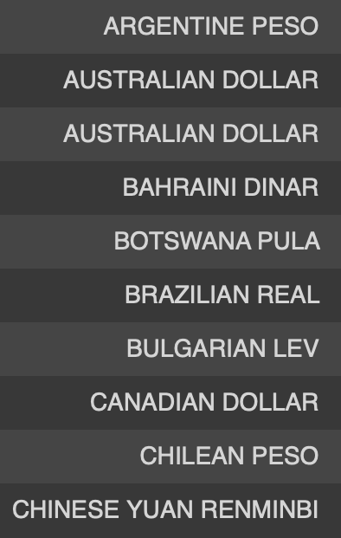
Joining exchange rate table
Capitalizing currency names

Slide 9
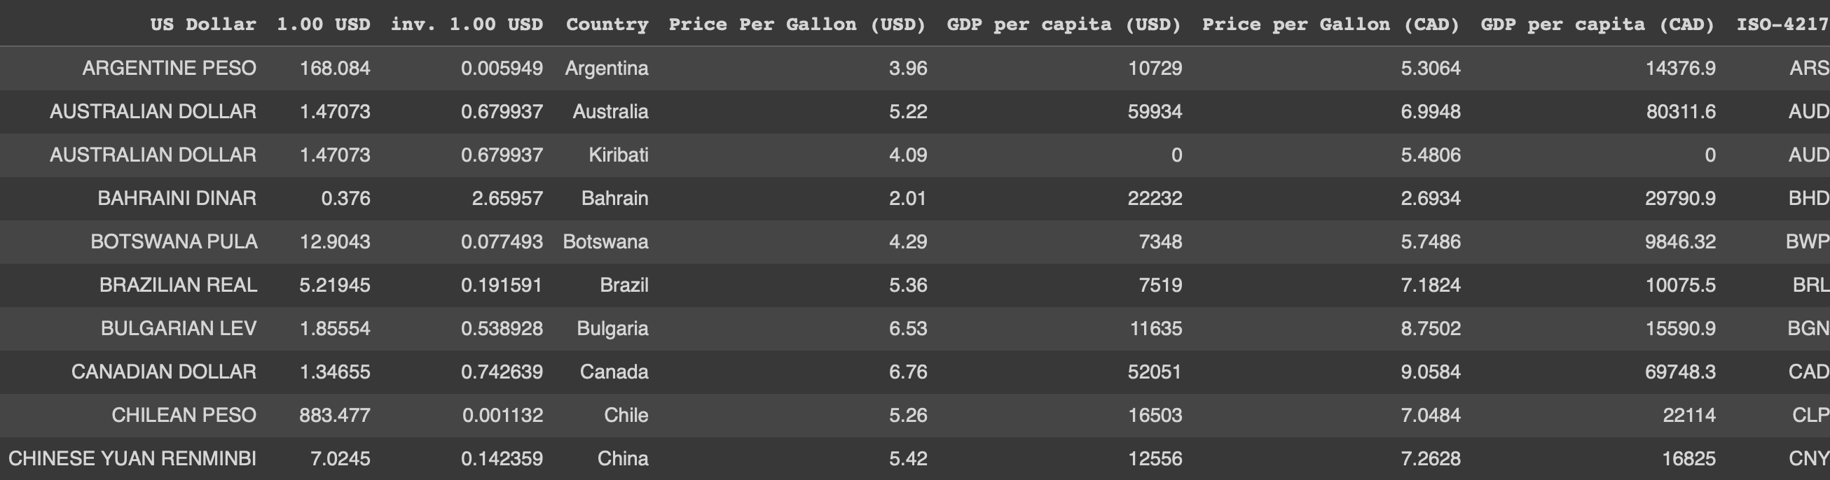
Calculating original values

Slide 10
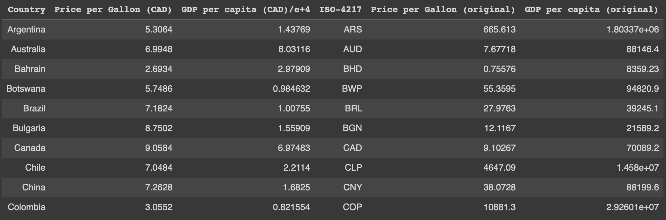
Updated Table

Slide 11
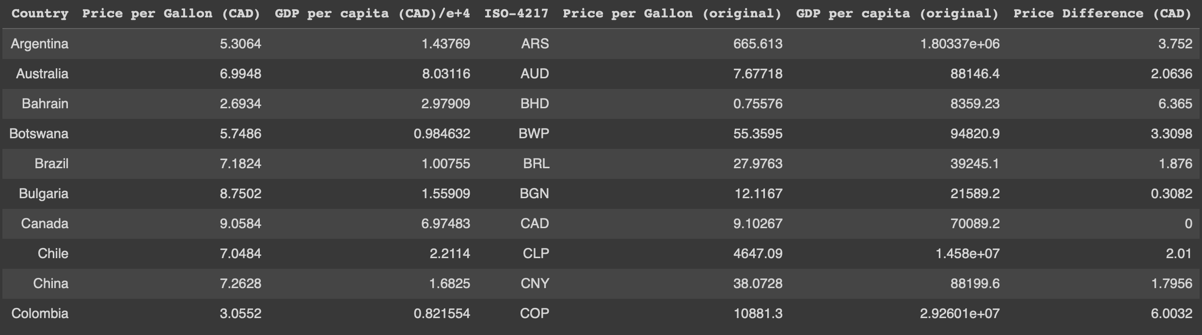
Price differences included

Slide 12
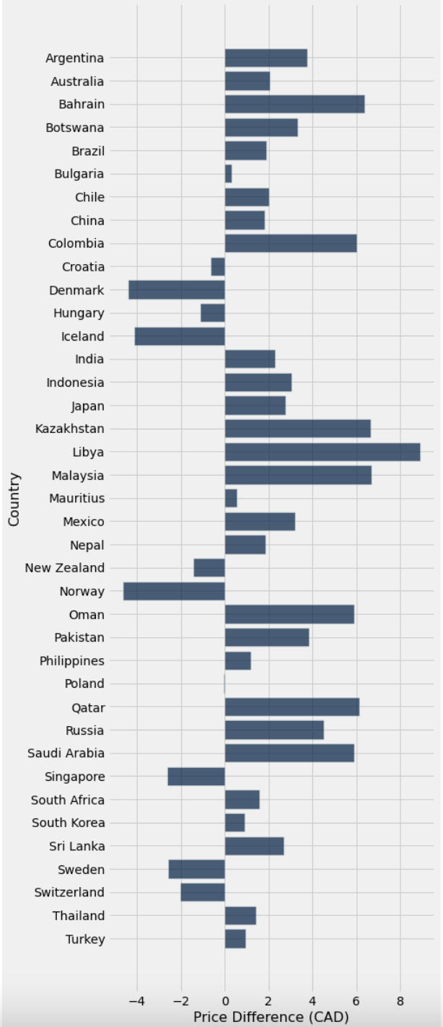
VISUALISATIONs
Bar Chart of Price Differences
Libya
lowest
Norway
highest
Poland
~
Price difference = Canada – x country

Slide 13
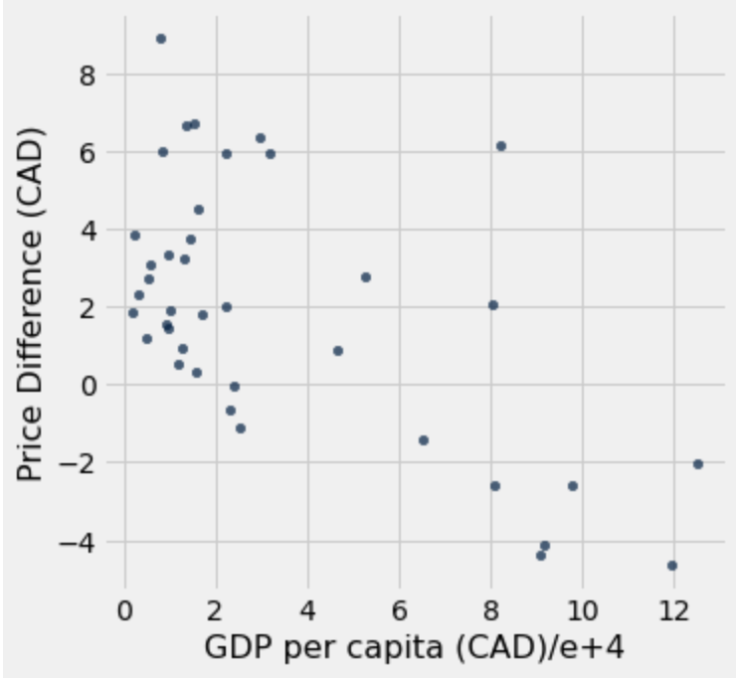
Scatter Plot
Negative correlation
GDP per capita
Price difference
Petrol price
Price difference = Canada – x country

Slide 14
correlation coefficient
-0.589

