Slide 1

VIRTUAL TRY-ON
ADNAN LADJI (01FE19BEC252) , NIRANJAN BHUTI (01FE19BEC248) , SHIVKUMAR GHAMANI (01FE19BEC084)
Under the guidance of
Uma Mudenagudi and Ramesh Ashok Tabib
KLE Technological University, Vidyanagar, Hubballi-580031, Karnataka, India
January 7, 2022
VIRTUAL TRY-ON

Slide 2
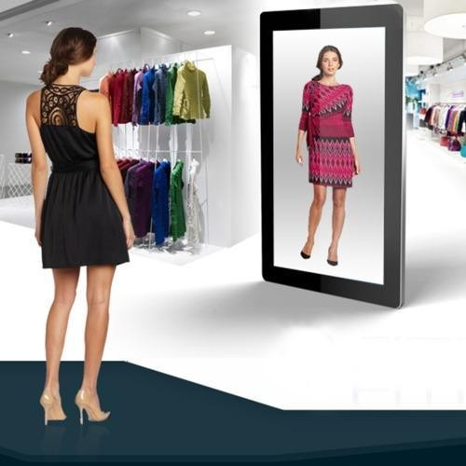
Introduction
The term ”virtual try-on” refers to the process of converting the clothing item on a person into a new item.
There has been rapid growth in online shopping and its technology. Virtually wearing the clothes can enrich a customer’s experience.
Figure:Virtual try-on Mirror
source:-Google
VIRTUAL TRY-ON

Slide 3
Motivation
In this modern world, most of the times customers find it difficult and challenging to try on clothes physically in the store.
Customers buy clothes and return the clothes being unsatisfied with fitting, colour etc. because of not been able to try clothes before buying which has increased the number of returns.
Companies need to look for more attractive and effective methodologies to attract the customers online as well as in offline stores.
Without going to the store, you can try before you buy.
VIRTUAL TRY-ON

Slide 4
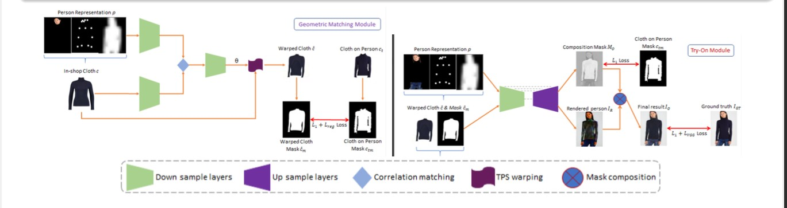
Literature Survey
Paper Title : CP-VTON+: Clothing Shape and Texture Preserving Image-Based Virtual Try-On (Matiur Minar. CVPR 2020)
Description:The try-on clothing is warped to align with the target human, and then the warped clothing is blended with the target human image.
Figure:Full pipeline of CP-VTON+.
VIRTUAL TRY-ON

Slide 5
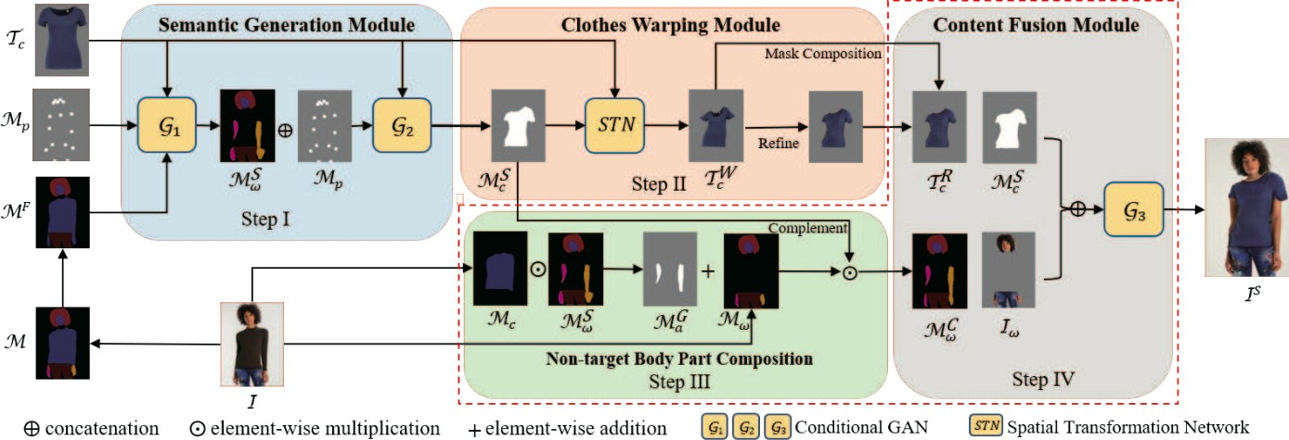
Literature Survey
Paper Title : Towards Photo-Realistic Virtual Try-On by Adaptively Generating Preserving Image Content (Han Yang. CVPR 2020)
Description:ACGPN: Here it uses 3 main steps they are Semantic Generation Module, Cloth Warping Module and Content Fusion.
Figure:The overall architecture of ACGPN.
VIRTUAL TRY-ON

Slide 6
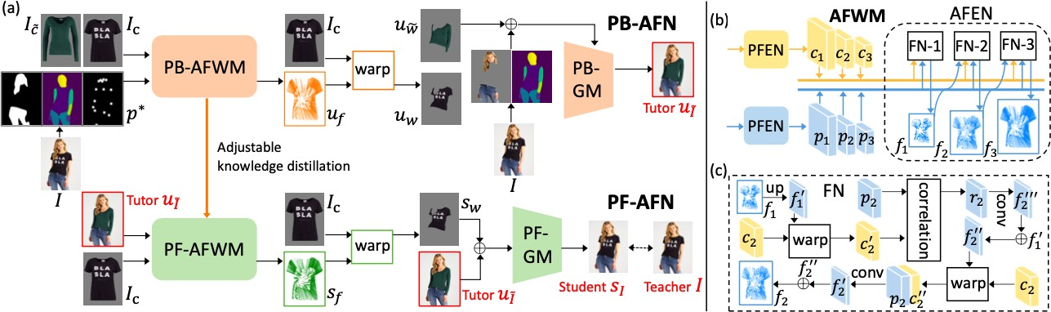
Literature Survey
Paper Title : Parser-Free Virtual Try-On via Distilling Appearance Flows(Yuying Ge. CVPR 2021)
Description: It cosists of paser-based model and paser-free model where paser based model is used as tutor knowledge to produce paser-free network
Figure:The training pipeline of PF-AFN
VIRTUAL TRY-ON

Slide 7
Problem Statement and Objectives
Problem Statement
Design of a Vitual try-on model which given with a pair of target cloth and person image , generates a photorealistic image of a person wearing a target cloth.
Objectives
Achieve Virtual Try-On.
Perform realistic rendering of clothes.
VIRTUAL TRY-ON

Slide 8
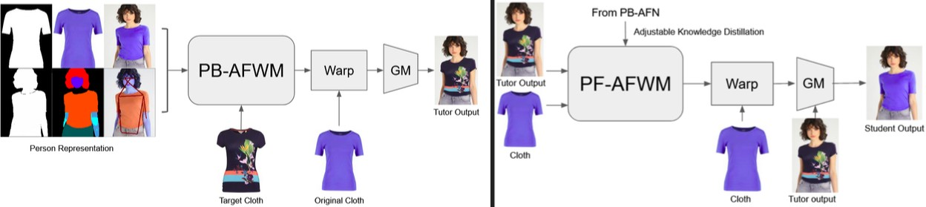
Block diagram-1
Figure:Proposed Block Diagram for the PF-AFN algorithm. PB-AFN on the left and PF-AFN on the right. Person representation and the cloth image are input to the PB-AFN. The output from the
PB-AFN are input to the PF-AFN.
VIRTUAL TRY-ON

Slide 9
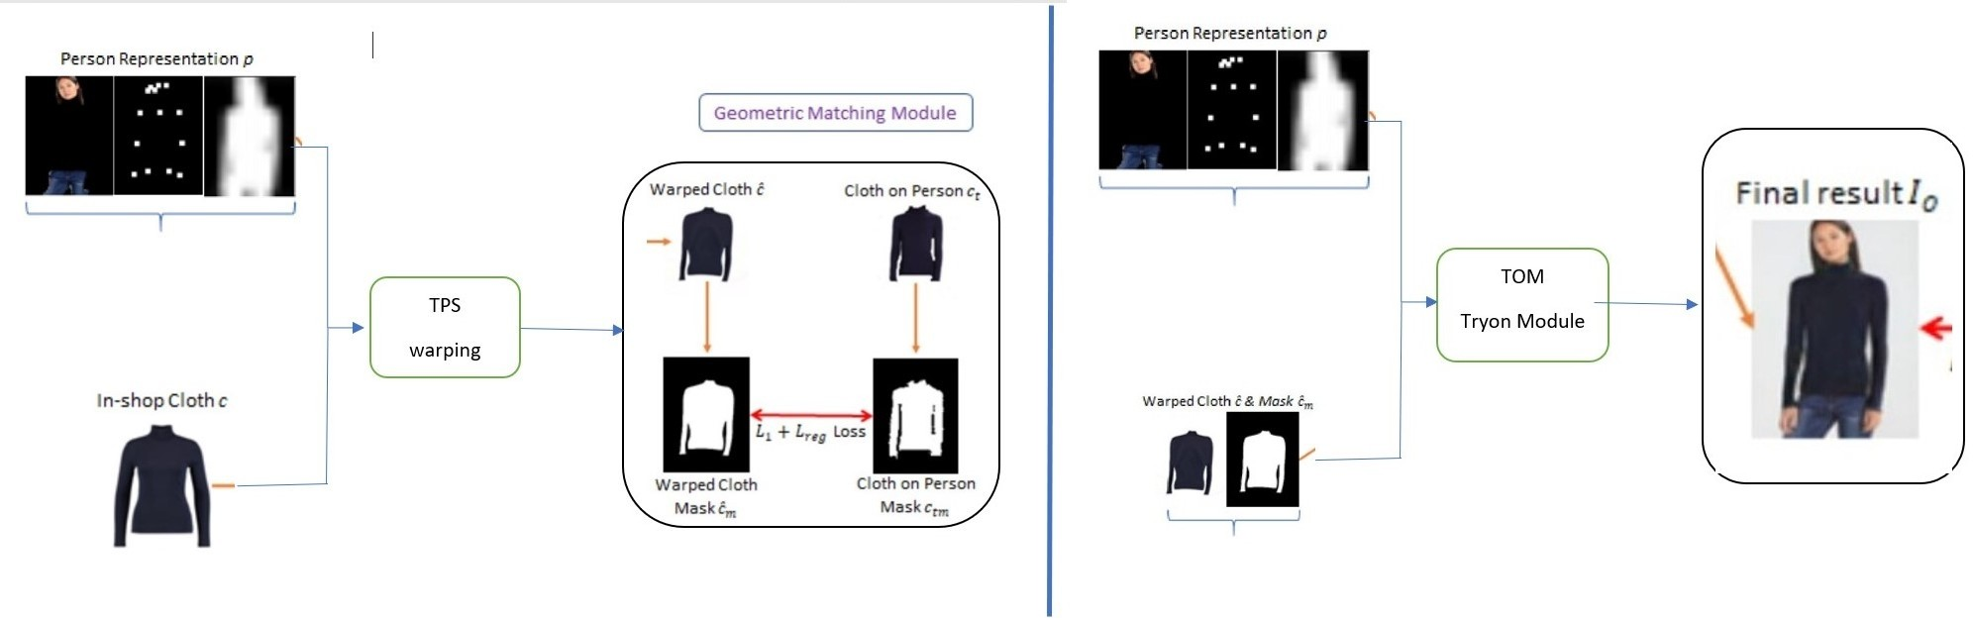
Block diagram-2
Figure:Proposed Block Diagram for the cp-viton+ algorithm. GMM module on the left and TOM module on the right. Person representation and the cloth image are input to the GMM and TOM module. The output from the GMM module are input to the TOM module.
VIRTUAL TRY-ON

Slide 10
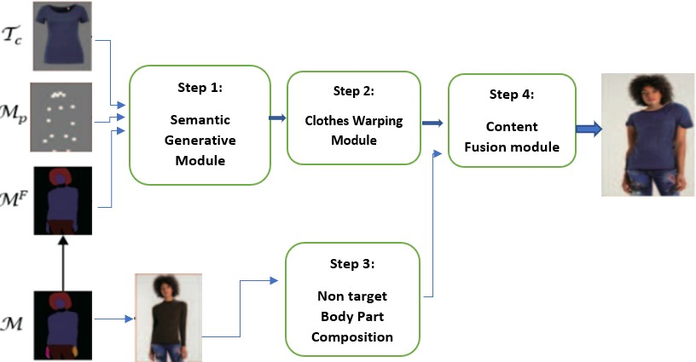
Block diagram-3
Figure:Proposed Block Diagram for the ACGPN algorithm. In first step semanticgeneration module and in second step cloth warping module and third step non-targetbody part composition will happen and at last step ther will be content fusion module willtake place then there will be output image.
VIRTUAL TRY-ON

Slide 11
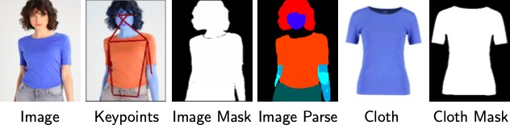
Dataset Analysis / Description
Detailed Explanation of VITON: Resolution: 256x192
Total image pairs: 19000 (front view woman and top-clothing image pairs) Cleaned pairs : 16253
Training set : 14221 Validation set : 2032
sample image from dataset
VIRTUAL TRY-ON

Slide 12
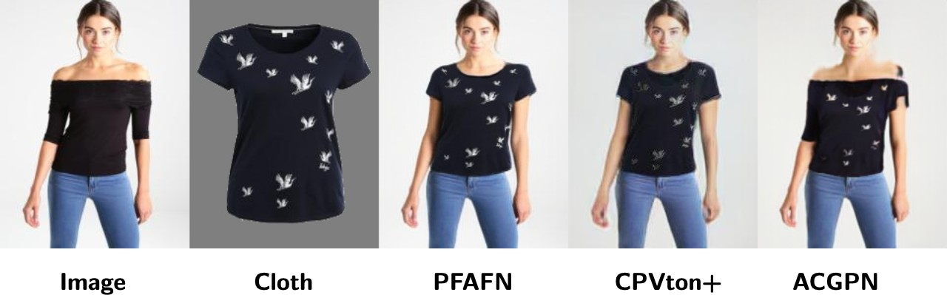
Experimental Results
General Result
Inference : Cloth texture is retained in case of PF-AFN, and is not retained in CPVton+,while the cloth is not rendered correctly in ACGPN
VIRTUAL TRY-ON

Slide 13
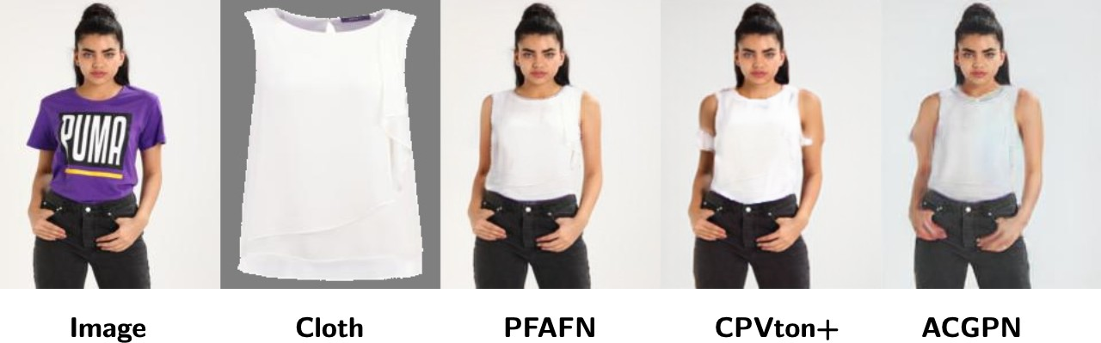
Experimental Results
simple cloth - simple pose
Inference:Cloth texture and type is retained in case of PF-AFN, cloth type is not retained in
CPVton+, while the cloth is rendered correctly but extra skin is generated in ACGPN.
VIRTUAL TRY-ON

Slide 14
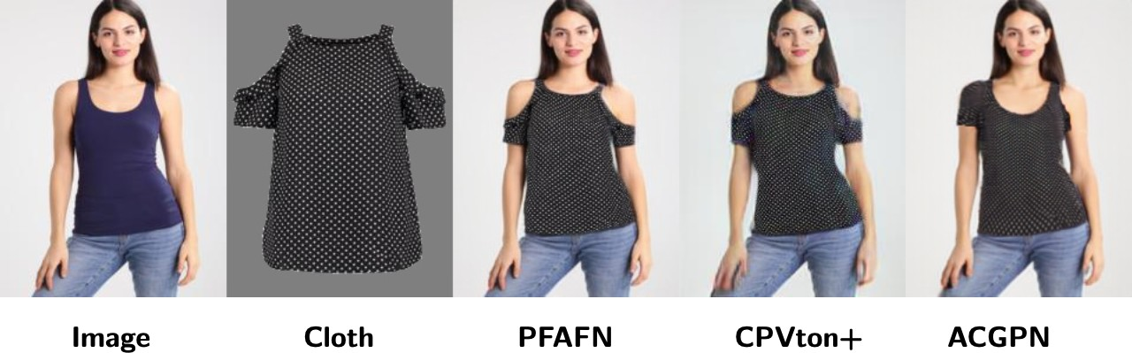
Experimental Results
complex cloth - simple pose
Inference:Cloth shape is retained in case of PF-AFN and CPVton+, while the cloth is not
rendered correctly in ACGPN. The quality of CPVton+ is inferior compared to PF-AFN
VIRTUAL TRY-ON

Slide 15
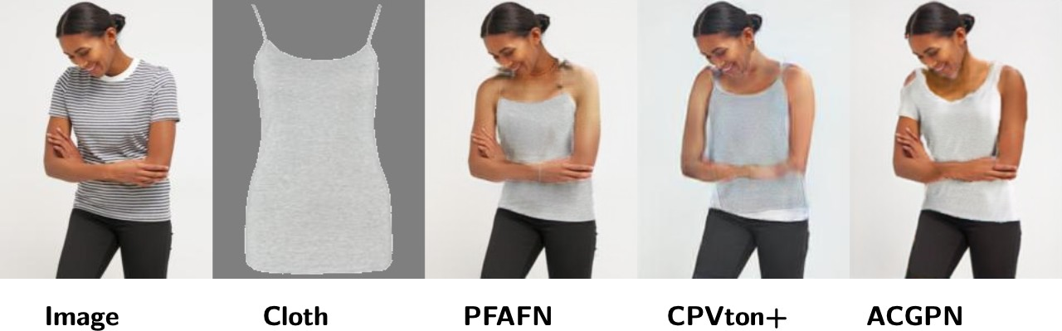
Experimental Results
simple cloth - complex pose
Inference:Occlusion has been handled perfectly in PF-AFN and ACGPN, but the cloth shape
is not retained in ACGPN.
VIRTUAL TRY-ON

Slide 16
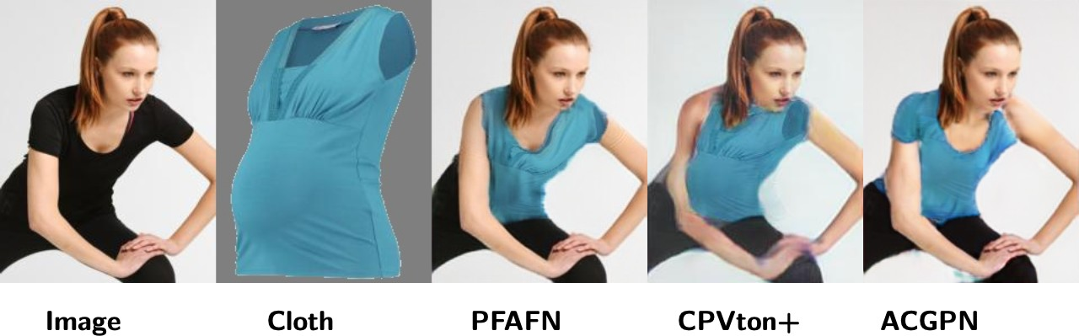
Experimental Results
complex cloth - complex pose
Inference:Cloth does not fit the body in CP-Vton+, whereas cloth shape is not perfectly
rendered in ACGPN
ADNAN, NIRANJAN,SHI
VIRTUAL TRY-ON

Slide 17
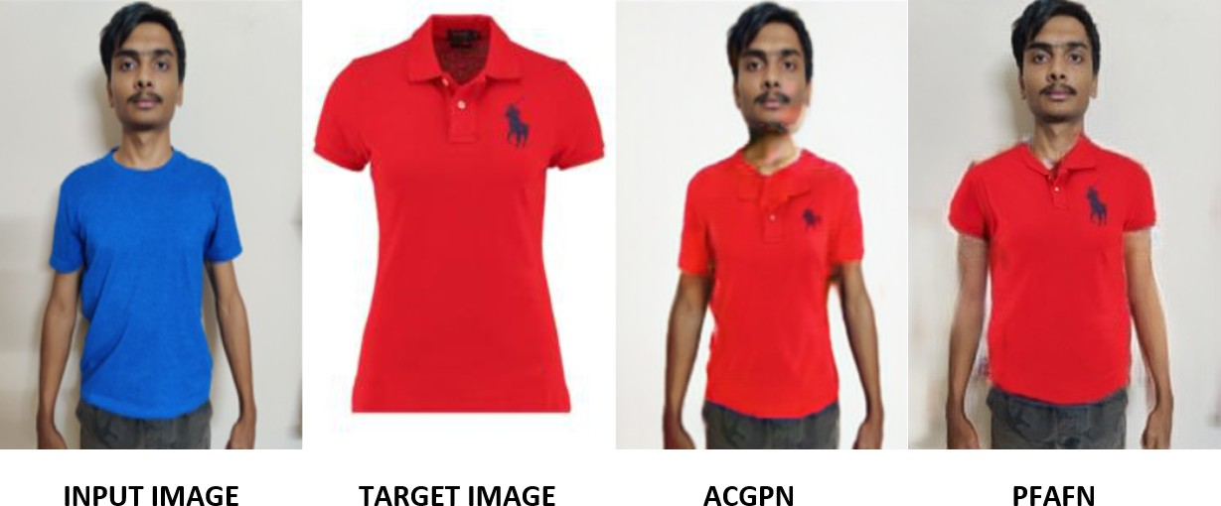
Experimental Results
Custom input image and target cloth
Inference:Because of shadows in the input image, the output for both ACGPN and PFAFN
are not that perfect.
ADNAN, NIRANJAN,SHI
VIRTUAL TRY-ON

Slide 18
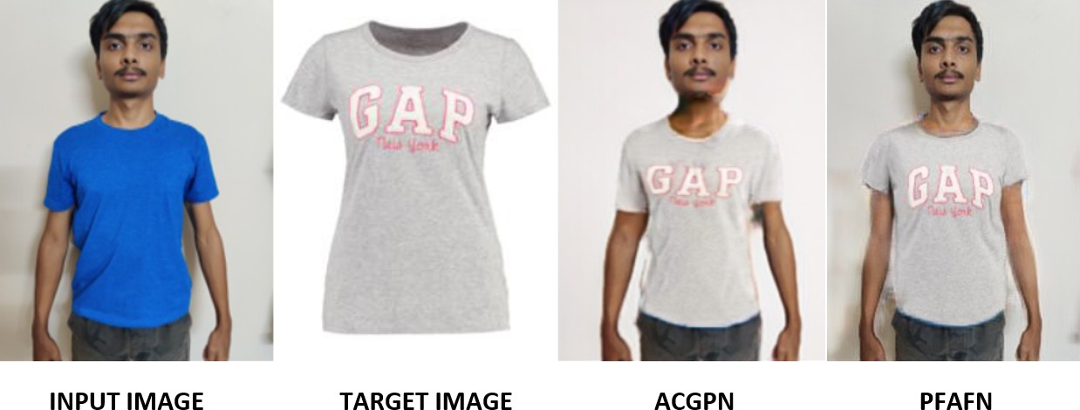
Experimental Results
Custom input image and target cloth
Inference:Almost same as the above output but different target image.
VIRTUAL TRY-ON
18 / 22

Slide 19
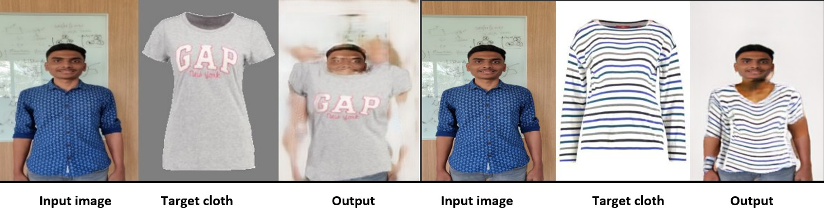
Experimental Results
Custom input image and target cloth in uncontrolled environment
Inference:PF-AFN alogorithm output on the right and ACGPN on the left .
VIRTUAL TRY-ON

Slide 20
Plan of Action and Conclusion
PF-AFN generates better results than CP-VTON+ and ACGPN.
ACGPN also generates good results but has challenges for complex clothes and poses. It is necessary to work in a controlled environment.
VIRTUAL TRY-ON

Slide 21
Reference
Y. Ge, Y. Song, R. Zhang, C. Ge, W. Liu, and P. Luo. Parser-free virtual try-on via distilling appearance flows. arXiv preprint arXiv:2103.04559, 2021.
M. Minar, T. Tuan, H. Ahn, P. Rosin, and Y. Lai. Cp-vton+: Clothing shape and texture preserving image-based virtual try-on. 2(3):11, 2020.
B. Wang, H. Zheng, X. Liang, Y. Chen, L. Lin, and M. Yang. Toward characteristic-preserving image-based virtual try-on network. 2018.
H. Yang, R. Zhang, X. Guo, W. Liu, W. Zuo, and P. Luo. Towards photo-realistic virtual try-on by adaptively generating-preserving image content. pages 7850–7859, 2020.
VIRTUAL TRY-ON

Slide 22
Thank You
VIRTUAL TRY-ON

