Slide 1

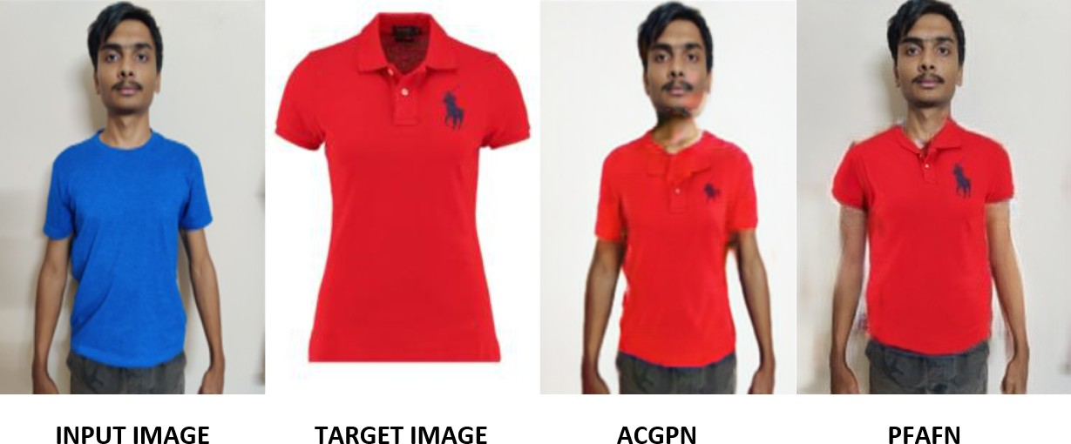
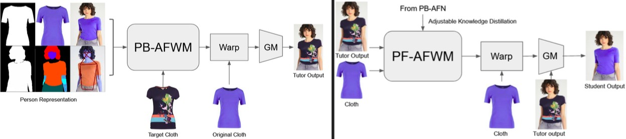
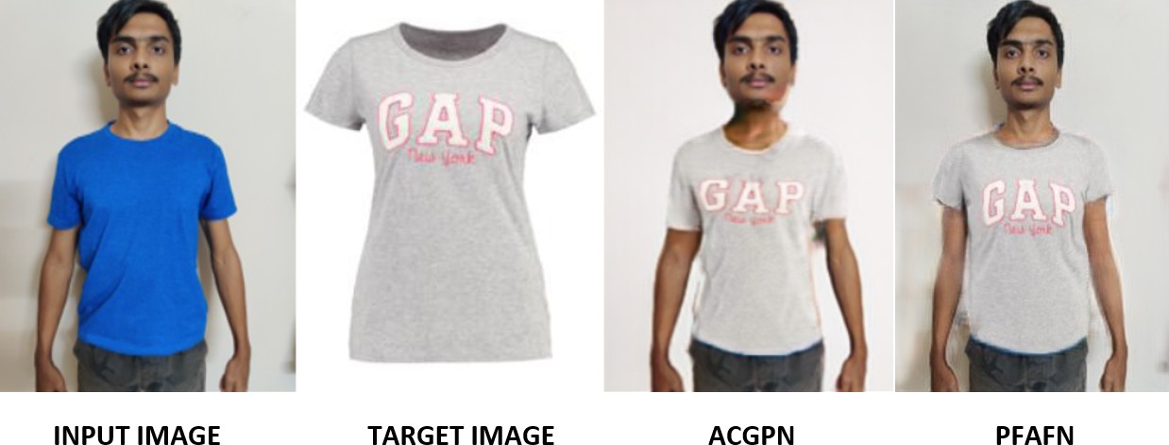
VIRTUAL TRY-ON
Niranjan, Shivkumar, Adnan & Guide : Uma Mudenagudi and Ramesh Ashok Tabib
pppp
Problem statement
Proposed Framework
For PF-AFN algorithm
Results and Discussion
Design an end-to-end pipeline such that given a pair of target cloth and person image, generate an output image of the person wearing the target cloth.
Input image Target Cloth ACGPN PFAFN
Objectives
Achieve Virtual Try-On.
Perform realistic rendering of clothes.
Input image Target Cloth ACGPN PFAFN
Contributions
Conclusions
Learnt and Compared all three algorithms.(ACGPN,PF-AFN,CPVTON+).
PF-AFN generates better results than CP-VTON+ and ACGPN.

