Slide 1

UK Road Safety Analysis:
Understanding Accidents
& Predicting Severity

Slide 2

UK road accident Analysis, Statistical Insights and Feature selection
Exploring accidents trends and key influencing factors
Presented by: Group 8
Group Members: Abdul Adnan
Sahil Sahil
Shubham Shubham
Vaibhav Vaibhav
Shalu Choudhary
Mohit Rexwal

Slide 3

Introduction
Road accidents are a significant global concern, causing injury, death, and economic loss.
By leveraging data and AI, we aim to uncover patterns and build a system that can predict accident severity and support decision-making for safer roads.
Our project focuses on predicting road accident severity — whether an accident is likely to be Minor, Serious, or Fatal — using machine learning models.
The key objective is to build a highly accurate model that can predict accident severity, and to understand which factors contribute most to severe accidents.

Slide 4
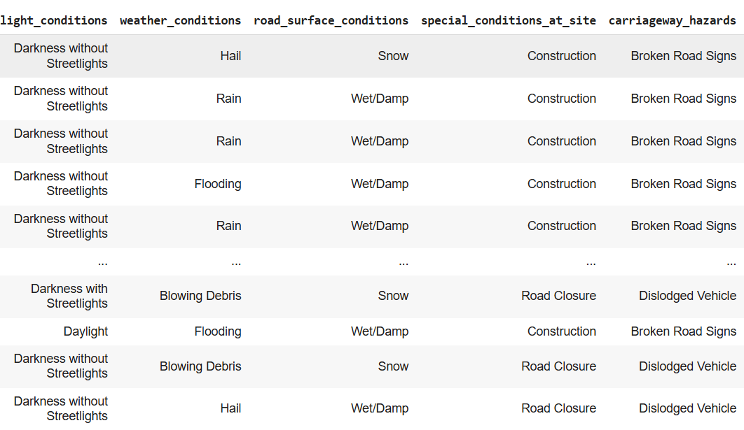
UK road accident 2023 Dataset Overview
Sourced : UK government Website & Road Transport dept of UK
Total Records: 104259 Rows & 36 Columns
Key Attributes:
Accident Severity : Minor, Serious, Fatal
Number of vehicles involved
Weather & Road Conditions
Speed limits
Road Types
Location Data (Longitude, Latitude)
Objective: Identifying significant accident patterns and key influencing factors

Slide 5
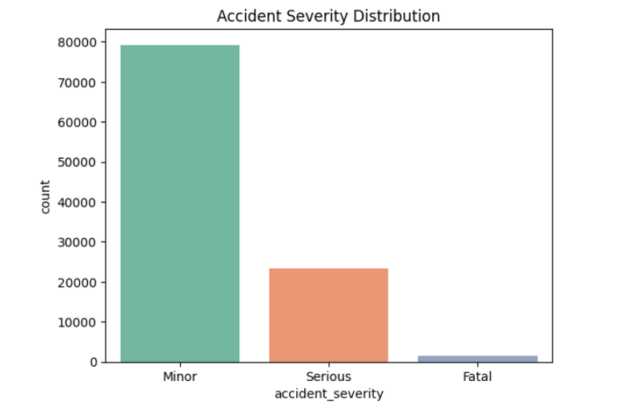
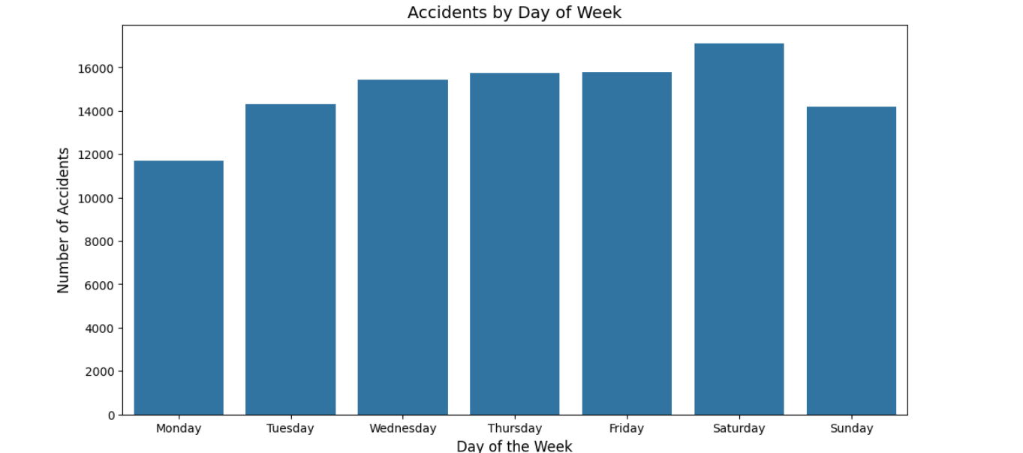
Exploratory Data Analysis.
Showing Accident Severity based on different factors:
The majority of accidents are significantly Minor than any other category.
Saturday has the highest number of accidents, suggesting weekends might be riskier due to increased traffic, leisure activities, or impaired driving.

Slide 6
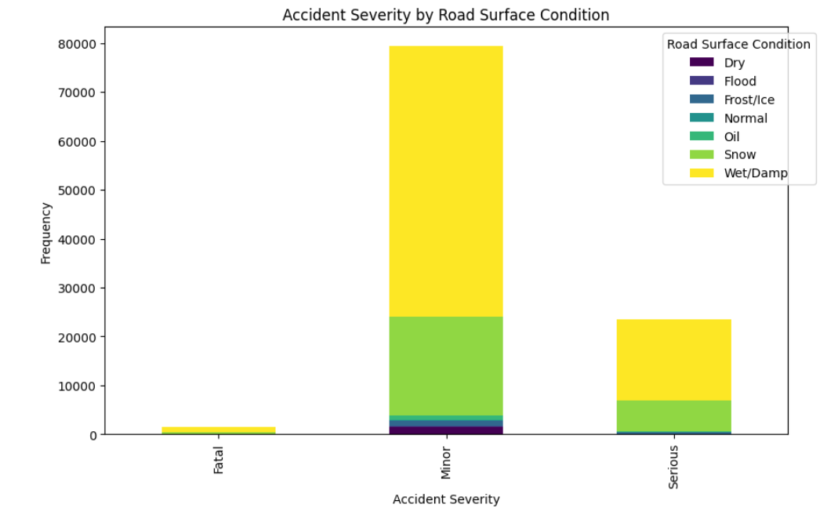
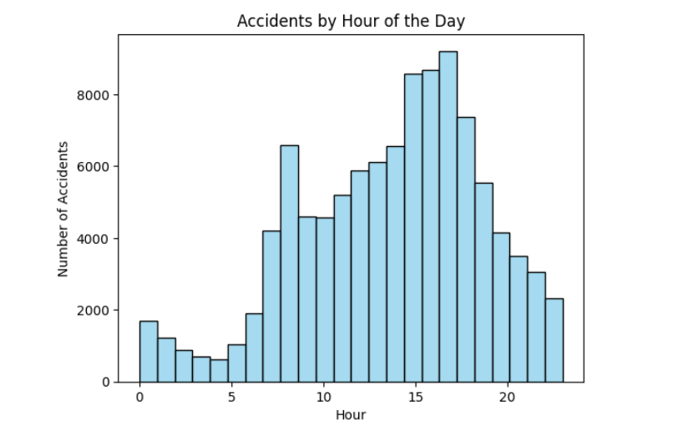
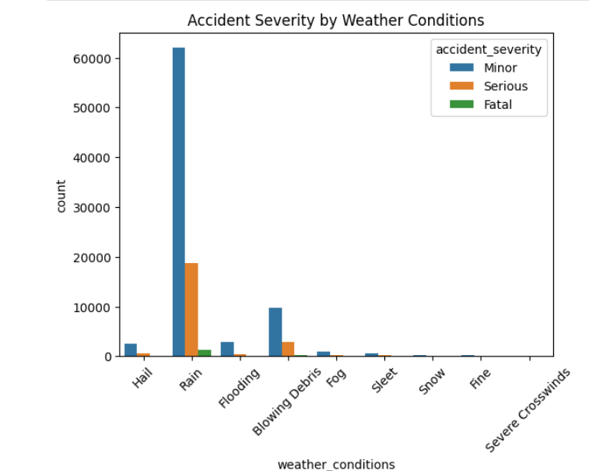
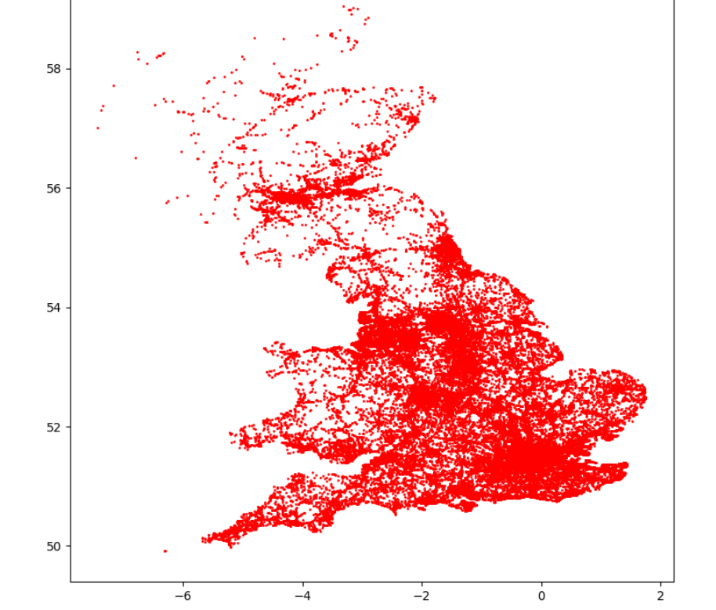
Most minor and serious accidents occur on wet/damp roads, with fewer on dry or icy surfaces.
Accidents peak between 3 PM and 6 PM, with fewer incidents during early morning hours.
A geographic plot shows accident locations, densely clustered in central and southern regions.
Most accidents happen during rain, with fewer incidents in severe weather like hail, fog, or snow.

Slide 7
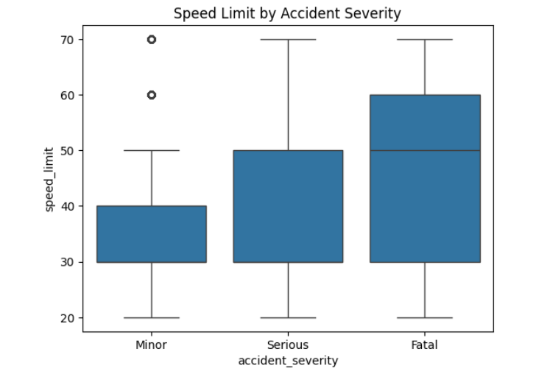
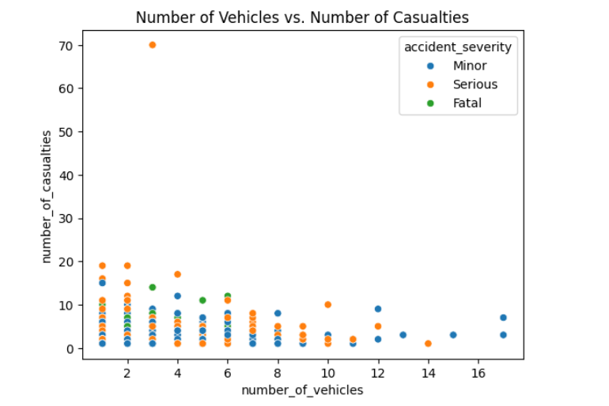

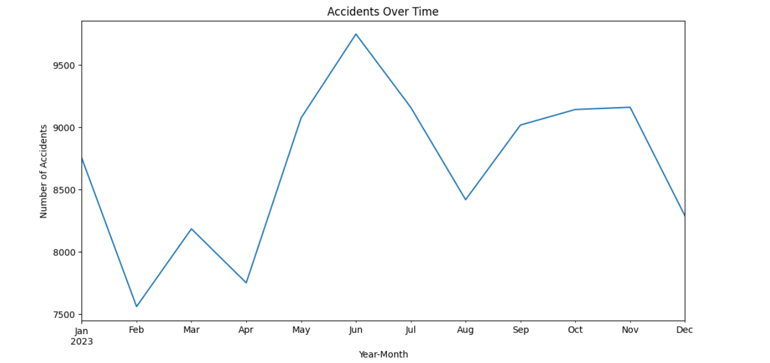
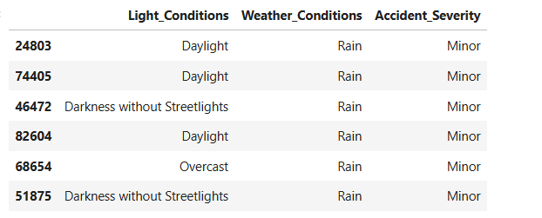
Higher speed limits are linked to more severe accidents, with fatal accidents occurring at higher average speeds.
Accidents with more vehicles tend to have more casualties, though most incidents involve fewer than 6 vehicles.
Most minor accidents happen during daylight or rain, with some occurring in darkness without streetlights or overcast conditions.
The number of accidents fluctuates throughout the year, peaking around June and dipping in February.

Slide 8
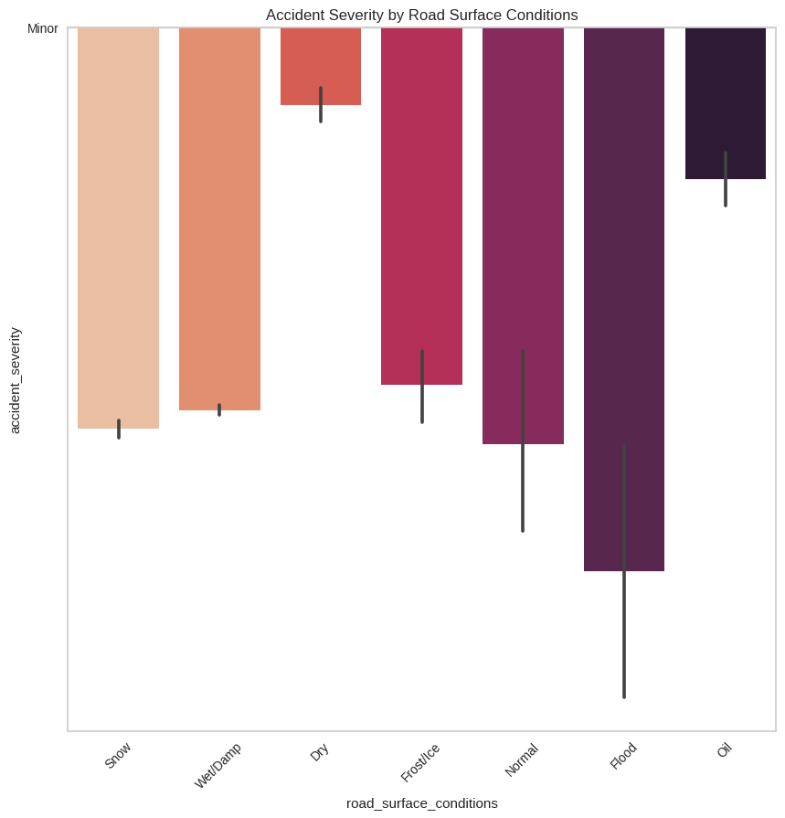
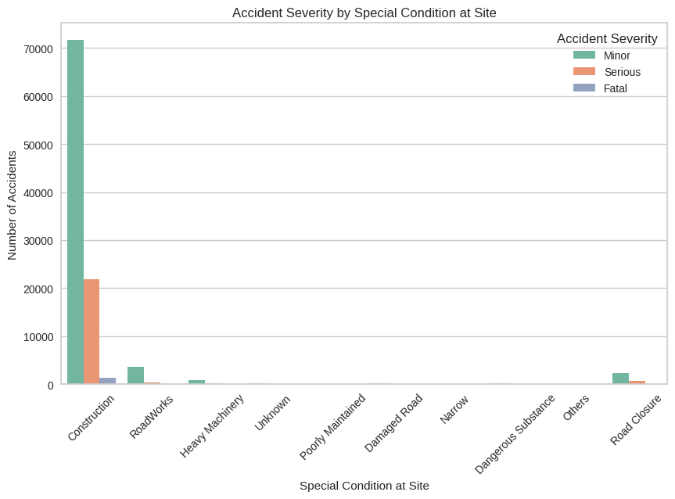
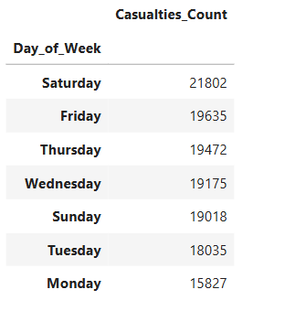
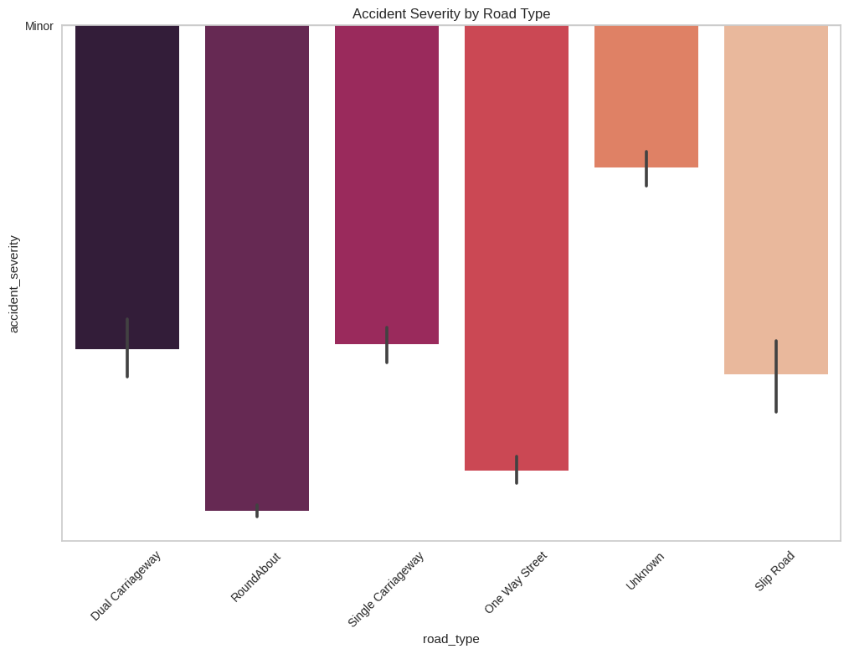
Accident Severity by Road Surface Conditions
Accident Severity by Special Condition at Site
Accident Severity by Road Type

Slide 9
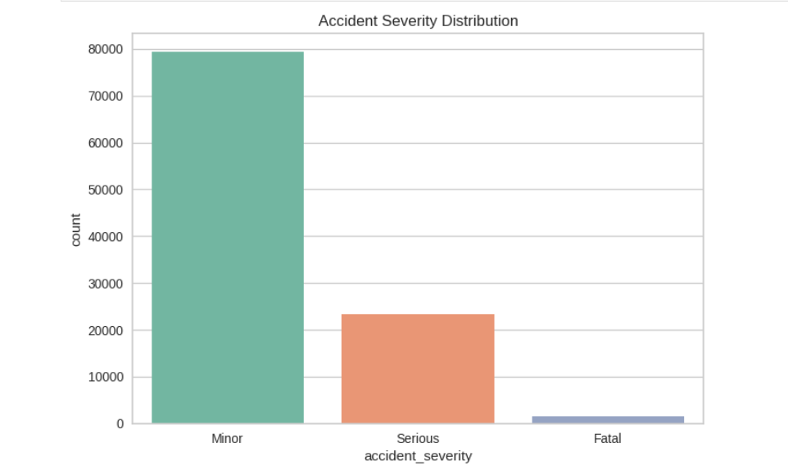
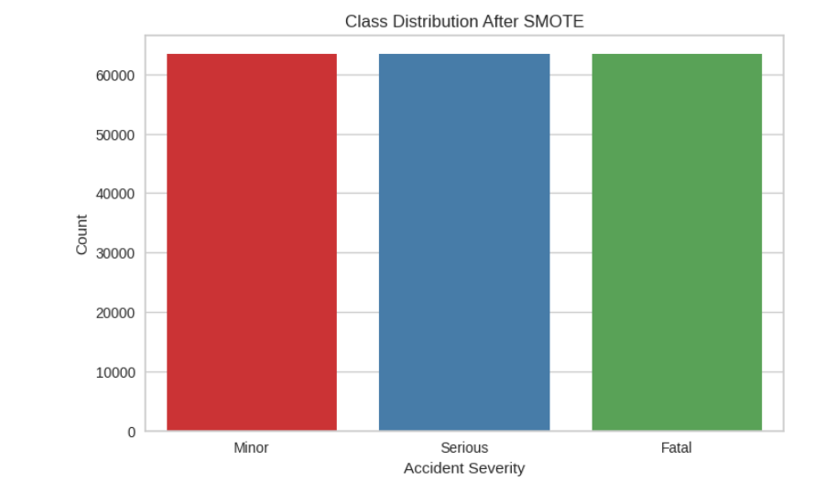
Data Imbalance
Class Imbalance and SMOTE:
The original dataset was highly imbalanced:
  Minor: 63,392
  Serious: 18,766
  Fatal: 1,238
This could bias the model towards predicting accidents.
SMOTE (Synthetic Minority Over-sampling Technique) was used to balance the classes, resampling all to 63,392 each.
This ensures the model learns patterns from Serious and Fatal cases, improving its prediction accuracy for rare but critical events.

Slide 10
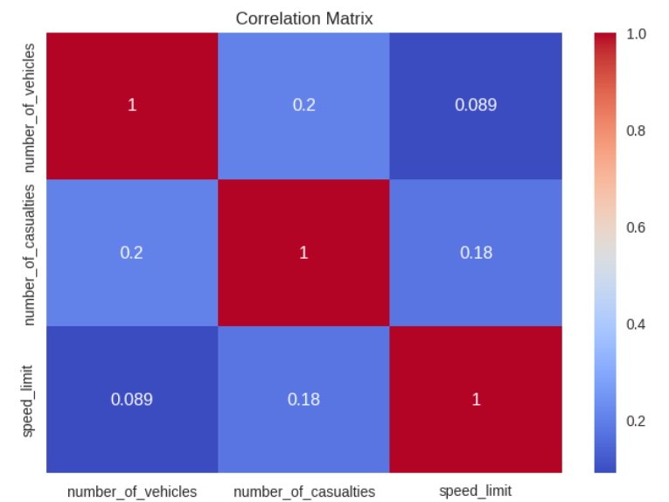
CORELATION MATRIX
This shows that speed limit has minimal impact on number of vehicles and number of casualties. where number of vehicles and number casualties has a bit stronger relation that is 0.2 compared to speed limit.

Slide 11
Methodology
Chi-Square Test
Chi-Square Test on light conditions and accident severity:
p-value: 1.1803413019381023e-132 (even smaller than the first), showing an even stronger statistical significance.
Chi-Square Test on weather conditions and accident severity:
p-value: 1.3539774741973777e-74 (extremely small), indicating a strong statistical significance.

Slide 12
HYPOTHESIS TESTING FOR WEATHER AND LIGHT CONDITIONS
Hypothesis testing on light conditions and accident severity:
  Chi-square Statistic: 638.58
  Degrees of Freedom: 8
  P-value: 0.00000
  Hypothesis Decision: Reject the null hypothesis (H₀) since p-value < 0.05.
  Conclusion: 🔴 Light conditions significantly affect accident severity.
Hypothesis testing on weather conditions and accident severity:
Chi-square Statistic: 397.28
Degrees of Freedom: 16
P-value: 0.00000
Hypothesis Decision: Reject the null hypothesis (H₀) since p-value < 0.05.
Conclusion: 🔴 Weather conditions significantly affect accident severity.

Slide 13
Feature Selection
Filter Method
Top Features (Filter - MI):
time,
speed_limit,
date,
junction_control,
first_road_number,
junction_detail,
latitude,
number_of_vehicles,
longitude,
second_road_number]

Slide 14
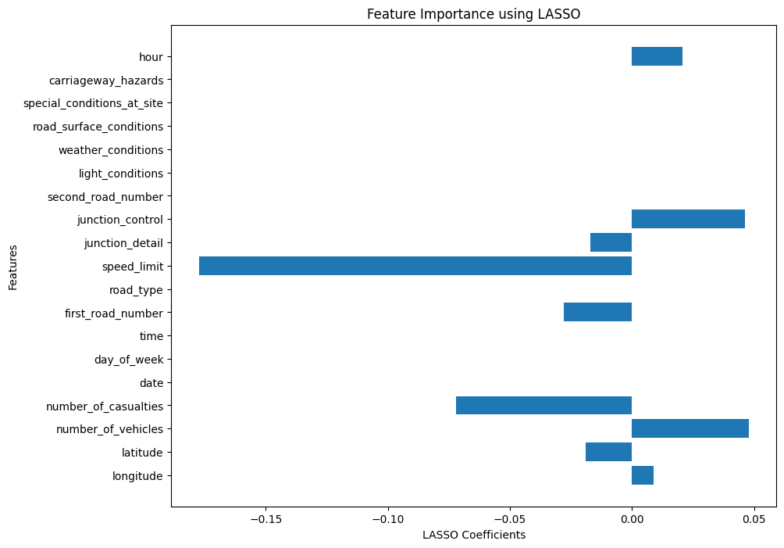
EMBEDDED METHOD
LASSO
Results
'longitude’
'latitude' 'number_of_vehicles' 'number_of_casualties' 'first_road_number' 'speed_limit' 'junction_detail' 'junction_control' 'hour’
These are the top Features

Slide 15
Wrapper Method
Recursive feature Elimination

Slide 16
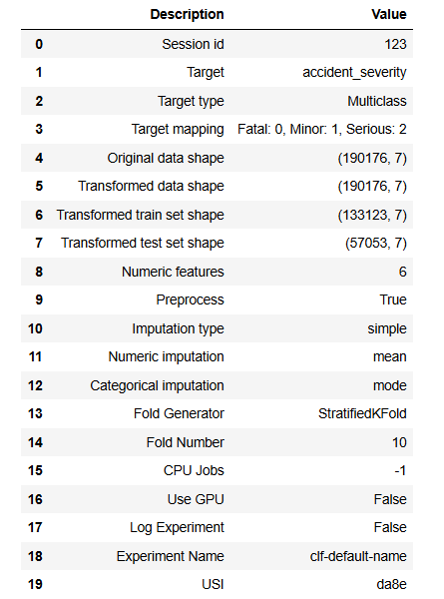
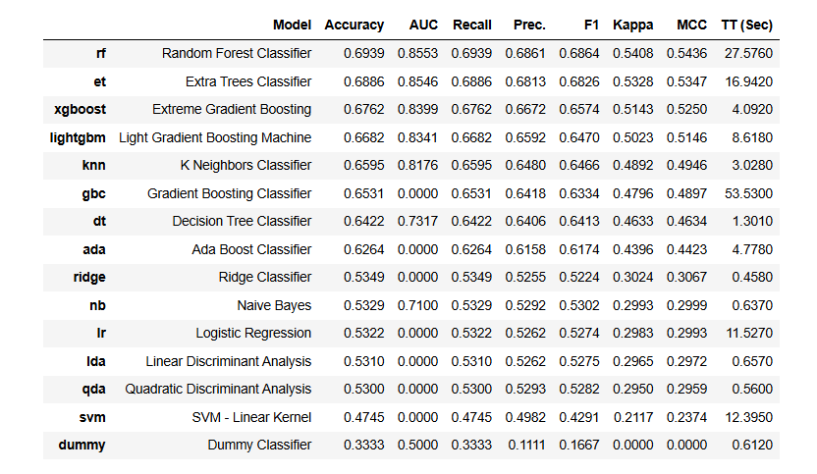
Results: Final Model
Using PyCaret

Slide 17
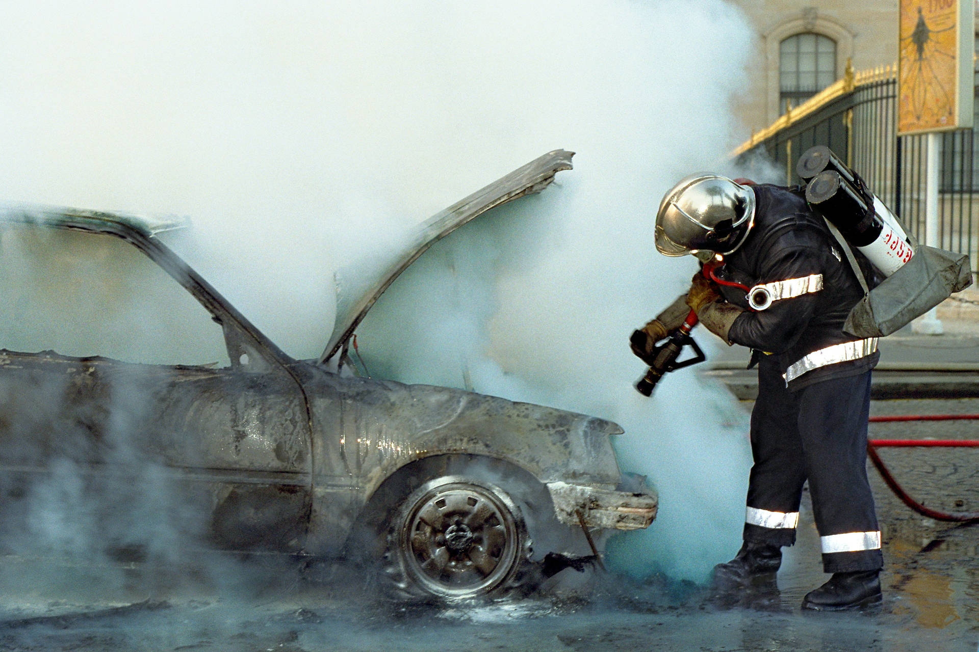
After running the models using PyCaret with our selected features, each group member picked one model to work on. We focused on tuning, hyperparameter optimization, and cross-validation for these models. The models we explored included Random Forest, Extra Trees, XGBoost, LightGBM, K-Nearest Neighbors, and Gradient Boosting Classifier. After comparing their performances, we found that Random Forest gave us the highest accuracy and consistent results across metrics, so we chose it as our final model."

Slide 18
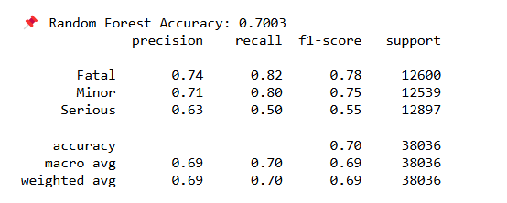
Training Models and Evaluation Using Random Forest
The Random Forest classifier achieved an overall accuracy of 70.03% in predicting accident severity. The model performed well for the Fatal (F1-score: 0.78) and Minor (F1-score: 0.75) classes, showing strong precision and recall. However, performance for the Serious class was weaker, with an F1-score of 0.55 and recall of only 50%, indicating that half of the serious cases were missed.

Slide 19
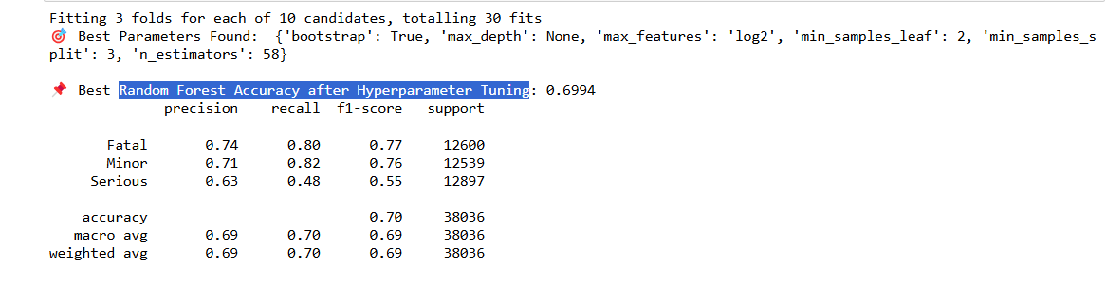
Random Forest Accuracy after Hyperparameter Tuning
After applying hyperparameter tuning, the best Random Forest model achieved an accuracy of 69.94%, which is comparable to the default model performance. The model continued to perform well on the Fatal (F1-score: 0.77) and Minor (F1-score: 0.76) classes, with high recall values of 0.80 and 0.82 respectively, indicating good sensitivity.
However, the Serious class remains a challenge, with a lower recall of 0.48 and F1-score of 0.55, suggesting that the model struggles to correctly identify many of the serious cases.
Despite tuning, the class imbalance and overlapping feature space may be limiting the model's ability to improve. To enhance performance further, additional steps such as class balancing, feature selection, or alternative models like XGBoost or LightGBM can be considered.

Slide 20
Cross-validation on the Random Forest
The Random Forest model was evaluated using 5-fold cross-validation, producing the following accuracy scores:
[0.5865, 0.6845, 0.7319, 0.7311, 0.7335]
The mean cross-validation accuracy is 69.35%, with a standard deviation of 0.0566.
This indicates that the model is generally consistent in its performance across different data splits, though one fold (58.65%) showed notably lower accuracy, suggesting some variability possibly due to data imbalance or distribution differences.
To improve stability and performance, further tuning, stratified sampling, or addressing class imbalance could be beneficial.

Slide 21

Model Deployment
Gradio was used to create an interactive web interface for the UK road accident severity prediction model. It allows users to input accident-related features and instantly receive severity predictions from the trained Random Forest model.

Slide 22
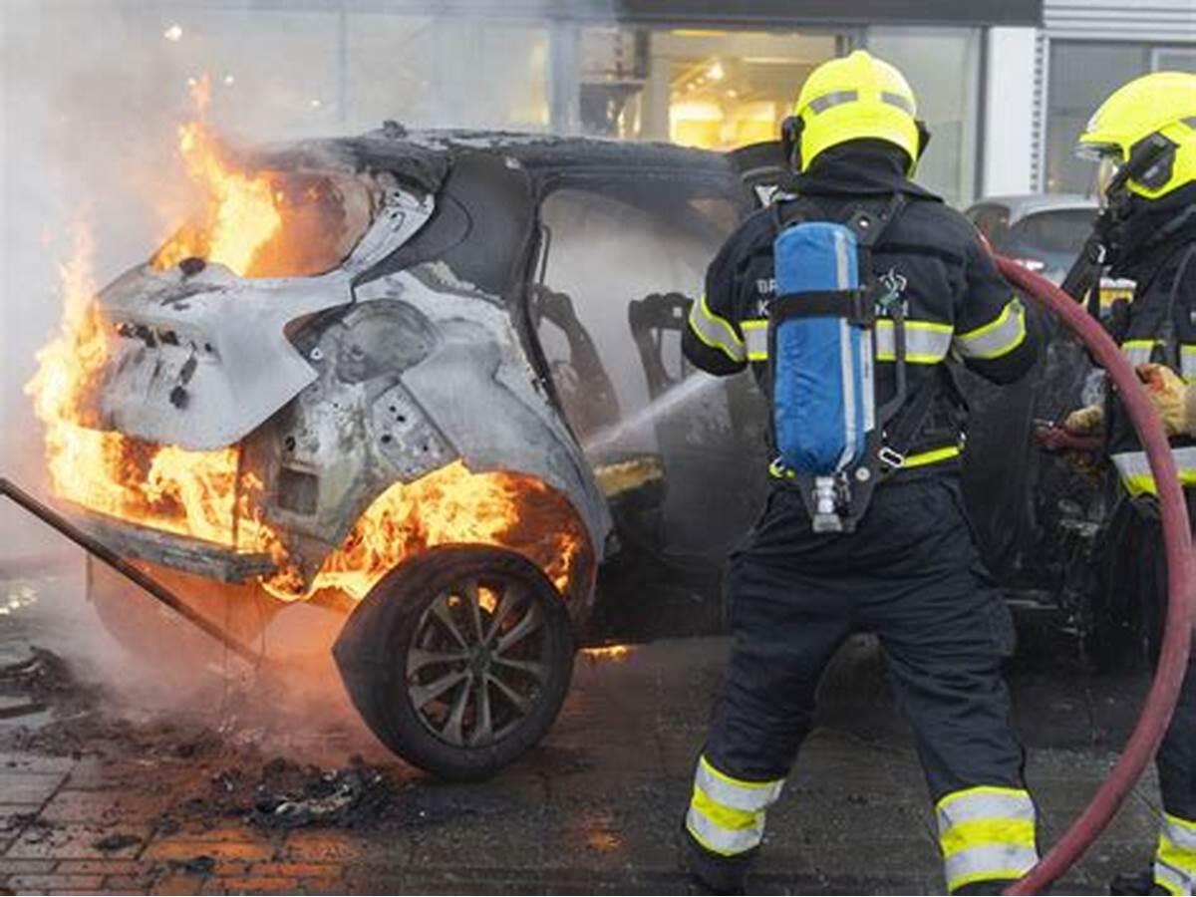
Conclusions
The Random Forest model demonstrated satisfactory performance in predicting accident severity, achieving a maximum accuracy of 70.03% before tuning and 69.94% after hyperparameter tuning. Cross-validation results further confirmed model stability, with a mean accuracy of 69.35% and a standard deviation of 0.0566.
The model performed well in identifying Fatal and Minor accidents, with high precision and recall. However, it struggled to accurately classify the Serious category, highlighting the impact of class imbalance and overlapping features. Despite tuning, gains were marginal, suggesting the need for further enhancements such as advanced resampling techniques, feature engineering, or alternative ensemble models.
Overall, the Random Forest model provides a solid baseline for accident severity prediction and can be effectively deployed with additional improvements for real-world use.

Slide 23


