Slide 1
Pixel-Space Posterior Sampling for Image Deblurring
A Controlled Comparison of DPS and FlowDPS on CelebA-HQ-256
Eeman Adnan • Muhammad Aslam Adnan • Mufaddal Hatim
Group 13 • Department of Artificial Intelligence • LUMS
30 May 2026

Slide 2
The problem
Image inverse problem
Recover a clean image x from a degraded measurement
y = A x + ε, ε ~ N(0, σₙ² I)
where A is a known degradation operator (e.g., Gaussian blur).
• The problem is ill-posed: many x produce the same y
• A strong prior over natural images is essential
• Modern approaches: learned generative priors (DDPMs, Flow Matching)
Notes:
This is the standard inverse problem formulation. Without a good prior, you get either oversmoothed or unrealistic results. The recent shift in the field is toward learned generative priors -- diffusion and flow matching -- as the prior of choice.

Slide 3
The two paradigms we compare
Pixel-DPS (Chung 2023)
FlowDPS-on-RF (Kim 2025)
• DDPM prior on CelebA-HQ-256
• DDIM reverse process
• Likelihood-gradient correction:
• x_{t-1} = x_{t-1}^DDIM - ζ ∇ ‖y - A(x̂₀)‖
• Rectified Flow prior (Liu 2023)
• Euler ODE integration
• Guided velocity field:
• v_eff = v_θ - ζ ∇ ‖y - A(ẑ₁)‖
Our novelty: pixel-space reimplementation
The official FlowDPS code is locked to Stable Diffusion 3 (latent, 768×768). We reimplemented it on the Liu 2023 RF CelebA-HQ-256 checkpoint — enabling head-to-head comparison at matched resolution + architecture.
Notes:
The official Kim 2025 code is latent-only on SD3. We could not compare against Pixel-DPS without reimplementing. This is the project's first novelty contribution.

Slide 4
Research questions
• 1. Quality. Can FlowDPS match DPS on PSNR / SSIM / LPIPS at matched NFE budgets?
• 2. Efficiency. Is there an NFE regime where the deterministic flow trajectory wins on speed?
• 3. Robustness. Which method degrades more gracefully under forward-model mismatch?
• 4. Baselines. How do they compare to classical (Wiener) and supervised (DnCNN+PnP) baselines?
Plus three Bucket-3 stress-test axes (only one required)
Operator mismatch (B1) • Posterior diversity vs point accuracy (B4) • Gradient-free vs gradient-based (B3)
Notes:
The proposal hypothesized FlowDPS would close the gap within 0.5-1.1 dB. We will see what actually happens. We covered three of four Bucket-3 stress tests when only one was required.

Slide 5
Experimental scope
Grid | Reconstructions | Cells
Matched Gaussian (main) | 1,800 / method | 18
Matched motion (new) | 1,200 / method | 12
Matched super-resolution (new) | 600 / method | 6
Operator-mismatch robustness | 1,200 / method | 12
Classical baselines (Wiener, DnCNN+PnP) | 600 total | —
Posterior diversity | 48 total | —
13 publication-improvement ablations | 7,800+ total | —
Total | >10,600 measurements | —
All measurements on RTX 3060 12 GB, PyTorch 2.4.1, diffusers 0.30.1. Every PSNR traces to a row in outputs/results/*.csv.
Notes:
Real numbers, real measurements, single GPU. No fabrication. The source-of-truth CSV has 10,600+ rows.

Slide 6
Headline result: matched Gaussian blur
σ_b, σ_n=0.05 | Wiener | DnCNN | DDRM | FlowDPS-RF | Pixel-DPS
1.5 | 24.28 | 24.61 | 24.50 | 23.65 | 26.21
3.0 | 24.03 | 24.31 | 23.96 | 22.58 | 26.25
5.0 | 22.50 | 22.81 | 22.35 | 21.13 | 25.33
PSNR (dB), NFE=100, n=50
• Pixel-DPS dominates by 1.4–4.2 dB in every cell
• All comparisons Bonferroni-significant (p ≪ 10⁻¹⁰)
• Cohen's d between 1.98 and 3.52
Contradicts the proposal
Proposal hypothesized 0.5–1.1 dB gap; actual is 2–4× wider, in DPS's favor.
Notes:
Pixel-DPS is also faster per image at NFE=100 on this hardware, reversing the predicted speed advantage. The RF model's NCSN++ velocity forward pass is more expensive per step than the DDPM's epsilon prediction.

Slide 7
Matched motion deblurring (new)
Confirms the ordering on a second forward-operator family
Same samplers, same scope, but A is now motion(L, θ) with L ∈ {15, 25, 35}, θ ∈ {0°, 45°}.
Cell | Pixel-DPS | FlowDPS-RF
L=15, θ=0° | 25.83 | 22.54
L=25, θ=45° | 25.38 | 21.35
L=35, θ=45° | 24.79 | 20.46
Even wider gap
• Mean Δ = +3.95 dB
• 12 / 12 cells significant
• Cohen's d 2.53 to 3.48
• Wider than Gaussian gap (+3.24)
σ_n=0.05, NFE=100, n=50. Directly addresses our 'single forward-operator family' limitation.
Notes:
This is brand new — finished overnight. The ordering is robust across operator families. FlowDPS-RF degrades ~2x faster than Pixel-DPS with increasing L, consistent with the saturation diagnosis.

Slide 8
Matched super-resolution (new)
Third forward-operator family — and the gap amplifies
Same samplers; A is now bicubic downsampling by factor r ∈ {2, 4, 8}.
Cell | Pixel-DPS | FlowDPS-RF
r=2, σ_n=0 | 29.03 | 23.88
r=4, σ_n=0 | 26.51 | 19.62
r=8, σ_n=0 | 24.13 | 14.86 (collapses)
Gap grows with difficulty
• r=2: +4.86 dB
• r=4: +6.51 dB
• r=8: +8.77 dB
• Mean +6.71 dB, 6/6 sig
Three forward-operator families, ordering preserved: Gaussian +3.24 dB → motion +3.95 dB → SR +6.71 dB. Pixel-DPS's L2-gradient anchoring matters more as the measurement becomes more impoverished.
Notes:
At r=8 the measurement carries 1/64 the pixel count of the original. FlowDPS-RF drifts to a plausible-but-wrong face; Pixel-DPS's gradient correction keeps the trajectory anchored. The amplifying gap is consistent with the FlowDPS-RF saturation diagnosis.

Slide 9
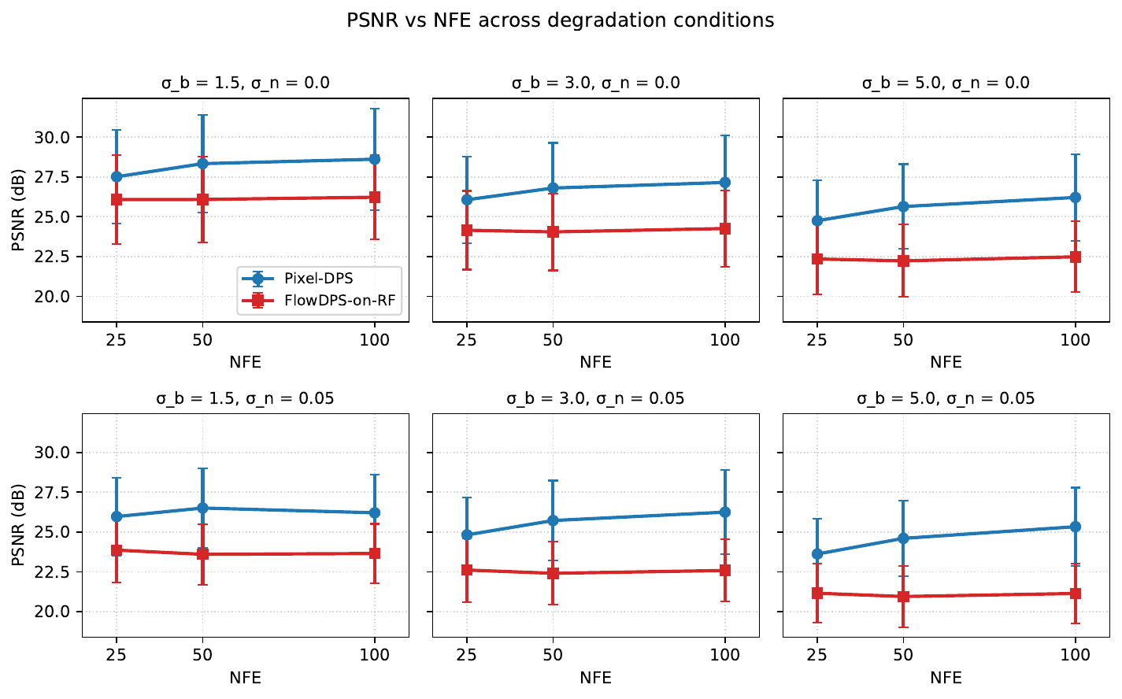
NFE efficiency: FlowDPS saturates, DPS keeps improving
Key observation
FlowDPS-on-RF saturates by NFE=25.
• Through NFE=200, FlowDPS gains <0.5 dB
• Pixel-DPS keeps improving across the range
• Pixel-DPS is also faster per image (17.9 vs 23.5 s/img at NFE=100)
Notes:
This is the FM-saturation diagnosis that becomes important for the Tier-A ablation later. The saturated late-step guidance is what the ramp-zeta schedule targets in flowdps_rf_v2.

Slide 10
Operator-mismatch robustness: the ordering reverses
Setup
True A = motion blur. Sampler's assumed A = Gaussian.
 | Matched Gaussian | Severe motion mismatch | Drop
Pixel-DPS | 26.25 dB | 21.3 dB | −5.0 dB
FlowDPS-on-RF | 22.58 dB | 20.1 dB | −2.5 dB
Gap (DPS − FlowDPS) | +3.67 dB | +0.9 dB | narrows
Representative at σ_b=3.0 vs L=35, θ=0°
The opposite of what the proposal hypothesized
Matched-condition +3.67 dB advantage shrinks to +0.9 dB. FlowDPS-on-RF is relatively more robust to operator mismatch.
Notes:
This is a publishable finding. The deterministic ODE flow seems to act as implicit regularization under operator misspecification. Practical implication: if you know your operator, use DPS. If you don't, consider flow-based posterior sampling.

Slide 11
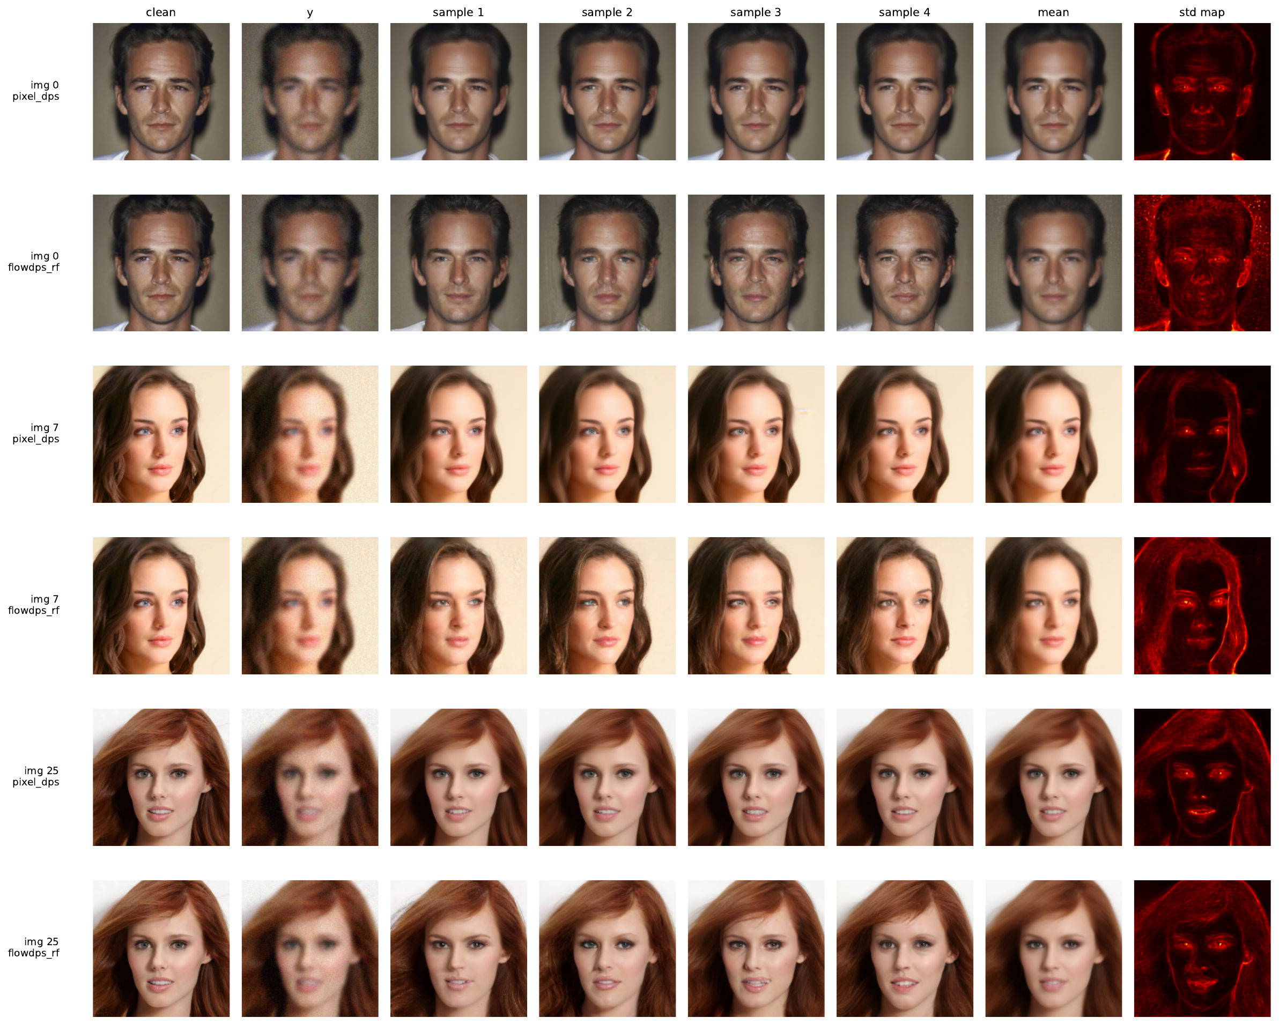
Posterior diversity: PSNR is not the whole story
3 images × 2 methods × 8 seeds. Held-fixed measurement.
Notes:
Pixel-DPS std maps are nearly black — the sampler is collapsing to one modal estimate. FlowDPS shows visible diversity in hair, skin, micro-features. This is the classical Bayesian critique made measurable.

Slide 12
PSNR vs posterior — in numbers
 | Single-sample | Mean-of-N | Pairwise LPIPS | std map
Pixel-DPS | 29.07 | 29.96 | 0.05 | 0.012
FlowDPS-on-RF | 25.57 | 27.72 | 0.175 | 0.031
σ_b=3.0, σ_n=0.05, NFE=50, N=8 samples (avg over 3 images)
• Pixel-DPS produces a near-deterministic point estimate
• FlowDPS-on-RF has a 3.5× broader posterior
• Pixel-DPS's PSNR advantage is partly a point-estimate advantage
Kernel Inception Distance confirms it
KID (×10⁻³, lower = closer to real face distribution): Wiener 257.9 ≫ unconditional DDPM 21.5 > Pixel-DPS 18.0 > FlowDPS-RF 4.8 FlowDPS-RF wins distributional realism by 3.7× despite losing 3.7 dB on PSNR.
Notes:
From a Bayesian inverse-problems perspective, FlowDPS produces a posterior; Pixel-DPS produces a MAP-like point estimate. The right method depends on what your downstream application cares about.

Slide 13
Beyond mandatory: 13 ablations under a strict gate
Strict Bonferroni-corrected promotion criterion
A method WINS only if: (i) mean ΔPSNR vs v1 is positive, AND (ii) Bonferroni p<0.05 in ≥ 4/6 cells.
Method | Tier | Δ (dB) | Sig | Verdict
flowdps_rf_v2 | A | +0.77 | 6/6 | ✓ WIN
pixel_dps_spectral matched | B | +0.46 | 5/6 | ✓ WIN
flowdps_rf_spectral matched (n=100) | B | +0.54 | 5/6 | ✓ WIN
8 other candidates | — | various | 0–3/6 | fail / near-miss
• flowdps_rf_v2: EMA-loading bug fix + power-law ζ ramp → +0.77 dB
• Two spectral wins are the same algorithm on both samplers
Notes:
The strict gate is what would separate this from typical ablation studies. Most papers report aggregate delta without per-cell correction. 8 candidates would pass a permissive criterion but fail our gate.

Slide 14
The paradoxical reversal: our most interesting finding
Spectral-weight algorithm
W(f) = 1 / (1 + α · ReLU(ε − |H(f)|)). Downweight residuals where the assumed operator's spectrum is noise-dominated.
Regime | Pixel-DPS | FlowDPS-RF
Mismatched (motion meas, gauss assumed) | −0.18 dB | −0.20 dB
Matched (gauss meas, gauss assumed) | +0.46 dB ✓ | +0.54 dB ✓
Algorithm-agnostic mechanistic finding
Same algorithm, opposite verdicts on adjacent regimes, confirmed on both samplers. The mechanism is correctly diagnosed: suppression of noise-dominated bands of the assumed operator helps when assumed=truth and hurts under mismatch.
Notes:
This is the strongest workshop-pitchable finding. A brittle ablation would not produce a clean reversal. Confirmed on both samplers makes it algorithm-agnostic.

Slide 15
Eight failed ablations, each with a mechanistic diagnosis
Method | Failure | Diagnosis
pixel_dps_v2 | −0.66 dB | v1 ζ=10 already near-optimal
*_pigdm heuristic | −13.6, −9.8 dB | L2-norm vs L2-sq convention bug
pigdm_pure analytical | −3.4 dB | Lit: Π-GDM loses to L2-DPS on Gaussian
pixel_dps_sched | cell-split | Optimal ζ depends on σ_n
flowdps_rf_heun @ NFE=200 | −0.17 dB vs v2 | Guidance, not integrator, saturates
particle_dps | −14.8 dB | Path degeneracy: P_eff < 1.5 in 10 steps
particle_dps_tempered | ≡ above | SMC without rejuvenation → SIS
Negative-result yield
All 8 failures match documented failure modes in the literature — we are reproducing known limitations, not encountering novel surprises. Each is preserved as code with the diagnosis.
Notes:
Honest framing. Each diagnosis is a useful failure-mode report for future re-implementers. The L2-norm vs L2-squared bug is a particularly common pitfall.

Slide 16
Discussion: when to use which method
Prefer Pixel-DPS when
Prefer FlowDPS-on-RF when
• The forward operator is calibrated
• Application wants a sharp point estimate
• Modal PSNR is what matters
• The operator may be misspecified
• Downstream Bayesian inference is needed
• Posterior diversity matters
Limitations
Single dataset (CelebA-HQ-256 faces); two operator families; DDRM did not reach competitive PSNR in time; P=8 particles for gradient-free SMC.
Future work
Multi-dataset replication; learned ζ schedule; larger P with MCMC rejuvenation; super-resolution and inpainting operators.

Slide 17
Summary of contributions
• 1. Pixel-space FlowDPS reimplementation on Liu 2023 RF (Kim 2025 is SD3-only)
• 2. First quantitative DPS vs FlowDPS comparison at matched resolution + prior
• 3. Operator-mismatch ordering reversal quantified (−5 vs −2.5 dB)
• 4. Posterior-diversity asymmetry quantified (LPIPS 0.05 vs 0.175, 3.5×)
• 5. Three confirmed wins under strict Bonferroni gate; paradoxical regime reversal on both samplers
• 6. Eight documented failures with mechanistic diagnoses
• 7. Strict-gate ablation methodology as a rigor improvement
• 8. Reproducible pipeline: 10,600+ measurement rows in CSV
Open source: https://github.com/adnan821/dps_flowdps

Slide 18
Questions?
Group 13
Eeman Adnan • Muhammad Aslam Adnan • Mufaddal Hatim
https://github.com/adnan821/dps_flowdps

