Slide 1
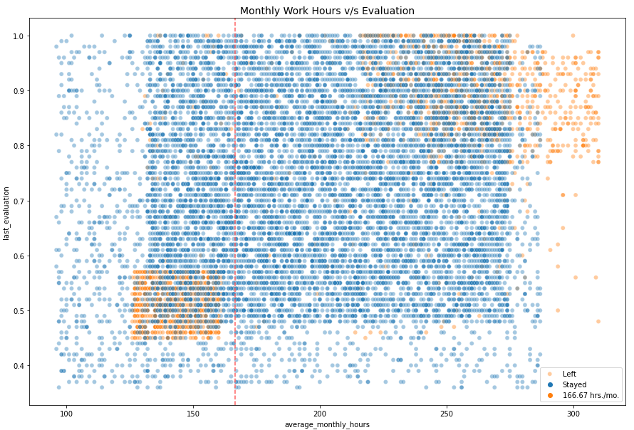
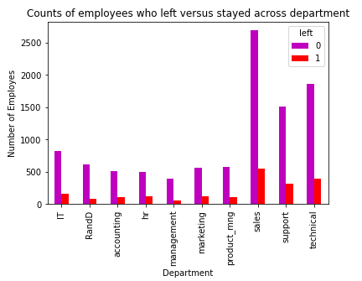
Salifort Motors
Employee Retention Project
Salifort Motors seeks to improve employee retention and answer the following question:
What’s likely to make the employee leave the company?
The models and the feature importances extracted from the models confirm that employees at the company are overworked.
Two groups of leavers: overworked high performers, underworked low performers. Most employees work excessive hours.
Addressing employee dissatisfaction can improve employee morale, productivity, and company performance. This can be achieved by reducing burnout, increasing job satisfaction, lowering turnover rates, and improving employee retention.
The sales department has the highest number of employees who left the company. The technical department has the highest number of employees who stayed.
Cap the number of projects that employees can work on.
Consider promoting employees who have been with the company for at least four years, or conduct further investigation about why four-year tenured employees are so dissatisfied.
Either reward employees for working longer hours, or don't require them to do so.
If employees aren't familiar with the company's overtime pay policies, inform them about this. If the expectations around workload and time off aren't explicit, make them clear.
Hold company-wide and within-team discussions to understand and address the company work culture, across the board and in specific contexts.
High evaluation scores should not be reserved for employees who work 200+ hours per month. Consider a proportionate scale for rewarding employees who contribute more/put in more effort.

