Slide 1
Principles of Marketing
8th edition
Chapter 10
Placement: Customer value fulfilment
Copyright © 2021 Pearson Australia (a division of Pearson Australia Group Pty Ltd)
9781488626203/Armstrong/Principles of Marketing, 8e

Slide 2
Place
Place (the 3rd P) refers to how a company makes its products or services available to customers.
It is all about
  getting the right product,
  in the right quantity,
  at the right time, and
  in the right location
so, customers can buy it conveniently.
Narrow View of Place – Customer Access:
This focuses on the final stage of distribution: how and where customers actually obtain the product.
Broader View of Place – Supply Chain & Distribution Network: This expands Place to include all the processes and structures that get the product from producer → distributor → retailer → customer.

Slide 3
Supply chains and the value delivery network
A supply chain
is a system of efficiently and effectively producing, making and getting products to end-users.
  A supply chain pertains to both physical goods and services.
Supply chain management
is the process of managing upstream and downstream value-added flows of materials, final goods and related information among suppliers, the marketing organisation, marketing intermediaries and final consumers.
  Marketing logistics (physical distribution)
  are the tasks involved in planning, implementing and controlling the physical flow of materials, final goods and related information from points of origin to points of consumption to meet customer requirements at a profit.

Slide 4
Supply chains and the value delivery network
A value delivery network (VDN) comprises the marketing organisation, suppliers, distributors and, ultimately, customers who partner with each other to improve the performance of the entire system.
Importance of a Value Delivery Network:
  Efficiency: By working closely with all partners in the network, a company can optimize processes, reduce waste, and lower costs.
  Responsiveness: A well-coordinated VDN can respond more quickly to changes in customer demand or market conditions, ensuring that the company remains competitive.
  Innovation: Collaboration within the network can lead to new ideas and innovations that improve products, services, or processes.
  Customer Satisfaction: The ultimate goal of a VDN is to enhance the customer experience, leading to greater customer satisfaction and loyalty.

Slide 5
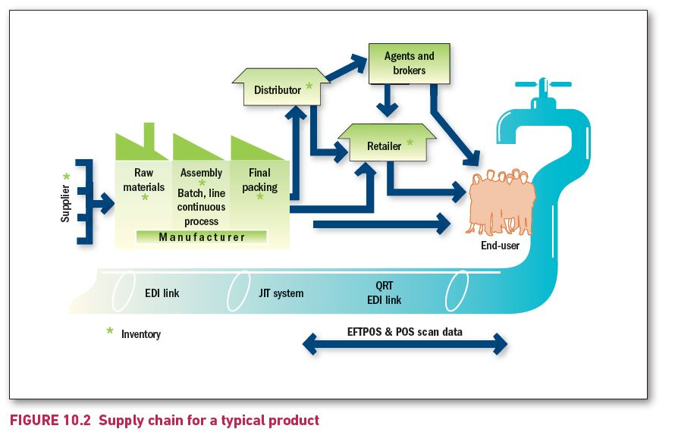
Supply chain for a typical product
Notes:
The flow diagram depicts the following:
Supplier supplies Raw materials to the Manufacturer.
Manufacturer buys Raw materials from Supplier, assembles them, provides Batch and Line continuous process, and finally packs them to deliver them to Distributor and Retailer.
Distributor supplies the same to Retailer and to Agents and brokers, who, in turn supply to the End user.
Inventory is created at every stage in case of Manufacturer, Distributor, Retailer, and Agents and brokers.
Pictorial depiction shows a water pipeline leading to End users.
EFTPOS and POS scan data pass through EDI link, JIT system and QRT EDI link in the pipeline.

Slide 6
Supply chains and the value delivery network
Major logistics functions
The main logistics functions include:
  Warehousing
    Production and consumption cycles rarely match
  Inventory management
    firms must balance the costs of carrying larger inventories against resulting sales and profits.
  Transportation
    Planes, trains, trucks, pipeline, ships and the internet
  Logistics information management
    electronic data interchange (EDI), the digital exchange of data between organisations
    vendor-managed inventory (VMI) systems or continuous inventory replenishment systems.

Slide 7
The nature of marketing channels and value creation
A marketing channel (or distribution channel) is a set of interdependent organisations involved in the process of making a product or service available to users.
Marketing channels involve the interaction of intermediaries to bring finished goods and services to the marketplace.

Slide 8
The nature of marketing channels and value creation
Number of channel levels
A channel level is a layer of intermediaries who perform some work in bringing the product and its ownership closer to the final buyer.
  The number of intermediary levels indicates the length of a channel.
A direct marketing channel has no intermediary levels.
An indirect marketing channel contains one or more intermediary levels.

Slide 9
Marketing channel options: a simplistic view
Manufacturer
Channel member
Channel member
Channel member
Consumer
Channel length: The number of intermediary levels.
M
C
Direct marketing channel
M
Channel member
C
One-level channel
M
Channel member
Channel member
C
Two-level channel
Copyright ©2015 Pearson Australia (a division of Pearson Australia Group Pty Ltd) – 9781486002696/Armstrong/Principles of Marketing/6e

Slide 10
Marketing Intermediaries/Service Providers - Marketing channel member functions
The nature of marketing channels and value creation
Channel members add value by performing a variety of functions:
Information: gathering & distributing marketing research & intelligence
Promotion: developing & spreading persuasive communications about an offer
Contact: finding & communicating with prospective buyers
Matching: shaping & fitting the offer to buyers’ needs
Negotiation: reaching an agreement on price and terms
Physical distribution: transporting & storing goods
Financing: providing & using funds to cover cost of channel work
Risk-taking: assuming the risk of carrying inventory and channel work

Slide 11
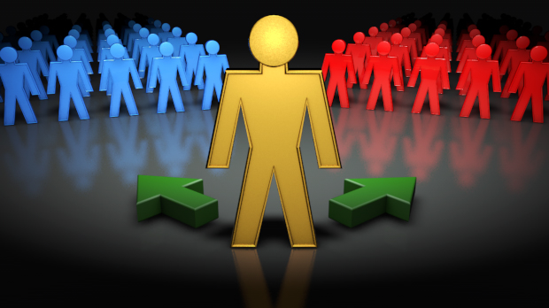
The Importance of Marketing Channels
Advantages of using intermediaries instead of selling direct:
  Wider Market Reach
    Access to Broader Customer Base
    Geographical Expansion
  Cost Efficiency
    Lower Distribution Costs
    Reduced Capital Investment
  Intermediaries have contacts, experience, specialisation and scale of operation, and can do it cheaper and better.
  Many suppliers lack the financial resources to carry out direct
  marketing to their customers.
  Many customers want personal interaction before buying large items.
Notes:
Relates to objective 3

Slide 12
Channel behaviour and organisation
Channel behaviour
Ideally all channel firms should work together smoothly.
Channel conflict
is disagreement among marketing channel members on goals, roles and rewards – that is, on who should do what and for what rewards.
  between different sales channels within the same organisation or
  between the organisation and its channel partners, such as distributors, retailers, or agents.
  Horizontal conflict is conflict between firms at the same channel level.
    Two retailers selling the same product might engage in a price war, leading to reduced profitability for both.
  Vertical conflict is conflict between different levels of the same channel.
    A manufacturer decides to sell directly to consumers online, bypassing its traditional retail partners.

Slide 13
Distribution Channel Structure
Conventional Marketing Channel
A conventional channel is a traditional, independent system of manufacturers, wholesalers, and retailers. Each member acts as a separate business, aiming to maximize its own profits, sometimes at the expense of overall channel efficiency.
Characteristics:
  Loose relationships between channel members.
  Each member has its own goals and strategies.
  Coordination is limited.
  Conflicts can arise (e.g., retailers demanding lower wholesale prices, wholesalers demanding higher margins).
Vertical Marketing System (VMS)
VMS is a coordinated distribution system where the manufacturer, wholesaler, and retailer work together as a unified system. This reduces conflict and increases efficiency.
Characteristics:
  Greater coordination and control.
  Focus on overall efficiency and profit, not just individual margins.
  Reduces duplication of effort and conflict.

Slide 14
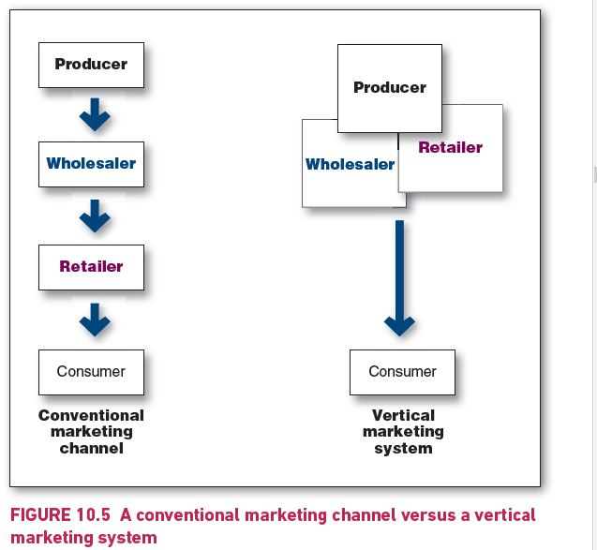
A conventional marketing channel versus a vertical marketing system
Notes:
The Conventional marketing channel progresses through Producer, Wholesaler and Retailer, each of which is depicted as an independent unit, leading to Consumer.
Vertical marketing system depicts Producer, Wholesaler and Retailer as a single unit to represent , acting as a unified system, leading to Consumer.

Slide 15
Channel behaviour and organisation
Vertical marketing systems (cont.)
There are three main types of VMS:
  corporate VMS
  contractual VMS
  administered VMS.
Each type of VMS uses a different means of setting leadership and power in the channel.

Slide 16
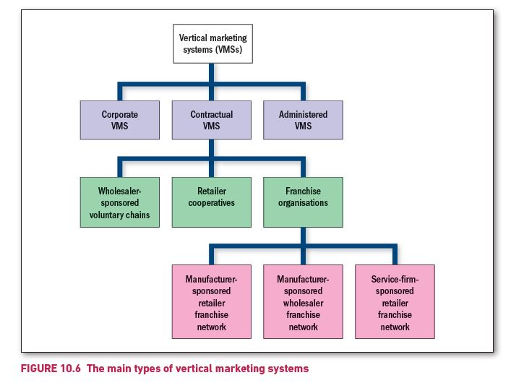
The main types of vertical marketing systems
Notes:
Vertical marketing systems (VMSs) are divided into Corporate VMS, Contractual VMS and Administered VMS.
Contractual VMS is further divided into three types: Wholesaler-sponsored voluntary chains, Retailer cooperatives and Franchise organisations.
Franchise organisations is further divided into Manufacturer-sponsored retailer franchise network, Manufacturer-sponsored wholesaler franchise network and Service-firm-sponsored retailer franchise network.

Slide 17
Channel behaviour and organisation
Vertical marketing systems (cont.)
Corporate VMS
A corporate VMS
is a vertical marketing system that combines successive stages of production and distribution under single ownership; channel leadership is established through common ownership.

Slide 18
Channel behaviour and organisation
Vertical marketing systems (cont.)
Contractual VMS
A contractual VMS is a vertical marketing system in which independent firms at different levels of production and distribution join through contracts.
The franchise organisation is the most common type of contractual VMS. There are three forms of franchise:
  manufacturer-sponsored retailer franchise networks
  e.g., Car Industry – Manufacturers such as Ford, Honda licenses dealers to sell their cars
  manufacturer-sponsored wholesaler franchise networks
  e.g., soft-drink industry – Coca Cola licenses bottlers such as CCA
  service-firm-sponsored franchise networks.
  Licenses a network of retailers to bring its service to consumers – car rental, food service business

Slide 19
Channel behaviour and organisation
Vertical marketing systems (cont.)
Administered VMS
An administered VMS is a vertical marketing system that coordinates successive stages of production and distribution, not through common ownership but through the size and power of one of the parties.
Contractual arrangements would be quite wide-ranging covering price, displays, shelf space and locations, promotions
Arnott’s, Panasonic, Unilever, Kraft etc can use the popularity of their products to negotiated favourable conditions/outcomes with retailers
Large retailers (Coles, Woolies, Aldi) can exert strong influence on smaller manufacturers or to demand manufacturers to make house brands

Slide 20
Channel behaviour and organisation
Horizontal marketing systems
A horizontal marketing system is a channel arrangement in which two or more companies at one level join to follow a new marketing opportunity.
  Companies may join forces with non-competitors (News Corp and Telstra – Foxtel) or with competitors (Qantas and numerous airlines – developing Oneworld alliance).

Slide 21
Channel behaviour and organisation
Multichannel distribution systems
A multichannel distribution system occurs when a single firm sets up two or more marketing channels to reach one or more marketing segments.
Marketers using such multichannel:
  gain sales with each new channel
  also, risk offending existing channels.

Slide 22
Distribution Strategies
Identifying major channel alternatives
Companies can use three strategies to determine the number of channel members to use at each level:
    Intensive distribution
      Companies stock their products in as many outlets as possible
      Many consumer-goods companies distribute this way
    Exclusive distribution
      Only a limited number of dealers have exclusive right to distribute in their territories
      Often used for luxury brands
    Selective distribution
      In between Intensive and Exclusive
      Companies use more than one but fewer than all intermediaries
      Many shopping products use this form

Slide 23
Wholesaling
Wholesaling includes all the activities involved in selling goods and services to those buying for resale or business use.
A wholesaler is a firm engaged primarily in wholesaling activity.
Wholesalers add value by performing one or more channel functions:
  selling and promoting
  buying and assortment building
  bulk breaking
  warehousing
  transportation
  financing
  risk bearing
  management services and advice.

Slide 24
Wholesaling
Types of wholesalers
Wholesalers fall into three main groups:
  merchant wholesalers
  agents and brokers
  manufacturers’ sales branches and offices.

Slide 25
Main types of wholesalers
Type |  | Examples
Merchant wholesalers | Independently owned businesses that take title to the merchandise they handle
 | Full-service wholesalers | Wholesale merchants; Industrial distributors
 | Limited-service wholesalers | Cash-and-carry wholesalers; Truck wholesalers; Rack jobbers; Producers’ cooperatives; Mail-order or web wholesalers
Brokers and agents | Do not take title to goods; perform only a few functions
 | Brokers | Food broker; Real estate broker; Insurance broker
 | Agents | Manufacturers’ agents; Selling agents; Purchasing agents; Commission merchants
Manufacturers’ sales branches and offices | Wholesaling operations conducted by sellers or buyers themselves
 | Sales branches and offices | In industries such as timber; car equipment and parts
 | Purchasing offices | Similar role to broker or agent but part of the buyer’s organisation

Slide 26
Retailing: Connecting brands with consumers
Refers to all activities involved in selling goods or services directly to final consumers for their personal, non-business use.
Shopper marketing
Shopper marketing is about influencing customers along their path to purchase — from when they start thinking about buying, up to the moment they decide which product to take home (or add to their online cart).
It’s not just about advertising a brand, but about shaping behaviour at the point of decision.
Traditionally this meant in-store tactics like shelf displays, signage, and special offers.
Today, it includes digital environments like e-commerce product pages, sponsored search results, mobile coupons, or targeted social ads.
The goal is to understand how shoppers think and act in real buying situations, then use promotions, messages, or product placement to guide their choice.

Slide 27
Retailing: Connecting brands with consumers
Omni-channel retailing
Omnichannel retailing is about creating a seamless shopping experience across all channels — physical stores, websites, mobile apps, social media, and even marketplaces like Amazon.
Customers don’t shop in a straight line anymore — they move between online and offline touchpoints.
Omnichannel ensures they get a consistent, connected experience no matter where they engage.
It requires integration of technology, logistics, and customer service, so a shopper can:
  Browse online → pick up in store (click-and-collect).
  Buy in store → reorder online later.
  Check store stock through the app before visiting.
It’s less about promotions and more about making the shopping journey smooth, flexible, and convenient.

Slide 28
Retailing
Retailing: Connecting brands with consumers
Types of retailers
Retailers can be classified by:
  amount of service offered (e.g. self-service, limited service and full service)
  product line sold (e.g. length and breadth of their product assortments; ‘product line’ can be a service (e.g. hotel, bank)
  relative prices charged (e.g. discount store, warehouse clubs)
  how they are organised (e.g. corporate chains, voluntary chains, retailer cooperatives, franchise organisations).

Slide 29
Major store retailer types
Type | Description | Examples
Speciality stores | Carry a narrow product line with a deep assortment, e.g. apparel stores, sporting-goods stores, furniture stores, florists, bookstores. | The Athletes Foot, JB Hi-Fi
Department stores | Carry several production lines (e.g. clothing, home furnishings, household goods) with each line operated as a separate department. | David Jones, Myers
Supermarkets | Relatively large, low-cost, low-margin, high-volume, self-service operations carrying grocery and household products. | Coles, Woollies, Aldi
Convenience stores | Relatively small stores located near residential areas, open long hours 7 days a week and carrying a limited line of high-turnover products at slightly higher prices. | 7-Eleven, Coles Express
Discount stores | Carry standard merchandise sold at lower prices with lower margins and higher volumes. | Big W, Kmart, Target
Mass merchants | Carry a large assortment of home and home-improvement merchandise, including DIY hardware items. | Mitre 10, Retravision
Off-price retailers | Sell merchandise bought at less-than-regular wholesale prices and sold at less than retail prices (e.g. leftover goods, seconds, overruns). | Costco, Metcash
Superstores | Very large stores traditionally aimed at meeting consumers’ total needs for routinely purchased food and non-food items | Bunnings, Ikea

