Slide 1
Principles of Marketing
8th edition
Chapter 5
Buyer behaviour: Understanding consumer and business buyers
Copyright © 2021 Pearson Australia (a division of Pearson Australia Group Pty Ltd)
9781488626203/Armstrong/Principles of Marketing, 8e

Slide 2
Consumer markets and consumer behaviour
Consumer buyer behaviour
Refers to the buying behaviour of final consumers – individuals and households – that buy goods and services for personal consumption.
Includes factors that influence purchase decisions and use of products
Marketers may attempt to use different promotional techniques to influence consumers decisions
Consumer Market
All these final consumers combine to make up the consumer market.
Motivations and consequences
Marketers should understand buying behaviour, its motivations and consequences, in order to do a better job for their products.

Slide 3
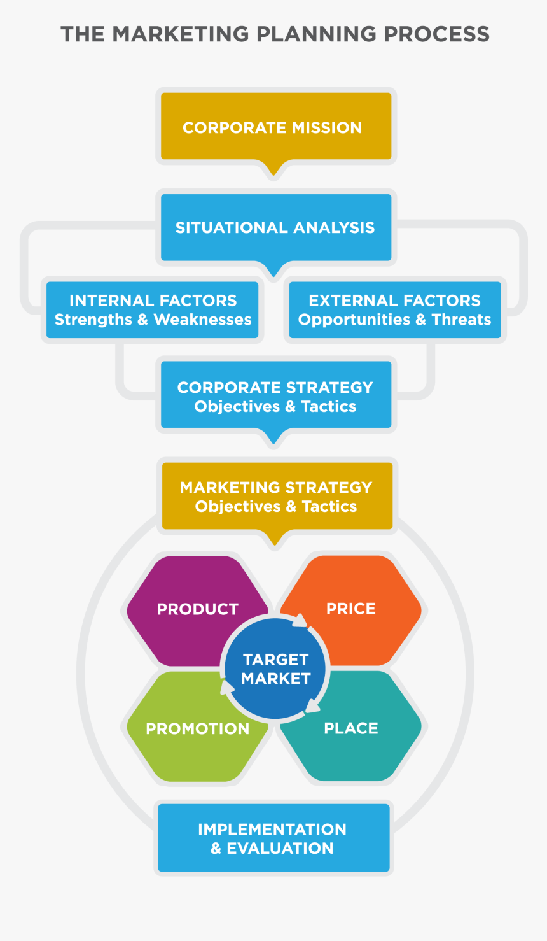
Where would you find Consumer Behaviour on our Marketing Process flowchart?

Slide 4
Consumer markets and consumer behaviour
Model of consumer behaviour
Marketers can study actual consumer purchases to find out what they buy, where and how much.
But learning about the whys of consumer buying behaviour is not so easy.
  Often, consumers themselves do not know exactly what influences their purchases.
The central question for marketers is: How do consumers respond to various marketing efforts the company might use?

Slide 5
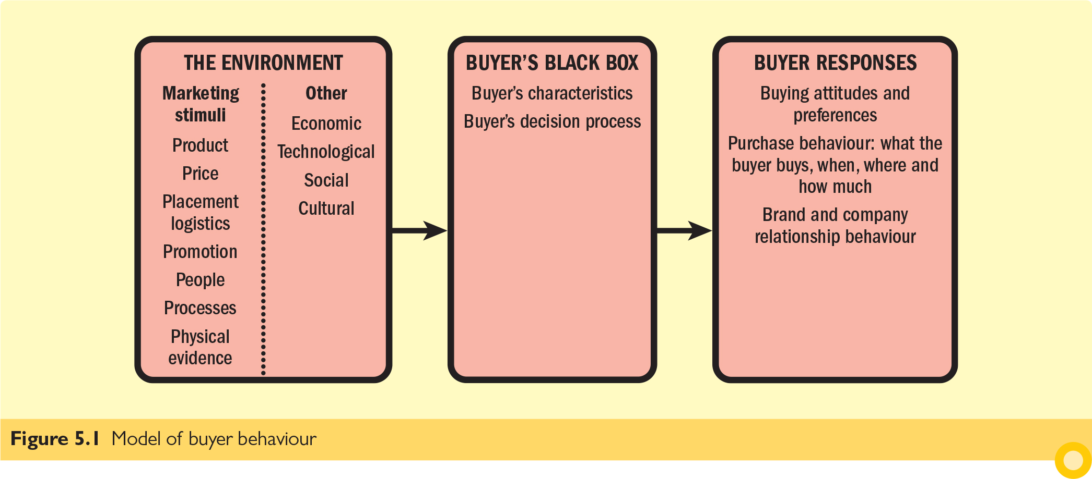
Model of buyer behaviour
Helps marketers understand what influences buyers.
Allows businesses to design better strategies to meet consumer needs.
Emphasises that buyers are influenced by both external stimuli and internal psychology.
Notes:
The model shows three components which point from one to another as follows: Environment; Buyer's black box; Buyer responses. Each of these components has subcomponents, displayed in boxes below:
Environment: Marketing stimuli and other stimuli.
Under Marketing stimuli are the following: Product; Price; Place; Promotion.
Under Other stimuli are the following: Economic; Technological; Social; Cultural.
Buyer’s black box includes Buyer’s characteristics and Buyer’s decision process.
Buyer responses includes the following:
Buying attitudes and preference
Purchase behaviour: what the buyer buys, when, where and how much
Brand engagements and relationships.

Slide 6
Consumer markets and consumer behaviour
Characteristics affecting consumer behaviour
Consumer purchases are influenced strongly by:
  cultural characteristics
  social characteristics
  personal characteristics
  psychological characteristics.
For the most part, marketers cannot control such factors, but they must take them into account.

Slide 7
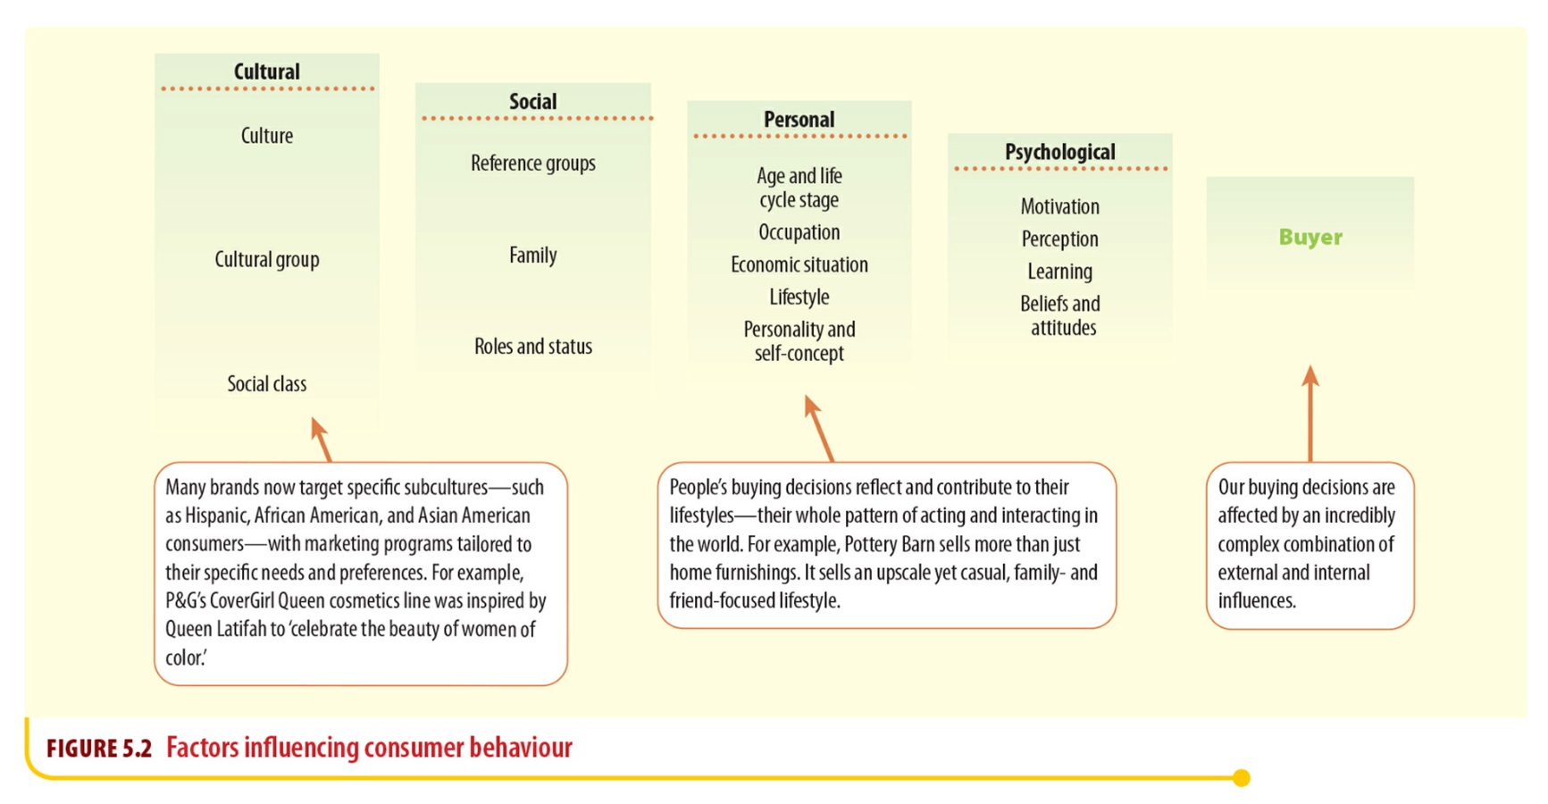
Factors influencing consumer behaviour
Notes:
The illustration shows five boxes of decreasing sizes depicted from left to right. The first four boxes list four categories of influencing factors, while the last box is labelled as ‘Buyer’.
The influencing factors are depicted as follows:
Cultural: Culture, Subculture and Social class.
Social: Groups and social networks, Family, and Roles and status.
Personal: Age and life-cycle stage, Occupation, Economic situation, Lifestyle, and Personality and self-concept.
Psychological: Motivation, Perception, Learning, and Beliefs and attitudes.

Slide 8
Characteristics affecting consumer behaviour
Cultural factors
Cultural factors play a significant role in shaping consumer behaviour, influencing preferences, purchasing decisions, and brand loyalty.
These factors are deeply embedded in society and affect how individuals perceive and interact with products and services.
Culture is the broadest influence on consumer behaviour and consists of values, beliefs, customs, and traditions shared by a group of people. It dictates:
What products are acceptable (e.g., food preferences vary by region).
How products are used (e.g., gift-giving traditions).
Attitudes toward materialism, saving, and spending.

Slide 9
Characteristics affecting consumer behaviour
Cultural factors
Sub-Cultural group
Subcultures are groups within a larger culture that share unique values and behaviors. They can be based on:
Ethnicity (e.g., Latin American consumers may prefer specific food brands).
Religion (e.g., Halal or Kosher food products cater to Muslim and Jewish consumers).
Geography (e.g., Rural vs. urban consumers have different shopping habits).
Generational Differences (e.g., Millennials vs. Baby Boomers prefer different marketing approaches).

Slide 10
Characteristics affecting consumer behaviour
Cultural factors
  Social classes
  are relatively permanent and ordered divisions in a society, whose members share similar values, interests and behaviours. Social class influences spending habits, brand preferences, and product choices. It is often determined by:
Income level
Education
Occupation
Wealth
Lifestyle preferences

Slide 11
Consumer markets and consumer behaviour
Social factors
Social factors include the consumer’s small groups, family, social role and social status.
Family:
Strongly influence buyer behaviour.
Roles and status:
Role and status can be defined by a person’s position in a group.
People usually choose products appropriate to their roles and status.
Groups and social networks:
Many small groups influence a person’s behaviour, such as:
reference groups | opinion leaders
aspirational groups | online social networks.

Slide 12
Consumer markets and consumer behaviour
Characteristics affecting consumer behaviour (cont.)
Personal factors
Buyers’ decisions
are influenced by personal characteristics:
  age and life-cycle stage
  occupation
  education
  economic situation
  lifestyle
  personality
  self-concept.

Slide 13
Consumer markets and consumer behaviour
Lifestyle
is a person’s pattern of living as expressed in his or her
  Activities – fitness, travel, socialising
  Interests – fashion, technology, sustainability
  Opinions – environmental consciousness, luxury preferences
Personality
is the unique psychological characteristics that distinguish a person or group.
  Often understood in terms of traits – e.g., orderly, adaptable or dominant
  Each person’s distinct personality influences his or her buying behaviour.
  People buy brands reflecting their personality traits

Slide 14
Consumer markets and consumer behaviour
Personality, brand personality and self-concept
The idea is that brands also have personalities, and consumers are likely to choose brands with personalities that match their own
Brand personality
The specific set of human traits that can be matched to a brand.
Common brand personality traits (identified in selected research)….
Sincerity: down-to-earth, honest, wholesome and cheerful
Excitement: daring, spirited, imaginative and up-to-date
Competence: reliable, intelligent an successful
Sophistication: upper-class and charming
Ruggedness: outdoorsy and tough

Slide 15
Consumer markets and consumer behaviour
Psychological factors
A person’s buying choices are influenced by four main psychological factors:
  motivation
  perception
  learning
  beliefs and attitudes.

Slide 16
Consumer markets and consumer behaviour
Psychological factors (cont.)
Motivation
Motive (drive) is a need that is sufficiently pressing to direct the person to seek satisfaction.
Two of the most popular theories of human motivation are those of Sigmund Freud and Abraham Maslow.
Motivation research refers to qualitative research designed to probe consumers’ hidden, subconscious motivations.

Slide 17
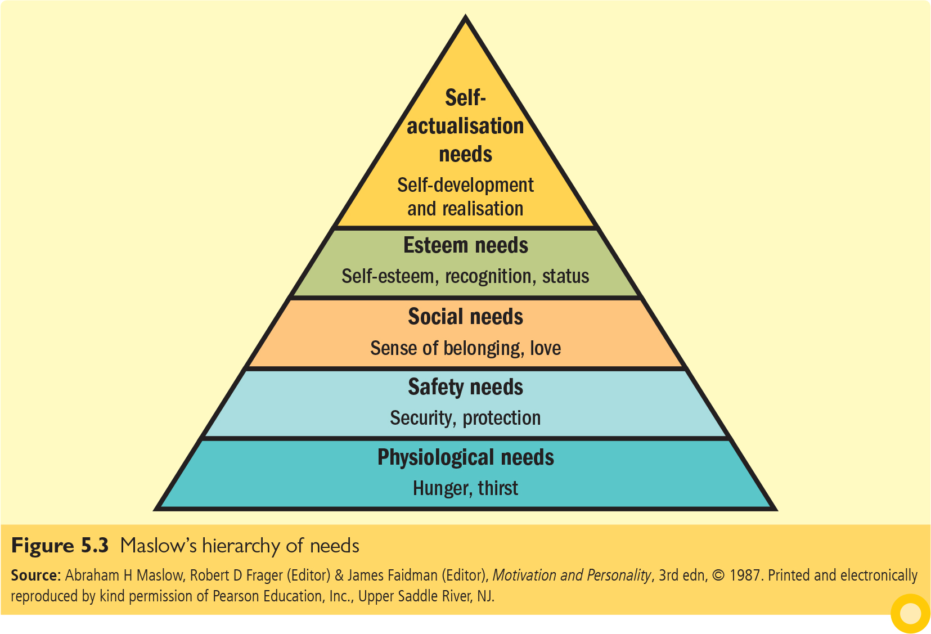
Maslow’s hierarchy of needs
One of the most well-known theories explaining consumer motivation is Maslow’s Hierarchy of Needs, which categorizes human needs into five levels:
Notes:
The five needs depicted from bottom to top of the pyramid are as follows:
Physiological needs: Hunger, thirst
Safety needs: Security, protection
Social needs: Sense of belonging, love
Esteem needs: Self-esteem, recognition, status
Self-actualisation needs: Self-development and realisation

Slide 18


Consumer markets and consumer behaviour
Psychological factors (cont.)
Perception
is the process by which people select, organise and interpret information to form a meaningful picture of the world.
Learning
refers to the changes in an individual’s
behaviour arising from experience.
Learning occurs through the interplay of
drives, stimuli, cues, responses and
reinforcement.

Slide 19
Consumer markets and consumer behaviour
Psychological factors (cont.)
Attitudes
Attitude refers to a person’s consistently favourable or unfavourable evaluations, feelings and tendencies towards an object or idea.
Attitudes comprise three parts:
  thoughts and beliefs: Knowledge, Opinion, Faith (cognition)
  feelings (affect)
  an intention to behave in a certain way (conation).
Attitude plays a significant role in consumer behavior by shaping perceptions, guiding decision-making, and influencing loyalty.
Marketers must understand how to create and nurture positive attitudes toward their products, as well as how to address negative attitudes to build a strong and lasting relationship with their target audience.

Slide 20
What is a decision…..Key consumer decisions
A decision is the selection of an action from two or more alternative choices. Consumer decisions can be on :
  Whether to purchase
  Choice of purchasing a specific brand
  How much to purchase
  Whether to purchase the usual brand or branch out and try a new one
  The type of store and specific store to buy from
  Whether to buy in a store or online
  The well-known influence of ‘country of origin’ of product

Slide 21
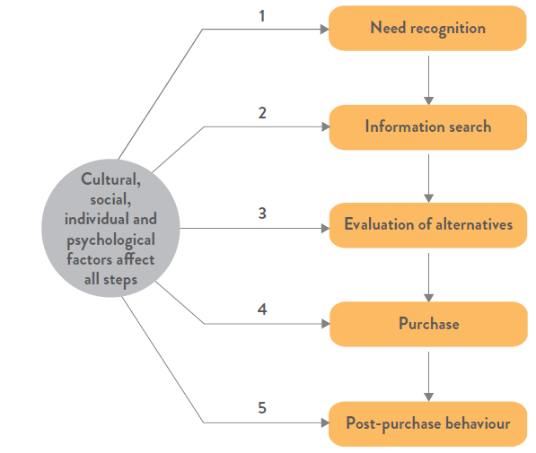
Consumer Decision-Making Process

Slide 22
The buyer decision process
The first stage in the buyer decision process
Need recognition
The buyer recognises a need, triggered by internal or external stimuli.
Imbalance between actual and desired states.
A want exists when the need manifests into desire for a product to resolve the imbalance
Consumer behaviourists try to:
  understand the circumstances that trigger the need, For example: electricity and gas companies advertise heavily in March/April?
Consumers recognise unfulfilled needs by
    Dissatisfaction with performance of existing product: computer crashes/glitches.
    Run out of something generally kept on hand: soap
    Changed circumstances: such as having a baby
    Product acquisition: bought a camera now need a lens, razor > blades, new sport > need equipment.
    Learn about a superior product/feature; iPhone 16

Slide 23
The buyer decision process
The second stage in the buyer decision process
Information Search
The buyer seeks out information about products or services with potential to satisfy the need.
Here the consumer is motivated to search for more information.
Sources of information (internal vs external):
  External (Non-marketing controlled)
  Experiential sources (personal experience)
  Personal sources(e.g., family/friends)
  Public sources(e.g., consumer report, magazine, blog, internet)
  Internal (Marketing controlled)
  Commercial sources (marketing-driven-advertising, company web-site, salesperson)
Generally, the higher the risk, the greater the search >> Goal is to reduce uncertainty

Slide 24

The buyer decision process
The third stage in the buyer decision process
Evaluation of Alternatives
The consumer processes information in order to arrive at brand choices.
No single process is used by consumers.
Evaluation involves the development of a set of criteria, followed by a ranking process based on the most important attributes
Marketers try to determine which attributes are most important
Consumers will use both objective (facts) and subjective (emotions) evaluation criteria
Consumers narrow their choice of brands by evaluating brands according to attributes that are important to them, e.g., a good camera on a phone. Then they will select brands that have that attribute.
Brands can impact choice
  Used to simplify decision making process
  Signal trust and quality
    Might trust a brand based on experience with it
    Might trust based on type of people you think use it
    Don’t want to ‘think’ so buy market leader > e.g. Panadol
    Australia's most trusted brand of pain reliever

Slide 25
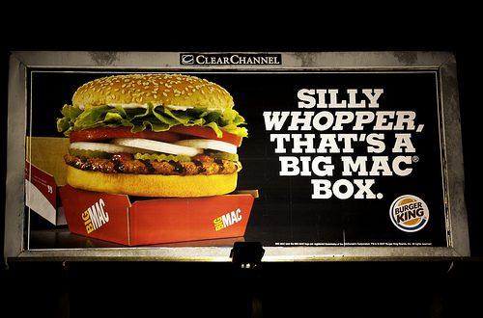

The buyer decision process
Evaluation of Alternatives
Marketers can influence a consumer’s evaluations by framing the alternatives
  Describes the alternatives and their attributes in a certain manner
  Make a certain attribute seem more important to consumers
More likely to influence inexperienced buyers

Slide 26
The ‘evaluation of alternatives’ stage; examples of consumer criteria used
Personal computers
Speed, price, type of display, laptop versus desktop
Watches
Size, water resistance, alarms, wrist band
Frozen dinner
Taste, size, preparation requirements, kilojoule count
Paper towels
Strength, colour, design, absorbency, price

Slide 27
The buyer decision process
The five stages in the buyer decision process
Purchase Decision
The consumer forms a purchase intention and ultimately makes the actual purchase.This process can be impacted by attitudes of others and unexpected situational factors.
Purchase decision is the buyer’s decision about which brand to purchase, from whom to purchase and when to purchase.
The purchase intention may not be the purchase decision. Factors that may distort the intention to purchase due to:
  Unexpected situational factors (e.g., supermarket aisle placement and promotions)
  Attitudes of others & Social desirability bias

Slide 28
The buyer decision process
The five stages in the buyer decision process
Post Purchase
Following purchase, the consumer will engage in a variety of post-purchase behaviours – including satisfaction, formation of future purchase intentions and loyalty intentions.
The stage where consumers take further action after purchase, based on their satisfaction or dissatisfaction.
Potential for “post-purchase dissonance” an inner tension over the perceived appropriateness of a purchase
Marketing can minimise dissonance through effective communication with purchasers.
Consumers seek to reduce dissonance by justifying their purchase decision and may:
seek information that reinforces positive ideas about the purchase
deliberately seek contrary information so as to refute it
change their attitudes to conform to the decision.

