Slide 1
Principles of Marketing
8th edition
Chapter 6
Customer-driven market strategy: Creating value for target customers
Copyright © 2021 Pearson Australia (a division of Pearson Australia Group Pty Ltd)
9781488626203/Armstrong/Principles of Marketing, 8e

Slide 2
Customer-driven marketing strategy
Companies must design customer-driven marketing strategies that build the right relationships with the right customers.
To do this, most companies have moved away from
mass marketing (the shotgun approach) and
towards target marketing (the rifle approach).
This means identifying market segments, selecting one or more of them, and developing products and marketing programs tailored to each.

Slide 3
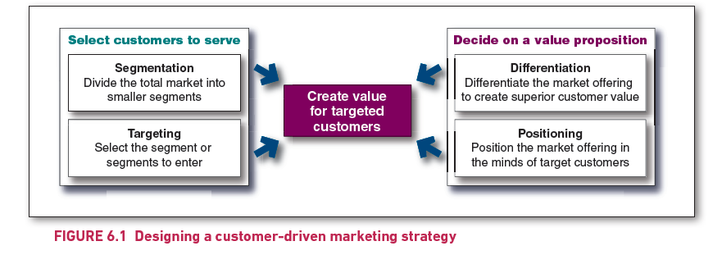
Designing a customer-driven marketing strategy
Notes:
The four steps are grouped under two categories. All four steps point to a rectangle shown between the two categories. The rectangle is labelled as ‘Create value for targeted customers’.
The four steps along with their respective categories are as follows.
Under Select customers to serve are the following:
Segmentation: Divide the total market into smaller segments
Targeting: Select the segment or segments to enter.
Under Decide on a value proposition are the following:
Differentiation: Differentiate the market offering to create superior customer value
Positioning: Position the market offering in the minds of target customers.

Slide 4
Market segmentation
  Buyers in any market differ in their wants, resources, locations, buying attitudes and buying practices.
  Segmentation allows companies to divide large, heterogeneous markets into smaller segments that can be reached more efficiently and effectively.
Using multiple segmentation bases
  There is no single way to segment a market.
  Marketers rarely limit their segmentation analysis to only one or a few variables.
  A marketer must try different segmentation variables, alone and in combination, to find the best way to view the market structure.

Slide 5
The marketing “logic”
People aspire to be better (Consumer Behaviour)
Marketers need to know to what the consumer aspires so they can tap into it (Market Research)
Marketers need to know who has what aspirations (Market Research & Segmentation)
Businesses need to be convinced that there are enough people that have the same aspiration to make production worthwhile.

Slide 6
Market targeting
Socially responsible target marketing
Socially responsible target marketing should consider brand impact of:
  targeting vulnerable or disadvantaged consumers
    low-income populations, elderly individuals, or people with certain health conditions, may be more susceptible to marketing tactics due to lower education levels, financial constraints, emotional vulnerability
  marketing controversial or potentially harmful products
    Products like tobacco, alcohol, or high-sugar foods can have harmful effects on health.
  marketing efforts directed towards children
    Children are a particularly impressionable audience and may not fully understand the persuasive intent of advertising. Marketers must be careful not to exploit children's naivety by promoting unhealthy food, unrealistic body images, or materialistic values.

Slide 7
Market targeting
Socially responsible target marketing
Socially responsible target marketing should consider:
  Use of the internet and other targeted direct media
    Marketers must respect consumer privacy, obtain consent when collecting personal data, and ensure that their marketing messages are appropriate for the audience they are targeting.
  Responsible advertising and advertising codes of conduct and guidelines.
    Adhering to established advertising codes of conduct helps ensure that marketing practices are fair, truthful, and non-deceptive.
    These guidelines often include rules about truthful representation of products, avoiding misleading claims, and being respectful of cultural and societal values.
Socially responsible marketing calls for segmentation and targeting that serve the interests of both the company and those being targeted.

Slide 8
Why use segmentation?
Groups of people or organisations have different product needs and preferences
Market segmentation helps marketers define customer needs and wants more precisely
Segmentation helps decision makers define more accurate marketing objectives
The more precise your marketing objectives, the more precise your evaluation of performance

Slide 9
Benefits of Market Segmentation
Helps design effective marketing programs for reaching groups of buyers
Identifies opportunities for new product development
Improves allocation of marketing resources

Slide 10
Market
People or organisations with
needs or wants and the ability and willingness to buy.
Market
segment
A subgroup of people or organisations sharing one or more characteristics that cause them to have similar product needs.
Market
segmentation
The process of dividing a market into groups of buyers who might require separate products or marketing mixes.
Notes:
Market requirement;
Must need or desire a particular product
Must have the ability to purchase the product
Must be willing to use their buying power to purchase the product
Must have the authority to buy the product

Slide 11
The steps in segmenting a market
Step 1
Select a market or product category
Step 2
Select bases for segmentation and segment descriptors
Step 3
Profile segments and identify target markets
Step 4
Select and develop targeting strategies
Step 5
Develop a positioning strategy

Slide 12
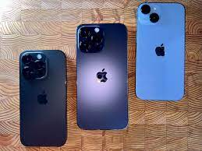
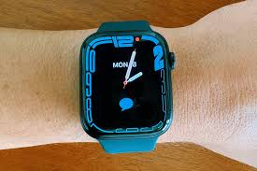

Step One: Selecting a market or product category for study
An existing market
A related market
A new market
Deepening your understanding of the current market dynamics,
Improving product offerings, and
Strengthening your competitive position
Different product category that appeals to the same customer base or
New customer segment for an existing product
Your company or product has no presence

Slide 13
Stage Two: Select the major bases and variables for segmenting markets
A set of characteristics common to individuals, groups or organisations that can be used to segment a market
Geographic segmentation
Divides buyers into different geographical units such as nations, regions, states, LGAs, cities or even neighbourhoods. The company pays attention to geographic differences in need and wants.
Demographic segmentation
Divides buyers into segment based on demographic variables (e.g., age, gender, income, occupation etc). Widely used base because customer needs and wants often vary according to demographics.
Psychographic segmentation
Divides buyers into different segments based on social class, lifestyle or personality characteristics. People in the same demographic group can have very different pychographic profiles.
Behavioural segmentation
Divides buyers into segments based on their knowledge, attitudes, uses or responses to products. For many marketers, this is the starting point for building market segments.
Copyright ©2015 Pearson Australia (a division of Pearson Australia Group Pty Ltd) – 9781486002696/Armstrong/Principles of Marketing/6e

Slide 14
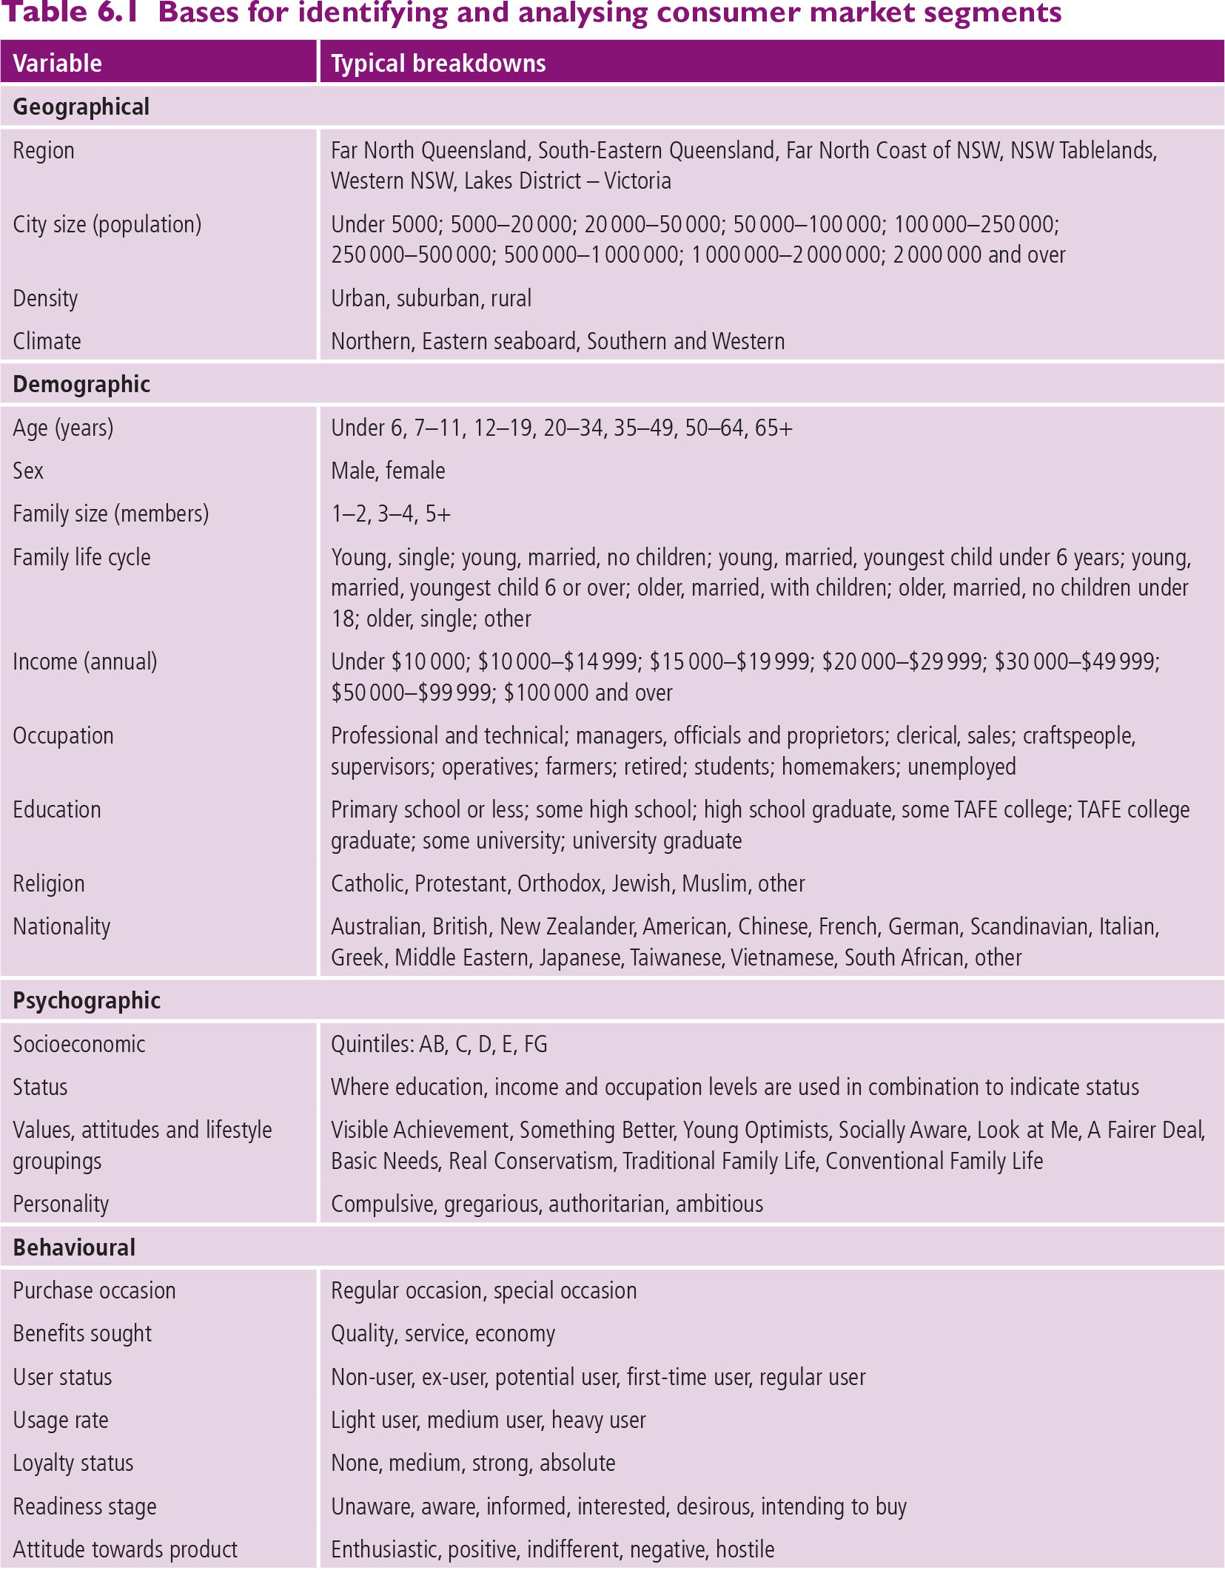
Market segmentation (contd.)

Slide 15
Market segmentation (contd.)

Slide 16
Step Three: Build a profile of your segment.
Creating segment profiles
Profiles of segments are constructed based on need and types of product
No “one size fits all” approach to segments
Roy Morgan (General Aus):
  http://www.roymorgan.com/products/values-segments
VALS (General US):
  http://www.strategicbusinessinsights.com/vals/ustypes/strivers.shtml
Experian (General UK):
  https://www.experian.co.uk/blogs/latest-thinking/marketing/customer-segments/
McKinsey (Banking Digital):
  https://www.youtube.com/watch?v=iM6hnYb2oiw&feature=youtu.be

Slide 17
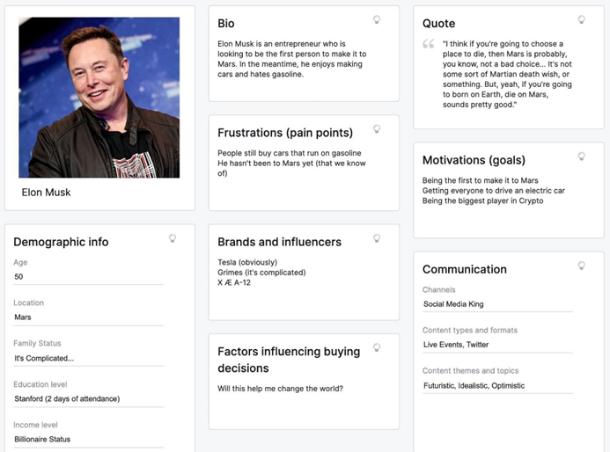
Step Three: Build a profile of your segment.
Creating “personas” of segments
A customer persona is a detailed description of someone who represents your target audience.
This persona is fictional but based on deep research of your existing or desired audience.
You can’t get to know every
customer or prospect
individually.
However, you can create a
customer persona/s to
represent your customer base.
You’ll give this customer
persona a name, demographic
details, interests, and
behavioural traits.

Slide 18
Step Three: Build a profile of your segment.
Creating “personas” of segments
You’ll understand their goals, pain points, and buying patterns.
You can even give them a face using stock photography or illustration if you want — because sometimes it’s important for your team to put a face to a name.
You want to think about and speak about this model customer as if they were a real person.
This will allow you to craft marketing messages targeted specifically to them.
Keeping your customer persona (or personas) in mind keeps the voice and direction of everything consistent, from product development to your brand voice to the social channels you use.

Slide 19
Requirements for effective segmentation
There are many ways to segment a market, but not all segmentations are effective. To be useful, market segments must be…
Measurable: size and profile of segment can be measured
Accessible: Are our resources enough to reach and serve this segment efficiently
Substantial: segment size is profitable
Differentiable: Given our company objectives and/or identity, will the target market respond to our marketing mix elements
Actionable: the company can design effective programs to serve segments
Copyright ©2015 Pearson Australia (a division of Pearson Australia Group Pty Ltd) – 9781486002696/Armstrong/Principles of Marketing/6e

Slide 20
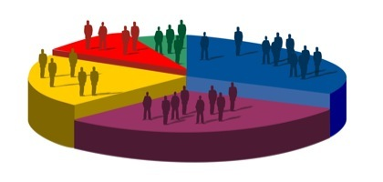
Step Four: How to choose a Market-Coverage Strategy
Many factors must be considered. Which strategy is best depending on:
your own marketing resources (money and expertise)
product range & variability
the stage in the product life cycle
diversity of different segments
competitors’ marketing strategies.
Notes:
Relates to objective 3

Slide 21
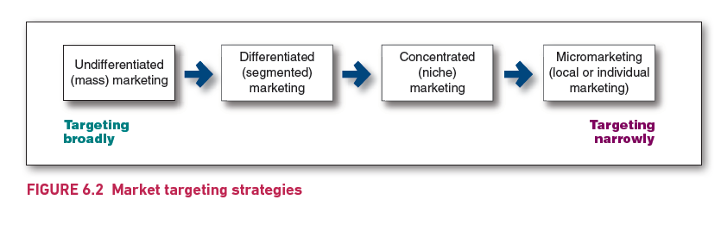
Figure 6.2
Market targeting strategies
Notes:
The four strategies are shown on a horizontal scale between 'Targeting broadly' on left extreme and 'Targeting narrowly' on right extreme.
Strategies listed from left to right are in the following order: Undifferentiated (mass) marketing; Differentiated (segmented) marketing; Concentrated (niche) marketing; Micromarketing (local or individual marketing).

Slide 22
Market targeting
Selecting target market segments
A target market is a set of buyers sharing common needs or characteristics that the company decides to serve.
The marketer identifies market segments, selects one or more, and develops products and marketing mixes tailored to each
Undifferentiated marketing
Undifferentiated (mass) marketing is a
  market-coverage strategy in which a firm decides to ignore market segment differences, and uses a single marketing mix (product, price, place, promotion) to target the entire market, without segmenting it into different groups.
  For example:
    Coca-Cola’s original marketing strategy, where the same product and message were aimed at everyone, regardless of age, gender, or location.

Slide 23
Market targeting
Selecting target market segments
Differentiated marketing
Differentiated (segmented) marketing is a
  market-coverage strategy in which a firm decides to target several market segments with distinct needs or preferences and tailors its products and marketing strategies to meet those specific needs.
  For example: A car manufacturer might market
    a luxury sedan to high-income consumers,
    an SUV to families, and
    an electric vehicle to environmentally conscious buyers.

Slide 24
Market targeting
Selecting target market segments (cont.)
Niche
Niche is
  the practice of tailoring products and marketing programs to the needs and wants of on a very specific, well-defined segment of the market, often with specialized needs.
  For example:
    A company that produces high-end vegan skincare products only for a small segment of consumers who are both vegan and willing to pay a premium for luxury.

Slide 25
Market targeting
Selecting target market segments (cont.)
Micromarketing
Micromarketing is a highly targeted marketing strategy where products and marketing efforts are tailored to suit the tastes of specific individuals or local customer segments.
  It can involve either local marketing (focusing on marketing within a specific geographic area) or
  individual marketing (customizing products and marketing for individual customers, also known as one-to-one marketing)
  For example:
    Local micromarketing might involve a chain store offering different product assortments in different neighborhoods based on the local demographics.
    Individual micromarketing might include personalized email campaigns based on individual buying behavior or preferences.

Slide 26
Step Five: Positioning strategy
Product position is the complex set of perceptions, impressions and feelings that consumers have for the product compared with competing products.
The product position must resonate with each of the segments the company chooses to target.
Positioning
Position
Product differentiation
  The process of developing a specific marketing mix to influence current and potential customers’ overall perception of a brand, product line or organisation
  The place a product, brand or groups of products hold in the consumers’ mind in relation to similar products
  A positioning strategy that some organisations use to distinguish their products from those competitors

Slide 27
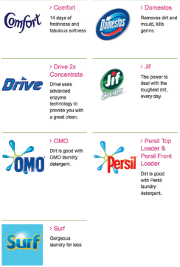
Positioning strategy
Each of Unilever’s laundry detergents have a unique market position:
Unilever Australia & New Zealand www.unilever.com.au.

Slide 28
Importance of positioning in value-driven marketing
Consumers seek out highest value trade-off
Having a distinct positioning in the marketplace enables a company to:
  Highlight value proposition
  Establishes competitive advantage
  Better customer relationship (either voluntary or involuntary)
  Justifies price premium

Slide 29
  Identifying possible value differences and competitive advantages
To find points of differentiation, marketers must think through the customer’s entire experience with the company’s product or service.
An alert company can find ways to differentiate itself at every customer contact point.
It can differentiate along the lines of:
  Product: includes features, performance, durability, conformance, reliability, reparability, styles, designs.
  Service: includes delivery, installation, customer training, consulting, maintenance, other services (e.g., warranty and guarantee).
  Personnel: includes competence, hospitality, credibility, trustworthiness, responsiveness, communicative.
  Image: includes symbols, printed media, audio/visual media, atmosphere, sponsorship.

Slide 30
Developing an Effective Positioning Strategy
Once a company has decided which segments of the market it will enter, it must decide on a ‘position’ or ‘value proposition’.
Positioning involves decisions on attributes important to customers
Positioning strategy can take place at several different levels, (product, service, personnel, image) depending on the nature of the business in question.
Product position is the way the product is defined by consumers on important attributes—the place the product occupies in consumers’ minds relative to competing products.
An explicit positioning strategy is valuable to help prospective customers to get a ‘mental fix’ on what to expect

Slide 31
Choosing a differentiation and positioning strategy
Identifying a set of differentiating competitive advantages
Choosing the right competitive advantages
Developing a positioning statement
Selecting an overall positioning strategy

Slide 32
Differentiation and positioning
  Choosing the right competitive advantages
  Not all points of difference are meaningful or worthwhile.
  A difference that is worth establishing has the following criteria:
    Important: is highly valued by customers
    Distinctive: competitors do not offer the difference
    Superior: the difference is superior to other ways in which customers might obtain the benefit
    Communicable: visible to buyers
    Pre-emptive: competitors cannot easily copy the difference
    Affordable: buyers can afford to pay for the difference
    Profitable: the company can introduce the difference profitably

Slide 33
Developing a Positioning Statement
Company determines how to succinctly communicate the market position.
Company and brand positioning should be summed up in a positioning statement,
Positioning statement often then becomes the source of company slogan

Slide 34
Developing a positioning statement
A positioning statement is a statement that summarises company or brand positioning.
To (target segment and need),
our (brand)
is (concept)
that (point of difference).
Example
‘To busy, mobile professionals who need always to be in the loop, BlackBerry is a wireless connectivity solution that gives you an easier, more reliable way to stay connected to data, people and resources while on the go.’

Slide 35
Positioning maps
  In planning their differentiation and positioning strategies, marketers often prepare perceptual positioning maps.
Positioning maps show consumer perceptions of marketer’s brands versus competing products on important buying dimensions (criteria).
The buying dimensions (criteria), depends on what attributes the business is basing decisions on either:
  Define the industry/product category
  Is valued by the consumer
    Mapping ‘energy drinks will most likely have ‘caffeine content’ but maybe not price
  The biggest mistake in position mapping is to name one of the axis “Quality”. Why?
    Quality is Often Subjective and Hard to Quantify e.g., durability, design, brand reputation, customer service etc.
    Quality is Expected, Not a Differentiator e.g., luxury brands – needs to become more targeted - craftmanship, safety. reliability
    Quality is Often Implicit in Other Attributes e.g., premium-priced products are generally perceived as high quality

Slide 36
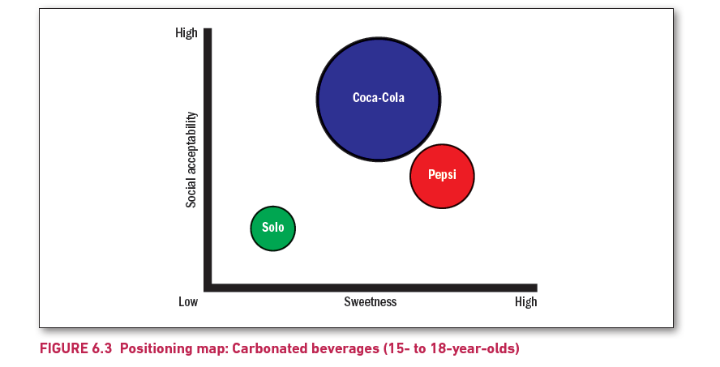
Figure 6.3
Positioning map: Carbonated beverages (15- to 18-year-olds)
Notes:
The graph plots Sweetness on the horizontal axis and Social acceptability on the vertical axis, both ranging from low to high.
Three circles representing three carbonated beverage brands are depicted on the graph at different positions.
The largest circle is labelled Coca-Cola which is high on social acceptability and medium on sweetness.
The medium-size circle is labelled Pepsi. It is shown below and to the right of the circle depicting Coca-Cola, indicating less social acceptability, but more sweetness in comparison.
The smallest circle labelled Solo is closer to the origin, indicating less sweetness and less social acceptability compared to the other two brands of beverages.

Slide 37
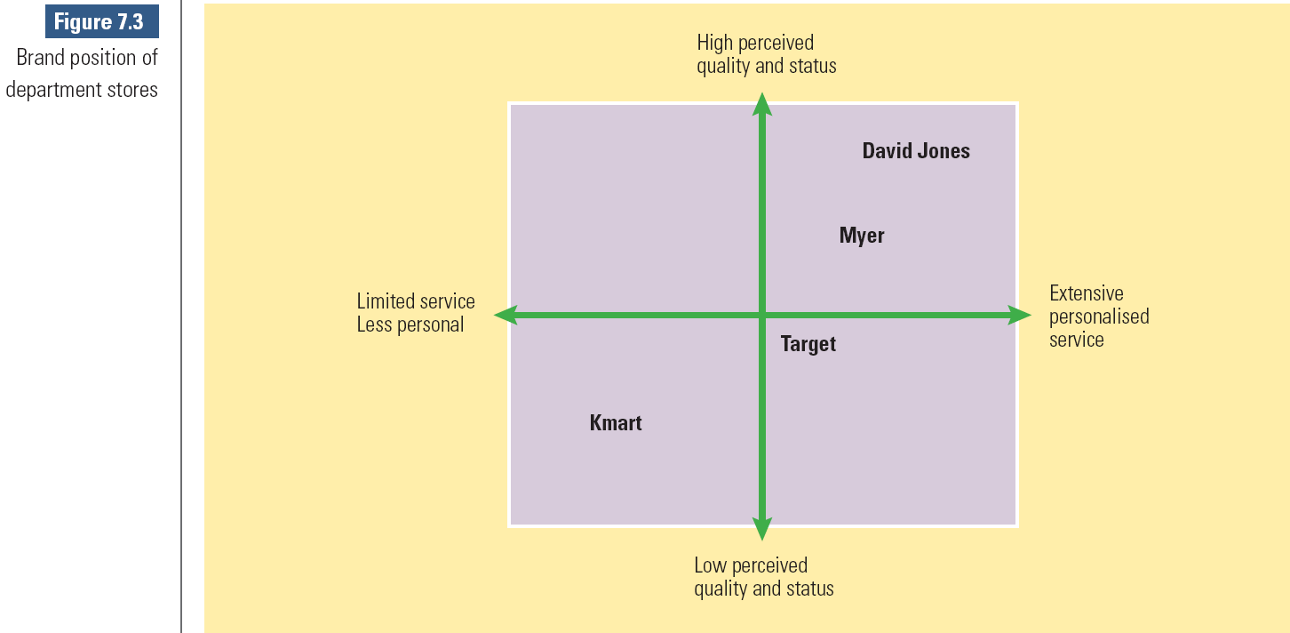
Choosing an overall positioning strategy. One common and important aid: The Positioning Map
Example of a Positioning Map for a whole organisation. Note that this is normally done for individual products.
Notes:
Relates to objective 4 & 5

Slide 38
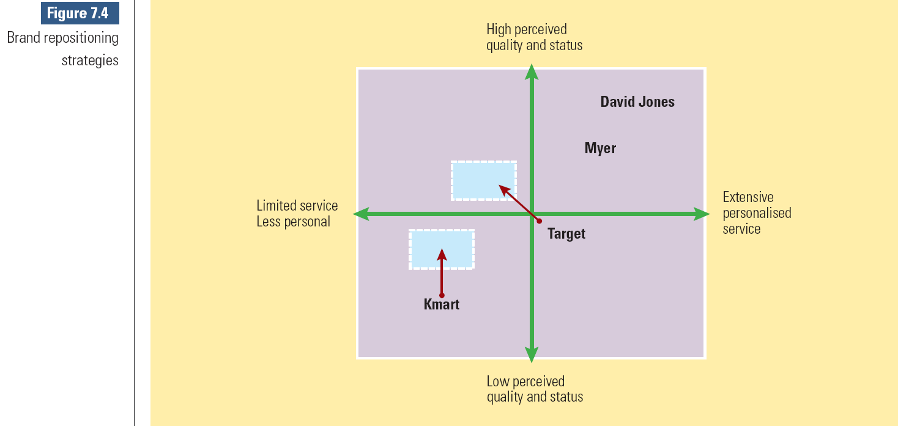
Choosing an overall positioning strategy.
Re-positioning
Notes:
Relates to objective 4

Slide 39
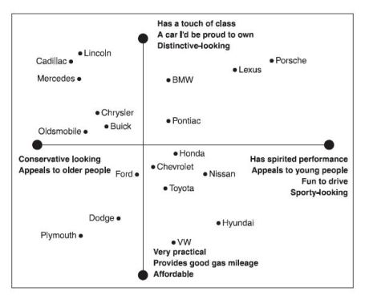
Another example of a positioning map
Showing where the consumer segments are (too many criteria): Poor use

Slide 40


Slide 41
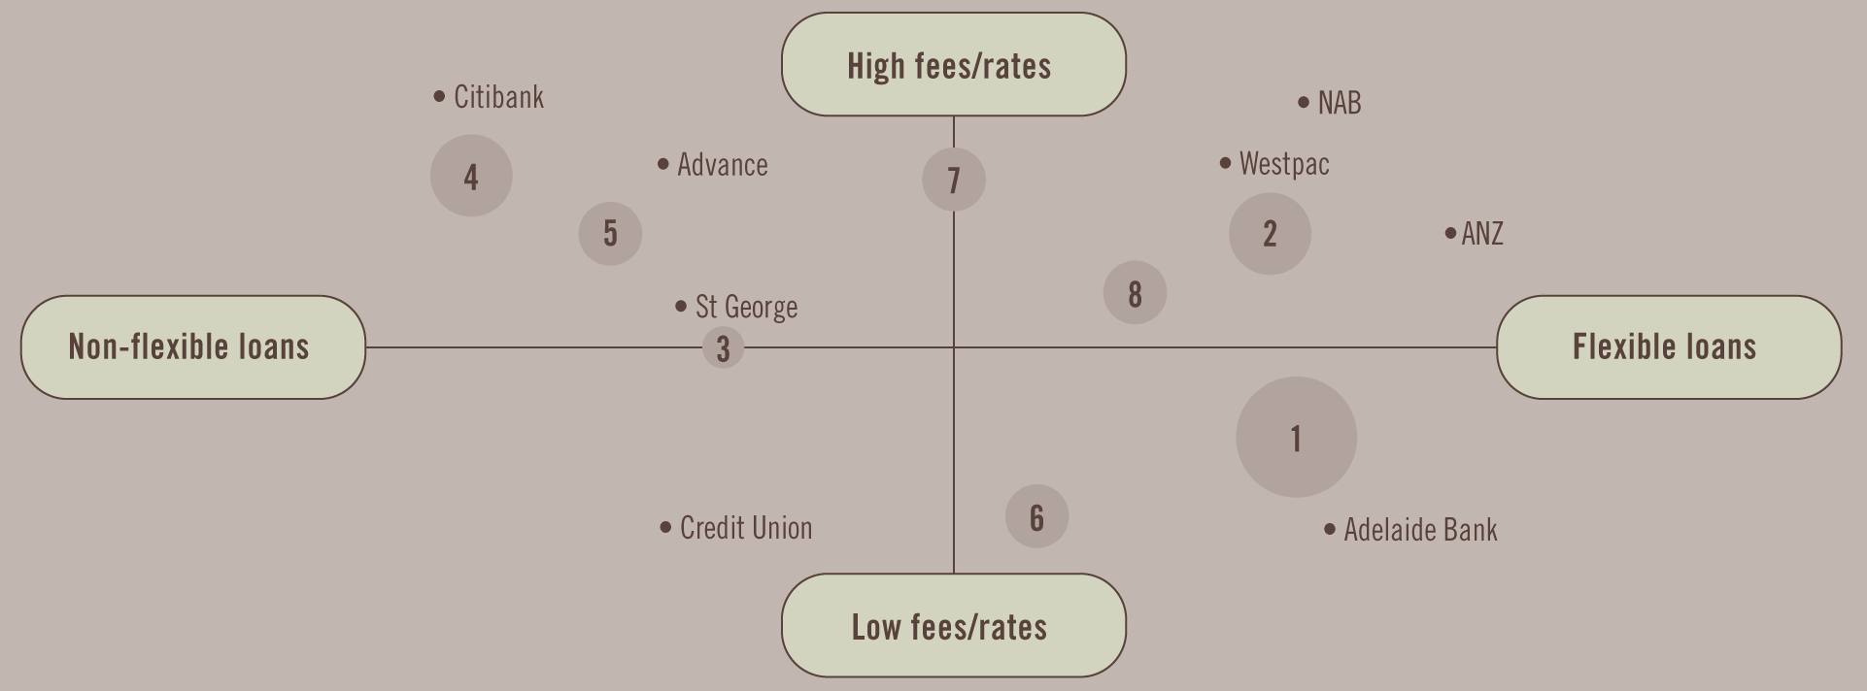
Choosing an overall positioning strategy - another Positioning Map
Showing where the consumer segments are (perceptions of different home loans): Poor use

Slide 42
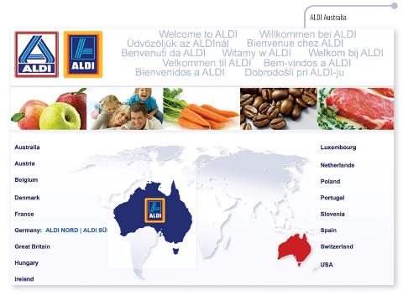
Choosing an overall positioning strategy
Target: Price-conscious shoppers
Market position: Low prices, good quality
The offer: Limited choice of well-presented stock at low prices, in small yet accessible stores
Service
Self-serve, minimal ancillary services: no free shopping bags, no home delivery
Marketing program
Product
Range of 700 most popular lines, mainly sold under private label.
Location
Shopping centres & locations where price-conscious shoppers congregate, e.g. adjacent DFO outlets
Physical evidence ?
Price
?
Promotion
?
Process
?
Copyright ©2015 Pearson Australia (a division of Pearson Australia Group Pty Ltd) – 9781486002696/Armstrong/Principles of Marketing/6e

Slide 43
Differentiation and positioning
Communicating and delivering the chosen position
  All the company’s marketing mix efforts must support the positioning strategy.
  Designing the marketing mix involves working out the tactical details of the positioning strategy.
  Companies often find it easier to produce a good positioning strategy than to implement it.
  Establishing or changing a position usually takes a long time.
  The company should avoid abrupt changes that might confuse consumers.
  A product’s position should evolve gradually as it adapts to the ever-changing marketing environment.

