Slide 1
Principles of Marketing
8th edition
Chapter 9
Pricing: Capturing customer value
Copyright © 2021 Pearson Australia (a division of Pearson Australia Group Pty Ltd)
9781488626203/Armstrong/Principles of Marketing, 8e

Slide 2
What is a price?
Price
is the amount of money charged for a product or service,
or
the sum of the values consumers exchange for the benefits of having or using the product or service.
  is the only element in the marketing mix that produces revenue; all other elements represent costs
  is one of the most flexible marketing mix elements
  is also the number-one problem facing many marketing executives
  has a direct impact on a firm’s bottom line.
  Smart managers treat pricing as a key strategic tool for creating and capturing customer value.

Slide 3
The importance of price
The price the company charges will fall somewhere between one that is too high to produce any demand and one that is too low to produce a profit.
Here are some of the considerations in setting price:
  Price: what is given in an exchange for a good or service
  Revenue: the price charged to customers multiplied by the number of units sold
  Profit: revenue minus expenses
  To earn a profit: managers must choose a price that isn’t too high or too low
  Customer perception
  Competition.

Slide 4

Marketing objective of pricing
Price decisions must be coordinated with product design, distribution and promotion decisions to form a consistent and effective marketing program
Price decisions must also be based on the understanding of the target market
JC Penny and pricing strategy

Slide 5
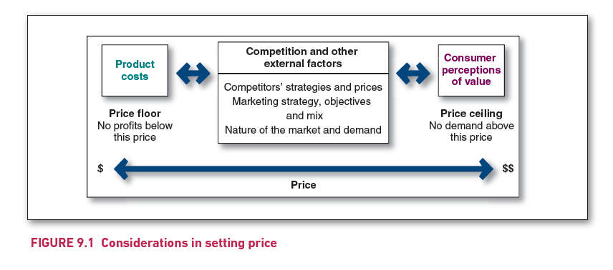
Considerations in setting price
Marketers must select a price that
    Ensures the sustainability of the business
    Equals the perceived value to target consumers
Notes:
The diagram depicts three components: Product costs and Consumer perceptions of value are connected with bidirectional arrows with the middle component, which is titled ‘Competition and other external factors’.
The middle component includes: Competitors’ strategies and prices; Marketing strategy, objectives and mix; Nature of the market and demand.
Below the first component Product costs is the text ‘Price floor; No profits below this price’.
Below the third component Consumer perceptions of value is the text ‘Price ceiling; No demand above the price’.
Below all three components is a bidirectional arrow labelled ‘Price’, leading from ‘$’ at the left-hand side to ‘$$’ at the right-hand side.

Slide 6
Concepts of price & value
When considering price setting, it is important to remember that…
Low Price
Good Value
That is, OTHER factors than just price also determine ‘value’ in the customer’s mind
Copyright ©2015 Pearson Australia (a division of Pearson Australia Group Pty Ltd) – 9781486002696/Armstrong/Principles of Marketing/6e

Slide 7
Major “ongoing” pricing strategies
There are three main “ongoing” pricing strategies:
  customer value-based pricing
  cost-based pricing
  competition-based pricing.

Slide 8
Major “ongoing” pricing strategies
Customer value-based pricing
refers to the process of setting the price based on buyers’ perceptions of value, rather than on the seller’s costs.
This approach requires a deep understanding of the customer's needs, preferences, and how they perceive the benefits of the product or service.
Perceived Value: The price is set based on the value that the customer perceives they are getting from the product or service.
Customer Segmentation: Different customer segments may perceive value differently, so pricing can be adjusted to match the value perceived by different groups.
Competitive Differentiation: The unique value that a product or service offers compared to competitors is crucial in determining price eg features, quality, customer experience
Willingness to Pay: Understanding what the customer is willing to pay is essential.
Value Communication: It’s important to effectively communicate the value proposition to customers so that they understand why the price is set at a certain level.

Slide 9
Major “ongoing” pricing strategies
Two sub-types of value-based pricing
Good-value pricing
  refers to the process of offering just the right combination of quality and good service that customers want at a fair price.
    Hungry Jack’s and McDonalds offering value meals
    Mercedes offering A-Class entry models
Value added pricing
  companies attach value-added features and services to differentiate their offers and thus support higher prices
  Airline Industry: Example:
    Airlines offer value-added pricing for their business and first-class tickets.
    Value-Added Features: Extra legroom, lie-flat seats, gourmet meals, priority boarding, access to exclusive airport lounges.
    Customer Perception: Passengers, especially business travelers, are willing to pay a premium for the added comfort, convenience, and service.

Slide 10
Major “ongoing” pricing strategies
Cost-based pricing
Refers to the process of setting prices based on the costs for producing, distributing and selling the product, plus a fair rate of return for company’s effort and risk.
Costs set the floor for the price the company can charge
Benefits
  Sellers are certain about costs.
  Price competition is minimised.
  Buyers feel it is “fair”.
Disadvantages
  Ignores demand and competitor prices
  Narrow definition of value and/or benefits
  Tangible vs intangible value (how much would you pay to be “cool”?

Slide 11
Major “ongoing” pricing strategies
Cost-based pricing (cont.)
Types of costs
Fixed costs (overhead) are those costs that do not vary with production or sales level.
Variable costs are those costs that vary directly with the level of production.
Total costs are the sum of the fixed costs and variable costs for any given level of production.
Fixed costs
Variable costs
Total costs

Slide 12
Major “ongoing” pricing strategies
Cost-based pricing
Cost-plus pricing (markup pricing)
refers to the process of adding a standard markup to the cost of the product.
  For example, an electronics retailer might pay a manufacturer $20 for a 64Gb flash drive and mark it up to sell at $30, a 50 per cent markup on cost.
Breakeven pricing (target-return pricing)
refers to the process of setting the price to break even on the costs of making and marketing a product or to make the desired profit.
  If the flash-drive manufacturer wants a target return of $2 million, it must sell at least 800 000 units (@ $15 per unit) to obtain the $12 million of total revenue needed to cover the total cost of $10 million plus the $2 million of target profits.
  Key issue for business, as price increase, consumer demand falls

Slide 13
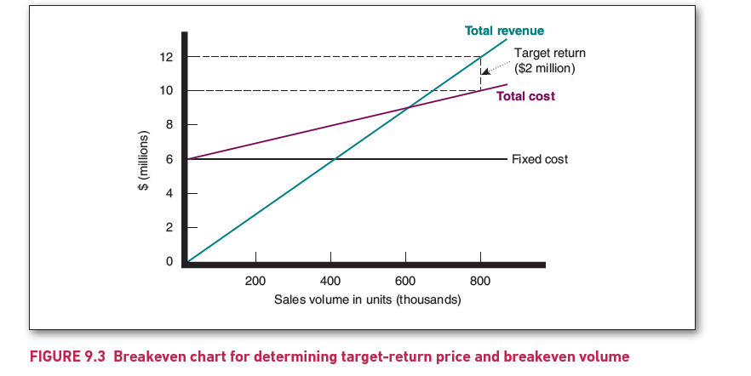
Breakeven chart for determining target-return price and breakeven volume
Notes:
Horizontal axis shows 'Sales volume in units' in thousands, ranging from zero to 800, in increments of 200. Vertical axis shows 'dollars' in millions, ranging from zero to 12, in increments of 2.
A horizontal straight-line curve is starting from 6 million dollars, and is labelled as ‘Fixed cost’.
An upward-sloping straight-line curve, starting from the origin, is intersecting the Fixed cost curve at 400 thousand sales units. This line is labelled as ‘Total revenue’.
Another upward-sloping straight-line curve, depicting Total cost, is starting from the Fixed cost curve at 6 million dollars. The Total cost curve is intersecting the Total revenue curve at 600 thousand sales units. Vertical distance between the Total cost curve and the Total revenue curve, measured at 800 sales units, is labelled as Target return (2 million dollars).

Slide 14
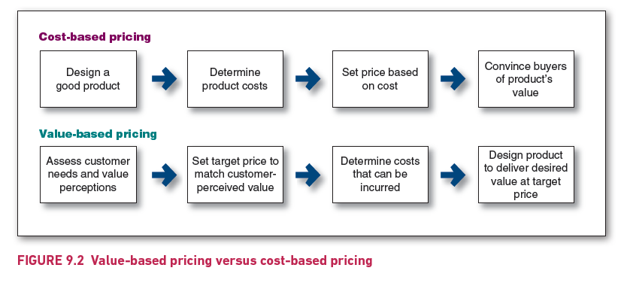
Value-based pricing versus cost-based pricing
Notes:
Components of Cost-based pricing are in the following order:
Design a good product
Determine product costs
Set price based on cost
Convince buyers of product’s value.
Components of Value-based pricing are in the following order:
Assess customer needs and value perceptions
Set target price to match customer-perceived value
Determine costs that can be incurred
Design product to deliver desired value at target price.

Slide 15
Major “ongoing” pricing strategies
Competition-based pricing
Competition-based pricing refers to the process of setting prices based on competitors’ strategies, costs, prices and market offerings.
Consumers base their judgments of a product’s value on the prices that competitors charge for similar products.
In the competitive marketplace, pricing pressure has increased.
Yet, cutting prices is often not always the best solution. Reducing prices:
  unnecessarily erodes profits
  contributes to damaging price wars and
  has the potential to erode brand value.
The challenge is to find the right balance between profit and pressure to reduce prices.

Slide 16
Other internal and external considerations affecting price decisions
Overall marketing strategy, objectives and mix
Marketers must consider the total marketing strategy and mix when setting prices.
Pricing can be used to:
  attract new customers or profitably retain existing ones
  deter competitors from entering the market
  stabilise the market by matching competitors’ prices
  retain the loyalty and support of resellers
  avoid government intervention
  create excitement for a brand
  help the sales of other products in the company’s line.

Slide 17
New-product pricing strategies
Market-skimming pricing
Market-skimming pricing (price skimming)
refers to the process of setting a high price for a new product to skim maximum revenue from the segments willing to pay the high price; the company makes fewer but more profitable sales.
Key features
  High initial price – captures early adopters who value being first or see high value.
  Price decreases over time – as competition increases or demand from early buyers is satisfied.
Success is often determined by:
  Product is new, unique, or innovative (e.g., new technology, luxury goods).
  Demand from early adopters is strong.
  Superior product and/or brand reputation.
  Barriers to competitive entry,
  Legal protection of product or technological breakthroughs
  Inelasticity of demand

Slide 18
New-product pricing strategies
Market-penetration pricing
Market-penetration pricing
refers to the process of setting a low price for a new product in order to attract many buyers and a large market share.
Designed to capture a large share of a substantial market, resulting in eventual lower production costs after (or if) market is dominated.
Successful when:
  Market is price sensitive
  Economies of mass production are feasible
  Firm has substantial resources to sustain short-run losses needed to obtain penetration
Disadvantages:
  Lower profits per unit
  Higher volume required to reach the break-even point
  Slow recovery of development costs
  Inability to later raise prices as consumers become used to low prices

Slide 19
Price-adjustment strategies
Companies usually adjust their basic prices to account for differences in:
  customers
  products
  locations
  changing situations.

Slide 20
Price adjustments Strategies
Strategy | Description
Discount and allowance pricing | Reducing prices to reward customer responses such as volume purchases, paying early or promoting the product
Segmented pricing | Adjusting prices to allow for differences in customers, products or locations
Psychological pricing | Adjusting prices for psychological effect
Promotional pricing | Temporarily reducing prices to increase short-term sales
Geographical pricing | Adjusting prices to account for the geographic location of customers
Dynamic pricing | Adjusting prices continually to meet the characteristics and needs of individual customers and situations
International pricing | Adjusting prices for international markets

Slide 21
Price-adjustment strategies
Discount and allowance pricing
  Discount
  is a straight reduction in price on purchases during a stated period or when purchasing larger quantities.
  The many forms of discounts include:
    Cash discount –
    a price reduction to buyers who pay their bills promptly
    Quantity discount –
    a price reduction to buyers who buy large volumes
    Functional discount (trade discount) –
    is offered by the seller to trade-channel members who perform certain functions, such as selling, storing and record keeping
    Seasonal discount –
    a price reduction to buyers who buy merchandise or services out of season

Slide 22
Price-adjustment strategies
Discount and allowance pricing
  Allowance
  is promotional money paid by suppliers to retailers in return for an agreement to feature the suppliers’ products in some way.
  The many forms of allowances include:
    Trade-in allowances –
    price reductions given for turning in an old item when buying a new one
    Promotional allowances –
    payments or price reductions to reward dealers for participating in advertising and sales support programs.

Slide 23
Price-adjustment strategies
Segmented pricing
The company sells a product or service at two or more prices, even though the difference in price is not based on differences in costs.
Customer-segment pricing:
customers pay different prices for the same product – Museums/train rides/cinema
Product-form pricing:
different forms of the product are priced differently, but not based on costs - a retailer’s house-brand product and manufacturer’s brand
Location-based pricing:
different prices for specific locations, not based on costs (e.g., price of different theatre seats)
Time-based pricing:
different prices for time of day, time of year etc. (e.g., off-peak prices) c

Slide 24
Price-adjustment strategies
Psychological pricing
Psychological pricing
is where sellers consider the psychology of prices and not simply the economics.
  consumers usually perceive higher-priced products as having higher quality
Reference prices
are prices that buyers carry in their minds and refer to when looking at a given product.

Slide 25
Price-adjustment
Promotional pricing
Promotional pricing is where a company temporarily prices its product below list price, and sometimes even below cost, to create buying excitement and urgency.
  Promotional pricing can take many forms, including:
    Discounts
    Rebates
    Functional (trade) discounts
    Special-event pricing
    Low-interest finance
    Free maintenance

Slide 26
Price-adjustment strategies
Dynamic and personalised pricing
Refers to the process where prices are adjusted continually to meet the characteristics and needs of individual customers and situations.
The flexibility of the internet allows online sellers to instantly and constantly adjust prices on a wide range of goods based on demand dynamics.
This type of dynamic online pricing is sometimes called real-time pricing.
Dynamic pricing offers both advantages for marketers and benefits for consumers.
It can also be controversial.
Prices routinely set hour by hour depending on availability, demand and competitor price changes (e.g., airlines)

Slide 27
Non-Price competition strategies
Price competition can only go so far, firms often engage in non-price competition.
Non-price competition typically involves promotional expenditures (such as advertising, selling staff, the location's convenience, sales promotions, coupons, special orders, or free gifts), marketing research, new product development, and brand management costs.
Firms will engage in non-price competition, in spite of the additional costs involved, because it is usually more profitable than selling for a lower price and avoids the risk of a price war.
Non-price competition may also promote innovation as firms try to distinguish their product.

