Slide 1
WELCOME TO OUR PRESENTATION
Lane Changing System Of Army Ants in Autonomous Car

Slide 2
Here is our Group Members:
Name ID No.
Chowdhury Mobarat Haider 143014017
Sohag Saha 143014004
Muhibbul Hasan 143014035
Shakaoth Hossain 143014043

Slide 3
About Our Project
Our Project is to design an algorithm how a automated car changes its lanes just like new world army ants by using agent based modeling.
The whole project is depended on each and every characteristics of an army ants which are blind by nature . If we can apply it to the swarm robotics or automated car system it would be a huge thing to discover .
We will be describing briefly in our next few slides which will make u more clear about our Project and presentation.

Slide 4
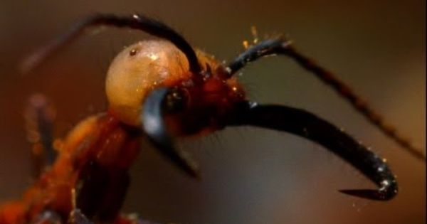
Motivation
As you all know that ‘ Eciton burchellii ’ is a new world army ants, they are blind, they track their food by making pheromones , each of the army follow this chemical trails to follow predators even they can make bridge out of it , so our motivation for project is to design an algorithm for an automated car to see whether it changes lanes just like the blind army ants or not !

Slide 5
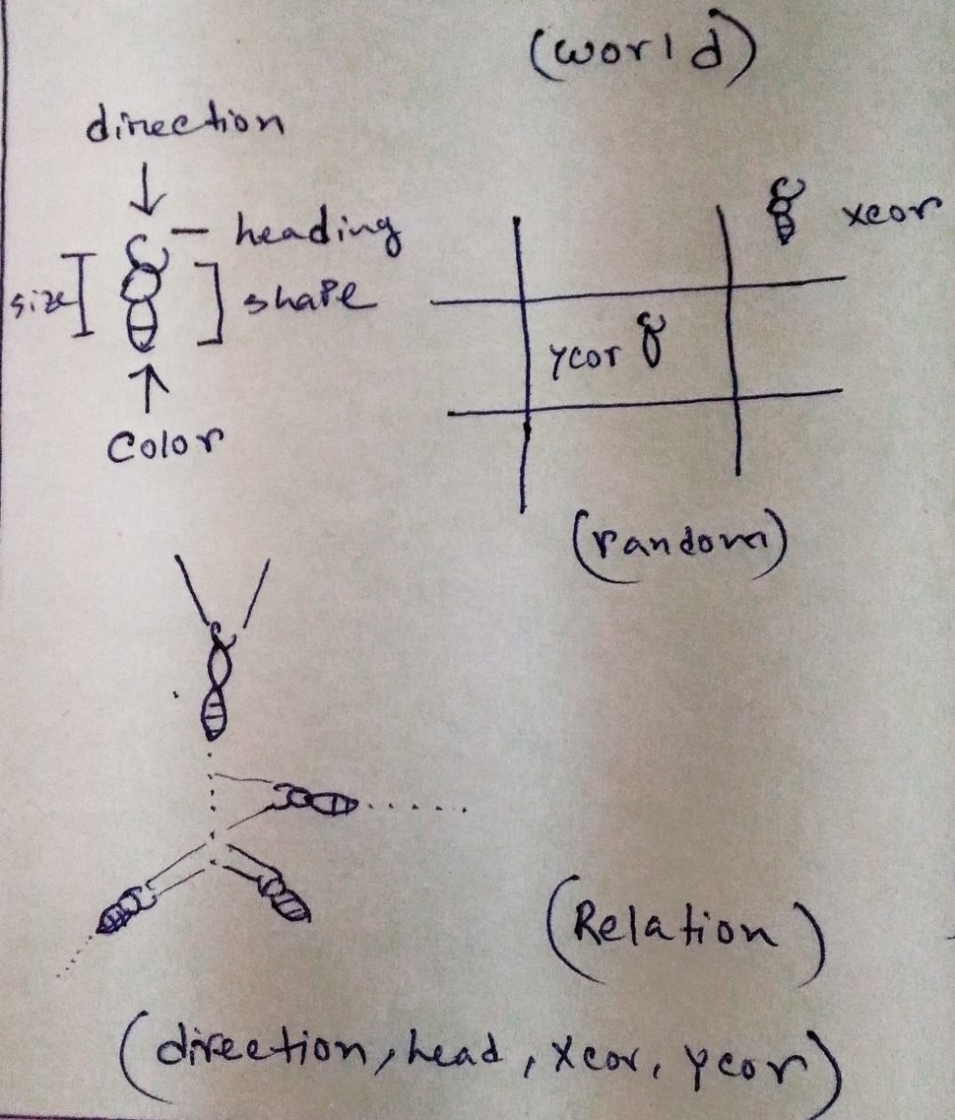
How can we use it in Agent based modeling?
Agents will be created by Breed .
Agent will have 8 properties Heading ,shape,size,color, Xcor,Ycor(random),not Hidden ,who(ants) ,set line.
Every agents will create line and others will follow same line as like pheromones.
If one is in xcor another one will change it direction and come to xcor.
Their direction will be same.

Slide 6
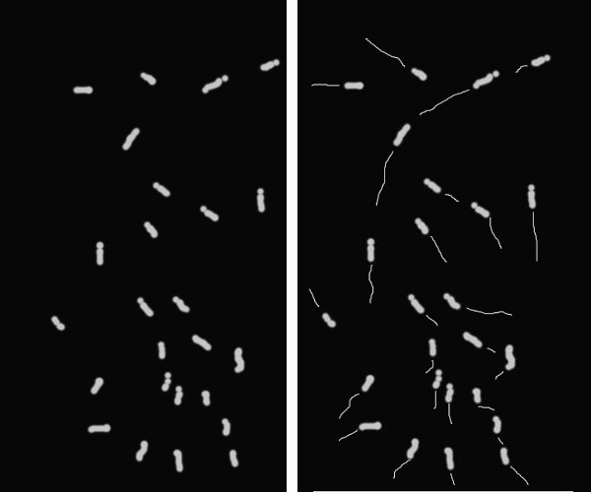
Specification of the Model
At this Diagram we can see a net logo model of agents call Ants .
Their position is random X cor Ycor , their heading is random .
When they started they create line .
Backend ants follow the closer line trials.
By that they create a track which is similar to Pheromones.

Slide 7
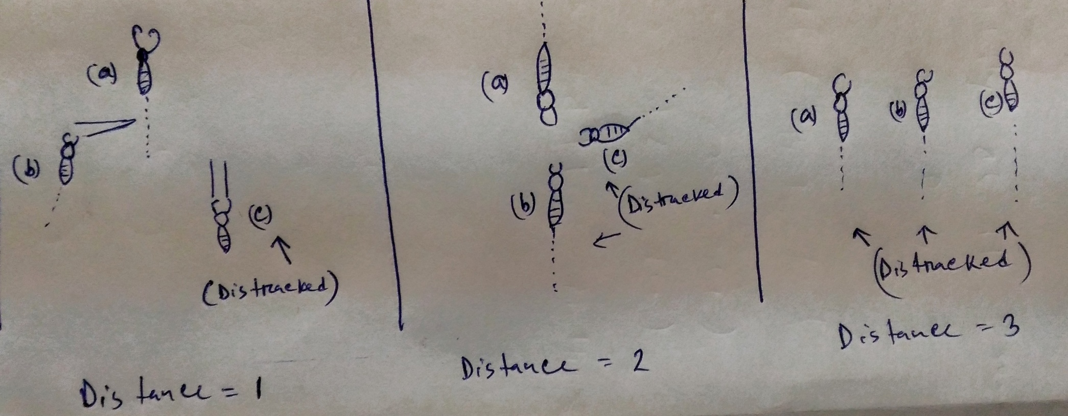
We take 3 diagram of distance 1,2,3. we place 3 agents of ants which is a random distance , now let us see whether its detracted or not ?

Slide 8
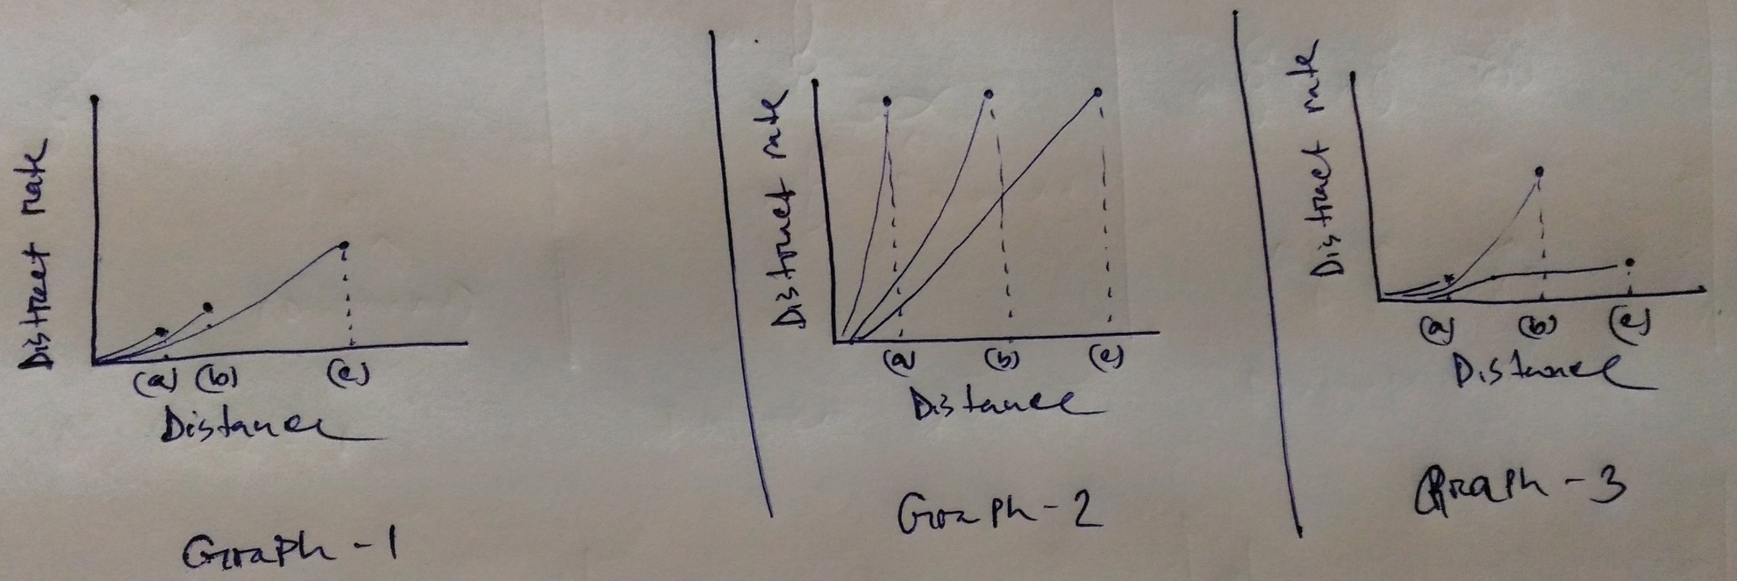
Let us see Graph 1 : a &b is closer but c is far aways from them it distracted.
Let us see Graph 2 : a,b &c all of them are far away from their line so distracted rate is high.
Let us see Graph 3: same as Graph 2 all are distracted .
So the more you get closer the distracted rate will be lesser .

Slide 9
Rules of the Agents :
Agent will move randomly in the world .
Each Agent will create a path
Closer Agents will attract and follow the same direction .
Majority agents will follow the trials and changes its path to right ,left , up & down.
If lost follow the closer line of the other agents .
Distance will be measured for each agents .
closer distance have high chances to follow .
larger distance have high chances to distract .
Obstacle can be detected/ignored.

Slide 10
What are we going to measure? Outputs :
Distance between each Agents .
Population of Agents .
Population of Agent following trails.
Population of Agent distract.
Max aligned turning angle of each Agents.
Max cohere turning angle of each Agents.
Speed of the rotation .
Collation/separation of the Agents .
Trails turning degree measurements .

Slide 11
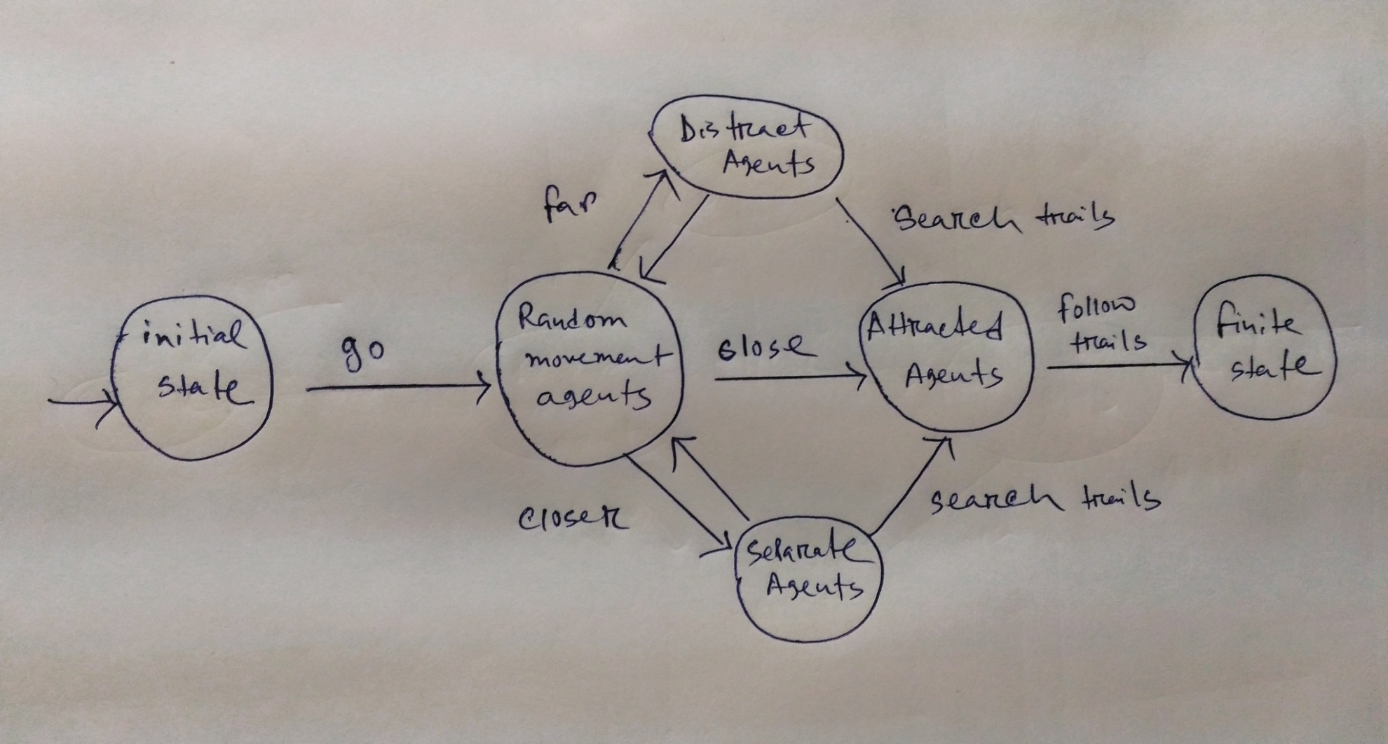
Parameters of the model
Finite state Diagram of movement of Ants :

Slide 12
Randomly move : Create population move randomly in the world.
Create line : Each agents create a line when the move.
Follow line : back agent follow the line of front agent.
Rotate with the trail : turn right/left with the trial without losing trails.
Do not collide with each other : keep a minimum distance so that collation don’t occur .
Do not separate too much from each other : don’t move too far from each other or from trail . It distracts the agents and it loose the tracks .

Slide 13
Thank You

Slide 14
Any Question ? Feel free to ask !!!

Slide 15
Distract
Agent
Attracted Agent
Initial State
Random
Movement
Agent
Final State
Separate Agent

