Slide 1



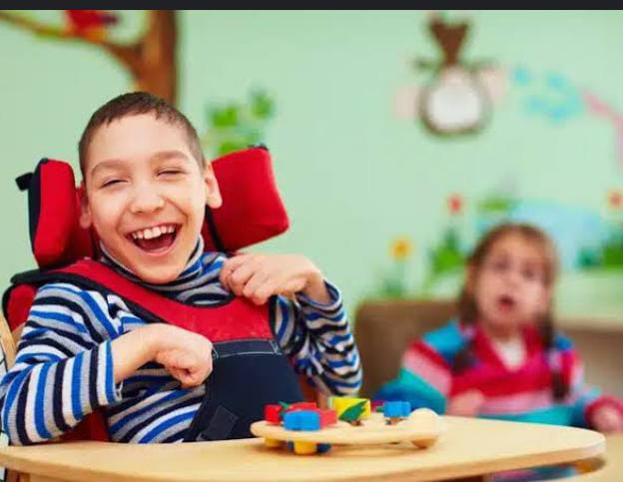
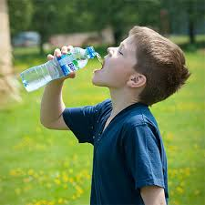

Presented by: Adanan shaheen
Presented to: Ma'am Sadia latif
Class: BS SE
Subject: Clianical Psychology
Semester: 5th
University of Mianwali
Department of Software

Slide 2
Global developmental delay
Department of psychology

Slide 3
Introduction.
Growth: : increase in mass and dimension of the body, it
includes aspects as weight, length and head circumference.
Development: maturation of functions and gaining of
various skills
Domains of Develpoment: gross motor, fine motor,
language, and social.
Abnormality in one aspects is called monodelay.
Abnormality in the more than one aspect is called
global developmental delay.

Slide 4
Introduction to global developmental delay?
Global developmental delay is an umbrella term used when children are
significantly delayed in their cognitive and physical development. It affects 5% of children from after birth till the age of 8 year. It’s more common in boys due to x-linked chromosomal abnormalities, there are five main areas at
which the child can show delay.
It can be diagnosed when a child is delayed in one or more milestones,
categorized into motor skills, speech, cognitive skills, and social and emotional
development. There is usually a specific condition which causes this delay, such
as Fragile X syndrome or other
chromosomal abnormalities. However, it is sometimes difficult to
identify
this underlying condition.

Slide 5
Factors affecting global developmental delay
Poverty , malnutrition, and lack of appropriate care.
Child abuse and neglect.
Congenital infections, meningitis and Iron deficiency
anemia.
Failure to thrive, maternal substance abuse.
Environmental exposures.

Slide 6
Intellectual delays

Slide 7


Infancy and Toddlerhood (0-3 years)
Delayed Milestones: Slow progress in sitting, crawling, or walking.
Limited Communication: Challenges with cooing, babbling, or gesturing.
Social Withdrawal: Avoiding interactions or difficulty responding to cues.

Slide 8

Early Childhood (4-6 years)
Delayed Language Development:
Struggles with vocabulary, grammar, or syntx.
Cognitive Delays: Difficulty in problem-solving, memory, or attention.
Motor Skill Delays: Challenges with fine motor tasks like drawing or buttoning

Slide 9
Middle Childhood (7-12 years)
Academic Struggles:
Issues with reading, writing, or mathematics.
Social Difficulties:
Problems with friendships and understanding social cues.
Emotional Regulation: Mood swings or irritability.

Slide 10
Adolescence and Adulthood
Independent Living Challenges: Struggles with cooking, cleaning, or financs.
Employment Difficulties: Challenges in finding or maintaining jobs.
Social Isolation: Difficulty forming or maintaining relationships.

Slide 11
Intellectual Disability (DSM-5 Overview)

Slide 12
Definition:
A neurodevelopmental disorder that affects a person's ability to function in daily life.
Key Areas of Deficit:
Intellectual Functioning:
Reasoning
Problem solving
Planning
Abstract thinking
Judgment
Academic learning
Learning from experience

Slide 13
Adaptive Functioning:
Personal independence
Social responsibility
Domain
Conceptual: Academic and cognitive abilities.
Social: Interpersonal skills and social cues.
Practical: Personal care, money management, and job responsibilities.

Slide 14
Severity Levels:
Vary across individuals and domains.
Examples of Intellectual Disabilities:
Down syndrome
Fragile X syndrome
Phenylketonuria
Adaptive Functioning Skills:
Understanding time and money
Interpreting social cues
Attending to personal needs (e.g., eating, dressing)

Slide 15
Definition:
Difficulties in acquiring and using academic skills.
Specific Learning Disorders:
Reading Disorder:
Difficulty with reading skills, including accuracy, fluency, and comprehension.
Mathematics Disorder:
Difficulty with mathematical skills, including number sense, calculation, and problem-solving.
Written Expression Disorder:
Difficulty with writing skills, including handwriting, spelling, grammar, and composition.
Learning Disorder, Not Otherwise Specified:
A learning disorder that does not meet the criteria for a specific learning disorder.

Slide 16
Comprehensive Management Plan for Learning Disorders
Instructional Strategies:
Multisensory instruction
Differentiated instruction
Assistive technology
Modified assignments
Extra time to complete tasks
Behavioral Interventions:
Positive reinforcement
Behavioral contracts
Social skills training
Emotional regulation techniques
Self-monitoring and self-evaluation
Educational Therapy:
Orton-Gillingham approach (reading)
Wilson Reading System (reading)
Cognitive-behavioral therapy (CBT)
Math therapy (e.g., Kumon method)
Writing therapy (e.g., Handwriting Without Tears)

Slide 17
Comprehensive Management Plan for Learning Disorders
Accommodations and Modifications:
Extended time for tests and assignments
Note-taker or recorder
Audio books or text-to-speech software
Modified grading system
Adaptive physical education
Support Services:
Speech therapy
Occupational therapy
Counseling (individual or group)
Academic support (tutoring or mentoring)
Parent training and support
Collaboration and Communication:
Multidisciplinary team meetings
Regular progress updates
Parent-teacher conferences
Collaboration with related service providers
Student self-advocacy and empowerment

Slide 18
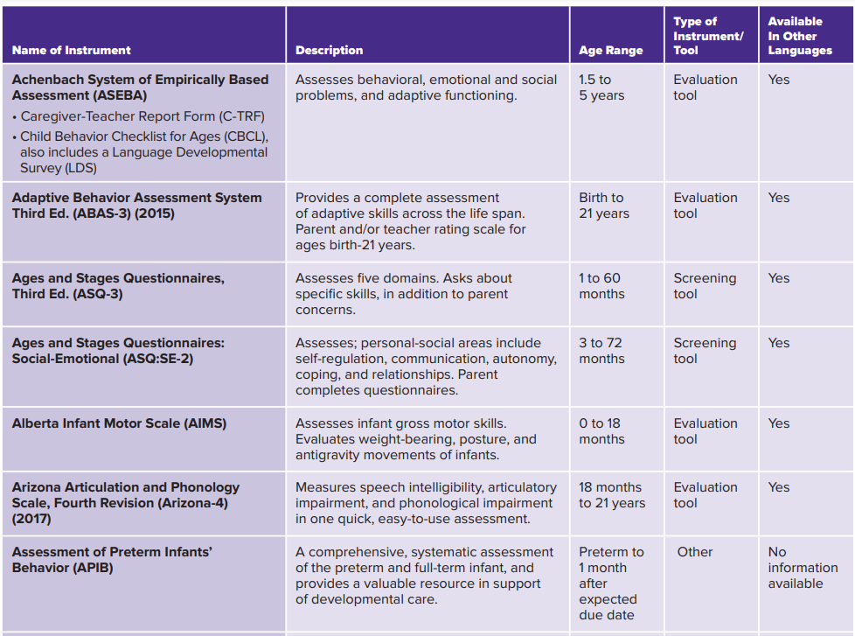
List of Developmental Assessment Instruments May 2023

Slide 19
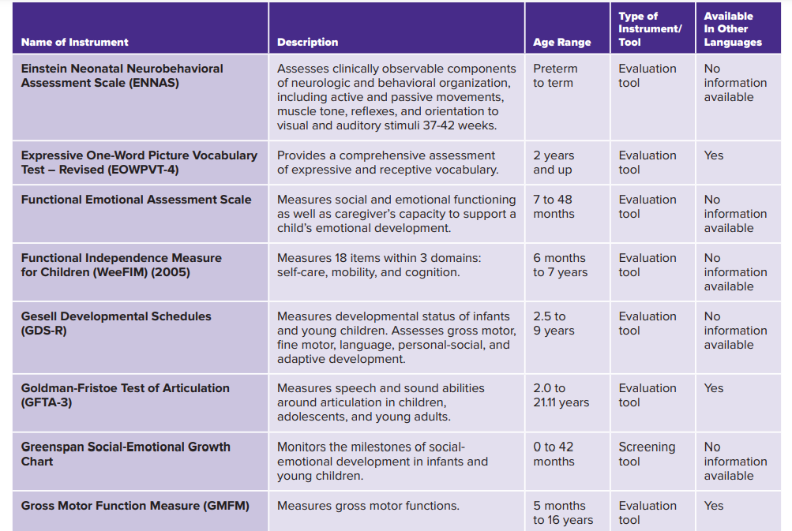

Slide 20
Case Overview and Presenting Symptoms
Background:
Name: John
Age: 10 years old
Referral Reason: Concerns about cognitive and adaptive development.
Birth History: Born at 28 weeks gestation; complicated neonatal course.
Presenting Symptoms:
Academic Skills:
Struggles with reading, writing, and math.
Performing below grade level.
Communication:
Difficulty articulating thoughts and ideas.
Uses simple sentences.
Social Interactions:
Trouble initiating and maintaining conversations.
Appears shy or withdrawn.
Daily Living Skills:
Requires assistance with dressing and grooming.

Slide 21
Assessment, Diagnosis, and Intervention
Assessment:
Cognitive Assessment:
IQ score of 50 (significant cognitive impairment).
Adaptive Behavior Assessment:
Scores below average (difficulty with daily living skills).
Communication Assessment:
Below average communication skills.
Diagnosis:
Intellectual Disability (Mild):
Criteria met based on IQ and adaptive behavior scores.
Speech and Language Disorder:
Below average communication skills.

Slide 22
Intervention:
Special Education Services:
Individualized instruction and accommodations.
Speech and Language Therapy:
To improve communication skills.
Occupational Therapy:
To enhance daily living skills.
Parent Training:
Guidance for supporting cognitive and adaptive development.

Slide 23


Slide 24


Slide 25
WARNING SIGNS
OF DEVELOPMENTAL DELAY

Slide 26
Gross Motor
Fine Motor
Social
Language
28 weeks gestation
Moro Reflex
Suckling
Rooting Reflex
Grasp Reflex
Light Reflex
At birth
-Flexion Attitude
-side to side movemnet
Blinks to flshing
light
Crying
Absent Moro Reflex
Poor Feeding
Convulsion
One Week
When prone:
raise head slightly
Follows moving
object to midline(90d)
Alert to sound by blinking or startling
1 month
Regards face
6 Weeks
No face
Regarding
Raise Head
more while prone
Fitsts no more clenched
Follows 180 degrees by eyes
Smile
socially
2 Months

Slide 27
Gross Motor
Fine Motor
Social
Language
On prone :
Raise Chest & support
weight with forearm
On erect :Head support
COOS
Says “AAH”
Laughs loud
3 Months
Opens hands
spontaneously
Smiles appropriately
on social contact
Anticipate feeding
3 Months
Clenched hands
No smiling
responsively
4 Months
Poor head control
No interest in
own hands
Dissapearnce of
(moro, suckling ,
rooting ) reflexes
4 Months
Interest in own
hands
6 months
Persistant
moro Reflex
No interest
in toys
6 Months
Sits momentary
supported by arm
Transfer objects
Shows like &
dislike
Bubble “ba,ba” sounds

Slide 28
Gross Motor
Fine Motor
Social
Language
9 Months
Sits alone, back straight
Creeps or crawls
Plays
(peek a boo )
Double Bubble “da,da”,“ma,ma”
sounds
Pincer grasp
Not reaching or
transferring, baulks on solid
9 Months
Not sitting alone
11-12 M
No pincer grasp
Poor attend span
Walks supported with one hand held
Walks alone well
12 Months
Release object
to mother on
request
Comes when
called plays
1-2 meaningful words
- Ascend stairs with
one hand held
- Seats himself in a small chair
- Runs stiffingly
Build towes of 3 cubes
Points to parts on request
Feeds himself by a spoon
18months
Mimcs actions of others
At least 6
words
18 Months
Not walking
No usefull speech

Slide 29
Gross Motor
Fine Motor
Social
Language
Run Well. Ascend& Descend stairs alone With: 1 step at time
Build tower of 6
cubes.
Draw a line
(not imitate )
Play with other
children.
Sentences of 2-3
words
2 Years
2 Years
Aimless overactivity
-Ascend stairs: with
alternate feet.
-Seats himself in a
small chair.
30 M
Build tower of 9 blocks.
Copies circles & Crosses
Eats with knife & fork
Goes to Toilet alone
Sentences of 4
words together
Recognizes 4 colors
Rides and pedals
Tricycle -Climb up stairs well jump on spot
36 M
Know Full name,
age & sex.
Recognize colors
3 Years
Cannot draw circle
Not Comes when
called to play

Slide 30
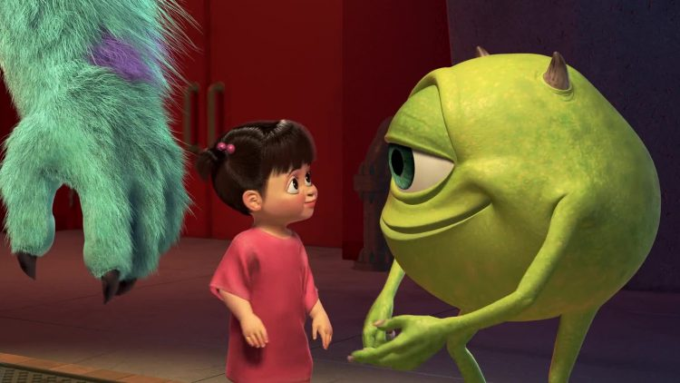
Gross Motor
Fine Motor
Social
Language
Jump on one foot. Walks Heel to Toe along line
Draws a man
(6 parts) with pencil
Chooses own
friends. Dramatic group play
Fluent Speaker. Asking
about: Words &
Things meaning
60 M
4-5 years
Cannot tell his full
Name
6 years
No usefull speech
Cannot know colures
yellow, green, red, and
blue
1 word قطتي
2 words مارد وشوشني
Social smile
Social Laughing
Walks without support
Ascend stairs well
Jump on spot
So She was 13-15 mothns
development language
2 years Gross motor
5 years Fine motor
18 months social

Slide 31
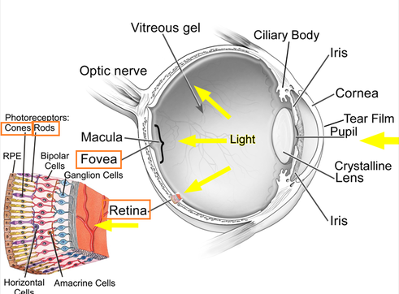


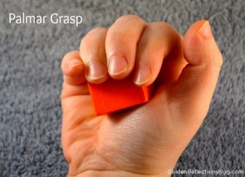

Grasp Reflex
28th week gestation
Palmar Grasp
Retina develops centrally first
then peripherally
Rods(1month) before cones(2months)

Slide 32
CAUSES:
Familial predisposition.
Systemic disorder e.g.: congenital heart disease.
Skeletal disorder e.g.: achondroplasia & rickets.
Muscular disorder e.g.: myopathies.
CNS disorder e.g.: cerebral palsy & mental handicap.
Neurological disorder e.g.: congenital neuropathies, poliomyelitis.
Perceptual disorder e.g.: blind child.
Nutritional disorder e.g. severe protein energy malnutrition (PEM)
Environmental factors e.g.: emotional deprivation and lack of stimulation. -

Slide 33

MANAGEMENT
AND SUMMARY
OF GDD

Slide 34
DIAGNOSIS
Developmental delay can be difficult to diagnose.
There are some types of tests that can be done:
Developmental screening & Evaluation tests .
Developmental screening:
to tell if children are learning basic skills when they
should, or if they might have problems
Pediatric doctor may ask questions or talk and play
with child during an exam to see how he or she learns, speaks, behaves, and moves. Since there is no lab or blood test to tell
if the child may have a delay, the developmental screening will
help tell if the child needs to see a specialist.

Slide 35
TREATMENT
The specific management of children with global developmental delay will depend on their individual needs and underlying diagnosis. Early intervention is essential to support the child to reach their full potential. Specialists involved in the management of GDD in children include....
Speech therapists
Physical therapists
Occupational therapists
Hearing specialists (Audiologist)
Developmental paediatricians
Neurologists
Providers of Early Intervention Services (depending on location)
As well as involving professionals, parents can support the development of
their child by playing with them, reading with them, showing them how to do tasks, and supporting them to participate in activities of daily living such as washing, dressing, and eating.

Slide 36
PROGNOSIS
Many developmental delays can be treated early so that by
the time a child is in school, he or she has caught up to his
or her peers.
However, since many delays are not diagnosed until
a child is in school, this creates a greater impact on the child
since the window for early intervention has been lost.
Even if the delay, in fact, is the first sign or symptom of a
disability, early identification and treatment, most often, will minimize the problem and maximize the child’s potential.
Once a child is diagnosed and a proper treatment plan is in
place, many children are still able to overcome the impact of
their developmental delays.

Slide 37
REFFERENCES :
- Al_Azhar Cairo University Department Book
- Nelson Textbook of pediatrics
- Kasr Eleiny Pediatric Book
- https://www.medscape.com/viewarticle/515575
- https://nyulangone.org/conditions/developmental-delays-in-children/types

