Slide 1

Why performance testing?
Do want to use an Movie Booking web-site to book a ticket
and wait for 15 minutes to know that there are no seats available?

Slide 2
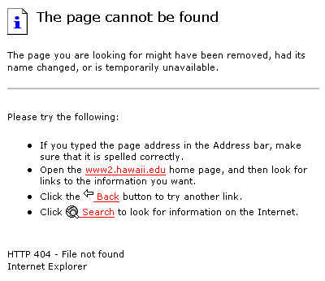
Why performance testing?
How many of us like to click on a button and see the result –
“Error : Page not found”?

Slide 3
Bad performance is bad for business
Lack of proper performance testing results in loss of revenue, loss of credibility, loss of customers

Slide 4
Why Applications become slow?
Multiple users using the application at the same point of time
Load on the application increases
Applications become slow

Slide 5
What is Performance Testing
Check Performance of application
Application Under test
(Lets assume Gmail application)
Creating the load on the application

Slide 6
What are Vusers
Image there were 1000 users
Can we have real users
These were real users
Virtual Users
OR
Vusers

Slide 7
Types of users
User Base (100000) → registered
Application Users / Online users (100) (90 +10)
Concurrent users (10)
Key Facts
Number of concurrent users is not same as the number of application users

Slide 8
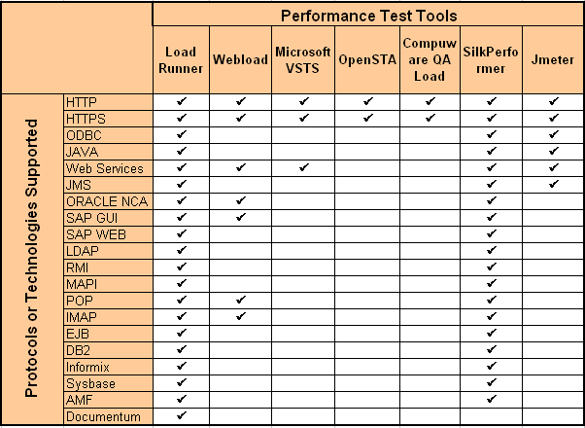
Performance testing tools and protocols
8

Slide 9
What is Architecture?

Slide 10
What is architecture?
An architecture is a
combination of software and system components and connections

Slide 11
Importance of architecture
Helps in
Designing smaller and more manageable pieces of application
Understanding dependencies between components
Enables interaction
Between different parties (stakeholders) who intend to develop the computer-based system
Between different systems and system components

Slide 12
What is a server
Software (Computer Program) or Hardware which
Understands your request
Process your request
Send the response back

Slide 13
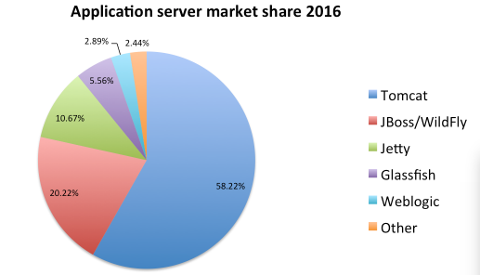
Application Server (APP Server)
An application server is a server program in a computer in a distributed network that provides the business logic
for an application program

Slide 14
Web Server
An web server is full implementation of HTTP Protocol
A Browser is partial implementation of Http Protocol

Slide 15
Application layers Presentation layer Accepts user inputs, displays data and any results computation on the user interface Application processing layer Provides application specific functionality e.g., in a banking system, banking functions such as open account, close account, view account details etc. Data management layer It manages the system database

Slide 16
Client/Server - 2 Tier architecture
Improves multi-user updating.
These days again this model is picking up because of mobile apps
There are 2 types of Models
16

Slide 17


3-Tier Architecture
Presentation Layer
Business Logic Layer
Business logic tier between presentation logic and data tier
Data Access Layer
Data
PC
(Thin Client)
Database
Server
Application
Server
17

Slide 18
Three tier architecture
Advantages
Separate processor might be present for each application layer
This architecture is simpler to
manage than fat-client model and also gives better performance than a thin-client model
Can be scaled easily
more servers can be added as demands increase
18

Slide 19
N-Tier (Multi-Tier Architecture)
Business Logic Layer
Presentation Layer
Data Access Layer
Enterprise Data
Database
Server
PC (Thin Client)
Web Server
Application
Server
Specialized web servers were introduced which can generate presentation content which is transferred to the browser on the client tier, which takes care of rendering the user interfaces
19
Notes:
An N-Tier application usually has three tiers – Presentation Tier, Business Tier and Data Tier

Slide 20
What is performance testing?
PT is testing an application for speed, stability and scalability in “Production like Environment” under virtual user load to meet Non-Functional requirements. (NFR’s)
Speed: How fast the application responds to your request. In other words, Response time should be less
Stability: Performance should not degrade even after using the Application for very long time.
Scalability: Application’s ability to handle increasing user without performance degradation

Slide 21
Purpose of Performance Testing
To identify Performance Bottlenecks
Functionality of the application should not be changed under real world conditions
Key Notes:
Performance Tester are required to identify Performance Bottlenecks but not Defects (Bugs)

Slide 22
Important Terms in PT
PT: Performance testing
NFR : Non-Functional testing.
Response Time - Time taken by the system to respond to a specific transaction request
Think Time –Time taken for selecting new transaction after receiving the response for previous transaction.
Throughput - Transactions per second, Bytes per second

Slide 23
90 percentile response time
When we execute a Performance Test, same transaction will be executed multiple times.
Since, the same transaction is executed multiple times, multiple response times are captured
Client will be provided with Max, min , Avg, and 90% response times.
LoadRunner automatically calculate the 90% response times
Refer to inserted spreadsheet for 90% RT calculations.

Slide 24
Performance Testing VS Performance Engineering
Performance testing is a subset of performance engineering
Performance Testing | Performance Engineering
Performance Testing usually deals with identifying issues in the Application Under Test | PE not only deals with identifying the issues but also eliminating the same.

Slide 25
Types of Performance Testing
Load Testing
This is a mandatory test which will be done prior to any test.
This test usually simulate current user load on the AUT.
Usually Peak load for the application is considered for this test.
This test ensures that the AUT is stable and handle expected peak load once the application is deployed.

Slide 26
Scenario Name | Load Test – MERCURY SAMPLE PROJECT
Scenario Type | Load Test – Duration 1 hour.
Scenario Objective | To simulate the peak Load and to monitor the performance of the MERCURY SAMPLE PROJECT online system
Steps | The online load will be maintained at steady state for 1 hour with only critical transactions
Entry Criteria | All the Monitors are in place Test Data is set-up Shakedown completed successfully
Exit Criteria | Response times meet the SLA Test completion report is agreed upon by stakeholders

Slide 27
Stress Testing
Stress Test is conducted by increasing the user load gradually until the application breaks.
Objective of this test is to obtain the breaking point or saturation point.
Usually once the breaking point is attained there is a noticeable increase in errors and also there is a big increase in response time.
This test is performed to check if application can accept spikes.
Spike Testing
Spike Testing is considered to be subset of Stress Testing.
It is done by increasing the user load beyond anticipated load for short periods of time.

Slide 28
Scenario Name | Stress Test
Scenario Type | Stress Test – Duration N/A
Scenario Objective | To objective is verify that the application can handle the projected growth and to discover the breaking point of MERCURY SAMPLE PROJECT Online
Steps | Ramp up to 150% of peak load volume and thereafter continuously increase load until breaking point is found Break point – When the error rate is more than 20% or response times are really high
Entry Criteria | All the Monitors are in place Test Data is set-up Peak Load test completed successfully
Exit Criteria | Test completion report is agreed upon by stakeholders

Slide 29
Endurance Testing
It is also called as Soak Test.
This test is performed for long periods of time (8 hrs, 16 hrs, 1 day, 3 day) with expected user load.
Purpose of this test is to identify performance bottlenecks like Memory Leaks, connection leaks etc.

Slide 30
Scenario Name | Soak Test – MERCURY SAMPLE PROJECT
Scenario Type | Endurance – Duration 8 hour.
Scenario Objective | To discover memory issues and bottlenecks that might occur under daily usage of the application
Steps | Steady state Test is maintained for 8 hour with half the Peak Load.
Entry Criteria | All the Monitors are in place Test Data is set-up Peak Load test completed successfully
Exit Criteria | Test completion report is agreed upon by stakeholders

Slide 31
Scalability Testing
Test is performed using the user load considering the growth of the application under test down the years.
This test is performed to check the capability to scale up or scale out in terms of User Load.

Slide 32
Volume Testing
It is a load test except that huge data populated in the database.
The data populated in the DB is expected down the years.
Purpose of this test is to check if there is any change in the response time with increase DB volumes.

Slide 33
Performance Testing Lifecycle Stages
Non-functional Requirement Gathering and Analysis
Test Requirement
Test Strategy and Planning
Test Plan
Test Design and Development
Test Execution
Iterations
Test Scripts
Bottleneck Analysis
Test Results
Test Result Analysis
Final Test Reports
Test Reports

Slide 34
Workload Load Modeling

Slide 35
Work load
Includes the number of virtual users and the volume of transactions per user
Estimation for number of users required for a given volume or vice-versa
Collect information on
various combination of business transactions
For each business transaction
information collected is probable number of users performing same transactions simultaneously
during normal operation
peak time operations.
Refer to below work load modeling example

Slide 36
Little’s LAW
N = X * (Rt)
N = No. of Concurrent Users
X = Throughput (TPS)
Rt = Response time (Secs)
N = X * (Rt + Zt) (For system with think time)
Zt = Think Time
Industry standard for Zt is 10 secs
Rt + Zt = Script Execution Time

Slide 37
Little’s LAW
For Work load Modeling, Pacing is required to be calculated. So the formula would be
N = X * (Rt + Zt + Pacing)
Rt + Zt = SET

Slide 38
NFR Gathering

Slide 39
Infrastructure Details
As part of NFR gathering, PT team is supposed to capture the configuration details of both production environment and performance testing environment
Data collected
Operating System of each server– OS version
Hardware configuration of each server – Number of CPU’s, speed, memory etc..
Details of server clusters.
Support software on each server – Web server, application server, database
Example
Apache Tomcat Server 8
1.6GHz processors with 32MB Cache, 16GB Memory, 100GB Hard Disks, HP-UX and Java ES pre-installed

Slide 40
Transaction Details
As part of NFR gathering, PT team is supposed to captures list of performance critical transactions.
What are Performance Critical Transactions:
Transactions which are executed Frequently.
Transactions which are critical for Business.
Transactions that are suspected to have high resource requirements

Slide 41
Transaction Details (Contd..)
Example
For a banking application, following transactions are critical
Account Summary Details
Checking Transaction History
Balance Transfer
Login
Logout
Following transactions are not critical
Change Password
Change Username
Change Theme
Order Checkbook
Open a new account

Slide 42
Scalability Related data
Few years down the line, there is chance that user load on the application might increase because of the business growth.
Because of this increased load, the performance of the application might get affected.
So, performance Testing team is supposed to capture the future user volume growth.
Example
There is a 100% increase in user load annually.

Slide 43
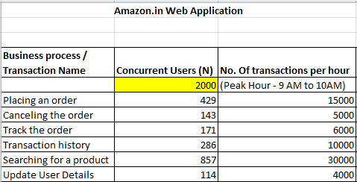
Workload Related data
Application usage patterns and volumes for each performance Critical Transaction is captured as part of this model.
This data is identified by
Interviewing Clients
Analyzing existing logs
Example

Slide 44
Data related to response times and other metrics
As part of NFR Collection, Performance Testing Team is suppose to capture Response Time (RT) related data.
After the Performance test execution, the test results are compared with the SLA to determine if the application meets performance expectations
Examples -
When application is subjected to 1000 concurrent user load, “Login” transaction should not take more then 2 seconds to complete
When application is subjected to 1000 concurrent user load, CPU utilization of the WebApp Server should never cross 60%.

Slide 45
DB Data
Database volumes affect round times for operations that access the database
To simulate realistic load on the application the DB tables should be loaded with sufficient number of records
The data retention model is used to capture the key DB tables and estimated number of records in each of these tables
All this data will help in simulating realistic database volumes during test execution

Slide 46
LoadRunner

Slide 47
Components of LR
Virtual User Generator
Controller
Analyzer
Load Generator

Slide 48
Virtual User Generator (VuGen)
VuGen is the main component of LR which is used to create scripts to simulate user actions on the AUT.
Scripts are created in C language of JavaScript Language.
The scripts are usually generated by recording the events between client and server.
VuGen component provides the Performance Tester with the replay option.
Note: Scripts are executed using VuGen for not applying the load. It is done only for debugging purpose.

Slide 49
Controller
Controller is configured to
Number of Vusers
Number of scripts to be executed.
Number of LG’s
Design Ramp up and ramp down
Define the group name

Slide 50
Load Generator
Load Generators are systems that will create Virtual users.
Depending on the hardware configuration of the LG, number of Vusers generated by LG changes.
Consider a case, where LG memory is 500 MB. Since each Vusers is required to have 2.3 MB of memory, this LG can support 220 Vusers (Approx)
In the above case, we might require 5 LG’s to get a Vusers load of 1000 users

Slide 51
Load Generator
Controller component of LR has the ability to control multiple load generators
Also remember that your Vusers scripts will be downloaded to LG machines during the scenario execution. So, results needs to be collated by controller from all the LG’s after the execution.
User needs to have the appropriate license to access Load Generator and Controller

Slide 52
Analyzer
This component will provide the Test Results.
On further analysis of this test results, one can identify Performance Bottlenecks of the Application Under Test.
Test report can also be prepared using this component.

Slide 53
LoadRunner Architecture
&
Installation

Slide 54
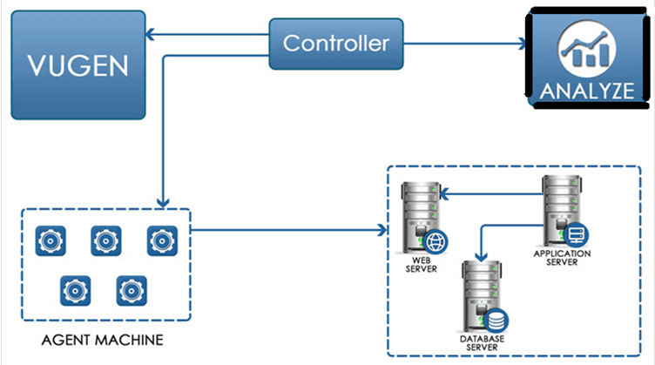
LR Architecture

Slide 55
Where to install LoadRunner components?
In a real time set-up..
Vugen is installed on the performance tester’s machine / desktop.
Controller & LG’s are installed on different windows machines / servers.
Note: Each LG requires a separate machine
Analysis is installed on the performance tester’s machine / desktop.
For our session..
All the components are installed on your desktop

Slide 56
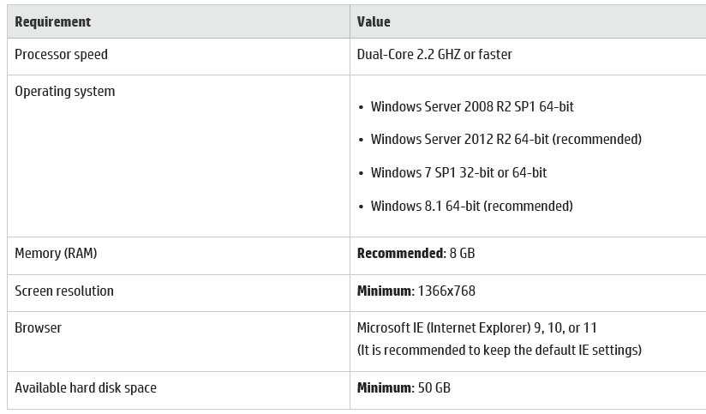
Identify hardware and software needed for installation

Slide 57
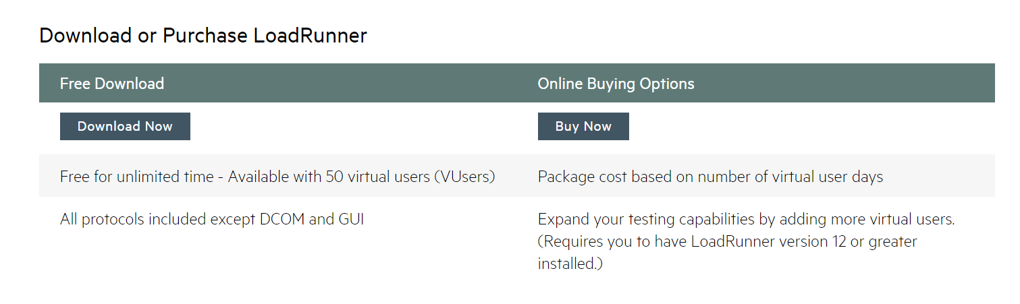
Installation of LR
LR can be downloaded from following link
http://www8.hp.com/us/en/software-solutions/loadrunner-load-testing/try-now.html
Select Free trail

Slide 58
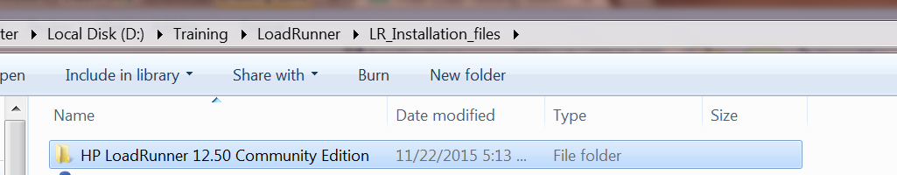
Installation of LR
Complete the sign up process
Download starts

Slide 59
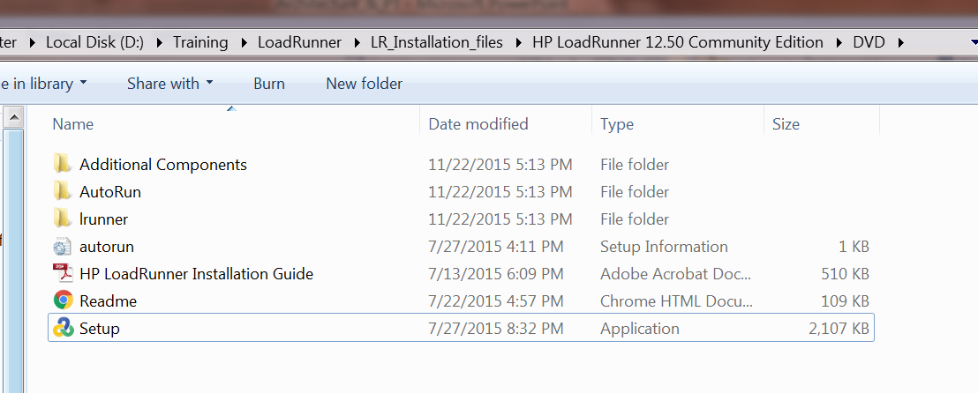
Installation of LR
Browse to DVD folder and Double click on set-up file to start the installation

Slide 60
Installation of LR
Select the required installation option as “LoadRunner Full Setup” and finish the installation.
Note: Installation process might require latest version of Java. So, when prompted, go ahead and install
Once the installation is complete, all the components are installed on your desktop.

Slide 61
Installation of LR
For additional help, refer to the “HP LoadRunner Installation Guide” in the DVD folder

Slide 62
LR Basic Flow
Create Vuser Scripts using VuGen component
Create Scenarios using Controller Component
Run Scenarios using controller component
Tune system based on Analysis
Analyze Results using “Analysis”Components

Slide 63
Virtual User Generator

Slide 64
Functioning of Virtual User Generator
VuGen creates scripts by recording the activity between the client and server when a user performs actions on the application.

Slide 65
Functioning of Virtual User Generator
Virtual User
It is not the real users. It is a tool generated user. In other words, human users are replaced by virtual users.
Virtual User Script
The actions performed by the human users are recorded in the form of a script. The scripts, when replayed emulate the real user performing the business actions.

Slide 66
Functioning of Virtual User Generator
Each Virtual user script will always have 3 default transactions.
Vuser_init:
Actions:
Vuser_end:

Slide 67
Steps to Create a Script in VUGEN

Slide 68
Steps to Create a Script
Understand the AUT
Record various transactions using VUGEN
Enhance the script
Play back to make sure there are no issues with the script

Slide 69
Protocol Advisor

Slide 70
Protocol Advisor
Select Record > Protocol Advisor > Analyze Application.
Try to walk through a variety of business processes to make sure that your results are comprehensive. Click Finish Analyzing to end the analysis and display the results.
As per the results, select the protocol and create a new Vuser Script

Slide 71
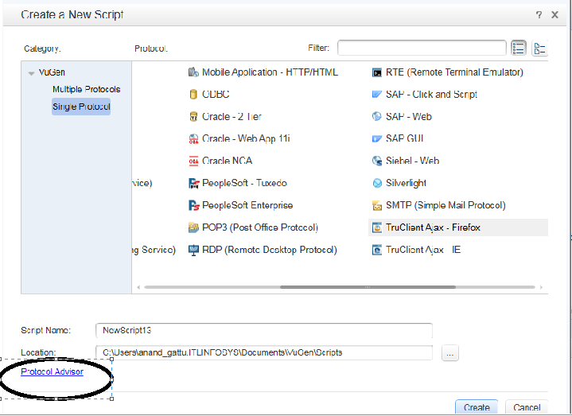
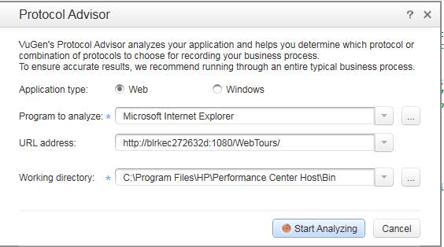


Slide 72
Recording Options

Slide 73
Recording Options
General
Recording
Script
Protocol
Code Generation
Correlations
Configuration

Slide 74
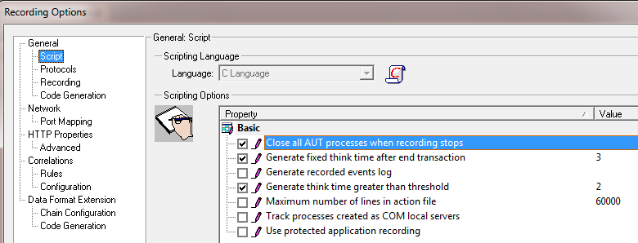
Recording Options
Automatically close any application process when VuGen stops recording
When End Transaction is inserted during recording time, automatically insert lr_think_time in the script
Generate recorded event logs in event viewer of the system
During recording, if user is pausing for more that 2 seconds, then auto generate lr_think_time(<actual think time duration>).
If actual pause during recording is less than 2 seconds, ignore think time
Maximum number of lines of code that can be stored in one action.c file

Slide 75
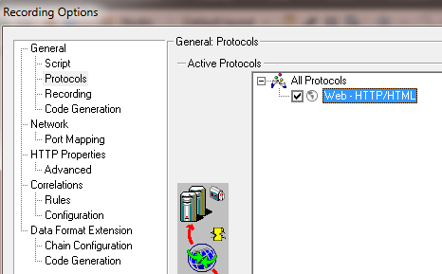
Recording Options
General – Protocol option shows all the protocols chosen for the recording of the script

Slide 76
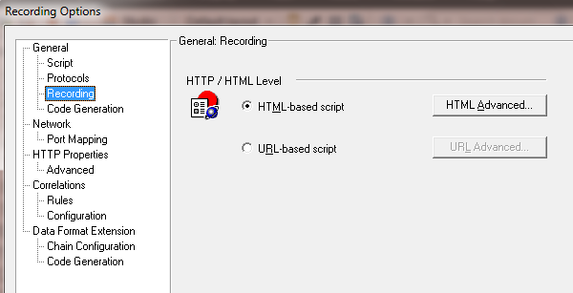
Recording Options
General – Recording has two options
HTML Based Script
Generates steps for each user action.
The script size is small
Preferable when we are interested in measuring entire page load time
URL Based Script
Records all requests and resources from the sever
Script size is larger
Preferred when we want to measure individual page components (resources, non resources) load times

Slide 77
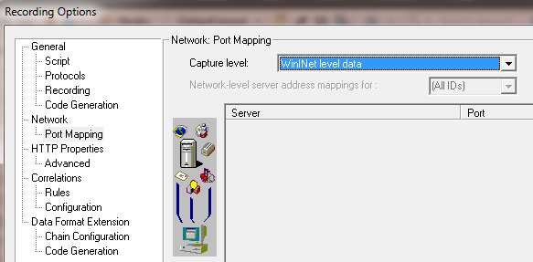
Recording Options
Network – Port Mapping is used to configure the port setting for capturing user actions
Three options available
Socket level data
WinInet level data
Socket level and WinInet level data

Slide 78
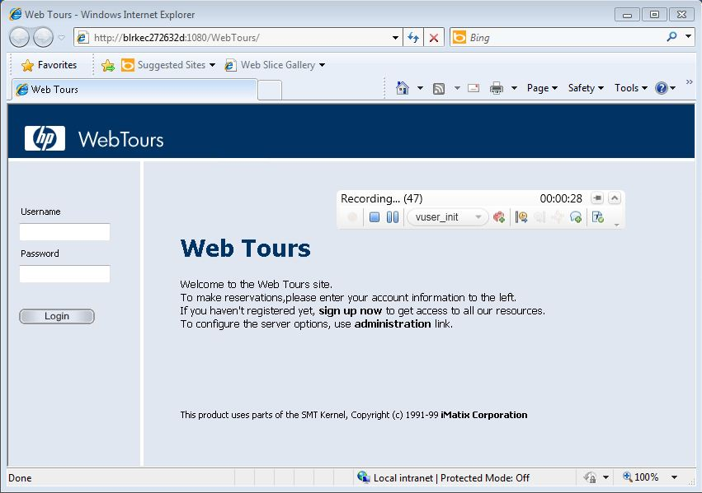
Recording script using Vugen
Emulate the user actions

Slide 79
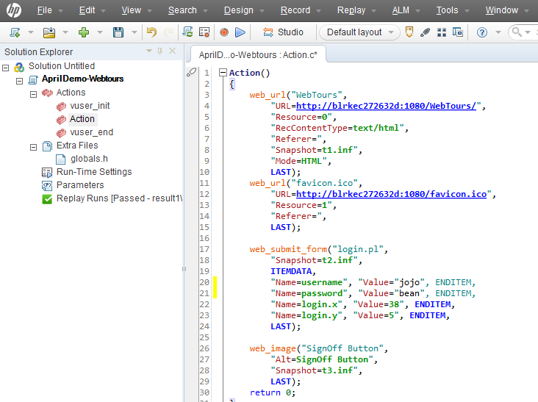
Recording script using Vugen
Script created after recording ends

Slide 80
HTML Based Script Vs URL Based Script

Slide 81
HTML Based Script Vs URL Based Script
HTML Based Script | URL Based Script
The script size is small | Script size is larger
Preferable when we are interested in measuring entire page load time | Preferred when we want to measure individual page components (resources, non resources) load times

Slide 82
Transactions

Slide 83
Transactions
Transactions measures the system performance resulting from one or more user actions
Only means of measuring application response time and transaction pass/fail count

Slide 84
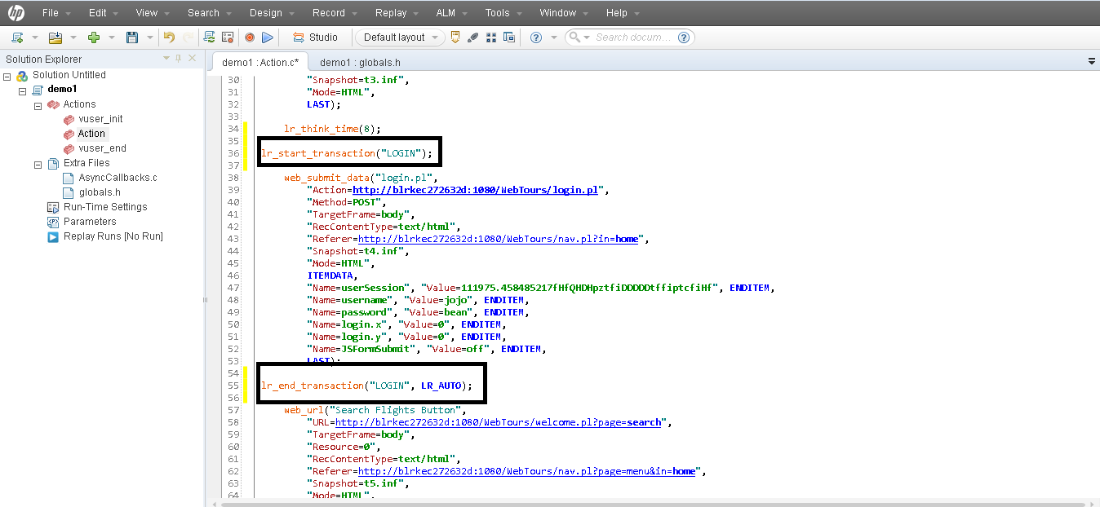
Inserting transactions
Notes:
There are three methods in which Transaction can be included in the script.
Inserting Transaction while recording the script
Inserting Transaction after recording through Design.
Inserting Transaction via Step Tool box

Slide 85
Think Time

Slide 86
Think Time
The delay caused by the user between two subsequent requests is called think time
Inserted automatically by VuGen during recording depending upon the Recording Options

Slide 87
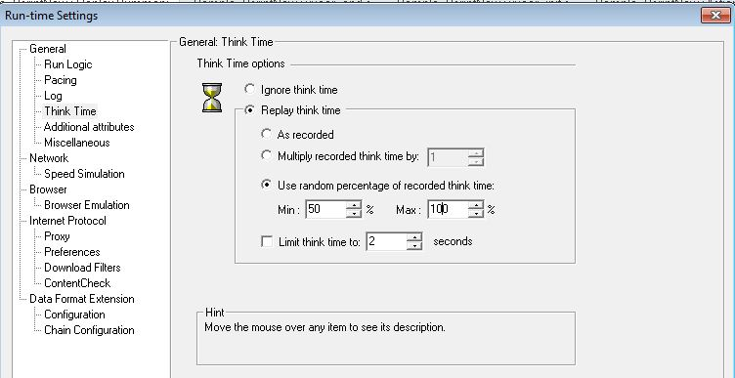
Think Time
Inserted automatically by VuGen during recording
Think time settings can be customized as needed using run-time settings

Slide 88
Comments

Slide 89
Comments
A comment can be added to provide additional information on the script
For inserting comments use
//
/* ……..*/

Slide 90
Check Points

Slide 91
Check Points
Two types of Check Points are available with VuGen
Text CP
Image CP
It verifies if a particular text or image is present on the web page.
By adding the Check Point, one can confirm if a particular transaction has passed or failed.

Slide 92
Text checkpoints

Slide 93
Text checkpoints
Check Point is placed on a particular text available on the Web Page.
Web_reg_find() function is used for inserting the text check point

Slide 94
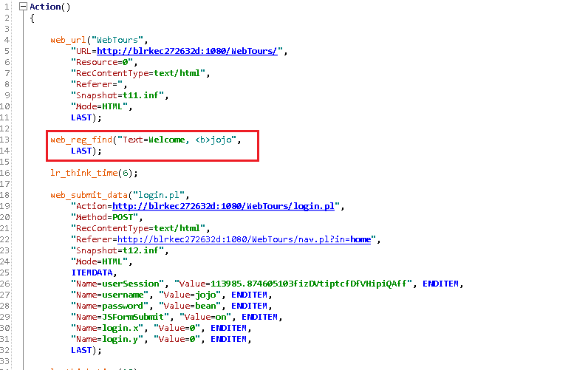
To add text check point for text, use web_reg_find() function
This function can be added during recording, typed directly in the script or can be added using steps toolbox.

Slide 95
Image Check Point

Slide 96
Image Check Point
Check Point is placed by using a ALT or SRC attribute of a particular image available on the Web Page.
web_image_check() function is used for inserting the text check point

Slide 97
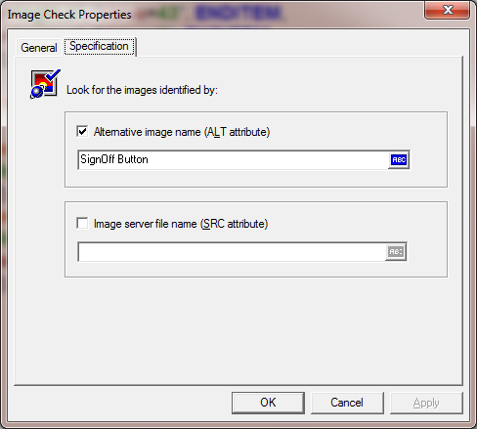
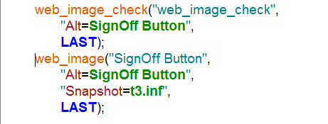
To add verification check point for image, use web_image_check() function
This function can be typed directly in the script or can be added using steps toolbox.

Slide 98
Rendezvous Point

Slide 99
Rendezvous Point
Rendezvous point is used to synchronize all the Vusers to perform a particular transaction at the same point of time.
When a Vuser reaches the rendezvous point, the Controller holds execution of the Vuser until all the other participating Vusers reach the point.
When all the participating vusers reach the rendezvous point, these Vusers will be released all at once to create a spike.

Slide 100
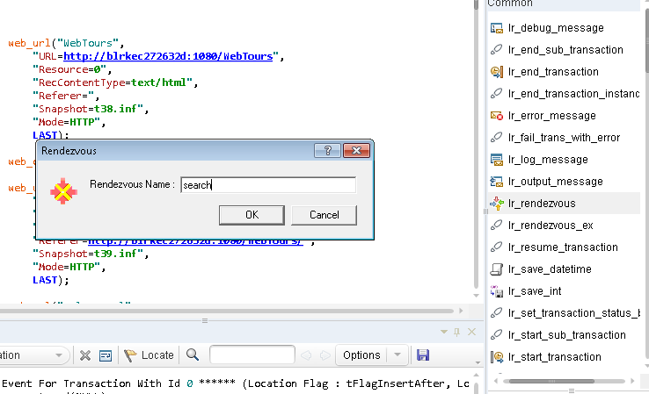
Double click on Steps Tool Bar and give the rendezvous name and click ok

Slide 101
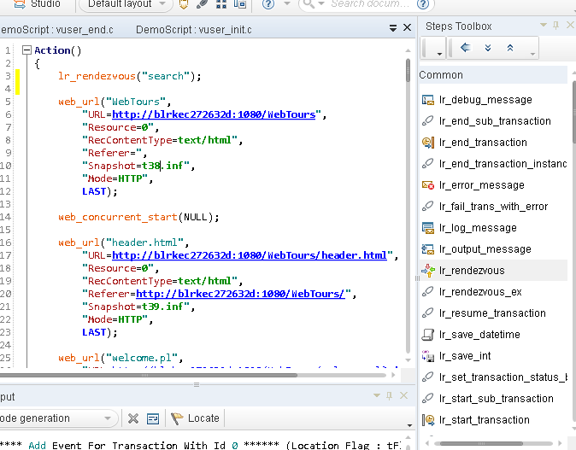
Rendezvous point should be inserted before start of a transaction

Slide 102
Parameterization

Slide 103
Parameterization
It is a process by which a hard coded value is replaced with a parameter in the script.
This option helps the script to execute with multiple values, thereby, simulating a real time scenario

Slide 104
Parameterization
Steps Involved for Parametrization
Create a Parameter
Assign the values to the Parameter
Replace the Hard-coded values in the script with these Parameters

Slide 105
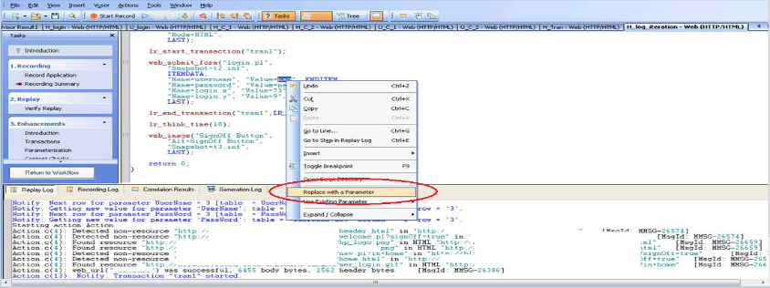
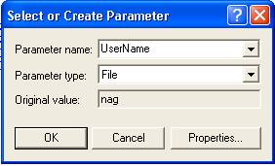
Select the value of the field on which you want to apply parameterization and right click and select “Replace with a parameter” as shown below.
“Select or Create parameter” window will be opened.

Slide 106
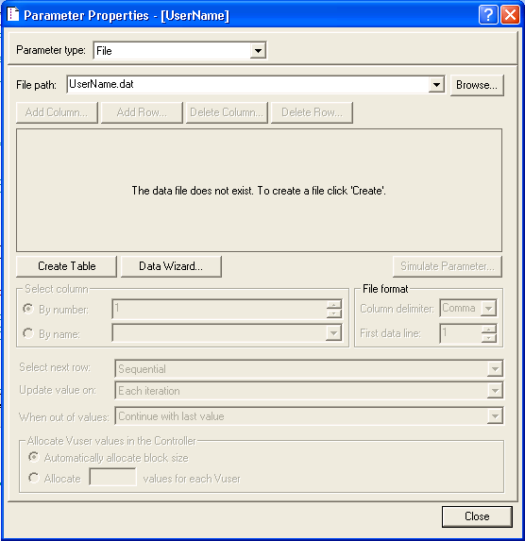
Give the parameter name, by default Parameter type and Original value will be populated. You can change the Parameter type as required.
Click on “Properties” button.
“Parameter Properties” window will be opened.
Click on “Create Table” and enter the data by adding a new column if needed.

Slide 107
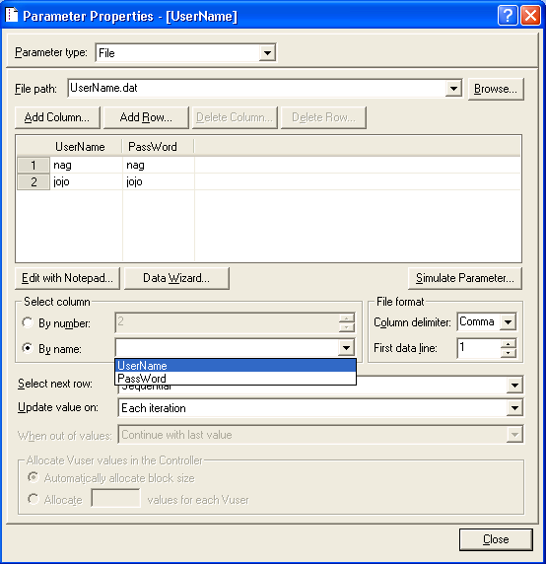
Close the Window
You can create different tables for different parameters or you can add all parameters in same table with different columns and you can make the other parameters use the same table by selecting the same “File path”.

Slide 108
Correlation

Slide 109
Correlation
There are some dynamic values in the script which changes from iteration to iteration.
Since these values are dynamic in nature, their value changes with each execution.
So, there is a need for these dynamic values to be captured from server response and pass it subsequently to any part of script.
Process of capturing these values using web_Reg_Save_param_Ex function and pass it wherever required is called correlation.

Slide 110
Automatic Correlation

Slide 111
Automatic Correlation
Scan the script for identifying the values to be correlated
Vugen will provide the recommendations.
Click on the value to be correlated and click on “Apply”

Slide 112
Manual Correlation

Slide 113
Manual Correlation
Identify the values to be correlated : Record the same script twice and compare both the recordings to identify the values
Search for that value in the server response: Once, the value is identified, check for that value in the server response to identify left boundary and right boundary
Correlate: Correlate that value using web_Reg_save_param_ex using LB and RB
Replace: Replace the dynamic value present in the script with the LR parameter of correlation function.

Slide 114
Defining Rules for Correlation

Slide 115
Defining Rules for Correlation
Rules can defined in the recording options for the automatic correlation.
This feature is useful, if your project contains lot of scripts and there is necessity to correlate same values multiple time.

Slide 116
Run Time Settings

Slide 117
Run Time Settings
Run logic
Pacing
Log
Think Time
Speed Emulation
Browser Emulation
Preferences

Slide 118
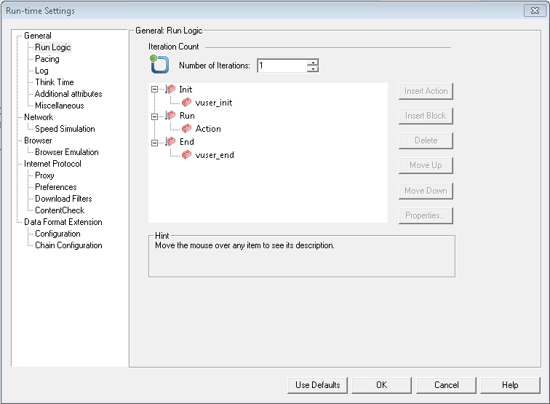
Run Logic
Run logic : Allows manipulation of the run logic by setting different iteration values

Slide 119
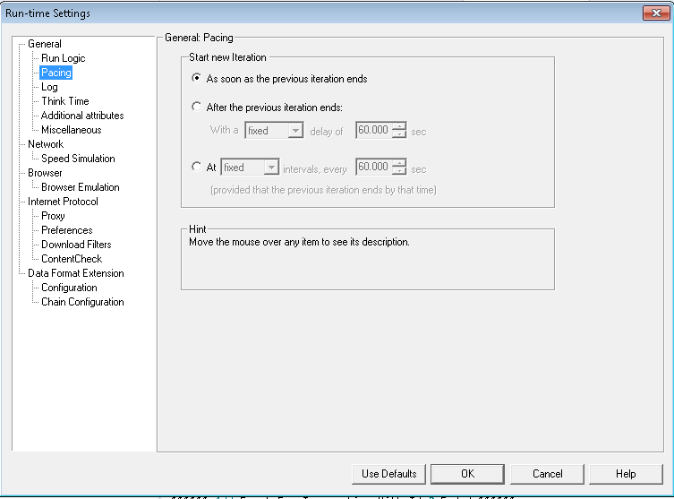
Pacing
Pacing – Provides different options regarding when the next iteration starts

Slide 120
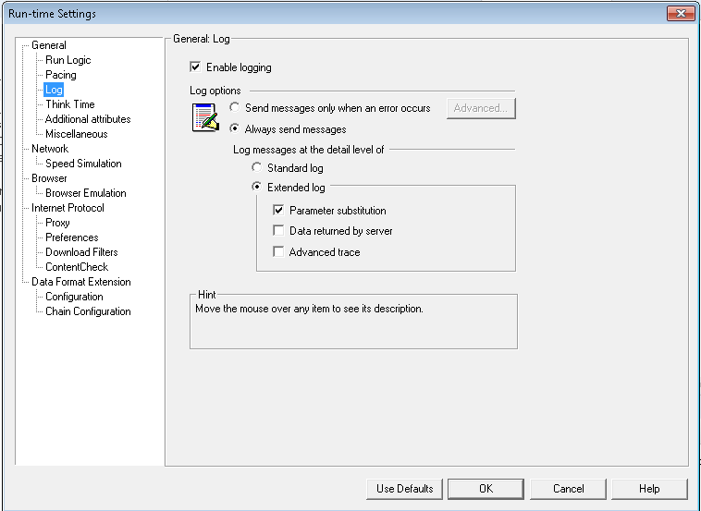
Log
Provides various logging options

Slide 121
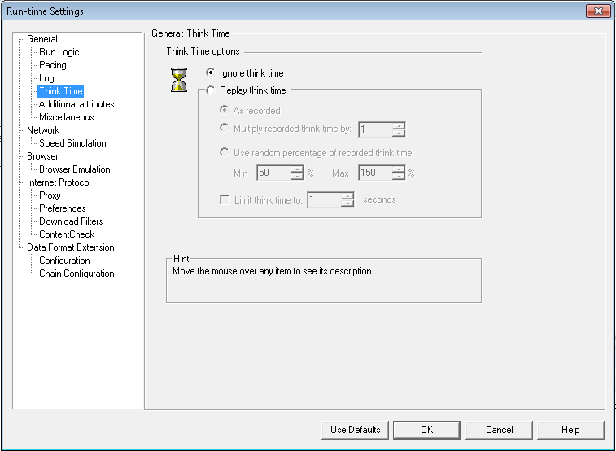
Think Time
Provides different options of how the think times are replayed during run-time.

Slide 122
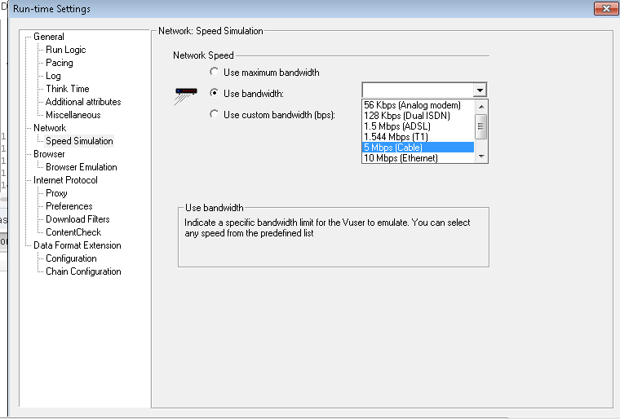
Network
Provides Network speed simulation options

Slide 123
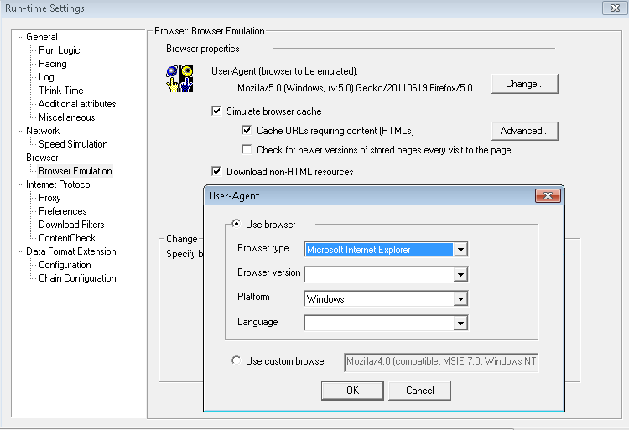
Browser
Simulates browser during runtime

Slide 124
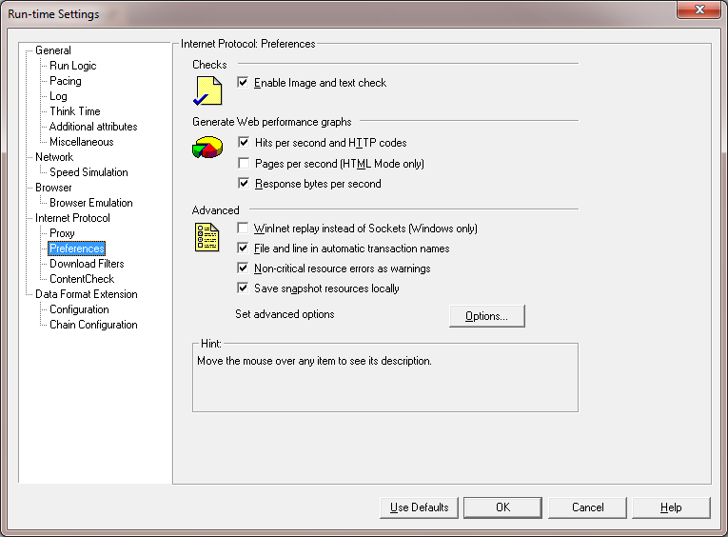
Internet Protocol
Preferences: Set preference for verification check point and other advanced options

Slide 125
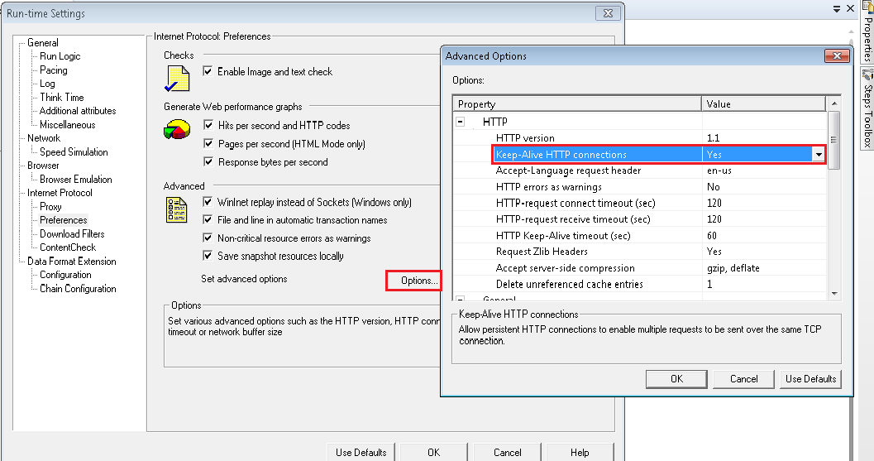
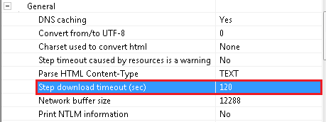
Internet Protocol
Advanced Options: Set advanced options like step download timeout period, Keep alive connections by

Slide 126
Other Miscellaneous options

Slide 127
Logs
Replay
Recording
Generation

Slide 128
Regenerating the Script
Using this option, Script can be regenerated without doing the recording again.

Slide 129
Controller

Slide 130
Controller
Execution of test scripts happens using the LR component called Controller.
Although it is possible to execute the scripts using VuGen, Load cannot be applied on the AUT. Execution using VuGen is done only for debugging purpose.
Actual Load on the AUT can be applied using controller as test can be executed using multiple scripts with multiple Vusers.
Test designed with multiple scripts using multiple Vusers is called Test Scenario.

Slide 131



Internal Working of the Controller
Controller
Vusers
Vusers
Server(s)
LG1
LG2

Slide 132
Test Scenario Creation

Slide 133
Test Scenario
Test designed with multiple scripts using multiple Vusers is called Test Scenario.
Each Test Scenario can contain one or more groups.
A scenario contains all the information about groups of Vusers which are required to emulate human users during test
Steps involved for Test Scenario creation
Create Test scenario
Configure Run-time Settings

Slide 134
Test Scenario Creation
Selecting the type of Test Scenario
Adding the test scripts to the test scenario
Selecting the required number of LG’s
Configure the schedule (Defining the Ramp-up, Ramp-Down and Steady state)
Selecting Scenario Schedule
Setting the SLA (Optional Step)

Slide 135
Test Scenario Type

Slide 136
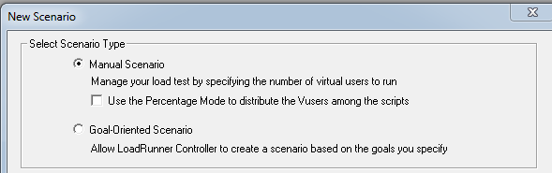
Selecting the Type of Test Scenario
Manual Scenario
Goal-Oriented Scenario

Slide 137
Adding Scripts to the Scenario

Slide 138
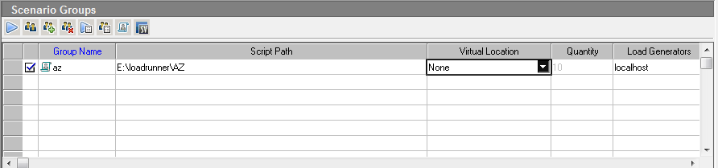
Adding Scripts to the Scenario
Select scripts to added

Slide 139
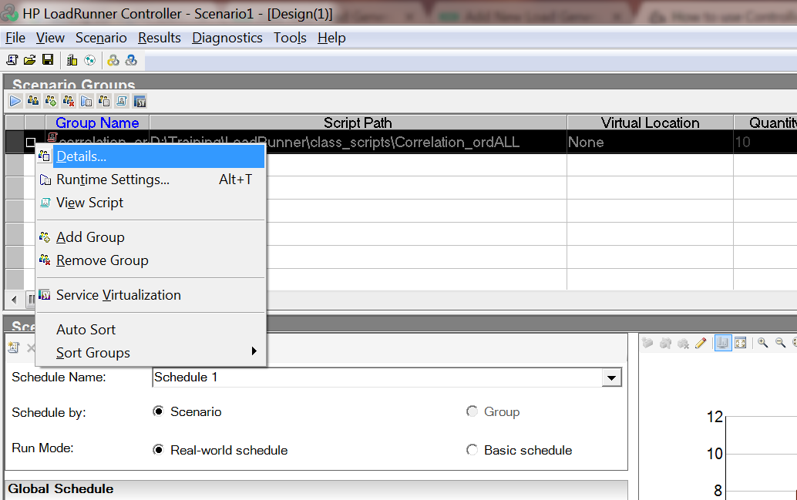
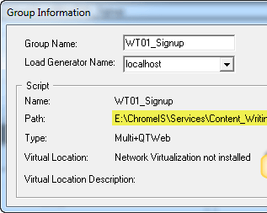
Click on Details to change the Group Name

Slide 140
Configure Load Generators

Slide 141
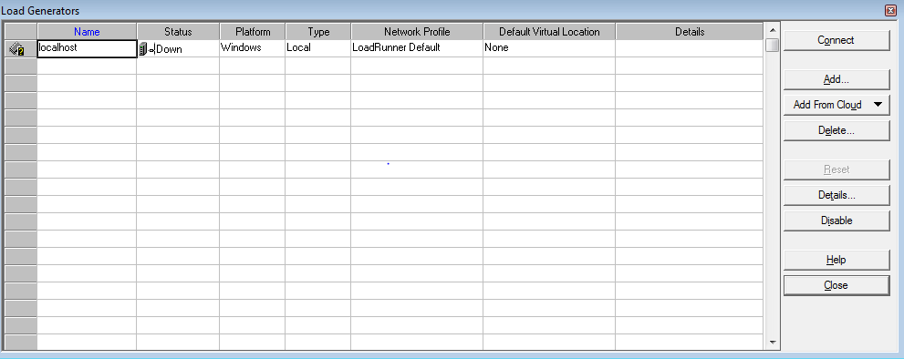
Configure Load Generators
Scenario → Load Generator
Add new LG’s

Slide 142
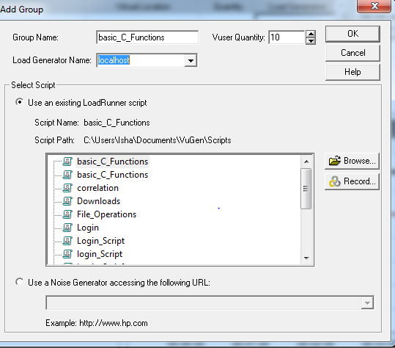
Add LG to the Group
Add the LG to the group.

Slide 143
Defining the Scenario Schedule

Slide 144
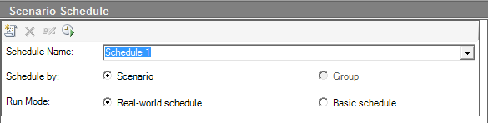
Scenario Schedule
Schedule By Scenario
Schedule By Group
Basic Schedule
Real world schedule

Slide 145
Configure the Schedule

Slide 146
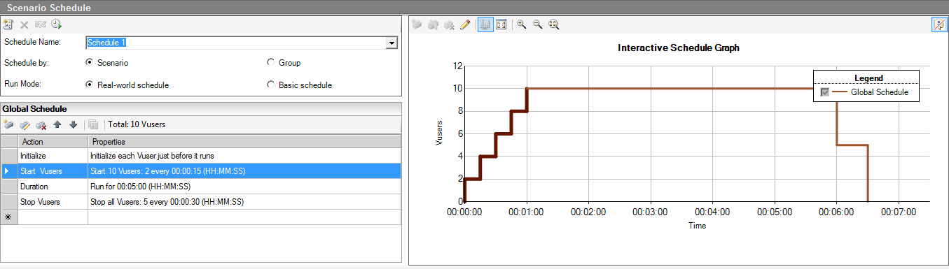
Configure the Schedule
Defining the Ramp-up, Ramp-Down and Steady state

Slide 147
Set-up the SLA’s

Slide 148
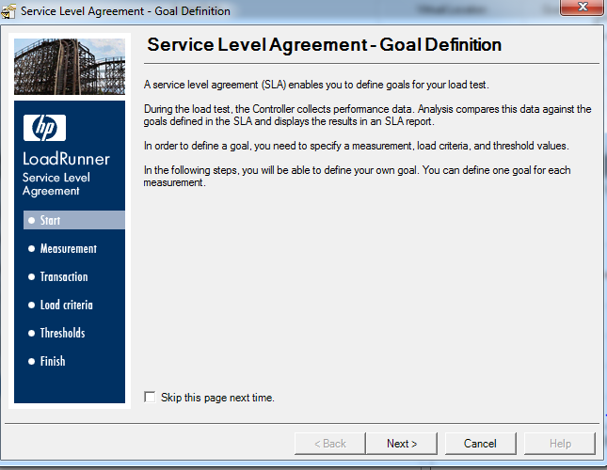
Set-up the SLA’s
The SLA in LoadRunner or Controller, gives an opportunity to you to test your application against an SLA.

Slide 149
Configuring Run Time Settings

Slide 150
Run Time Settings
Run logic
Pacing
Log
Think Time
Speed Emulation
Browser Emulation

Slide 151
Test Execution

Slide 152
Test Execution
Set-up the Result Directory for storing the results.
Execute the Test

Slide 153
Test Execution
Steps during Test Scenario execution
Required number of Vusers can be generated to create the load on AUT.
Each Vuser can be controlled using options: Initialize, Run, Stop.
Controller can display status messages for all Vusers under execution
Collects and presents live data for all defined metrics of server resources
Steps after Test Scenario execution
Collects and organizes performance data

Slide 154
Analyzer

Slide 155
Analysis
Analyzer
Generates graphs
Includes utilities for report generation (HTML format and Word format)
Helps in identification of bottlenecks

Slide 156
Analysis of Test Results
The Analysis session contains summary Reports and basic graphs like Running Vusers, Throughput, Transaction response time, Hits per sec..
The Summary Report contains SLA, running Vusers etc…
Summary report
90 Percentile
SLA
Running Vusers
Hits per second
Throughput
Average Transaction Response Time
OS level(CPU & Memory utilization)

Slide 157
Graphs - Options

Slide 158
Graphs - Options
Graphs in the Analysis session can be
Enhanced for its granularity.
It can be drilled down
Merged
Overlay
Tile
Correlate

Slide 159
Test Report Generation

Slide 160
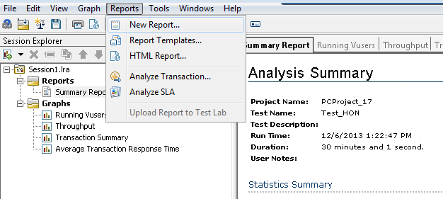
Test Report Generation
Once Analysis is done, a Test report can be generated in any one of the formats.

