Slide 1

Hey there! Welcome
This presentation will help you understand:
The domain of Procurement
What is Source-to-Pay
What are the various Products
Functional aspects of each Product

Slide 2
What is Procurement ?
Procurement is the act of finding, acquiring, buying goods or materials, services or works from an external source.
The process is used to ensure the buyer receives goods or materials, services or works at the best possible price with acceptable/desired quality, quantity, time, and location.

Slide 3
Procurement Examples
Buying Desktops for New employees
Buying Office Supplies like Printing Paper, Pen, Pencil, White board markers, stapling pins, drawing pins, writing pads etc.
Buying a new Air Conditioner
Buying chairs for the conference room
Buying a coffee vending machine

Slide 4
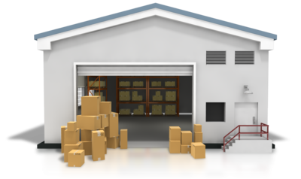

Who does this buying for an Organization ?
Organization
Purchase
Department
From
Suppliers
Buys Goods, Raw Materials, Spare parts, services etc. as Required by the company or Organization.
Who accepts the order and delivers goods and services as agreed.

Slide 5




Buying Desktops for New Employees
I need this desktop
Okay done! for USD 699.99
Agreed!
I need this Desktop. There is a new joiner
Here is the Desktop!
Okay! Approved. Let me get it in 2-3 days
Got it.. Here is your money!
Got it.. Thanks!
HR MANAGER
PURCHASING MANAGER
PURCHASING MANAGER
SUPPLIER
CONTACT

Slide 6
Spend Analyst – How much did I spend on Desktops last FY ?
How better can I spend during the next year.
Sourcing Manager – Let me look for potential suppliers who can deliver good quality desktops, at low cost, with free after sales service, fast delivery, good payment options….
Contract Manager – Now since we have a good customer lets get into a long term agreement. Dell Inc. will supply Desktops at $520 for next 5 years, delivered in 1 day, min order 2, payment in 30 days…
Email ? Telephone Call ? Skype Chat ?
No Tracking, Non Auditable
Flipkart, Amazon, Dell.in, eBay ?
Price fluctuation ? Stock out ?
HR/You – Who Raised the Request
WS Retail ?, Dell India Ltd ?, Acme Computers ?
Buyer – Who placed an order to the Supplier
I haven't heard of Acme! Are they good ?
eKart ?, DTDC, FedEx ?
Supplier – So many computer dealers out there!
Will they deliver on time ?
Courier Guy ? – Who delivered the desktop to your location
In house IT guy
How does he know that laptop has come ?
Admin/IT IS – Person who kept it on your desk and did the installation
Zycus Finance Department
Finance Girl – Who did the payment
Is it within budget ? Who approved to buy this ?
This is too costly for us!

Slide 7
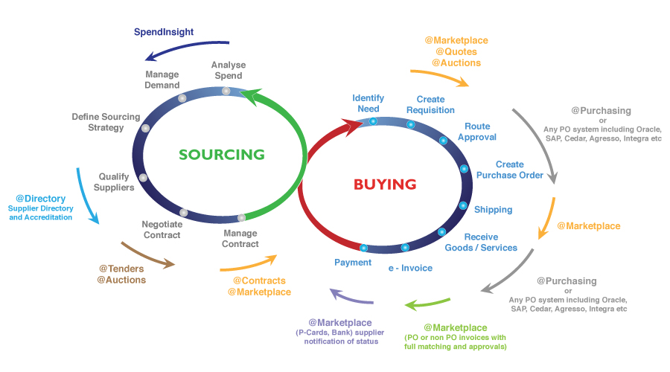
Source to Pay Cycle

Slide 8
Source to Pay Cycle
1
2
3
4
5
6
iAnalyze
iManage
iCost
iSource
iContract
iSupplier
Analyze Spend
Start Spend Management Project
Analyze Cost of Goods
Sourcing of goods and qualified suppliers
Contracting with Suppliers
Onboard Supplier and manage information
7
8
9
10
11
12
iRequest
eProc
eProc
eProc
eInvoicing
eInvoicing
Create Request
Create Requisition
Create Purchase Order
Deliver Goods and Services
Create Invoice
Payment of Invoice
13
14
iPerform
Save
Zycus Supplier Network
Evaluate Supplier Performance
Publish Savings to Finance
Supplier Participates in the above steps via this Portal

Slide 9
Supplier Company 7
Employees
of
the Organization
Supplier Company 1
Supplier Company 8
Sales
Employees of Purchase Department
Supplier Company 6
Sales
Sales
Supplier Company 2
Supplier Company 9
Employees of Finance Department
Sales
Supplier Company 5
Sales
Sales
Supplier Company 3
Supplier Company 0
Sales
Supplier Company 4
Sales
Sales
Sales

Slide 10





Employees of the organization - Examples
Manager
HR
Vice President HR
Marketing Ninja
Vice President Marketing
Software Engineer
Engineering
Vice President
Engineering

Slide 11







Purchase Department Employees - Examples
Chief Procurement Officer
Spend Analyst
Sourcing Manager
Contract Manager
Purchasing Manager
Supplier Relations Manager
Project Manager
Legal Advisor

Slide 12


Finance Department Employees - Examples
Finance Manager
ACCOUNTS PAYABLE MANAGER

Slide 13
Source to Pay Cycle
1
2
3
4
5
6
UPSTREAM - Strategic
iAnalyze
iManage
iCost
iSource
iContract
iSupplier
Analyze Spend
Start Spend Management Project
Analyze Cost of Goods
Sourcing of goods and qualified suppliers
Contracting with Suppliers
Onboard Supplier and manage information
7
8
9
10
11
12
Downstream - Tactical
iRequest
eProc
eProc
eProc
eInvoicing
eInvoicing
Create Request
Create Requisition
Create Purchase Order
Deliver Goods and Services
Create Invoice
Payment of Invoice
13
14
iPerform
iSave
Zycus Supplier Network
Evaluate Supplier Performance
Publish Savings to Finance
Supplier Participates in the above steps via this Portal

Slide 14
Spend Analysis – Reporting Module (Analyze)
- Look into the orgs Spend History
- Slice and dice spend data
eg: Spend on Printing Paper for Asia Pacific Region
Spend on Electricity for Zycus Bangalore Office
Spend on Office Supplies for entire organization across locations.
How much did the organization spend on Design Consultancies over the last 3 years ?
How much did the organization spend on Apple ?
Apple ?
Apple brought from Big Bazaar is a Fruit
Apple brought from Univercell Mobiles is a Smartphone
100 Apples (Fruit) at 20$ Each from Big Bazaar
100 Apples at 20$ Each from Big Bazaar
100 Apples (Mobile) at 200$ Each from Univercell Mobiles
100 Apples at 200$ Each from Univercell Mobiles
Total Spend on Fruits : 20*100 = $2000
Total Spend on Mobile : 200*100 = $20000
Total Spend on Fruits : 20*100 + 200*100 = $22000
Auto classification – AutoClass

Slide 15

Sourcing Management – Source
- Create and manage sourcing events – RFI, RFQ, RFP, Auctions
- Invite suppliers, get their quotes, compare quotes, democratically score the quotes, finalize on Suppliers whom you want to do business with!
eg: Zycus wants to air condition its new office at Bangalore
Zycus creates an auction and invites Samsung, LG, Haier, Hitachi, Godrej. The auction is live for 2 hours during which the suppliers can read through the requirement and quote their price.
At the end of 2 hours this is the state of bidding:
Price Quoted
Servicing ?
Quality ISO Certified ?
Samsung | $20,000
LG | $21,000
Haier | $20,500
Hitachi | $10,000
Godrej | $50,000
No | No
Yes | No
No | No
No | Yes
No | No

Slide 16
Contract Management – Contract
Get into a contract with LG.
Create Draft of the contract by collaborating with LG contact, Buyer Contact, Zycus Legal Department, Finance Department..
Include Clauses that can be crucial – Like LG has poor quality. So if anything goes wrong LG should be made responsible.
Include What type of AC, When and How will it be installed, How will the payments be made etc. etc.…
When will the contract start and expire ? When will it renew ? Will it Auto renew ?
Negotiate with supplier on all the above things and finally Sign the contract between the two parties.
Move the contract to Repository for all future reference.
Contract basically has
Drag and Drop clauses and create a contract document online.
Create it in a word document and upload
Approval workflow to negotiate and approve the contract content.
Sign the document using Docusign or other options like signing – scanning – uploading.

Slide 17
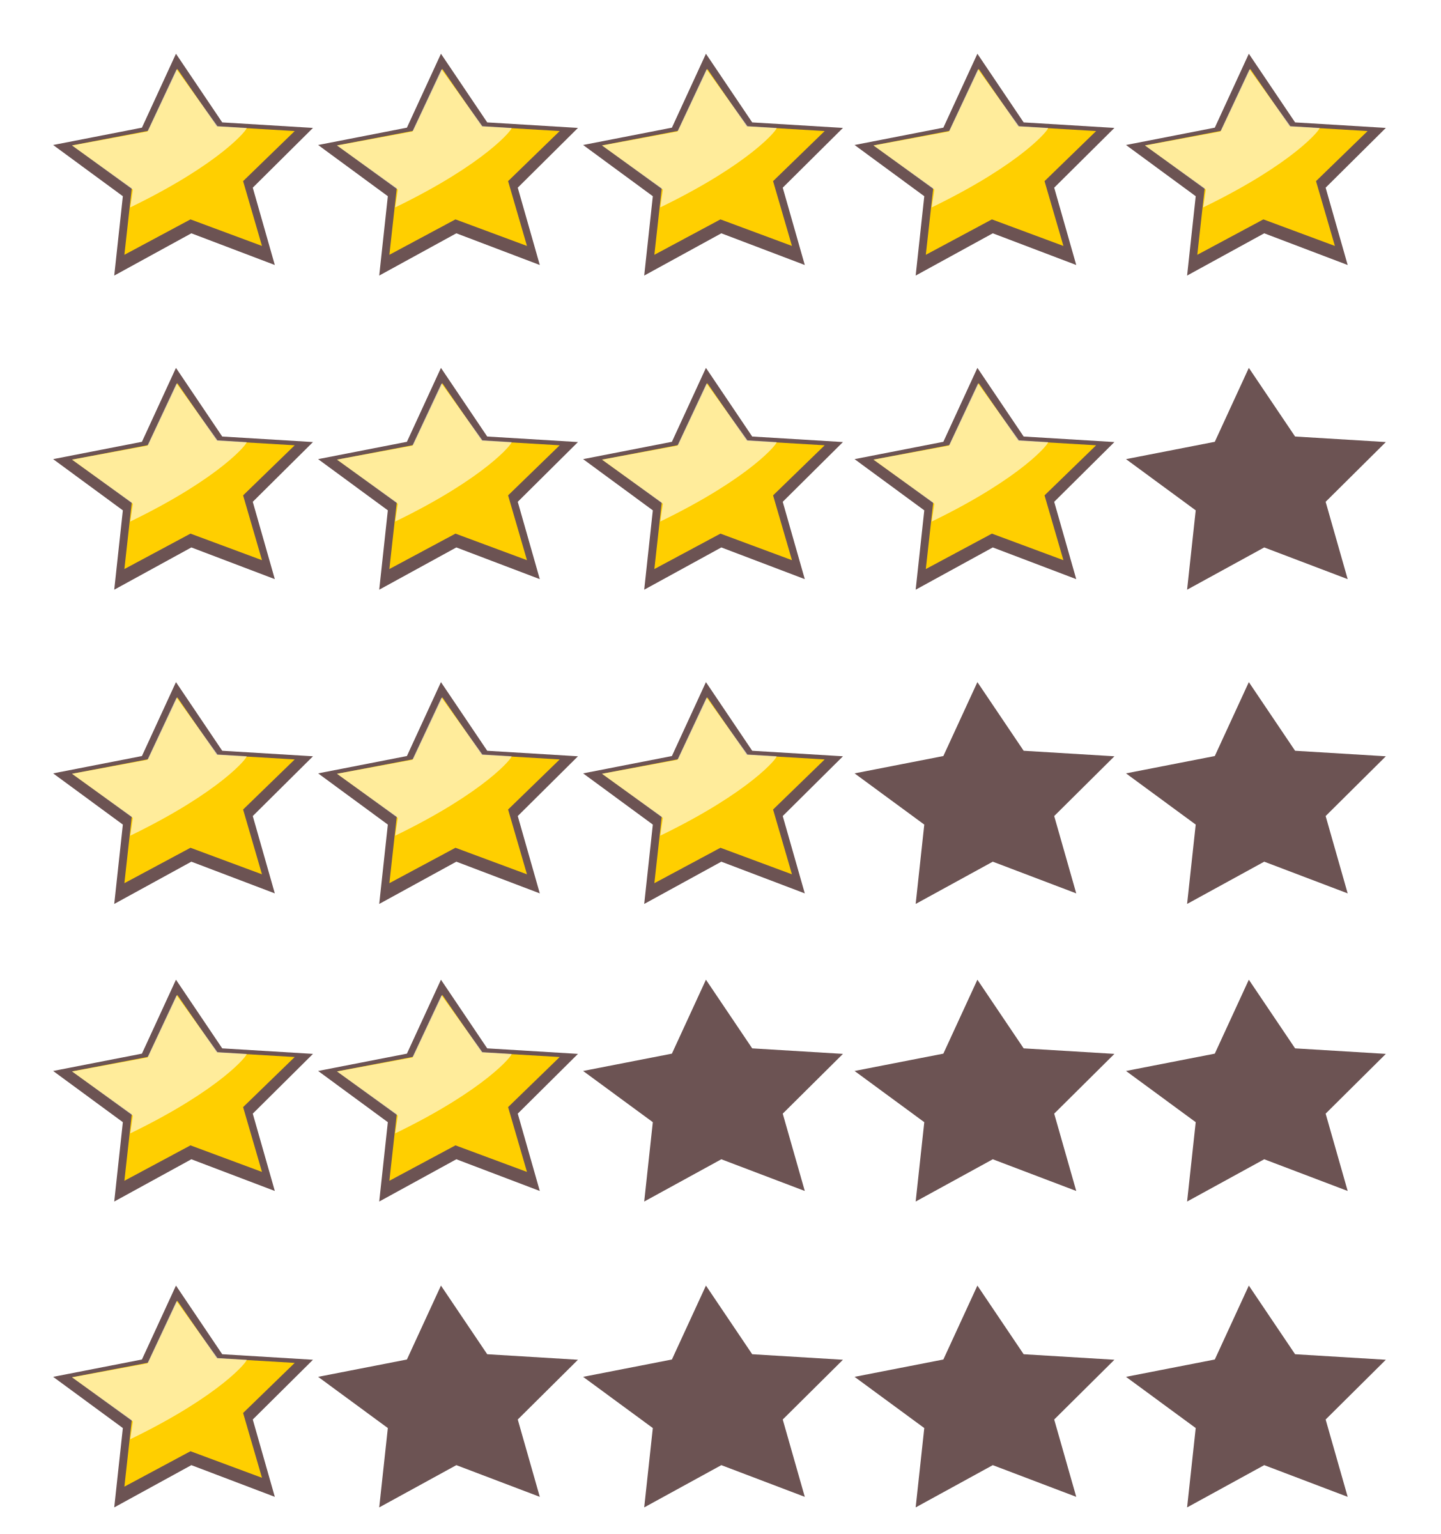
Supplier Information Management - Supplier
Data base of supplier information
Each supplier should have a profile created in iSupplier so that they can be included in a Contract or Sourcing Event etc.
Before a supplier can do business with Zycus, they have to be registered/on-boarded to iSupplier
Supplier Performance Management - Perform
KPIs – Quality, Delivery, Cost, Ease to do Business, Risk
Qualitative assessment of Suppliers in collaboration with all departments
Eg: Laptops are used by Engineering Department.
so Dell Inc, the supplier is rated by members of Purchase Department and Engineering Department and come up with an overall score for the Supplier.

Slide 18
Proc and Invoicing
Tactical aspects of buying – From a Need to Payment
Eg: you want to buy a laptop for your project
Logs in and Search
through catalogs
Add to Cart & Checkout
Create Requisition
Create Purchase Order
Create Free Text Requisition
Requester Wants Laptop
Finance does payment
Send to Supplier
Purchase Department gets the Laptop
And creates Goods Receipt
Gives it to the Requester
Supplier Sends back Laptop and Invoice/Bill

Slide 19
iRequest – Request Management
Flexi Form Creation for various requests
Eg: Form to be filled to request for a new laptop
Form to be filled to request for a joining kit
RMS/CDS/CRMS
Report creation tools – Visual Reports, Dashboards etc
Rainbow UI
Cross Product functional dashboard consuming data from a common cross product data repository
TMS – Tenant Management System
Where all Tenant information and User information are stored and maintained.
User roles and Activities are stored and maintained here.
Eg: Roll: Contract Manager Activities – Create Contract, Edit Contract, Delete Contract, Sign Contract etc.
Dew Drops
New UX for all the products. Revamp of products current User interface.
Mobile Apps – iOS and Android
Supplier app, Requisitioner app, Buyer app, Dew Drops App, Business User App
iManage
Procurement Project Management Tool

Slide 20
Product Suite
Strategic Sourcing Suite - Upstream
iAnalyze
iManage
iCost
iSource
iContract
iSave
Procure to Pay Suite - Downstream
iPerform
iSupplier
RMS/CDS
Rainbow UI – Suite Landing Page & Search
CRMS
iOS & Android
Mobile Apps
iRequest
eProc
eInvoicing
Zycus Supplier Network
Dew Drops UI
Tenant Management System

Slide 21
Questions ?

