Slide 1
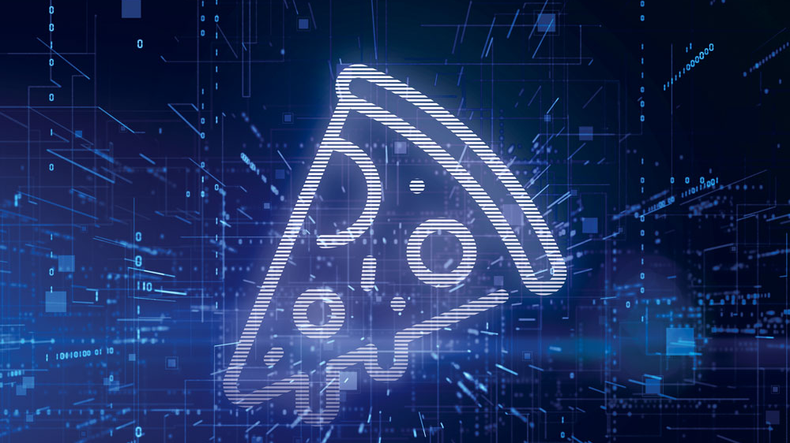
Pizza Assistant
Hira Afzal, Adnan Irshad

Slide 2

Domain Study:
The domain of our pizza assistant revolves around facilitating users in ordering pizzas, customizing their preferences, providing information about menu items, and assisting with the overall pizza ordering process. This involves understanding various aspects of the pizza menu, handling user preferences, and processing orders seamlessly.

Slide 3
Tasks:
Menu Information:
Provide detailed information about available pizzas, toppings, and crust options.
Suggest popular or recommended pizza combinations based on user preferences.
Customization:
Assist users in customizing their pizzas according to personal preferences.
Order Placement and Pickup:
Understand user requests to place pizza orders.
Confirm order details, such as pizza type, size, crust, and toppings.
Schedule The Pizza Pickup Time
Inquiring about rest. opening time

Slide 4

Related Examples:
User Initiated Interaction:
User: "Hey Pizza Bot, I'd like to order a large pepperoni pizza with extra cheese."
Pizza Bot: "Sure thing! Would you like to add any additional toppings or sides?"
Mixed-Initiative Dialog:
User: "What's the special pizza of the day?"
Pizza Bot: "Our special today is the Supreme Delight with pepperoni, sausage, mushrooms, and bell peppers. Would you like more information or are you interested in trying it?"
Customization Request:
User: "I'm allergic to gluten. Can you recommend a gluten-free crust option?"
Pizza Bot: "Certainly! We offer a gluten-free crust option. Would you like to customize your pizza with that crust?"

Slide 5

Mixed Initiative Dialog:
In a mixed-initiative dialog, the Pizza Bot should proactively engage with users while also responding to user queries. For example:
Pizza Bot: "Hello! Our special today is the BBQ Chicken Pizza. Would you like to try it, or do you have a specific pizza in mind?"
User: "Tell me about the vegetarian options."
Pizza Bot: "We have a delicious Veggie Supreme with a variety of fresh vegetables. Would you like details on the toppings or have any specific preferences?"
The mixed-initiative approach ensures a dynamic and user-friendly interaction, where the Pizza Bot can guide users through the ordering process while also responding to their unique requests and preferences.

