Slide 1

FINAL PROJECT: DATA SCIENCE
30-Day Hospital Readmission
Risk Prediction for Diabetic Patients
Adnan Jamali | adnanahmedkj@gmail.com

Slide 2
Table of Contents
01
02
04
05
06
03
Problem Definition
Data & Cleaning
Feature Engineering
Model Building
Results & Impact
EDA
Understanding the readmission challenge
Dataset overview and preprocessing
Exploratory data analysis
Feature creation & SMOTE
ML model training & tuning
Evaluation & business value
30-Day Hospital Readmission Risk Prediction

Slide 3
Problem Statement
$15B+ Annual Cost
1
Hospital readmissions cost the US healthcare system over $15 billion annually
Diabetic Patients
2
Among the most vulnerable population for unplanned readmissions
CMS Penalties
3
Hospitals face financial penalties under the Hospital Readmissions Reduction Program
Our Goal
4
Build an ML model to identify high-risk patients for preventive intervention

Slide 4
Dataset Overview
Diabetes 130-US Hospitals Dataset (UCI Machine Learning Repository)
101,766
50
130
1999-2008
Records
Features
Hospitals
Time Span
Patient encounters
Clinical + demographic
Across the United States
10 years of data

Slide 5
Data Cleaning & Preprocessing
Removed expired patients and invalid records (discharge codes 11, 13, 19, 20, 21)
Dropped high-missing columns: weight (97%), payer_code (40%), medical_specialty (49%)
Replaced '?' with NaN and imputed missing values
Removed single-value columns (examide, citoglipton)
Final clean dataset: 99,340 records, 45 features

Slide 6
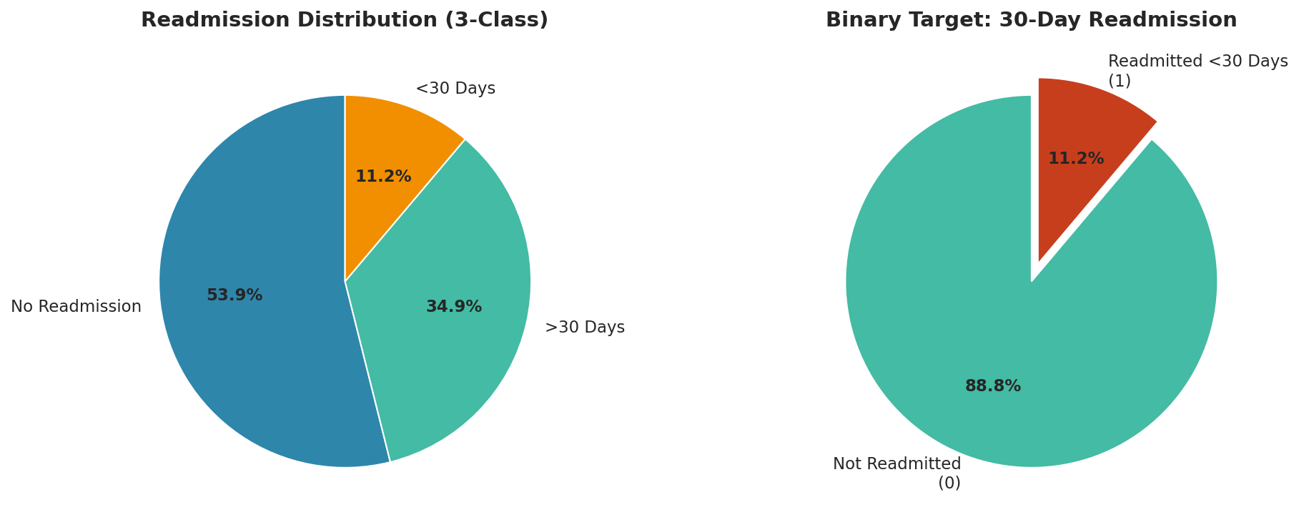
Target Distribution
Binary Classification
Target: Readmitted within 30 days
<30 days = 1 (Positive Class)
Else = 0 (Negative Class)
Severe Imbalance
Only 11.2% readmitted within 30 days
Key challenge: minority class prediction

Slide 7
Key EDA Insights
70-80
Insulin
Prior IP
Meds
Age Group
Users
Visits
Changes
Has the highest readmission rate among all age groups
At significantly higher risk of 30-day readmission
Strongest predictor of future readmission risk
Medication changes correlate with readmission

Slide 8
Feature Engineering
01
02
03
04
Age Encoding
Prior Visits
Medication Count
Label Encoding
Ordinal encoding for 10 age groups from 0-10 to 90-100
Combined outpatient + emergency + inpatient visits
Count of active diabetes medications per patient
All categorical features encoded for ML compatibility

Slide 9
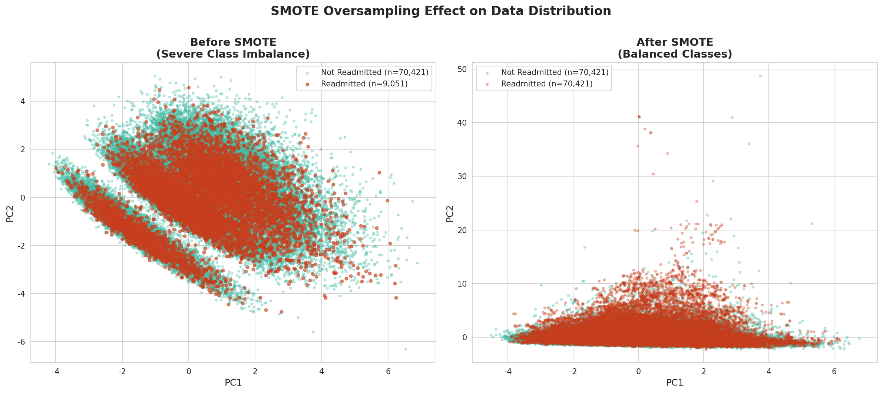
Handling Imbalance with SMOTE
SMOTE Overview
Original ratio: 88.6% vs 11.4%
SMOTE generates synthetic minority samples
Applied only on training set to prevent data leakage
XGBoost Tuning
scale_pos_weight = 7.78 for class balance

Slide 10
Model Building
Logistic Regression
Random Forest
XGBoost
class_weight='balanced'
200 estimators
300 estimators
max_iter=1000
max_depth=15
scale_pos_weight=7.78
Baseline model with L2 regularization
class_weight='balanced'
learning_rate=0.1
Ensemble of decision trees
Best performing model
Trained on SMOTE-balanced training data

Slide 11
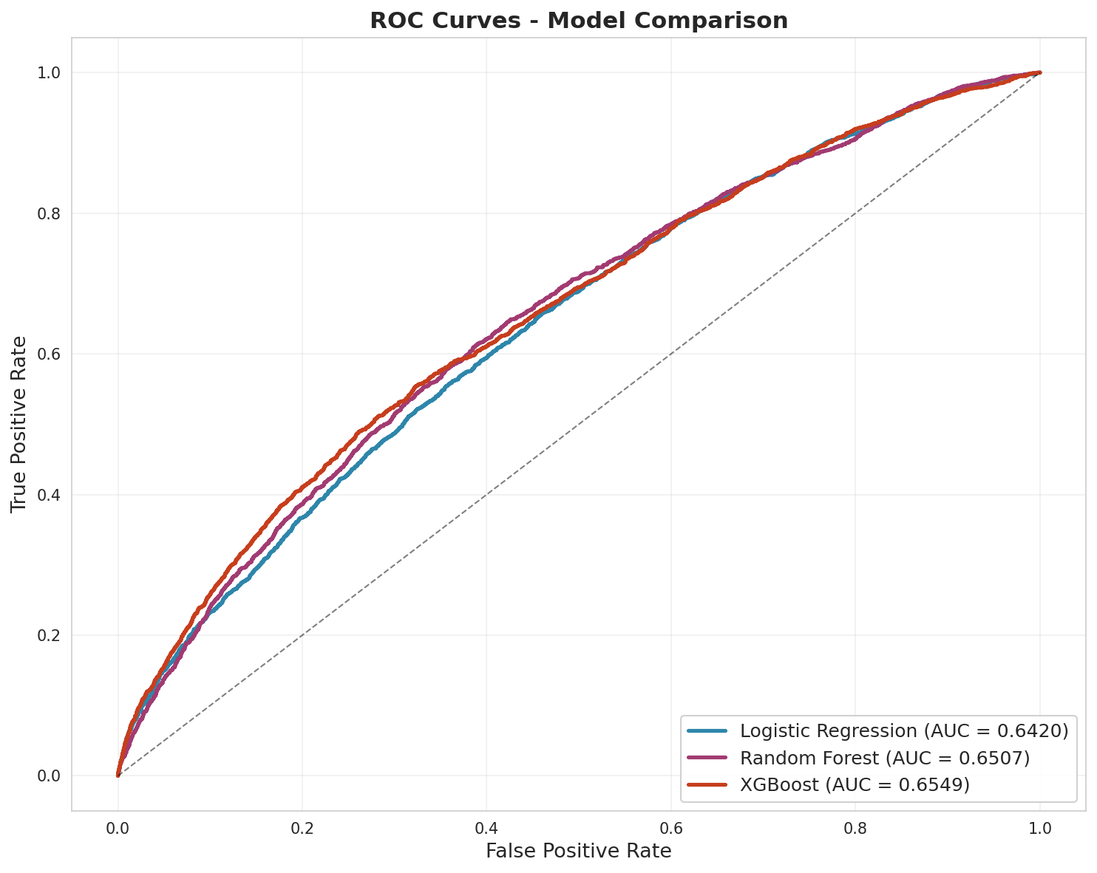
Model Evaluation - ROC Curves
XGBoost achieves highest AUC of 0.6549

Slide 12
Model Performance Comparison
Model
ROC-AUC
Avg Prec
Recall
Precision
F1-Score
Logistic Regression
0.6420
0.1998
0.54
0.17
0.26
Random Forest
0.6507
0.1976
0.09
0.29
0.14
XGBoost
0.6549
0.2147
0.55
0.18
0.27
XGBoost outperforms across all primary metrics

Slide 13
Key Findings
#1
#2
#3
Top Predictor
Most Vulnerable
Insulin Risk
number_inpatient is the strongest predictor of 30-day readmission risk
Age 70-80 patients are most vulnerable to 30-day readmission
Insulin users show 2x higher readmission rate vs non-insulin patients

Slide 14
Business Impact
$2M+
Each preventable readmission costs $15,000 - $25,000
A hospital with 5,000 annual diabetic discharges could save $2M - $4M
Potential savings
per 1,000 patients
Predictive models enable proactive discharge planning
Targeted follow-up care for high-risk patients reduces readmissions

Slide 15

Thank You
Adnan Jamali
adnanahmedkj@gmail.com
github.com/adnanjamali02
linkedin.com/in/adnan-jamali-22a12231b/

