Slide 1
Introduction to Computer Systems & Technology
Course: Introduction to Computing
Topic: Data, Information, and Computer Systems
Instructor: Sir Adnan Majeed
Institution: Lahore Leads University, GC University
Semester: BSCS 1st Semester

Slide 2
Lecture Objectives
• Understand the concept of Data and Information
• Learn how computers process data
• Explore components of computer systems
• Understand Analog and Digital computers
• Learn about Computer & Communication Technologies

Slide 3
What is Data?
Definition: Raw facts and figures without context
Examples:
- Numbers: 98, 65, 120
- Words: 'Red', 'Large', 'Student'
- Symbols: %, $, #

Slide 4
Characteristics of Data
• Raw and unprocessed
• Collected from various sources
• Can be qualitative or quantitative
• Needs processing to become meaningful

Slide 5
What is Information?
Definition: Processed data that is meaningful and useful
Example:
- Data: [45, 67, 89]
- Information: The average score of students is 67%

Slide 6
Relationship between Data and Information
Data → Processing → Information
Input → Process → Output
Raw Facts → Programs → Useful Output

Slide 7
Information Processing Cycle
1. Input
2. Processing
3. Storage
4. Output
5. Feedback

Slide 8
Computer and Communication Technology
• Computer Technology: Hardware, software, networks
• Communication Technology: Data transmission via wired/wireless media

Slide 9
Importance of ICT
• Facilitates data exchange
• Supports business automation
• Enhances education and healthcare
• Enables global connectivity

Slide 10
Components of ICT
1. Hardware
2. Software
3. Networks
4. Data
5. People

Slide 11
Introduction to Computer System
A computer is an electronic device that processes data to produce information.
Performs: Input → Process → Output → Storage

Slide 12
Basic Components of Computer System
1. Input Unit – Keyboard, Mouse
2. Processing Unit – CPU (ALU + CU)
3. Memory Unit – RAM, ROM
4. Output Unit – Monitor, Printer

Slide 13
Input Devices
Devices used to enter data into the computer:
Keyboard, Mouse, Microphone, Scanner

Slide 14
Output Devices
Devices that display or produce results:
Monitor, Printer, Speakers, Projector

Slide 15
Central Processing Unit (CPU)
Brain of the computer
Components:
1. Arithmetic Logic Unit (ALU)
2. Control Unit (CU)
3. Registers

Slide 16
Memory and Storage
Primary: RAM, ROM
Secondary: Hard Disk, SSD
Tertiary: Cloud, Optical Media

Slide 17
Characteristics of Computer
• Speed
• Accuracy
• Diligence
• Versatility
• Storage
• Connectivity

Slide 18
Classification of Computers
1. Analog Computers
2. Digital Computers
3. Hybrid Computers

Slide 19
Analog Computers
Work with continuous data
Examples: Thermometer, Speedometer, Analog Clock

Slide 20
Digital Computers
Work with discrete data (0s & 1s)
Examples: PCs, Laptops, Smartphones

Slide 21
Hybrid Computers
Combine analog and digital features
Used in hospitals, aerospace, weather forecasting

Slide 22
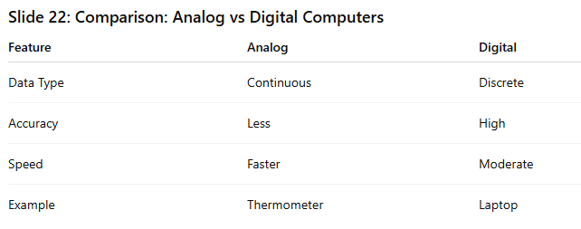
Comparison: Analog vs Digital Computers
Analog: Continuous data, less accurate
Digital: Discrete data, more accurate

Slide 23
Applications of Computers
• Education
• Business
• Healthcare
• Banking
• Scientific Research

Slide 24
Future Trends in Computing
• Artificial Intelligence
• Quantum Computing
• Internet of Things
• Cloud Computing
• 5G Communication

Slide 25
Summary & Questions
• Data → Information
• ICT integrates computing & communication
• Computer = Input + Process + Output
• Analog vs Digital systems
Q/A Session

