Slide 1

CS-401
Computer Architecture & Assembly Language Programming
Lecture-16
Display Memory

Slide 2

Lets Revise the Last Lecture

Slide 3
Character Mode

Slide 4
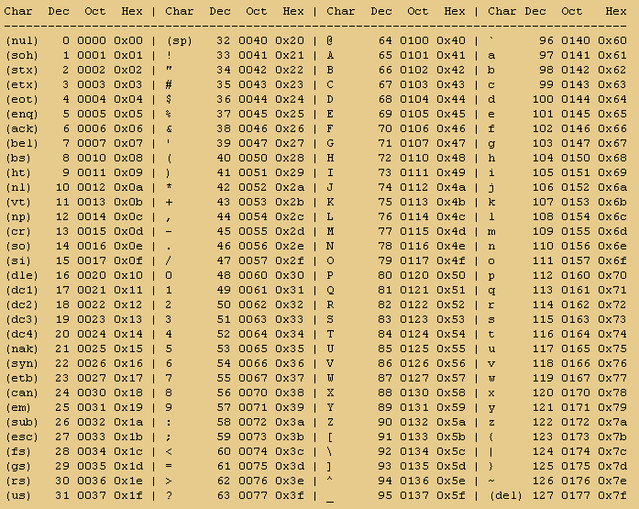
ASCII Table

Slide 5
String Declaration
db 0x61, 0x62, . . .
db ‘a’, ‘b’, . . .
db ‘abcdef’

Slide 6
Video Device Function in Computer

Slide 7
Character Formation

Slide 8
Character Formation
ASCII CODE
Attributes
blink
R
G
B
I
R
G
B
Back Ground
Fore Ground

Slide 9
Character Formation
R = Red
G = Green
B = Blue
I = Intensity
Bl = Blinking
Attributes
blink
R
G
B
I
R
G
B
Back Ground
Fore Ground

Slide 10
Accecing Video Memory
Mov ax, 0*b800
Mov ex, ax
Mov word [es:0], 0*0741
; print A at the top left in
;White on the Black bg
Move word [es:160], 0*1230
;print 0 at second line
;Left in green on blue bg

