Slide 1
Computer Organization & Assembly Language
Lecture-1
Adnan Majeed

Slide 2
Course Introduction
This course is design to understand the basics organization of computers

Slide 3
Basic Computer Organization
Processor
Memory
I/O

Slide 4
Basic Computer Organization
Processor
Operation
Memory Data

Slide 5
Basic Computer Organization
Processor
Operation
Memory Data

Slide 6
Basic Computer Organization
Processor
Address Bus
Memory
Data Bus
Control Bus

Slide 7
Dimensions of Memory
Horizontal Dimensions = Width of Memory Cell
00000000
Vertical Dimensions
=
Size of
Memory
00000001
Binary
Addresses
Of
Memory
Cells
00100011
00100100
00100101

Slide 8
Basic Computer Organization
Processor
Memory
Control Bus

Slide 9

CS-401
Assembly Language Programming
Lecture-2
Introduction to Assembly Language

Slide 10
Basic Computer Organization
REGISTERS

Slide 11
Registers
Accumulator Register
Function:
Mathematical and Logical Operations

Slide 12
Registers
Pointer / Index / Base
Function:
Holds the Address of Operands

Slide 13
Registers
General Purpose
Function:
Temporary Storage
of
Intermediate Results

Slide 14
Registers
Flag / Program Status Word
Function:
Collection of different boolean
information each bit has an
independent meaning

Slide 15
Registers
Flag / Program Status Word
C
O
P
D
Z
I
A
S
A sample 8 – bit flag register
C = Carry Flag
Z = Zero Flag

Slide 16
Registers
Carry Flag
1111111111111111
+1111111111111111
0000000000000001
0000000000000000
16 – bit Accumulator
Carry Flag = CF

Slide 17
Registers
Program Counter
Instruction Pointer
Function:
Address of next instruction to be executed

Slide 18
MNEMONIC

Slide 19
Instruction Groups
Data Movement Instructions
Arithmetic / Logic Instructions
Program Control Instructions
Special Instructions

Slide 20
Data Movement
mov ax,bx ; move data from bx to ax
lda 0234 ; load 0234 into ; accumulator

Slide 21
Arithmetic and Logic Instructions
and ax,1234 ; AND 1234 with ax
add bx,0534 ; ADD 0534 to bx
add bx,[1200] ; ADD data at address 1200 to bx
add ax,[1234] ; ADD data from address 1234 to ax

Slide 22
Program Control Instructions
cmp ax,0 ; Compare ax with 0
jne 1234 ; Jump if not equal to the instruction
; at address 1234

Slide 23
Special Instructions
cli ; Clear the interrupt flag
sti ; Set the interrupt flag

Slide 24
CS-401
Computer Architecture & Assembly Language Programming
Lecture-3
Introduction to Assembly Language

Slide 25
Lets revise the last lecture

Slide 26
Basic Computer Organization
iAPX 88 Registers (16-bit)

Slide 27
iAPX 88 Registers (16-bit)
General Purpose
AX
BX
CX
DX

Slide 28
iAPX 88 Registers (16-bit)
General Purpose
16-bit
AX
AH
AL
8-bit
8-bit

Slide 29
iAPX 88 Registers (16-bit)
General Purpose
16-bit
BX
BH
BL
8-bit
8-bit

Slide 30
iAPX 88 Registers (16-bit)
General Purpose
AX A→ Accumulator Register
BX B→ Base Register
CX C→ Counter Register
DX D→ Destination Register

Slide 31
iAPX 88 Registers (16-bit)
Pointer / Index / Base
SI
DI

Slide 32
iAPX 88 Registers (16-bit)
Pointer / Index / Base
SI SI→ Source Index
DI DI→ Destination Index
IP IP→ Instruction Pointer
SP SP→ Stack Pointer
BP BP→ Base Pointer

Slide 33
iAPX 88 Registers (16-bit)
Flag Register
-
-
-
-
O
D
I
T
S
Z
-
A
-
P
-
C
C = Carry S = Sign Bit
P = Parity T = Trap Flag
A= Auxiliary Carry I = Interrupt Flag
Z= Zero Bit D = Direction Flag
O = Overflow

Slide 34
Registers
Program Counter
Instruction Pointer
Function:
Address of next instruction to be executed

Slide 35
Instruction Groups
Data Movement Instructions
Arithmetic / Logic Instructions
Program Control Instructions
Special Instructions

Slide 36
Data Movement
mov ax,bx ; move data from bx to ax
lda 0234 ; load 0234 into ; accumulator

Slide 37
Arithmetic and Logic Instructions
and ax,1234 ; AND 1234 with ax
add bx,0534 ; ADD 0534 to bx
add bx,[1200] ; ADD data at address 1200 to bx
add ax,[1234] ; ADD data from address 1234 to ax

Slide 38
iAPX 88 Registers (16-bit)
Segment
CS CS→ Code Segment
DS DS→ Data Segment
SS SS→ Stack Segment
ES ES→ Extra Segment

Slide 39
iAPX 88 Registers (16-bit)
General Purpose
AX AH,AL
BX BH,BL
CX CH,CL
DX DH,DL

Slide 40
A Simple Program
Move 5 to AX mov ax,5
Move 10 to BX mov bx,10
ADD BX to AX add ax,bx
Move 15 to BX mov bx,15
ADD BX to AX add ax,bx

Slide 41
General Instruction Format
instruction dest, src
instruction dest
instruction src

Slide 42
Assembler
NASM
The Netwide Assembler

Slide 43
Linker
ALINK

Slide 44
Debugger
AFD
Advanced Full Screen Debug

Slide 45
EX01.ASM
[ORG 0X100]
mov ax,5
mov bx,10
Add ax,bx
Mov bx,15
Add ax,bx
Mov ax,0x4c00
Int 0x21

Slide 46
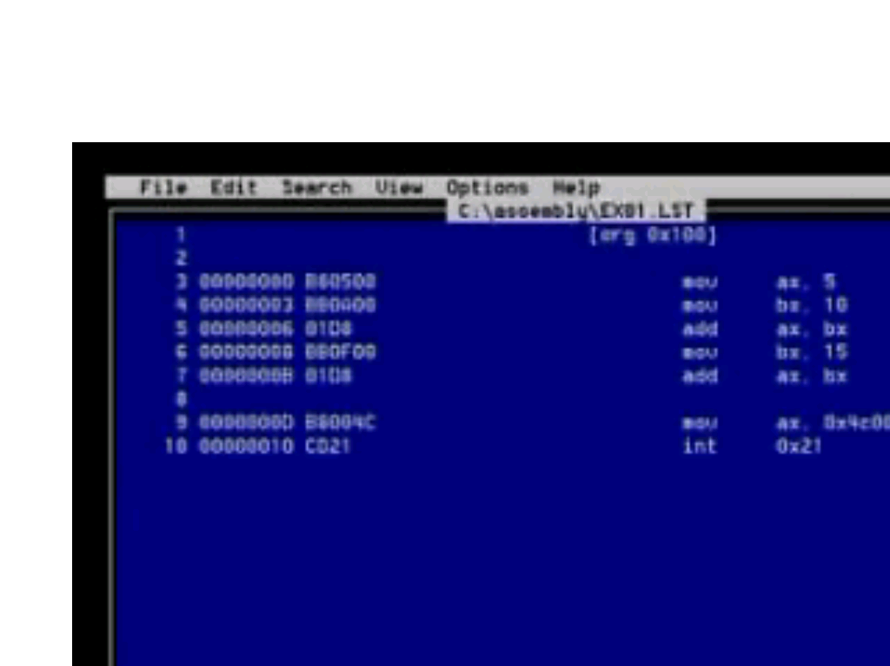
EX01.LST

Slide 47
Word Representation
4 Byte Word
Representation in Memory
MSB
LSB
Representation 1
Little Endian Notation
MSB
LSB
0 1 2 3
Representation 2
Big Endian Notation
LSB
MSB
0 1 2 3

