Slide 1


The Essence of Information: Bits & Context
What makes information meaningful? It's not just a collection of bits, but the context that binds them together. This presentation explores the fascinating interplay between bits and context, revealing the essence of information itself.
by Adnan Majeed

Slide 2
Bits as Building Blocks
Definition
Importance
Bits are the fundamental unit of information in computing, representing either a 0 or a 1. They are the building blocks of everything digital, from text and images to programs and data.
Bits alone are meaningless without context. They are like individual puzzle pieces that need to be assembled in the right order to form a complete picture.

Slide 3



Context Unlocks Meaning
Language
1
A sequence of bits can represent a word, but only when interpreted within the context of a language.
Format
2
Knowing the format of the data, such as image, audio, or video, dictates how the bits are processed and displayed.
Purpose
3
Understanding the purpose of the information, whether it's a message, a command, or data, shapes how we interact with it.

Slide 4

Real-World Examples
Web Pages
Music Files
A webpage's HTML code is a collection of bits that represent the layout, content, and interactions when viewed within the context of a web browser.
A music file's bits are arranged according to a specific audio format like MP3 or FLAC, enabling a device to decode the bits into sound waves.
Digital Photos
The pixels of a digital image are represented by bits, but their meaning is determined by the context of the image format, color palette, and compression techniques.

Slide 5

Translation in the Digital World
1
2
3
Source Code
Machine Code
Translation
Human-readable instructions written in a programming language.
Low-level instructions directly understood by the computer's central processing unit (CPU).
Programs called compilers, assemblers, and interpreters bridge the gap between source code and machine code.

Slide 6
The Role of Compilers
Lexical Analysis
1
Breaking down source code into individual tokens (words, symbols) to identify syntax.
Parsing
2
Analyzing the structure of the program and ensuring it adheres to grammar rules.
Code Generation
3
Generating machine code that executes the program's instructions on the CPU.

Slide 7
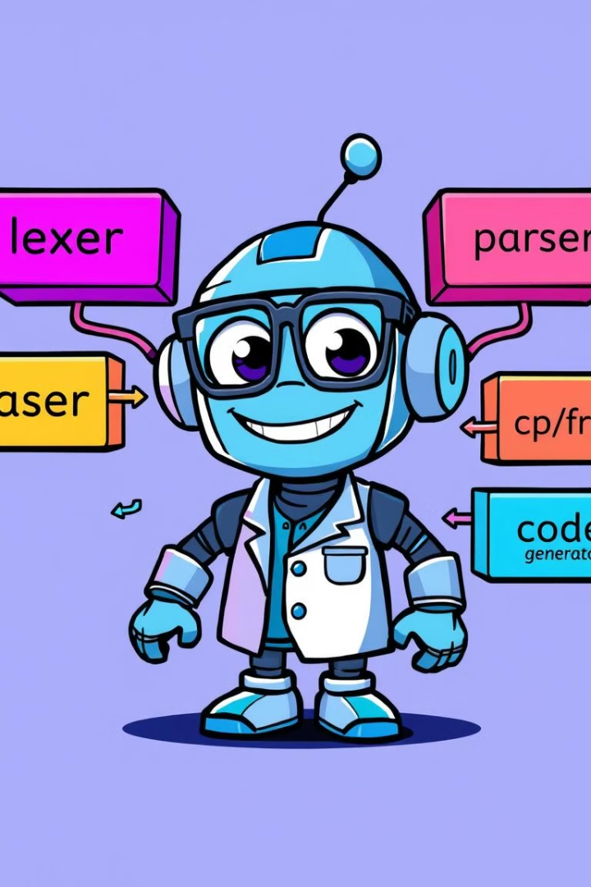

The Compilation System
Source Code
Compiler
Instructions written in a high-level programming language.
A program that translates source code into machine code.
Machine Code
Instructions understood by the computer's CPU.

Slide 8
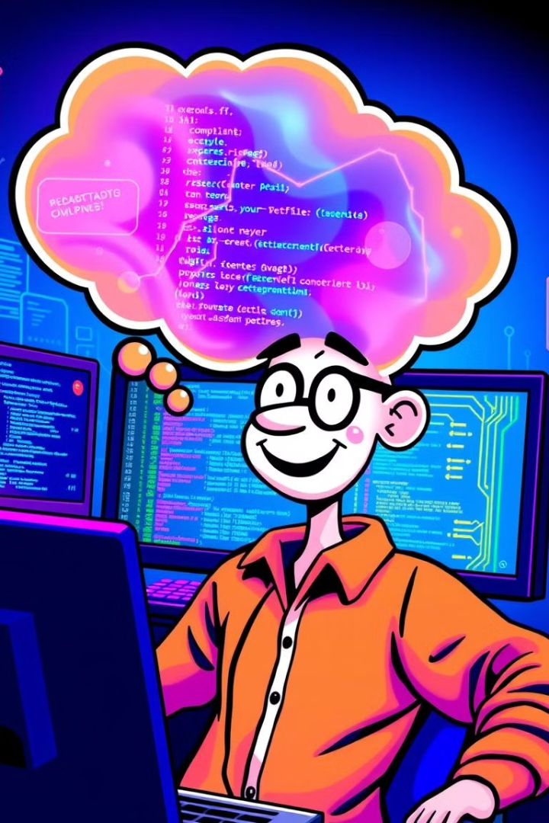
The Importance of Understanding
1
2
Optimization
Debugging
Compilers can optimize code to make it more efficient and faster.
Understanding the compilation process can help with debugging errors in code.
3
Cross-Platform
Compilers enable programs to run on different operating systems and hardware.

Slide 9
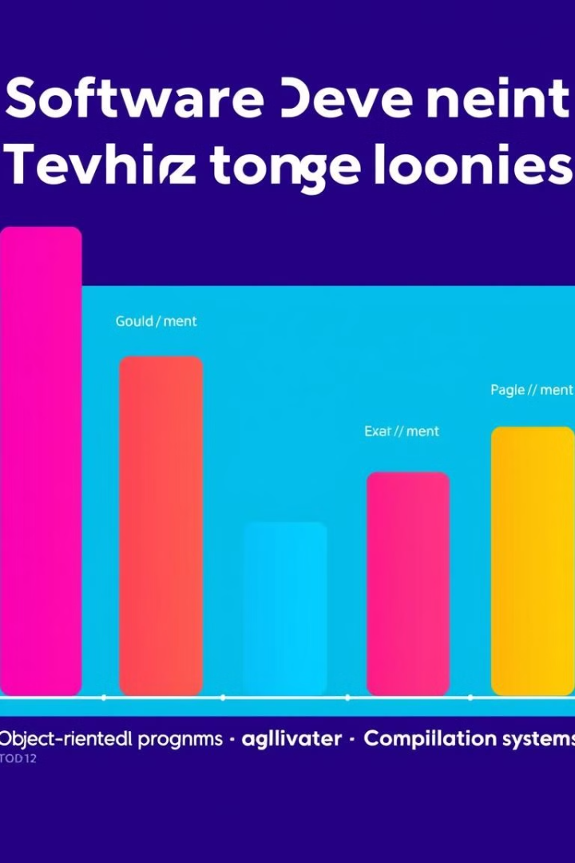
Key Takeaways
Information is more than just bits; it's bits with context. Understanding this interplay is crucial in the digital world. Compilers are essential tools that enable us to build and run programs on various platforms. By grasping the fundamental principles of compilation systems, we unlock a deeper understanding of how software works.

