Slide 1
Fragments and Buttons in Android (Java)
BSCS 7th Semester | Instructor: Adnan Majeed Android Studio Otter (2025.2.1)

Slide 2
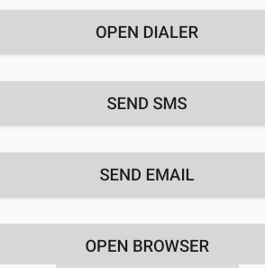

Slide 3
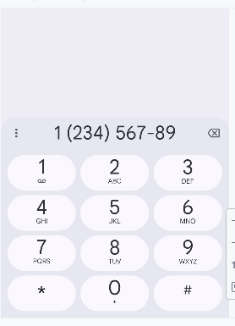

Slide 4
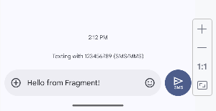

Slide 5
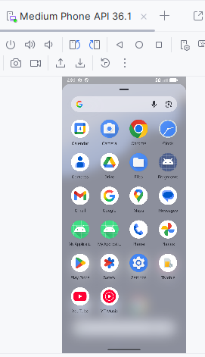

Slide 6
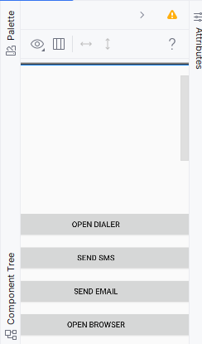

Slide 7
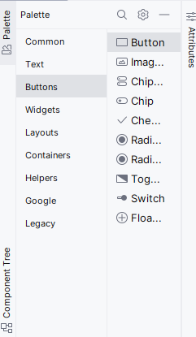

Slide 8
Introduction to Fragments
A Fragment is a reusable UI component in Android that represents a portion of the user interface inside an Activity. They help modularize the UI and support dynamic layouts.

Slide 9
Why Use Fragments?
✔ Reusable components ✔ Flexible UI for different screen sizes ✔ Easier management in multiple activities ✔ Part of modern Android architecture

Slide 10
Fragment Lifecycle
1. onAttach() 2. onCreate() 3. onCreateView() 4. onActivityCreated() 5. onStart() 6. onResume() 7. onPause() 8. onStop() 9. onDestroyView() 10. onDestroy() 11. onDetach()

Slide 11
Fragment Lifecycle Diagram
Illustration: Show Fragment lifecycle diagram (add in class presentation).

Slide 12
FragmentManager and FragmentTransaction
FragmentManager manages fragments within an Activity. FragmentTransaction is used to add, replace, or remove fragments dynamically.

Slide 13
Creating a Fragment Project
In Android Studio → File → New → New Project → Empty Views Activity. Add a new Fragment class under java/com/example/fragments.

Slide 14
activity_main.xml
<?xml version="1.0" encoding="utf-8"?> <FrameLayout xmlns:android="http://schemas.android.com/apk/res/android" android:id="@+id/fragment_container" android:layout_width="match_parent" android:layout_height="match_parent"/>

Slide 15
fragment_intent.xml
<?xml version="1.0" encoding="utf-8"?> <LinearLayout xmlns:android="http://schemas.android.com/apk/res/android" android:orientation="vertical" android:padding="16dp" android:layout_width="match_parent" android:layout_height="match_parent"> <Button android:id="@+id/btnDialer" android:text="Open Dialer"/> <Button android:id="@+id/btnSMS" android:text="Send SMS"/> <Button android:id="@+id/btnEmail" android:text="Send Email"/> <Button android:id="@+id/btnBrowser" android:text="Open Browser"/> </LinearLayout>

Slide 16
MainActivity.java
package com.example.fragments; import androidx.appcompat.app.AppCompatActivity; import androidx.fragment.app.FragmentManager; import androidx.fragment.app.FragmentTransaction; import android.os.Bundle; public class MainActivity extends AppCompatActivity { @Override protected void onCreate(Bundle savedInstanceState) { super.onCreate(savedInstanceState); setContentView(R.layout.activity_main); if (savedInstanceState == null) { FragmentManager fm = getSupportFragmentManager(); FragmentTransaction ft = fm.beginTransaction(); ft.replace(R.id.fragment_container, new IntentFragment()); ft.commit(); } } }

Slide 17
IntentFragment.java (Part 1)
package com.example.fragments; import android.content.Intent; import android.net.Uri; import android.os.Bundle; import android.view.LayoutInflater; import android.view.View; import android.view.ViewGroup; import android.widget.Button; import androidx.fragment.app.Fragment;

Slide 18
IntentFragment.java (Part 2)
public class IntentFragment extends Fragment { @Override public View onCreateView(LayoutInflater inflater, ViewGroup container, Bundle savedInstanceState) { View view = inflater.inflate(R.layout.fragment_intent, container, false); Button btnDialer = view.findViewById(R.id.btnDialer); Button btnSMS = view.findViewById(R.id.btnSMS); Button btnEmail = view.findViewById(R.id.btnEmail); Button btnBrowser = view.findViewById(R.id.btnBrowser);

Slide 19
IntentFragment.java (Part 3)
btnDialer.setOnClickListener(v -> startActivity(new Intent(Intent.ACTION_DIAL))); btnSMS.setOnClickListener(v -> { Intent sms = new Intent(Intent.ACTION_VIEW, Uri.parse("sms:123456789")); sms.putExtra("sms_body", "Hello from Fragment!"); startActivity(sms); }); btnEmail.setOnClickListener(v -> { Intent email = new Intent(Intent.ACTION_SENDTO, Uri.fromParts("mailto", "test@example.com", null)); email.putExtra(Intent.EXTRA_SUBJECT, "Subject"); startActivity(Intent.createChooser(email, "Send Email")); }); btnBrowser.setOnClickListener(v -> { Intent browser = new Intent(Intent.ACTION_VIEW, Uri.parse("https://www.google.com")); startActivity(browser); }); return view; } }

Slide 20
AndroidManifest.xml
<application ...> <activity android:name=".MainActivity"> <intent-filter> <action android:name="android.intent.action.MAIN"/> <category android:name="android.intent.category.LAUNCHER"/> </intent-filter> </activity> </application>

Slide 21
Running the App
1. Build → Clean Project 2. Build → Rebuild Project 3. Run on Emulator 4. Check for fragment display and button functionality.

Slide 22
Understanding Intents
Intent is a messaging object used to request an action from another app component. Types: ✔ Explicit Intents ✔ Implicit Intents

Slide 23
Intent Examples
✔ ACTION_DIAL → Open dialer ✔ ACTION_VIEW → Open browser or SMS ✔ ACTION_SENDTO → Send email

Slide 24
Common Errors & Fixes
⚠ Missing fragment_container ID → Ensure it exists in XML ⚠ Activity not declared → Check AndroidManifest.xml ⚠ Intent crashes → Verify correct URI syntax

Slide 25
Fragment vs Activity
Activity: Full screen UI controller. Fragment: Subpart of Activity. Both have their own lifecycle and can communicate using FragmentManager.

Slide 26
Fragment Lifecycle Diagram
Illustration Placeholder: Show onSlide diagram for fragment lifecycle.

Slide 27
Summary
✔ Fragment = modular UI block ✔ Can contain buttons and views ✔ Communicates with Activity ✔ Uses Intents to interact with system apps

Slide 28
Viva Questions
1. What is a Fragment? 2. Difference between Activity and Fragment? 3. What is FragmentTransaction? 4. What are implicit and explicit intents? 5. How do you open the dialer using Intent?

Slide 29
Lab Task 1
Create a Fragment with two buttons: 1. Open Maps 2. Open YouTube Hint: Use Intent with ACTION_VIEW and appropriate URIs.

Slide 30
Lab Task 2
Modify your Fragment to include EditText for user input and send it via SMS Intent.

