Slide 1


Operating Systems: A Foundation for Computing
Welcome to the world of operating systems! This presentation will explore the fundamentals of operating systems, their essential roles, and how they manage your computer's resources.
by Adnan Majeed

Slide 2
What is an Operating System?
The Heart of the System
Key Functions
An operating system (OS) is the software that manages a computer's hardware resources and provides a platform for applications to run.
Resource Management
Memory Management
Process Scheduling
Security and Protection

Slide 3
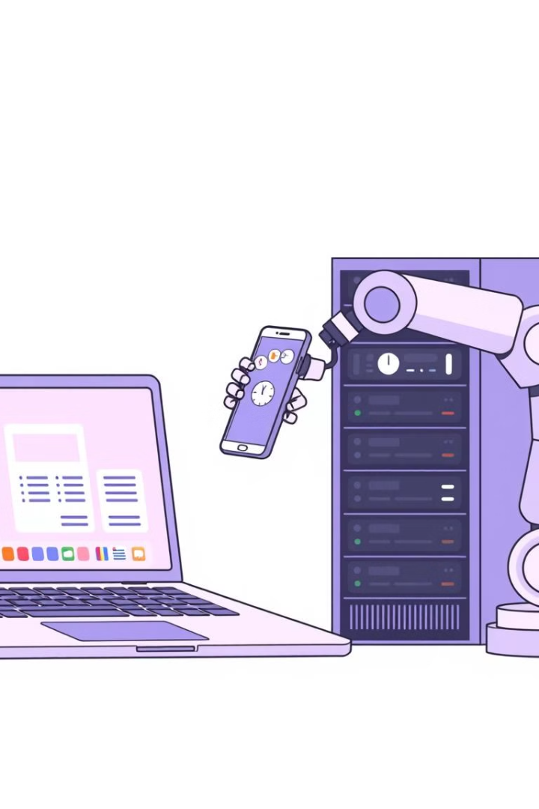
Types of Operating Systems
Desktop OS
Mobile OS
Designed for personal computers, with user-friendly interfaces and wide application support. Examples: Windows, macOS, Linux.
Optimized for mobile devices, providing touch-based interfaces, power management, and app ecosystems. Examples: Android, iOS.
Server OS
Built for powerful servers, managing network resources, storage, and security for multiple users. Examples: Windows Server, Linux Server.

Slide 4
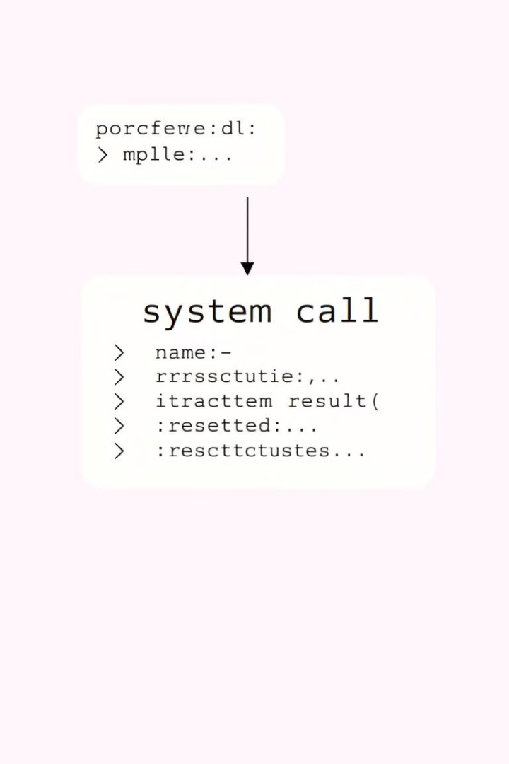


System Calls: The Bridge Between Programs and Hardware
Definition
Types
System calls are special functions that provide programs with access to hardware and operating system resources.
File Management
Device Management
Process Management

Slide 5
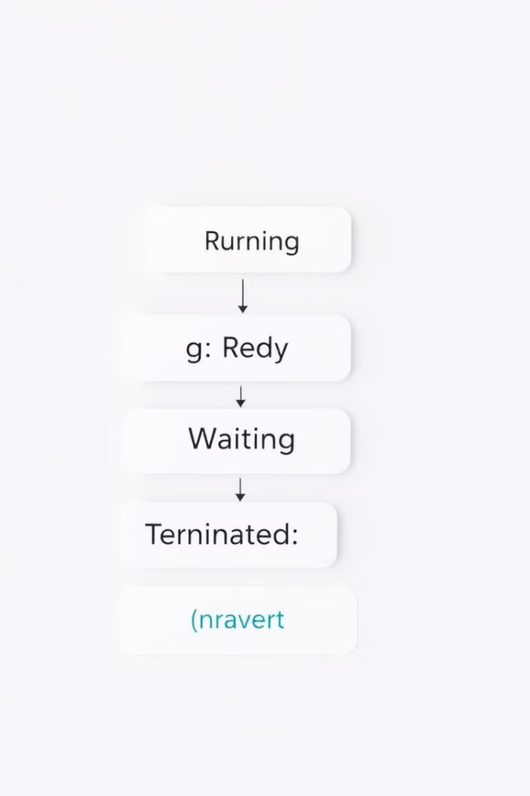
Process Concepts: The Building Blocks of Multitasking
1
Process Definition
A process represents an executing program with its own memory space, resources, and execution context.
2
Process States
Processes cycle through various states: Running, Ready, Waiting, and Terminated, reflecting their current activity and resource usage.

Slide 6
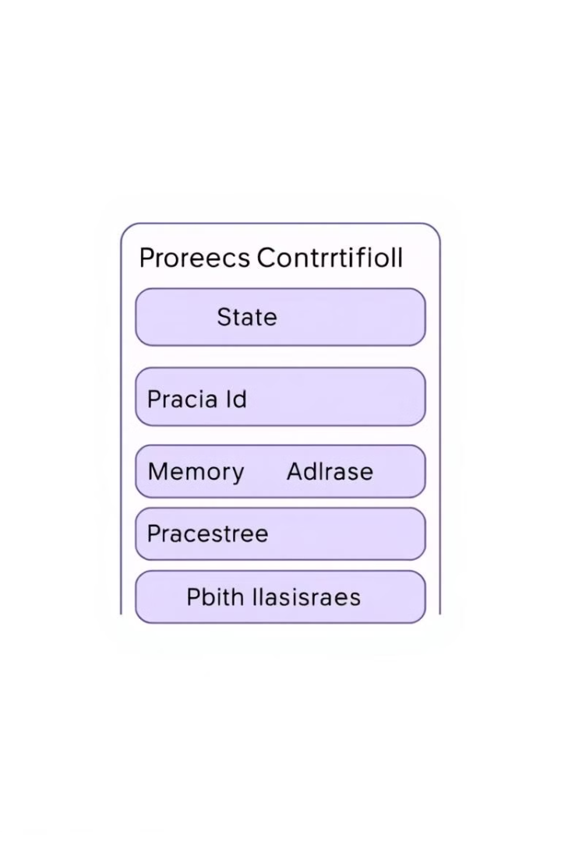


Process Management: Orchestrating Execution
Process Control Block (PCB)
A PCB is a data structure that stores important information about each process, enabling the operating system to track and manage their execution.
Process Scheduling
The operating system determines which process to execute next, using algorithms like round-robin or priority scheduling to optimize resource utilization.

Slide 7


Process Synchronization: Maintaining Order in Concurrency
Concurrency
1
When multiple processes or threads execute simultaneously, they may access shared resources.
Synchronization
2
Synchronization mechanisms ensure that access to shared resources is coordinated, preventing race conditions and maintaining data consistency.

Slide 8
Key Takeaways and Next Steps
Foundation of Computing
1
Operating systems provide the essential foundation for all software applications to run on a computer.
Understanding the Basics
2
Understanding system calls, process concepts, and synchronization is crucial for building robust and efficient software.
Further Exploration
3
Continue exploring advanced topics like memory management, file systems, and security to deepen your understanding of operating systems.

