Slide 1
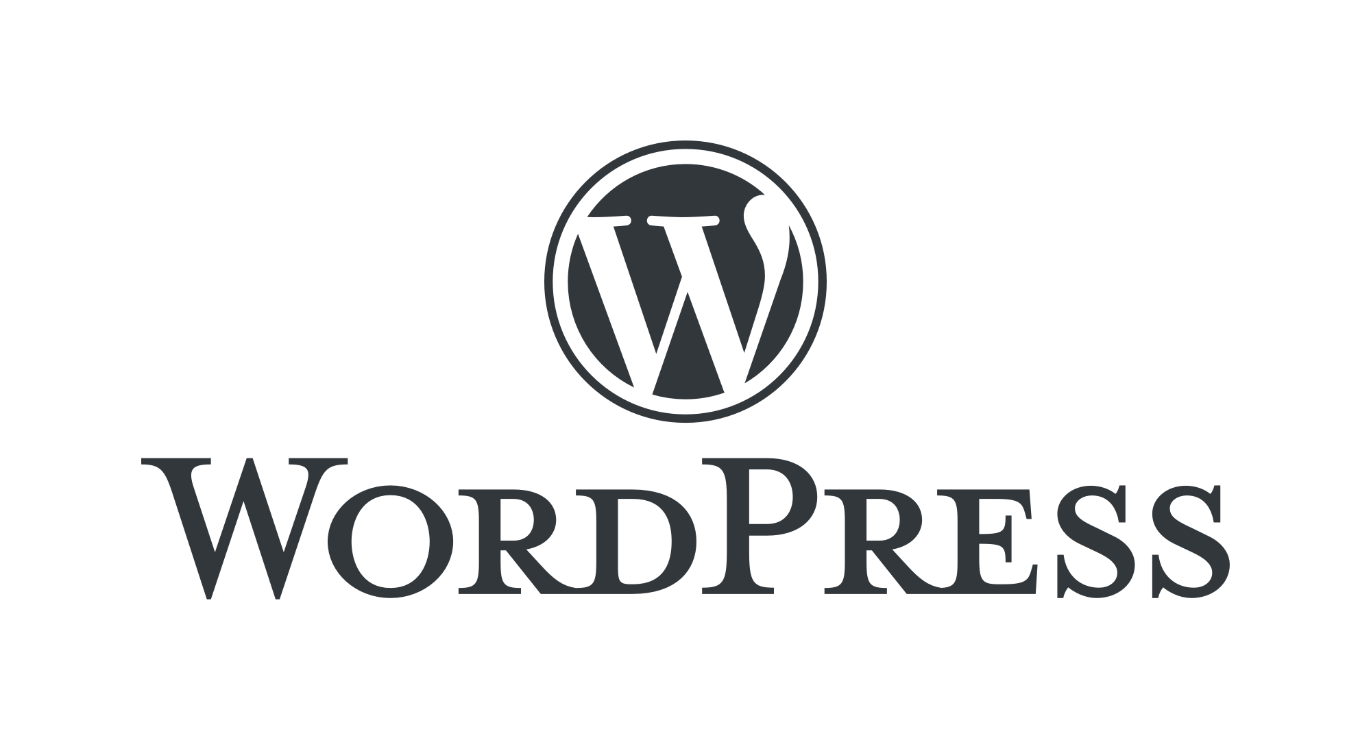
By Adnan Majeed
Computer learning center

Slide 2
About Me
A highly skilled IT professional with a Master’s degree in Computer Science (MCS) and over 12 years of experience in teaching, research, and industry.
Specialising in web development, data science, machine learning, and freelancing, this professional has successfully delivered numerous projects, trained professionals, and guided students in their academic and professional growth, making them a versatile and accomplished educator in the IT field.
+92 3004870104 322 8499993

Slide 3
What is WordPress
WordPress is an open source website platform designed to allow for easy website creation and administration. It's considered the most powerful and extensible website content management system (CMS) in existence today.

Slide 4
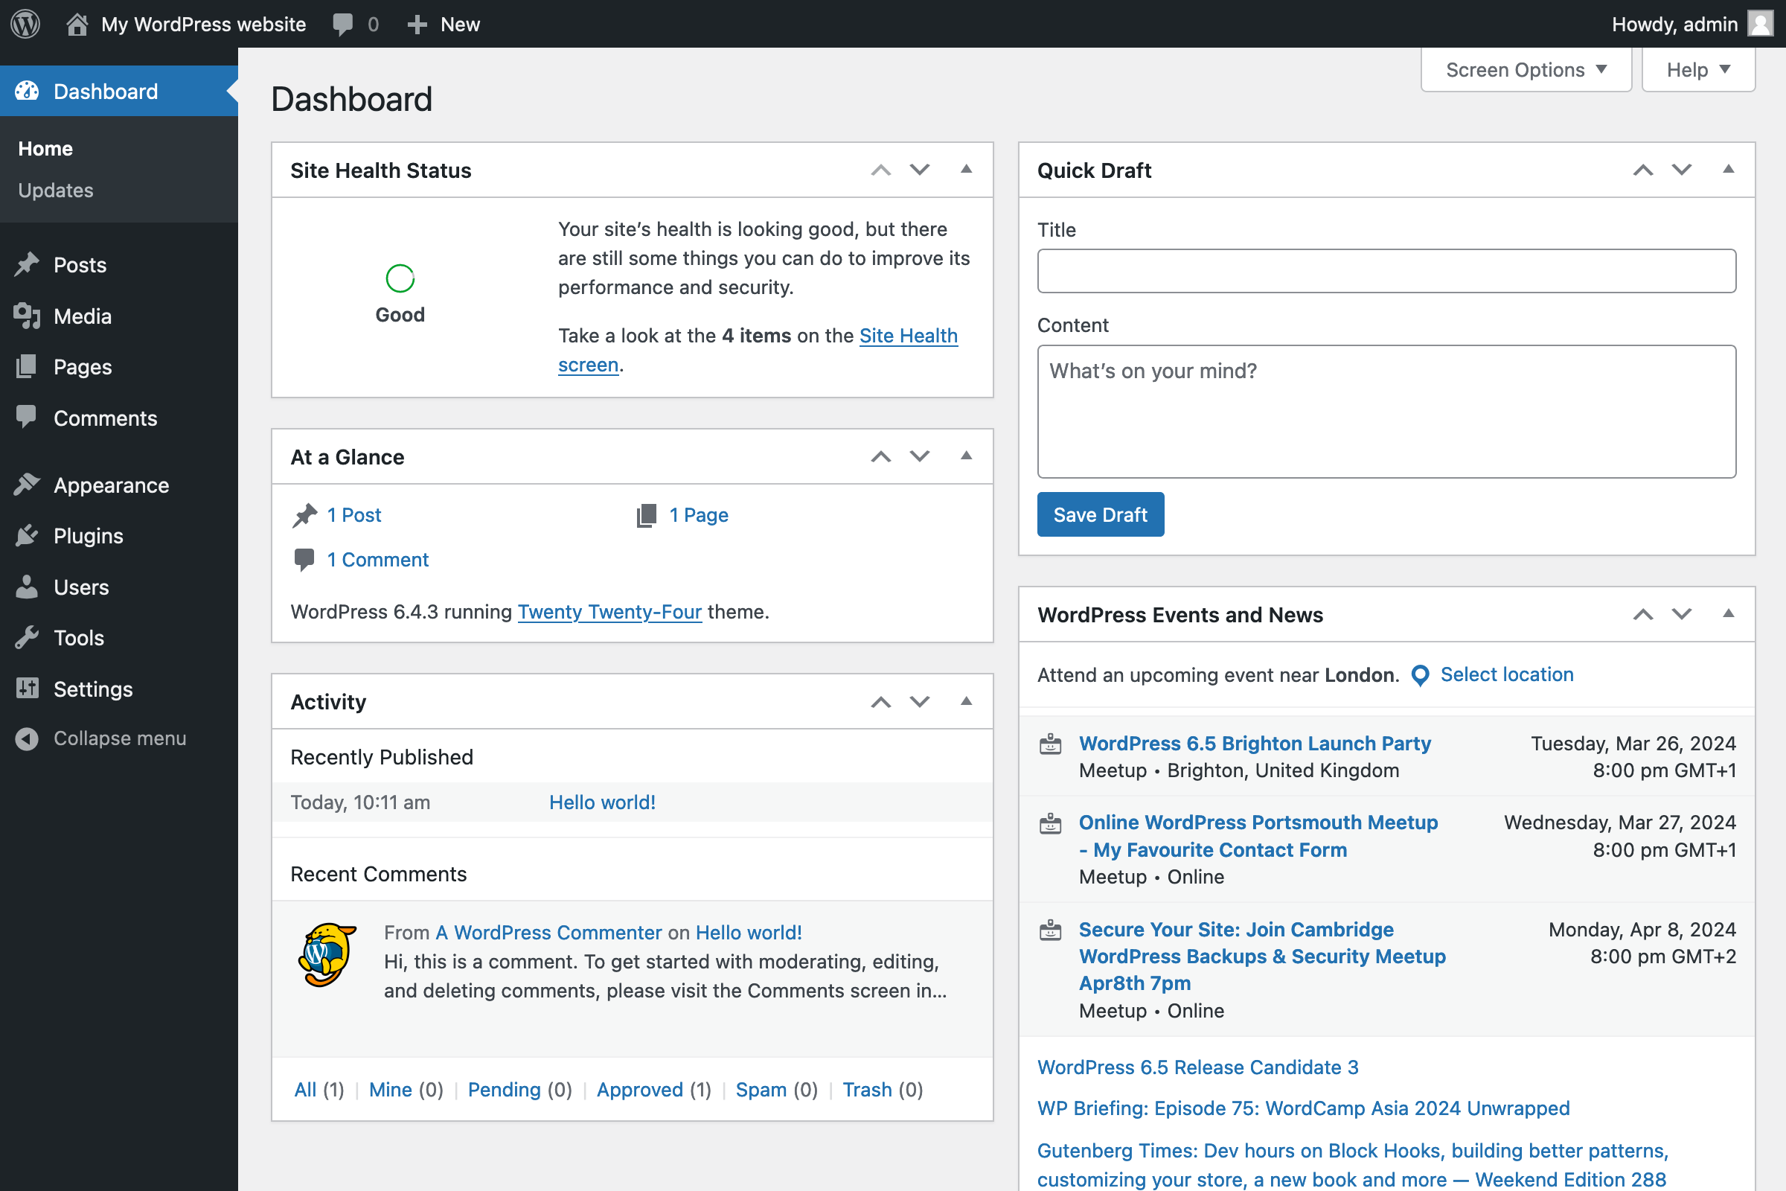
DASHBOARD

Slide 5
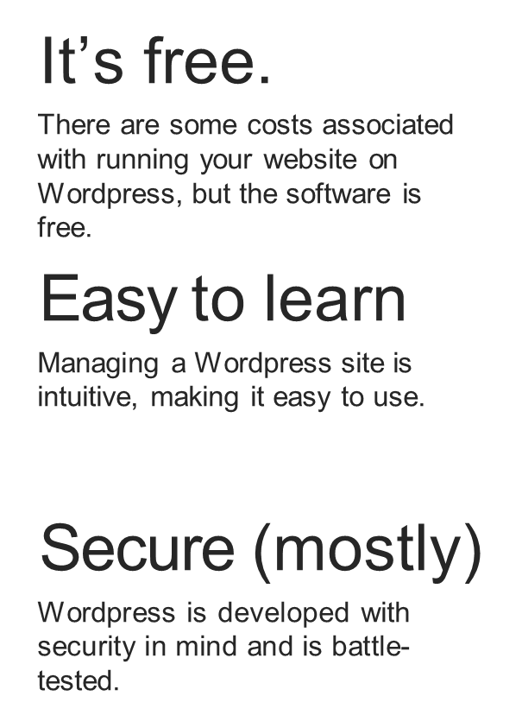
Why choose WordPress
Powerful
Wordpress has a large network of developers who are constantly making it better and more powerful.
Extensible
There are thousands of plugins, themes, and tools to add functionality to your Wordpress site.
SEO friendly
Wordpress is built with SEO in mind and uses SEO-friendly permalinks.

Slide 6
Procedures
Install xampp server
Start server
Download wordpress from wordpress.org
Copy wordpress file and paste it in htdocs folder
Create database in xampp
Install wordpress
Login to wordpress

Slide 7
Login to WordPress
Select WordPress themes of your choice
Add pages
Home page, about page, contact page etc.
Edit page
Add data
Add media files and video/images etc.
Update pages
Download seo plugins
Published site

Slide 8
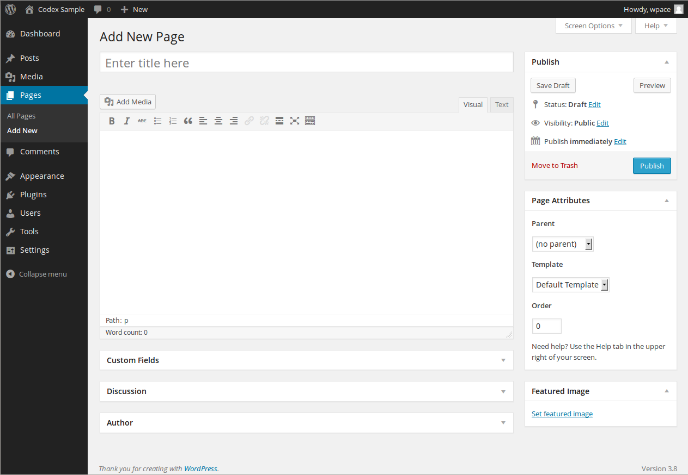
ADD NEW PAGE

Slide 9
PRIMARY CONTENT TYPES IN WORDPRESS
POSTS
Typically used for blog posts, announcements, content that is available for comment. Can be categorized and tagged.
PAGES
Typically used for static content such as the homepage, about, contact, etc. Can’t be categorized, but can be structured with subpages.
MEDIA
Images, videos, documents, and other content that may be contained in a page or post but is not text.

Slide 10
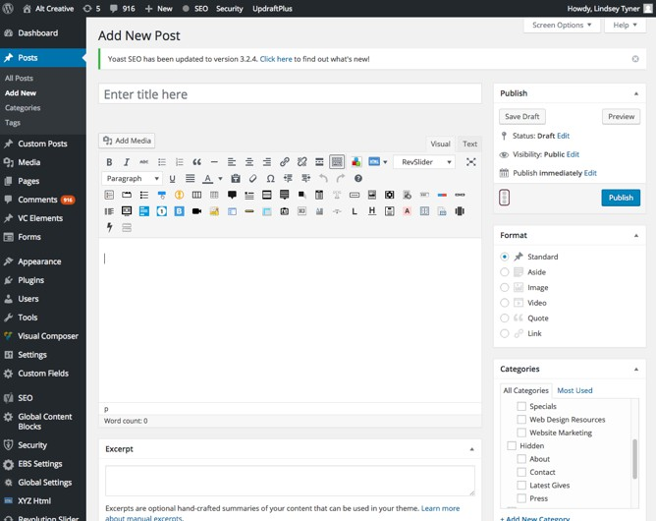
CREATING POSTS AND PAGES

Slide 11
WORDPRESS THEMES
A WordPress Theme is a collection of files (called template files) that work together to produce a graphical design interface for a Wordpress website. A Wordpress theme modifies the way the site is displayed, without modifying the underlying software.
Most WordPress themes provide the overall design or style of your site including:
font styling
colors
page layouts (or templates)
styles for blog posts and blog archives
additional stylistic details

Slide 12
CHOOSING AND INSTALLING WORDPRESS THEMESE
You can choose from over a thousand free themes from the WordPress Theme Directory or invest in premium, or paid themes. However, when choosing a theme for your small business website, make sure to carefully consider how it fits with your company’s brand and target audience.
You can install Wordpress themes from the Wordpress Theme Directory from directly inside your Wordpress administration area. You can install premium themes my uploading the theme files in the administration area.

Slide 13
WORDPRESS PLUGINS
Plugins are ways to extend and add to the functionality that already exists in WordPress. The core of WordPress is designed to be lean and lightweight, to maximize flexibility and minimize code bloat. Plugins then offer custom functions and features so that each user can tailor their site to their specific needs.
Wordpress plugin examples:
WooCommerce - extends Wordpress to allow for e-commerce capability.
Yoast SEO - adds SEO specific input fields to the page and post editor to allow for great search engine performance.
Backup Buddy - adds functionality to allow for automatic backups.
Contact Form 7 - adds functionality to embed contact forms into your pages.
AddThis - Sharing buttons to allow visitors to easily share your site content on Social Media.

Slide 14
REVIEW
World's most popular Content Management System (CMS)Powers 40% of websites globallyOpen-source and free to use
No coding required for basic functionalityDrag-and-drop features with page builders like ElementorUser-friendly interface even for beginners
Optimised for search engines out of the boxPlugins like Yoast SEO for advanced optimisationStructured content for better ranking
Most themes are mobile-friendly by defaultAutomatic adjustments for different devicesNo need for extra development for mobile versions

Slide 15


