Slide 1

Cost Benefit Analysis
Feasibility Study

Slide 2
Purpose
There are two main purposes in using CBA:
To determine if the project is sound, justifiable and feasible by figuring out if its benefits outweigh costs.
To offer a baseline for comparing projects by determining which project’s benefits are greater than its costs.

Slide 3
Cost analysis
One-time costs – occur only once during the implementation of the system
Capital cost – consists of outright capital expenditures for the purchase of capital equipment or service. These costs can be estimated simply by contacting the suppliers of these items.
Example- a new system may require additional software such as a DBMS, compiler, IDE, application package etc.

Slide 4

Development Cost
Administrative overhead
Computer charges
Consulting expenditure
Personnel
Training of computer personnel
Office supplies
Work lost due to disruption
Communication charges
travel

Slide 5

Conversion Costs
Occurs during the conversion from old to new system
Database conversion
Training of employees
Parallel running – personnel time

Slide 6
Annual Operating Cost
Fixed costs – costs that are constant throughout the year such as administrative, licensing and leasing cost
Variable costs – costs that vary according to the intensity with which the information system is utilized. For example, cost of supplies incurred in each time period during the year will depend on how intensively the information system is utilised in that period.

Slide 7
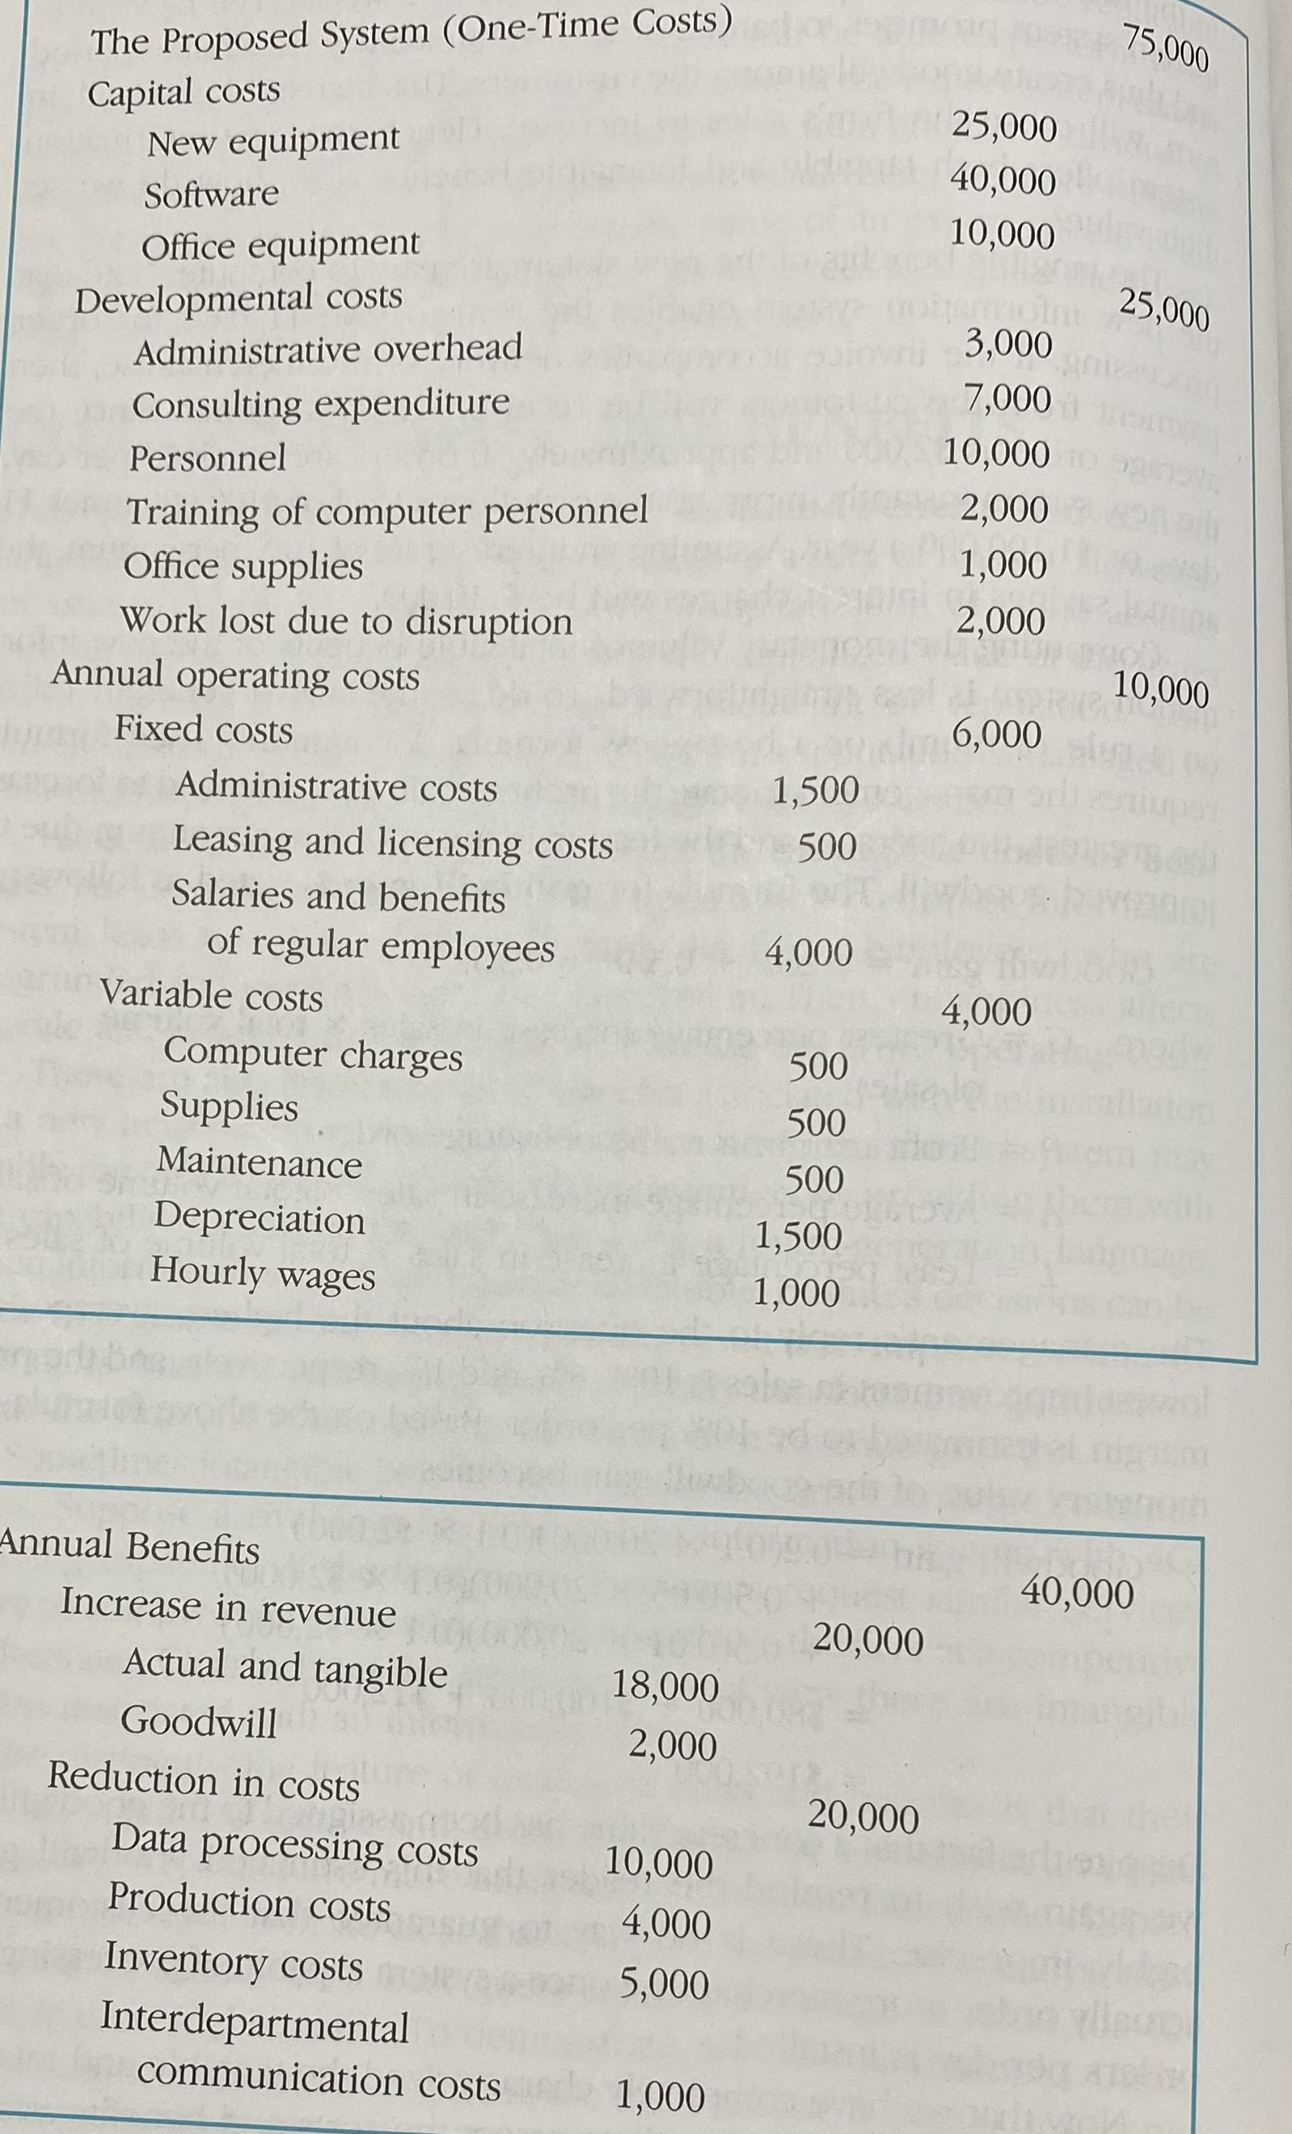
Projected cost and projected benefit of a simple information system

Slide 8
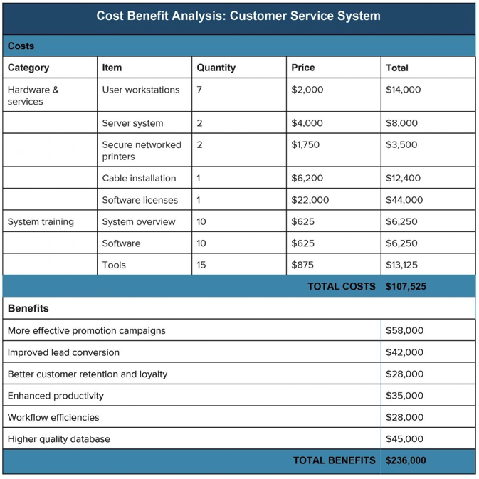
Example: CBA

Slide 9
Payback
Payback = costs / benefits
Units have to be consistent e.g. costs per year = pay back in a year
Using the example on the previous slide
  The costs = £107,525
  The benefits = £236,000
  Payback = 107525 = 0.455614
  236000
  0.455614 of a year is roughly six month, hence six months to pay back

Slide 10

Questions

Slide 11
Tasks
Look at the cost benefit analysis and payback document in Moodle
Work on the Assignment

