Slide 1
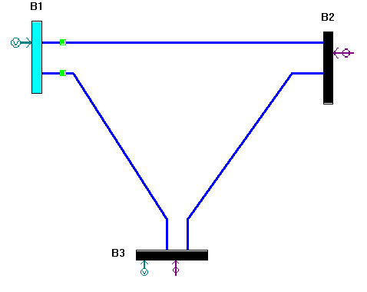
Realistic State Estimator For Energy Management System
Parsing Input Files (CDF, Measurement)
Process Parsed Data (Ybus & Power Meas.)
Observability Analysis (Rank of H or G)
Bad Data Detection & Identification
Plot Residuals & Normalized Residuals
Run AC-WLS Estimation (Print & Plot)
Supported Measurements
Voltage
Magnitude (Block 1)
Angle (Block 2)
Power Injection
Active (Block 3)
Reactive (Block 4)
Power Flow
Active (Block 5)
Reactive (Block 6)
Current
Magnitude (Block 7)
Angle (Block 8)
Tested Cases
SCADA Only
SCADA + PMU and Corrupted Data
Insufficient Measurements
Skipped Measurements
Resources
PET
PyCharm
Claude

