Slide 1
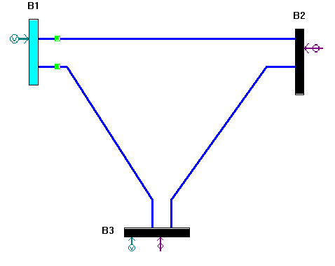
Realistic State Estimator For Energy Management System
Parsing Input Files (CDF, Measurement)
Process Parsed Data ($Y_{bus}$ & Power Meas.)
Process Parsed Data (𝑌_𝑏𝑢𝑠 & Power Meas.)
Observability Analysis (Rank)
Run AC-WLS Estimation (Print & Plot)
Bad Data Detection & Identification
Summary & Plot Final Residuals
Test Cases (3, 14 and 30 bus)
SCADA only
SCADA + PMU + Corrupted
Skipped / Insufficient Meas.
Supported Measurements
Voltage
Magnitude (Block 1)
Angle (Block 2)
Power Injection
Active (Block 3)
Reactive (Block 4)
Power Flow
Active (Block 5)
Reactive (Block 6)
Current
Magnitude (Block 7)
Angle (Block 8)
Learning Outcome
Errors can be correlated if more than one residuals are large (error is spread)
One Bad data can effect other residuals, it can be removed if the data is redundant
Removing Bad data (if it is not critical measurement) reduces almost all residuals
System is unobservable if G is singular or Rank deficient (G or H)
Resources
PET
PyCharm
Claude

