Slide 1

CLOUD / DEVOPS — PROJECT 2
Instrumented & Monitored
Cloud Service
Order & Inventory API — structured logging, custom metrics, a Golden Signals dashboard, tiered alerting, and three real, investigated failure scenarios on AWS.
Adnan Nooruddin
eu-north-1 (Stockholm) · EC2 + CloudWatch · Terraform

Slide 2

The Assignment
Observability first, application complexity last
Deploy a web app to EC2/ECS
Structured JSON logs -> CloudWatch Logs, with correlation IDs
ERROR / WARN / INFO log levels
5+ custom metrics, including real business metrics
Our guiding principle
CloudWatch dashboard covering the Golden Signals
"Simple application + strong observability beats complex application + weak observability."
CPU / memory / disk monitoring
3+ tiered CloudWatch alarms -> SNS -> email
3 failure scenarios, investigated and documented
No database, no Docker/ECS, no load balancer, no auto-scaling — every ounce of effort went into logs, metrics, dashboard, alerting.
Goals
Order & Inventory Service — Instrumented & Monitored Cloud Service
2

Slide 3






Architecture
One EC2 instance, one CloudWatch Agent, the full observability pipeline
EC2 Instance
CloudWatch Agent
CloudWatch
Dashboard
Alarms
SNS -> Email
order-service + inventory-service (pm2)
logs · StatsD metrics · CPU/mem/disk
Logs + Metrics (namespace P2OrderInventory)
7 widgets, Golden Signals
6 tiered, warning/critical
Real-time notification
t3.micro
:3000 only
SSM
Terraform
Amazon Linux 2023
Public port — no SSH
Session Manager access
EC2, IAM, SG, SNS, alarms
order-service (port 3000, public) calls inventory-service (port 3001) over localhost — never crosses the network, no security-group rule needed for it.
Architecture
Order & Inventory Service — Instrumented & Monitored Cloud Service
3

Slide 4



Instrumentation — Logs & Correlation IDs
One JSON object per line, no logging library — every field is visible in the code that emits it
Structured JSON logs
timestamp, level, service, event, correlationId + event-specific fields — queryable in CloudWatch Logs Insights
REAL EVIDENCE — same request, both services
{ "service":"inventory-service",
"event":"reservation_succeeded",
"correlationId":"095db674-...23d8",
"sku":"SKU-001", "remainingStock":49 }
3 log levels, chosen deliberately
INFO = expected outcome, WARN = handled edge case (bad SKU), ERROR = genuine unexpected failure (downstream unreachable)
{ "service":"order-service",
"event":"order_created",
"correlationId":"095db674-...23d8",
"orderId":1, "sku":"SKU-001" }
Correlation ID on every line
order-service generates it if missing, forwards X-Correlation-Id downstream; inventory-service reads or self-generates — never blank
Identical correlationId ties one order across both services — verified by grep, not assumed.
Instrumentation
Order & Inventory Service — Instrumented & Monitored Cloud Service
4

Slide 5
Instrumentation — 8 Custom Metrics
Namespace P2OrderInventory · hand-written StatsD sender, zero npm dependencies
BUSINESS METRICS
TECHNICAL METRICS
orders_created
order_errors
Successful orders, tagged by sku — orders/minute
Failed orders by reason (validation / rejected / unreachable)
order_value
order_latency
Revenue per order (USD) — Sum = revenue/period
End-to-end order time incl. the inventory-service call
reservation_failures
reservation_attempts
Failed reservations by reason + sku — surfaces which SKU is running out
Traffic/rate signal for inventory-service
stock_level
reservation_latency
Live stock remaining per SKU — "about to sell out" signal
Isolates whether slowness is order- or inventory-side
Instrumentation
Order & Inventory Service — Instrumented & Monitored Cloud Service
5

Slide 6
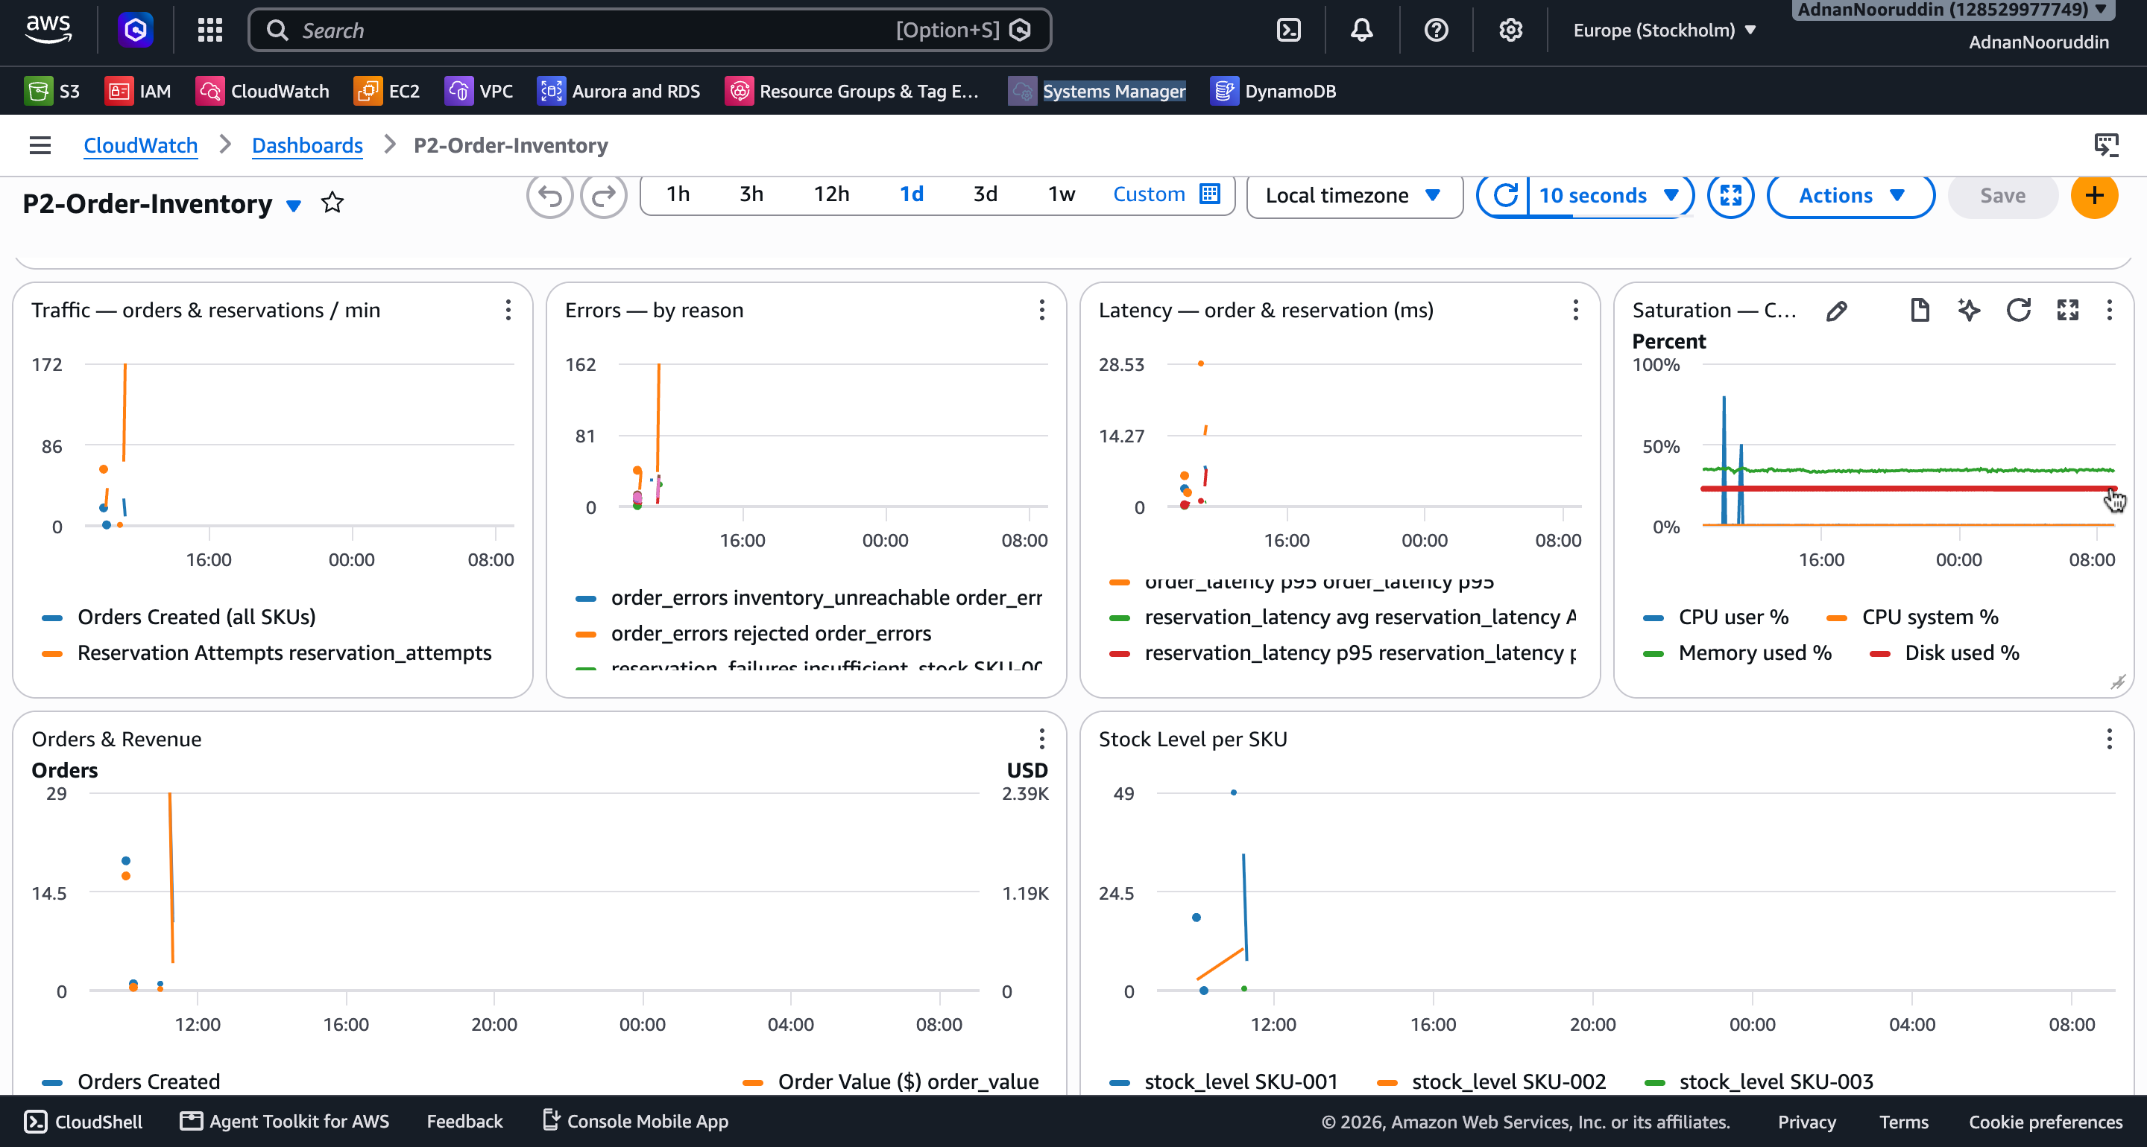
Live Demo
CloudWatch Dashboard — P2-Order-Inventory (backup capture shown below)
Live Demo
Order & Inventory Service — Instrumented & Monitored Cloud Service
6

Slide 7


The Golden Signals Dashboard
7 widgets — Golden Signals across the top, business detail below
Traffic
Errors
Orders + reservation attempts / min. A flat line when load is expected means requests aren't reaching the app.
order_errors + reservation_failures, auto-broken out by reason. The specific line spiking tells you the failure type at a glance.
Latency
Saturation
Average AND p95 for both services — p95 caught a real ~2-3x latency increase during CPU saturation that average alone would have hidden.
CPU / memory / disk %. The only widget that would have caught Incident #1 — a pure-CPU event with zero log output.
Monitoring
Order & Inventory Service — Instrumented & Monitored Cloud Service
7

Slide 8
Alerting — 6 Tiered Alarms
Thresholds set from real baseline data pulled from CloudWatch — not guessed
Alarm | Tier | Threshold | Observed baseline
order-error-rate-warning | WARNING | > 10% | ~0% expected w/ real traffic
order-error-rate-critical | CRITICAL | > 25% | Verified: fired at 100% during Incident #2
order-latency-warning | WARNING | p95 > 200ms | avg 3.6-4.5ms, p95 4.1-6.2ms
order-latency-critical | CRITICAL | p95 > 1000ms | Never breached, even under load
cpu-critical | CRITICAL | > 80% | ~0.3-0.6% — verified: fired cleanly at 100% (Incident #1)
memory-warning | WARNING | > 80% | ~34-36%, very stable
All alarms: 60s period, 2-of-3 evaluation windows (avoids single-blip false alarms, still alerts within ~2-3 min) · treat_missing_data = notBreaching
Alerting
Order & Inventory Service — Instrumented & Monitored Cloud Service
8

Slide 9
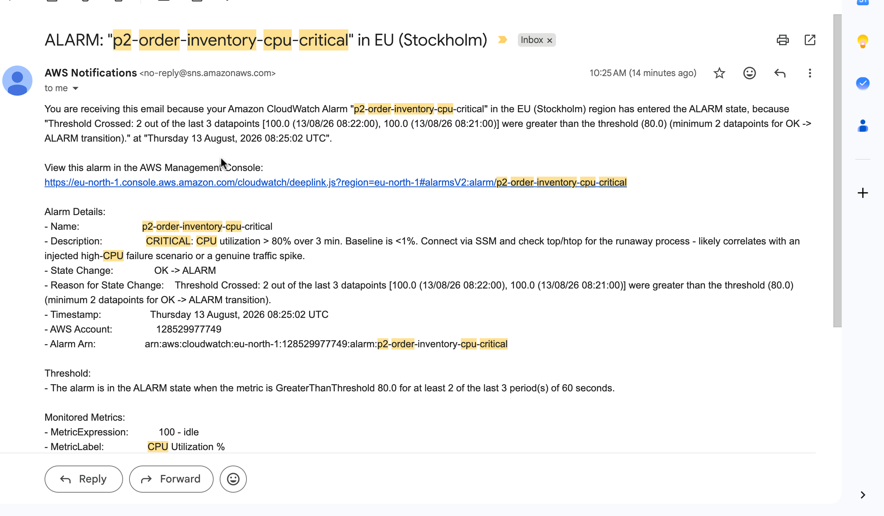

Alerting — SNS Email Flow
Verified end-to-end — real alarm, real email, not just a configured pipeline
Alarm fires
SNS Topic
Email delivered
State reverses (ALARM -> OK) -> a second email confirms recovery
"...cpu-critical...entered the ALARM state, because
"Threshold Crossed: 2 out of the last 3 datapoints
[100.0, 100.0] were greater than the threshold (80.0)"...'
Alerting
Order & Inventory Service — Instrumented & Monitored Cloud Service
9

Slide 10
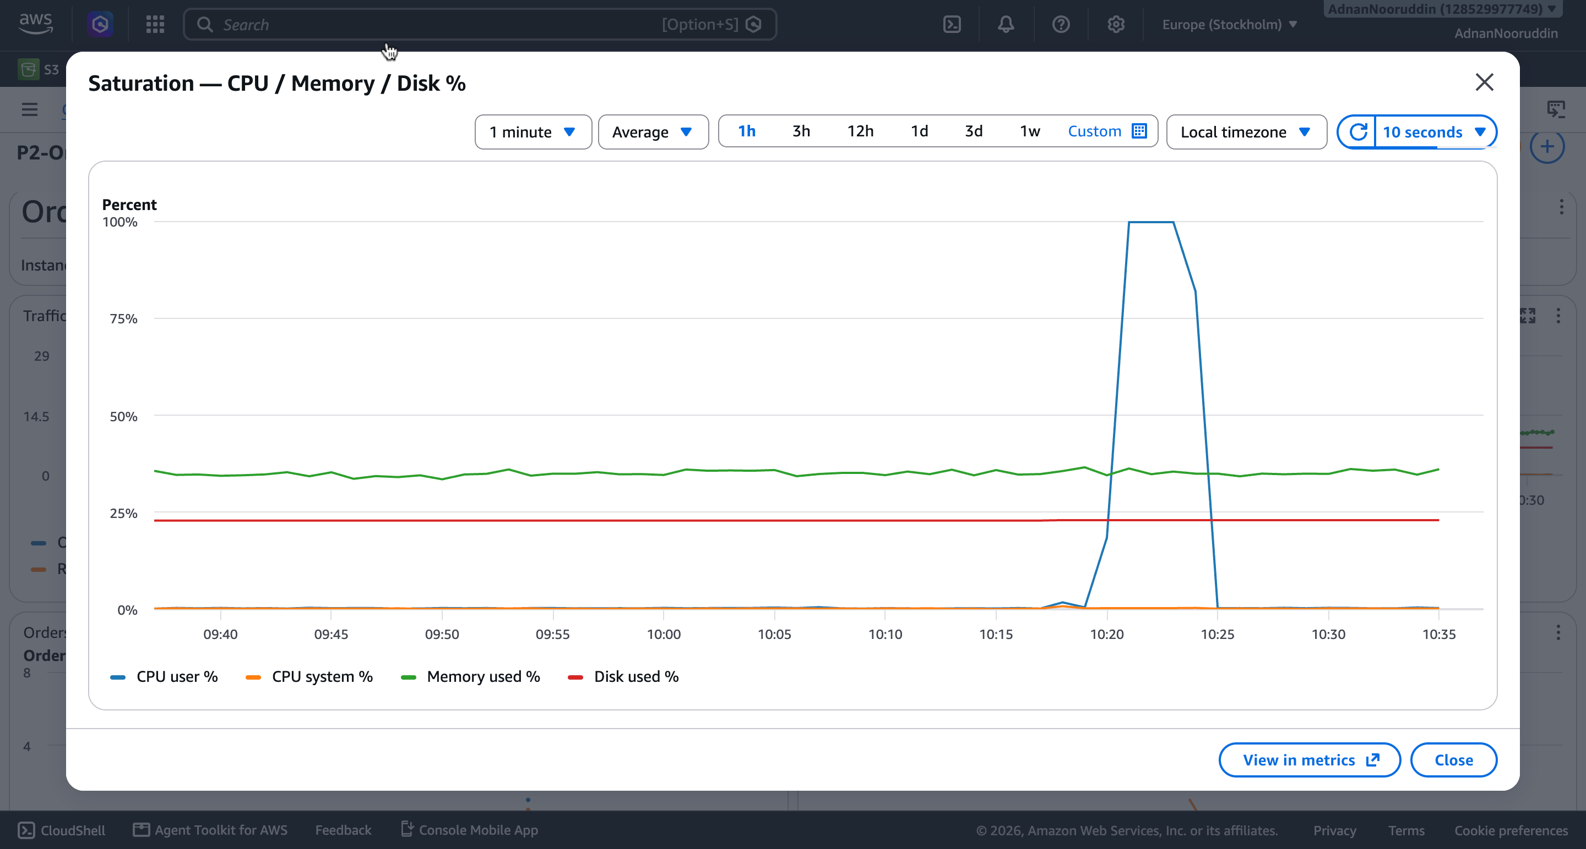


INCIDENT #1
High CPU (Injected)
Symptom
Investigation
CPU pegged at 100% for 4 min (stress-ng --cpu 2). cpu-critical alarm: OK -> ALARM at 08:25 UTC.
Zero application log output — a pure infrastructure event only the resource-metrics widget could surface.
Root cause & fix
Finding
Deliberate injection, self-resolving timeout. CPU + alarm both back to baseline within 4 minutes, no intervention needed.
App logs alone would have missed this entirely — confirms the value of OS-level metrics alongside application logs.
Incident Response
Order & Inventory Service — Instrumented & Monitored Cloud Service
10

Slide 11
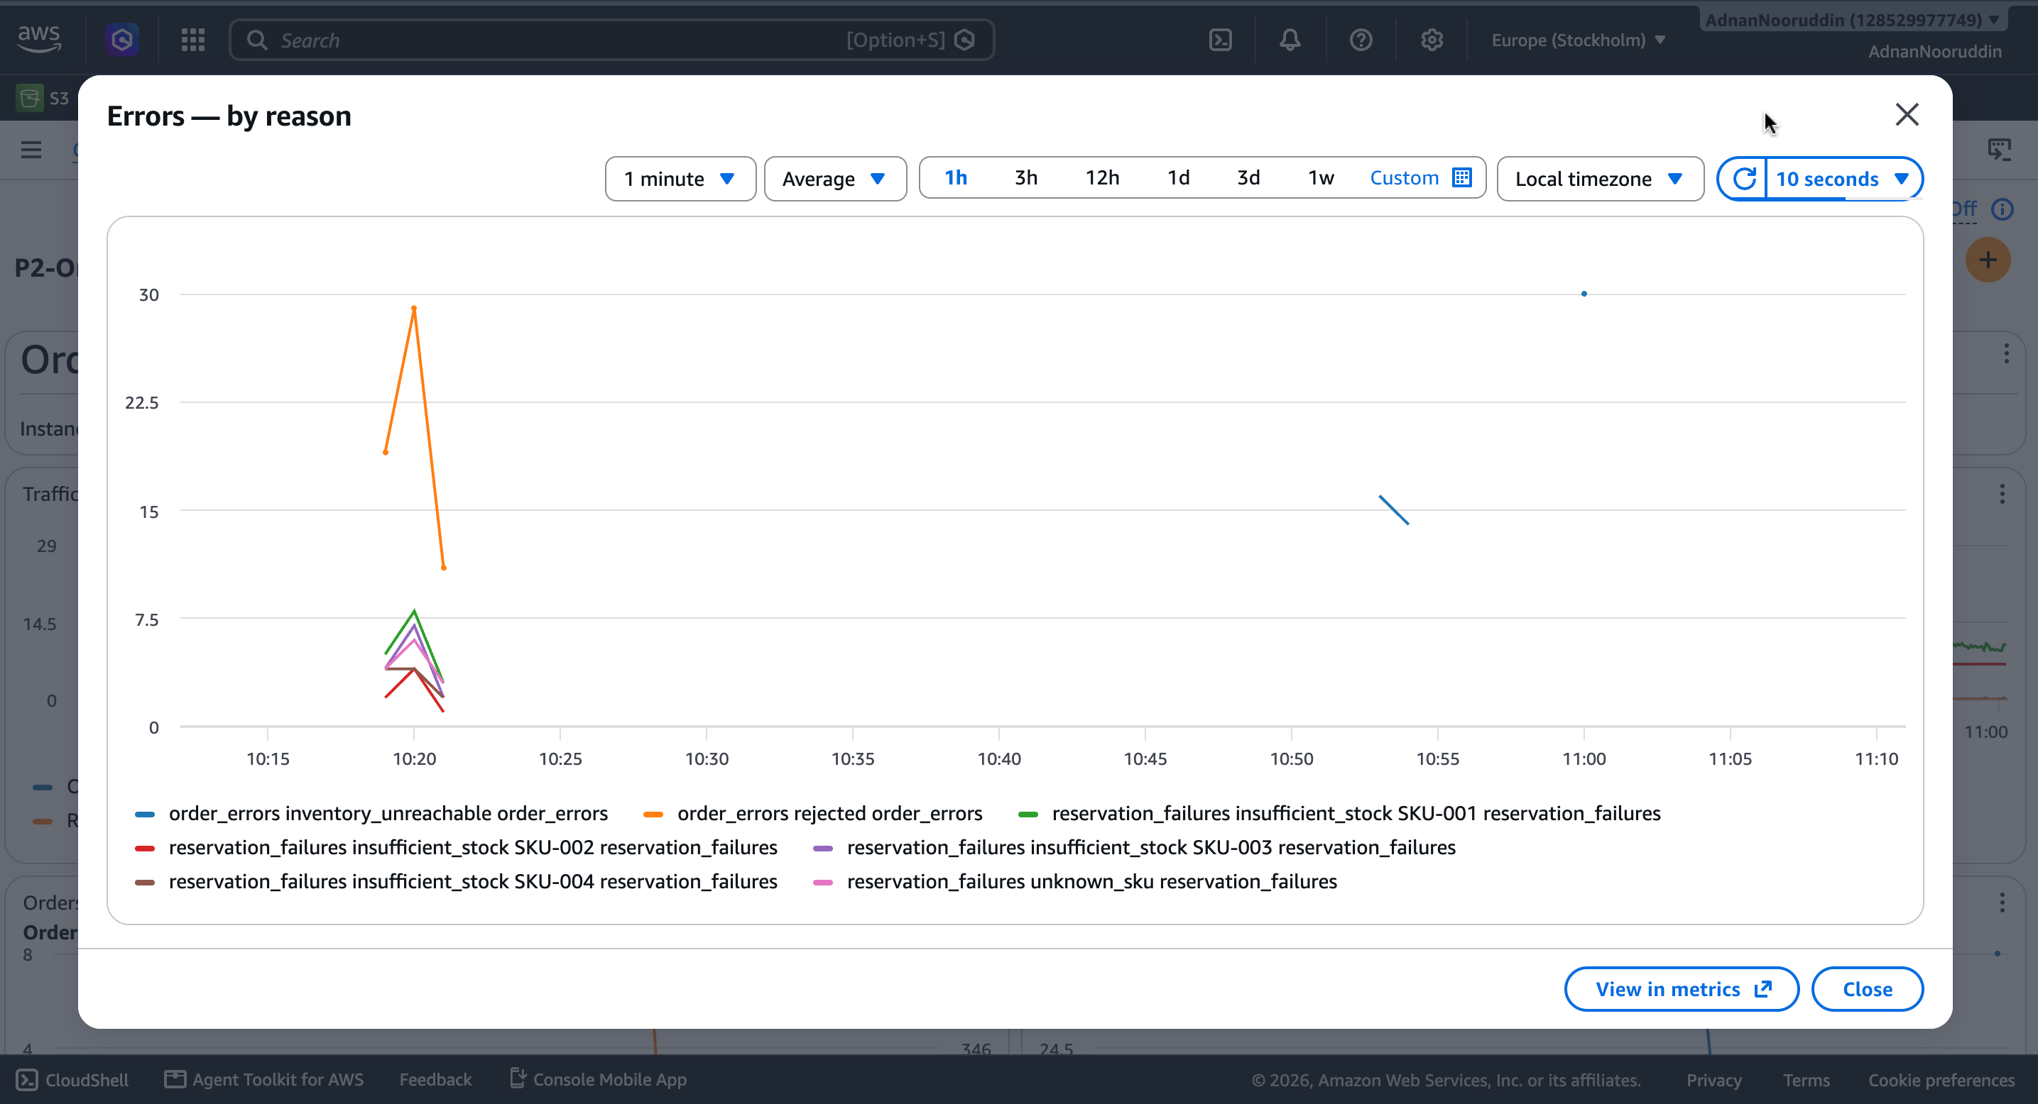

INCIDENT #2
Downstream Dependency Failure
Symptom
Investigation
inventory-service stopped via pm2. 100% of orders -> 502, ERROR-level inventory_service_unreachable on every request.
Uniform ECONNREFUSED across every request — the signature of a dependency outage, distinct from ordinary bad-SKU input.
Root cause & fix
Finding
pm2 start inventory-service. Recovery confirmed with a real successful order within ~2 minutes; both error-rate alarms cleared.
order-service has NO request timeout on the inventory-service call — a real production-readiness gap this test exposed.
Incident Response
Order & Inventory Service — Instrumented & Monitored Cloud Service
11

Slide 12
INCIDENT #3 — COMPLEX
CPU Saturation + Traffic Surge, Simultaneously
Closing the correlation question Incident #1 left open — this time load and traffic overlap on purpose
order_latency (ms) — baseline vs. under load
16.6
The real finding
13.9
~2-3x
increase in latency, directly caused by CPU contention — real, measurable, proven with overlapping data.
still 12-18x
below the 200ms warning threshold — confirming the threshold has real headroom, not miscalibrated.
8.8
6.4
5.1
4.0
Average
p95
Max
Baseline (no load)
Under CPU + traffic load
Incident Response
Order & Inventory Service — Instrumented & Monitored Cloud Service
12

Slide 13
Learnings & Production-Readiness Gaps
What three real, investigated incidents actually taught us
Missing request timeout
order-service's call to inventory-service has no bound — a hung (not just stopped) dependency could cascade. Found by Incident #2, not assumed.
Alarms lag reality by ~2-3 min
By design (M-of-N evaluation avoids single-blip false alarms) — but means "alarm cleared" and "problem fixed" aren't the same instant.
Which alarms fire is itself diagnostic
Saturation-only vs. errors-only vs. both pointed to three different root causes before a single log was opened.
CloudWatch Agent adds hidden dimensions
A metric_type dimension we never configured, discovered only by querying real data — led to using SEARCH() over hardcoded dashboard references.
Correlation ≠ severity
CPU contention measurably raised latency (2-3x) without being remotely alarm-worthy — proved with data instead of assumed either way.
Learnings
Order & Inventory Service — Instrumented & Monitored Cloud Service
13

Slide 14
Questions?
Structured logs · 8 custom metrics · Golden Signals dashboard · 6 tiered alarms · 3 real investigated incidents
Adnan Nooruddin · Order & Inventory Service · eu-north-1

