Slide 1
Bank Management System
Presented By:
Presented To:
  Luckman Rafique (20255103042)
  Md. Taimur Rahman (20255103046)
  Md. Yousuf Ali (20255103059)
  Md. Adnan Sami (20255103068)
  Siam Khan (20255103069)
  Kazi Yeaj Morshed Rizve (20255103074)
Humayra Ferdous
Lecturer
Dept. of CSE
Course Title: Software Development I
Course Code: CSE 100
Department of Computer Science and Engineering
Bangladesh University of Business and Technology

Slide 2
Topic Distribution
Siam Khan
System Overview
Md. Adnan Sami
System Architecture
Md. Yousuf Ali
Class Diagram
Luckman Rafique
Security & Data Validation
Kazi Yeaj Morshed Rizve
Current Limitation
Md. Taimur Rahman
Future Implementation
Bank Management System

Slide 3
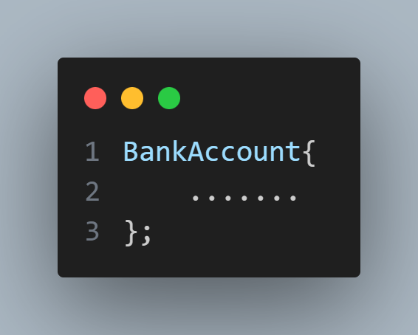
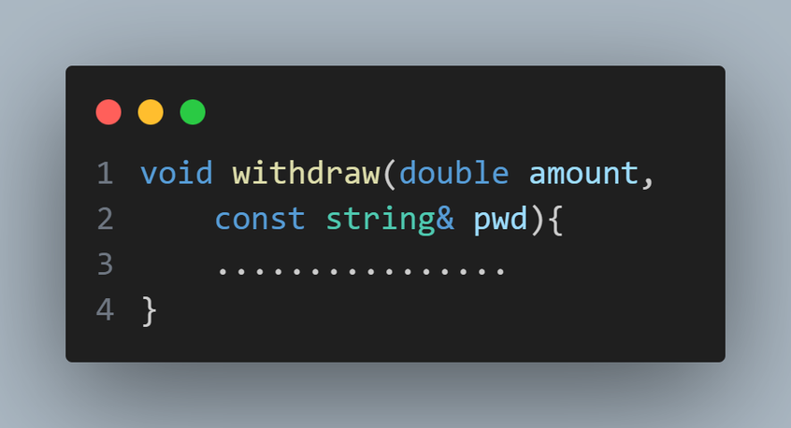
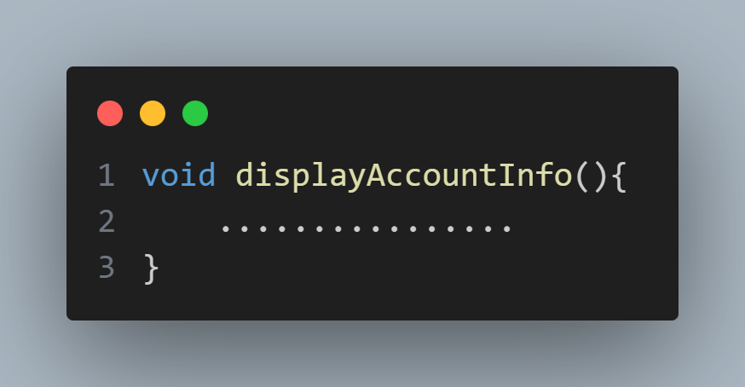
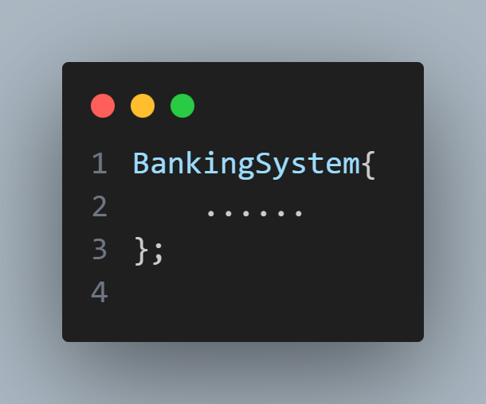
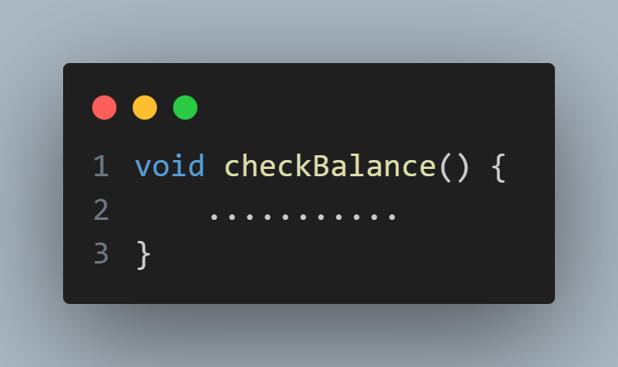
System Overview
BankAccount Class:
Withdraw Money:
Display Account Details:
BankingSystem Class:
Check Balance:
page 03
Presented by: Siam Khan
presented by:Siam Khan
Presented by: Siam Khan
Presented by: Adnan Sami
Bank Management System
page 02
4.1 Arrays of Objects
page 02
Presented by: Siam Khan

Slide 4
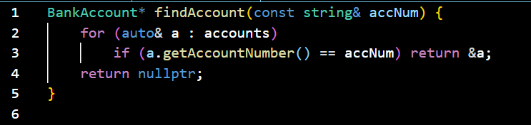
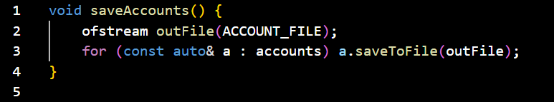
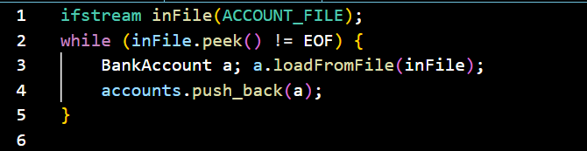
System Architecture
Find Account Function:
  Each class handles a specific task.
  Example: Bank Account manages account logic, Banking System handles operations.
...
Save Accounts Function:
  User → BankingSystem → BankAccount → Files → User
...
Loading Accounts from File:
  Accounts, transactions, counters stored in files.
...
...
Key Points:
  Modular & maintainable
  Secure & reliable (transaction logging)
  Scalable for new features.
Presented by: Md. Adnan Sami
Bank Management System

Slide 5
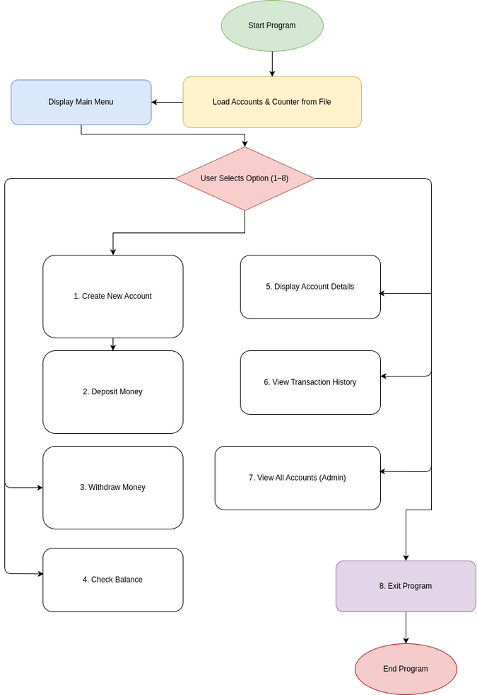
System Class Diagram
🏦 Banking Application – Key Flow
  Start program → Load accounts
  Show main menu (8 options)
  Core actions: Create,Deposit, Withdraw, Check Balance
  Extra features: Account details, Transaction history, Admin view
  Exit → End program
Presented by: Md. Yousuf Ali
Bank Management System

Slide 6
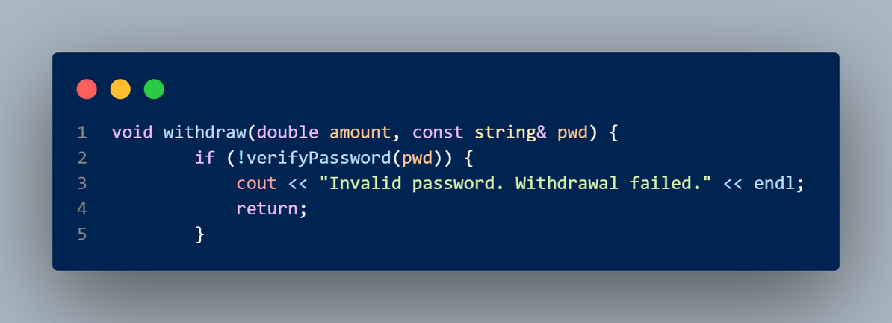
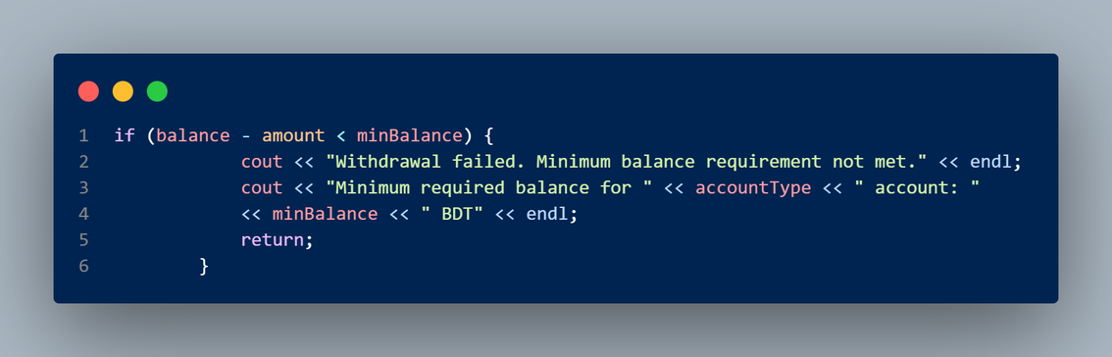
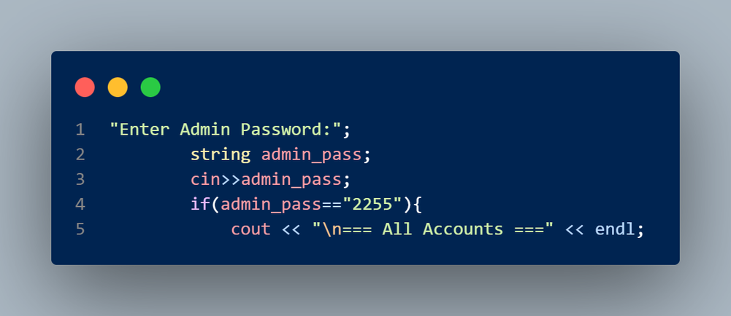
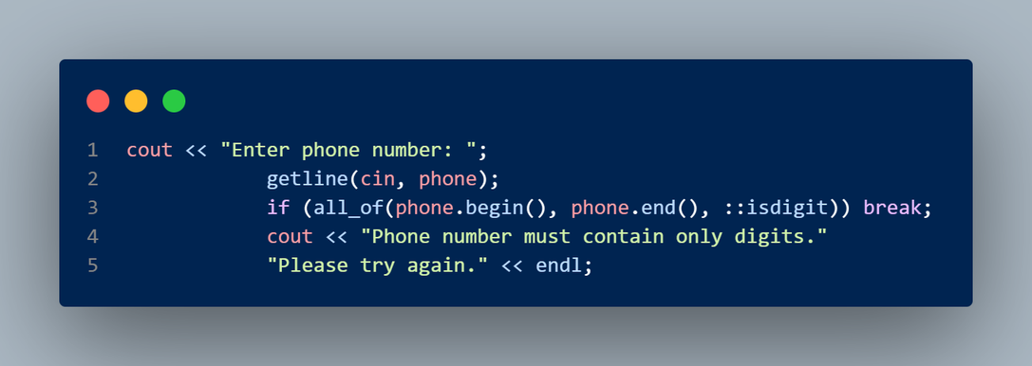
Security & Data Validation
Withdrawal Authentication: Transactions require a strict 4-digit PIN verification, preventing unauthorized access to funds.
Minimum Balance Enforcement: The system automatically blocks withdrawals that would drop the balance below the mandatory threshold (e.g., 500 BDT for Current).
Role-Based Access: A hardcoded admin layer protects the "View All Accounts" feature from standard users.
Input Sanitization: Rigorous validation ensures phone numbers are numeric and account types are valid before object creation.
Presented by: Luckman Rafique
Bank Management System

Slide 7

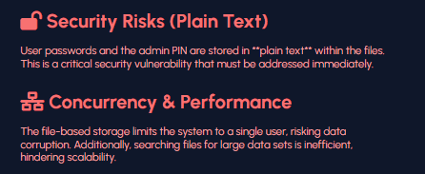
Current Limitations
Presented by: Kazi Yeaj Morshed Rizve
Bank Management System

Slide 8


Future Roadmap
  Password Hashing
  Database Migration
  Graphical User Interface (GUI)
  Advanced Features
Presented by: Md. Taimur Rahman

Slide 9


Thank You!
Thank you for your attention.
TEAM

